Slide 1

Fundamentals of Computing
Lec 11
Quantum Spins

Slide 2
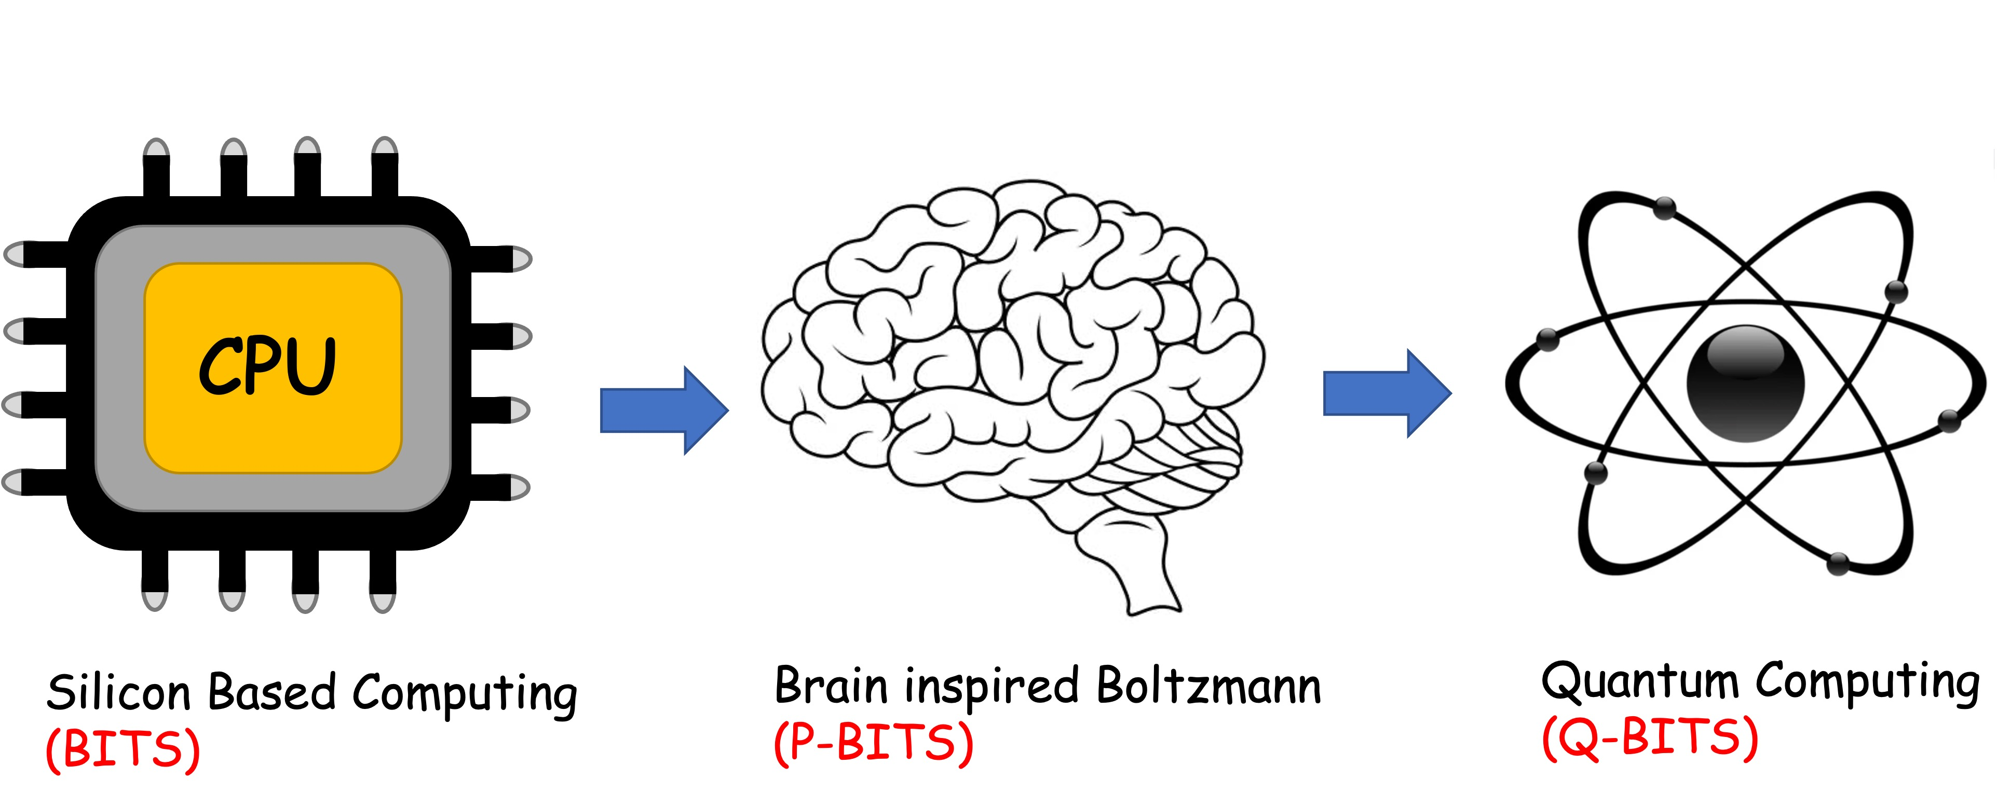
Overall structure of this course
Analog Computing in Carbo
How we train (Supervision)
Physics of Neurons (Boltzmann)
How we learn (time sampling)
Optimizing and Classifying
Transition Theory & Inferencing
Quantum Computing in Magneto
Quantum Spins and Hardware
Quantum Entanglement
Quantum Gates and Errors
Quantum Search and Annealing
Quantum Factorization
Digital Computing in Silico
How we compute (algorithms)
How we add (Gates)
How we add quickly (CMOS)
How we fix errors
Thermodynamics of Computing

Slide 3
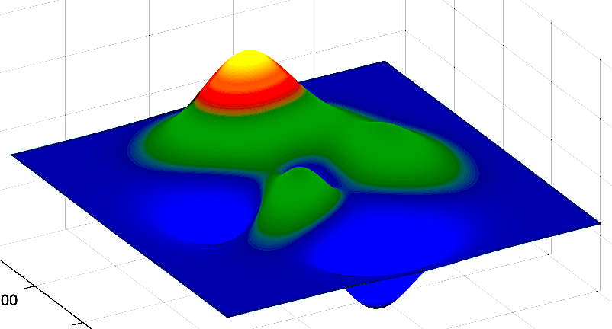
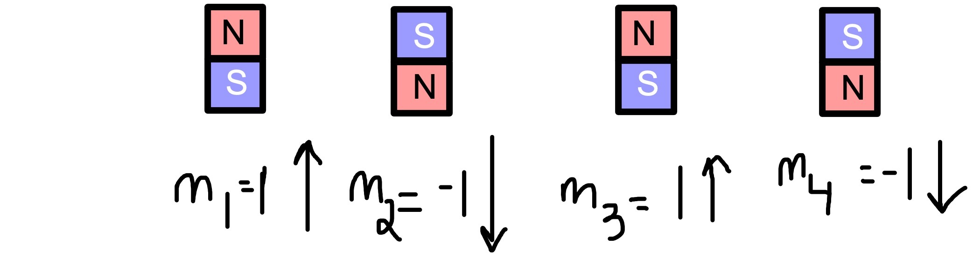
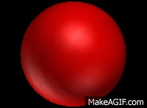
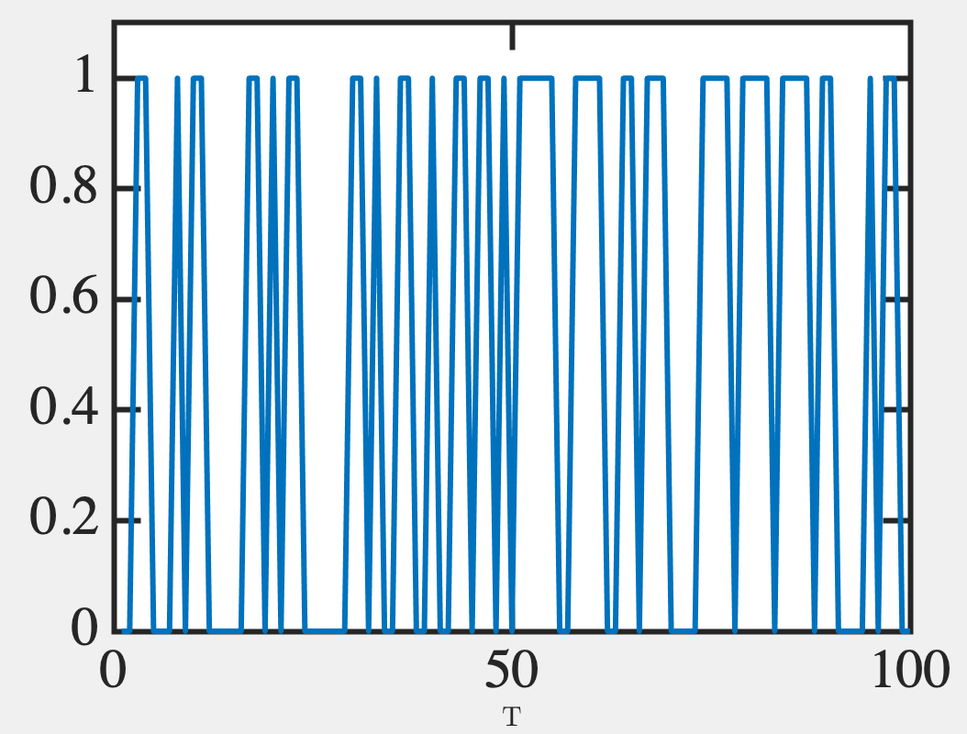
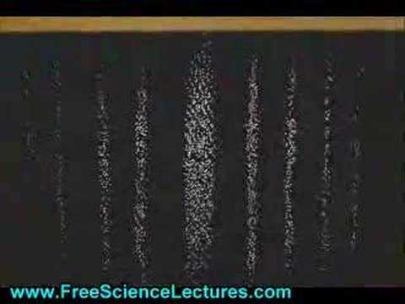
Overview
Fast, precise addition
Encode info in bits
Use gates, correct errors
Separate memory/logic
High power budget
Slow, imprecise - inferencing
Encode info in frequency/histograms
Errors in individual, resilience in collective
Memory/logic co-located
Low power budget
Parallel quantum algorithms
Encode info in collective phases
No cloning/limited ECC
Coherent storage-gating at odds
Power mostly in cooling

Slide 4
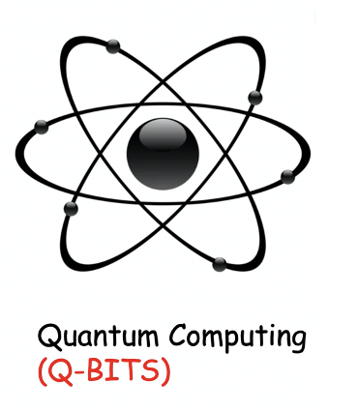

Slide 5
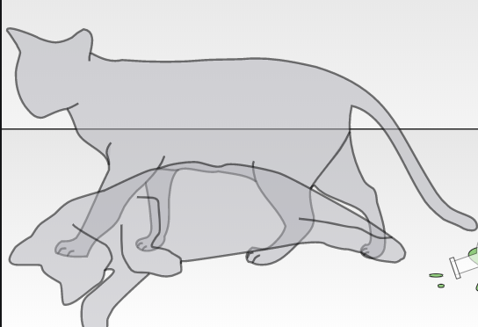
Quantum Properties pose unique opportunities..
Superposition (1 electron)
Will need Matrix algebra
States can interfere
Tuck them into off-diagonal terms
Polarized photon along 45⁰ line
is equal amounts of x and y
This offers parallel encoding
Entanglement (2 electrons)
Will need Tensor Products
Expands the space from N to 2^{N}
Correlates electrons
Two pions formed have opposite spin
This allows remote operation and readout

Slide 6
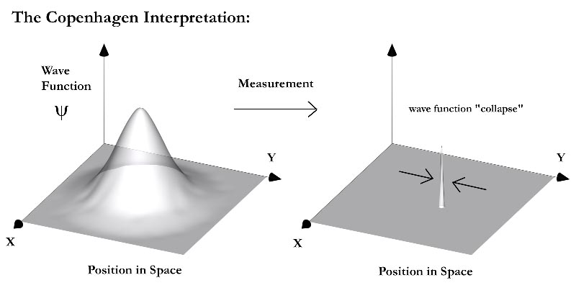
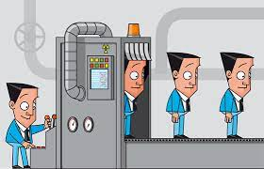
… but also unique challenges
If you measure it, it collapses
away from superposed state
If you do not measure it, you cannot clone (copy) it
This means you cannot replicate a superposition state

Slide 7
Recap magnetic encoding of a state (1010)
N
S
N
S
S
N
S
N

Slide 8
Tiny bar magnets all the way to an electron
N
N
N
N
N
S
S
S
S
N
N
N
N
S
S
S
S
N
N
S
N
N
S
S
S
S
S
N
S
N
N
N
N
N
S
N
S
S
S
S

Slide 9
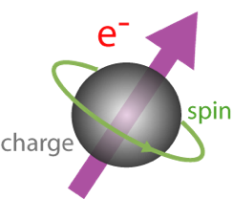
Spin
Electrons have “spin”. But this is not easy to visualize,
as electrons also act like somewhat fuzzy particle
distributions with no internal structure…

Slide 10
11A. Quantum Nature of Spin

Slide 11
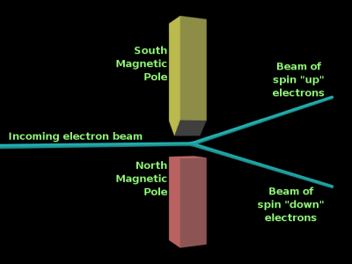
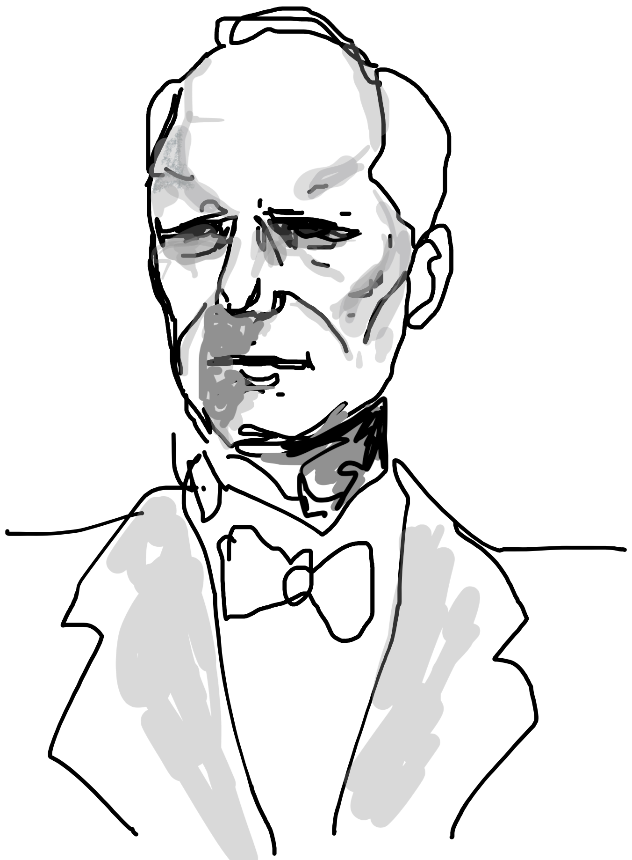
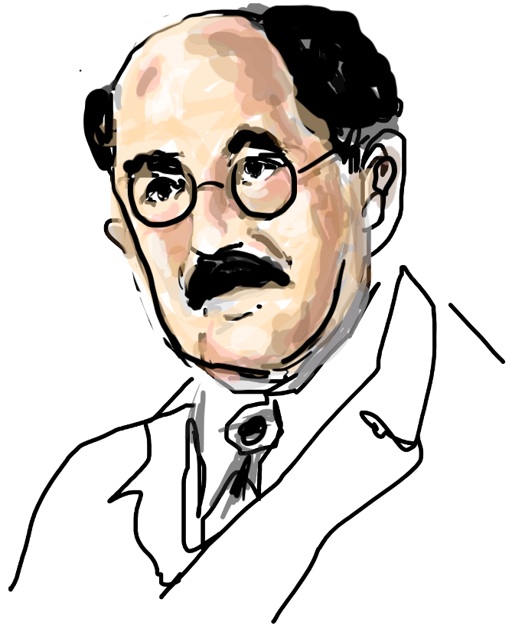

What is unique about spin
Otto
Stern
Walther
Gerlach
Stern-Gerlach experiment measures electron magnetic moment
Two lines imply only two possible moment values/orientations

Slide 12
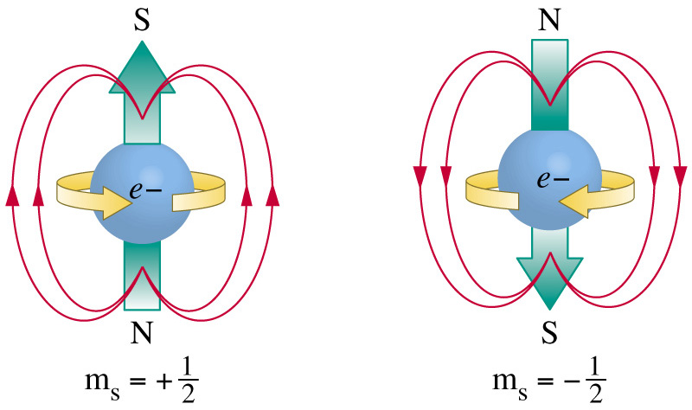
Up and Down spins
But what determines ‘up’ and ‘down’?

Slide 13
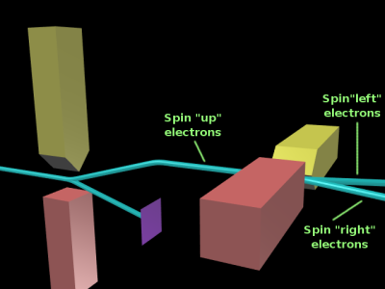
Why ‘spin’ is hard to understand !!
Start by filtering up/down spins
Further sort them into left/right
Classical determinism dictates that one of the
branches consists of electrons that are left and up
Is it still up? What does the measurement say?

Slide 14
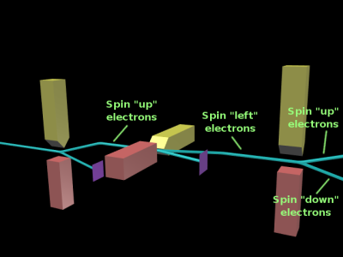
Why ‘spin’ is hard to understand !!
Instead of purely up electrons on the examined
branch, we again get up and down. So ‘Up’ electrons lose
their ‘upness’ when their left/right character is probed !!!

Slide 15


This is true in QM in general
RED
SIZE
BIG
BLUE
COLOR
RED
SMALL
BLUE
Quantum Operations do not Commute
This leads to uncertainty principle
But is it fair to say measurements simply
scramble previous data?

Slide 16
No - they are not fully random either !!
BIG
RED
RED
SMALL
BLUE
BIG
RED
BLUE
SMALL
BLUE
Not just a simple loss of memory!
Electrons act like polarized light
They can interfere

Slide 17
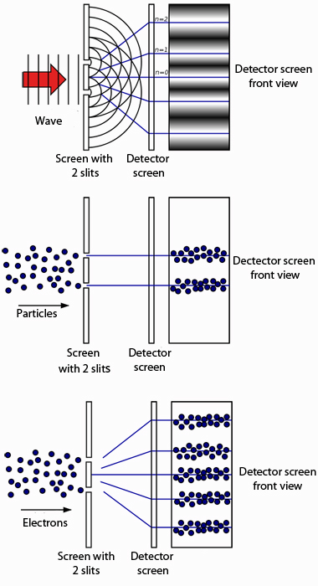
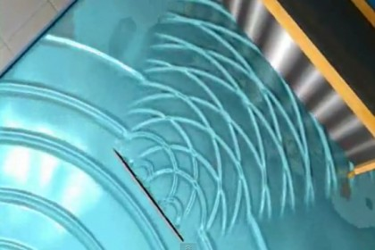
Two slit experiment
d
https://www.youtube.com/watch?v=Q1YqgPAtzho
http://plus.maths.org/content/sites/plus.maths.org/files/articles/2012/schrodinger/doubleslit.jpg

Slide 18
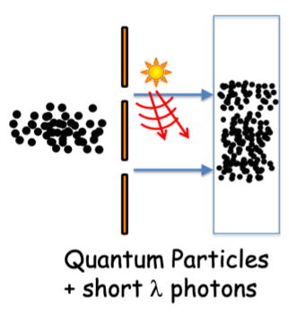
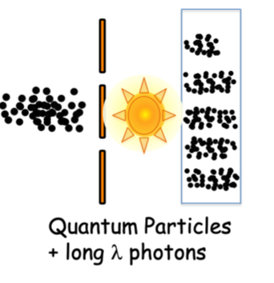
Can’t measure position and momentum together !
p_{y} = h/λ (De Broglie Relation)
Flash detects particle
Deflects it, scrambles momentum
Washes off interference
Longer wavelength preserves particle
Momentum unaffected
Cannot ‘see’ it anymore !

Slide 19
11B. Quantum Measurement
(Basic Quantum Physics)

Slide 20
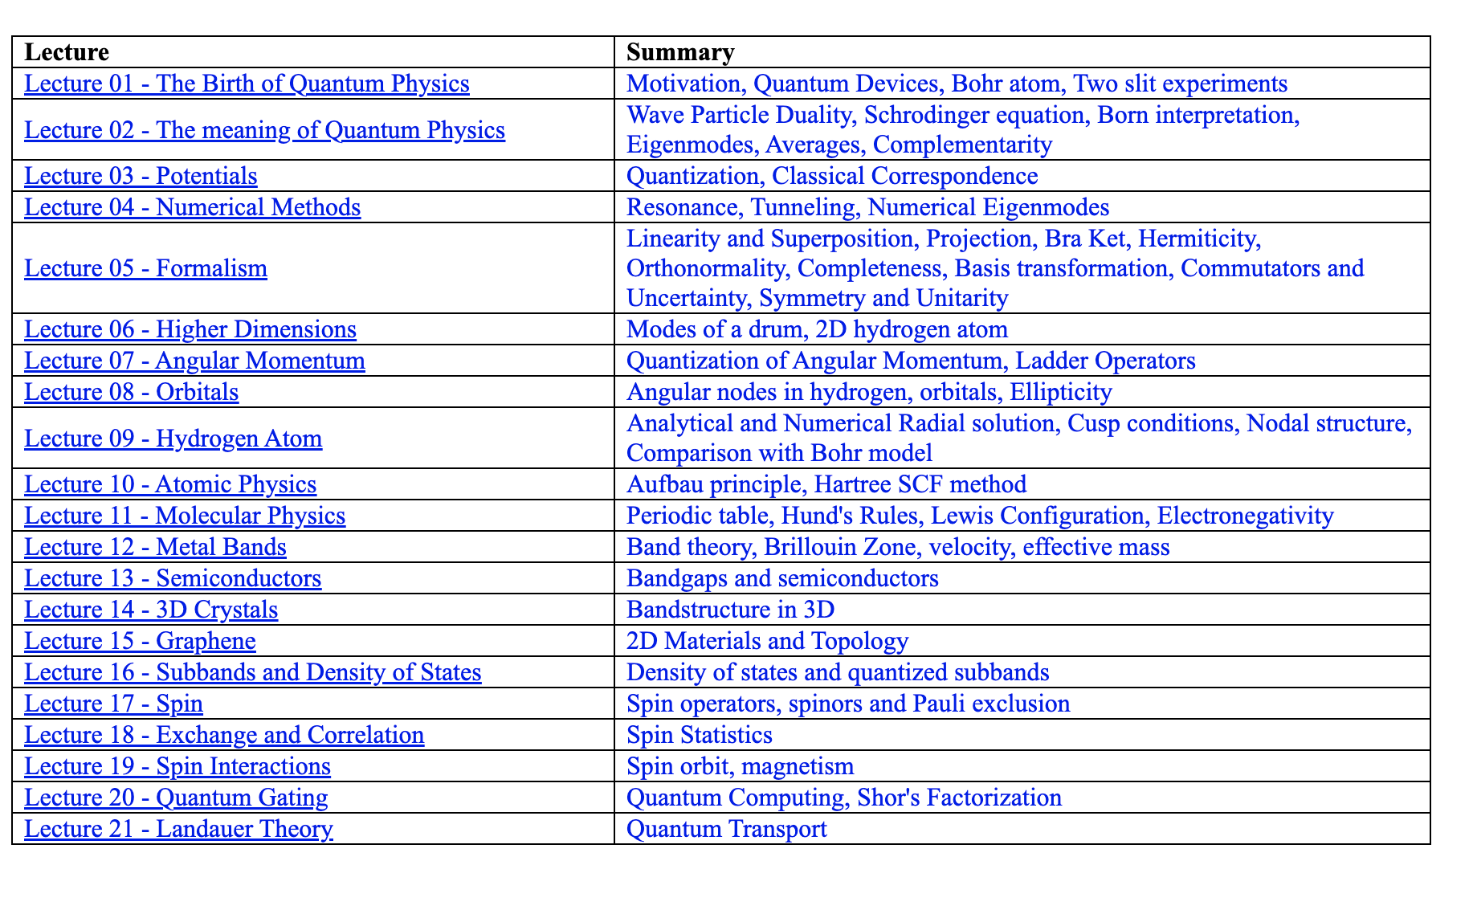
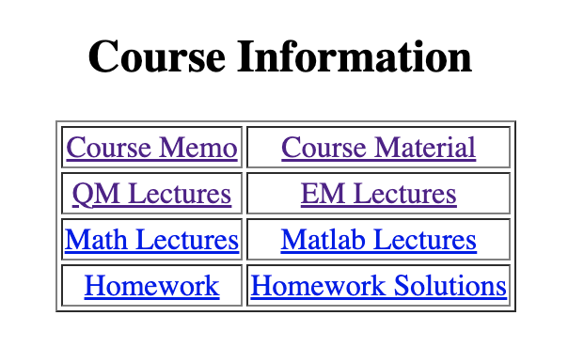

Slide 21
How do we make sense of all this?
Each measurement yields a definitive result
But which one it will give is not pre-determined
Probability shows up through ensemble histogram

Slide 22








There’s a probability wave

Slide 23


This gives interferences

Slide 24



We can still extract definitive #s

Slide 25
Also individual outcomes
& their odds
Collapse to
state ψ₁ with
Prob |c₁|²
to generate
Reading ε₁
ψ₂ with
Prob |c₂|²
to generate
Reading ε₂
ψ = c₁ψ₁ + c₂ψ₂ + c₃ψ₃ + …
Probability Wave
(analog)
Individual measurements
(digital)
Entanglement with classical measuring device rapidly phase washes (decoheres) all states
till one is left as a reading

Slide 26


Every measurable has an operator
This form is
not obvious

Slide 27


Readings .. Eigenstates (like modes)
Operator
Eigenvalue (reading/measurement)
Oψ_{n} = O_{n}ψ_{n}
⌃
eigenstate or eigenfunction
or eigenvector
(measurable state)
⌃
=
Height

Slide 28

Non-eigenstates?
⌃
= ???
Height
Arbitrary state can still be decomposed into a
superposition of individual measurable eigenstates

Slide 29
Eigenfunctions are a special set for a given operator
⌃
Oψ_{n} = O_{n}ψ_{n} (n=1,2,3…)
After operation, recover shape with a scale factor
Eigenstate of Fourier Transform operator → Gaussian
Eigenstate of position operator → blip in x
Eigenstate of momentum operator → plane wave

Slide 30


Quantum Operations may not commute
RED
SIZE
BIG
BLUE
COLOR
RED
SMALL
BLUE
No simultaneous eigen-state exists

Slide 31
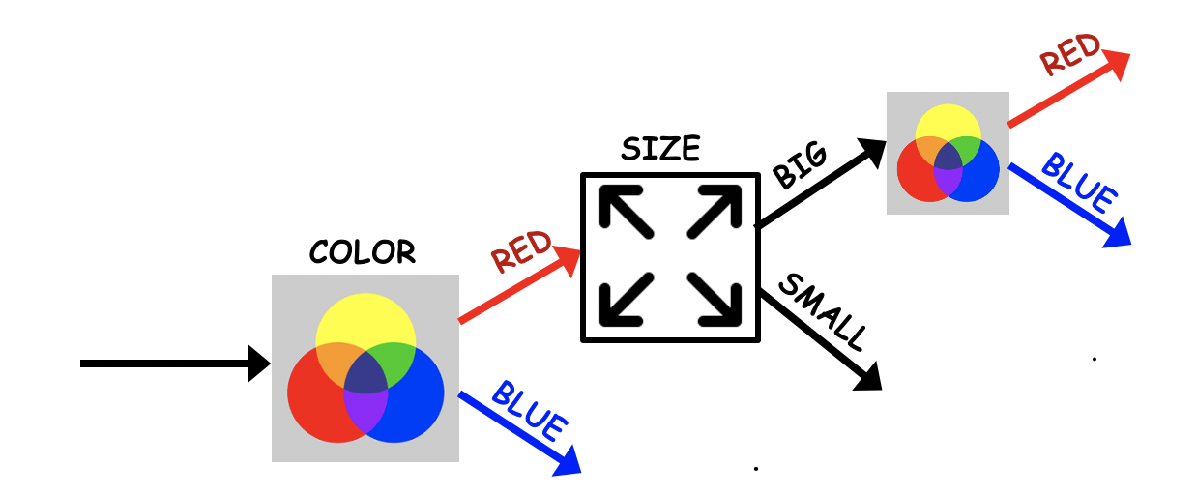

Commutator example

Slide 32
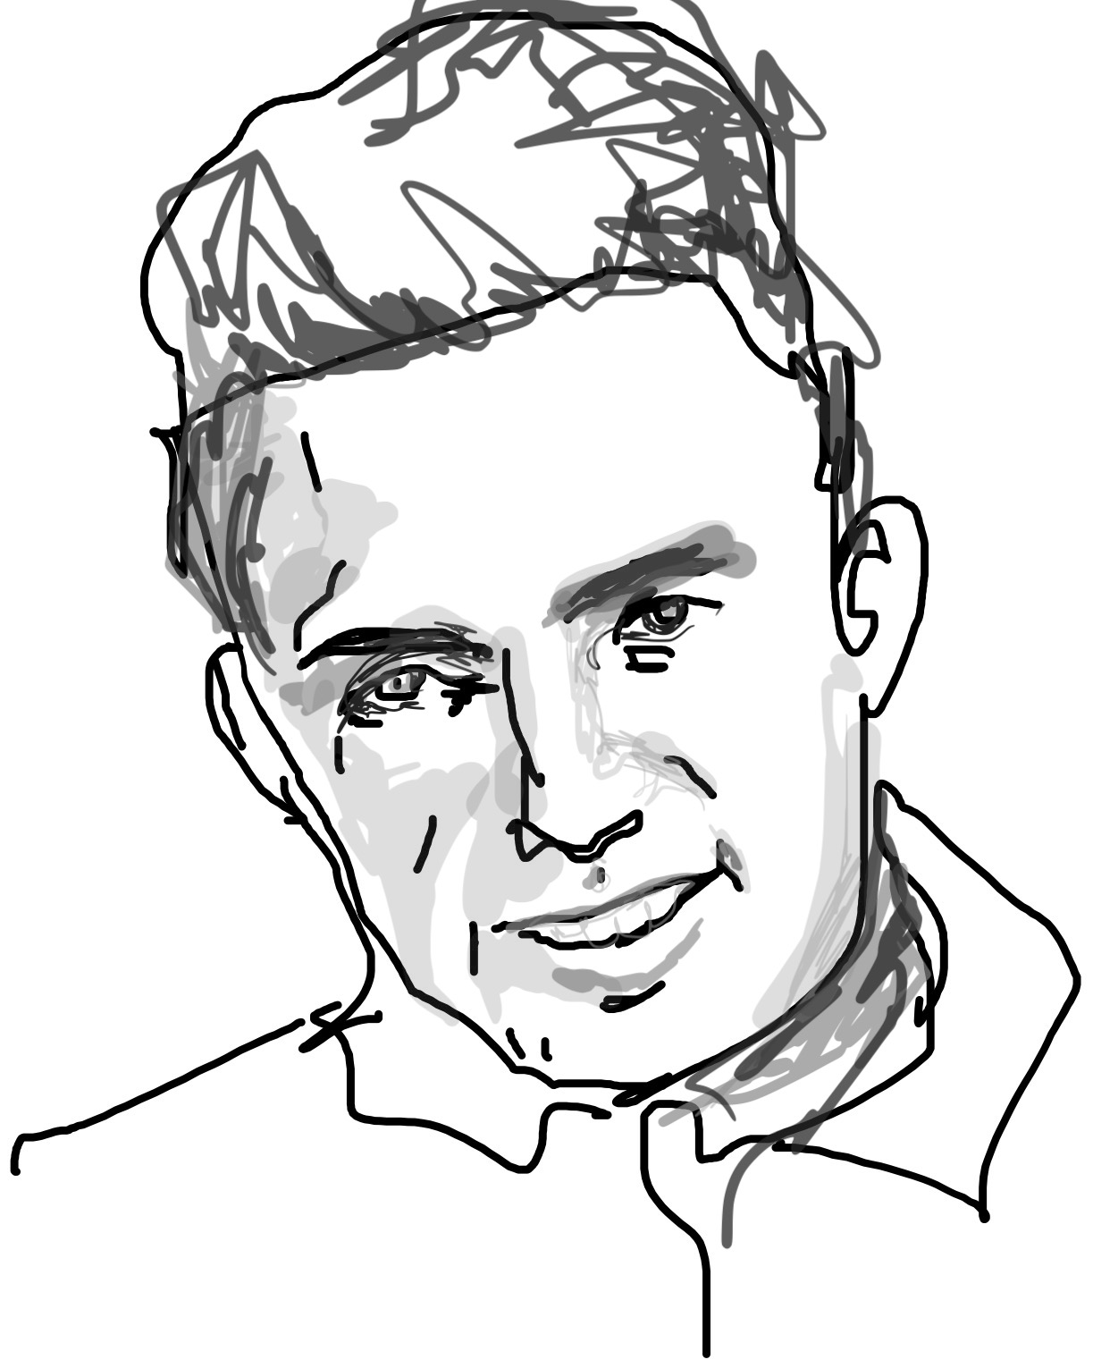
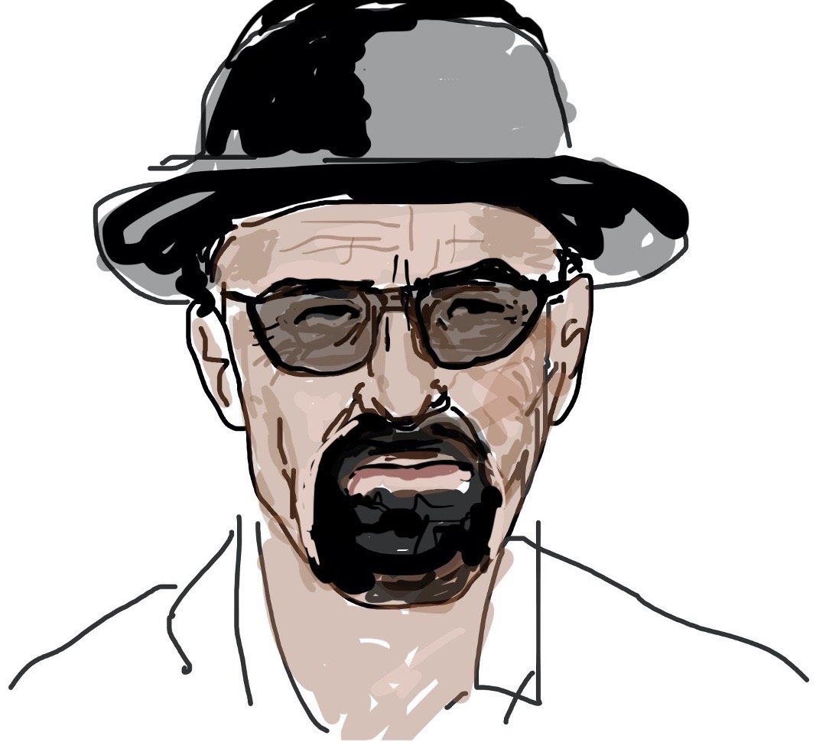




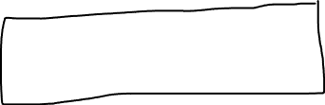

Commutator sets uncertainty
Heisenberg

Slide 33
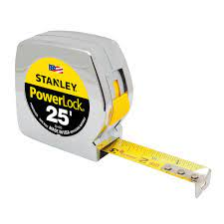
In summary
Operator
Eigenstate
Eigenvalue
Apply all this to quantum spins
[H] Energy operator (Hamiltonian)

Slide 34
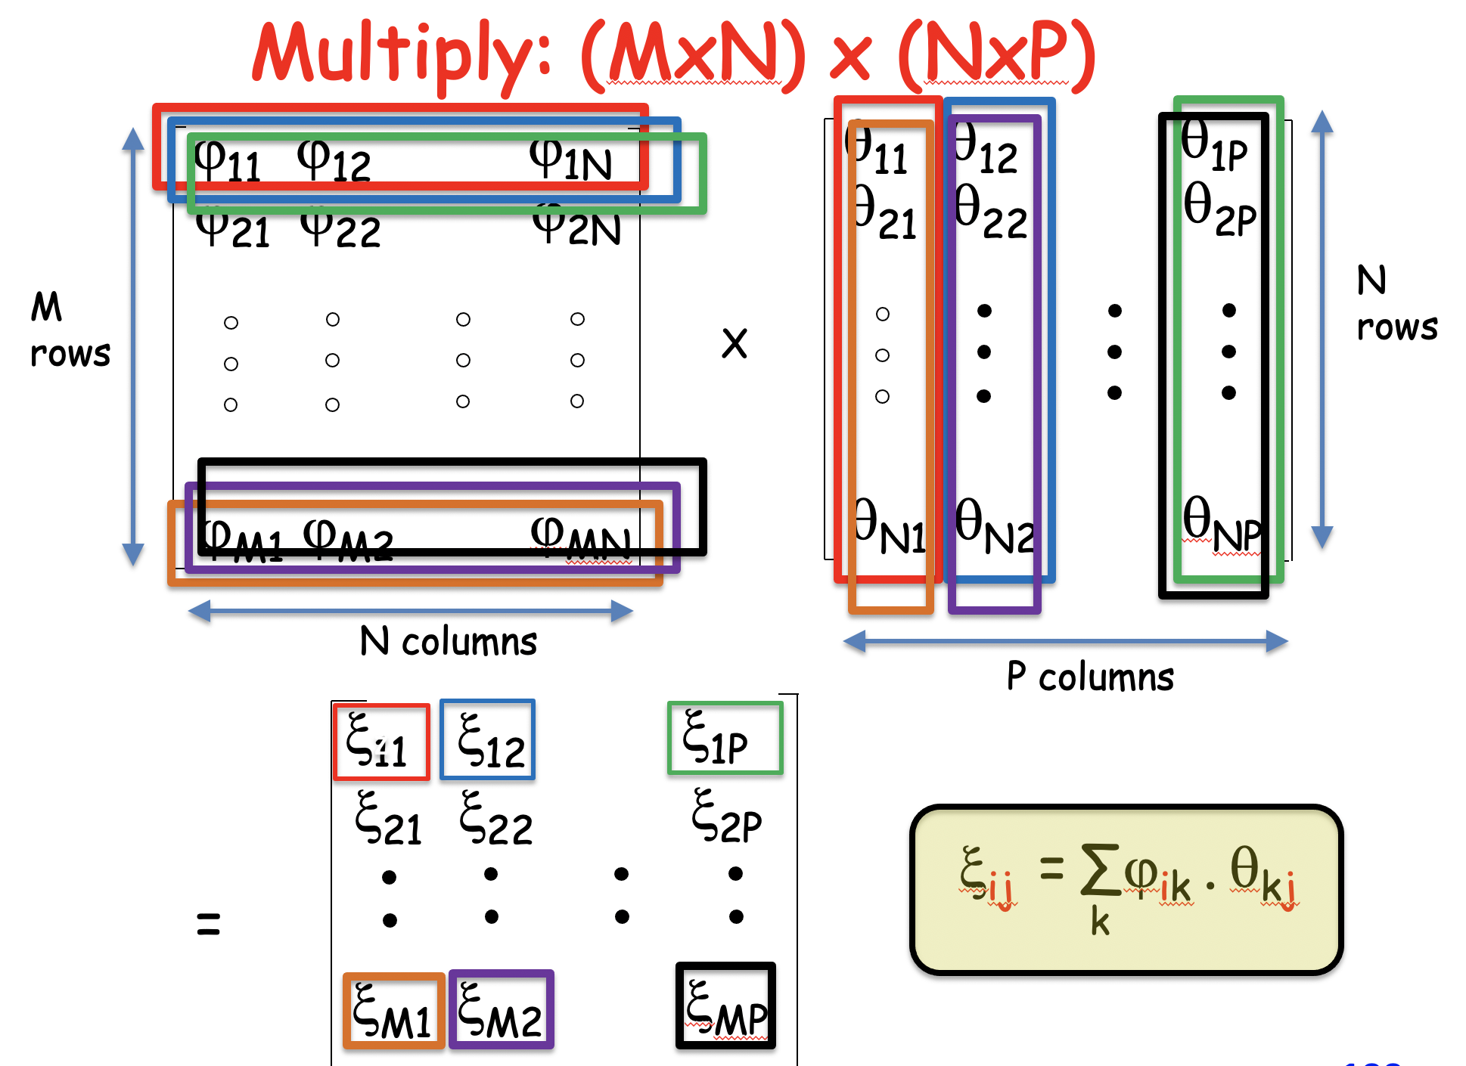
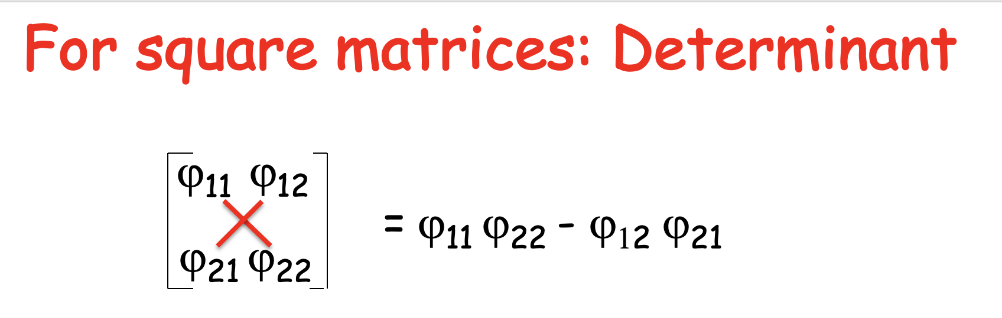
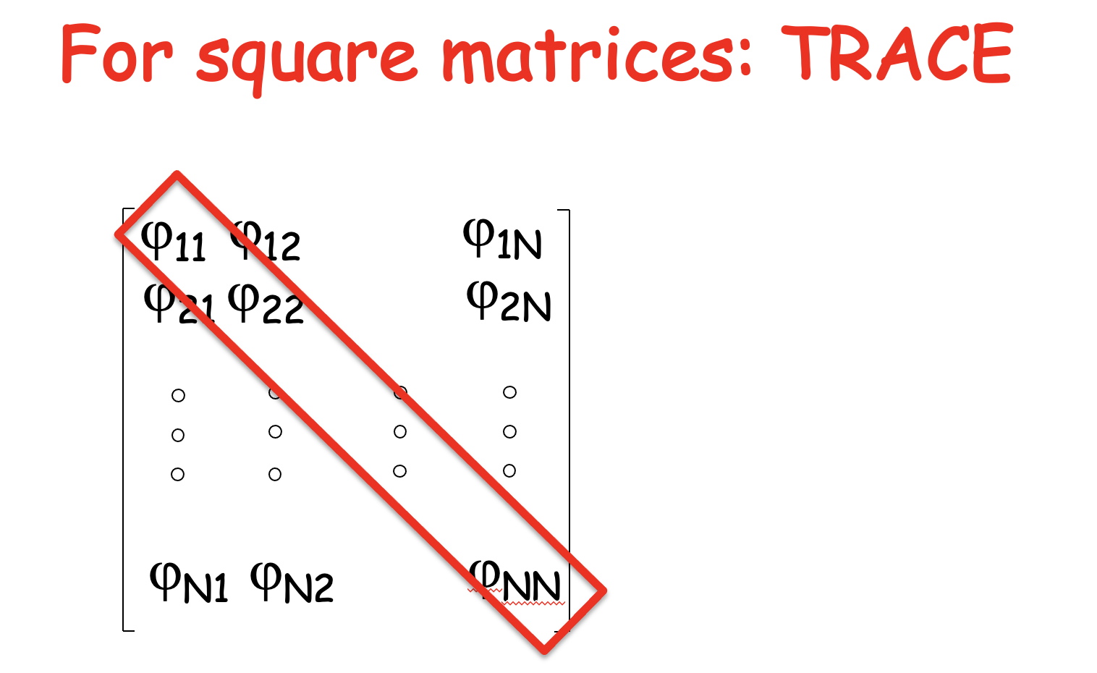
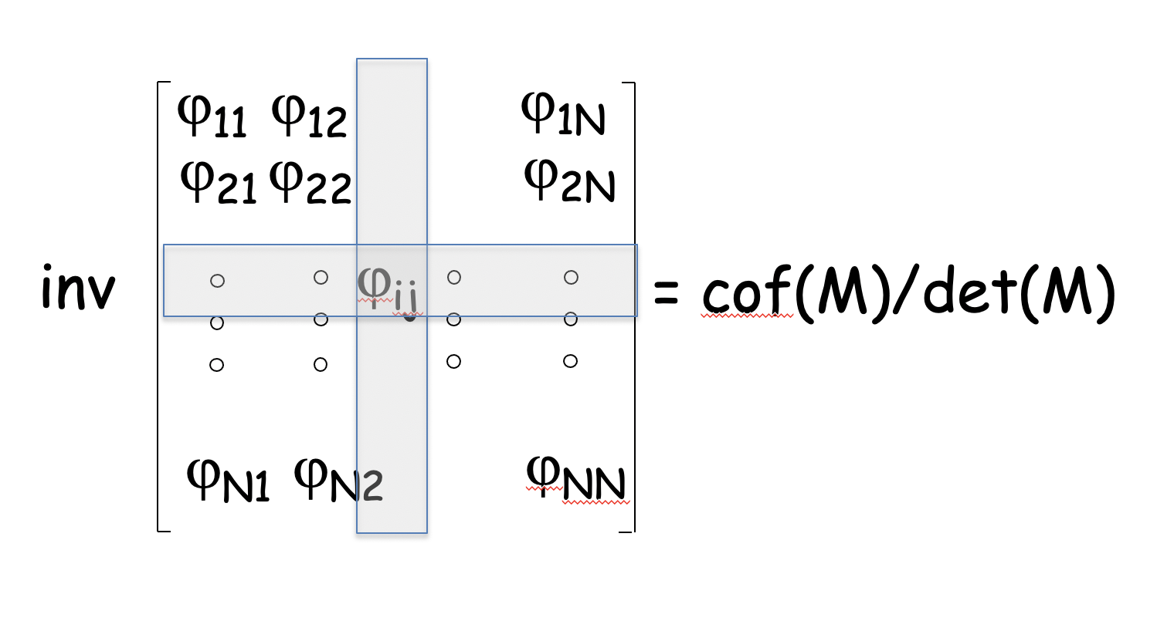
Inverse

Slide 35
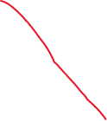


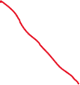
Operators can be described as matrices

Slide 36
To capture this, need matrix maths
https://collab.its.virginia.edu/access/content/group/d439a99b-c660-40e6-8591-f37f778527e5/Lectures/Maths.pptx

Slide 37


Quantum Mechanics IS matrix mechanics

Slide 38
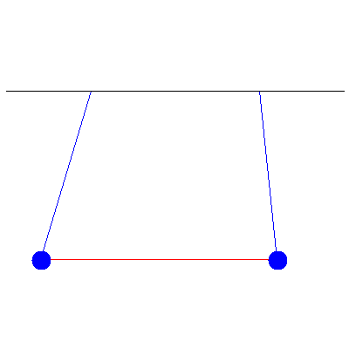

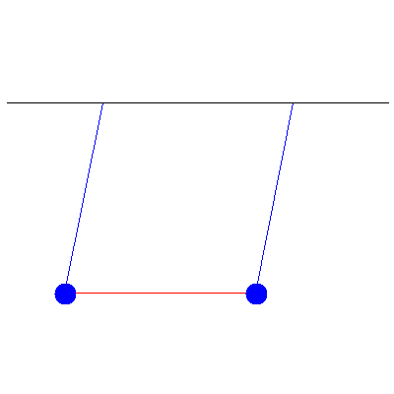
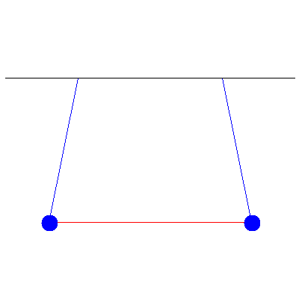
Matrix Eigenvalues are the measurables
They Decouple the system
Superposition of
Eigenstate 1 at ω₁
Eigenstate 2 at ω₂

Slide 39
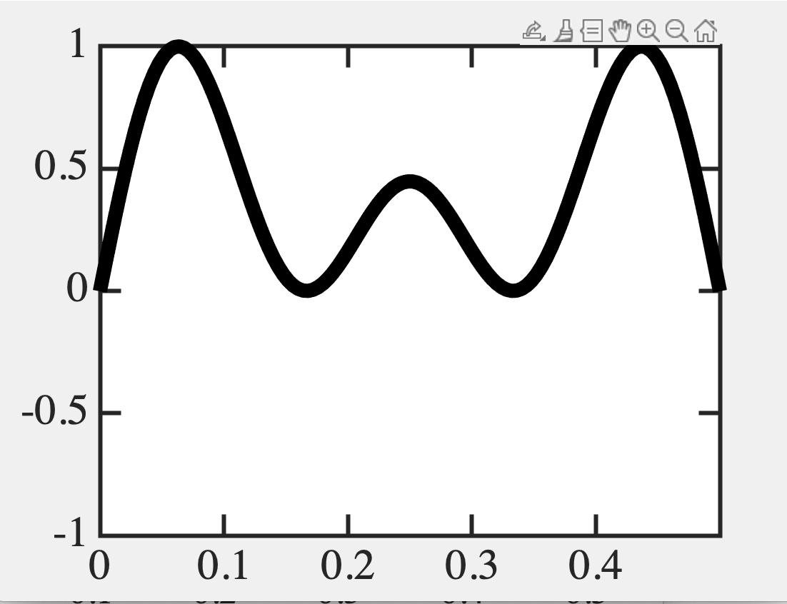
A single shot measurement gives a single eigenvalue
Coefficients show up in odds of each result
Position eigenstates (blips)
1.4
1.4
1
0.05 0.25 0.45
0.05
0.05
0.25
0.45
0.25
0.05
0.05
0.45
0.45
0.45
0.45
0.05
0.05
0.25
0.45
0.45
0.05
0.25
0.45
0.05
0.05 1.4²/5 → 8
0.25 1²/5. → 4
0.45 1.4²/5. → 8
0.05 0.25 0.45

Slide 40
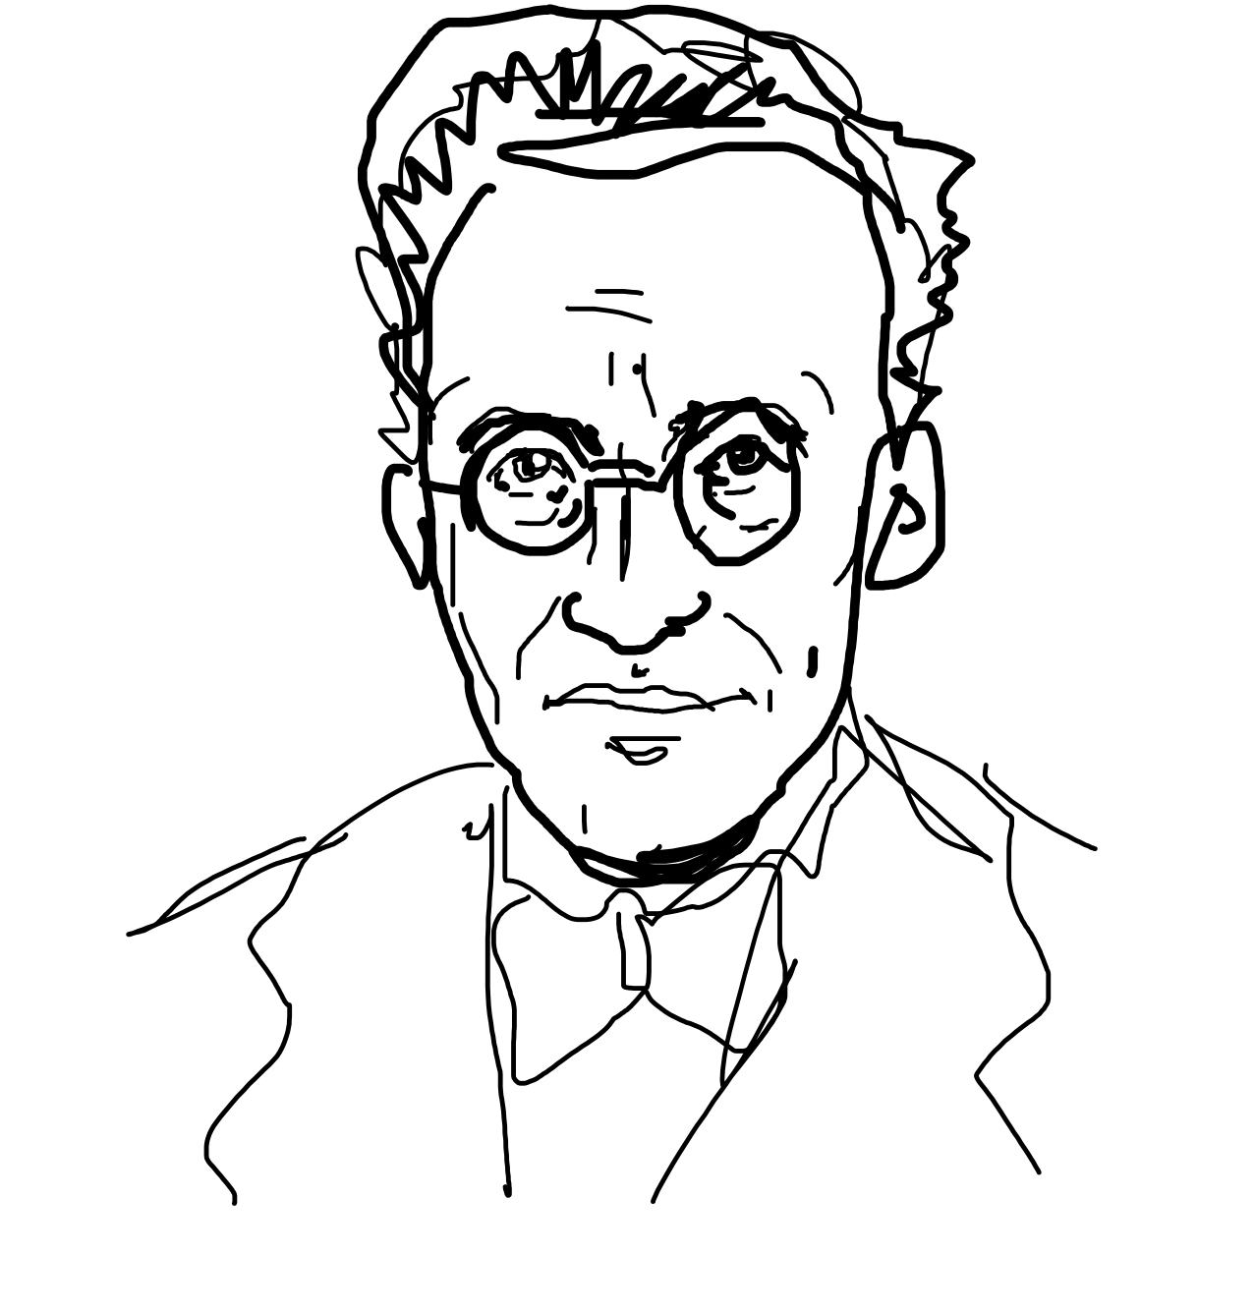







The nature of the wavefunction
Erwin Schrodinger

Slide 41
11C. Quantum Spin Operator

Slide 42
Define an arbitrary state
as a mixture of up-z and down-z ‘basis’ sets
Superposition of
|
|A> = a|
↑_{z}> + b|
↓_{z}>
↑_{z}> & |
↓_{z}>
Collect coefficients in up-down basis and write
state |A> as
a
b
1
We thus have, |↑_{z}> =
0
|↓_{z}> =
0
1

Slide 43
What does Sz operator look like?
Eigenvalues ±(ħ/2)
1
Eigenvectors, |↑_{z}> =
0
|↓_{z}> =
0
1
S_{z} |↑_{z}> = (ħ/2) |↑_{z}>
S_{z} |↓_{z}> = (-ħ/2) |↓_{z}>
1
0
S_{z} = ħ/2
0
-1

Slide 44
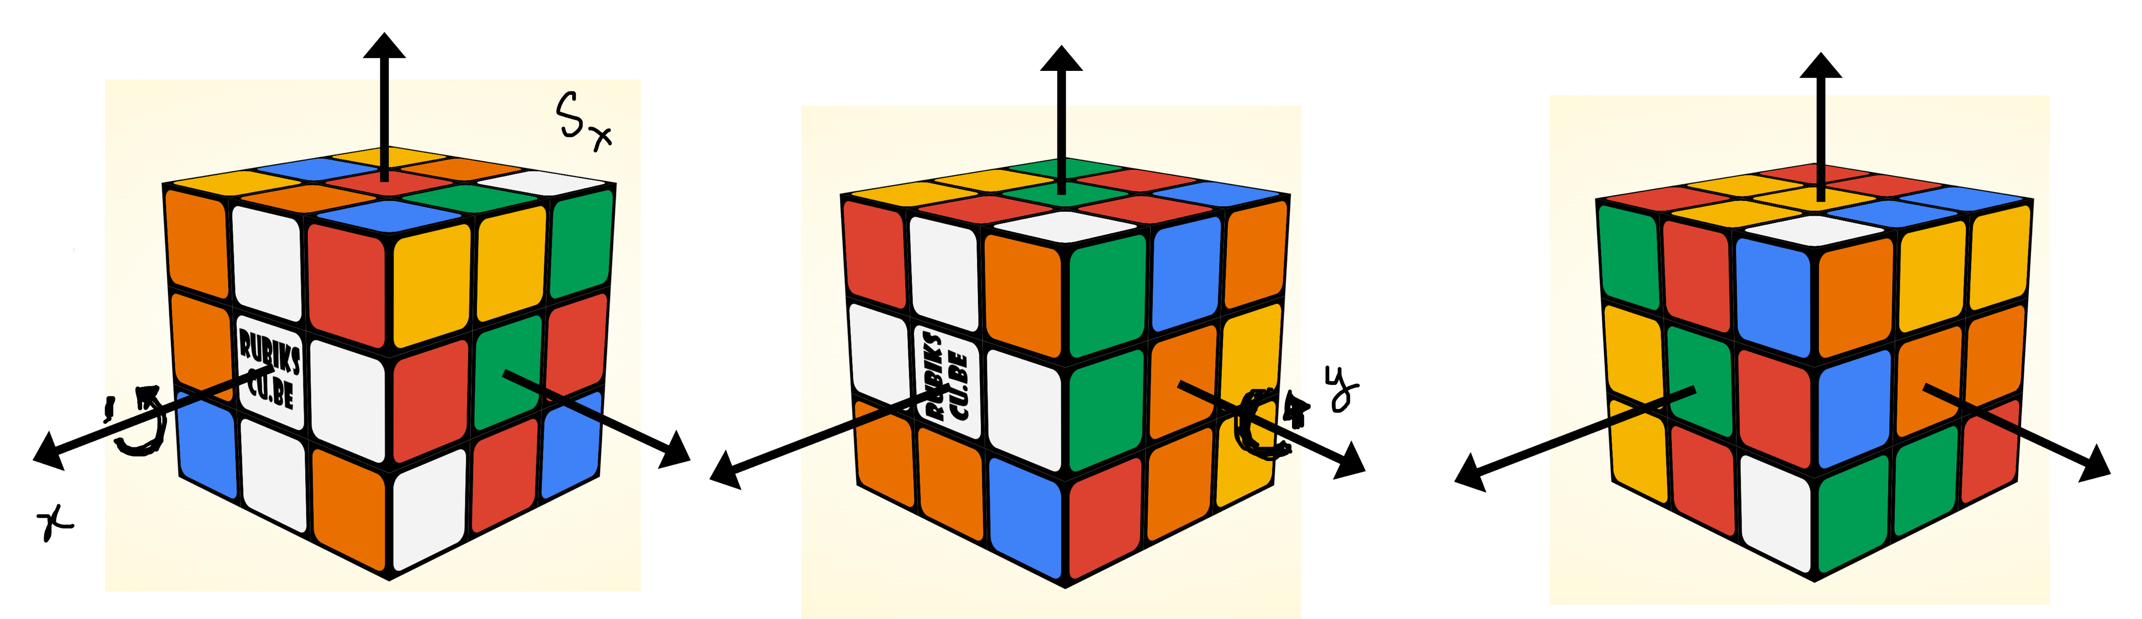
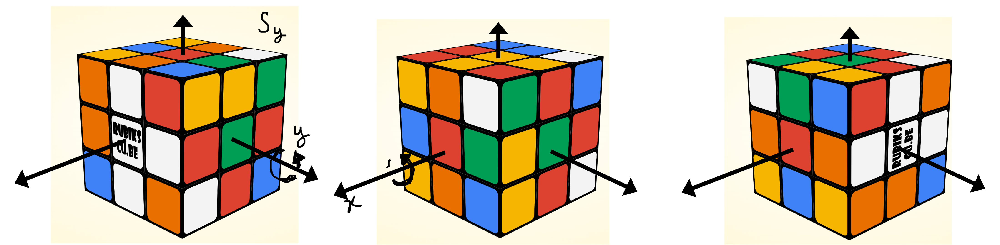
What do the other matrices look like?
Eigenvalues ±(ħ/2)
Matrix commutation relations
[S_{x}, S_{y}] = iħS_{z} and circular permutations

Slide 45
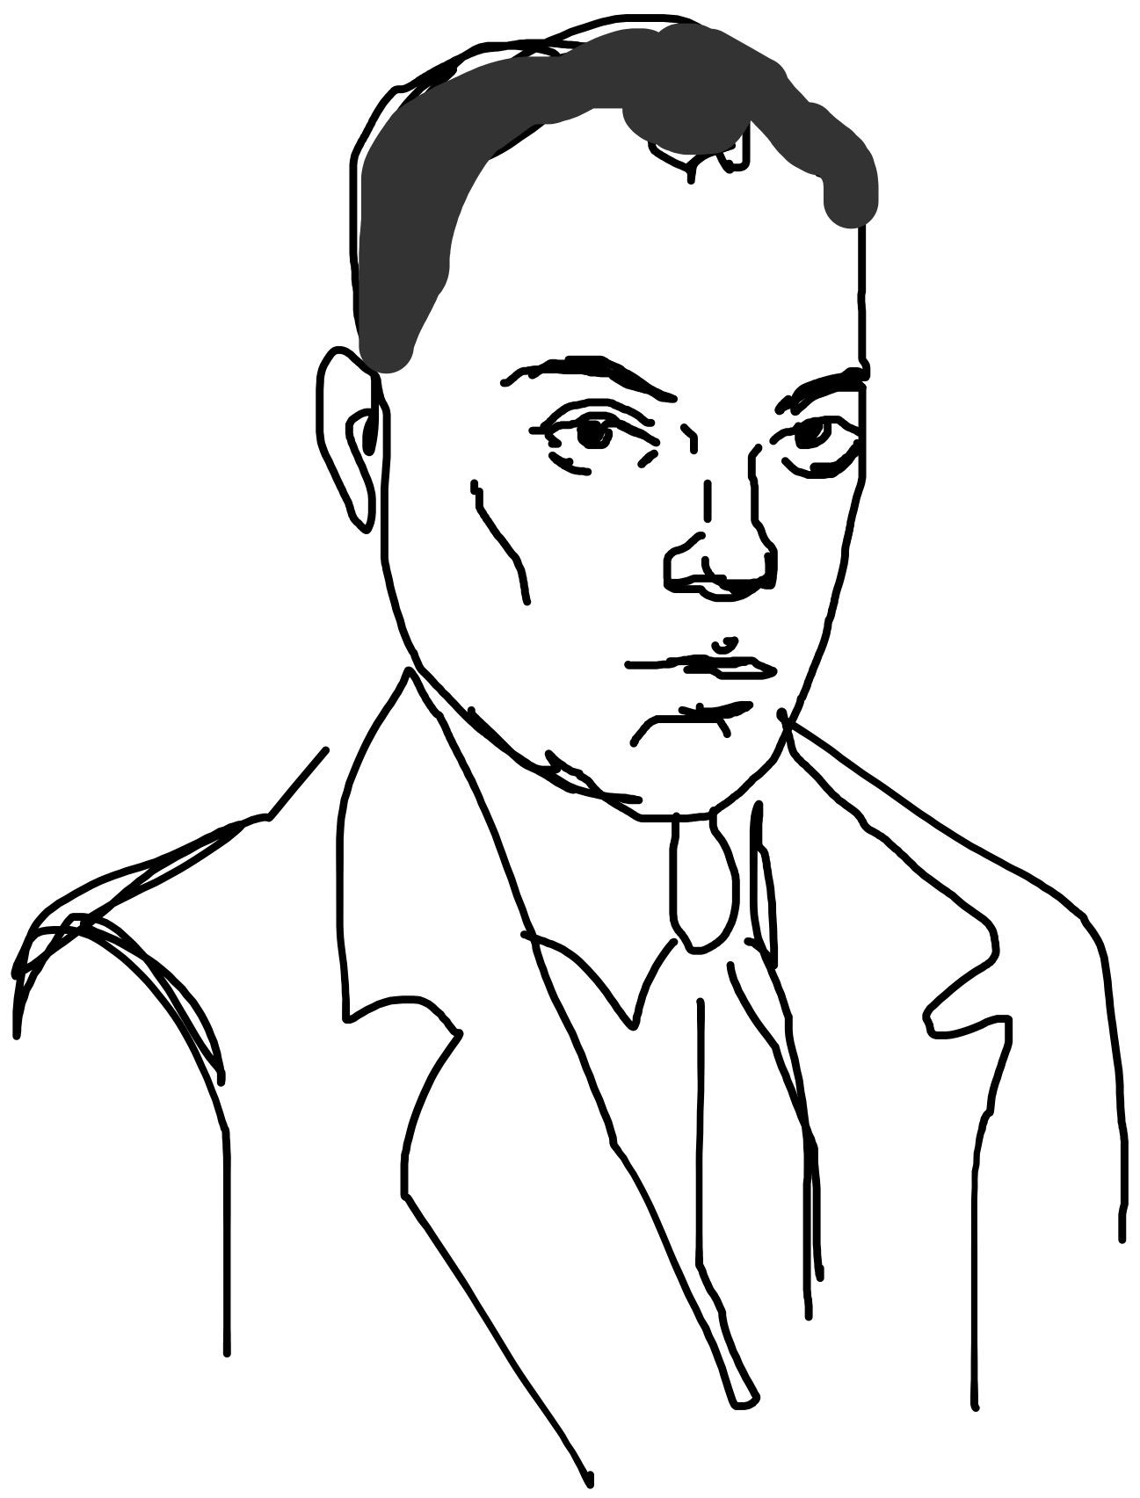


In this basis, matrix S’s…
0
1
S_{x} = ħ/2
1
0
0
-i
S_{y} = ħ/2
Pauli Matrices
σ_{x,y,z}
i
0
1
0
S_{z} = ħ/2
0
-1
Wolfgang
Pauli
S = ħσ/2
All S eigenvalues are ±ħ/2

Slide 46
Check S_{x} and S_{y} mix states
S_{z} |↑_{z}> = (ħ/2) |↑_{z}>
S_{z} |↓_{z}> = (-ħ/2) |↓_{z}>
S_{x} |↑_{z}> = (ħ/2) |↓_{z} >
S_{x} |↓_{z}> = (ħ/2) |↑_{z} >
S_{y} |↑_{z}> = (-iħ/2) |↓_{z} >
S_{y} |↓_{z}> = (iħ/2) |↑_{z} >

Slide 47
Eigenstates of [S] operators

Slide 48
Eigenstates of [S] operators

Slide 49
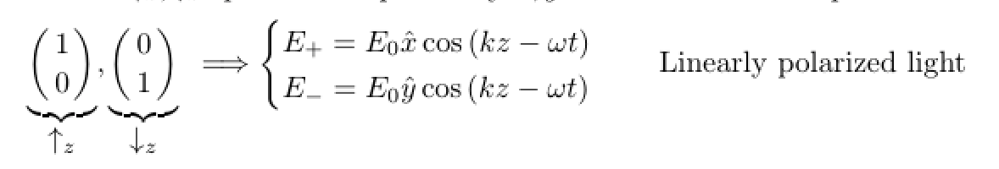
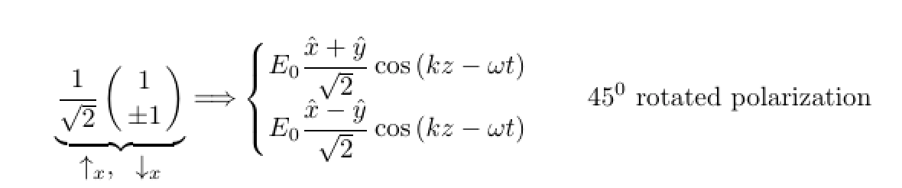
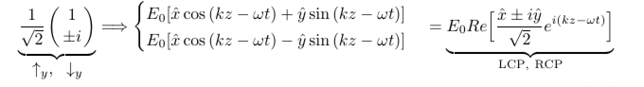
Eigenstates of [S] operators
As always, coefficients of how we mix the basis sets
Up-x is a mix of Up-z and Down-z. Same with Down-x.
UP and DOWN in any direction must be orthogonal

Slide 50
11D. Does it matter?
Quantum Thermodynamics

Slide 51

Boltzmann equation gets matricized

Slide 52
One Classical spin

Slide 53





One Classical spin

Slide 54


One Quantum spin

Slide 55




One Quantum spin

Slide 56

Matches Stern Gerlach
= 0 → h along x, then <m_{z}> is random
= π/2 → h along z, <m_{z}> is polarized

Slide 57



Slide 58
11E. What about 2 spins?

Slide 59




S₁.S₂

Slide 60
A little math background: Tensor Product
a
A =
B = (α β)
b
aB
aα aβ
bα bβ
A ⊗ B = =
bB
αa βa
αb βb
B ⊗ A = (αA βA) =

Slide 61




Slide 62

S_{1z} ⊗ S_{2z}

Slide 63


N spins → 2^{N} matrix size, 2^{N} eigenvalues, 2^{N} states

Slide 64






N spins → 2^{N} matrix size, 2^{N} eigenvalues, 2^{N} states

Slide 65



Back to two spins

Slide 66
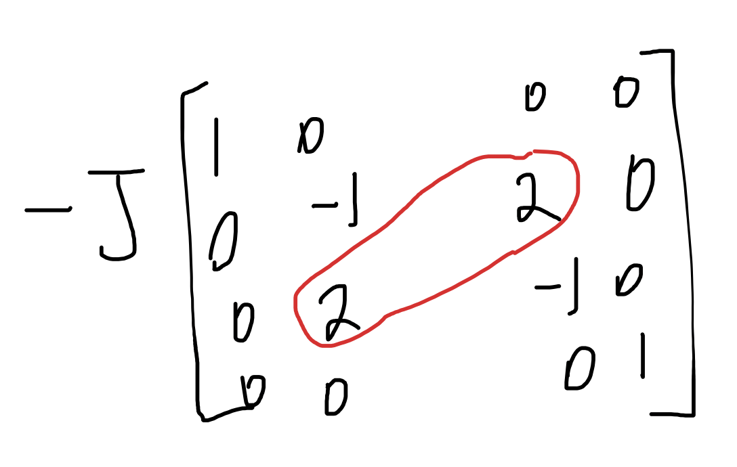
Off-diagonals matter !
Plot diagonals

Slide 67
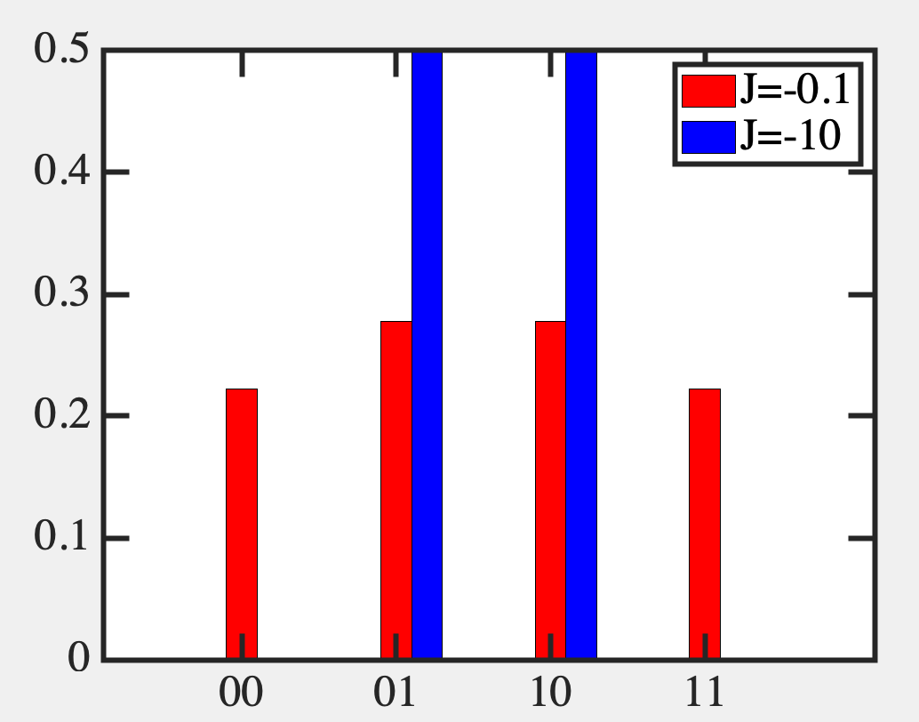
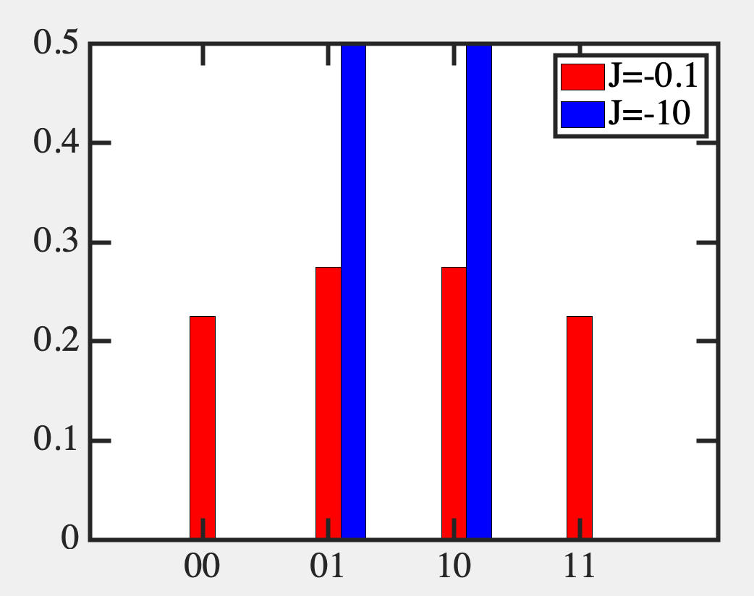
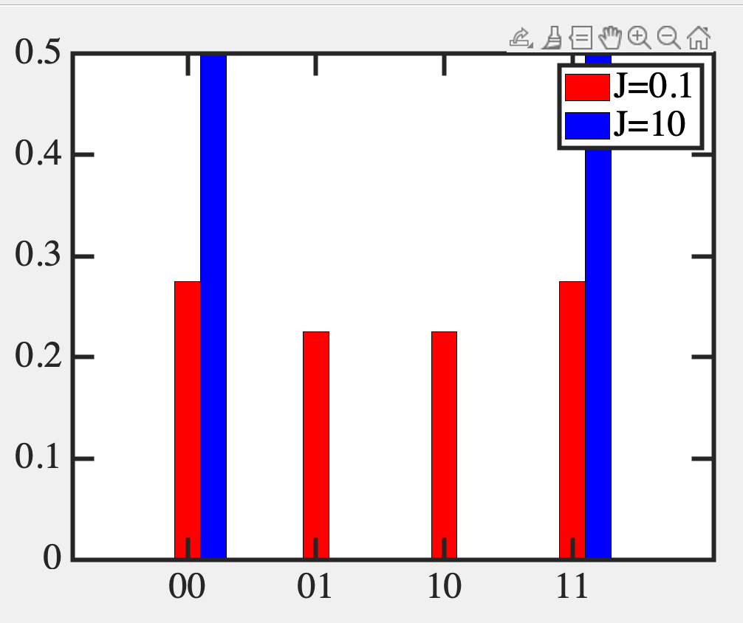
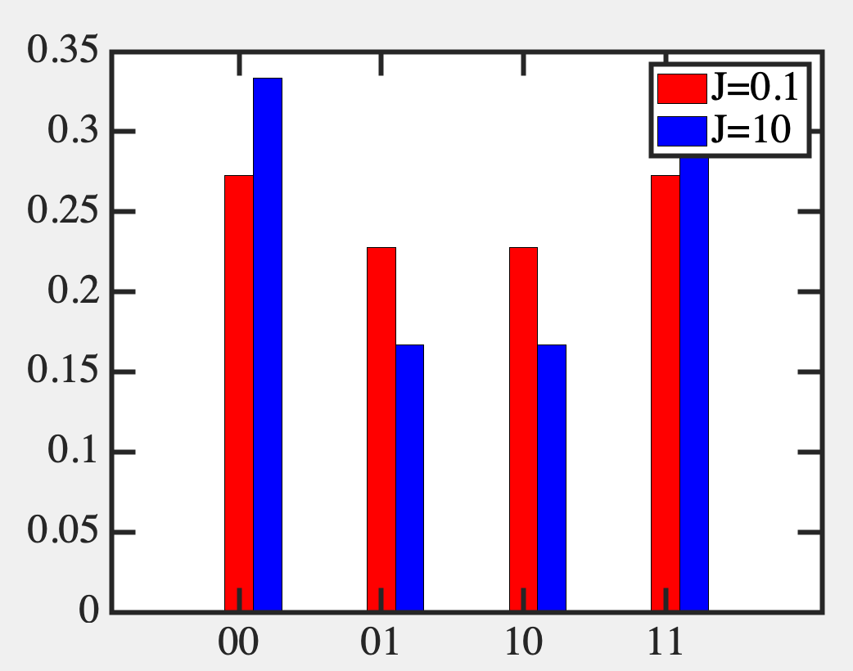
Classical (diagonals of H) vs Quantum

Slide 68
Off-diagonal terms are spreading states around
Use it like temperature !!!

Slide 69









Sz + Sx create a new qubit

Slide 70


Application – Quantum Annealing
At high temperature, the results get spread around
But at low temperature, you could be stuck in a local
minimum (metastable state)
Annealing: Start at high temperature so the system
finds its minima quickly, then lower temperature slowly

Slide 71
Quantum Annealing: Start at low temperature,
but high h_{x}-fields to spread, then reduce h_{x}

Slide 72





Slide 73
How do we create these off-diagonal states?
How do we do gating, readout, error correction?
What does the entanglement mean over long distances?
How can we model it?
How can we exploit it?
What are the challenges?
_{Specific gates (Hadamard etc)}
No Cloning Theorem, Quantum Key distribution
_{Bell’s Inequality}
Kronecker products, time evolution
Quantum Parallelism – Grover Search, Shor’s factoring
Coherence vs control and initializing

Slide 74






Fundamentals of Computing
Lec 12
Quantum Gates

