Slide 1
Fundamentals of Computing
Lec 13
Quantum Error Correction
And Entanglement

Slide 2
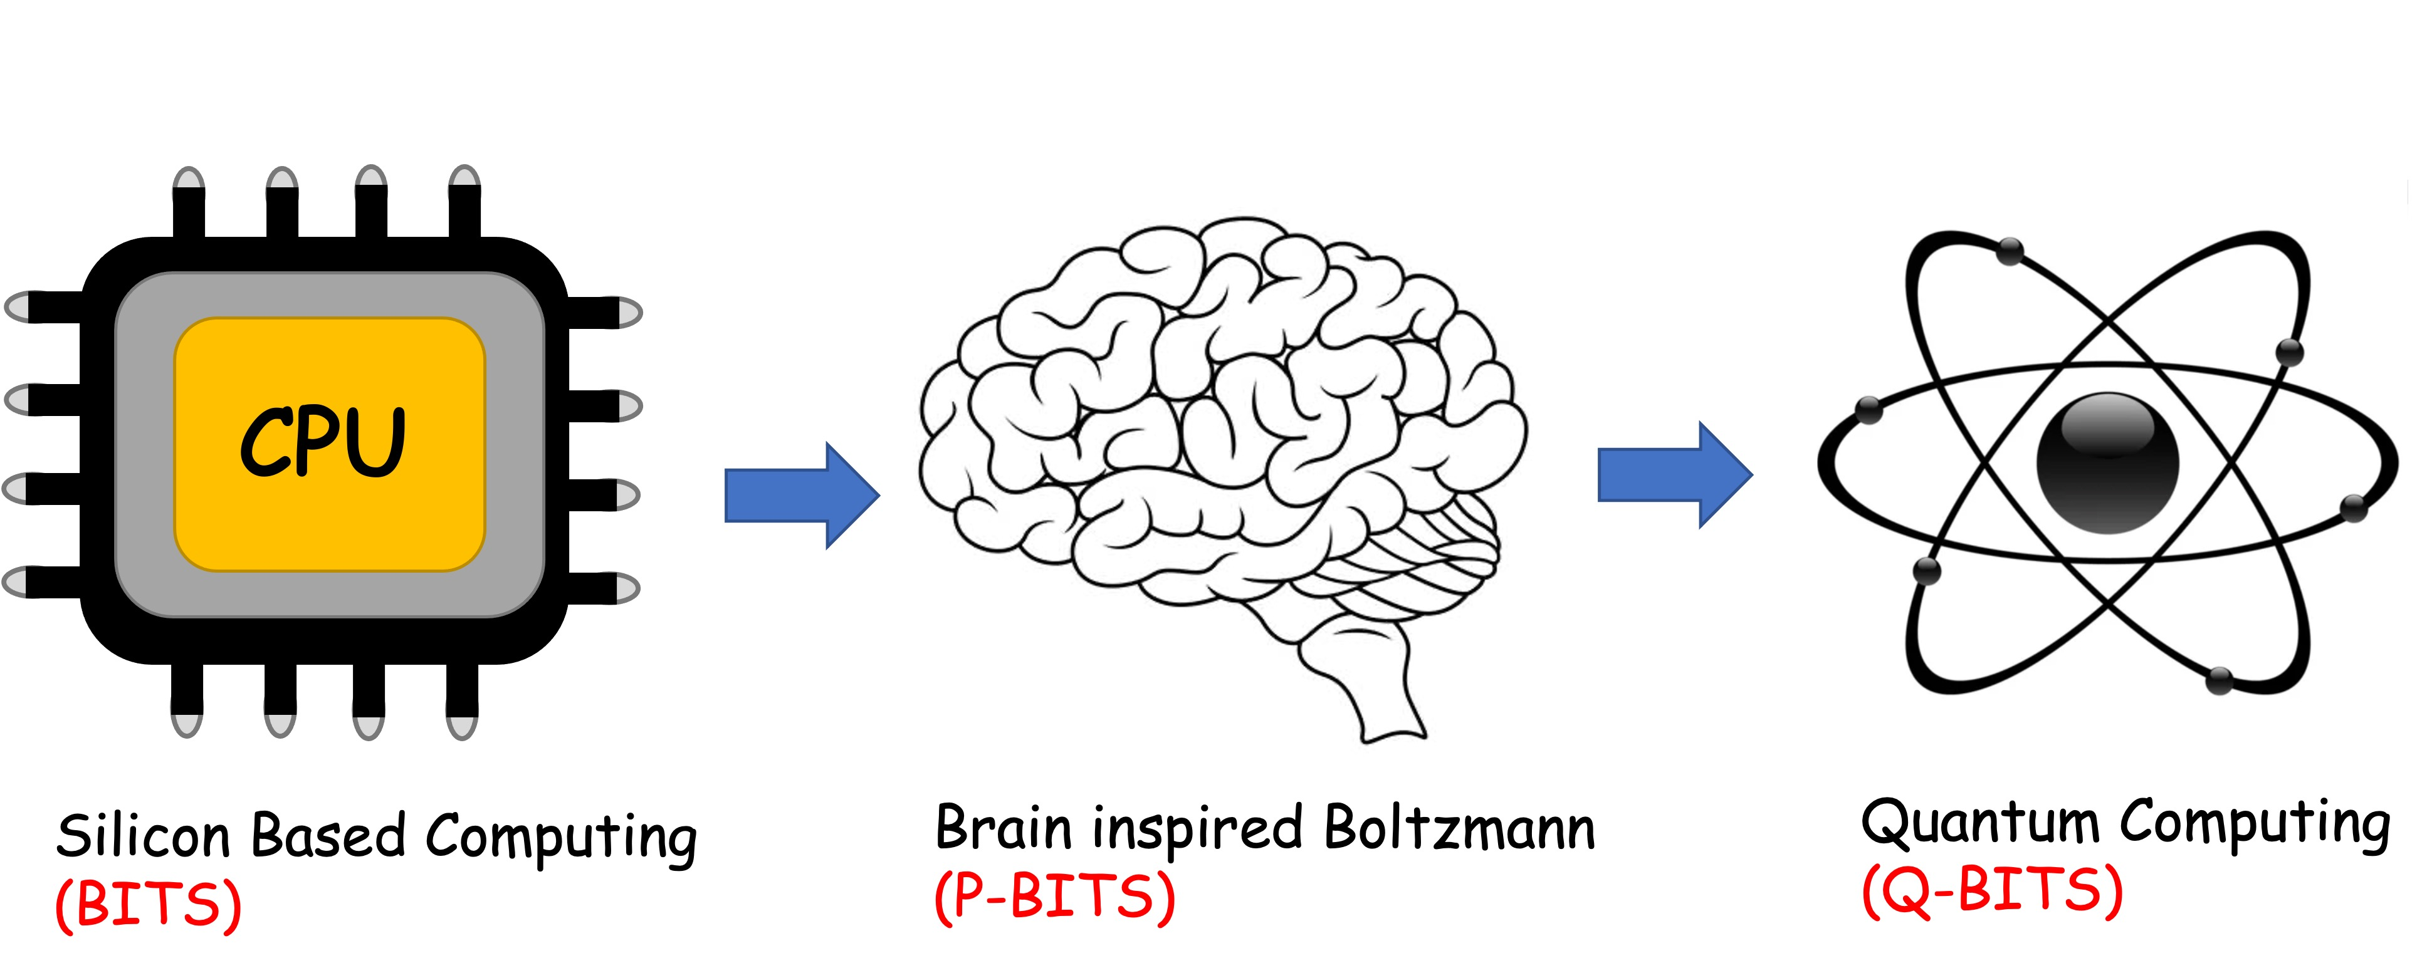
Overall structure of this course
Analog Computing in Carbo
How we train (Supervision)
Physics of Neurons (Boltzmann)
How we learn (time sampling)
Optimizing and Classifying
Transition Theory & Inferencing
Quantum Computing in Magneto
Quantum Spins and Hardware
Quantum Physics
Quantum Gates and Hardware
Quantum Entanglement
Quantum Gates and Factorization
Digital Computing in Silico
How we compute (algorithms)
How we add (Gates)
How we add quickly (CMOS)
How we fix errors
Thermodynamics of Computing

Slide 4
Quantum states are vectors
Operations are matrices
1
0
0
0
00
00
0
1
0
0
01
01
=
0
0
0
1
10
11
0
0
1
0
11
10
For any operation (e.g. R_{k},
QFT), need to check what
the states are and what
the operator is

Slide 5
The operators are unitary
Any unitary operator =
exponential of an
anti-Hermitian matrix

Slide 6
Steady-state

Slide 7
Quantum Statistical Mechanics
Replace vector with matrix
Field with Kronecker
Solve as before:
Boltzmann:
SCF/QMC:

Slide 8
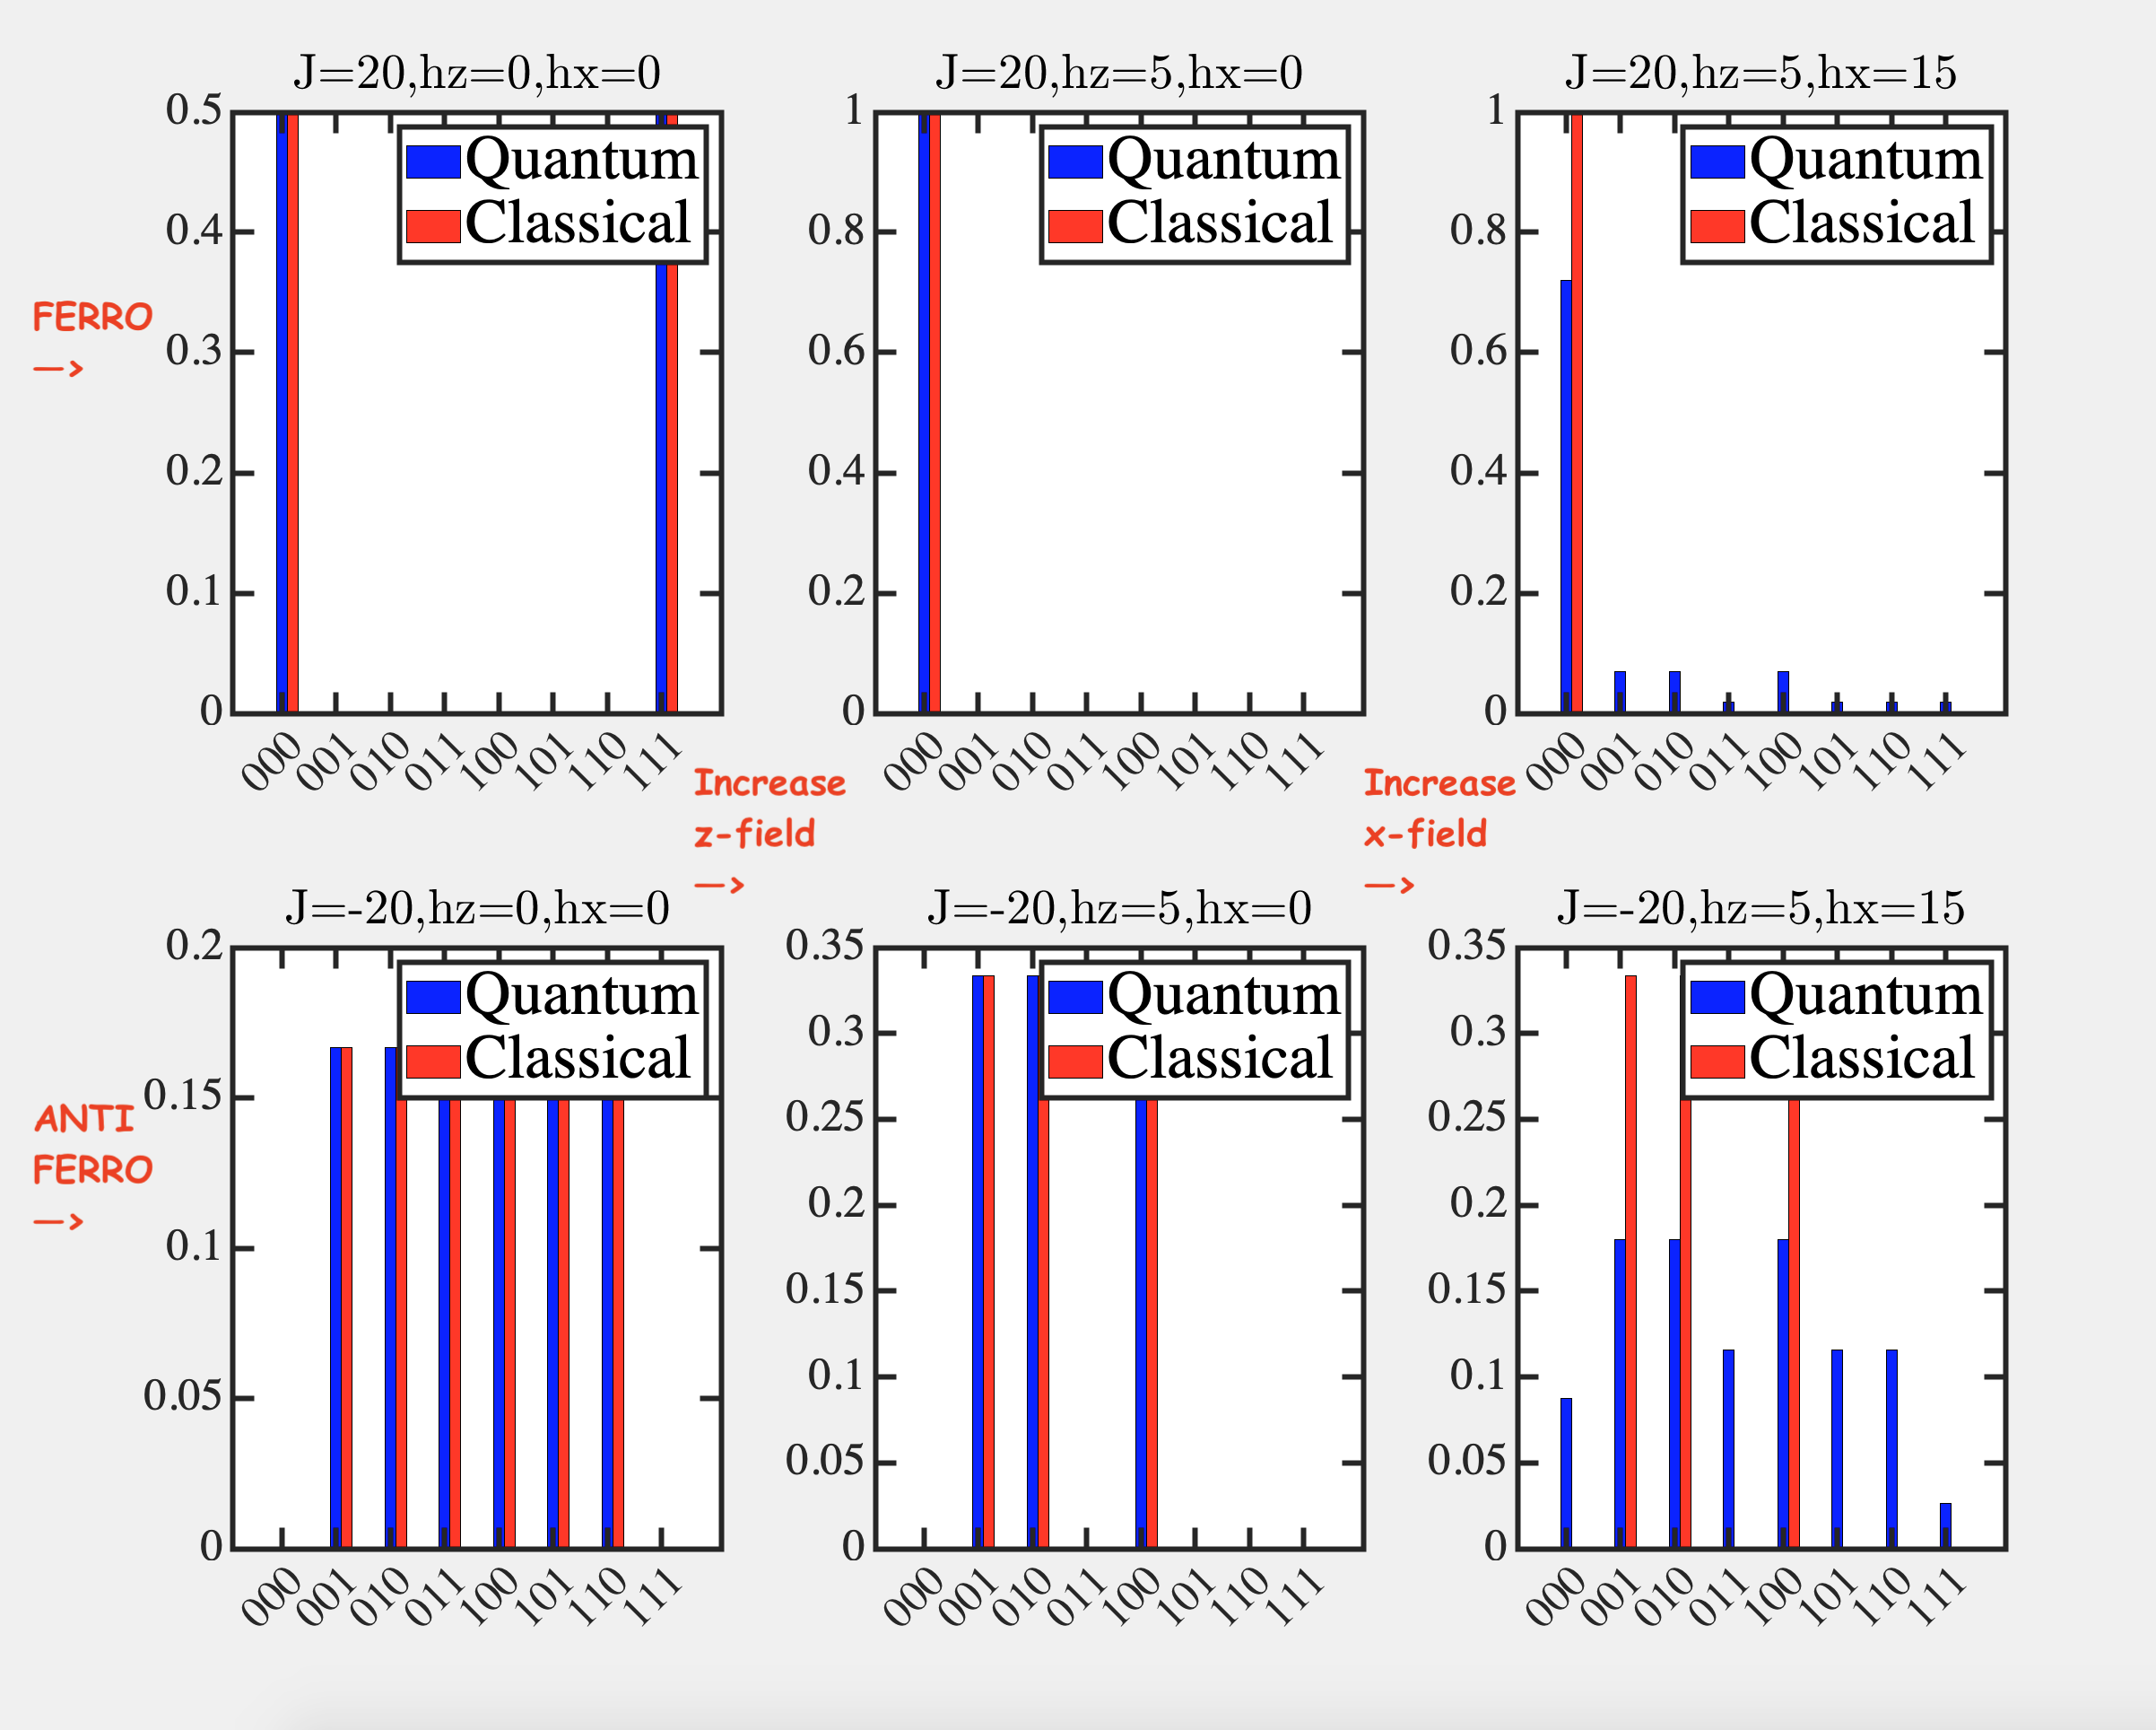
Quantum Statistical Mechanics

Slide 9
Importance of Linearity
Importance of Mixing

Slide 10
13A. How we copy and
error correct

Slide 11
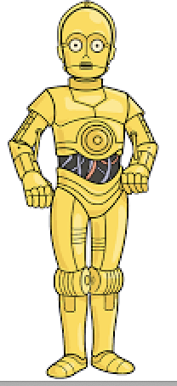
Suppose we can copy a given state

Slide 12
e.g. CNOT gate
A
B
Bout
A
A
0
0
0
0
A
1
0
1

Slide 13
Can we copy an unknown state?
No – it will not be linear !!!

Slide 14
Another way to state this

Slide 15
No Cloning Theorem
Not arbitrary and certainly not an unknown state !!

Slide 16
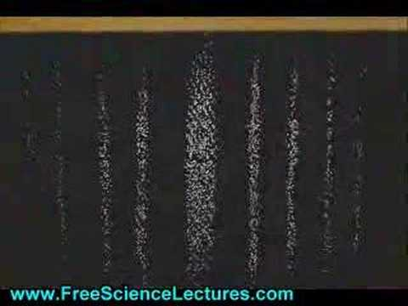
Makes sense!!! Only way the coeffs express themselves is through measurements, collapse, reprepare with identical
initial conditions, and remeasure

Slide 17
So how can we error correct?
110c1ba
Classical bits are easy to measure and repeat
Quantum bits can be entangled

Slide 18
Error Detection

Slide 19
Error Detection
Measurement along z-axis (‘classical’) does not help

Slide 20
Error Detection
Choose another axis
But again, only way we know this is through repeated
measurements

Slide 21
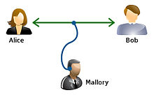
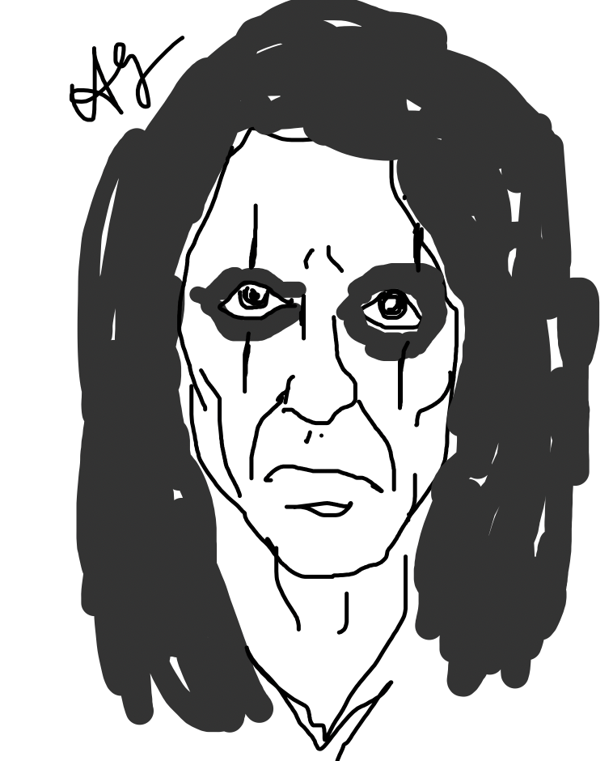
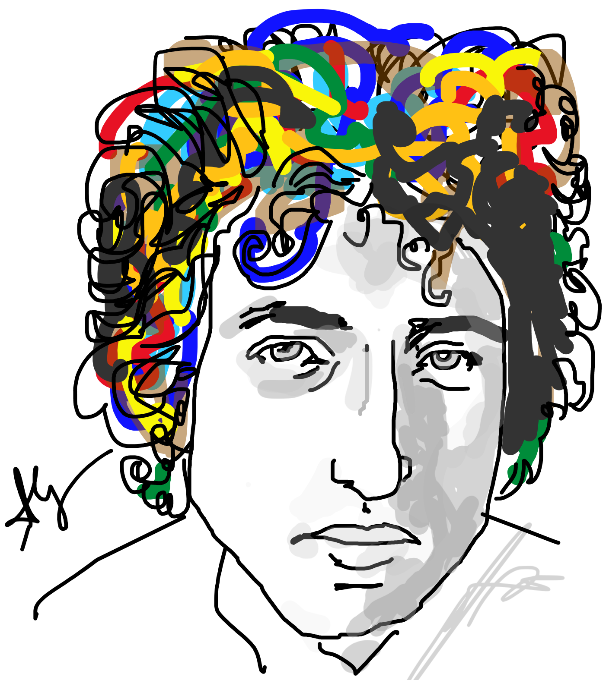
The saga of Alice and Bob

Slide 22
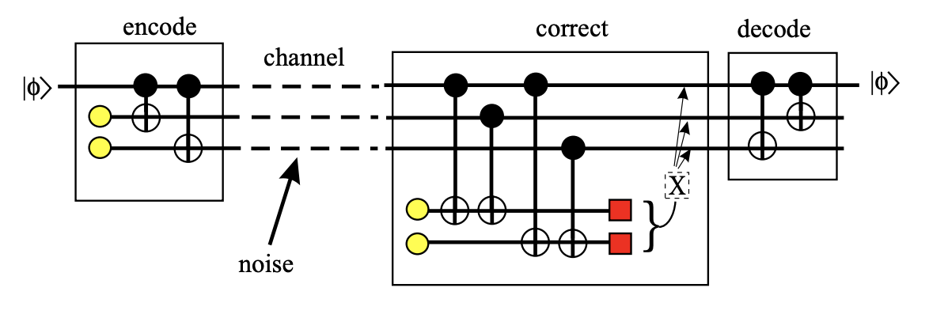
Error Correction: Alice does 2 CNOTs

Slide 23
Error corrupts qubits

Slide 24
Bob adds two ancilla bits, does CNOTs

Slide 25
Bob measures his ancillae & corrects

Slide 26
Bob’s error

Slide 27
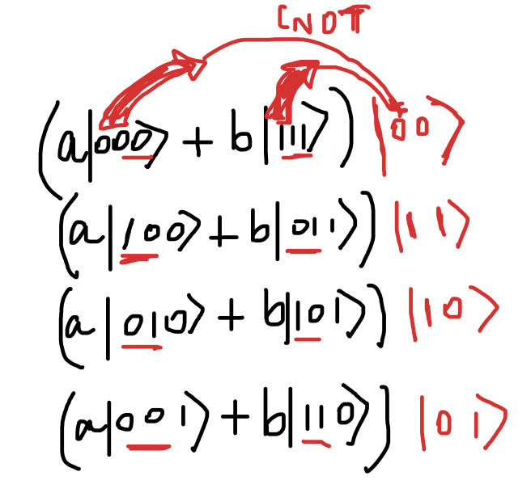
How could we measure ancilla without
Collapsing data bits?
Because they are factorized, ie,
not entangled.
In other words, a single set (not a
superposition) of Kronecker products

Slide 28
13B. Maths of mixing states

Slide 29
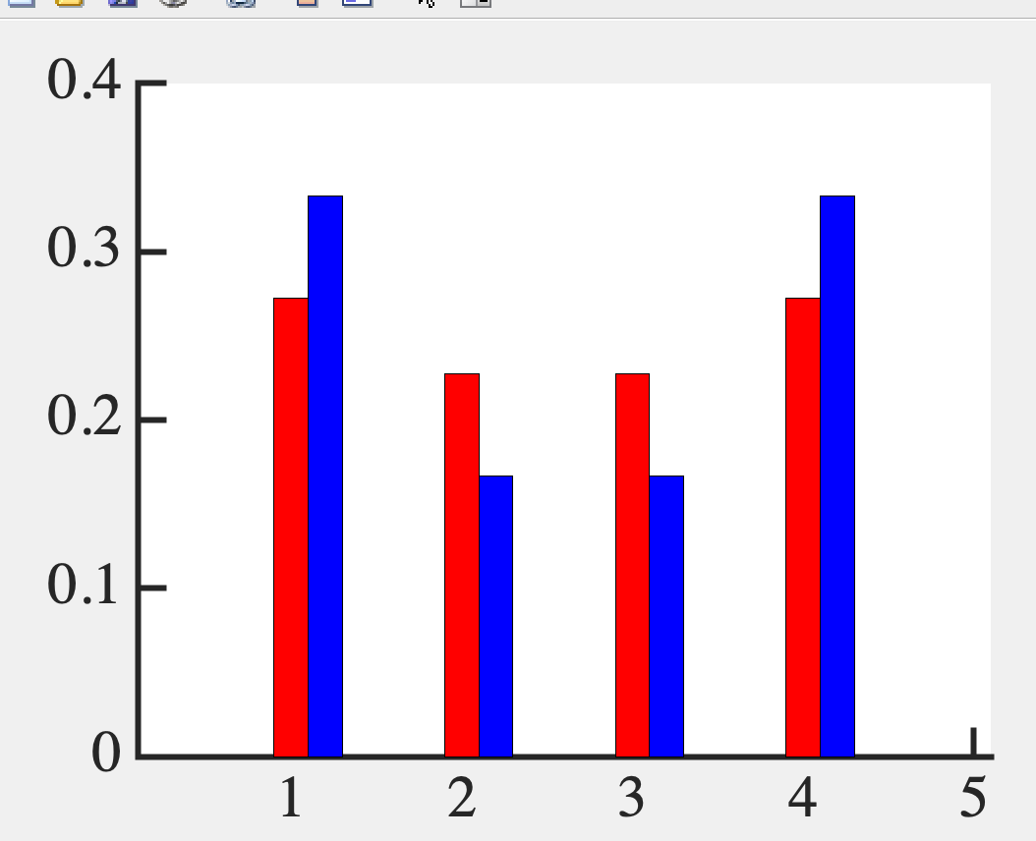
Average of a mixed state
How can we generalize?

Slide 30
Recall Bra-Kets
c₁
c₂
..
..
c_{n}
⎲
Ψ = c_{n}ψ_{n} =
⎳
_{n}
1
0
0
0
..
..
0
1
..
..
0
0
..
..
1
|ψ₁> =
|ψ₂> =
|ψ_{N}> =

Slide 31
“Bra-ket” (Bracket)
<Ψ|Ψ> = |c₁|² + |c₂|² +...+ |c_{N}|²

Slide 32
Pure States
< ψ_{i}|ψ_{j}> = δ_{ij}
< ψ_{i}|ψ_{i}> = 1
i
0
0
0
|ψ_{i} > < ψ_{i}| =
0
..
..
0
0
1
..
0
0
..
..
0
i
⎲
|ψ_{n} > < ψ_{n}| = I
⎳
_{n}

Slide 33
Mixed state
Quantum + Thermodynamic mix
p₁
0
0
ρ =
0
..
..
0
0
p_{i}
..
0
0
..
..
p_{n}
⎲
p_{n} |Ψ_{n}> <Ψ_{n}| =
⎳
_{n}

Slide 34
Pure State
p_{n} = 0 or 1
ρ² = ρ
Pure State

Slide 35
Average of a mixed state
<A> =
⎲
p_{n} <Ψ_{n}|A|Ψ_{n}>
⎳
_{n}
⎲
⎲
p_{n} <Ψ_{n}|A|Ψ_{m}> <Ψ_{m}|Ψ_{n}>
= Tr(ρA)
=
⎳
⎳
_{m n}

Slide 36
13C: Maths of entanglement

Slide 37
Polarized Light
A C
A B C
P(AB) = cos²(45⁰) = 1/2
P(AC) = 0
P(BC) = cos²(45⁰) = 1/2
P(AC) = P(AB).P(BC) = 1/4
Inserting a middle layer improved transmission!

Slide 38
EPR Paradox:
Pion decay → two entangled states in a
singlet (e and e+ with opposite spins)
|00> + |11> → Move far far away
Measure bit 1 → 0
Bit 2 must collapse to 0 instantly !!
(Nonlocality since light needs finite time)

Slide 39
Is entanglement real?
Could uncertainty accommodate
a hidden variable?
Is uncertainty just in knowledge
or fundamental ??

Slide 40
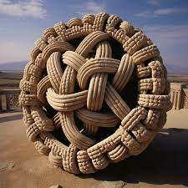
Maths of Entanglement
Entangled means you cannot separate (factorize)

Slide 41
Non-Entangled State (Factorizable)

Slide 42
One way to flip a state

Slide 43
How to turn a state over? Partial Density Matrix
Inverting a Kronecker product in a sense…

Slide 44
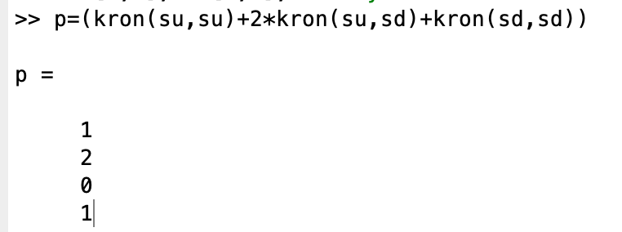
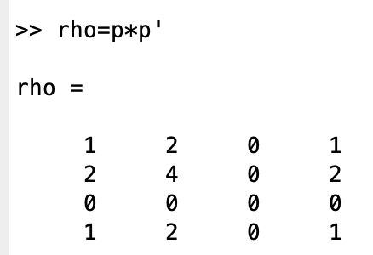
Entangled state

Slide 45
Partial Density Matrix

Slide 46
Partial Density Matrix

Slide 47
Unentangled (factorizable) state

Slide 48
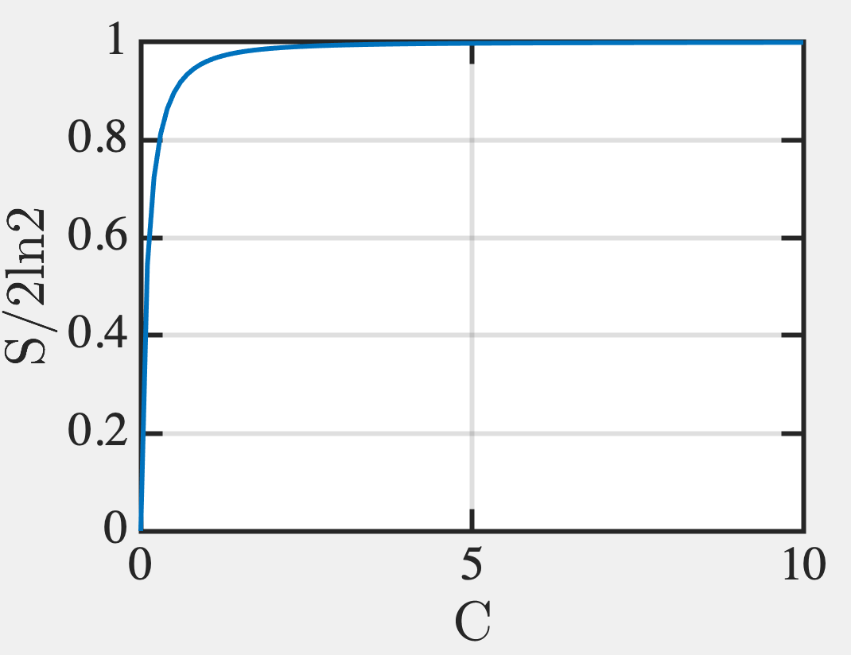
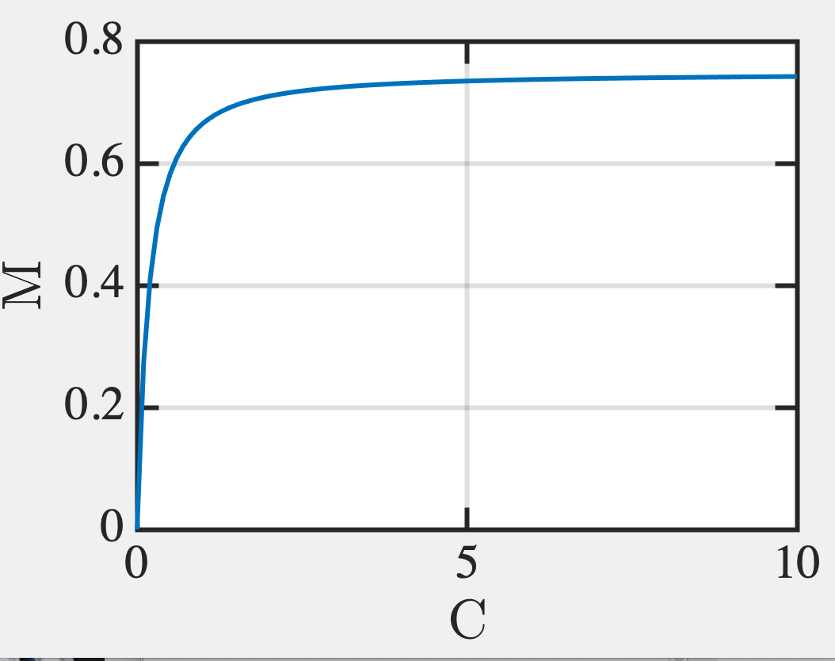
Von Neumann Entropy

Slide 49
For partial states

Slide 50
So Sign of Entanglement:
Partial Density Matrix must have
non-zero determinant
Matrices are not idempotent (not equal to their square)
Von Neumann entropy is non-zero

Slide 51
13D: How to measure
entanglement

Slide 52
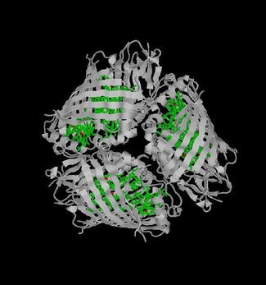
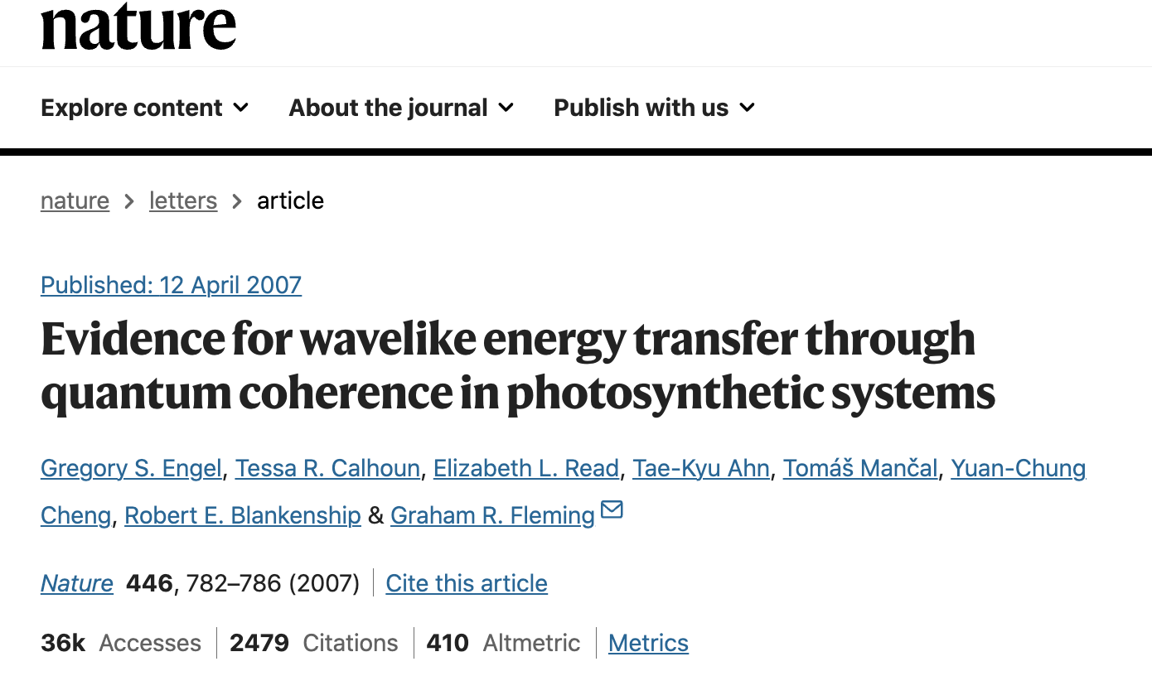
Photosynthesis needs Quantum Superposition
Energy efficiency ~ 100%

Slide 53
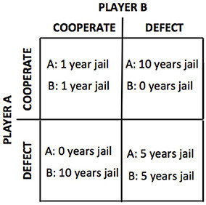
Prisoner’s Dilemma: A’s strategy?
If B defects, A should defect
(5 instead of 10 yr jail)
If B cooperates, A should defect
(0 instead of 1 yr jail)
SO A should Testify even if they are innocent !!! Expect 2.5 years in jail, but less than 5.5 if A does not defect.
This is the Nash Equilibrium in Game Theory, that dominates the Pareto optimal of (1,1) !!
(Where you can’t helping one person without hurting another)
Moreira, Catarina & Wichert, Andreas. (2016). Quantum Probabilistic
Models Revisited: The Case of Disjunction Effects in Cognition. Frontiers in Physics.
4. 10.3389/fphy.2016.00026.

Slide 54
Quantum Prisoner’s Dilemma
Can they share instructions without
consulting, so the probability of their
success is higher than classical physics?
Moreira, Catarina & Wichert, Andreas. (2016). Quantum Probabilistic Models Revisited: The Case of Disjunction Effects in Cognition. Frontiers in Physics. 4. 10.3389/fphy.2016.00026.

Slide 55
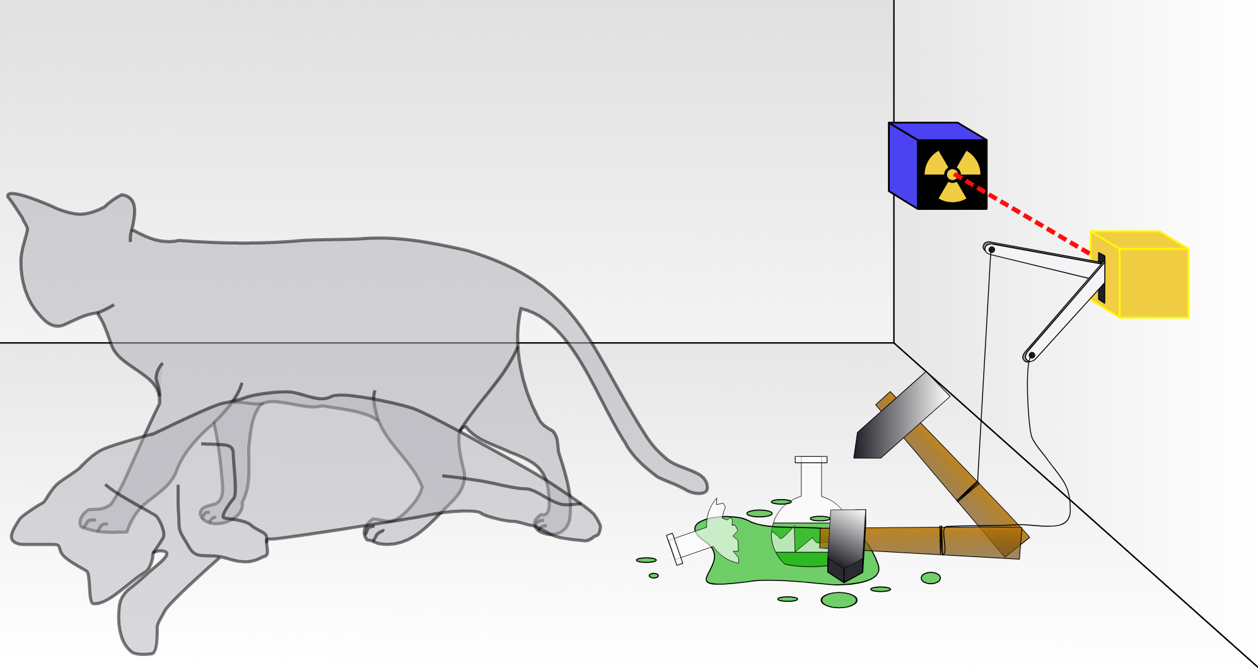
Bit Collapse upon measurement

Slide 56
Example: Alice and Bob share a photon qubit
Roulette: can your x and y satisfy:

Slide 57
Only freedom:
AB can report their measurement along any axes
Alice reports 0’s along the black ais (VH photons)
1’s along the red axis
Bob reports 0’s along the blue axis 1’s along the green axis
The ‘quantum’ reveals itself through statistics

Slide 58
Only freedom:
AB can report their measurement along any axes
00 → Joint probability cos²(π/8)
01 → Joint probability cos²(π/8)
10 → Joint probability cos²(π/8)
11 → Joint probability cos²(3π/8)
Prob of win = 1-cos²(3π/8) = cos²(π/8) ~ 85%
The ‘quantum’ reveals itself through statistics

Slide 59
Modified game: CHSH inequality

Slide 60
Classical CHSH Bound
±2 each time, so average ≤ 2
Realism (A, B value exist independent of being measured)
Locality (Alice and Bob don’t influence each other)
Quantum → Don’t have binary numbers, but 2x2 non-Commuting matrices with the same (but not simultaneous binary eigenvalues)

Slide 61
Just like 45 degree polarizers to mess
with probabilities.

Slide 62
QM violates it

Slide 63
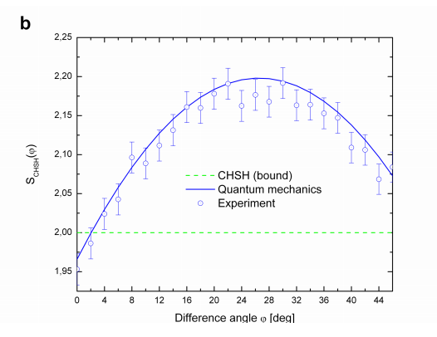

Slide 64
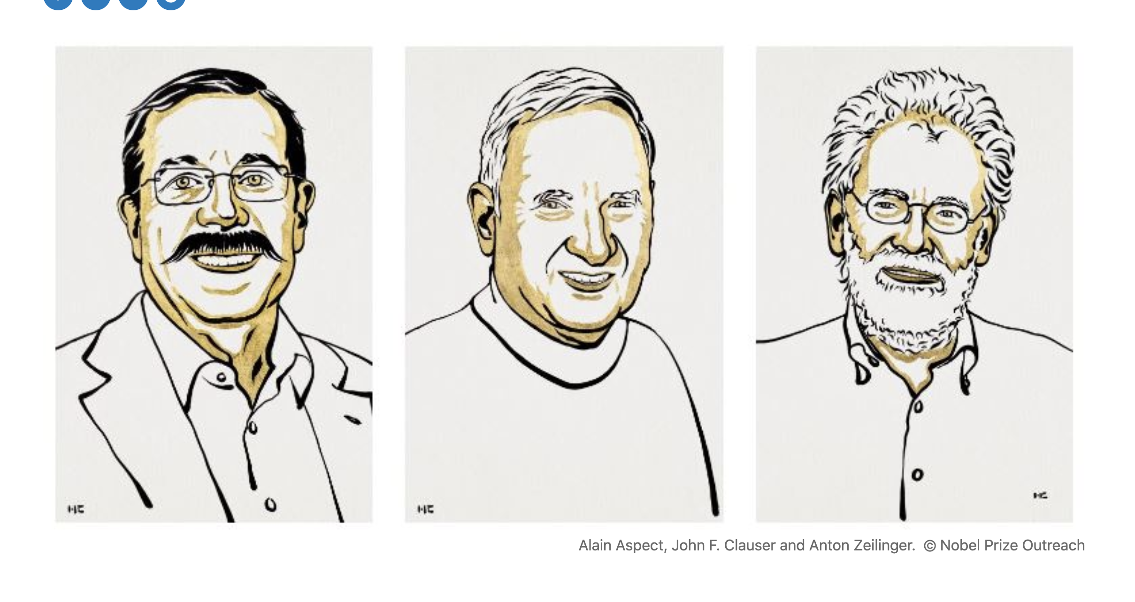

Slide 65
Entanglement is real
Electrons are in superposition
A classical measurement decouples
them by entangling with an apparatus.
Decoherence kills phase information

Slide 66
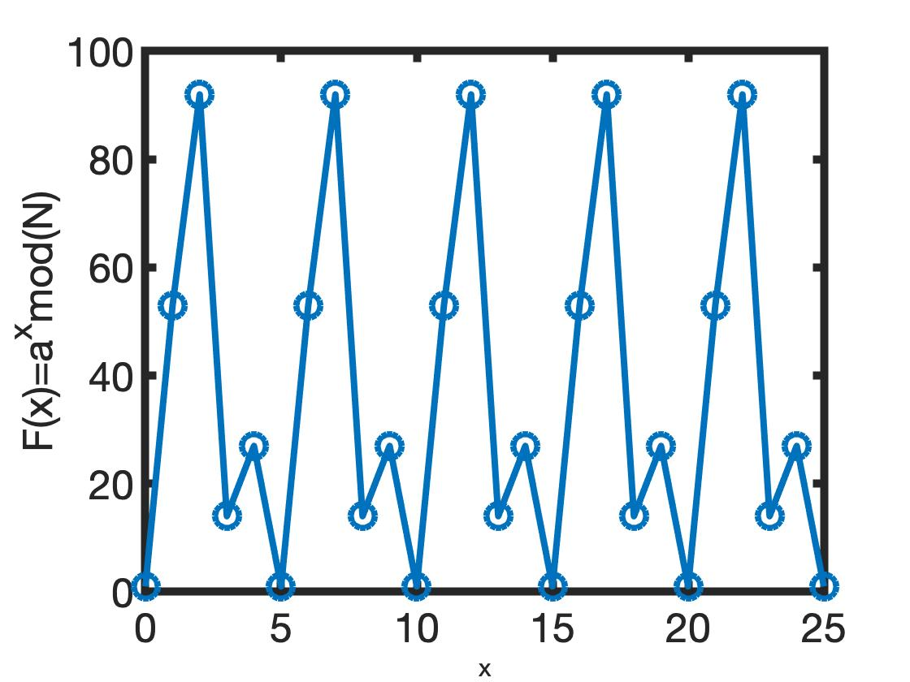
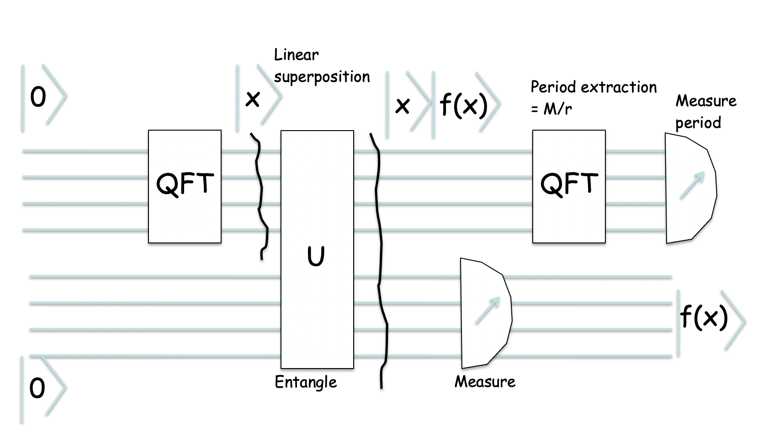
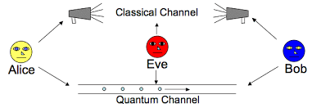
Next Lecture
How to use entanglement for quantum computing?
Grover Search
And Shor Factorizing (143)
Quantum Circuit
QC circuit
Quantum Cryptography
and Key distribution

