Slide 1
Fundamentals of Computing
Lec 14
Quantum Computing

Slide 2
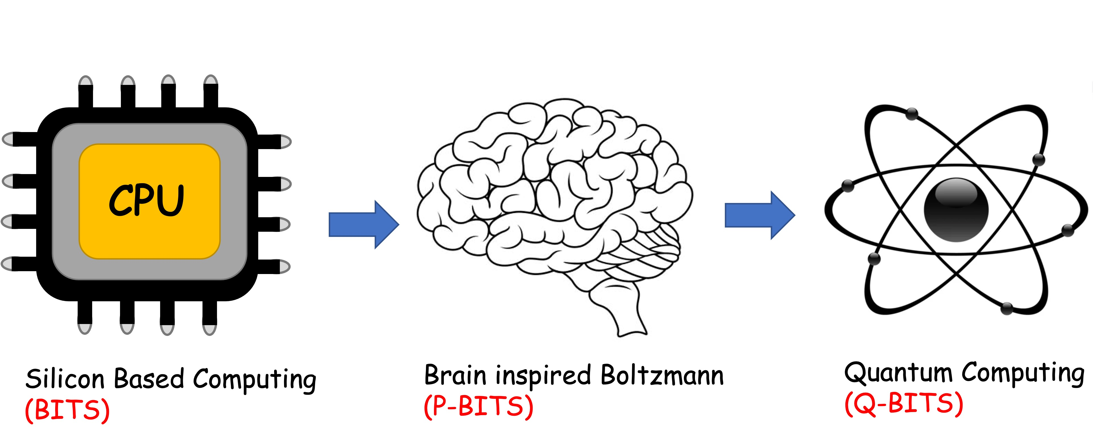
Overall structure of this course
Analog Computing in Carbo
How we train (Supervision)
Physics of Neurons (Boltzmann)
How we learn (time sampling)
Optimizing and Classifying
Transition Theory & Inferencing
Quantum Computing in Magneto
Quantum Spins and Hardware
Quantum Physics
Entanglement and Superposition
Quantum Computing
Digital Computing in Silico
How we compute (algorithms)
How we add (Gates)
How we add quickly (CMOS)
How we fix errors
Thermodynamics of Computing

Slide 4
Computing Speed-up
Simulating quantum processes on a classical computer??

Slide 5
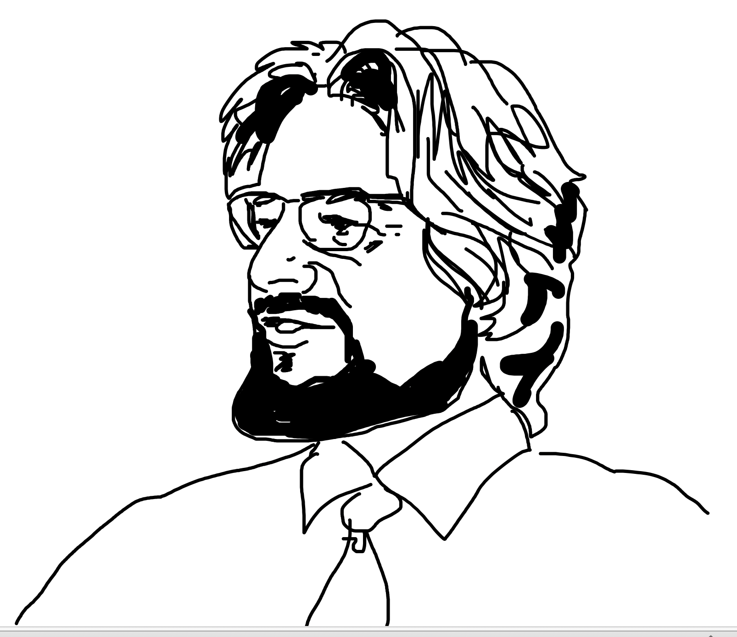
What we have seen so far
There is a fundamental, measurable difference between
classical variables that have an unknown but pre-assigned,
random value, vs quantum variables that do not possess
a value until you measure them.
The latter need non-commuting matrix representations
that manifest as entangled qubits (photons, spins)
John Stewart Bell

Slide 6
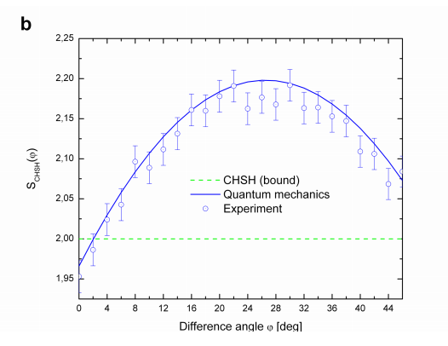
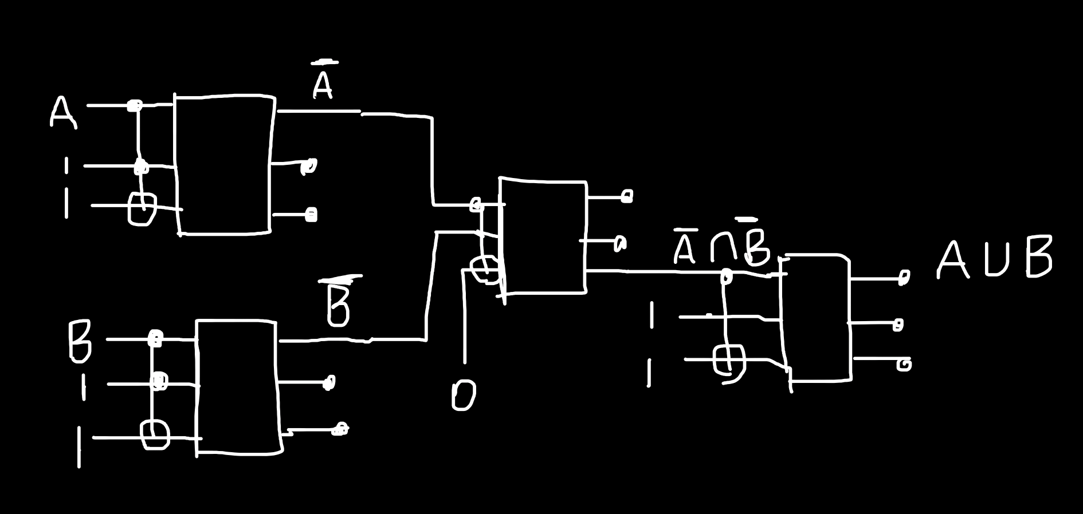
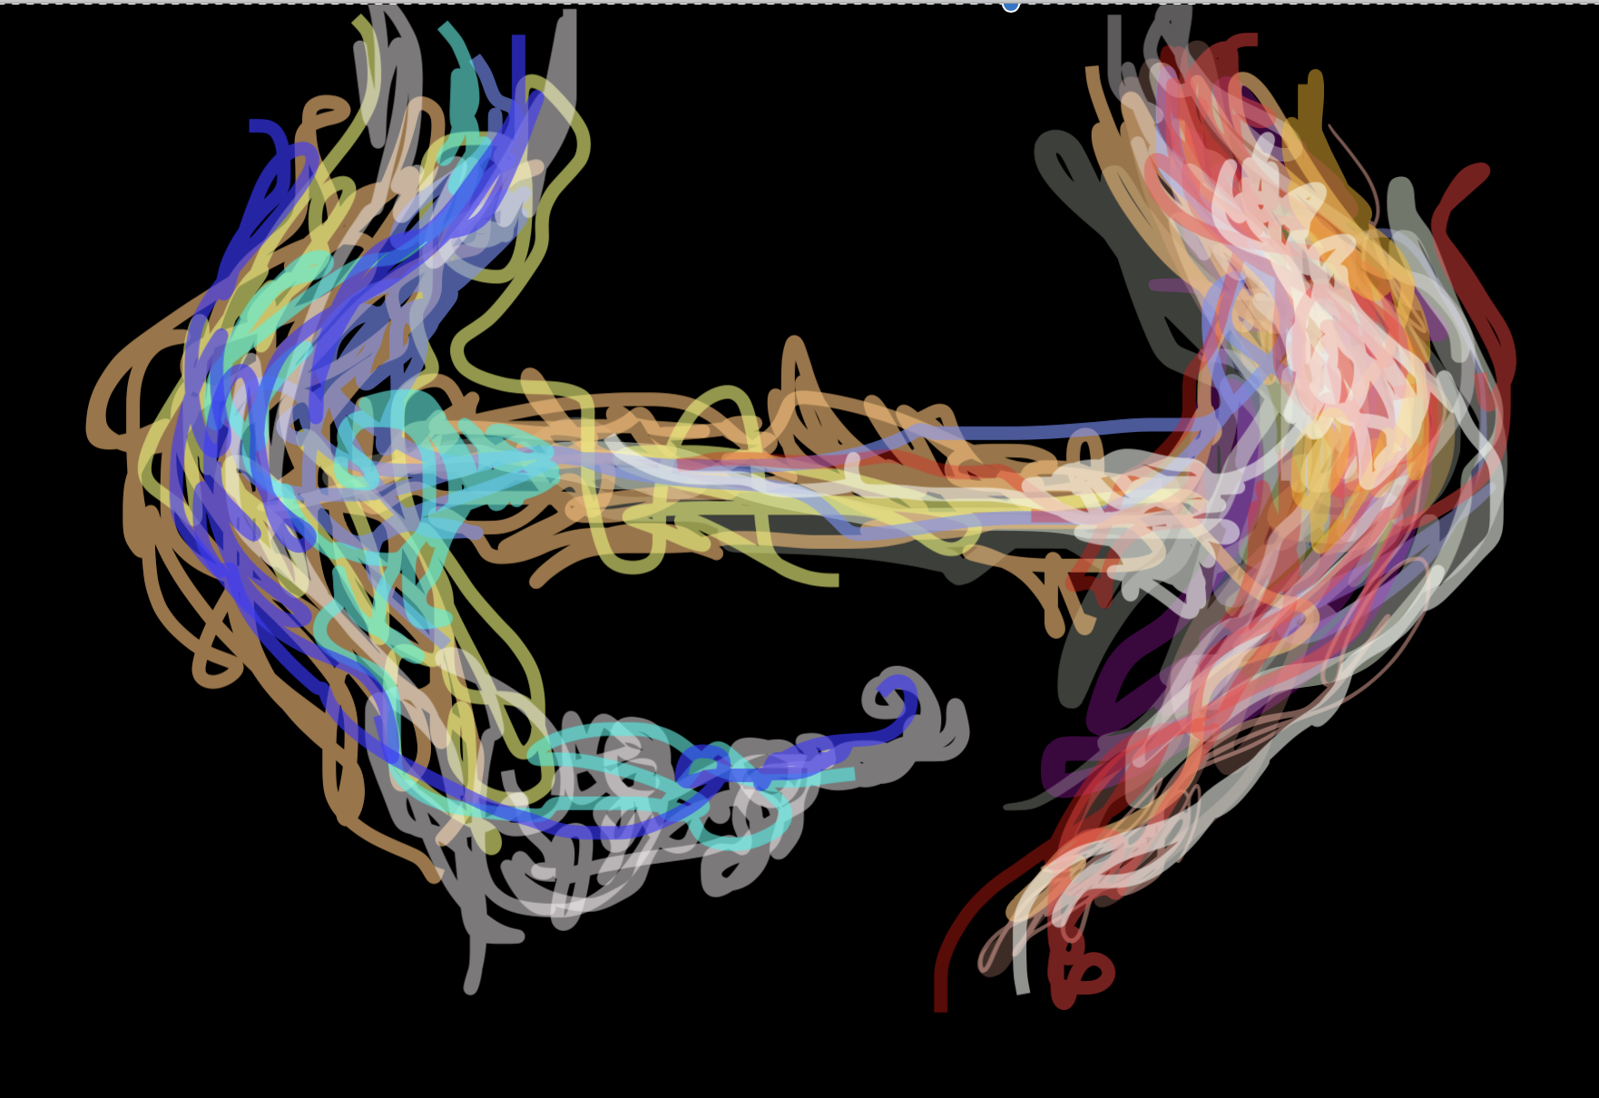
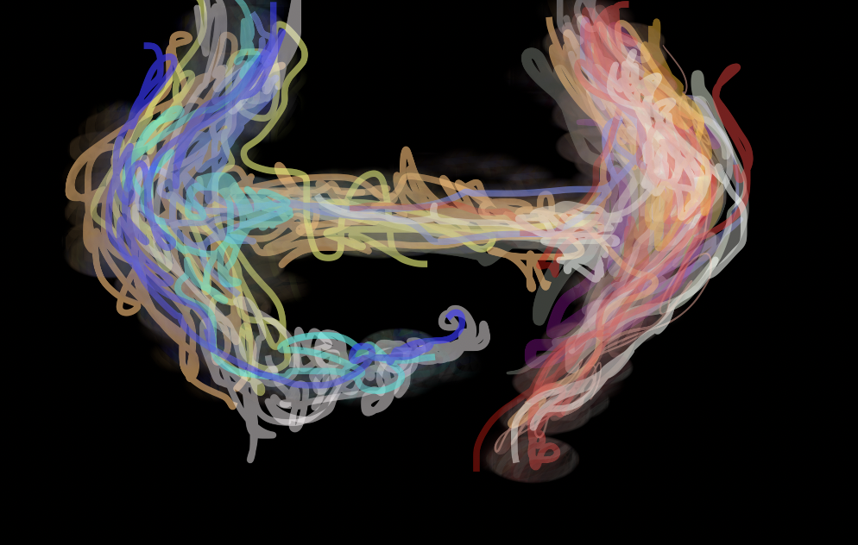
Quantum Circuits
Quantum Entanglement
Hadamard Gates
Phase Shift Gates
Toffoli-Fredkin Gates

Slide 7
14A. Quantum Key Distribution

Slide 8
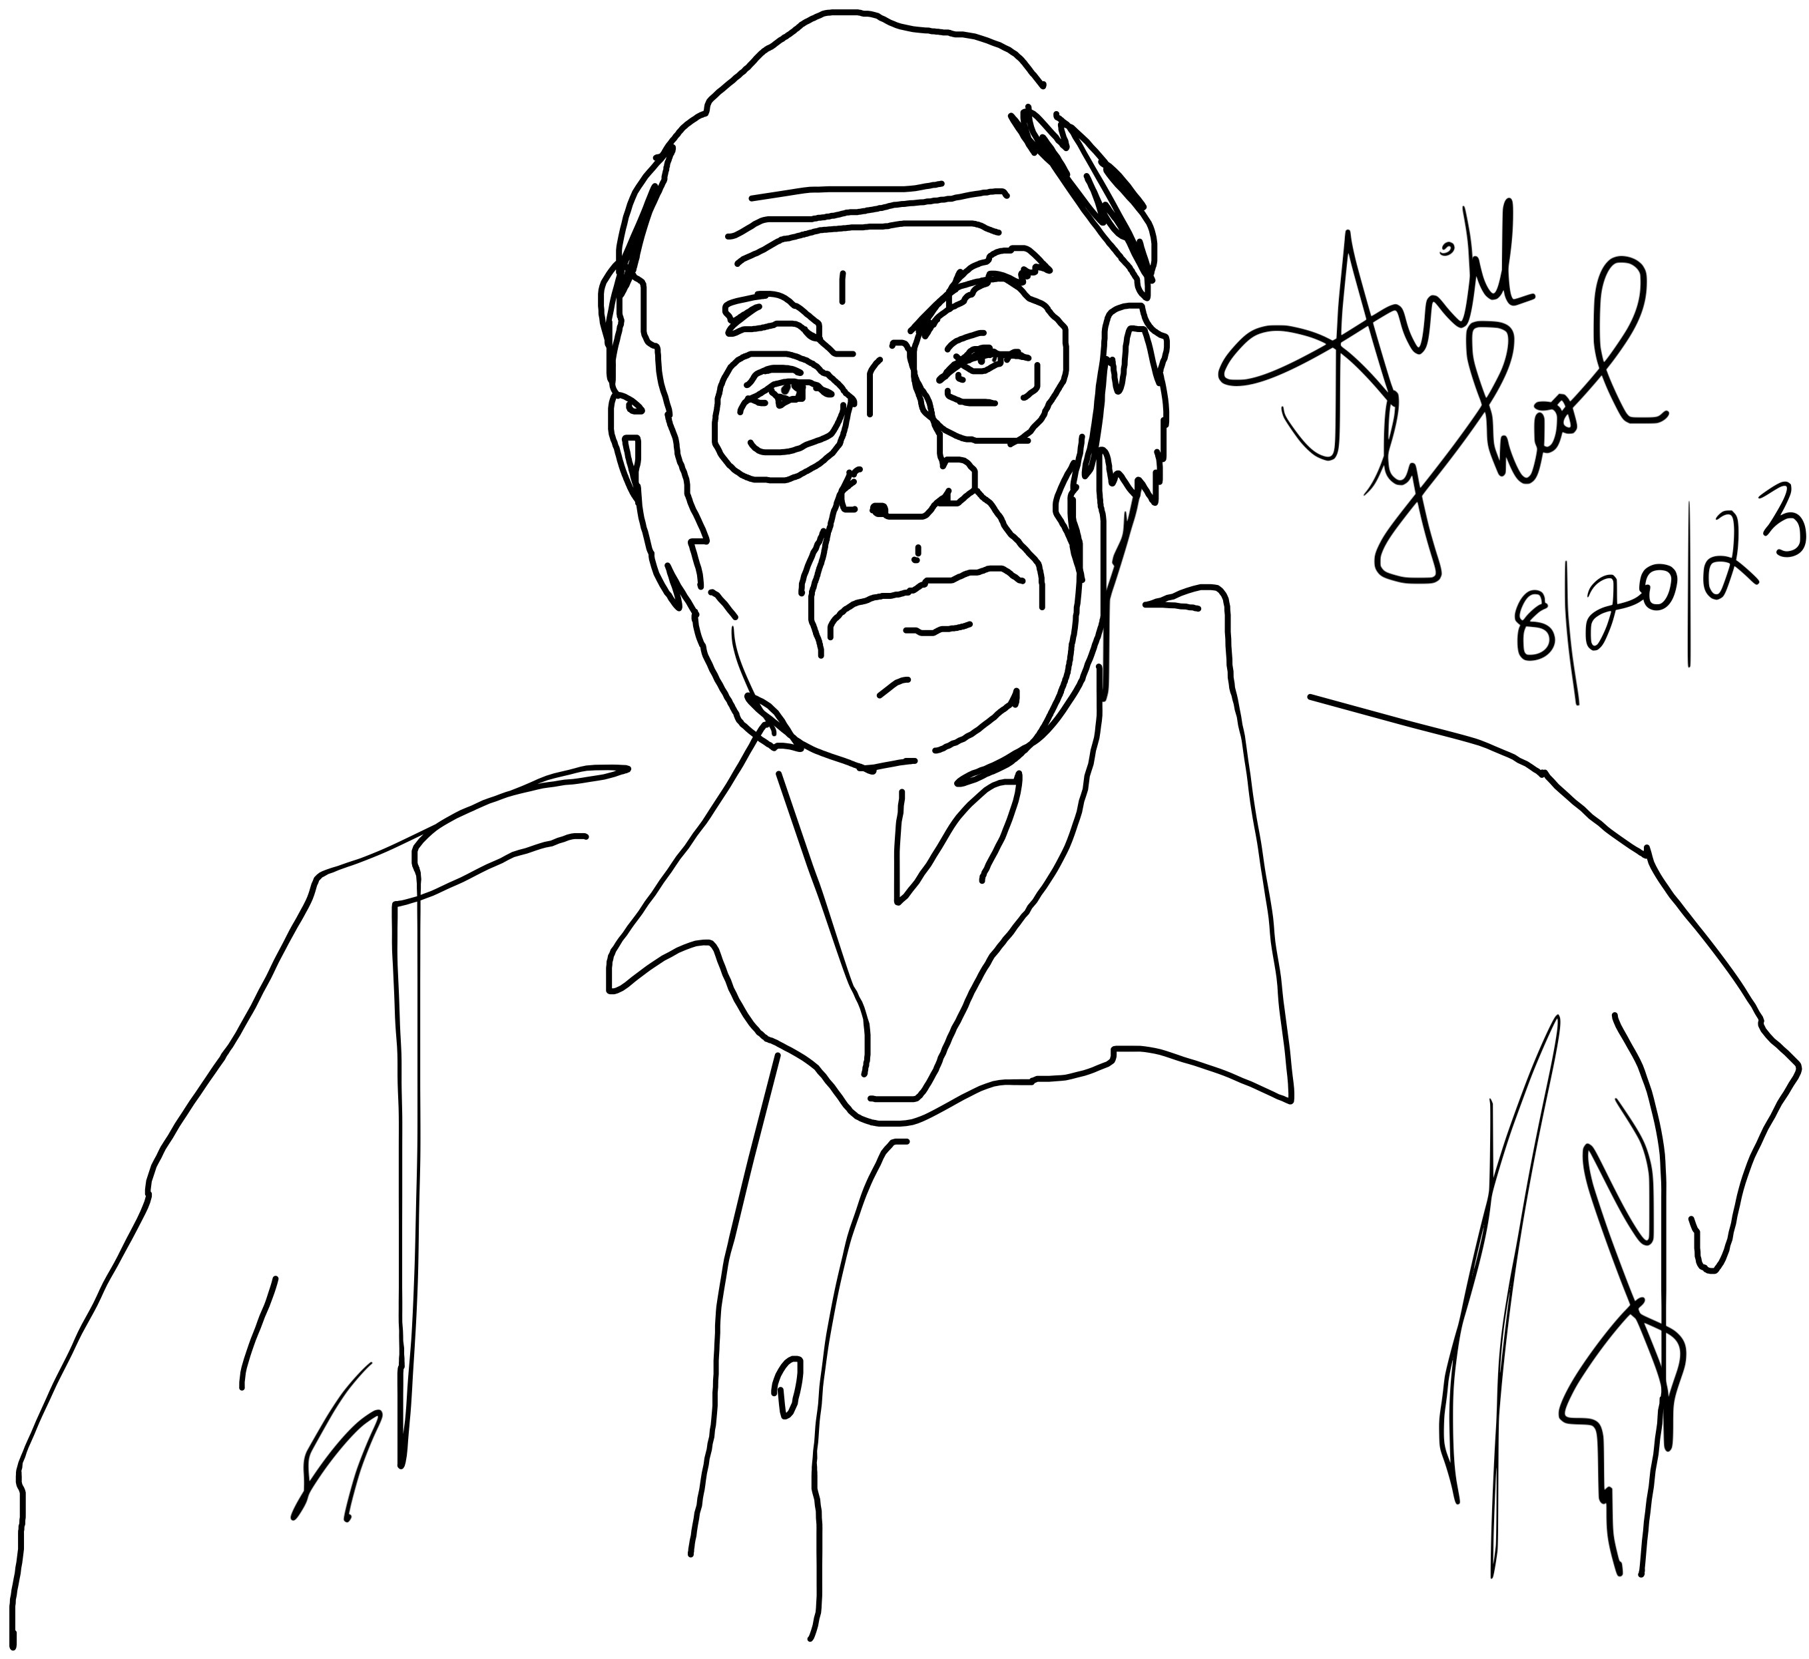
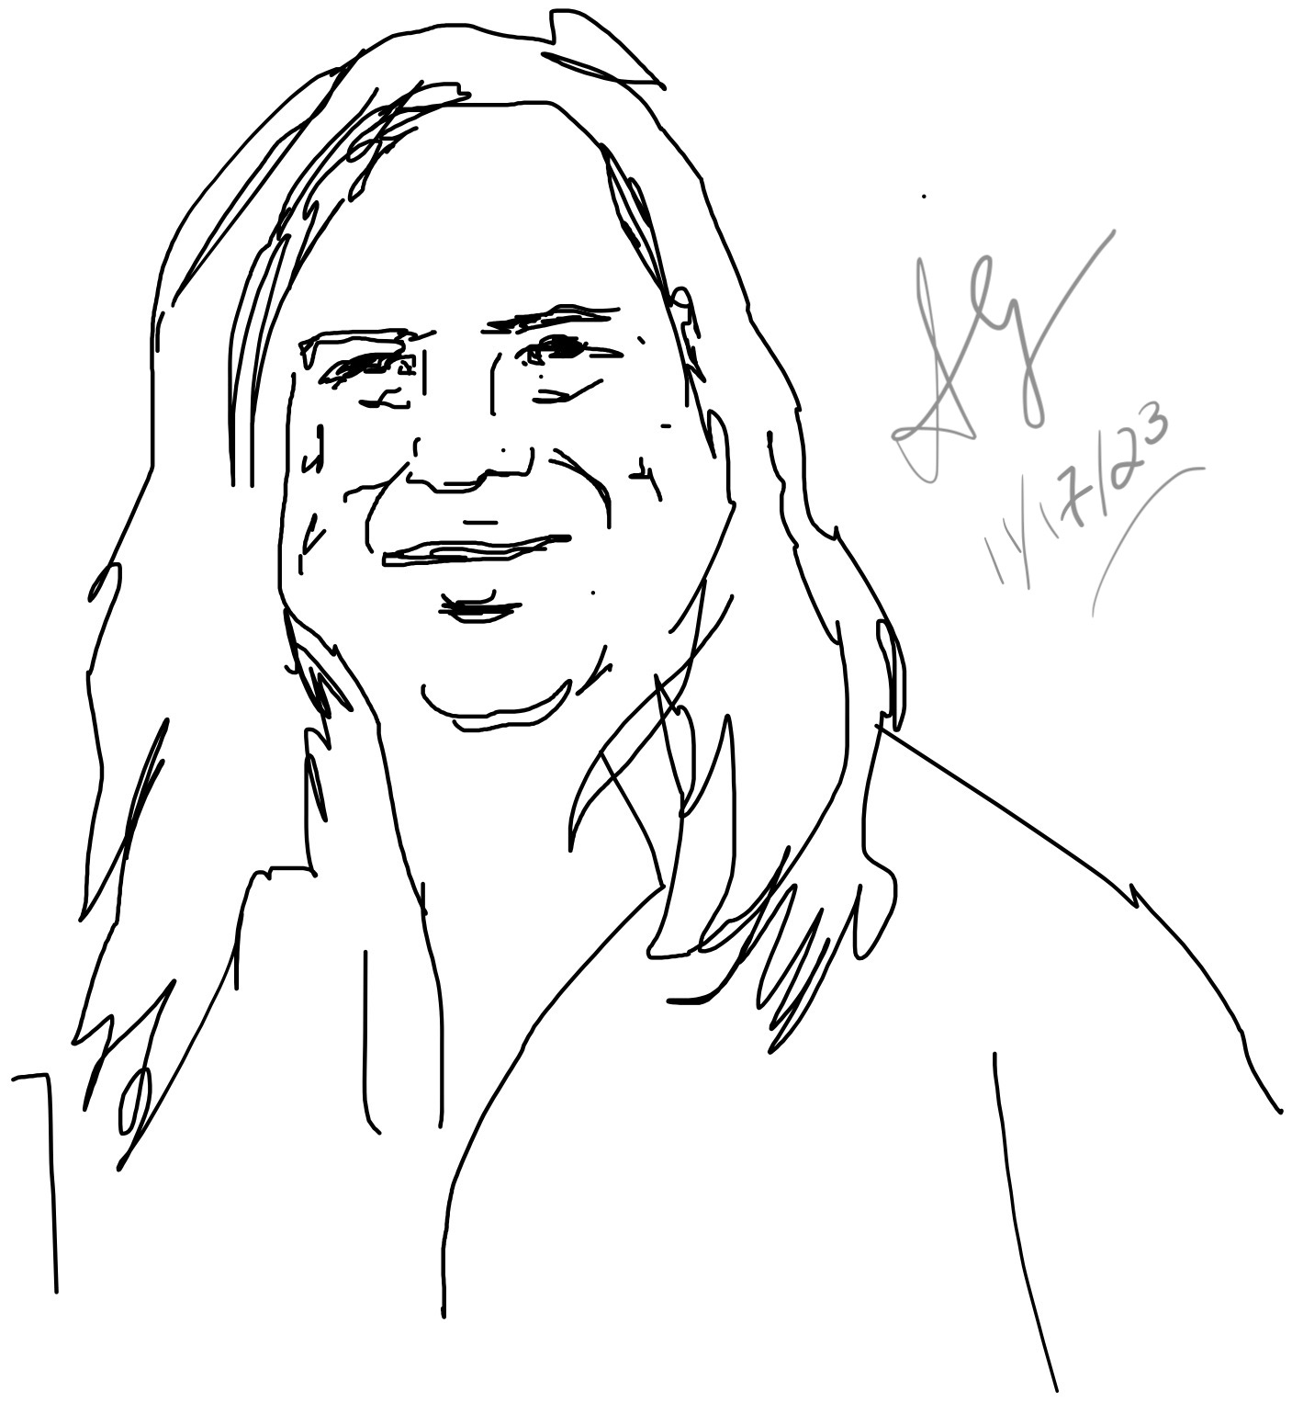
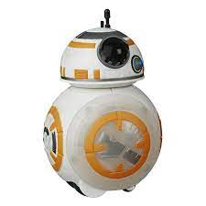
A well known key distribution approach
Charles Bennett
Gilles Brassard
4 protocol

Slide 9
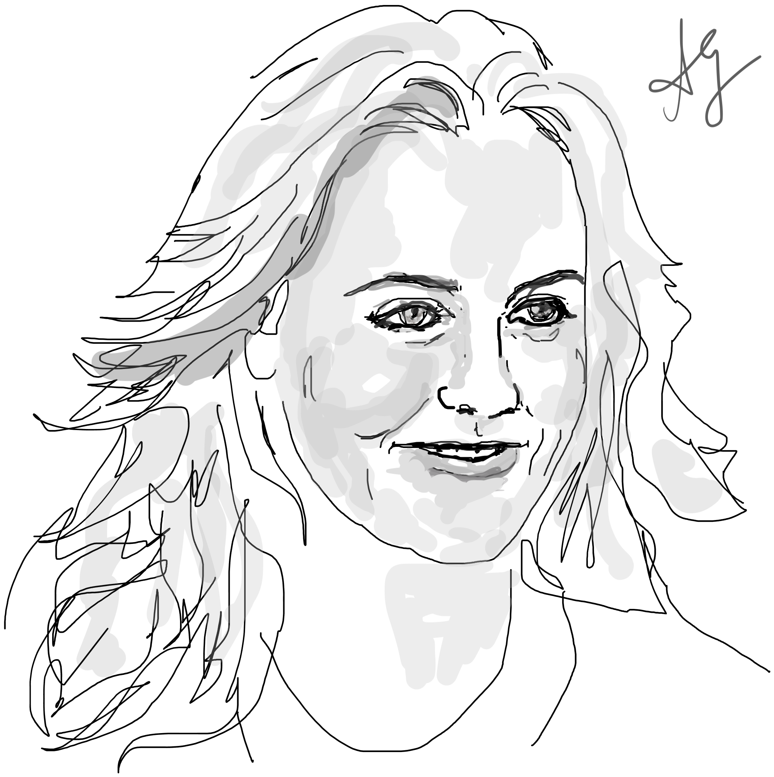
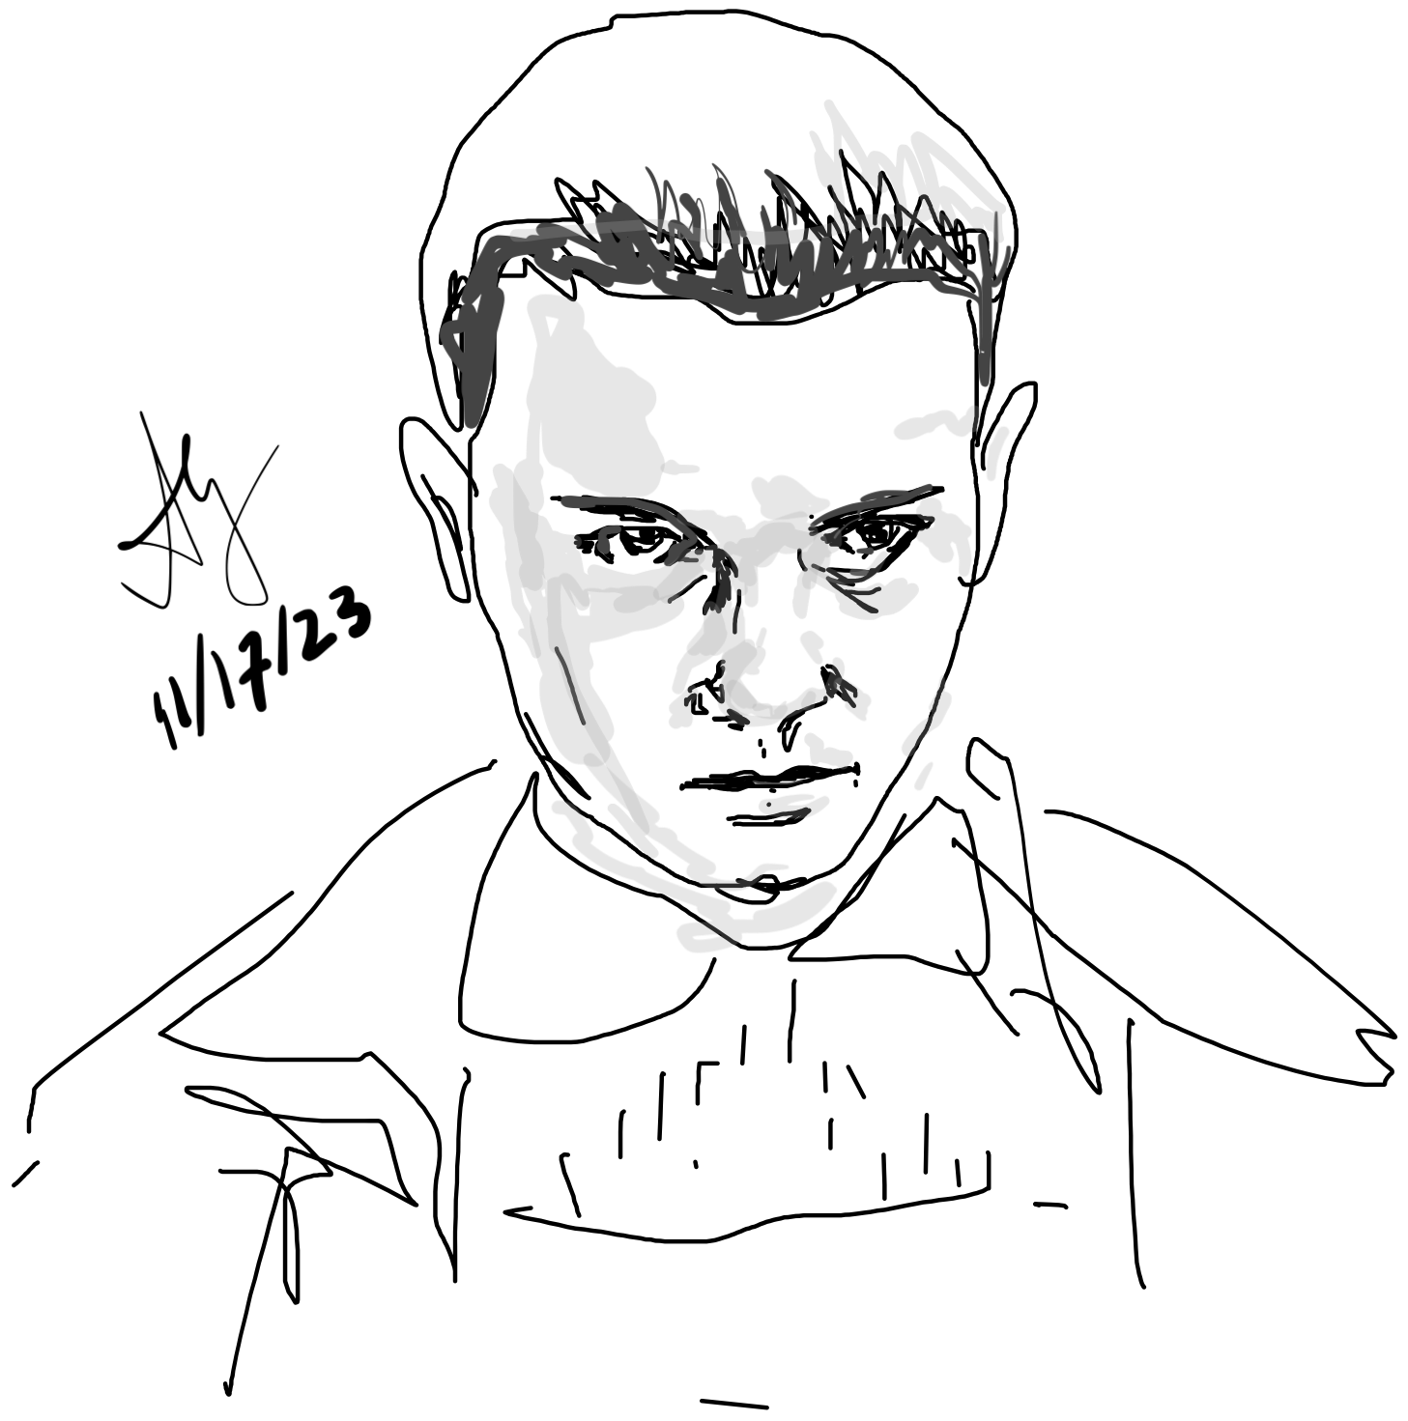
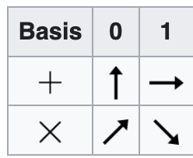
Alicia (“Alice”)
Millie Bobby (“Bob”)
”Eve”
Results are relevant along a measurement axis
Measure along random pair of non-orth. bases
Alice randomly chooses one basis each time
and sends her measurements to Bob
Bob reads these along random bases too

Slide 10
rand(1,50) > 0.5 (Alice)
1 0 0 0 0 1 0 1 0 0 0 1 0 0 0 1 0 1 0 1 0 1 0 0 0 1 1 1 0 1 1 1 1 1 0 1 0 0 1 0 0 1 1 0 1 0 1 1 0 1
%% Quantum Key Distribution
s = '+X';
%find number of random characters to choose from
numRands = length(s);
%specify length of random string to generate
sLength = 50;
%generate random string
randBasis = s( ceil(rand(1,sLength)*numRands) )
randBasis =
'+X+X+X+XXX+++X+XXX+++X+XXX+++X+X++++XXX+XX+X++++++’
(Bob)
randBasis=
'++XX+++X++X+++++XXX+++X+++XXX+X+X+X++XX+XX++++XXXX’
They match bases later (publicly) and discard mismatches

Slide 11
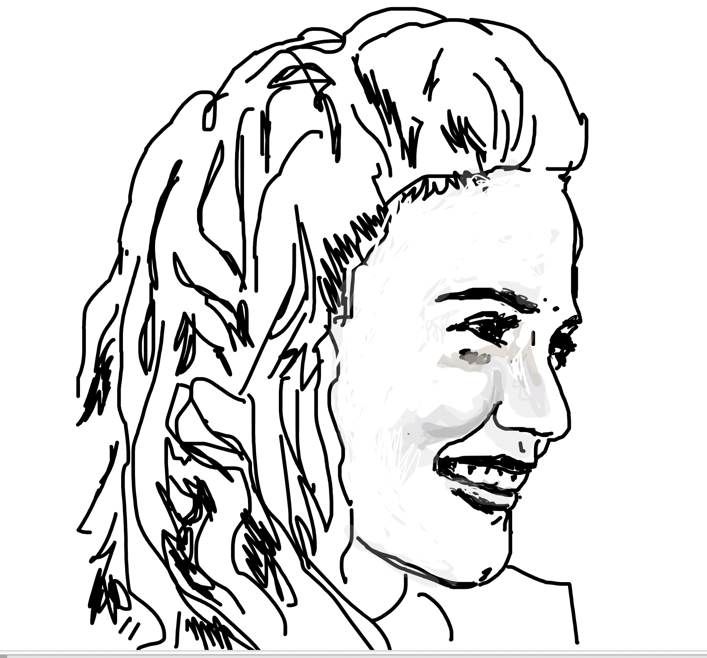
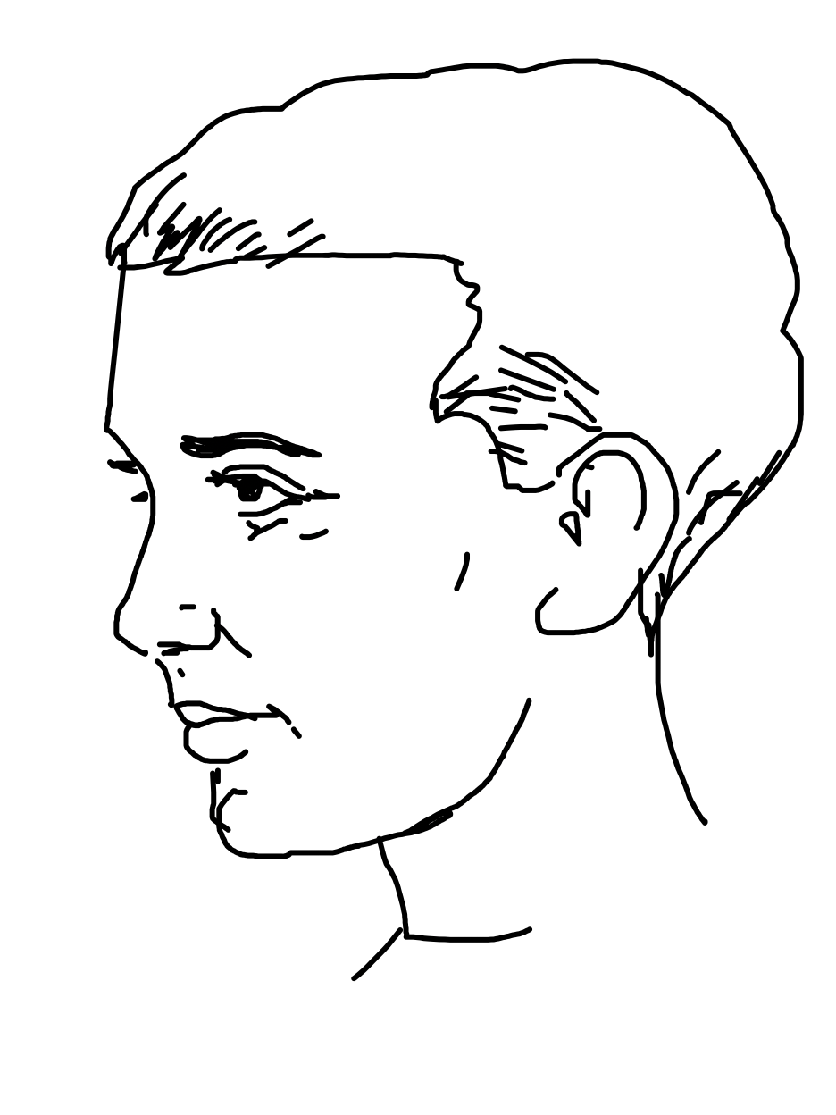
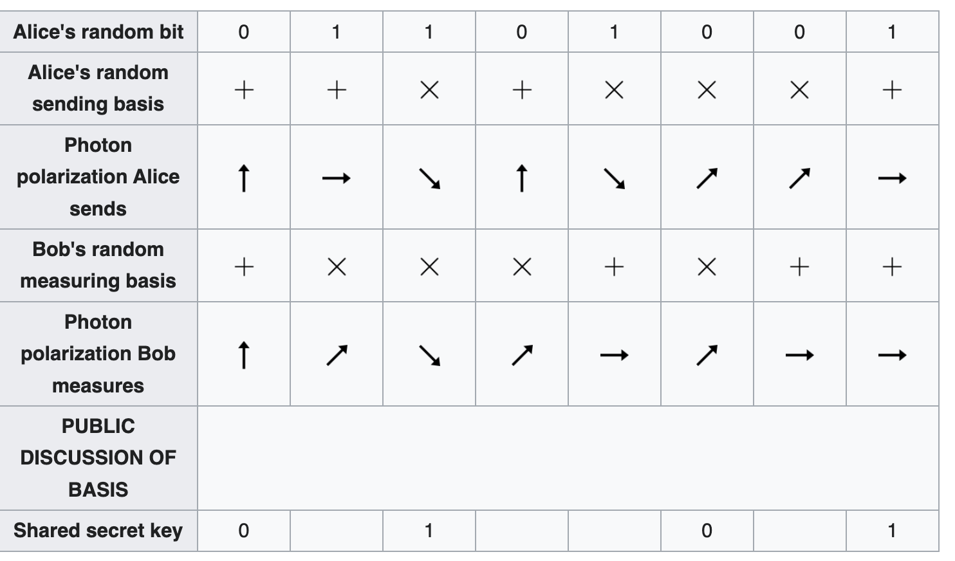
Discard non-matching bases
Eve knows the bases but not the measurements.
If she snoops, Bob’s results will be wrong. Bob can check a pre-determined subset to look for errors.

Slide 12
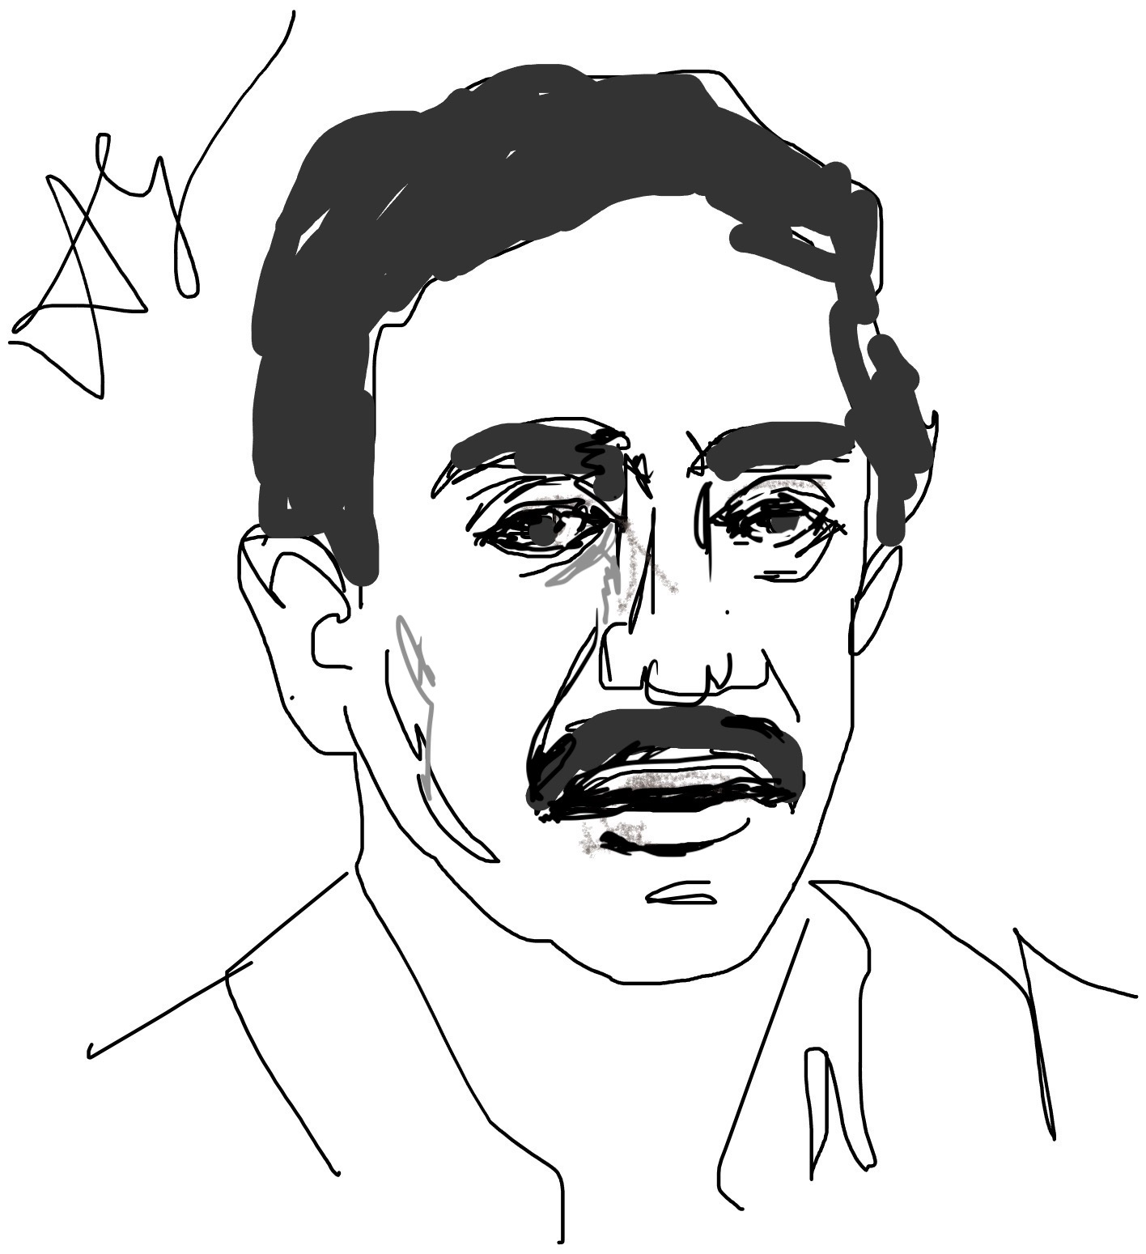
14B. Grover Search Algorithm
Lov Kumar Grover

Slide 13
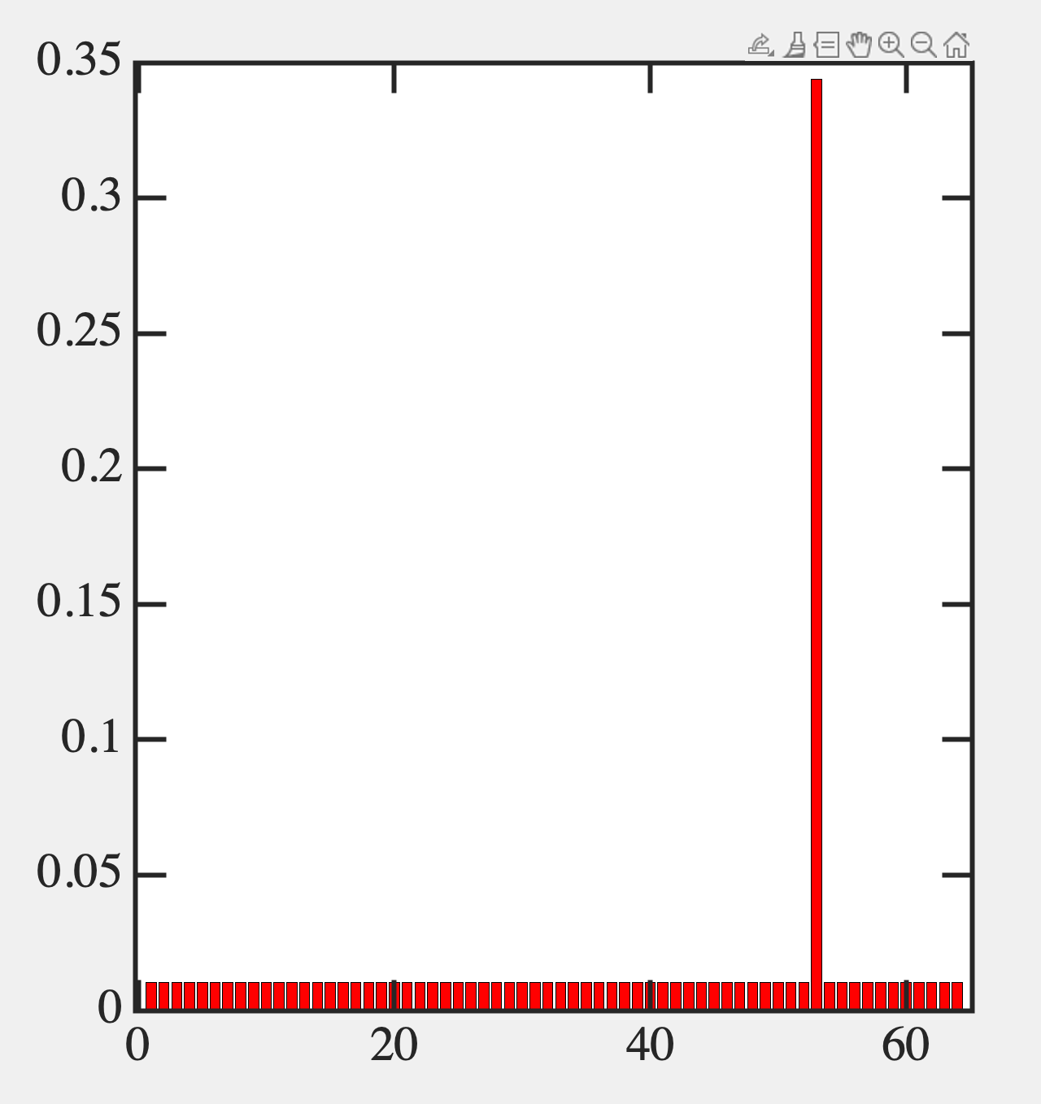
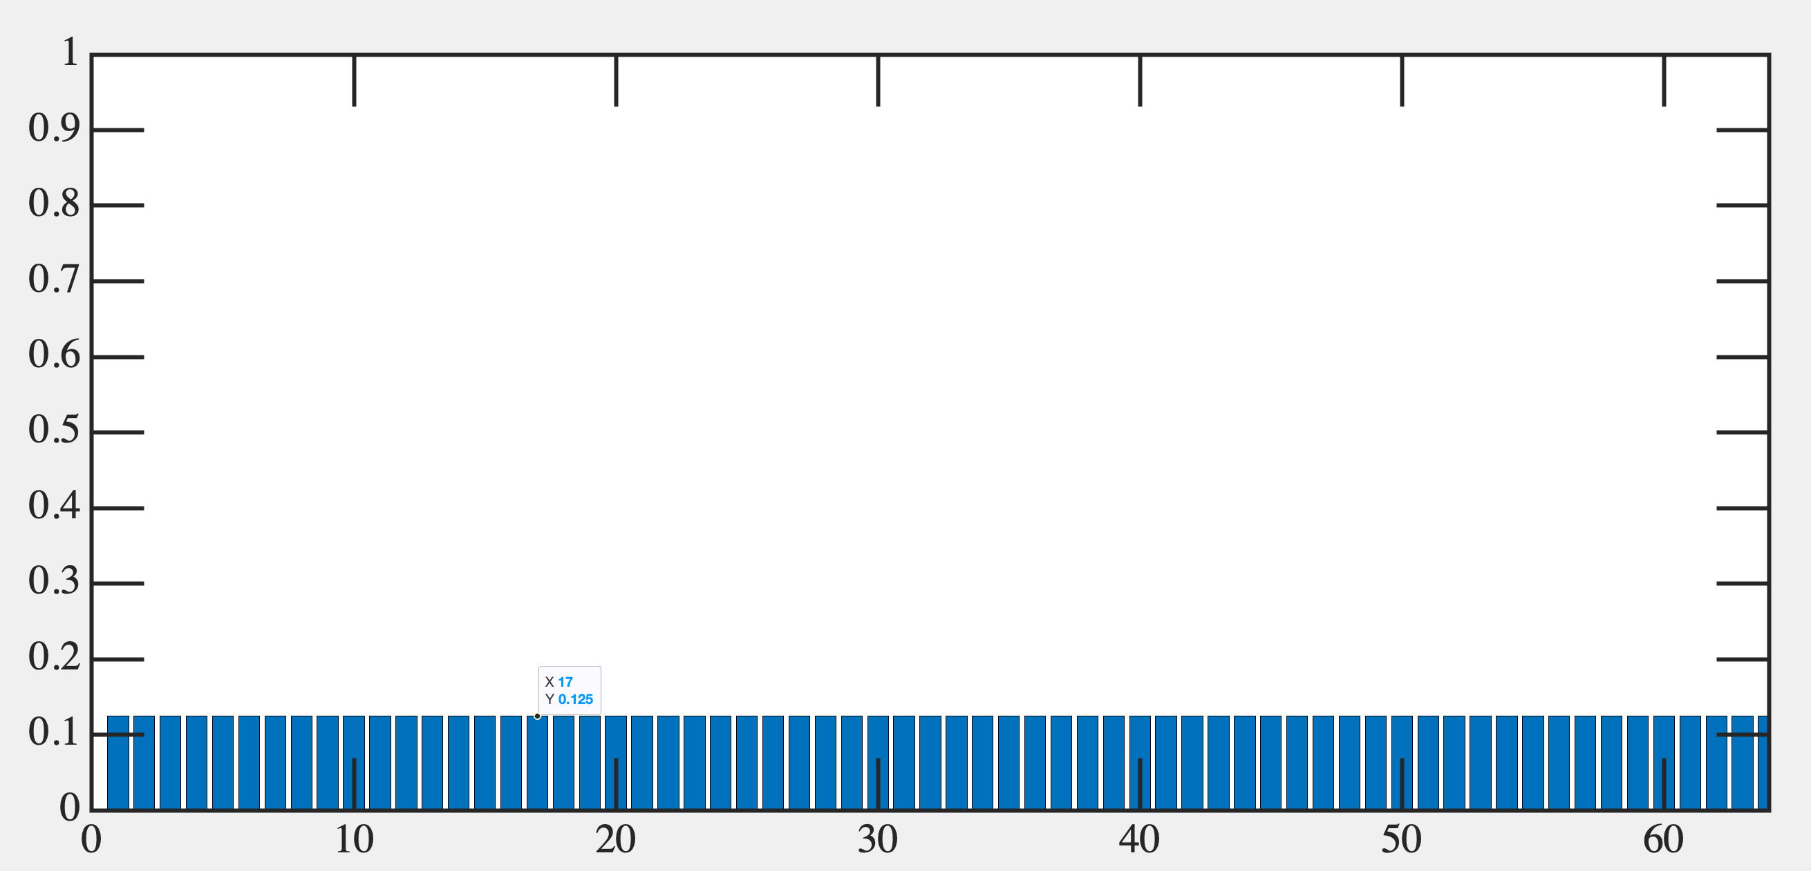
Search Algorithm

Slide 14
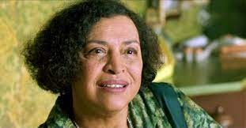
Oracle and Diffusion
Like a quantum Sobel Filter

Slide 16
Time Evolution

Slide 17
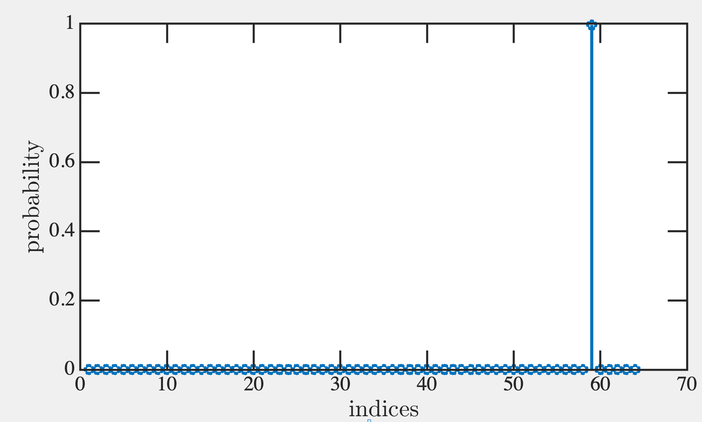
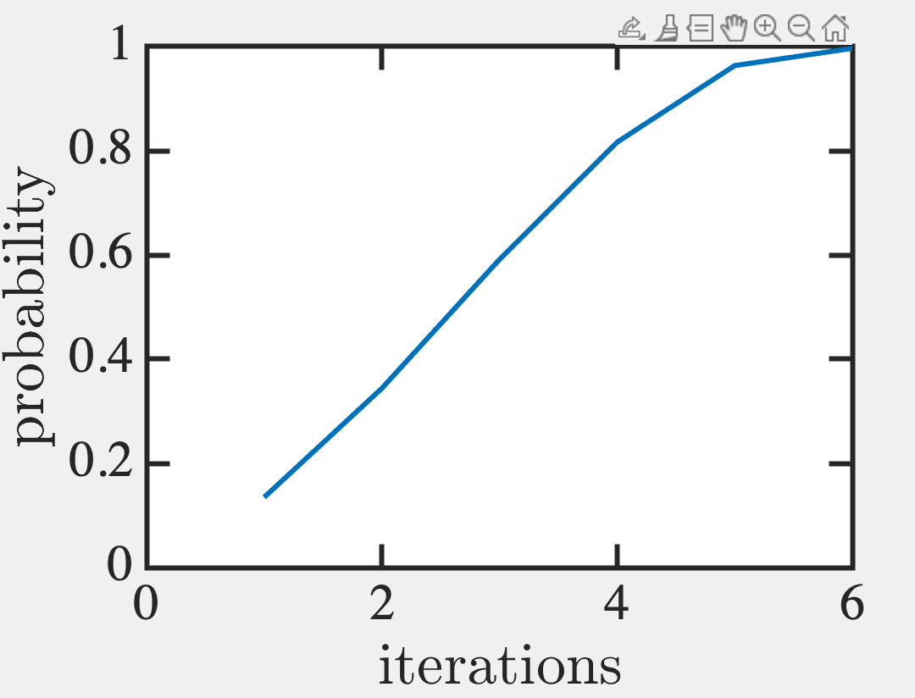
Eugene V. Makarov (2023). gsa.m (https://www.mathworks.com/matlabcentral/fileexchange/4711-gsa-m), MATLAB Central File Exchange. Retrieved November 20, 2023.
%This script simulates the Quantum Mechanical Lov Grover's Search Alghorithm.
clear all;
%-----parameters-----------
nqubits=6;%number of q-bits
n=2^nqubits;%nnumber of elements in database
findmode=mod(round(n*rand+1),n);%desired element
%-----defining quantum gates
d=-eye(n)+2/n;%diffusion transform
oracle=eye(n);%oracle
oracle(findmode,findmode)=-1;
%--calculate the optimal number of iterations---
finish=round(pi/4*sqrt(n));
%--step(i)--initialization----
psistart=ones(n,1)/sqrt(n);
psi=psistart*exp(i*rand);
%step (ii)--algorithm body----
for steps=1:finish
steps
psi=d*oracle*psi;
probability(steps)=psi(findmode)*conj(psi(findmode));
end
%see the probability dynamics
plot(probability);
%see the result distribution
figure;
stem(psi.*conj(psi));

Slide 18
Create a Hadamard Superposition of all bits
Do a Oracle Uω operator
Do a Grover diffusion operator U_{s}
4. Measure results
Rinse & Repeat

Slide 19
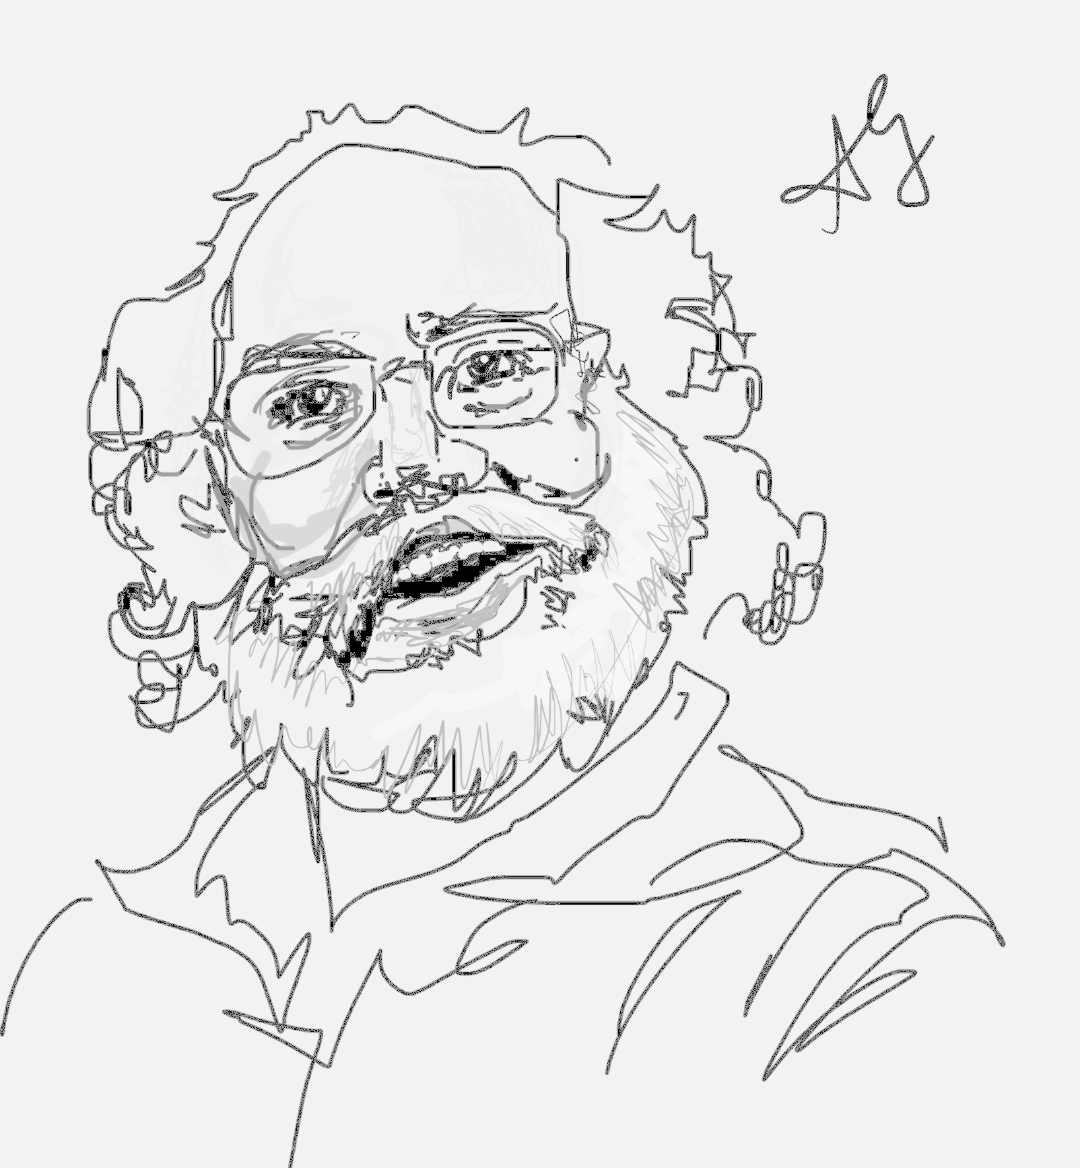
14C. Shor factoring algorithm
Peter Shor

Slide 20
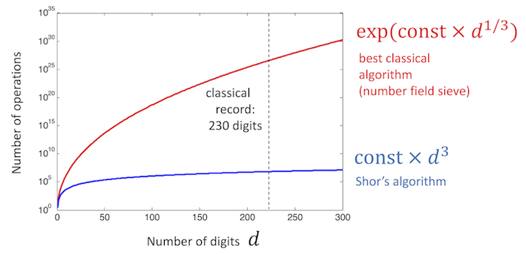
Useful for Quantum Cryptography
1e29 = 29996224275833 x 3475385758524527
(LOCK) (MESSAGE/CODE) (KEY)
Classical computer doing
20 GFLOPS needs
10¹⁵/20x10⁹ ~ 0.5 day
to solve this
Largest prime has
22,338,618 digits →
4000 years!

Slide 21
SHOR’S ALGORITHM
Given a number N, choose coprime a
Algo (from number theory)
F(x) = a^{x}mod(N) is periodic in x
Find period r of F(x) [QFT]
(it’s even)
2. Candidate Factors are
p, q = gcd(a^{r/2 ±} 1,N)

Slide 22
Example: N = 15, a = 7
Find period r of function
F(x) = 7^{x}mod(15)
F(0) = 1
F(1) = 7
F(2) = 4
F(3) = 13
F(4) = 1
.. → Period r = 4

Slide 23
2. Factors are
p = gcd(7^{4/2 +} 1,15) = gcd(50,15) = 5
q = gcd(7^{4/2 -} 1,15) = gcd(48,15) = 3
At least one of them guaranteed to work

Slide 24
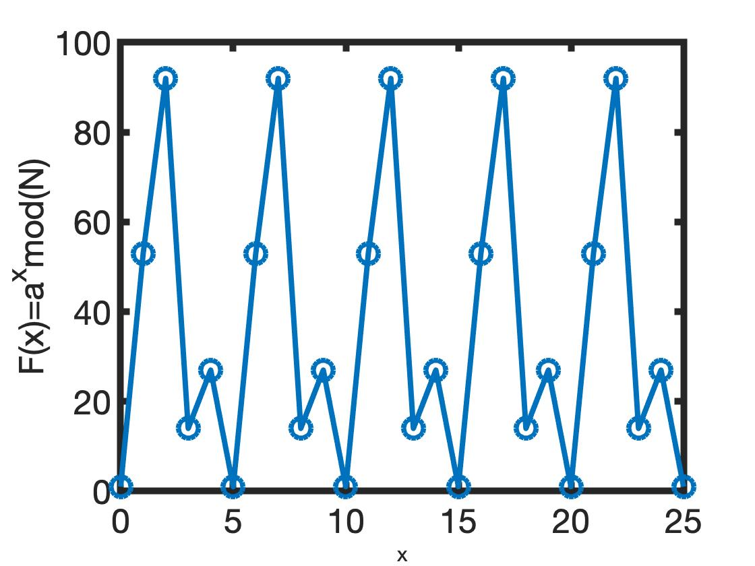
Larger Numbers
N = 143
a = 53
r = 5
Gcd(a^{r/2}+1,N) = 1
Gcd(a^{r/2}-1,N) = 13
143 = 13 x 11
To avoid round-off errors
use symbol operation
F=mod(sym(a).^x,N)
[ 1, 53, 92, 14, 27, 1, 53, 92, 14, 27, 1, 53, 92, ...]

Slide 25
IMPLEMENTATION (N=15, a=7)
Choose input and output registers
Choose q such that N² < q=2^{l} < 2N²
[e.g. q = 256 →
Input register: 8 qubits, 0 …. 255]
Output needs enough to capture N=15
[4 qubits]

Slide 26
To find periodicity r of F(x) = a^{x}modN
Superposition, Entangle input-output
|00000000, 0000> + |00000001, 0000> +
|00000010, 0000> + |00000011, 0000> +
……. + |11111111, 0000>
Operate with 7^{x}mod(15) → 255 answers
and place in output register
x₁=0
0
x₂=1
0
x₃=2
0
x₄=3
0
x₂₅₆=255
0

Slide 27
To find periodicity of a^{r}modN
Entangle input-output
|00000000, 0001> + |00000001, 0111> +
|00000010, 0100> + |00000011, 1101> +
|00000100, 0001> + …. repeating output
[Outputs - 1, 7, 4, 13 in binary]
x₁
7⁰mod15 = 1
x₂
7¹mod15 = 7
x₃
7²mod15 = 4
x₄
7³mod15 = 13
x₅
7⁴mod15 = 1

Slide 28
Measure output → Say we read “1”
Collapse input into a subset
[0, 4, 8, 12, 16, .., 252] Period r = 4.
We still haven’t opened blue box..
|00000000, 0001> + |00000100, 0001> +
|00001000, 0001> + |00010000, 0001> +
..…
+ | 11111100 , 0001>
How to read r in 1 shot?
0
1
4
1
8
1
12
1
252
1

Slide 29
Measure period with Q Fourier Transform
(Quantum Phase Shift Gates)
[0, 4, 8, 12, 16, .., 252]
But with different probabilities, peaking
around 252/r = 64. So highest probability
are 0, 64, 128, 192.
Let it collapse again repeatedly
→ GCD measures to p=64
Then from p=64 and q=256, we can get r=4
(continuous fraction expansion of q/p)
Finally, gcd(7^{r/2} ± 1)

Slide 30
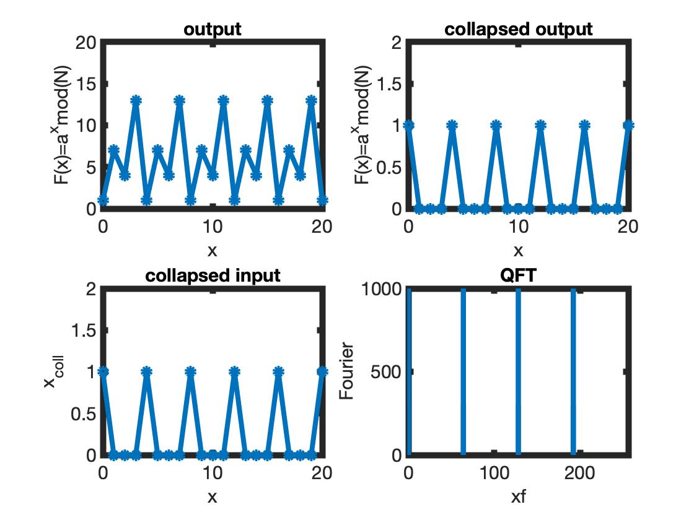
Read 1
Period 64
x = [0 4 8 12… 252]

Slide 31
Linear
superposition
0
x
x
f(x)
Period extraction
= M/r
Measure
period
QFT
QFT
U
f(x)
0
Entangle
Measure

Slide 32
14D. Quantum Teleportation

Slide 33
Back to Alice and Bob
Shared Entangled States
4 Bell states:
Alice’s message
Bob knows nothing
about α, β

Slide 35
Bob knows α, β in Bell basis set

Slide 36
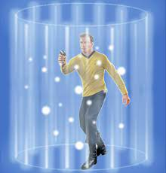
Transportation when Alice measures in Bell basis
Say Alice measures
Then Bob’s state collapses to

Slide 37
Bob knows Alice’s results and knows what Unitary transformation to make

Slide 38
How do you measure a Bell projection?
Alice runs her qubits labeled A and C through this circuit.
Depending on her measurement, Bob uses I, X, Y or Z gate.
Note that CNOT is a ‘local’ operation, so for distant qubits,
there are modified approaches.

Slide 39
Parting thoughts:
Alice’s qubit is part of an entangled state.
So no cloning theorem is OK (there’s no copy).
No energy transfer, just remote measurement

Slide 40
Opportunity:
Quantum Sensing
Quantum Cryptography
Quantum Teleportation
Solve many body problems
Qubitcoin
Is Quantum Computing
Really useful?

Slide 41
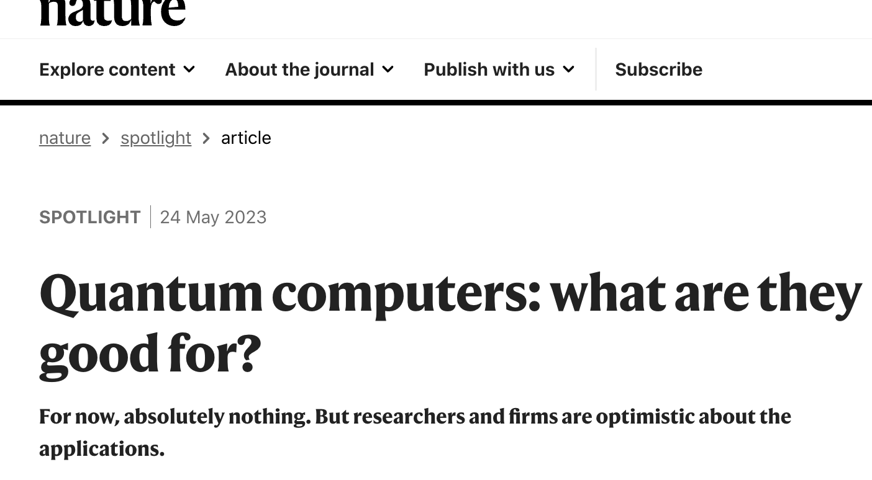
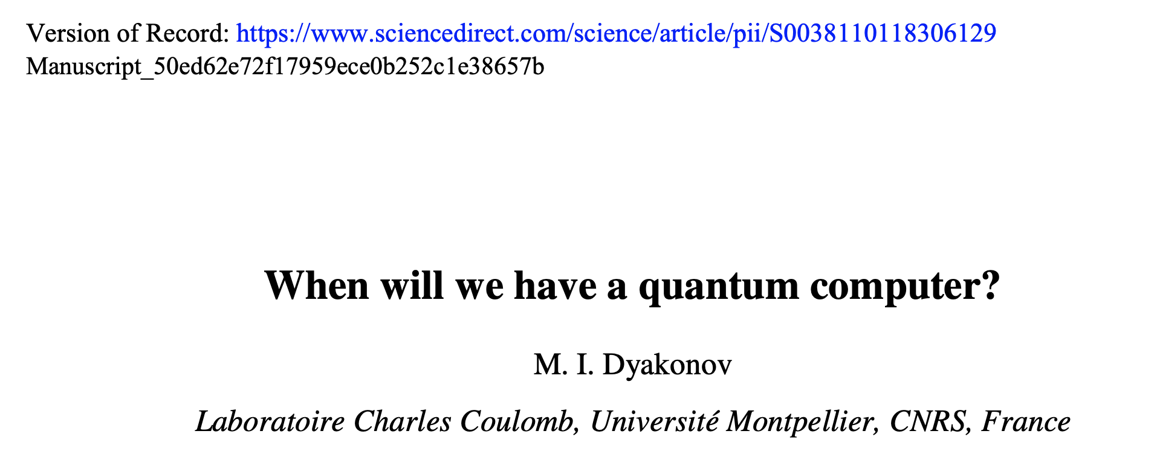
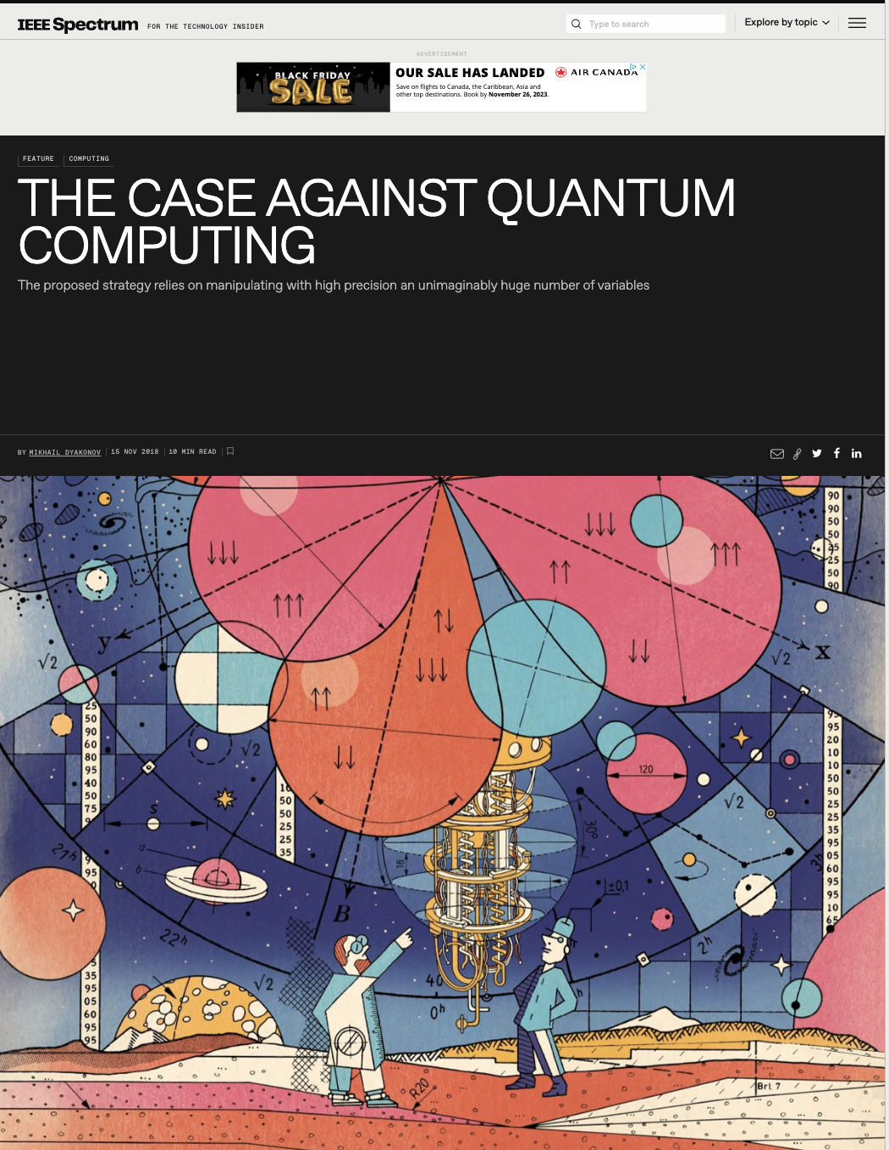
Well now, this is awkward…

Slide 42
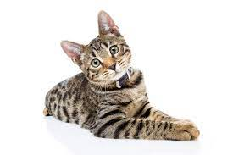
Initialize, measure, debug and reset a LOT (~10³⁰⁰) of states!!
Control those states without decohering (states evolve independently – ‘inhomogeneous broadening’ unless they are 100% degenerate. Plus external
thermal noise)
No continuous variable (e.g. a, b) can have an EXACT value, including zero. Some undesirable mixtures are inevitable. So is 99% fidelity OK???
|000000> + |111111> → Cat state for fault tolerant QC
→ |000000> + e^{inΩt}|111111>

Slide 43
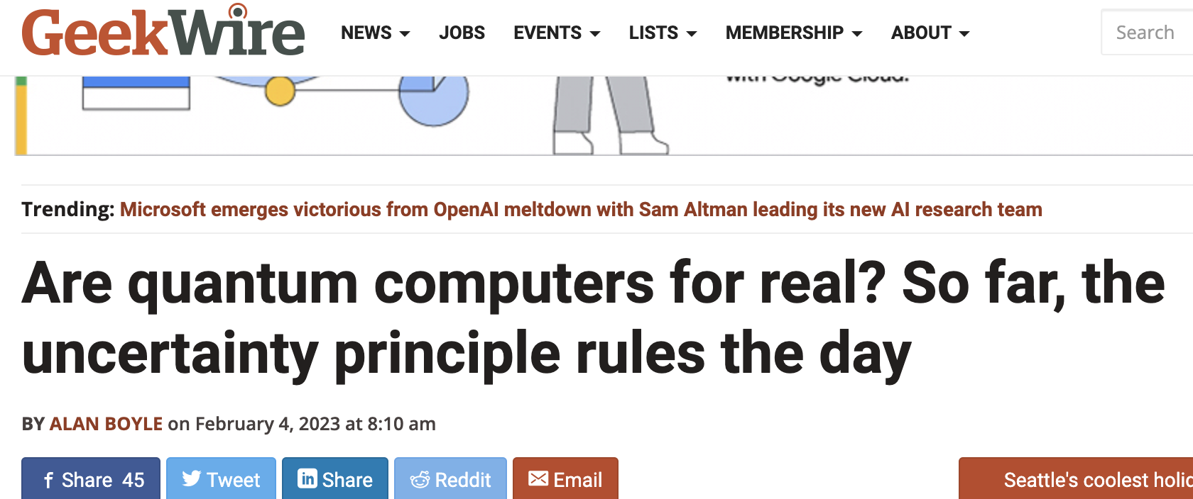
Let’s keep an open mind, shall we?…
D-wave, IBM, IonQ
½ (use)full

Slide 44
The world we inhabit is definitely Quantum

Slide 45
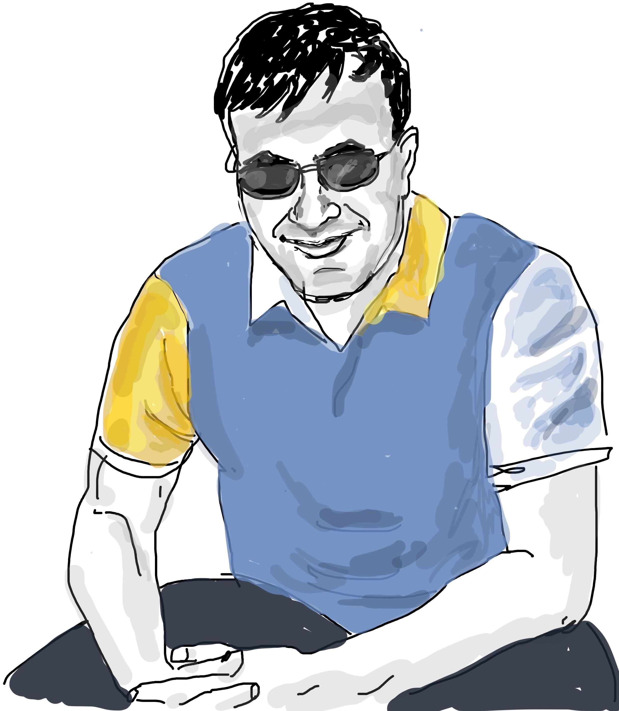
.. And there you have it folks. End of the road for us
Science keeps progressing. Read, and stay informed.
Always build a toy model. You learn by
replicating.
Try different viewpoints – math, code, expts
Have fun !!!! Results will follow…
If you like this course, please spread the word

