Slide 1
Fundamentals of Computing
Lec 1
How we Compute

Slide 2
Topics in computing

Slide 3
1A: Course Structure

Slide 4
Course information
Website: http://www.people.virginia.edu/~ag7rq/23nano/courseweb.html
Grader: Faiyaz Mullick (fm4fv@virginia.edu)
Office Hrs: TBD

Slide 5
Grading Info
Homework - weekly assignments on website, no late homework accepted but lowest score dropped
Expected average at B+, to be graded on curves.
Exams - three exams. Some Mathcad/Matlab, maybe necessary for some HWs/exams
Grade weighting:
Exam 1 ~12%
Exam 2 ~25%
Final ~35%
Homework ~25%
- Quiz ~3%

Slide 6
Honor Policy
Homework – You can collaborate in a group, but the answer you hand in HAS TO BE YOUR OWN WORK.
Exams – Typically open-book open-notes. However, no consultations or communications among examinees, no accessing unauthorized resources not available to all (i.e., outside text book and class notes), no accessing internet materials including past exams.
Exams and HWs must be pledged else they will not be graded.
Any unauthorized assistance on the exam would give you an automatic ZERO on the exam and be handed over to the honor committee.
https://news.virginia.edu/content/5-things-you-should-know-about-uvas-honor-system

Slide 7
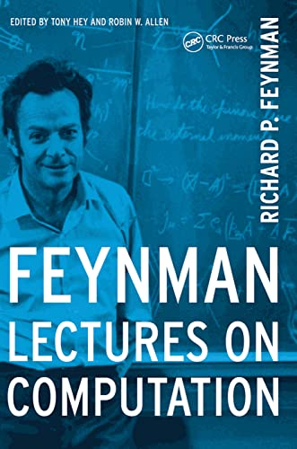
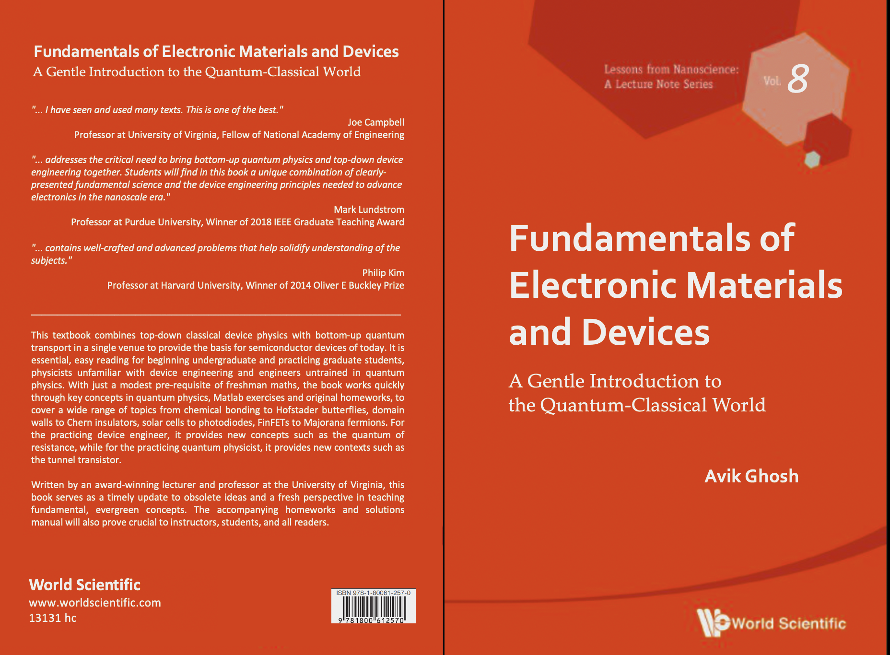
Text/References
Lecture Notes
(pre-recorded + live)
Physics of Computing:
Hardware for computing/SSD
Boltzmann machines/Neuromorphic
– “Boltzmann Law – Physics to
Computing” edX
http://www.amazon.com/Nanoelectronics-Molecular-Scientific-Nanoscience-Nanotechnology/dp/9813144491

Slide 8
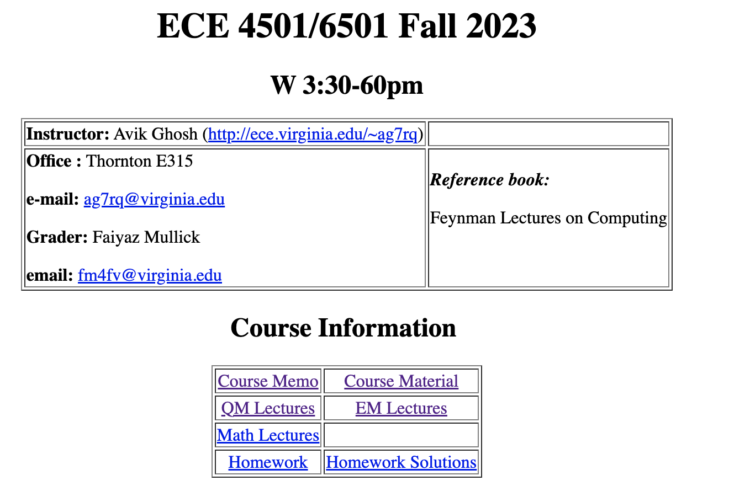
Course page (TBD)
http://www.ece.virginia.edu/~ag7rq/23comp/courseweb.html
Background/
Extras
http://www.amazon.com/Nanoelectronics-Molecular-Scientific-Nanoscience-Nanotechnology/dp/9813144491

Slide 9
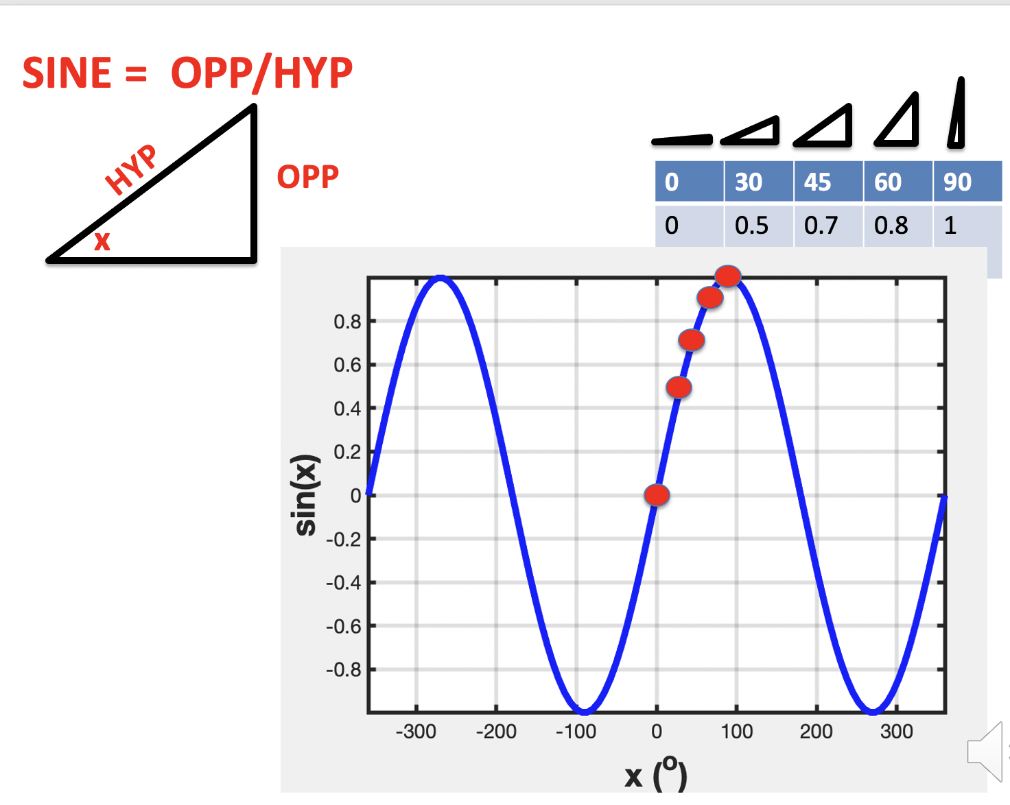
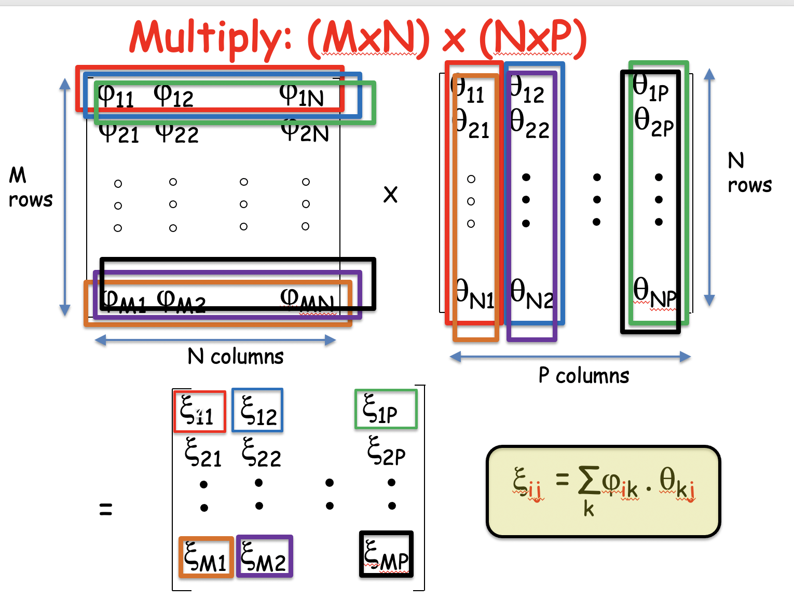
Math background
PROBABILITY
GEOMETRY
COMBINATORICS
TRIG
MATRIX/LIN ALG
CALCULUS
http://www.amazon.com/Nanoelectronics-Molecular-Scientific-Nanoscience-Nanotechnology/dp/9813144491

Slide 10
Course page
http://www.amazon.com/Nanoelectronics-Molecular-Scientific-Nanoscience-Nanotechnology/dp/9813144491

Slide 11
Course Lectures
Pre-recorded
Lectures
http://www.amazon.com/Nanoelectronics-Molecular-Scientific-Nanoscience-Nanotechnology/dp/9813144491

Slide 12
ON TO THE MATERIAL
What is computing?

Slide 13
What is computing?
Why do we compute?
Processing of Information

