Slide 1
1B. What is information?

Slide 2
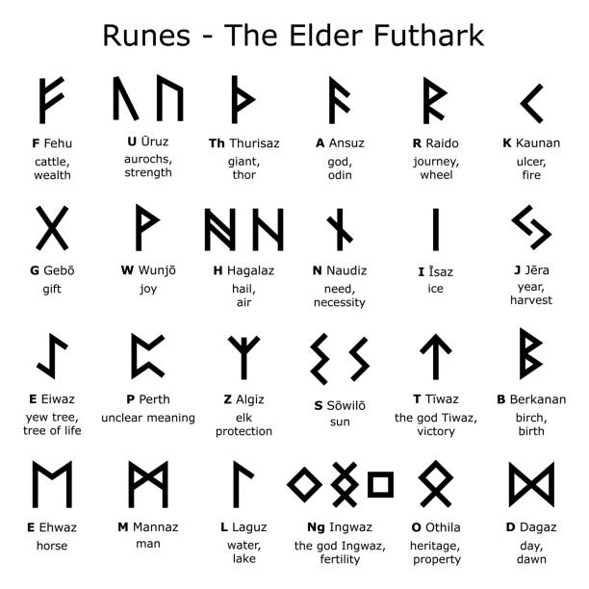
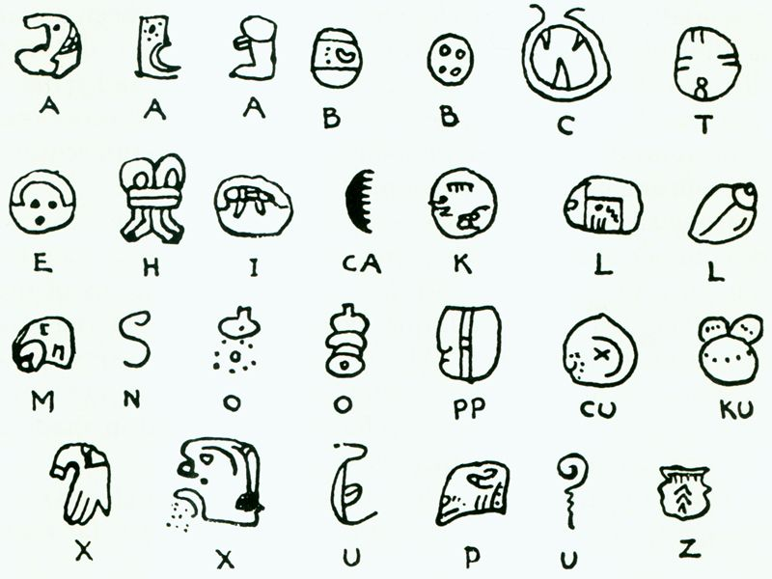
What is information?
Quantifiable bits of knowledge
Symbols, Letters, Numbers

Slide 3
How we ‘process’ information – Part 1
Create more information
1 + 3 = 4
Calculated Odds
of Survival are 10:1
Silicon ’brain’ does this today quickly
(Supercomputer @ ~6 pFLOPs)

Slide 4
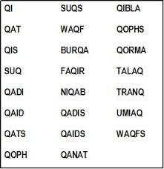
Quantifying information
26 letters
10-letter word
26^{10 ~} 1.4 x 10¹⁴ letter combinations
Barring few examples, need vowels to
make them pronounceable. Other rules
of grammar, phonetics, such as
Q followed by U
In reality, only about ~35,000
10 letter words in English
Mr. Mxyzptlk
Scrabble words

Slide 5
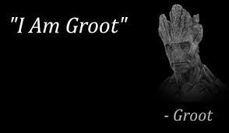
Information needs element of ‘surprise’
Only 1 letter A
4-letter Word: AAAA →
No real information
2 letters A, B (e.g. Morse Code)
ABBA → BABA →
ABAB →
Probability p of finding an A
1-p of finding a B
p=0 or 1, no surprise

Slide 6
Information related to ‘surprise’
It is hot in Arizona – that’s not news!!!
(Odds are high of that)
It is 100⁰ in Arizona – a little more specific info
(Probability of 100⁰ specifically a bit lower)
It is 100⁰ in Juneau Alaska – that IS news !!
(Probability is low!)
So I(p) inversely proportional to p

Slide 7
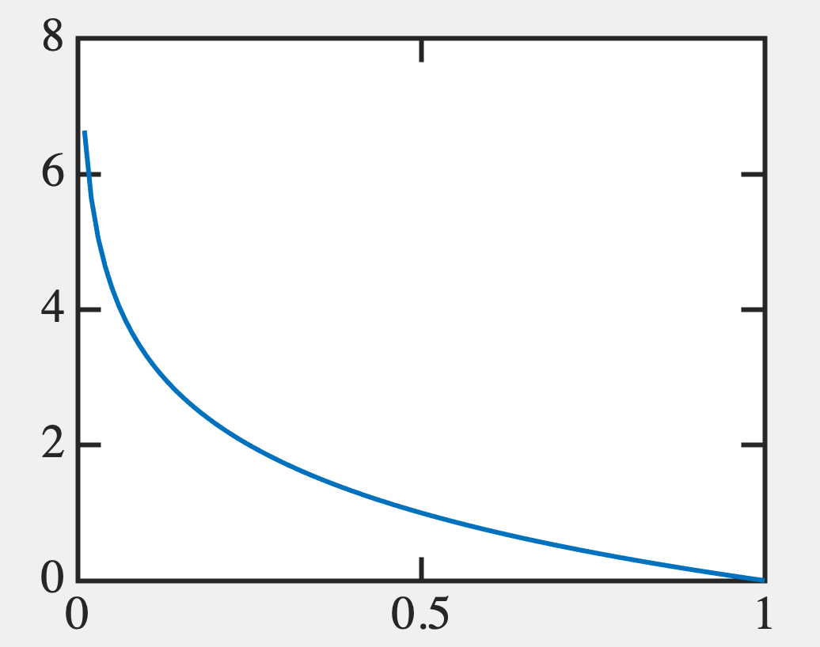
Information of a fixed event
I(p) ≥ 0, decreasing function of p
I(p=1) = 0 no surprise (“The Pope is Catholic”)
2 independent events
I(p₁.p₂) = I(p₁) + I(p₂)
Solution:
I(p) = log_{b}(1/p) = -log_{b}p
I(0) = ∞ → will deal with this
It is hot
in AK !!!!
I(p)
p
It is 100⁰
in AZ !!
It is hot
in AZ !

Slide 8
Binary basis: Bit
Base 2 → I(p) = -log₂p
N letter word: x₁x₂x₃.... x_{N} (x_{i} = 0,1)
e.g. “0101”
2^{N} possibilities, p = 2^{-N} for this word
I(N) = -log₂(2^{-N}) = N bits
Number of bits/letter = I(N)/N = 1 bit/letter

Slide 9
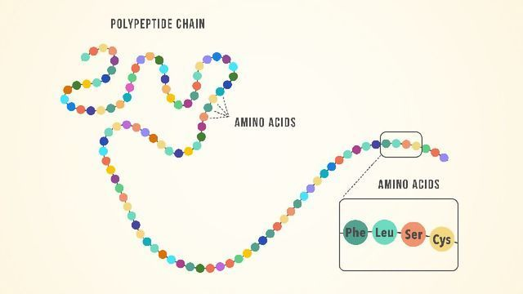
Biology
Amino Acids: 20 of them
Typical ‘word’ (protein size) = 360 in E-coli
I(360) = log₂(20³⁶⁰) = 1556 bit/protein
= 4.32 bit/amino acid
More because it’s less predictable than binary
Binary: if not 1, it must be 0
Protein: if not alanine,could be glutamine, histidine, tryptophan etc..)
https://www.technologynetworks.com/applied-sciences/articles/essential-amino-acids-chart-abbreviations-and-structure-324357

Slide 10
Bit
English: 26 alphabets + 1 space
I = log₂(27) = 4.75 bits/letter (more info because 26 letters not 2 or 20)

Slide 11
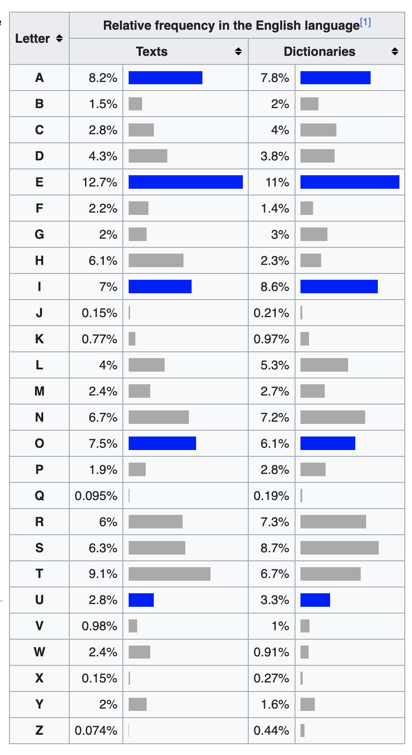
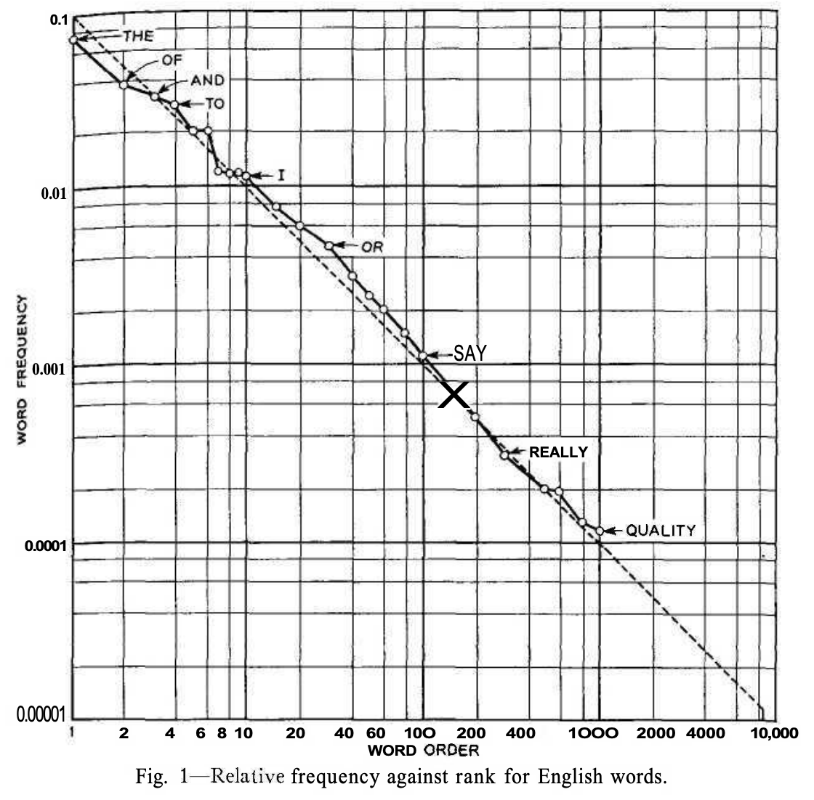
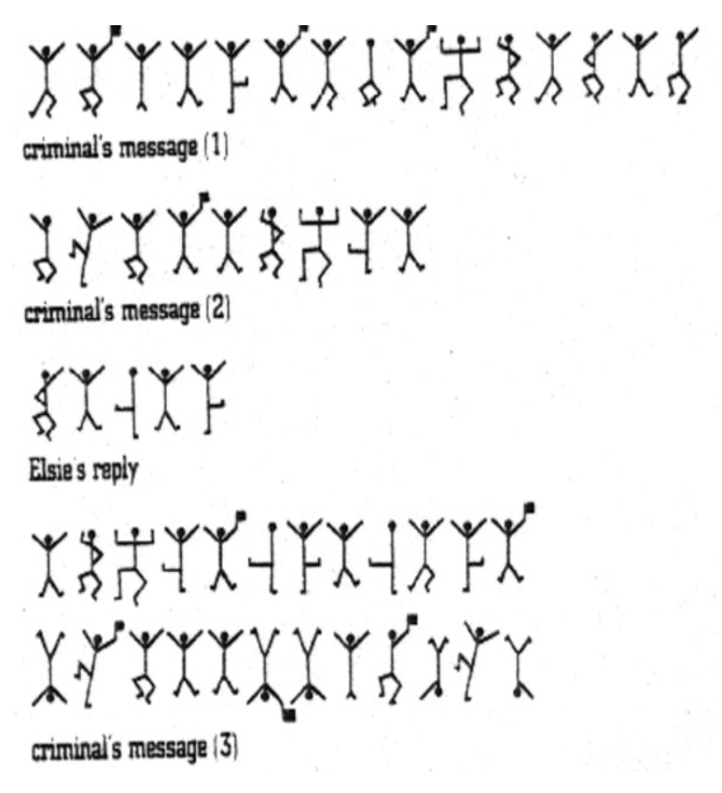
Bit
However, all letters don’t appear equally
Also, sequences are predictable (~2.62 bits/letter)
Sherlock Holmes
Dancing Men
Shannon
Wikipedia

Slide 12
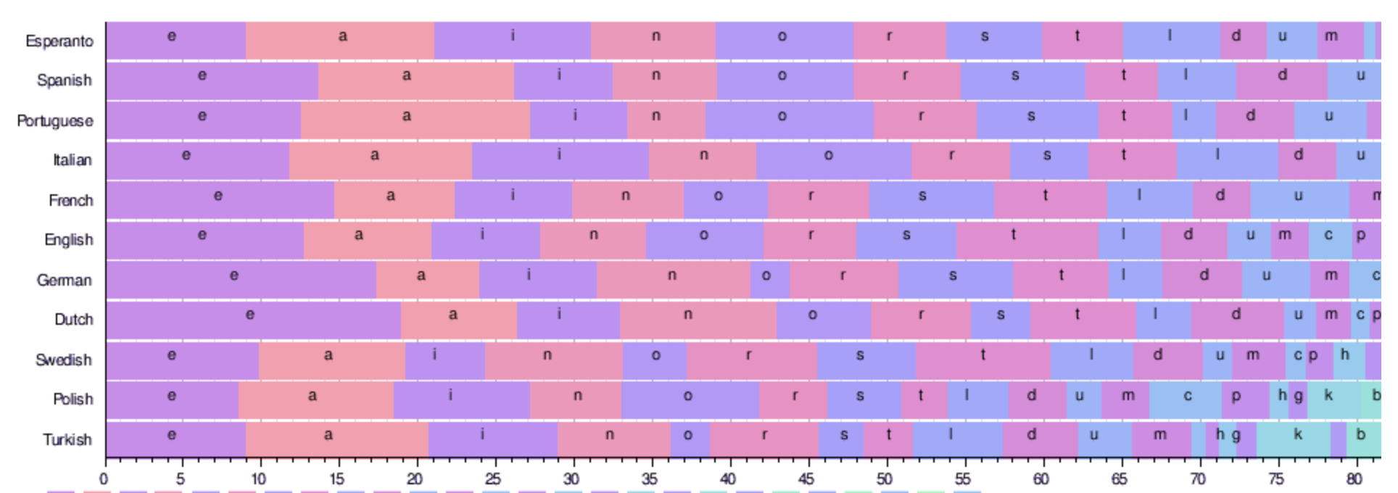
Which language is most efficient in letter usage???
Corollary: we communicate ~40bits/second (twice Morse code)

Slide 13
A binary variable (0, 1 values)
How do we capture competing probabilities?

Slide 14
Average Information for a non-uniform
distribution (e.g. English language)
P
A
E
Q
I(p_{i}) = -log_{b}p_{i}
⎲
⎲
S = < I > = p_{i} x I(p_{i}) = - p_{i}log_{b}p_{i}
⎳
⎳
_{i}
_{i}
Information Entropy

Slide 15
⎲
S= - p_{i}log_{b}p_{i}
⎳
_{i}

Slide 16
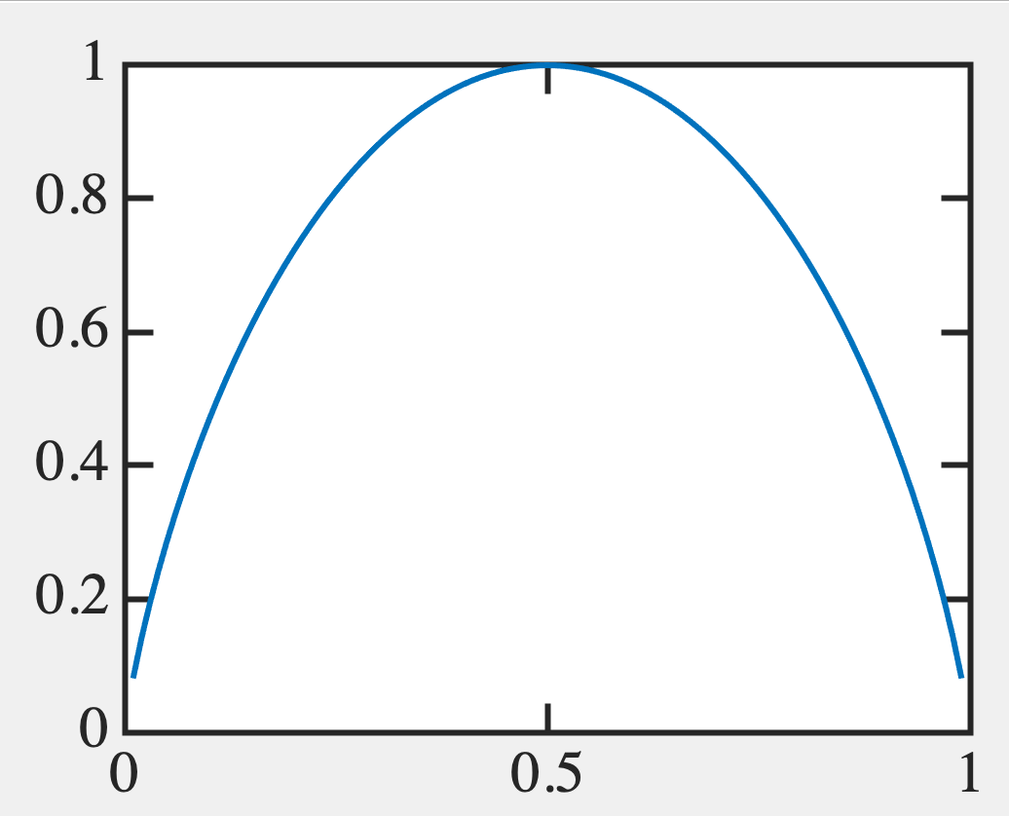
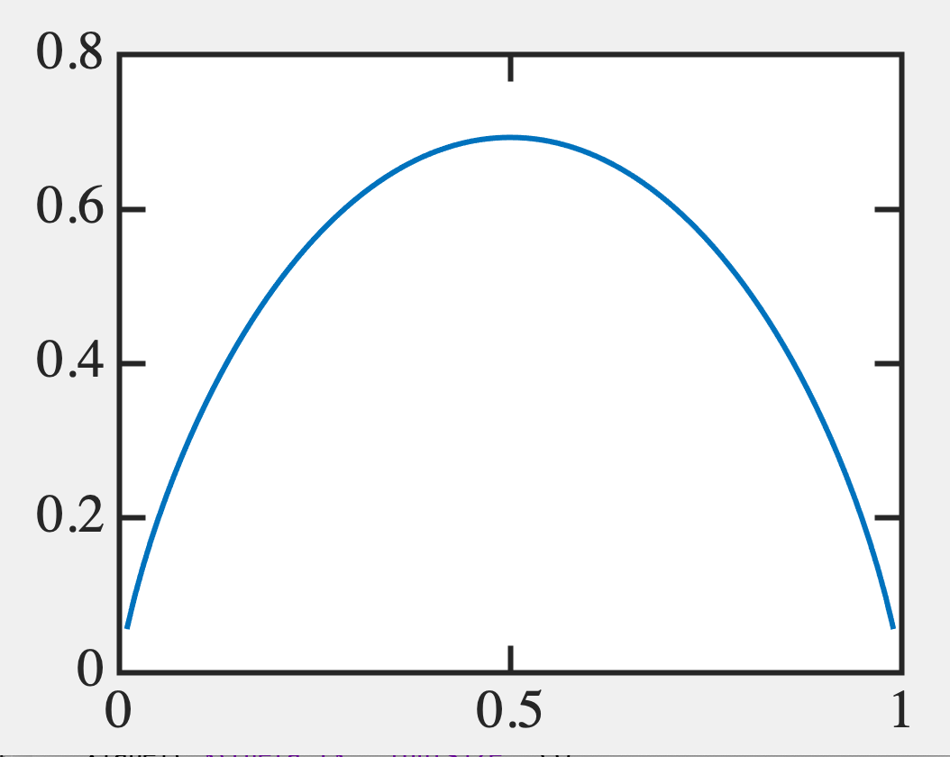
e.g. A binary variable (0, 1 values)
“0” with prob p, “1” with prob 1-p
S = -plog_{b}p-(1-p)log_{b}(1-p)
p=0 means “1” with certainty
p=1 means “0” with certainty
Device physics: Thermodynamic units
b=e
Biological units: b=2 (BIT)
ln2

Slide 17
Entropy in the English Language

Slide 18
Slighly different units in physics
⎲
S= -k_{B} p_{i}log_{e}p_{i}
⎳
_{i}

Slide 19
Manipulating a binary variable
S = -plog_{b}p-(1-p)log_{b}(1-p)
Computing → altering symbol sequences
This may or may not alter amount of information
Physical Relevance:
Heat is generated when information is erased (S reduces)
If S stays same, we can make that transformation reversibly
10100 → 01100
10100 → 00010

Slide 20
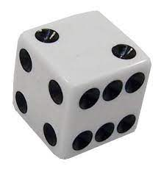
Data compression often creates loss
# dots in a die:
S₁ = -(1/6)log₂(1/6) - (1/6)log₂(1/6) + … = log₂(6) = 2.58 bits
S₂ = log₂ (6) = 2.58 bits
Sum of # dots on the two dies (between 2 → 12)
2: 1/36 8: 5/36
3: 2/36 9: 4/36
4: 3/36 10:3/36 S=3.27 bits < S₁ + S₂
5: 4/36 11:2/36
6: 5/36 12:1/36
7: 6/36
Less info so it’s not reversible
(You can ‘guess’ probabilistically or with AI)

Slide 21
But we can reverse some of it !
Sum of # dots on the two dies
2: 1/36 8: 5/36
3: 2/36 9: 4/36
4: 3/36 10: 3/36
5: 4/36 11: 2/36
6: 5/36 12: 1/36
7: 6/36
Bring in joint and conditional probabilities

Slide 22
Joint entropy
⎲
⎲
S(x,y) = - p_{X,Y}(x,y)log₂p_{X,Y}(x,y)
⎳
⎳
_{x}
_{y}
S(x), S(y) ⩽ S(x,y) ⩽ S(x) + S(y)

Slide 23
Conditional Probability: Monty Hall Prb.
Door A
Door B
Door C
Game show:
1 door has $1M prize behind it, two others have nothing.
You choose one door at random. The MC shows opens one
of the other doors and shows it is empty. Should you stick to your original choice, or move on to
the third door?

Slide 24
Conditional Probability
Door A
Door B
Door C
P=1/3 → You chose the right door. You shouldn’t switch.
Guaranteed failure.
P=2/3 → You chose the wrong door. You should switch.
Guaranteed success.
So… switch !!!

Slide 25
Conditional Probability
P=1/3
P=1/3
P=1/3
AFTER REVEAL
P=1/3
P=0
P=2/3

Slide 26
Why not ½ and ½ ?
AFTER REVEAL
P=1/3
P=0
P=2/3
P of your door does not change, because the
second door wasn’t chosen at random !!! Game show host knowingly choses one of the wrong
doors depending on your choice.
(in 1/3 cases that is NOT door B)

Slide 27
We will see later: Conditional Probability (Bayes’ Theorem)
p(x,y) = p(x).p(y|x)
Prob of y given x
If x,y independent, p(y|x) = p(y)
and p(x,y) = p(x).p(y)
Thomas Bayes
p(x,y) = p(x).p(y|x) = p(y).p(x|y)
p(y|x) = p(y).p(x|y)
Posterior
Prior
Likelihood
[ p(x|y).p(y)
+
p(x| y ).p( y )]
p(x)
_
_
Normalize

Slide 28
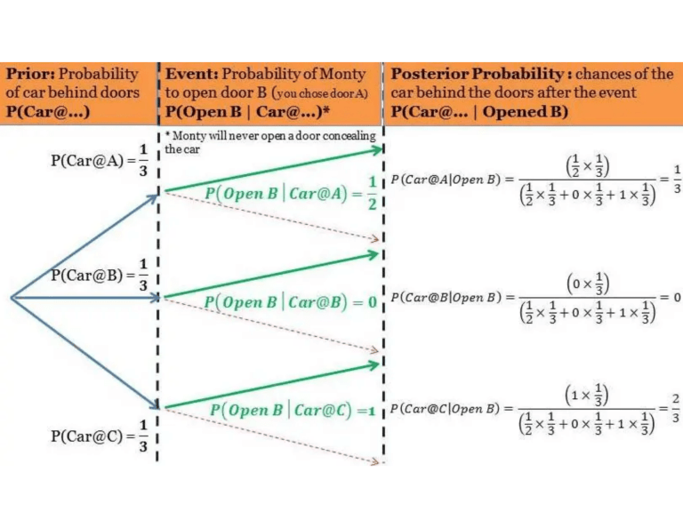
Conditional Probability
http://ucanalytics.com/blogs/bayes-theorem-monty-hall-problem/

Slide 29
We will later see:
Error Correction
Data Compression
Energy dissipation Reversible Computing

Slide 30
To summarize: probability distributions
carry info, synthesized into information
entropy S = -plog_{b}p
But how do we ‘compute’ on that info?
(ie, alter probabilities or eventualities
according to a recipe or a target)

