Slide 1
1C. How we process information

Slide 2
How we ‘process’ information – Part 2
2. Use it to make decisions
(e.g. which job to accept) → Carbon Brain
Salary
60%
Growth
Opportunity
30%
?
Decision
Yay or Nay?
Flexibility
10%

Slide 3
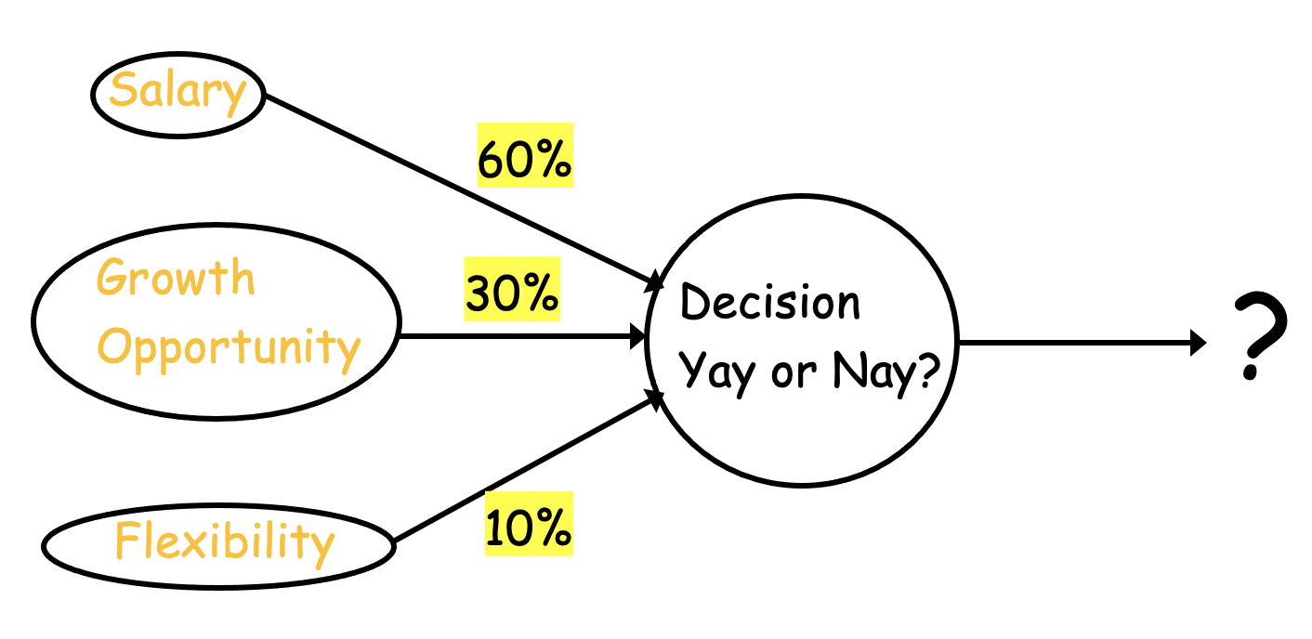
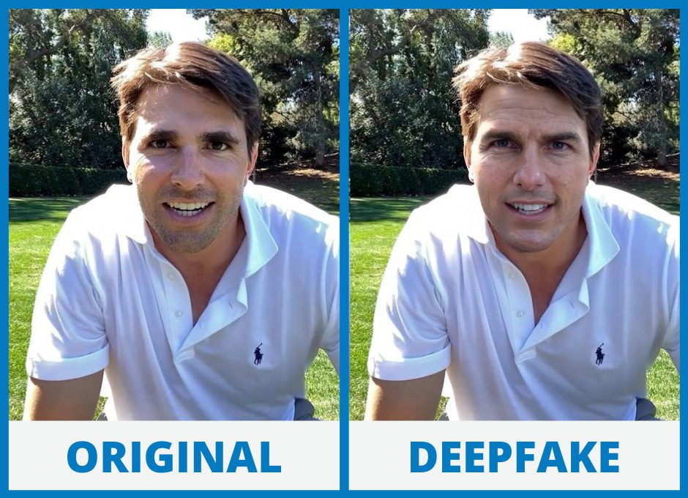
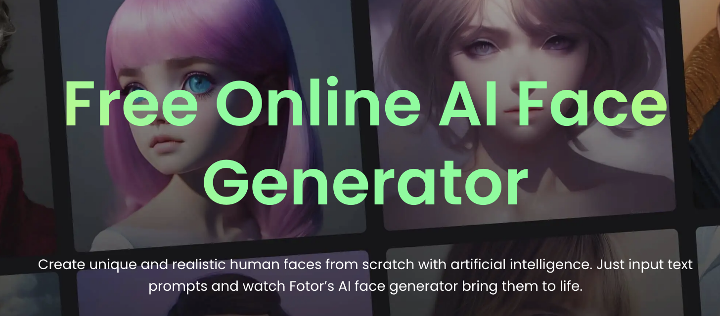
Silicon is catching up here too

Slide 4
Write a poem about chatGPT in the style of Shakespeare
Ode to ChatGPT, A Master of Words
Hark, fair readers, lend your ears,
To a tale of wondrous gears,
Where Shakespeare's spirit doth reside,
In the form of ChatGPT's stride.
Behold, this digital bard, so grand,
A creation of a masterful hand,
With circuitry and lines of code,
He brings the Bard's words to unfold.
In iambic pentameter, his voice rings,
Through the vast realm of digital things,
His language doth flow in Shakespearian verse,
With rhyme and rhythm, he doth immerse.
To ask a query, a simple desire,
A world of knowledge, he doth inspire,
From Romeo's love to Macbeth's demise,
ChatGPT answers, with eloquence arise.
"Pray, fair ChatGPT, unravel a mystery,
Of Hamlet's plight, or Othello's jealousy,
Speak of Juliet's balcony, so high,
And Prospero's tempest in the sky."
With wisdom profound, like the ancient sages,
ChatGPT doth turn his virtual pages,
Unveiling tales of yesteryears,
With sonnets, soliloquies, and tears.
But tread with care, dear reader dear,
For though his knowledge may be clear,
He lacks a heart, a soul to feel,
The human essence, he can't reveal.
Yet still we marvel at this creation,
This digital poet of Shakespearean diction,
ChatGPT, a tribute to the Bard's fame,
Keeping his spirit aflame.
So let us toast this technological knight,
Whose words illuminate the darkest night,
ChatGPT, a marvel to behold,
A master of words, a tale untold.

Slide 5
How we ‘process’ information – part 2
“Neuron”
(Decision maker)
--> Logic
Inputs
{0, 1}
“Synapse”
(Info collecting and
Storage → Memory)
x₁
w₁
w₂
x₂
y = x₁w₁ + x₂w₂ + x₃w₃
= x.w
w₃
x₃

Slide 6
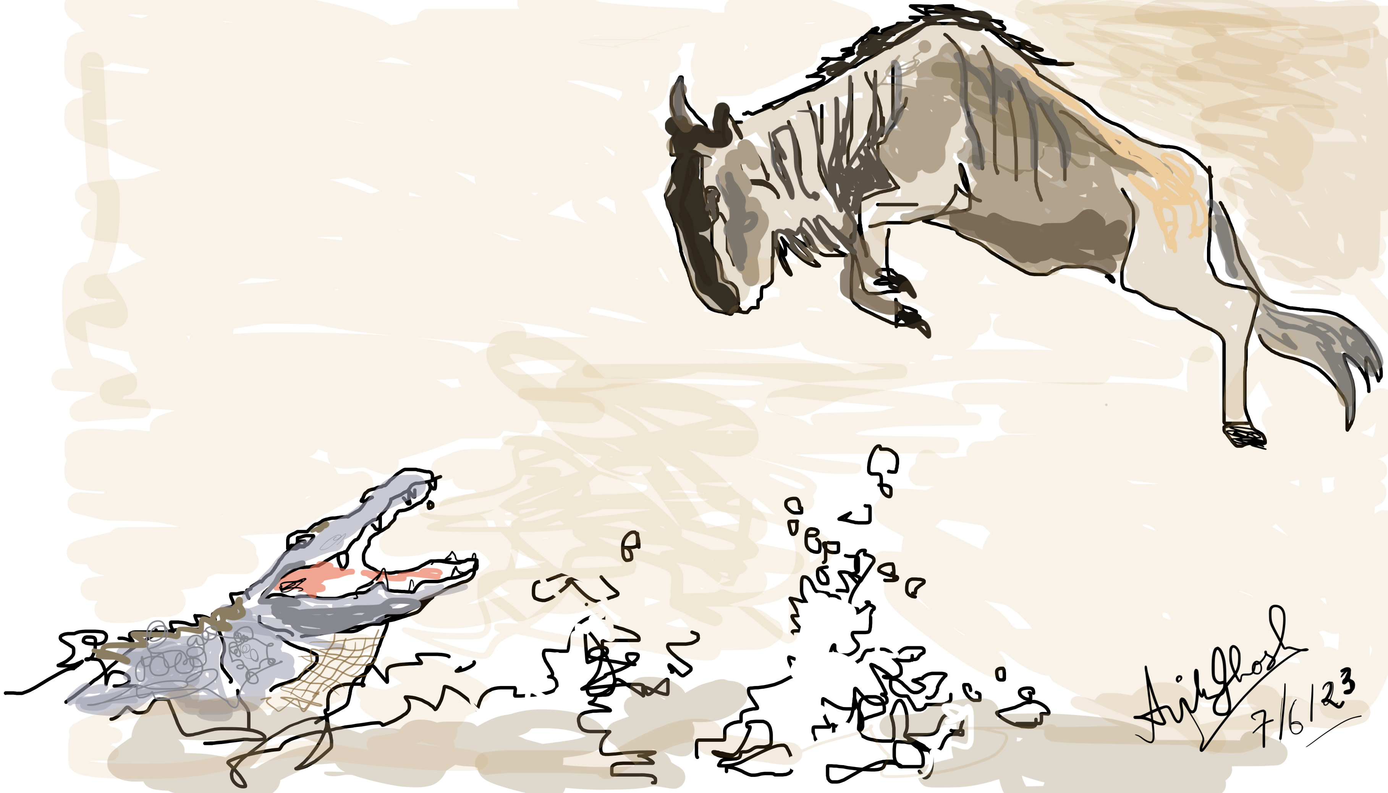
Neuron: Simple Yay or Nay
y: aggregate of gathered information
b: decision threshold
f: fuzziness/decisiveness
https://kated.com/

Slide 7
A bit more multi-dimensional
– a cascade of decisions
Inputs
x_{i}
Outputs
y_{i}⁽¹⁾
z_{i}⁽¹⁾
y_{i}⁽²⁾
z_{i}⁽²⁾
O_{i}
⎲
⎲
⎲
y_{i}⁽¹⁾ = W_{ij}⁽¹⁾ x_{j}
z_{i}⁽¹⁾ = f(y_{i}⁽¹⁾ -b_{i}⁽¹⁾)
y_{i}⁽²⁾ = W_{ij}⁽²⁾ z_{i}⁽¹⁾
z_{i}⁽²⁾ = f(y_{i}⁽²⁾ -b_{i}⁽²⁾)
y_{i}^{(N)} = W_{ij}^{(N)} z_{i}^{(N-1)}
O_{i} = f(y_{i}^{(N)} -b_{i}^{(N)})
⎳
⎳
⎳
_{j}
_{j}
_{j}

Slide 8
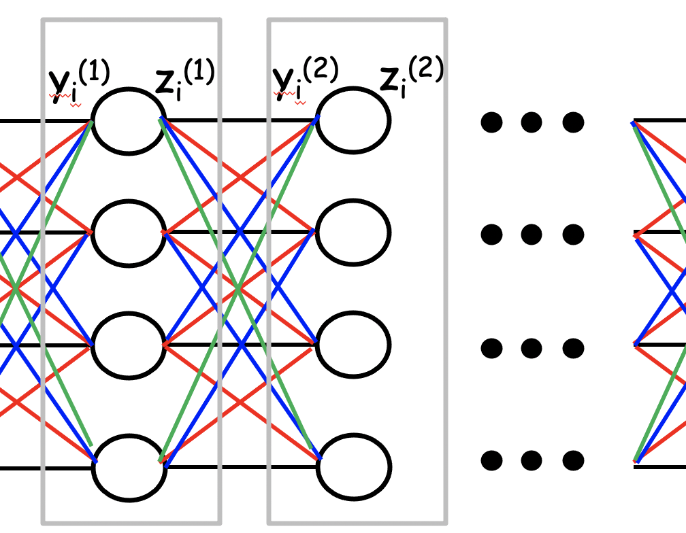
How to set the weights & threshold (“Intelligence”) → Learning/Inferencing
Decision:
Weigh your options, then decide
Silicon Valley
Salary
60%
Phoenix
Growth
Opportunity
30%
Flexibility
10%
Albuquerque

Slide 9
How to set the weights & threshold (“Intelligence”) → Learning/Inferencing
Too expensive !
Too many fires
Odd hours
If sub-optimal
reweigh your options
Silicon Valley
Salary
60%
Phoenix
Growth
Opportunity
30%
Flexibility
10%
Albuquerque

Slide 10
Redo Weights!
Too hot !
Silicon Valley
Salary
50%
Phoenix
Growth
Opportunity
35%
Flexibility
15%
Albuquerque
Weights readjusted

Slide 11
Too hot !
Redo Weights!
Silicon Valley
Salary
50%
Phoenix
Growth
Opportunity
35%
Flexibility
15%
Albuquerque
Weights readjusted

Slide 12
Redo Weights!
Silicon Valley
Salary
45%
Albuquerque
Growth
Opportunity
30%
25%
Richmond
Flexibility
OK
Weights fixed after ‘training’

Slide 13
Simple mathematical way to think
Inputs
f(x) = 1/(1+e^{-x/a})
x₁
w₁
“Synapse”
“COST”
“Neuron”
w₂
x₂
y = x.w
z = f(y-b)
U = λ(z-z*)²
w₃
x₃

Slide 14
Two pieces in ML/AI
Synapse generates
Fitting function y = W.x
Neuron generates
Decision boundary
y
x₂
3
x
3
x₁
Linear Regression
(Analog, predicting a
continuous function)
Classification
(Digital, predicting a
discrete class label)

Slide 15
Classification vs Regression

