Slide 1
1D. How do we implement this algorithm
in hardware?

Slide 2
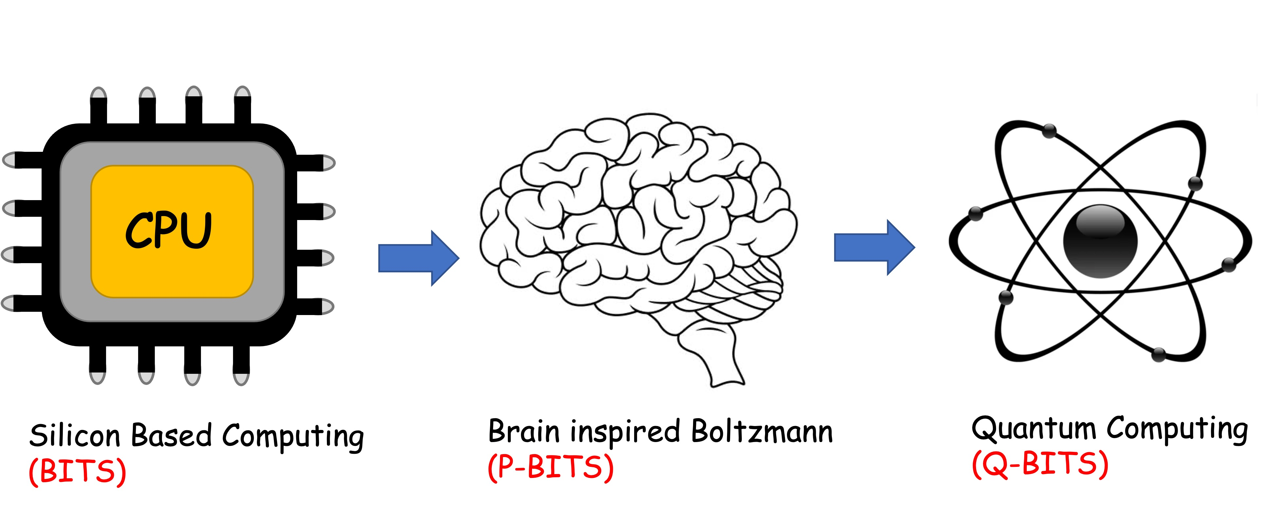
f(x-b)
δW
Unsupervised
weight adjusting
Bio offers plasticity
U
Quantum offers
parallelism
x.W
Fast adders
Silicon offers
speed

Slide 3
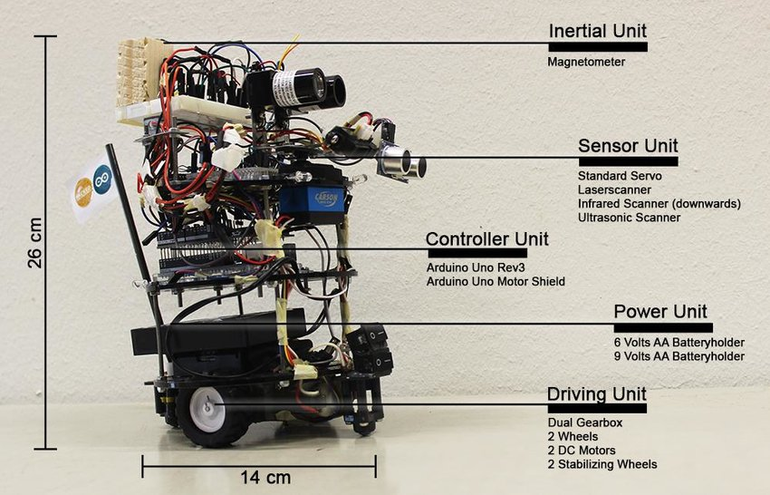
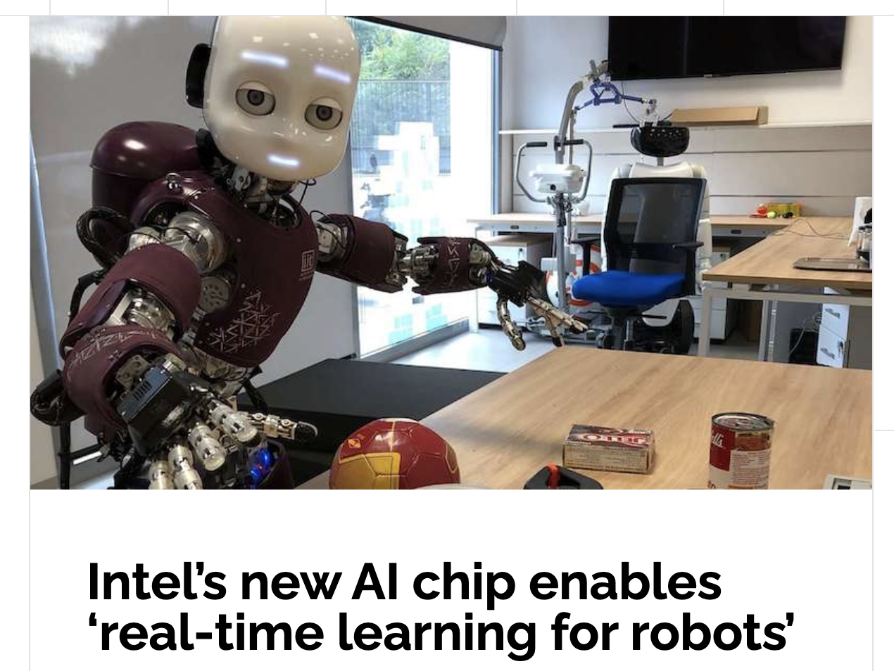
Why do it at all in hardware?
Many situations where cloud is unavailable or unreliable
Need a lot of on Chip computing
Need low Size Weight and Power (SWaP)
Edge Intelligence
Neuromorphic chip + Event Camera
Roger & Timpf, GI_Forum 2018, Issue.1
SLAM – Simultaneous Localization and Mapping

Slide 4
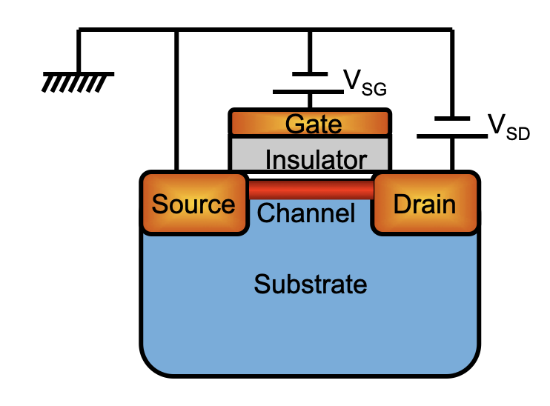
CMOS: Digital data digital read-out
Input (gate voltage) controls
Signal (electron current) amplitude
I
ON “1”
V_{SG} > 0
n-FET
OFF “0”
V_{SD}

Slide 5
Pulse amplitude modulation
Encode info in binary
(BITs):
→ 18
11011 → 27

Slide 6
CMOS can toggle binary
Information very fast
(~GHz)
and with high accuracy
(~10⁻¹²)

Slide 8
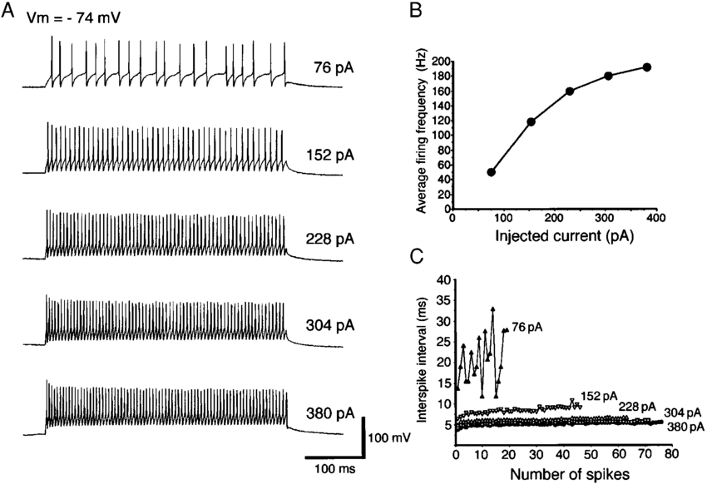
Input (ionic current) Controls signal (current) amplitude
Pulse Position Modulation
Electrophysiological and Morphological Properties of Neurons in the Rat Superior Colliculus. I. Neurons in the Intermediate Layer
Y. Saito and T. Isa
Journal of Neurophysiology 82(2):754-67, 1999.

Slide 9
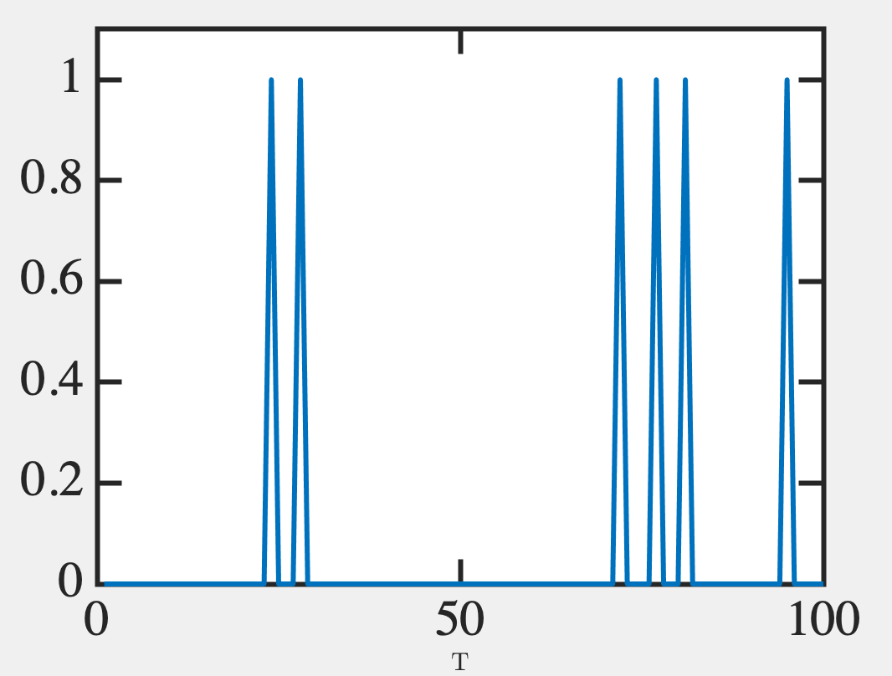
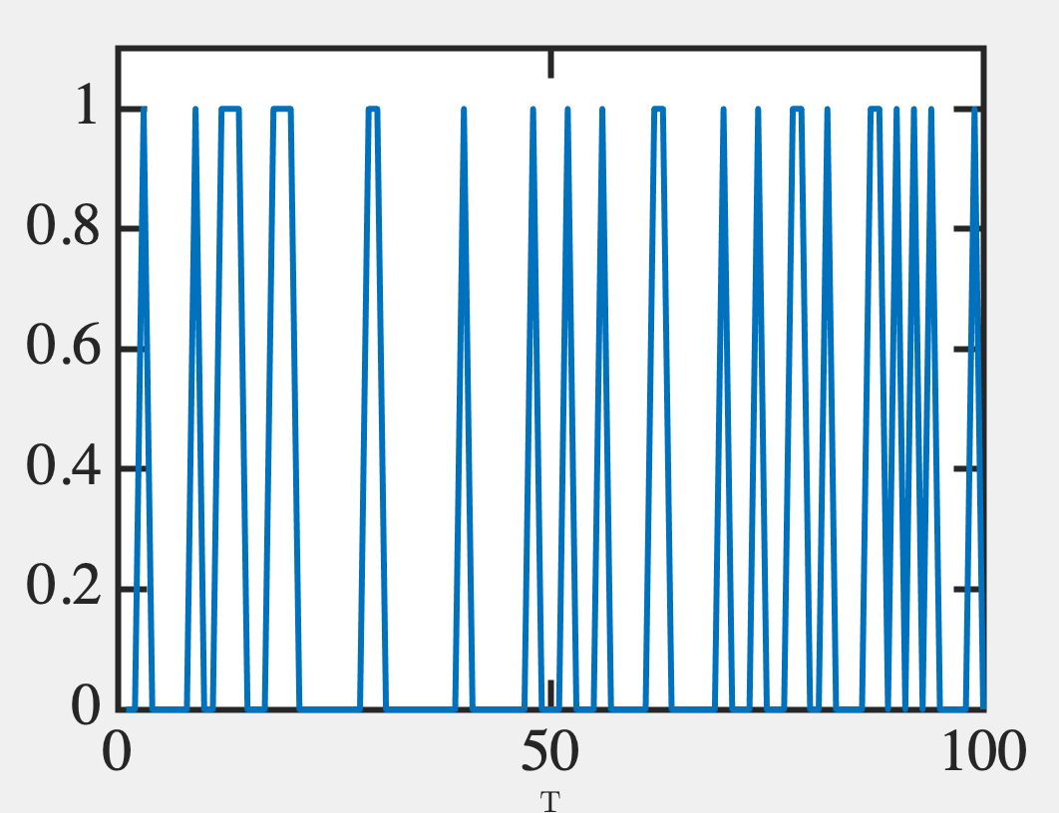
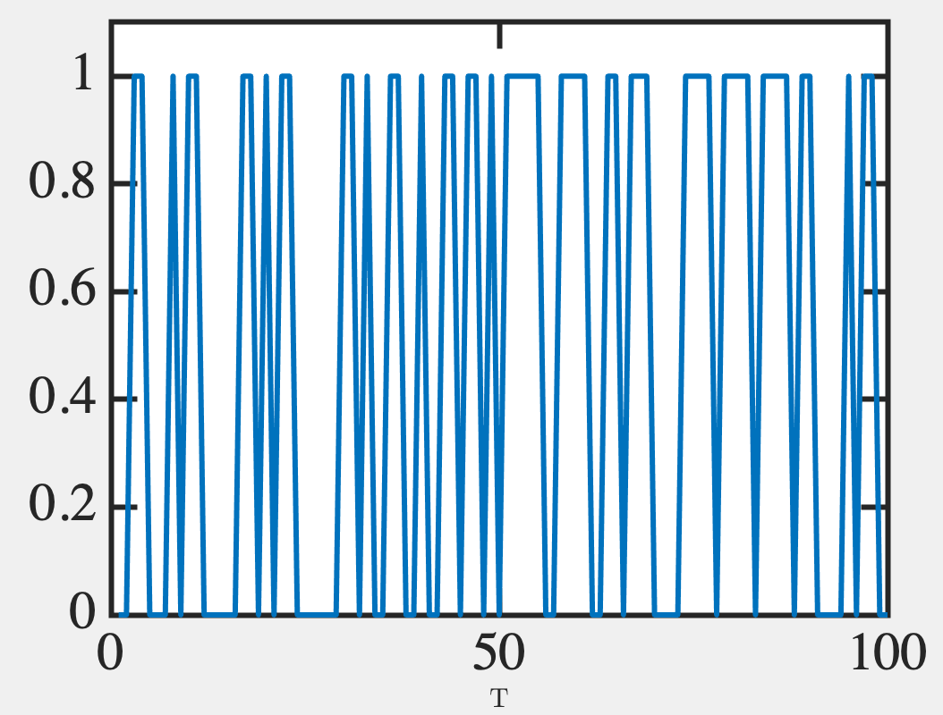
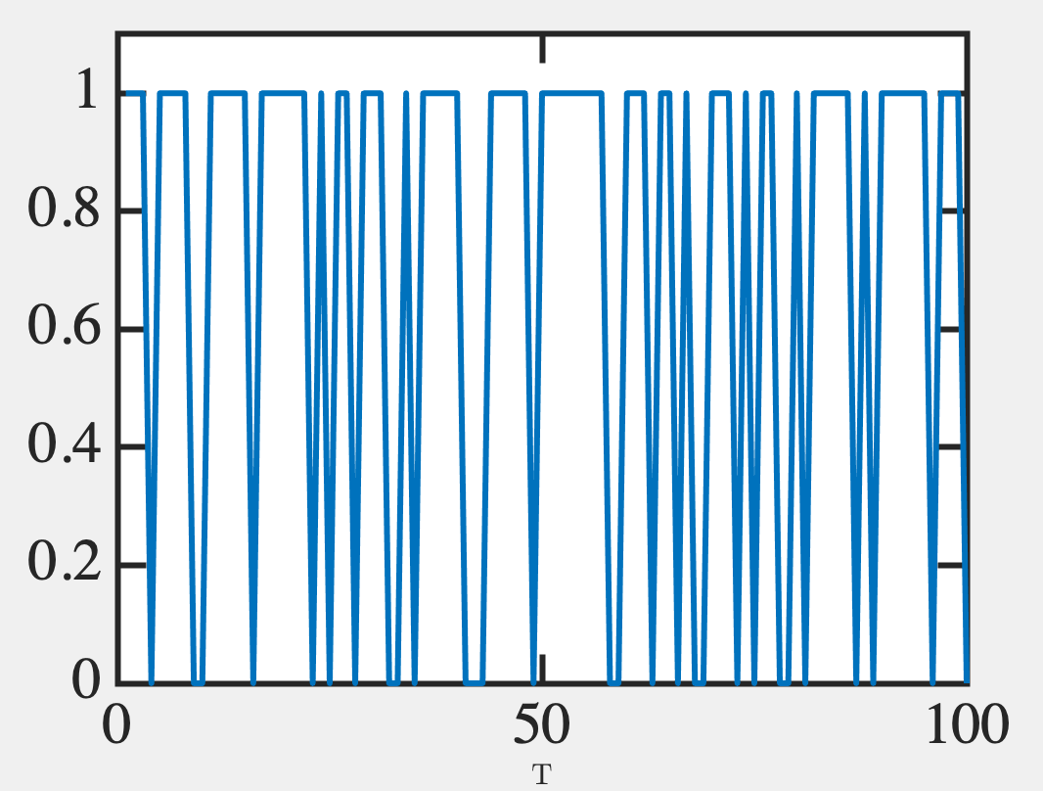
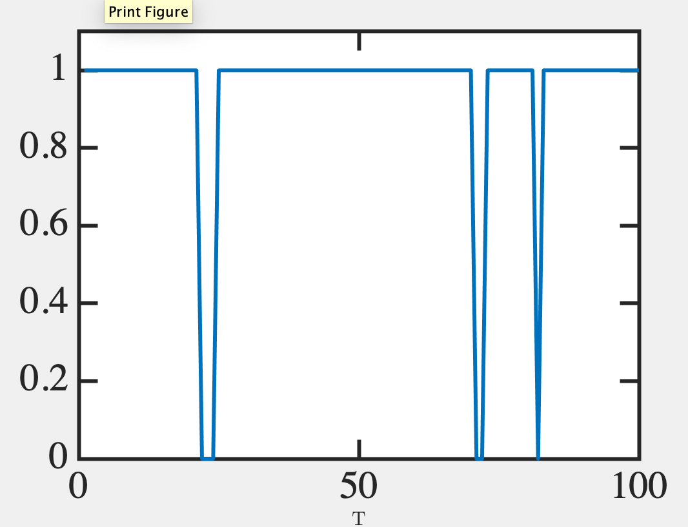
Probabilistic bits (p-bits)
Digital data analog read-out
0.5
0.3
0.1
0.9
0.7

Slide 10
Attributes of p-bits

Slide 11
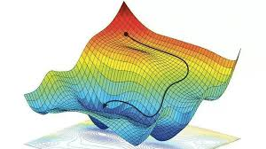
How do you program the W’s?
Si brain → Backpropagation
(Evaluate cost function, adjust W to
minimize the cost)
Steepest Descent

Slide 12
Carbon brain – Unsupervised Hebbian
Co-firing of neurons
wires them up
(W: 0 → 1)
Donald O Hebb

Slide 13
We programm interconnects in Artificial Neural Nets with a different end goal
For a given W distribution
minimizing ‘cost’ would amt
to solving a desired
Optimization problem

Slide 14
Max/Min Cut problem
We can reverse engineer a [W]
and a {b} so that its ground
state is the solution to max cut

Slide 15
Neuro-synaptic systems
can be programmed to
solve very large
optimization problems
approximately at moderate
speeds

Slide 17
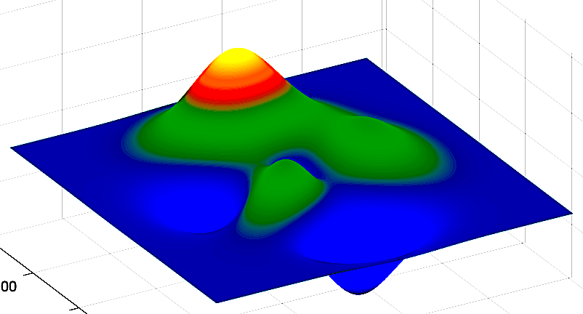
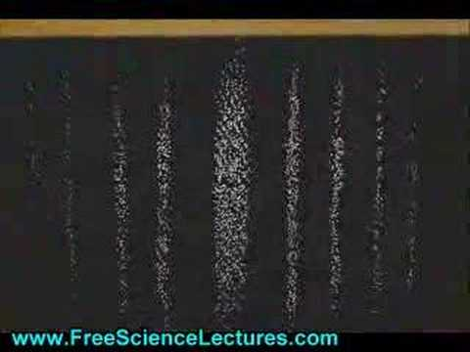
Quantum Wavefunction
Analog data digital read-out
Probabilistically collapse to
state 2
to generate
reading 2
Probabilistically collapse to
state 1
to generate
reading 1
Quantum Probability (more fundamental than classical uncertainty)
Mixture of possible states with
definite readings
Probability Wave
(analog)
Individual measurements
(digital)

Slide 18
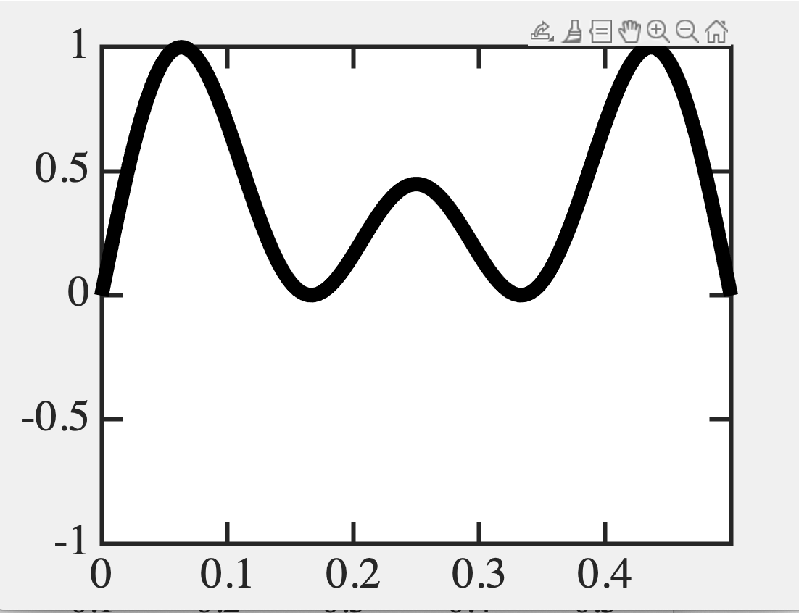
Position eigenstates (blips)
0.05 0.25 0.45
0.05
0.05
0.25
0.45
0.25
0.05
0.05
0.45
0.45
0.45
0.45
0.05
0.05
0.25
0.45
0.45
0.05
0.25
0.45
0.05
0.05 0.25 0.45

Slide 19
How to use this for Quantum Computing
Throw 10 balls into a course
with 100 holes. Which 10 will it
choose? (Combinatorics)
¹⁰⁰C₁₀ = 1.73e13
Quantum 1: Tunneling:
golf balls can penetrate mounds
→ Faster search
Quantum 2: Spin always clockwise/
anticlockwise when you measure
→ Pack in more bits
¹⁰⁰C₁₀ x 2¹⁰ = 1.77e16

Slide 20
Quantum Computing
Quantum 3: Superposition Spins don’t take a stance (clockwise/anti) UNTIL
you measure it (Q-bits), and can be in a truly mixed state.
Moreover, one ball can sample all the holes at the same time.
Quantum 4: Entanglement Finally, multiple Q-bits can be entangled and evolve coherently
(Physics Nobel 2022)

Slide 21
Quantum systems
can be programmed to
sample many outcomes
in parallel by entangling
several hybrid states

Slide 22
Overall structure of this course
Digital Computing in Silico
How we compute (algorithms)
How we add (Gates)
How we add quickly (CMOS)
Energy cost
How we fix errors
Analog Computing in Carbo
How we train (Supervision)
Physics of Neurons (Boltzmann)
How we learn (time sampling)
Optimizing and Classifying
Transition Theory & Inferencing
Quantum Computing in Magneto
Quantum Spins and Hardware
Quantum Physics
Entanglement and Superposition
Quantum Search and Annealing
Quantum Gates and Factorization

