Slide 1
Fundamentals of Computing
Lec 2
How we add

Slide 2
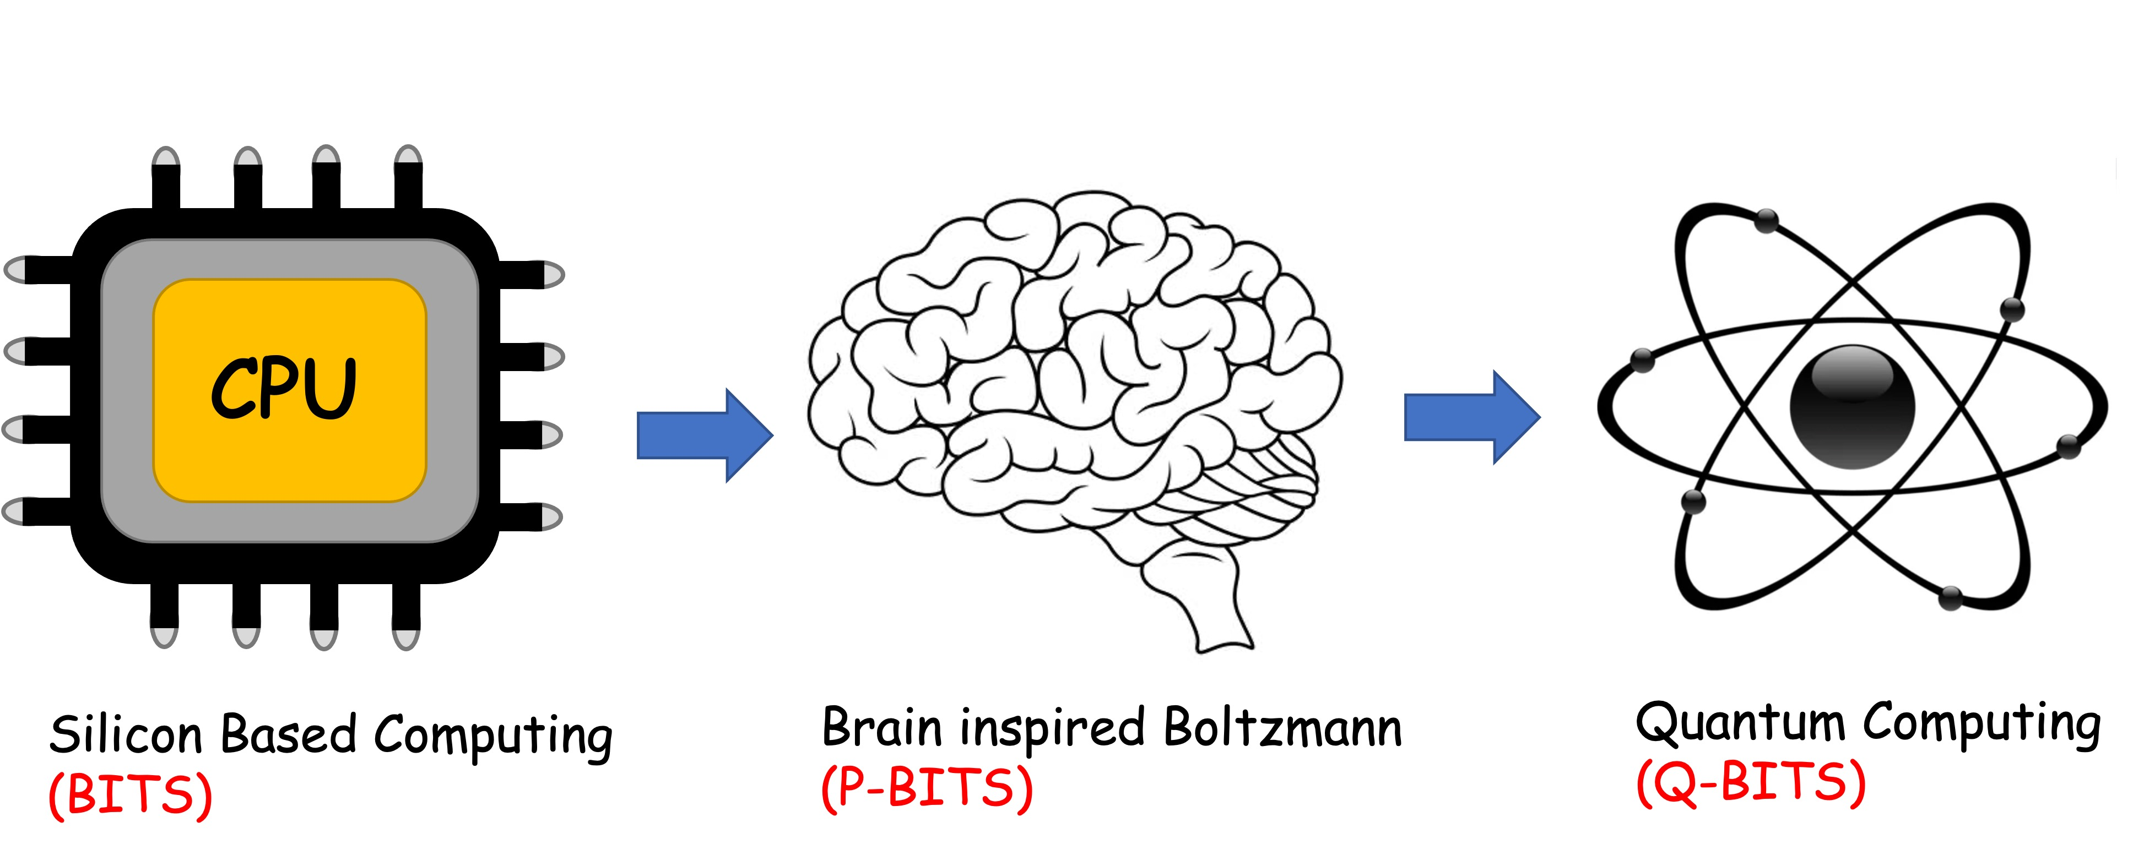
Overall structure of this course
Digital Computing in Silico
How we compute (algorithms)
How we add (Gates)
How we add quickly (CMOS)
Energy cost
How we fix errors
Analog Computing in Carbo
How we train (Supervision)
Physics of Neurons (Boltzmann)
How we learn (time sampling)
Optimizing and Classifying
Transition Theory & Inferencing
Quantum Computing in Magneto
Quantum Spins and Hardware
Quantum Physics
Entanglement and Superposition
Quantum Search and Annealing
Quantum Gates and Factorization

Slide 3
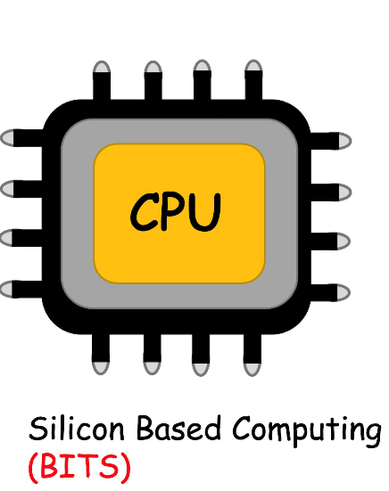

Slide 4
Neuron
Synapse
W.x
How to add?

Slide 5
2A. Elementary gates for addition

Slide 6
99 + 55 = ?
1. Encoder
9 → 1001, 5→ 0101
2. Processor
Col1: 9 + 5 = 14 (store 4 carry 1)
Col2: 9 + 5 = 14 + 1 = 15
Answer: 154 → 10011010
3. Decoder
10011010 → 154
4. Memory
Instruction sets (how to add), address, data upload/download
5. Clocks for synchronizing
6. Multiplexers for routing and Programmable Logic
¹
¹
99
+ 55
154

Slide 7
To control these operations,
we need gates

Slide 8
Simple gate: an inverter
1-input 1-output
in
out
NOT
in
out
0
1
1
0

Slide 9
2-input Logic Gates
OR
AND
A
A
A⋂B
A U B
B
B
A
B
A ⋂ B
A
B
A U B
0
0
0
0
0
0
0
1
0
0
1
1
1
0
0
1
0
1
1
1
1
1
1
1

Slide 10
2-input 1-output Logic Gates
NAND (A ⩃ B)
NOR (A ⩂ B)
XOR (A ⨁ B)
0
0
1
0
0
1
0
0
0
0
1
1
0
1
0
0
1
1
1
0
1
1
0
0
1
0
1
1
1
0
1
1
0
1
1
0

Slide 11
Other Logic Gates
Exchange
Fanout/
Copy

Slide 12
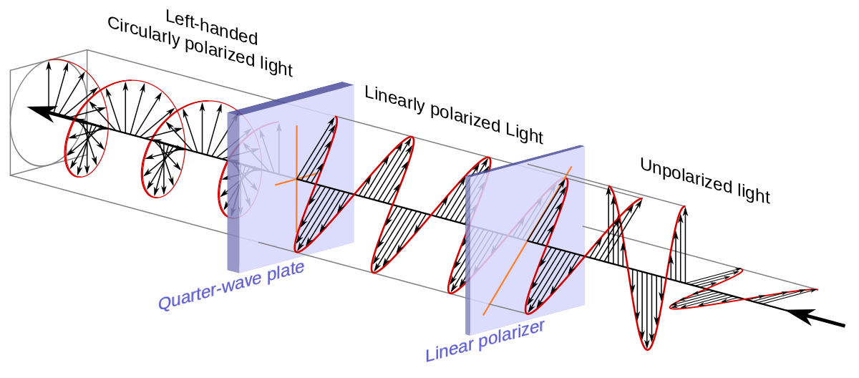
Quantum Logic Gates
Hadamard
(Quantum Superposition)
Boolean does not allow mixtures
(it’s either-or)

Slide 13
Quantum Logic Gates

Slide 14
Quantum Logic Gates

Slide 15
Classical Logic Gates

Slide 16
Quantum Logic Gates
Hadamard
(Quantum Superposition)
Boolean does not allow mixtures
(it’s either-or)

Slide 17
Quantum Logic Gates
Hadamard
(Quantum Superposition)
Reversible Gate

Slide 18
Irreversible gates
It is not reversible because you are
discarding information from input to output !!

Slide 19
Reversible gates
It is not reversible because you are
discarding information from input to output !!

Slide 20
How many flavors of logic gates do we need?

Slide 21
To be Universal
Must block an
input (e.g. A)
Here output ignores A
A
Only
Dep on
B
B = 0 or 1
Must generate
a NOT
A
A

Slide 22
NAND is universal
A
A
A
B
NAND
NOT
AND = NOT(NAND)
B=0, output = 1 independent of A (blocks A)

Slide 23
NAND is universal
A
B
NAND
A
A
A OR
B
B
B
A OR B = [A ⩃ B]
Come Rain or Shine = Not(rainless and shineless)

