Slide 1
2B. Binary representation

Slide 2
Write down truth table
Write in terms of known gates

Slide 3
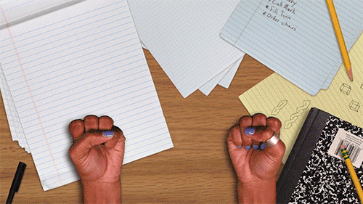
0
1
2
3
4
5
6
7
8
9
1
0
1
2
3
4
5
6
7
8
9
1
0
0
0
0
0
0
0
0
0
0
0
1
2
3
4
5
6
7
8
9

Slide 4
10 finger counting
1234
= 1 x 10³ + 2 x 10² + 3 x 10¹ + 4 x 10⁰

Slide 5
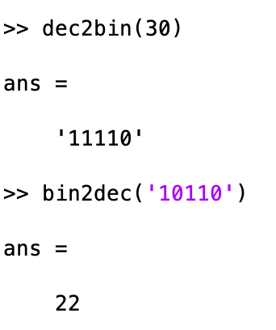
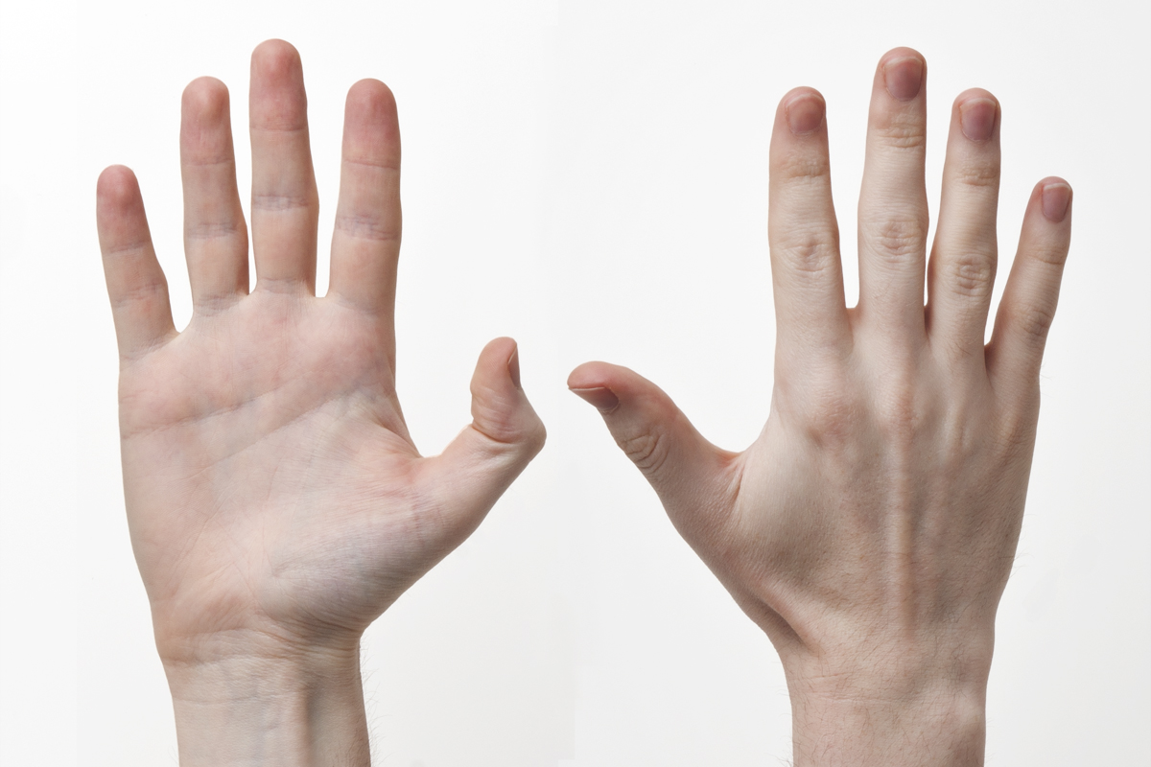
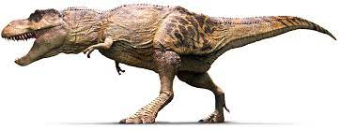
(10 finger to 2 finger logic)
7 = 0111
= 0 x 2³ + 1 x 2² + 1 x 2¹ + 1 x 2⁰
MATLAB
5 = 0101
12 = 1100

Slide 6
10 finger addition
1 2 3 4
+ 2 1 5 7
-----------

Slide 7
4 Bit Adder
7 = 0 1 1 1
5 = 0 1 0 1
12 =
1
¹ 0
¹ 1
¹ 0
2 = 10
2 = 10
3 = 11
1 = 01

Slide 8
Half-Adder
A
CARRY = AND = A ⋂ B
B
SUM = XOR = A ⨁ B
A
B
CARRY
SUM
0
0
0
0
0
0
1
0
1
1
1
0
0
1
1
1
1
1
0
2

Slide 9
Full-Adder
(include previous carry
as extra input)
C_{in} | A | B | C_{out} | S
0 | 0 | 0 | 0 | 0
0 | 0 | 1 | 0 | 1
0 | 1 | 0 | 0 | 1
0 | 1 | 1 | 1 | 0
1 | 0 | 0 | 0 | 1
1 | 0 | 1 | 1 | 0
1 | 1 | 0 | 1 | 0
1 | 1 | 1 | 1 | 1
A
Sum
S
B
Carry
C_{out}
C_{in}
S = A + B + C_{in}
C_{out} = (A ⋂ B) U (B ⋂ C) U (A ⋂ C)

Slide 10
C_{in}
2 Bit Adder
A
SUM = A XOR B
XOR C_{i}
B
CARRY =
(A ⋂ B)U(B ⋂ C_{in})U(A ⋂ C_{in})

Slide 11
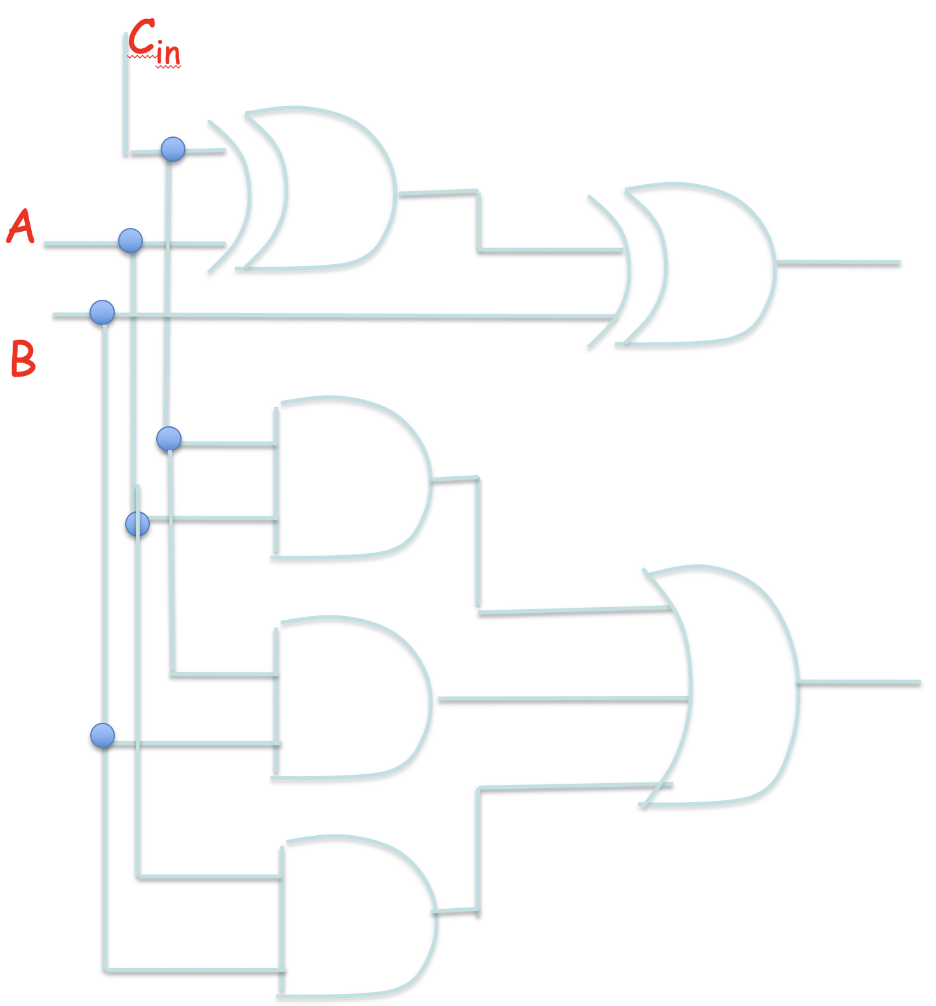
32 Bit Adder
+

Slide 12
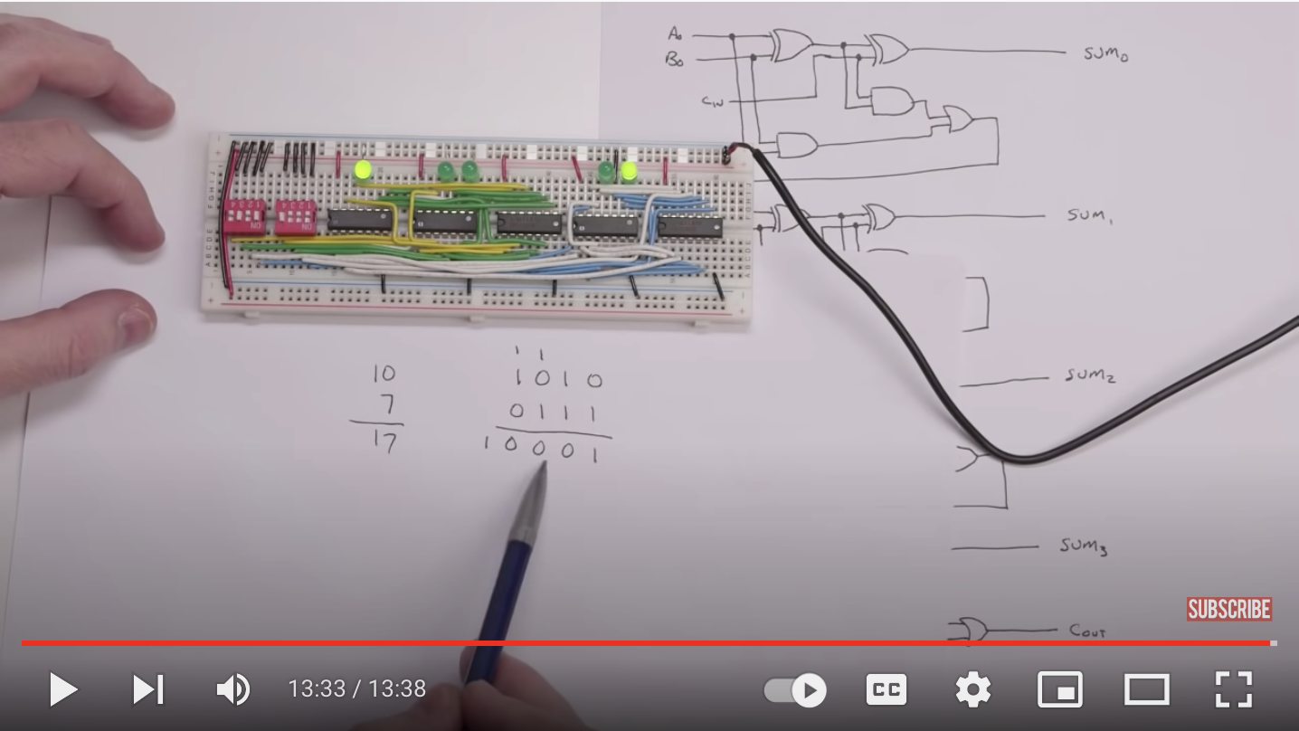
https://www.youtube.com/watch?time_continue=818&v=wvJc9CZcvBc&feature=emb_logo

