Slide 1
2C Signed addition (Negative numbers)

Slide 2
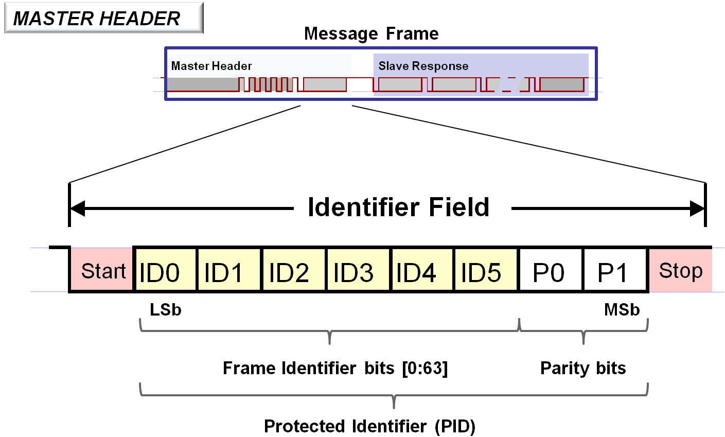
Designate a bit as ‘sign bit’
28 = 00011100
-28 = 10011100 ????
No because sum does not give 00000000 !!!
https://microchipdeveloper.com/lin:protocol-dll-lin-message-frame

Slide 3
28 = 00011100
TO GET NEGATIVE of ABCDEFGH,
WE NEED TO SUBTRACT FROM 0
00000000
-ABCDEFGH
SINCE WE DROP 9TH BIT, WE MIGHT AS WELL DO
100000000
-ABCDEFGH

Slide 4
But 100000000
= 11111111 + 1
AND
11111111
-ABCDEFGH
IS SIMPLY FLIPPING DIGITS OF ABCDEFGH
e.g. 1-0 = 1
1-1 = 0

Slide 5
THUS TWO’S COMPLEMENT: FLIP AND ADD 1
(1st DIGIT 0 means +, 1 means -)
-28 = 11100011+1
= 11100100

Slide 6
TO READ
Just binary → decimal, except first unit is subtracted
11100100
- 2⁷ x 1 + 2⁶ x 1 + 2⁵ x 1 + 2⁴ x 0 + 2³ x 0 + 2² x 1 + 2¹ x 0 + 2⁰ x 0
= -128 + 64 + 32 + 0 + 0 + 4 + 0 + 0 = -28

Slide 7
TO FLIP BACK
DO TWOS COMPLEMENT AGAIN
LEFTMOST BIT is still sign
00011011+1
= 00011100

Slide 8
32 Bit
Signed
Adder

Slide 9
Aside: Digital Multiply
11010
X 1111
-----------
11010
11010
11010
11010
-----------
COPY & SHIFT
+
101110110

Slide 10
Multiply
11010
X 1001
-----------
11010
00000
00000
11010
-----------
COPY
NO COPY
+
101110110
In practice, Booth algorithm to minimize copies

