Slide 1
2D.
Interfaces and Routing:
Encoder-Decoder
MUX-DEMUX

Slide 2
OK, so we know how to add in binary.
But how do we convert between decimal
& binary in the first place?
And how do we send multiple answers
on the same line without blowing up
I/O ports?

Slide 3
Encoder: 2^{n} inputs, n outputs
Decimal to binary
0
1
2
3
0
Enable
0
D0
0
1
2
3
0
0
A
1
D1
1
0
1
2
3
1
2
B
0
D2
0
1
2
3
1
3
D3
1

Slide 4
Encoder: 2^{n} inputs, n outputs
D0 | D1 | D2 | D3 | A | B
1 | 0 | 0 | 0 | 0 | 0
0 | 1 | 0 | 0 | 0 | 1
0 | 0 | 1 | 0 | 1 | 0
0 | 0 | 0 | 1 | 1 | 1
Enable
D0
A
D1
B
D2
A = D2 + D3 = NOT(XOR(D₀,D₁))
B = D1 + D3
OR GATES
D3

Slide 5
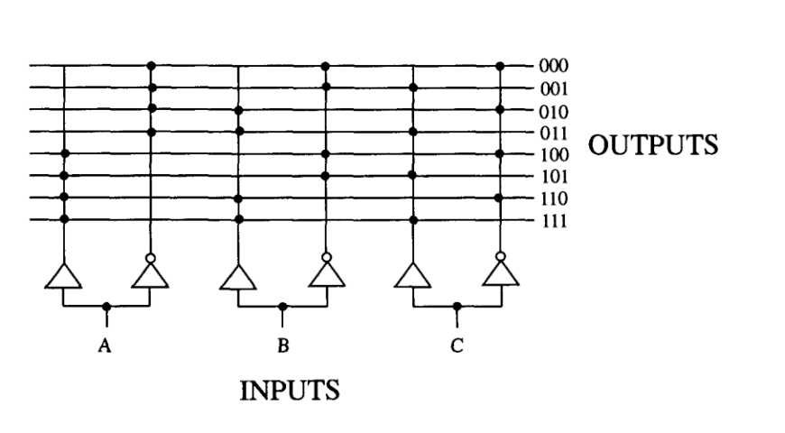
Decoder: n inputs, 2^{n} outputs
(Assign each 3 bit address to a
different line
e.g. Binary to Decimal)

Slide 6
Decoder: n inputs, 2^{n} outputs
(Convert Decimal into code
Identifies each A-B possibility)
Enable
A | B | D3 | D2 | D1 | D0
0 | 0 | 0 | 0 | 0 | 1
0 | 1 | 0 | 0 | 1 | 0
1 | 0 | 0 | 1 | 0 | 0
1 | 1 | 1 | 0 | 0 | 0
D0
A
D1
B
D2
D3
D0 = A NOR B = NOT(A) AND NOT(B)
D1 = NOT(A) AND B
D2 = A AND NOT(B)
D3 = A AND B
AND GATES

Slide 7
Multiple inputs-outputs
(n vs 2^{n})
Encoders vs Decoders
What if we have only 1 output line?
MUX/DEMUX

Slide 8
2x1 and 4x1 Multiplexer
(Selector – 1 output)
Control S
S0
S1
A
A
B
F
F
C
B
D
(S0,S1) = (0,0), F=A
(0,1), F=B
(1,0), F=C
(1,1), F=D
F = S0.S1.A + S0.S1.B + S0.S1.C + S0.S1.D
S=0, F=A
S=1, F=B
F = S.A + S.B

Slide 9
2x1 and 4x1 Multiplexer
(Selector – 1 output)
S0
S1
A
B
F
C
D
F = S0.S1.A + S0.S1.B + S0.S1.C + S0.S1.D

Slide 10
8 x 1 Multiplexer DEMUX
S0
S1
S2
S0
S1
S2
D0
D0
D1
D1
D2
D2
D3
D3
F
F
D4
D4
D5
D5
D6
D6
D7
D7

Slide 11
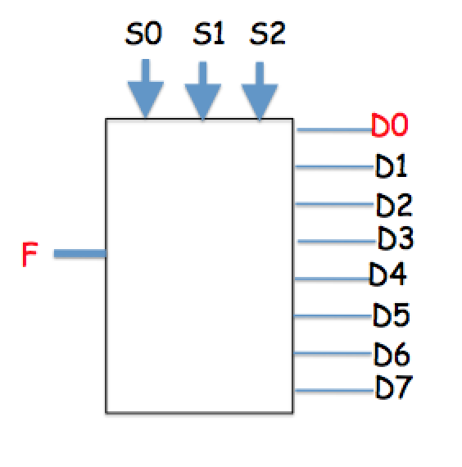
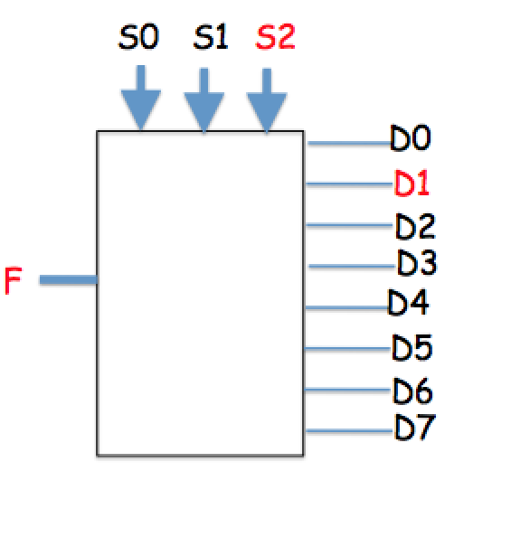
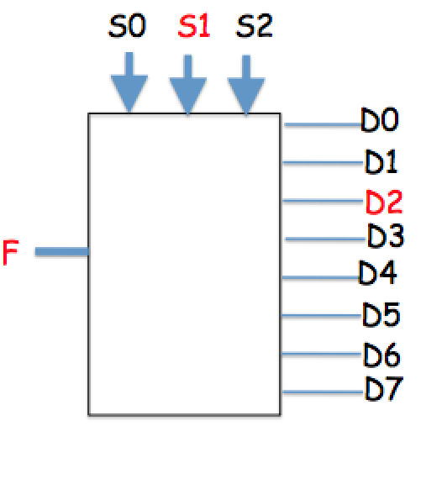
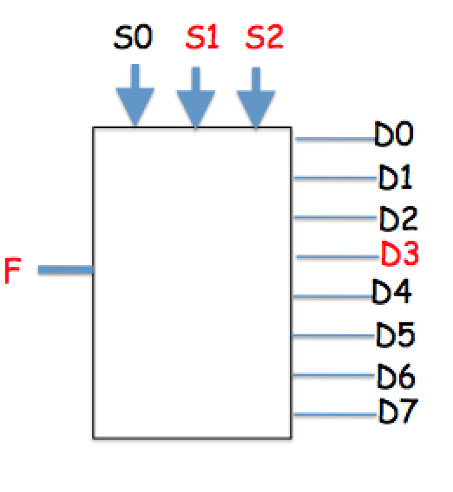
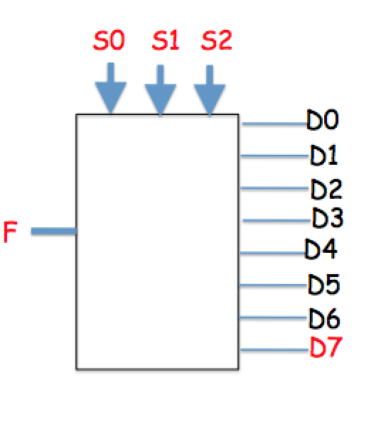
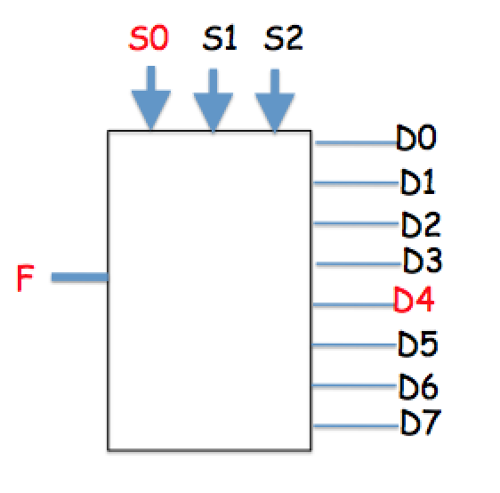
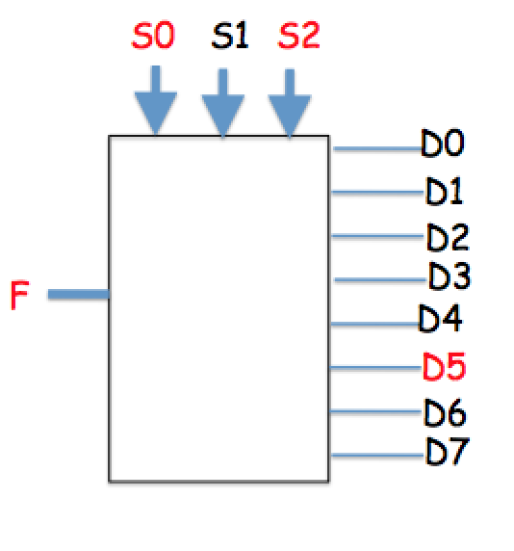
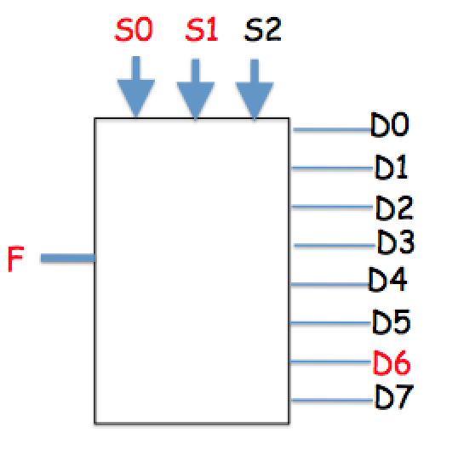
8 x 1 DEMUX

Slide 12
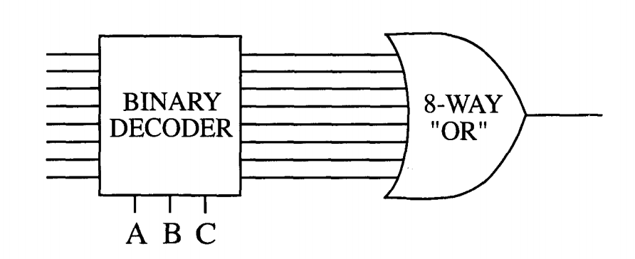
Multiplexer –
3 bit address code decides which input is transmitted
2^{N} MUX can implement any N input Boolean function

Slide 13
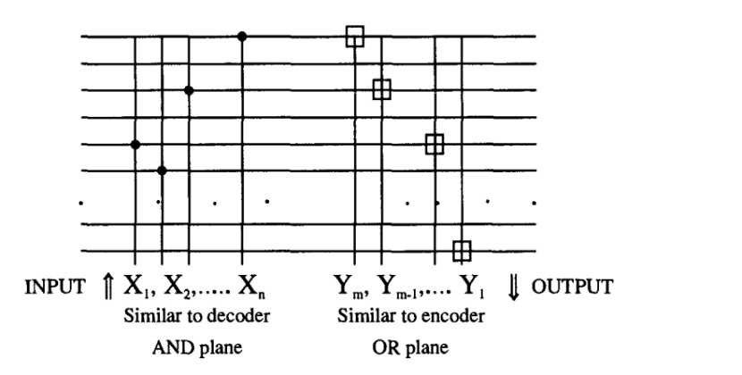
Universal Logic Function

Slide 14
Before we see how universal
logic is coded, let’s look at
memory

