Slide 1
2E. Memory

Slide 2
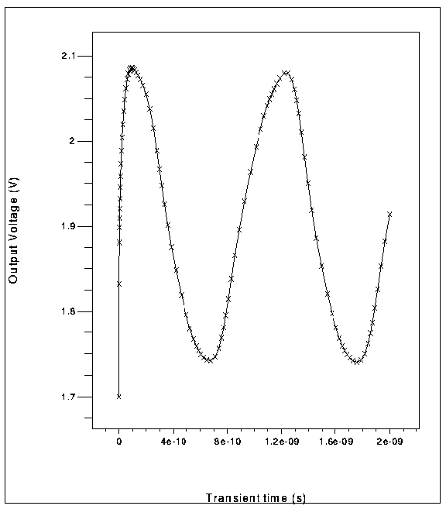
Odd # NOTs – oscillator; Even = memory
Odd Number with feedback – keeps changing
(Oscillator)
Even Number with feedback - Reaffirms (Memory)
Both need a clock to
control switching

Slide 3
Memory

