Slide 1
2F. Universal Logic

Slide 2
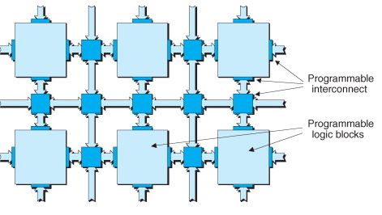
FPGAs
Inside FPGA → Each
‘universal Logic Function’ has two aspects:
Programmable logic block (PLB)
Programmable interconnect
their underlying fabric predominantly consists of large numbers of relatively simple programmable logic block “ islands ” embedded in a “ sea ” of programmable interconnect
Programmable logic block
Fine-grained Architecture
(universal gates like NAND, NOR)
Medium-grained Architecture
MUX/LUT
Coarse-grained Architecture
Configurability increases
Configurability decreases
Denser interconnect
Sparser interconnects

Slide 3
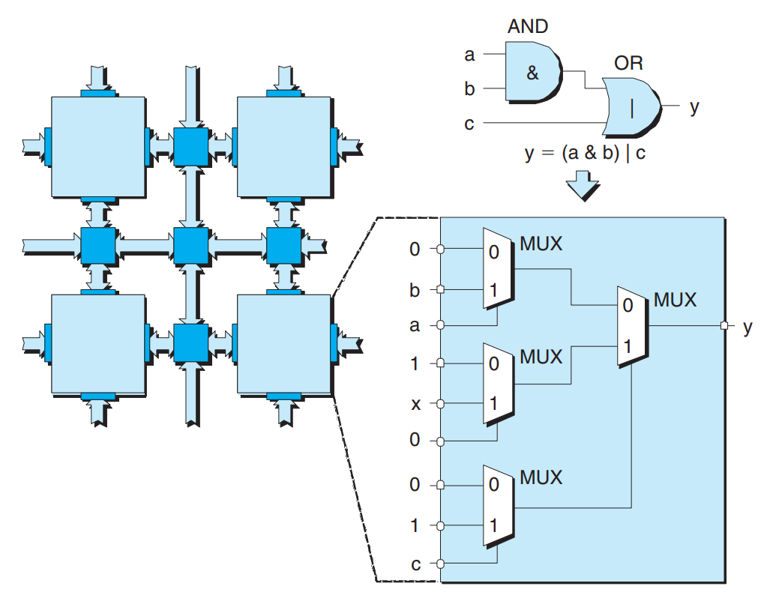
Medium Grained Architecture
MUX approach
each input to the block is presented with a 0, a 1, or the true or inverse version of a signal ( a , b , or c in this case) coming from another block or from a primary input to the device.
MUXes can be supplemented with registers to store a, b. Depending on the function, we update these. So while the MUX config is fixed, you can reprogram the inputs to get different outputs.

Slide 4
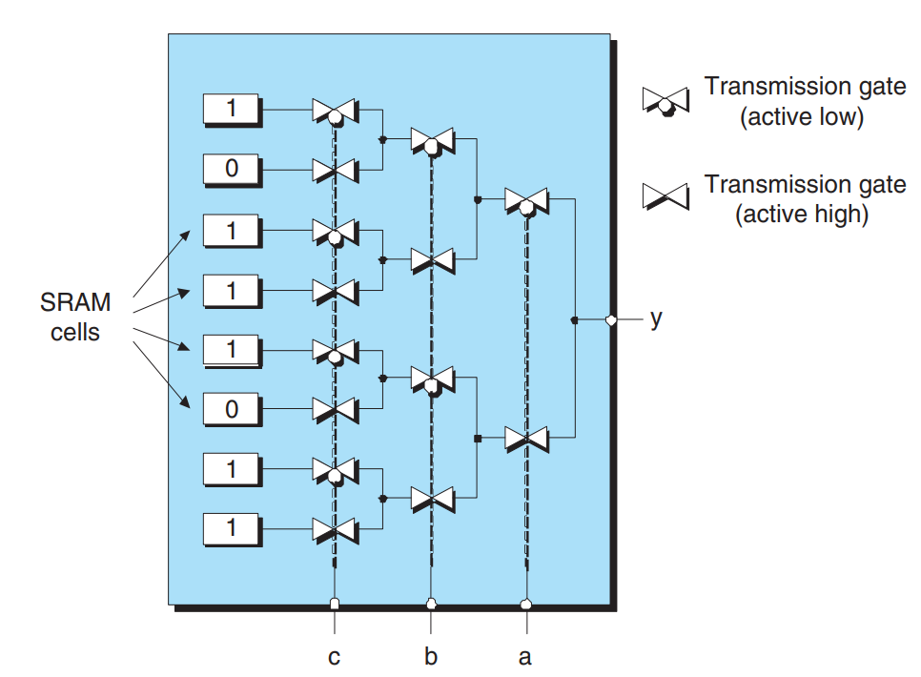
Medium Grained Architecture
LUT approach
A group of input signals → index (pointer) to a lookup table.
The contents of this table are arranged such that the cell pointed to by each input combination contains the desired value.
To implement:
load a 3-input LUT with the appropriate values into SRAM

Slide 5
MUX vs LUT
MUX PROs
MUX CONs
intermediate values are accessible from the signals linking the logic gates and the MUXes.
MUX logic chain → carry logic becomes slow
LUT PROs
LUT CONs
large complex circuit of logic gates → very efficient in terms of resource utilization and input-to-output delays (parallel)
to implement a small function(2-input AND gate), you’ll end up using an entire LUT to do so → wasteful
A LUT can be reconfigured to be used as RAM if needed

Slide 6
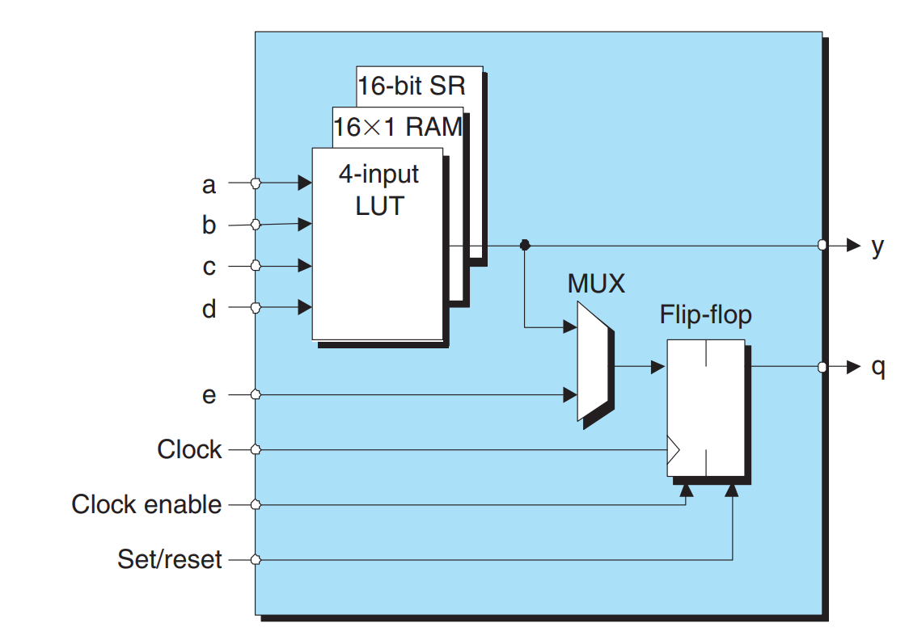
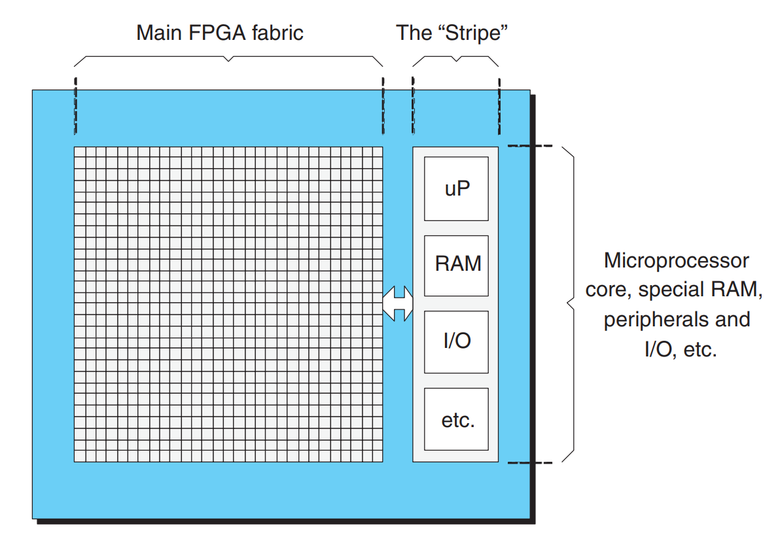
Coarse Grained Architecture
You have logic blocks/cells
Each block has its own little LUT, some RAM, a few MUXes etc.
They can also have dedicated multipliers/adders in each cell
Even a small microprocessor!
NOT DISCUSSED HERE:
Clock tree managers(manage all timing signals)
Softcore processors
Configurable I/O
IP(intellectual property) cores and their uses

Slide 7
In summary
Processors: AND/OR
Selectors: MUX/DEMUX, Encoders
Clocks: Shift Registers
Memory: Flip-Flops/Registers

Slide 8
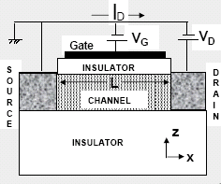
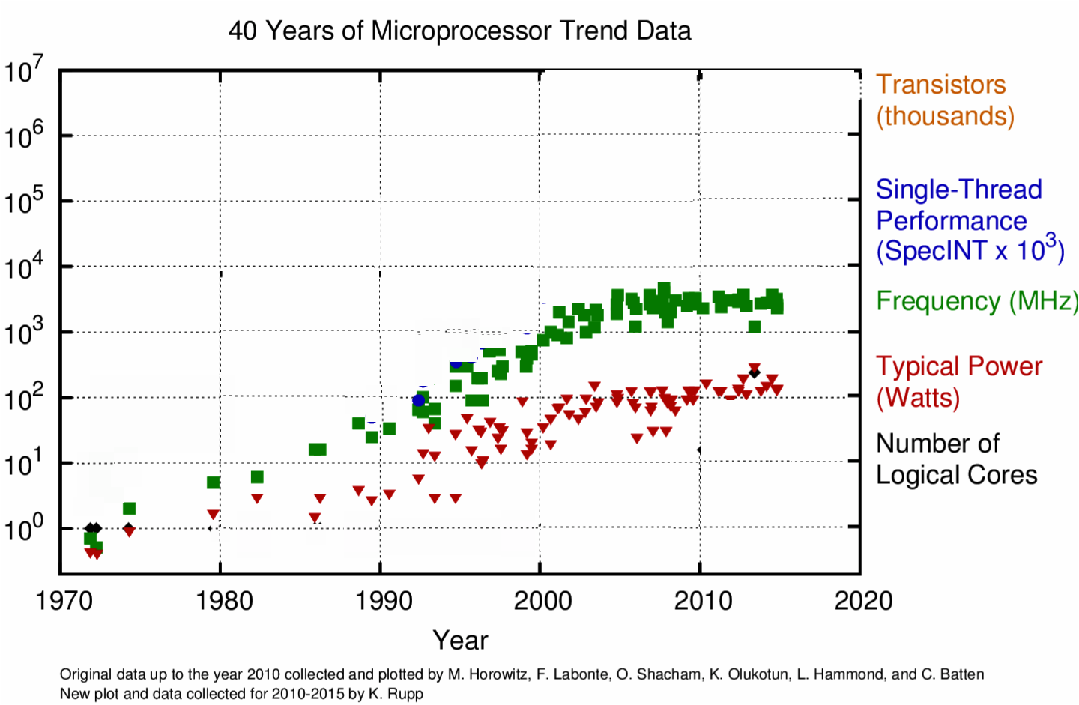
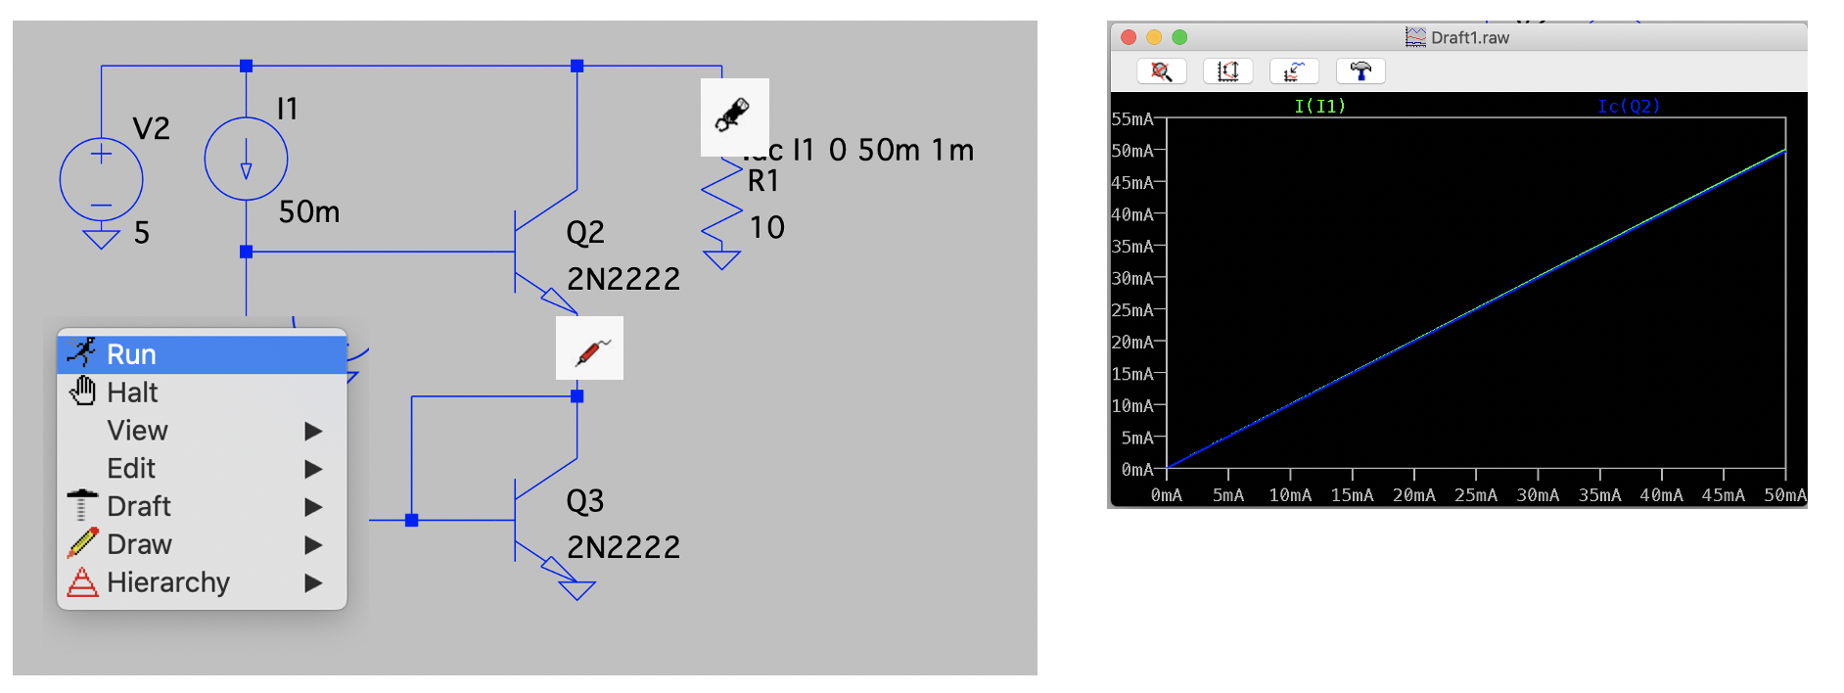
Next Lecture
How we add quickly
(Intro to CMOS)

