Slide 1
Fundamentals of Computing
Lec 2
How we add

Slide 2
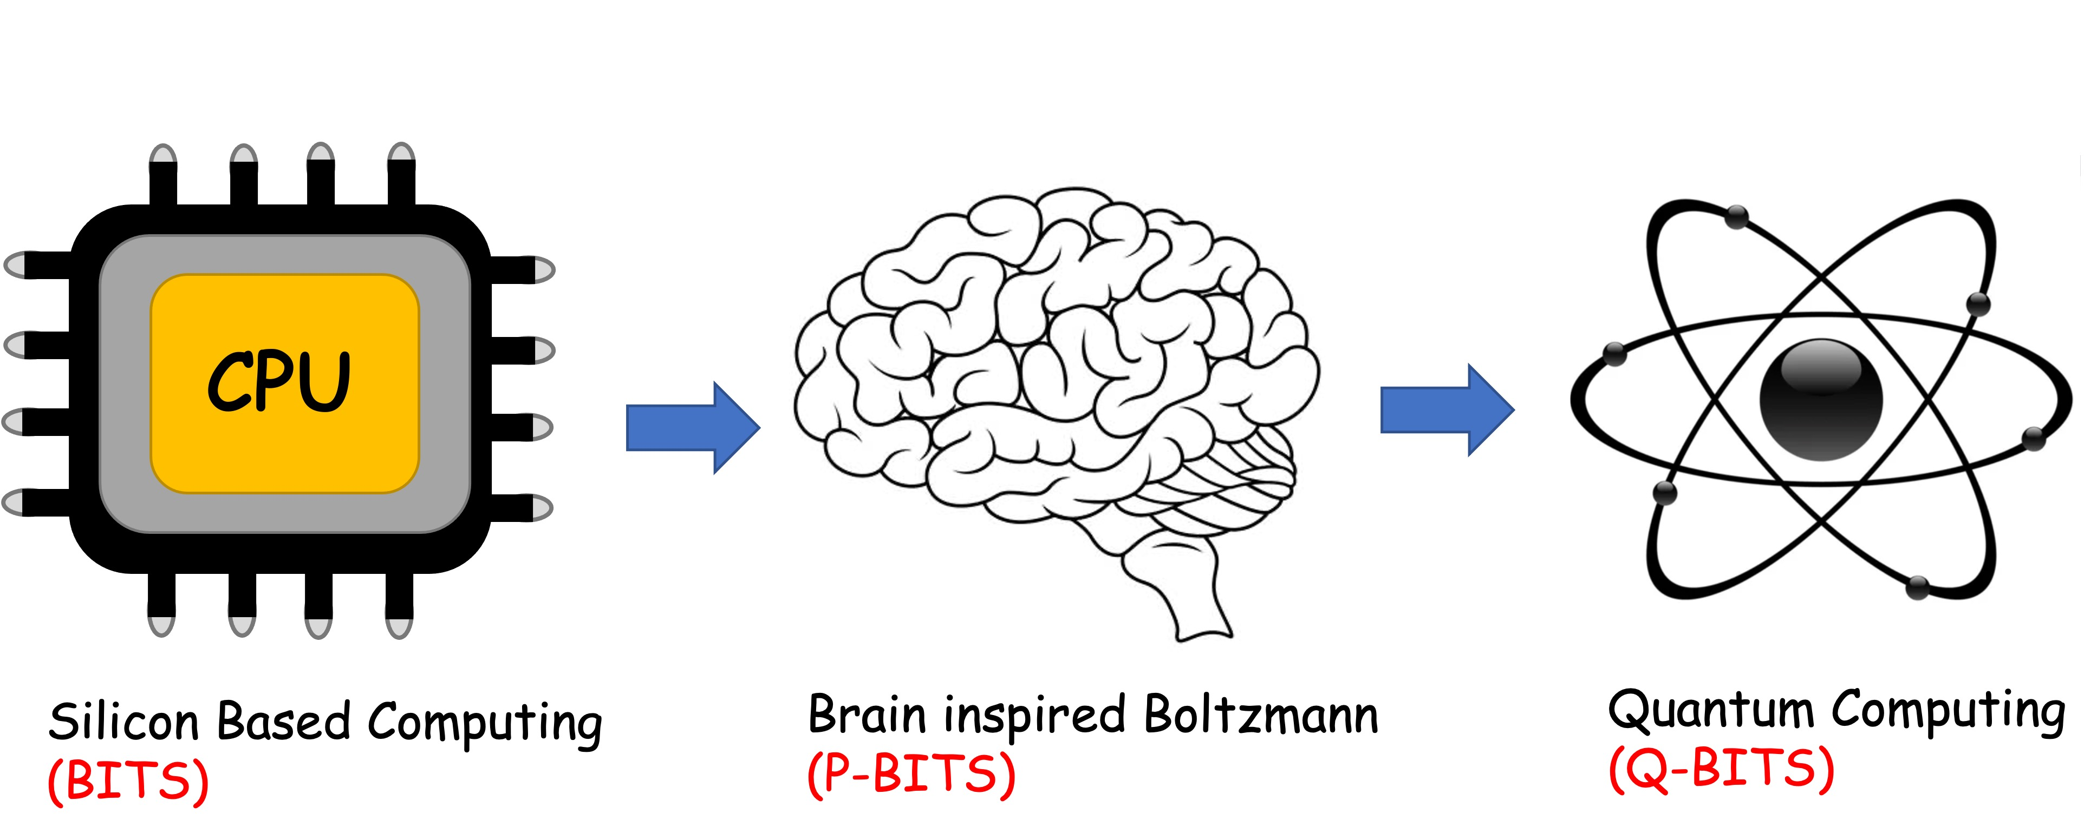
Overall structure of this course
Digital Computing in Silico
How we compute (algorithms)
How we add (Gates)
How we add quickly (CMOS)
Energy cost
How we fix errors
Analog Computing in Carbo
How we train (Supervision)
Physics of Neurons (Boltzmann)
How we learn (time sampling)
Optimizing and Classifying
Transition Theory & Inferencing
Quantum Computing in Magneto
Quantum Spins and Hardware
Quantum Physics
Entanglement and Superposition
Quantum Search and Annealing
Quantum Gates and Factorization

Slide 3
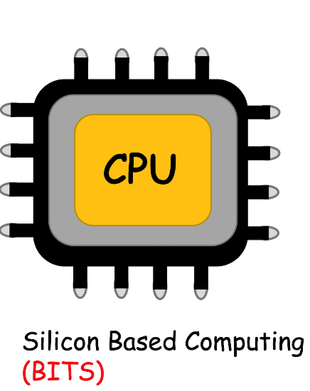

Slide 4
Neuron
Synapse
W.x
How to add?

Slide 5
2A. Elementary gates for addition

Slide 6
99 + 55 = ?
1. Encoder
9 → 1001, 5→ 0101
2. Processor
Col1: 9 + 5 = 14 (store 4 carry 1)
Col2: 9 + 5 = 14 + 1 = 15
Answer: 154 → 10011010
3. Decoder
10011010 → 154
4. Memory
Instruction sets (how to add), address, data upload/download
5. Clocks for synchronizing
6. Multiplexers for routing and Programmable Logic
¹
¹
99
+ 55
154

Slide 7
To control these operations,
we need gates

Slide 8
Simple gate: an inverter
1-input 1-output
in
out
NOT
in
out
0
1
1
0

Slide 9
2-input Logic Gates
OR
AND
A
A
A⋂B
A U B
B
B
A
B
A ⋂ B
A
B
A U B
0
0
0
0
0
0
0
1
0
0
1
1
1
0
0
1
0
1
1
1
1
1
1
1

Slide 10
2-input 1-output Logic Gates
NAND (A ⩃ B)
NOR (A ⩂ B)
XOR (A ⨁ B)
0
0
1
0
0
1
0
0
0
0
1
1
0
1
0
0
1
1
1
0
1
1
0
0
1
0
1
1
1
0
1
1
0
1
1
0

Slide 11
Other Logic Gates
Exchange
Fanout/
Copy

Slide 12
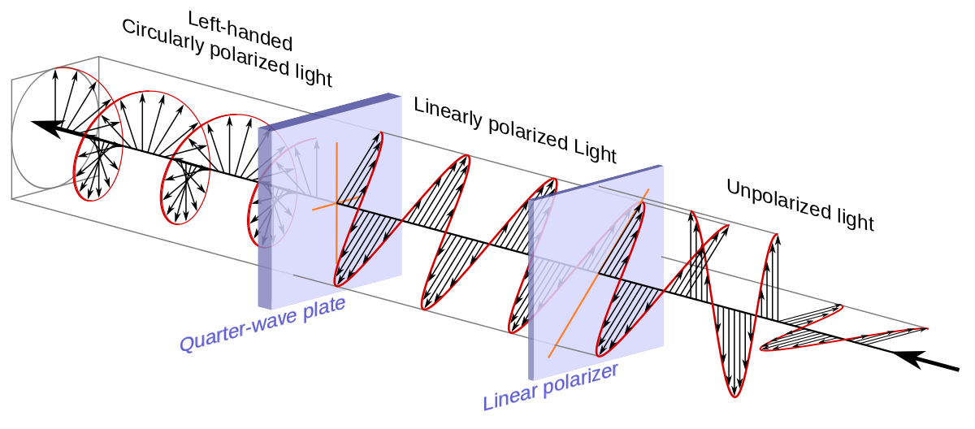
Quantum Logic Gates
Hadamard
(Quantum Superposition)
Boolean does not allow mixtures
(it’s either-or)

Slide 13
Quantum Logic Gates

Slide 14
Quantum Logic Gates

Slide 15
Classical Logic Gates

Slide 16
Quantum Logic Gates
Hadamard
(Quantum Superposition)
Boolean does not allow mixtures
(it’s either-or)

Slide 17
Quantum Logic Gates
Hadamard
(Quantum Superposition)
Reversible Gate

Slide 18
Irreversible gates
It is not reversible because you are
discarding information from input to output !!

Slide 19
Reversible gates
It is not reversible because you are
discarding information from input to output !!

Slide 20
How many flavors of logic gates do we need?

Slide 21
To be Universal
Must block an
input (e.g. A)
Here output ignores A
A
Only
Dep on
B
B = 0 or 1
Must generate
a NOT
A
A

Slide 22
NAND is universal
A
A
A
B
NAND
NOT
AND = NOT(NAND)
B=0, output = 1 independent of A (blocks A)

Slide 23
NAND is universal
A
B
NAND
A
A
A OR
B
B
B
A OR B = [A ⩃ B]
Come Rain or Shine = Not(rainless and shineless)

Slide 24
2B. Binary representation

Slide 25
Write down truth table
Write in terms of known gates

Slide 26
0
1
2
3
4
5
6
7
8
9
1
0
1
2
3
4
5
6
7
8
9
1
0
0
0
0
0
0
0
0
0
0
0
1
2
3
4
5
6
7
8
9

Slide 27
10 finger counting
1234
= 1 x 10³ + 2 x 10² + 3 x 10¹ + 4 x 10⁰

Slide 28
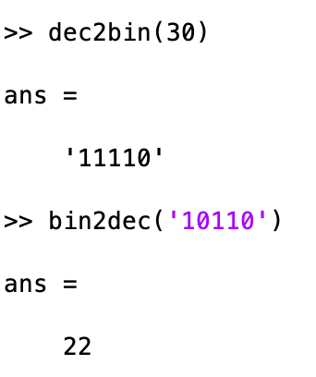
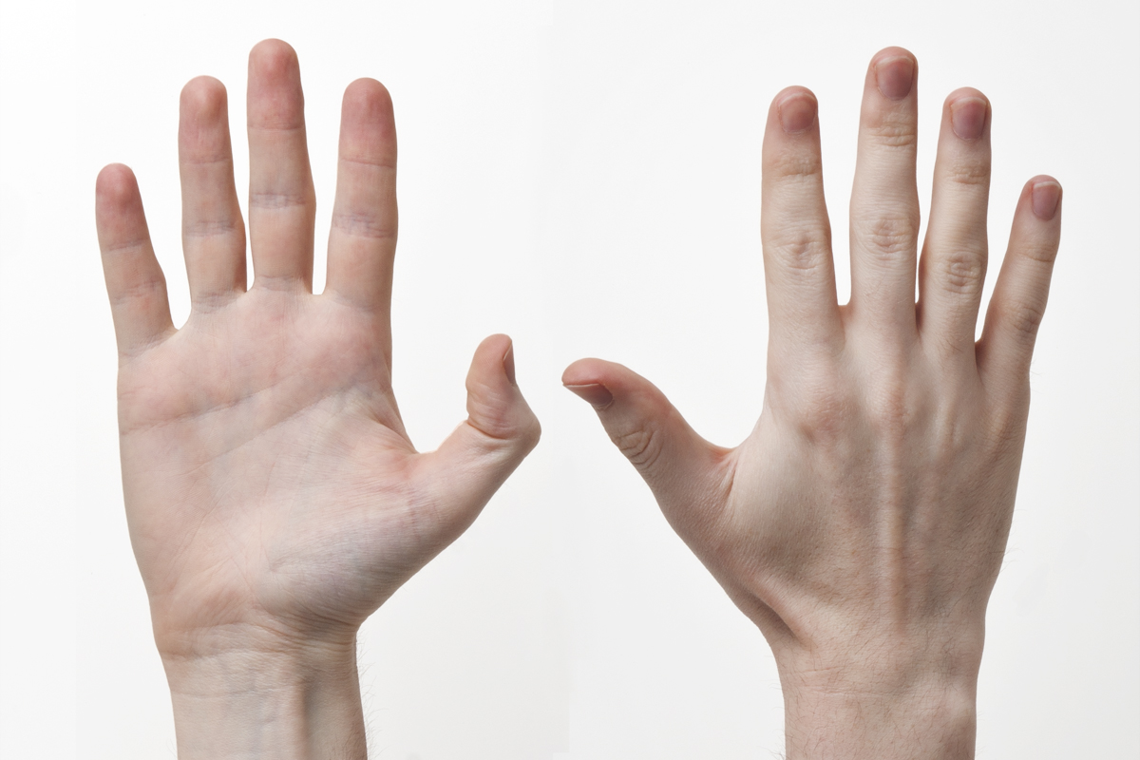
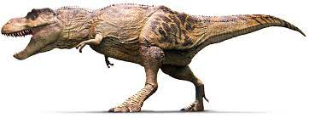
(10 finger to 2 finger logic)
7 = 0111
= 0 x 2³ + 1 x 2² + 1 x 2¹ + 1 x 2⁰
MATLAB
5 = 0101
12 = 1100

Slide 29
10 finger addition
1 2 3 4
+ 2 1 5 7
-----------

Slide 30
4 Bit Adder
7 = 0 1 1 1
5 = 0 1 0 1
12 =
1
¹ 0
¹ 1
¹ 0
2 = 10
2 = 10
3 = 11
1 = 01

Slide 31
Half-Adder
A
CARRY = AND = A ⋂ B
B
SUM = XOR = A ⨁ B
A
B
CARRY
SUM
0
0
0
0
0
0
1
0
1
1
1
0
0
1
1
1
1
1
0
2

Slide 32
Full-Adder
(include previous carry
as extra input)
C_{in} | A | B | C_{out} | S
0 | 0 | 0 | 0 | 0
0 | 0 | 1 | 0 | 1
0 | 1 | 0 | 0 | 1
0 | 1 | 1 | 1 | 0
1 | 0 | 0 | 0 | 1
1 | 0 | 1 | 1 | 0
1 | 1 | 0 | 1 | 0
1 | 1 | 1 | 1 | 1
A
Sum
S
B
Carry
C_{out}
C_{in}
S = A + B + C_{in}
C_{out} = (A ⋂ B) U (B ⋂ C) U (A ⋂ C)

Slide 33
C_{in}
2 Bit Adder
A
SUM = A XOR B
XOR C_{i}
B
CARRY =
(A ⋂ B)U(B ⋂ C_{in})U(A ⋂ C_{in})

Slide 34
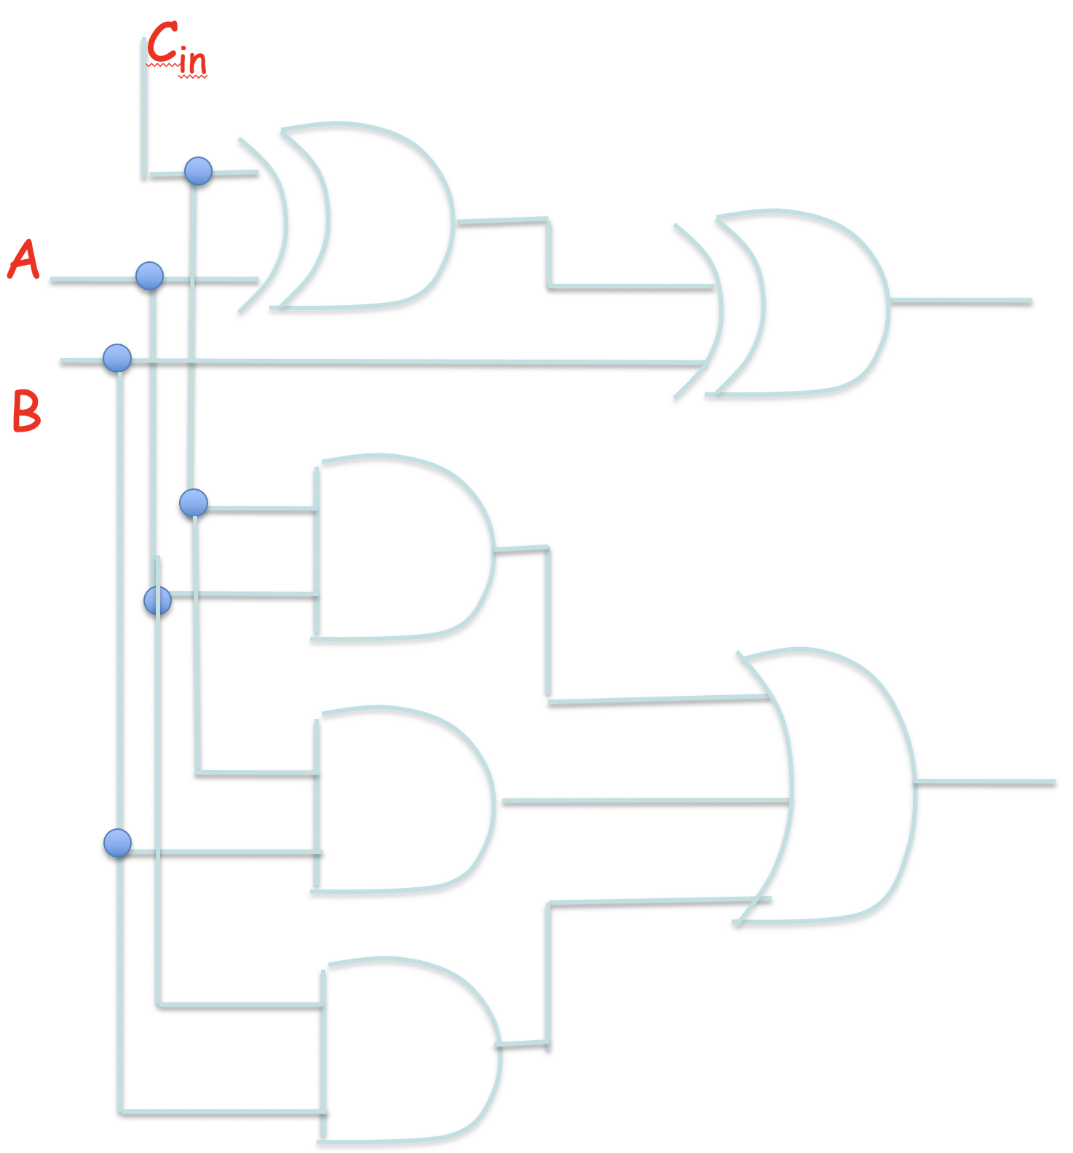
32 Bit Adder
+

Slide 35
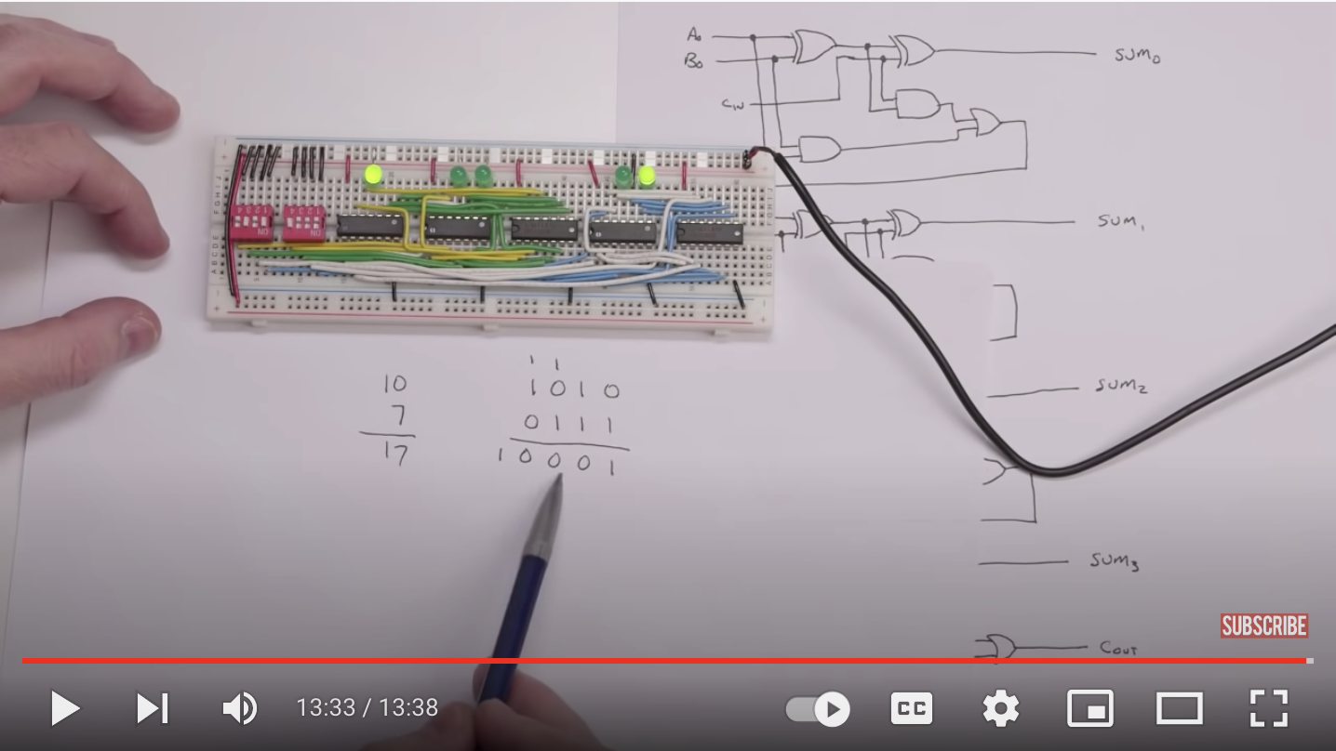
https://www.youtube.com/watch?time_continue=818&v=wvJc9CZcvBc&feature=emb_logo

Slide 36
2C Signed addition (Negative numbers)

Slide 37
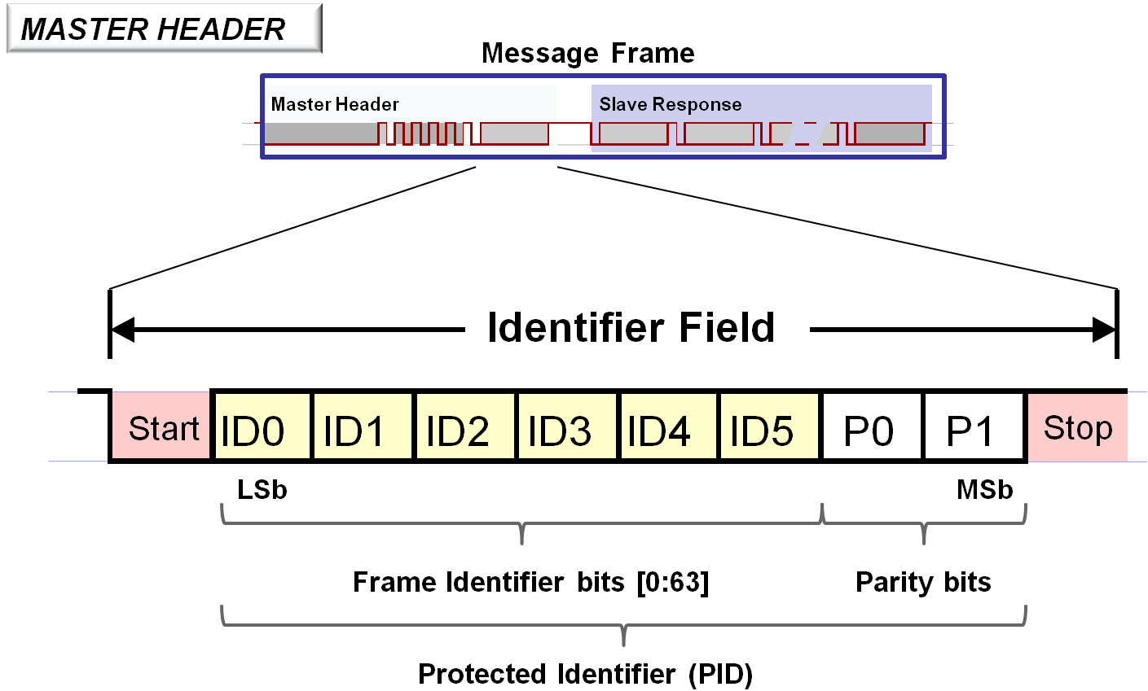
Designate a bit as ‘sign bit’
28 = 00011100
-28 = 10011100 ????
No because sum does not give 00000000 !!!
https://microchipdeveloper.com/lin:protocol-dll-lin-message-frame

Slide 38
28 = 00011100
TO GET NEGATIVE of ABCDEFGH,
WE NEED TO SUBTRACT FROM 0
00000000
-ABCDEFGH
SINCE WE DROP 9TH BIT, WE MIGHT AS WELL DO
100000000
-ABCDEFGH

Slide 39
But 100000000
= 11111111 + 1
AND
11111111
-ABCDEFGH
IS SIMPLY FLIPPING DIGITS OF ABCDEFGH
e.g. 1-0 = 1
1-1 = 0

Slide 40
THUS TWO’S COMPLEMENT: FLIP AND ADD 1
(1st DIGIT 0 means +, 1 means -)
-28 = 11100011+1
= 11100100

Slide 41
TO READ
Just binary → decimal, except first unit is subtracted
11100100
- 2⁷ x 1 + 2⁶ x 1 + 2⁵ x 1 + 2⁴ x 0 + 2³ x 0 + 2² x 1 + 2¹ x 0 + 2⁰ x 0
= -128 + 64 + 32 + 0 + 0 + 4 + 0 + 0 = -28

Slide 42
TO FLIP BACK
DO TWOS COMPLEMENT AGAIN
LEFTMOST BIT is still sign
00011011+1
= 00011100

Slide 43
32 Bit
Signed
Adder

Slide 44
Aside: Digital Multiply
11010
X 1111
-----------
11010
11010
11010
11010
-----------
COPY & SHIFT
+
101110110

Slide 45
Multiply
11010
X 1001
-----------
11010
00000
00000
11010
-----------
COPY
NO COPY
+
101110110
In practice, Booth algorithm to minimize copies

Slide 46
2D.
Interfaces and Routing:
Encoder-Decoder
MUX-DEMUX

Slide 47
OK, so we know how to add in binary.
But how do we convert between decimal
& binary in the first place?
And how do we send multiple answers
on the same line without blowing up
I/O ports?

Slide 48
Encoder: 2^{n} inputs, n outputs
Decimal to binary
0
1
2
3
0
Enable
0
D0
0
1
2
3
0
0
A
1
D1
1
0
1
2
3
1
2
B
0
D2
0
1
2
3
1
3
D3
1

Slide 49
Encoder: 2^{n} inputs, n outputs
D0 | D1 | D2 | D3 | A | B
1 | 0 | 0 | 0 | 0 | 0
0 | 1 | 0 | 0 | 0 | 1
0 | 0 | 1 | 0 | 1 | 0
0 | 0 | 0 | 1 | 1 | 1
Enable
D0
A
D1
B
D2
A = D2 + D3 = NOT(XOR(D₀,D₁))
B = D1 + D3
OR GATES
D3

Slide 50
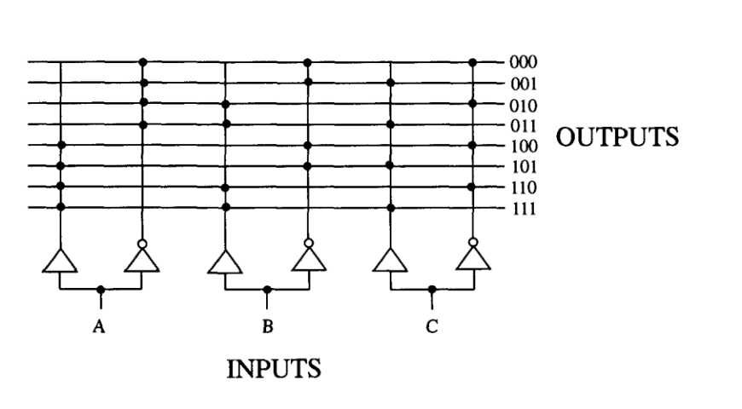
Decoder: n inputs, 2^{n} outputs
(Assign each 3 bit address to a
different line
e.g. Binary to Decimal)

Slide 51
Decoder: n inputs, 2^{n} outputs
(Convert Decimal into code
Identifies each A-B possibility)
Enable
A | B | D3 | D2 | D1 | D0
0 | 0 | 0 | 0 | 0 | 1
0 | 1 | 0 | 0 | 1 | 0
1 | 0 | 0 | 1 | 0 | 0
1 | 1 | 1 | 0 | 0 | 0
D0
A
D1
B
D2
D3
D0 = A NOR B = NOT(A) AND NOT(B)
D1 = NOT(A) AND B
D2 = A AND NOT(B)
D3 = A AND B
AND GATES

Slide 52
Multiple inputs-outputs
(n vs 2^{n})
Encoders vs Decoders
What if we have only 1 output line?
MUX/DEMUX

Slide 53
2x1 and 4x1 Multiplexer
(Selector – 1 output)
Control S
S0
S1
A
A
B
F
F
C
B
D
(S0,S1) = (0,0), F=A
(0,1), F=B
(1,0), F=C
(1,1), F=D
F = S0.S1.A + S0.S1.B + S0.S1.C + S0.S1.D
S=0, F=A
S=1, F=B
F = S.A + S.B

Slide 54
2x1 and 4x1 Multiplexer
(Selector – 1 output)
S0
S1
A
B
F
C
D
F = S0.S1.A + S0.S1.B + S0.S1.C + S0.S1.D

Slide 55
8 x 1 Multiplexer DEMUX
S0
S1
S2
S0
S1
S2
D0
D0
D1
D1
D2
D2
D3
D3
F
F
D4
D4
D5
D5
D6
D6
D7
D7

Slide 56
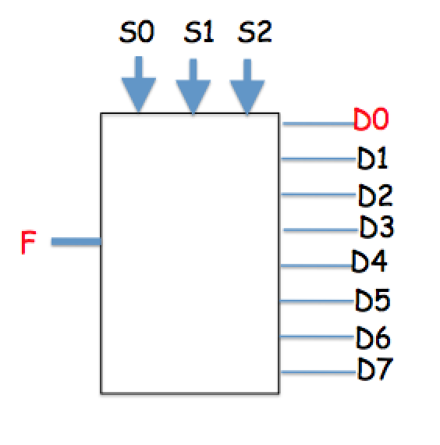
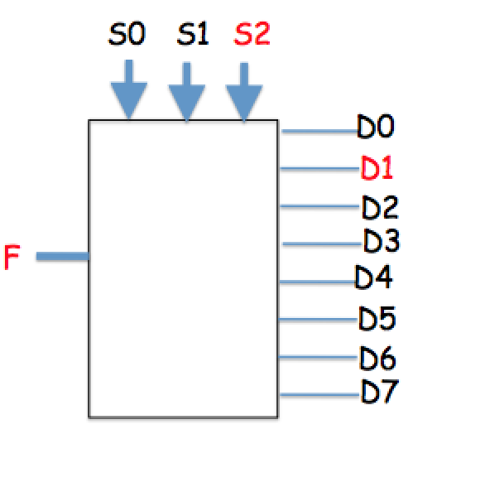
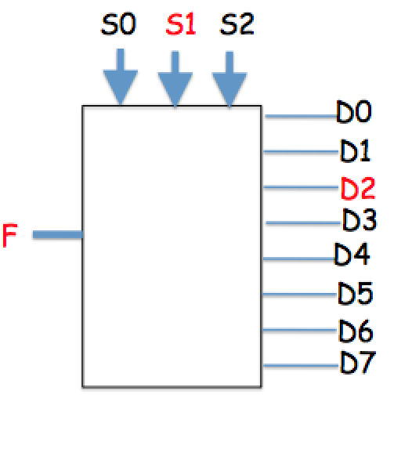
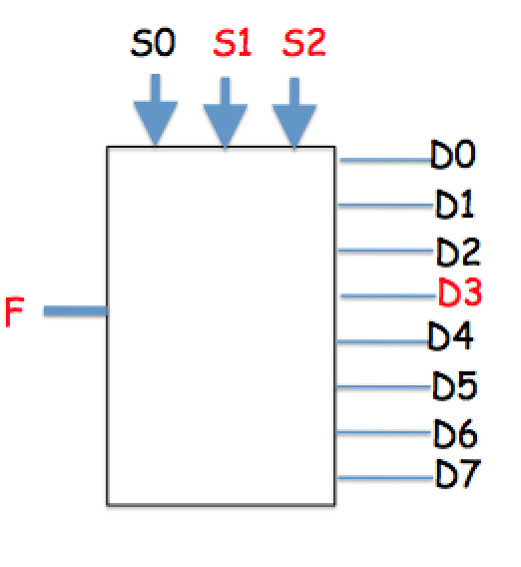
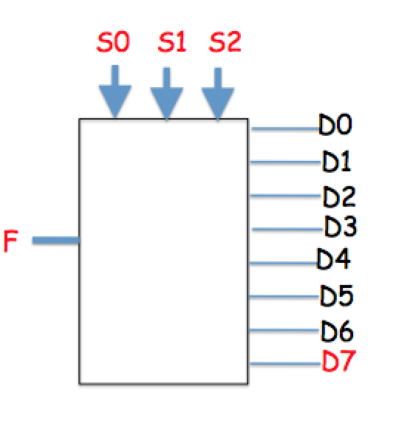
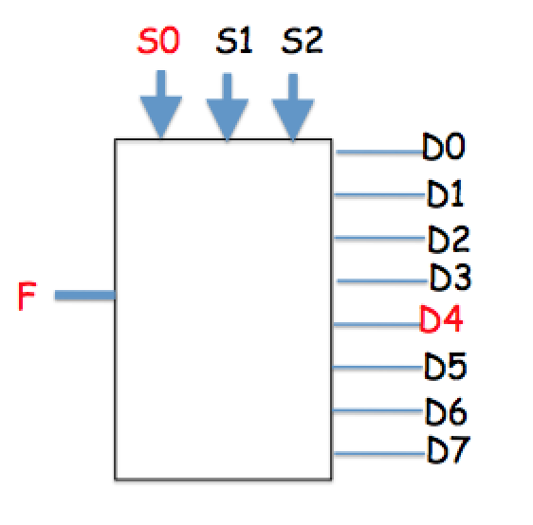
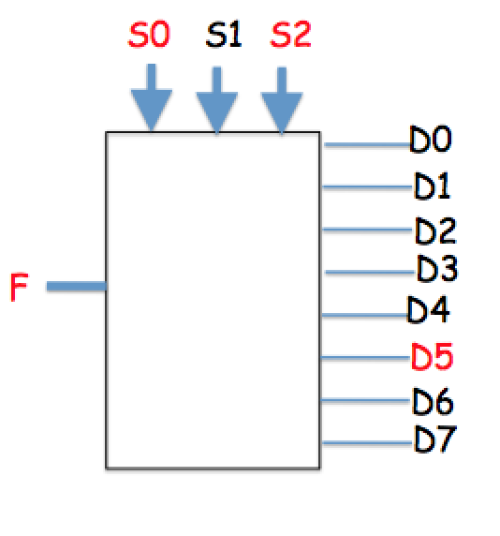
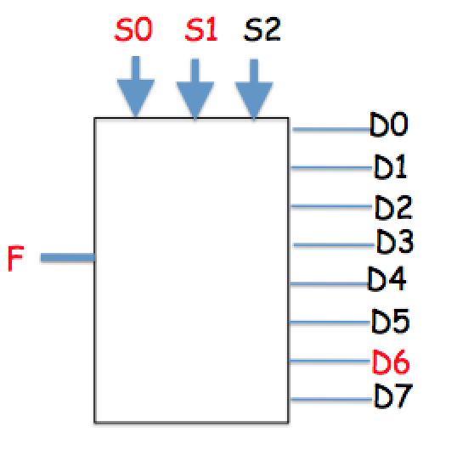
8 x 1 DEMUX

Slide 57
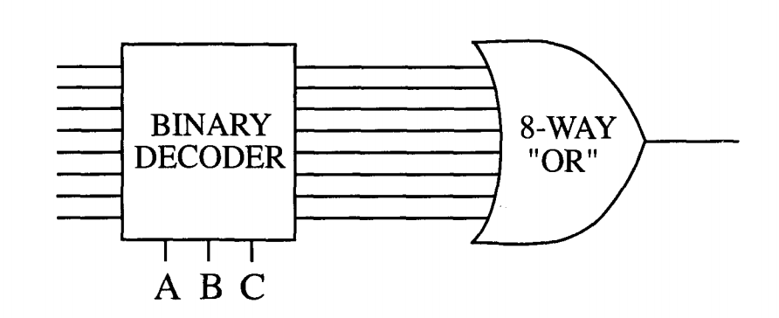
Multiplexer –
3 bit address code decides which input is transmitted
2^{N} MUX can implement any N input Boolean function

Slide 58
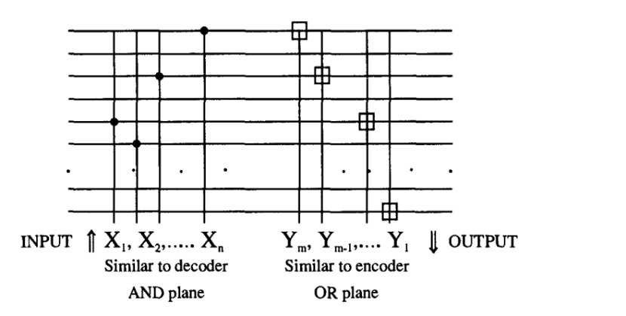
Universal Logic Function

Slide 59
Before we see how universal
logic is coded, let’s look at
memory

Slide 60
2E. Memory

Slide 61
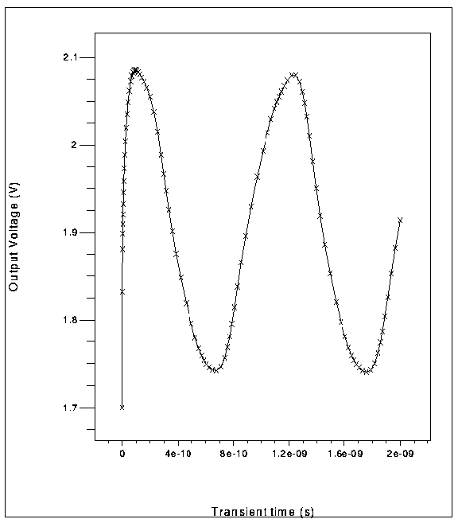
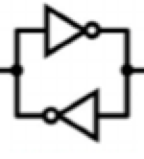
Odd # NOTs – oscillator; Even = memory
Odd Number with feedback – keeps changing
(Oscillator)
Even Number with feedback - Reaffirms (Memory)
Both need a clock to
control switching

Slide 62
Memory

Slide 66
2F. Universal Logic

Slide 67
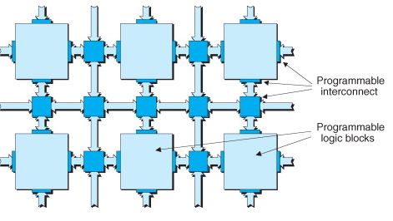
FPGAs
Inside FPGA → Each
‘universal Logic Function’ has two aspects:
Programmable logic block (PLB)
Programmable interconnect
their underlying fabric predominantly consists of large numbers of relatively simple programmable logic block “ islands ” embedded in a “ sea ” of programmable interconnect
Programmable logic block
Fine-grained Architecture
(universal gates like NAND, NOR)
Medium-grained Architecture
MUX/LUT
Coarse-grained Architecture
Configurability increases
Configurability decreases
Denser interconnect
Sparser interconnects

Slide 68
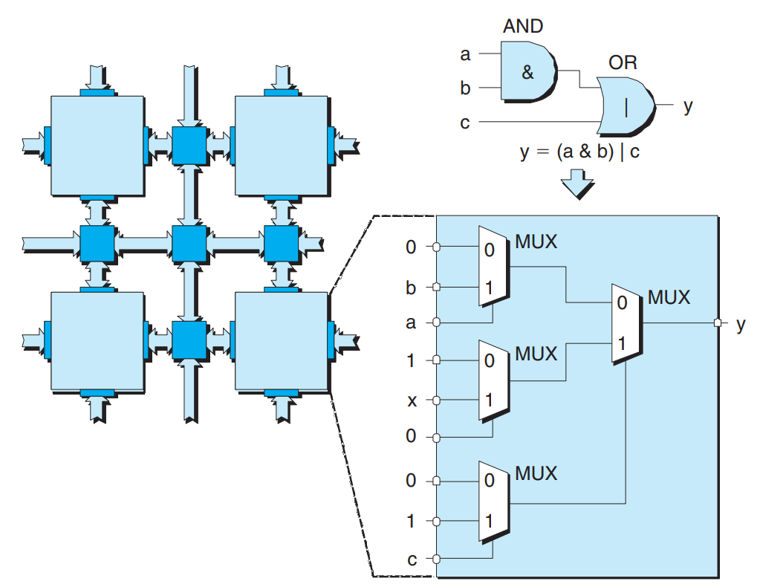
Medium Grained Architecture
MUX approach
each input to the block is presented with a 0, a 1, or the true or inverse version of a signal ( a , b , or c in this case) coming from another block or from a primary input to the device.
MUXes can be supplemented with registers to store a, b. Depending on the function, we update these. So while the MUX config is fixed, you can reprogram the inputs to get different outputs.

Slide 69
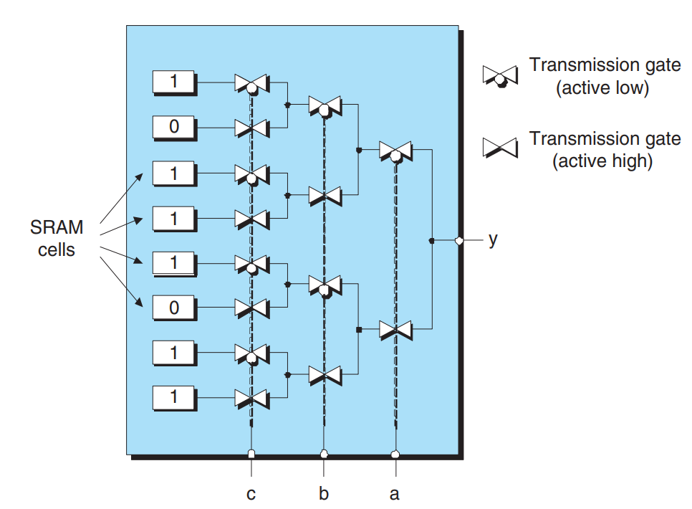
Medium Grained Architecture
LUT approach
A group of input signals → index (pointer) to a lookup table.
The contents of this table are arranged such that the cell pointed to by each input combination contains the desired value.
To implement:
load a 3-input LUT with the appropriate values into SRAM

Slide 70
MUX vs LUT
MUX PROs
MUX CONs
intermediate values are accessible from the signals linking the logic gates and the MUXes.
MUX logic chain → carry logic becomes slow
LUT PROs
LUT CONs
large complex circuit of logic gates → very efficient in terms of resource utilization and input-to-output delays (parallel)
to implement a small function(2-input AND gate), you’ll end up using an entire LUT to do so → wasteful
A LUT can be reconfigured to be used as RAM if needed

Slide 71
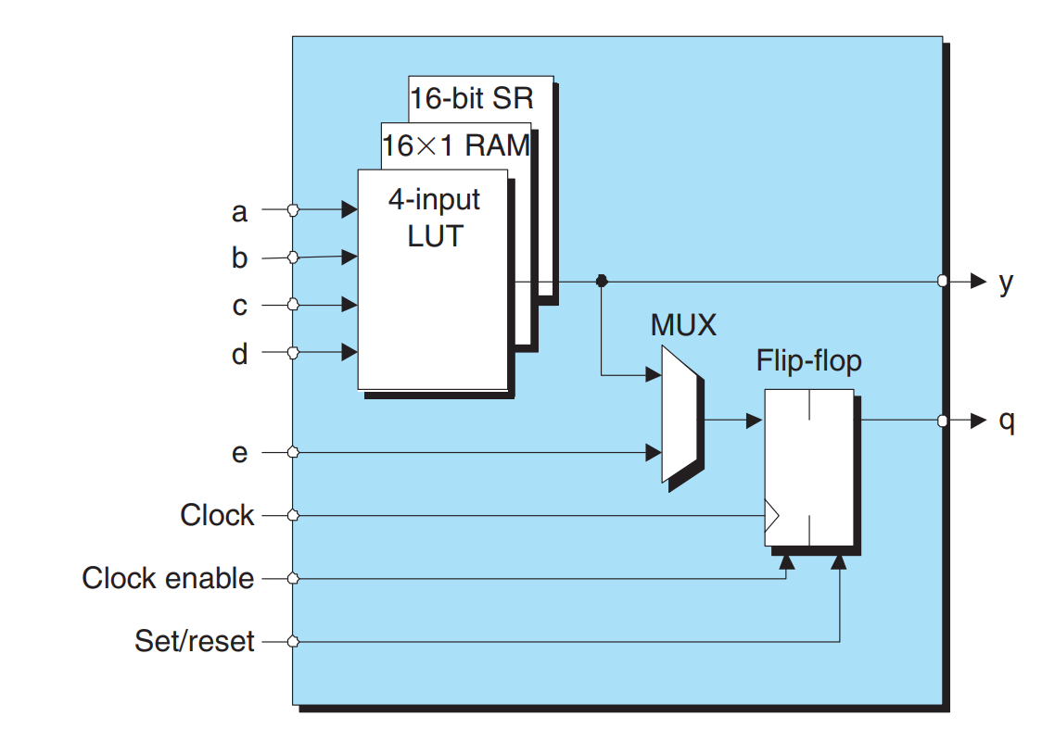
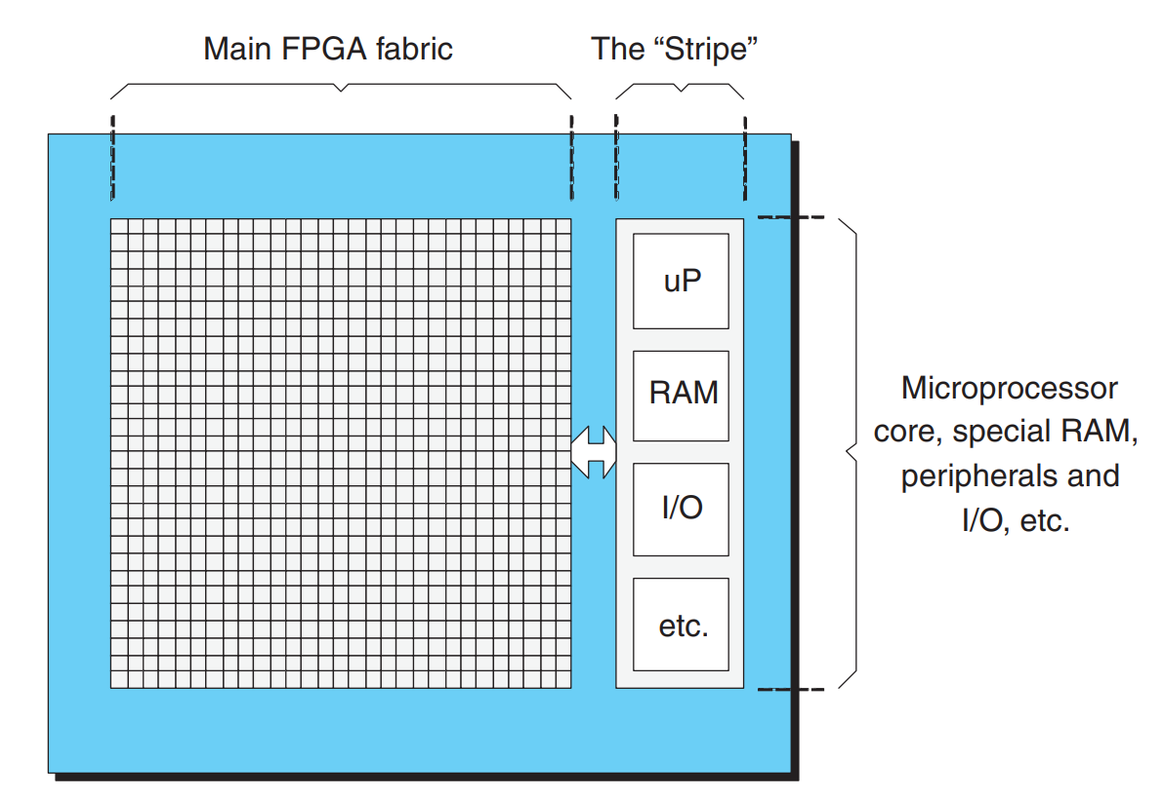
Coarse Grained Architecture
You have logic blocks/cells
Each block has its own little LUT, some RAM, a few MUXes etc.
They can also have dedicated multipliers/adders in each cell
Even a small microprocessor!
NOT DISCUSSED HERE:
Clock tree managers(manage all timing signals)
Softcore processors
Configurable I/O
IP(intellectual property) cores and their uses

Slide 72
In summary
Processors: AND/OR
Selectors: MUX/DEMUX, Encoders
Clocks: Shift Registers
Memory: Flip-Flops/Registers

Slide 73
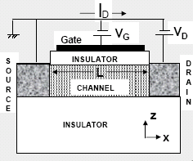
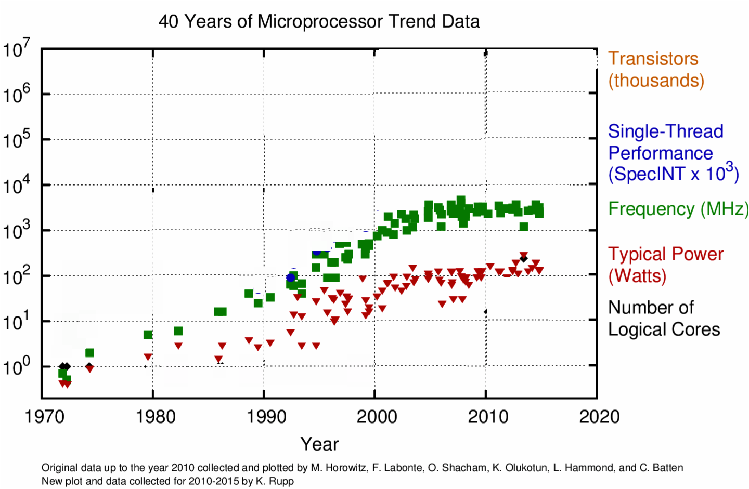
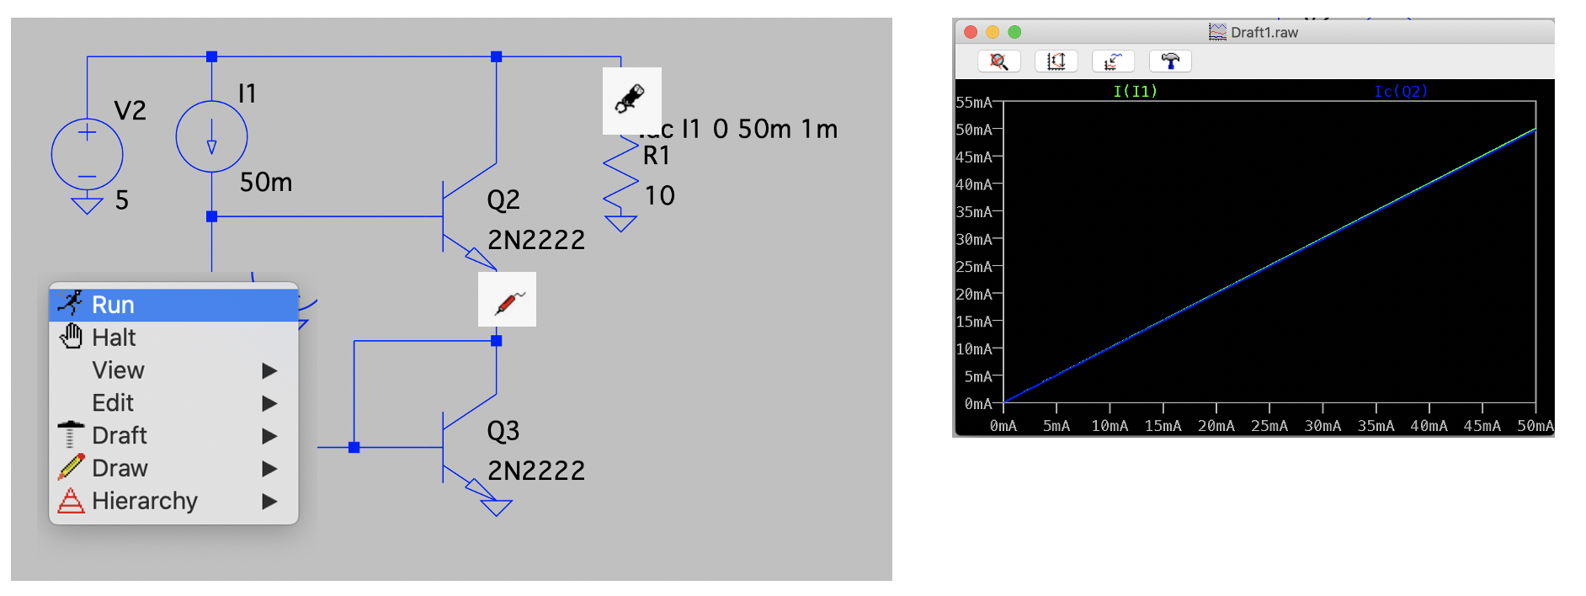
Next Lecture
How we add quickly
(Intro to CMOS)

