Slide 1
Fundamentals of Computing
Lec 3
How we add quickly

Slide 2
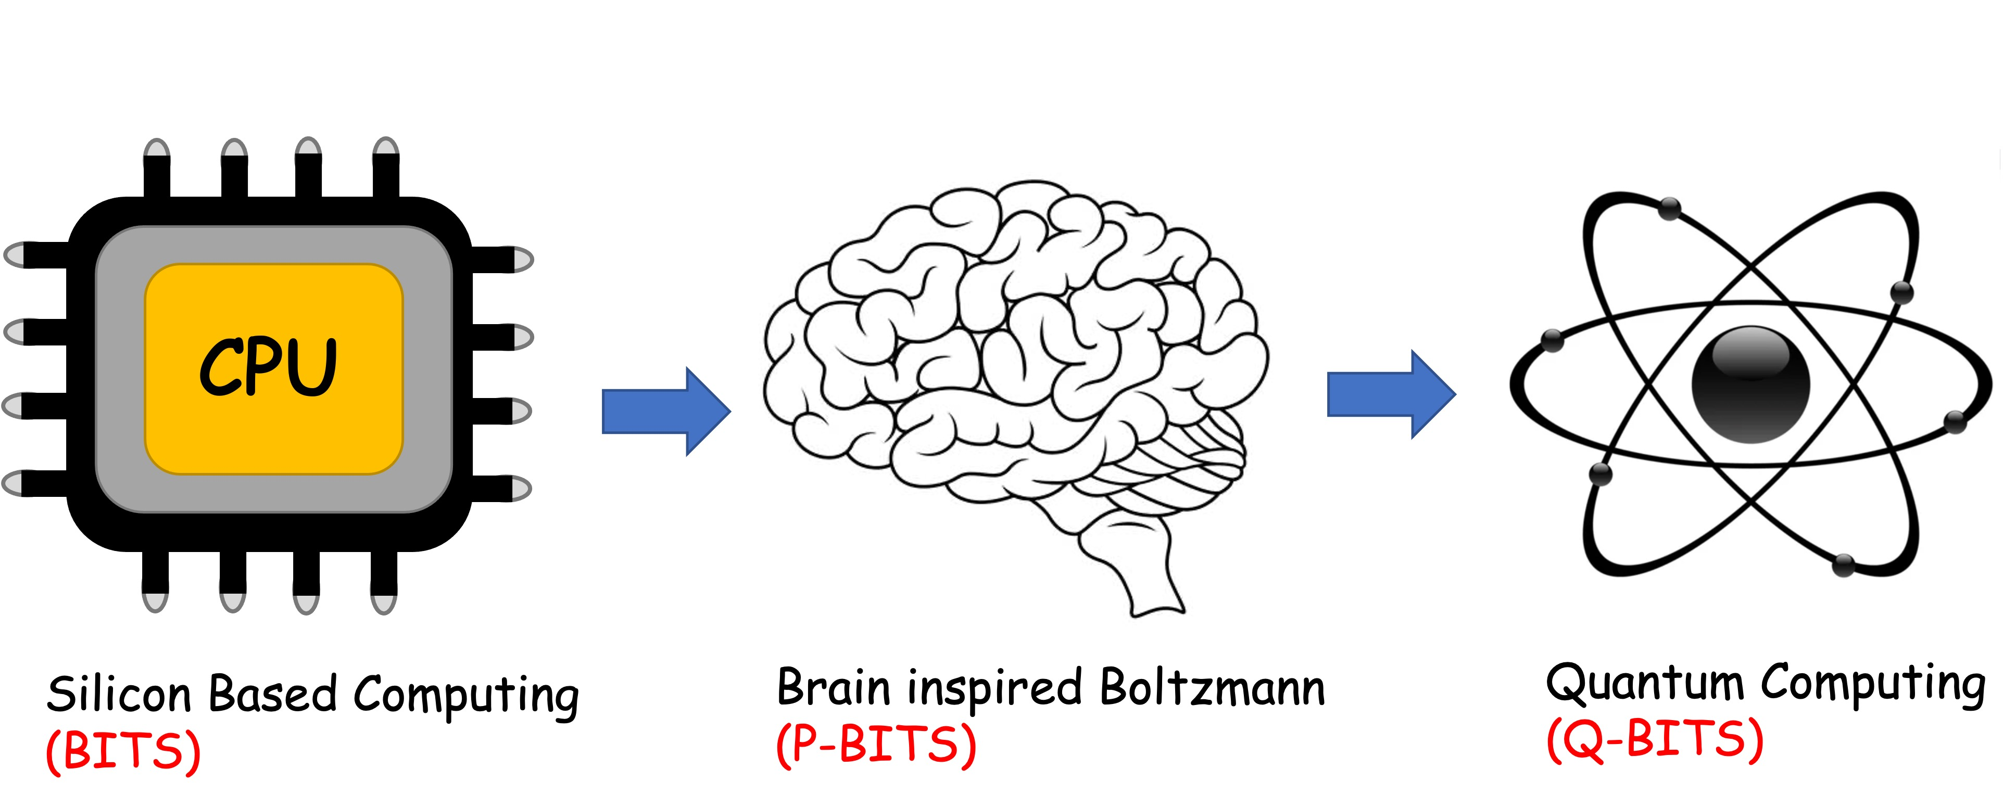
Overall structure of this course
Digital Computing in Silico
How we compute (algorithms)
How we add (Gates)
How we add quickly (CMOS)
Energy cost
How we fix errors
Analog Computing in Carbo
How we train (Supervision)
Physics of Neurons (Boltzmann)
How we learn (time sampling)
Optimizing and Classifying
Transition Theory & Inferencing
Quantum Computing in Magneto
Quantum Spins and Hardware
Quantum Physics
Entanglement and Superposition
Quantum Search and Annealing
Quantum Gates and Factorization

Slide 3
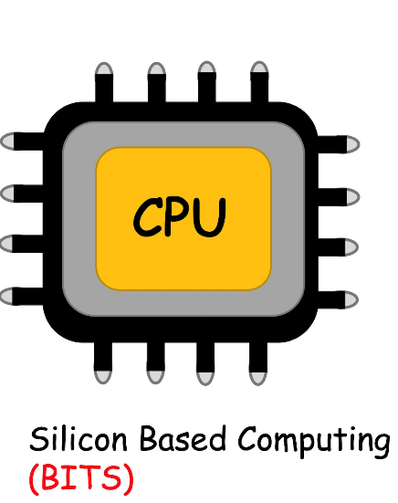

Slide 4
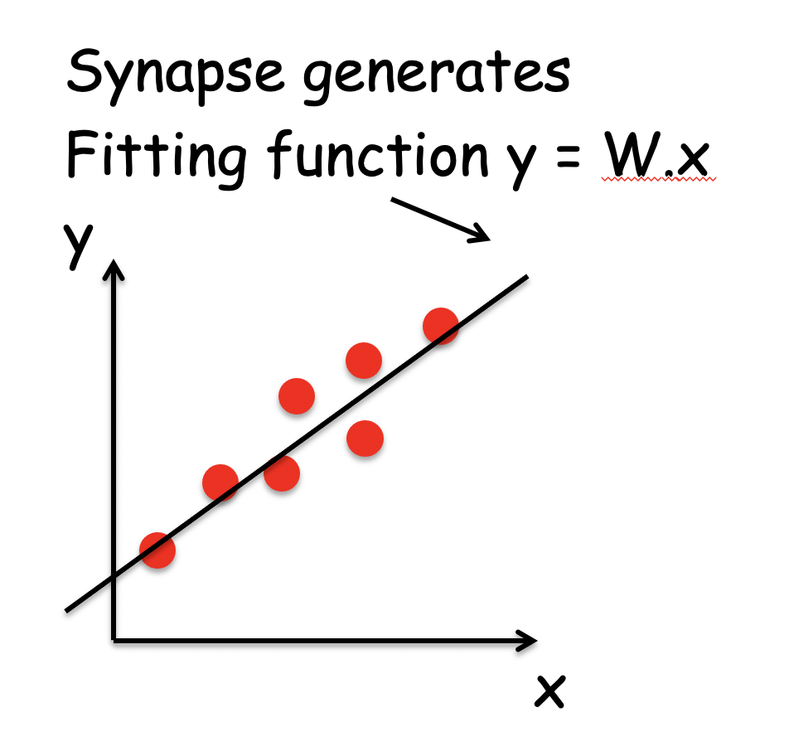
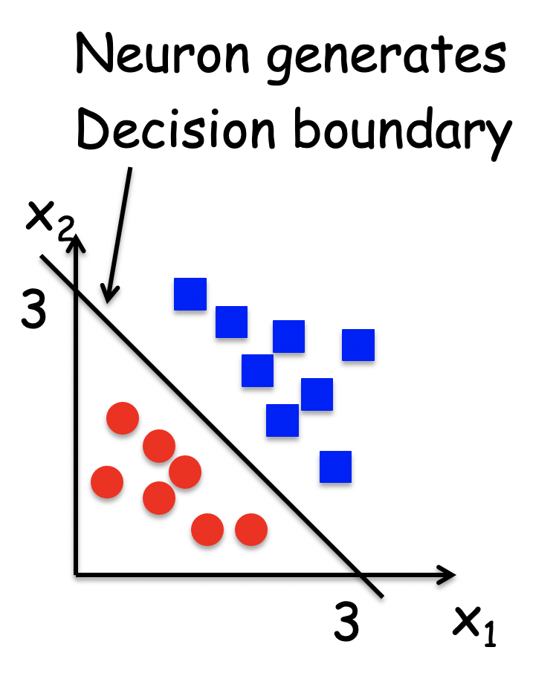
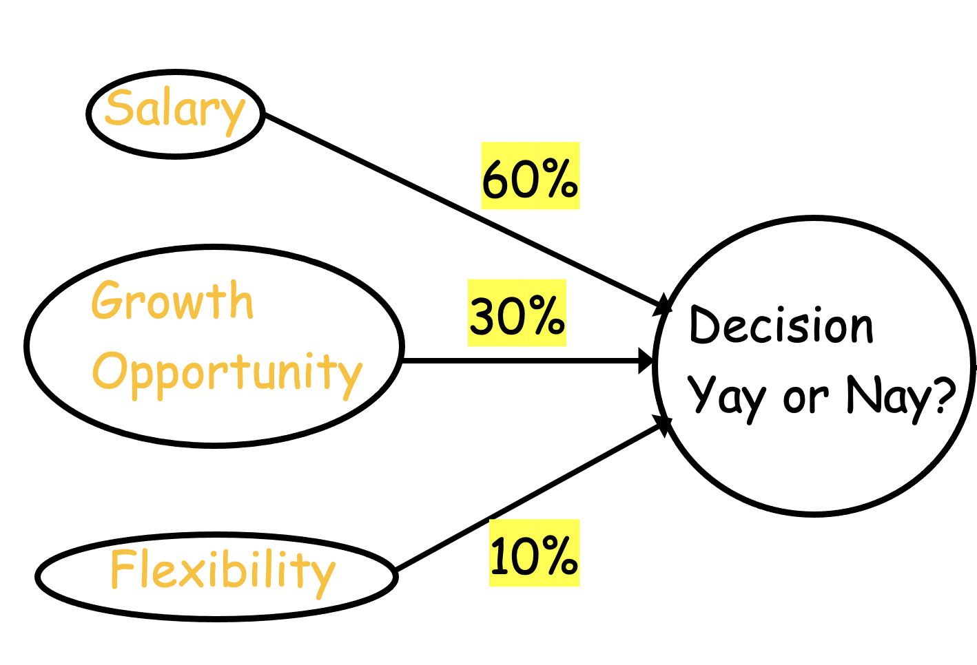
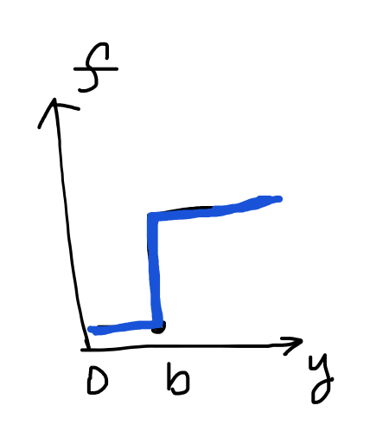
Recall Two pieces in ML/AI
Sum
Threshold

Slide 5
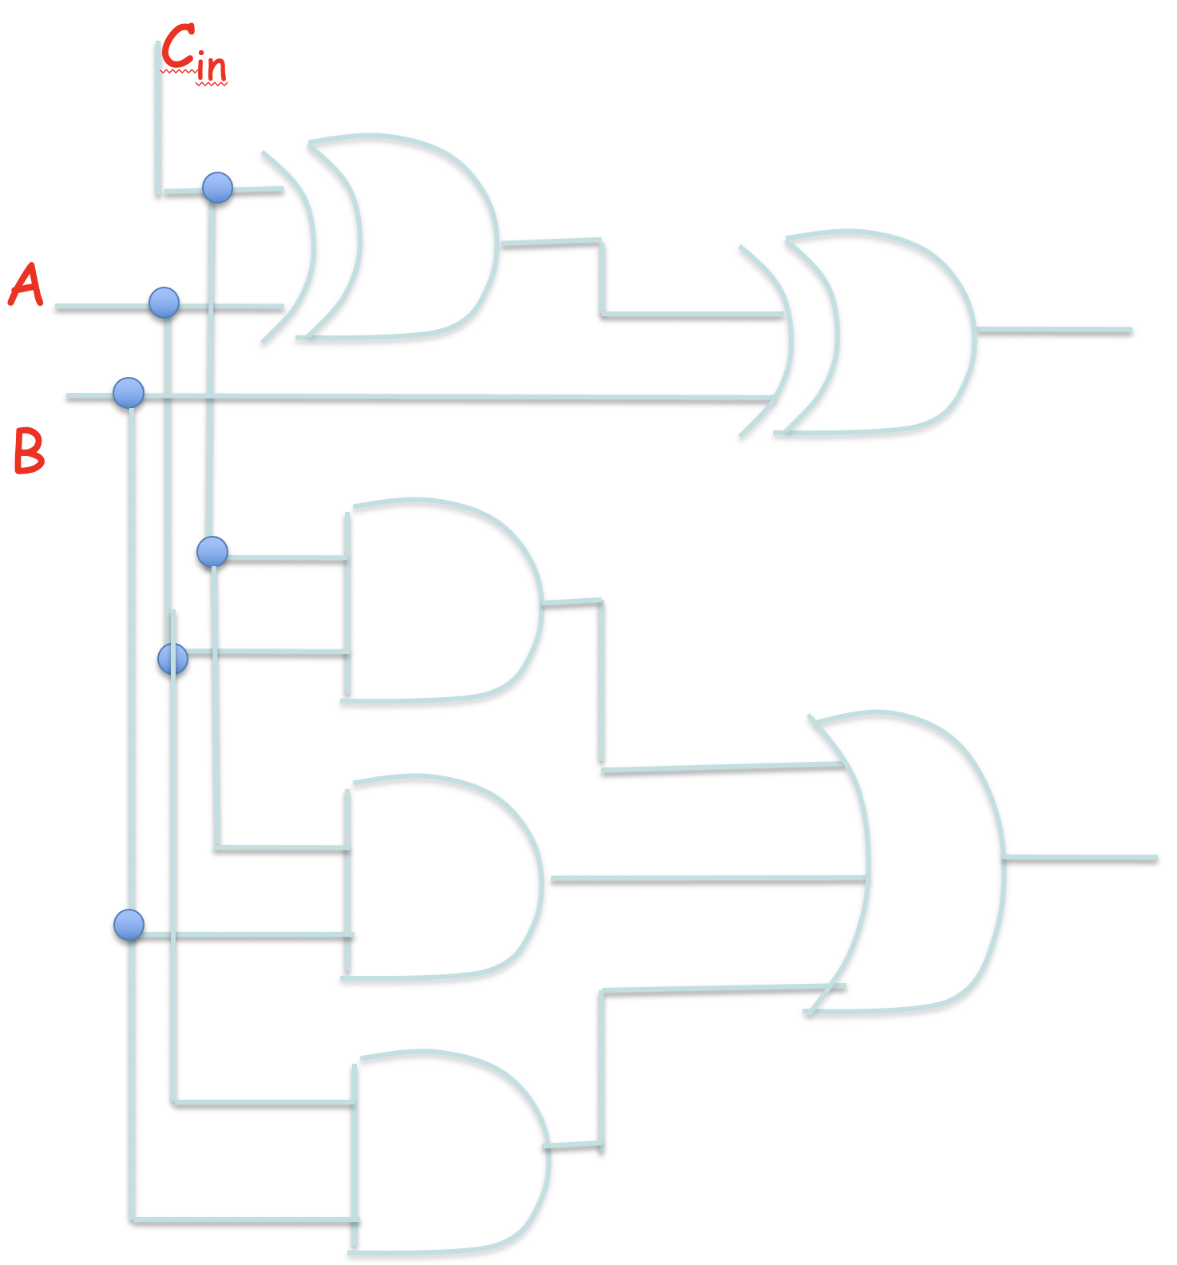
Silicon Brain
Encode info in binary (BITs):
→ 18
11011 → 27
We can store 0’s and 1’s as data strings
Logic gates map binary strings between
input and output
AND, XOR: (2 bits → 1 bit)
FA: (32+32 → 33)

Slide 6
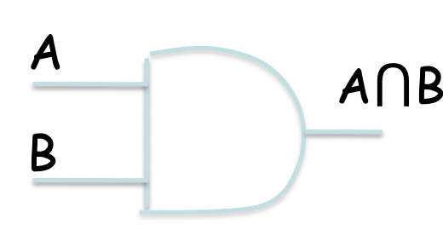
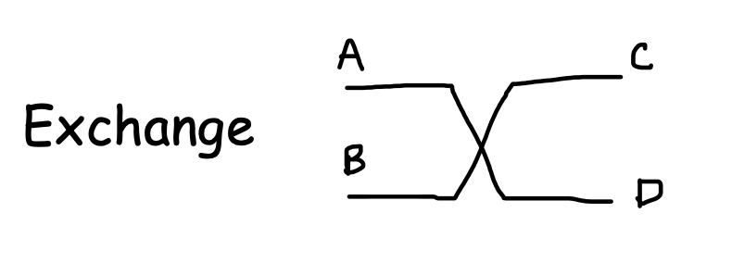
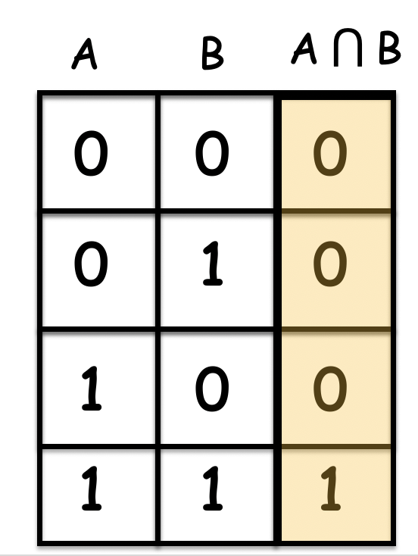
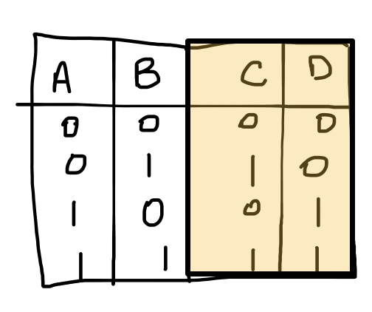
Silicon Brain
Manipulating these cost energy. How much? Energy loss related with information loss
Reduction of entropy consumes energy – Lec 4.

Slide 7
Silicon Brain
Encode info in binary (BITs):
1 1 0 1 1
1 0 0 1 0

Slide 8
Silicon Brain
Instead of mechanical switches, it’s electrical
1 0 0 1 0

Slide 9
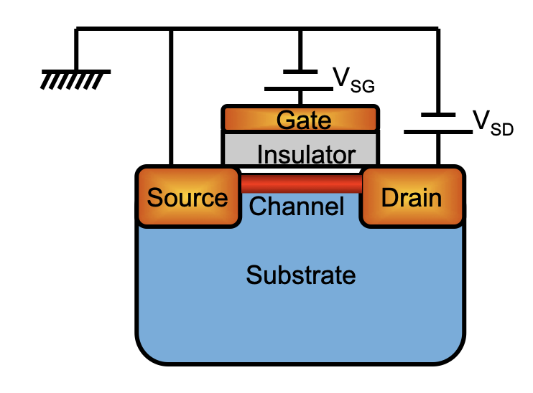
Silicon Brain
I
ON “1”
OFF “0”
V_{SD}
Signs flip between PMOS and NMOS

Slide 10
3A. Intro to CMOS

Slide 11
Basic NOT gate: an inverter
in
out
NOT
in
out
0
1
1
0
Do billions of this at
High speed (~GHz)
Low power (~mW in IoT, W on cell phones/laptops)
Low dynamic error (~10⁻¹²)

Slide 12
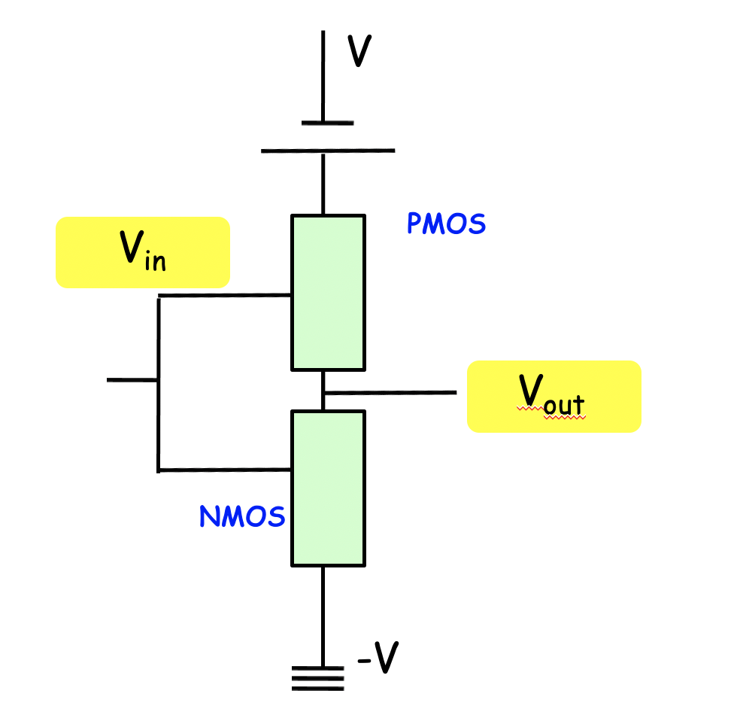
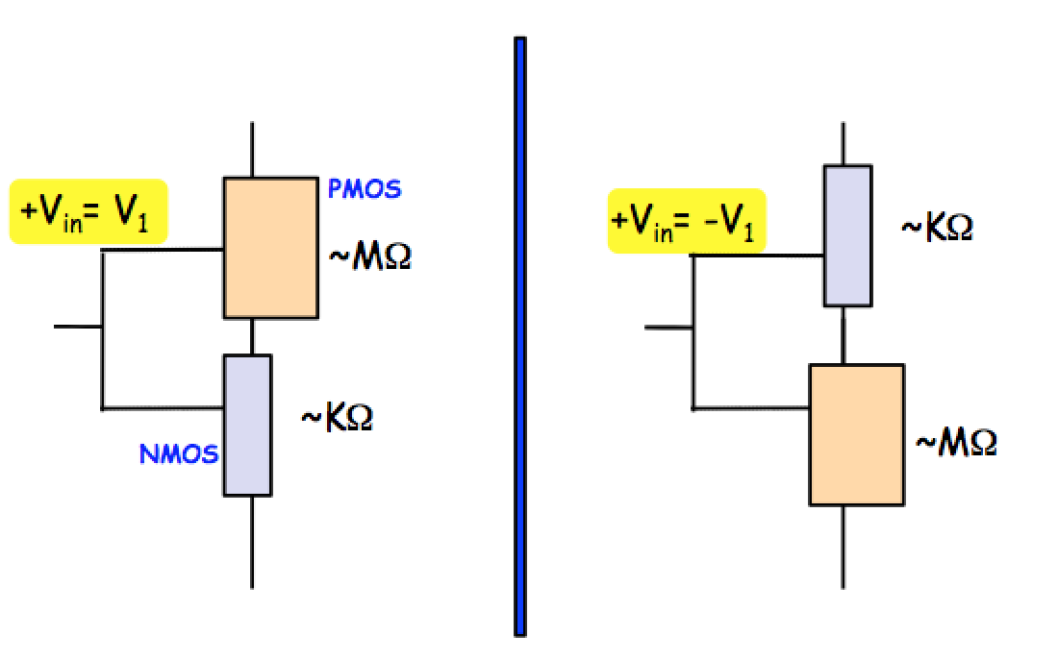
Electrical switching
V
V
V_{out} = V
V_{out} = 0
Positive input turns the lower limb (NMOS) on
Negative input turns the upper limb (PMOS) on → Inverter!!

Slide 13
Complementary Metal Oxide Semiconductor (CMOS)
Difference is orders of magnitude !
(resistivity of metals vs oxides ~10⁻⁶-10¹⁴ Ω–cm)
One is always off (static dissipation ideally ZERO)
V
V
V_{out} = V
V_{out} = 0

