Slide 1
3B. How does each MOS transistor work?

Slide 2
Need a Band diagram first

Slide 3
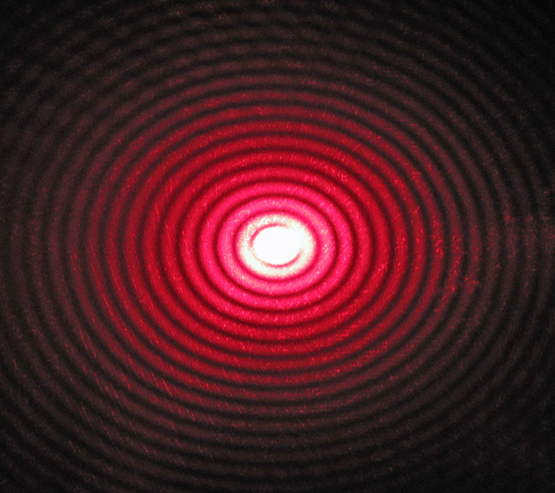
Electrons form standing waves in a grating
Some wavelengths filtered out
→ Energy gaps
E
Gap

Slide 4
Bands are direction dependent
Chemical orbitals (s,p,d)
Brillouin zone
Valleys and optical activity
Effective mass
Valence Bands and strain
Symmetry and topology
Heterostructures and band splitting
Density of States

Slide 5
E-k plots carry a lot of information
Optical absorption for direct bands (photons have zero mass and low momentum)
Fit a parabola to get an effective mass
Steeper is lighter (m_{GaAs} < m_{Si})
Orbital and spin characters control transitions between bands

Slide 6
Electrons occupy bands based on Pauli exclusion
E
Empty
Unavailable
Bandgap
~1 eV
Transition
~25meV
Fermi Energy E_{F}
Bandwidth
~5eV
Filled

Slide 7
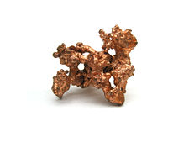
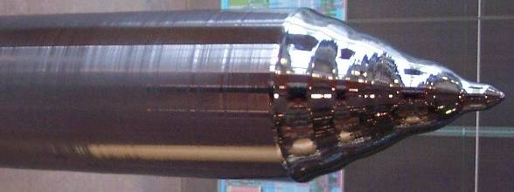
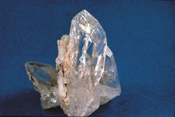
Bands determine what kind of solid we have
E
Empty levels
~1eV
~10eV
Filled
levels
Semiconductor (Si)
(charge movement
can be controlled)
Insulator (Silica)
(charges can’t move)
Metal (Copper)
(charges move)
1eV = 1.6 x 10⁻¹⁹ J = 1.24/λ(μm)

Slide 8
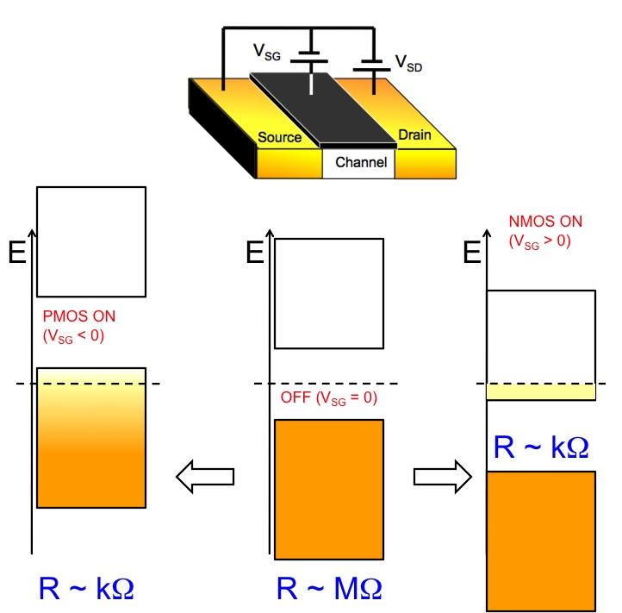
Act of electronic switching

Slide 9
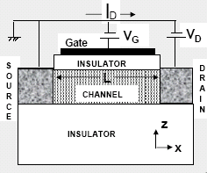
In plain English…
V_{G} > 0
n type operation
Vacuum
Level
More
electrons
Positive gate bias attracts electrons into channel
Channel now becomes more conductive

Slide 10
In plain English…
V_{G} < 0
p type operation
Vacuum
Level
More
holes
Negative gate bias attracts holes into channel
Channel now becomes more conductive

Slide 11
The origin of high ON-OFF

Slide 12
What is ‘n’?
Number of ‘free’ electrons in NMOS
(untied to parent)

Slide 13
There is a corresponding ‘p’
Number of ‘free’ holes in PMOS

Slide 14
Intrinsic semiconductor

Slide 15
Create excess electrons and holes by doping
This also moves E_{F} towards CB

Slide 16
Create electrons and holes by doping
This also moves E_{F} towards VB

Slide 17
Charges grow at each other’s expense
Arithmetic Mean can change with doping
Geometric Mean stays fixed

Slide 18
Charges grow at each other’s expense

Slide 19
Note how voltages are related
to concentration logarithmically
How can we use this?

