Slide 1
3C. Building devices out of
PN junctions

Slide 2
P and N together

Slide 3
P and N together

Slide 4
P and N together

Slide 5
P and N together

Slide 6
Forward Bias – Exponentially grow current

Slide 7
Reverse bias – Reduce current to saturation

Slide 8
Barrier Engineering

Slide 9
Speed of the diode

Slide 10
Speed of the diode

Slide 11
Mobility in an electric field

Slide 12
Diffusion in thermal field

Slide 13
Electrons in semiconductors are fast because
1. They are light!
2. Less interruptions in a clean solid (low scattering)
λ^{e}_{sc} ~ 10—100s of nm
(1000x electron size ~0.1 nm)
λ^{H20}_{sc} ~ 100 nm
(25x molecule size ~ 4 nm)

Slide 14
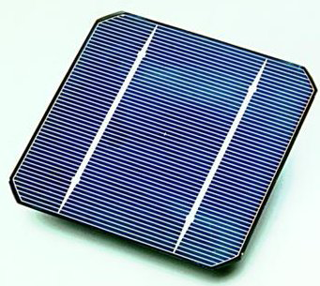
Use for a PN junction: Solar Cell

Slide 15
Solar Cell

