Slide 1
3D. From single PN junction to MOS
transistor

Slide 2
Transistor acts like a solar cell
(Inundates with excess charges)

Slide 3
Transistor acts like a solar cell
(Inundates with excess charges)

Slide 4
NPN transistor → NMOS transfer characteristic

Slide 5
PNP transistor → PMOS transfer characteristic

Slide 6
Drain bias reverse biases one end
(like solar cell)

Slide 7
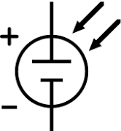
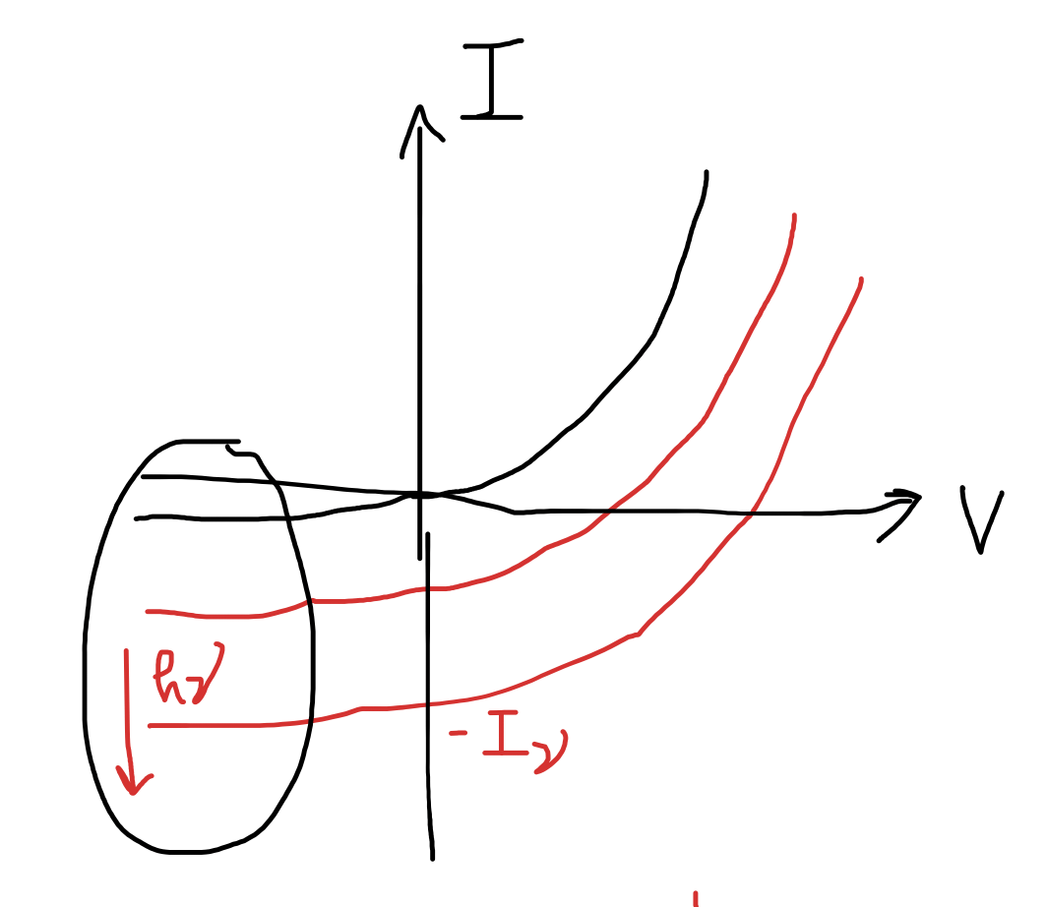
Output characteristics

Slide 8
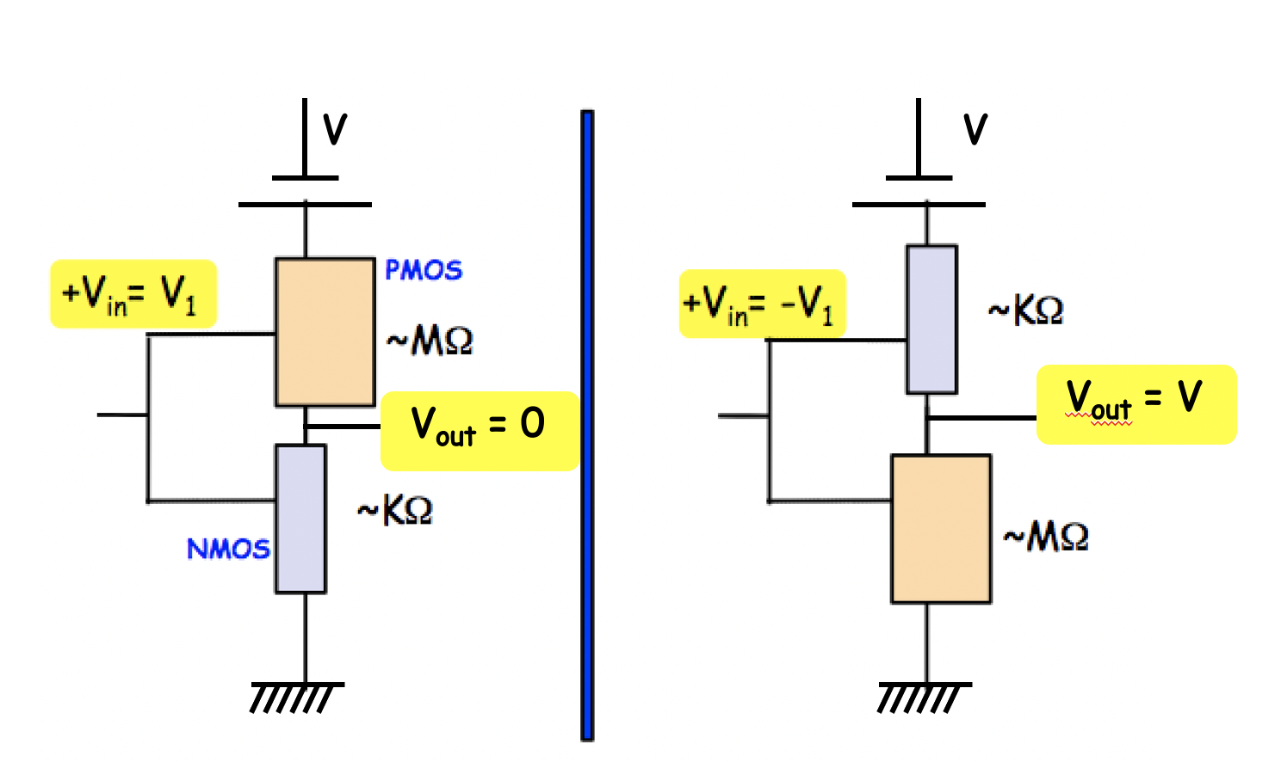
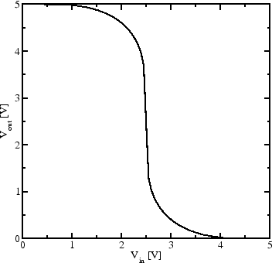
How do these I-Vs translate to CMOS inverter?
ON
Gain
OFF

Slide 9
CMOS – Combine NMOS and PMOS

Slide 10
Short-channel effects

Slide 11
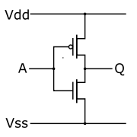
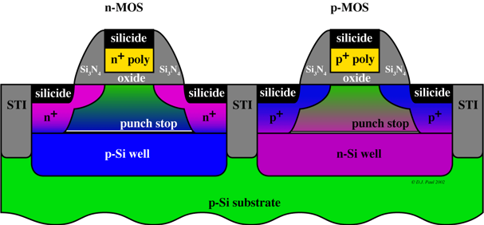
Build a “NOT” with CMOS inverters
PMOS
NMOS
+ voltage turns NMOS on, shorts to
ground
voltage turns
PMOS on, shorts
to power supply voltage
ON
Gain
OFF

Slide 12
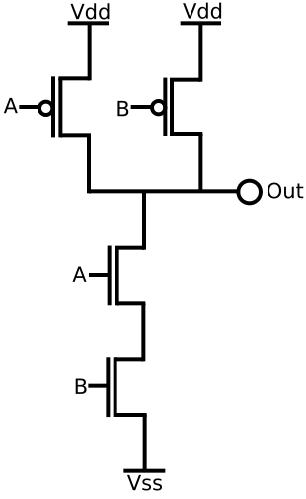
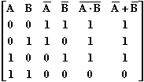
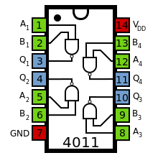
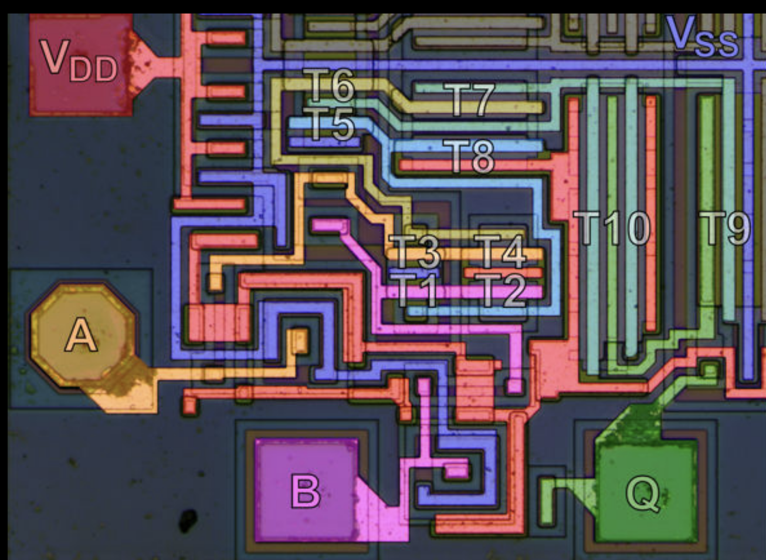
Build a NAND with CMOS inverters
NAND
0
0
1
0
1
1
1
0
1
1
1
0

Slide 13
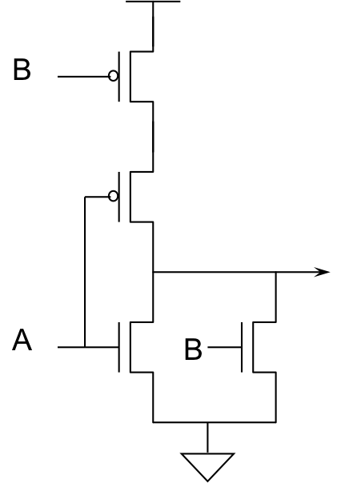
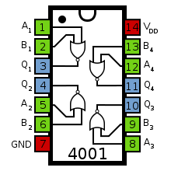
Build a NOR with CMOS inverters
NOR
0
0
1
0
1
0
1
0
0
1
1
0

Slide 14
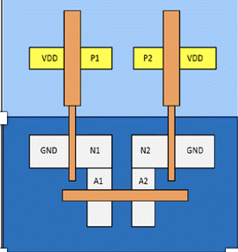
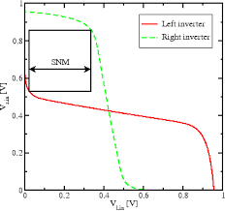
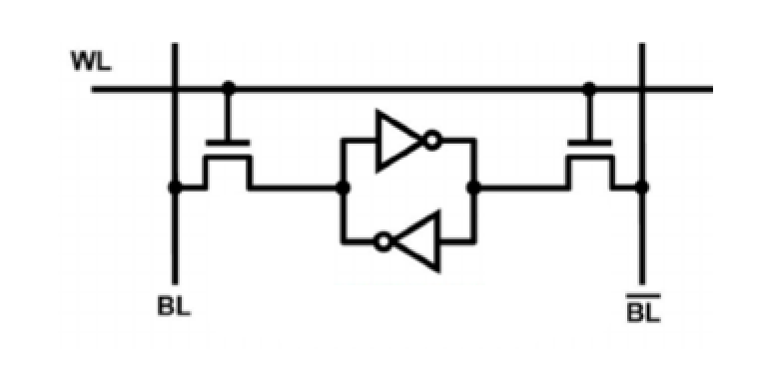
Build memory with CMOS
(6T-SRAM)
Cache memory

Slide 15
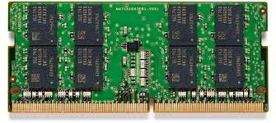
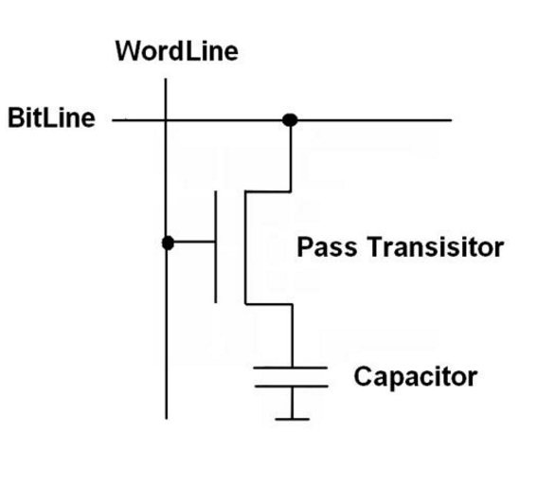
Build memory with CMOS
(DRAM)
Slower than SRAM (leakage)
Denser and cheaper
Main memory: PC, workstations, servers

Slide 16
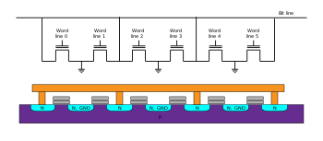
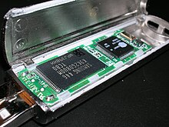
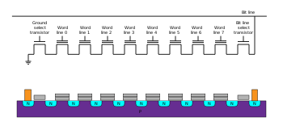
Memory Sticks, PC cards

Slide 17
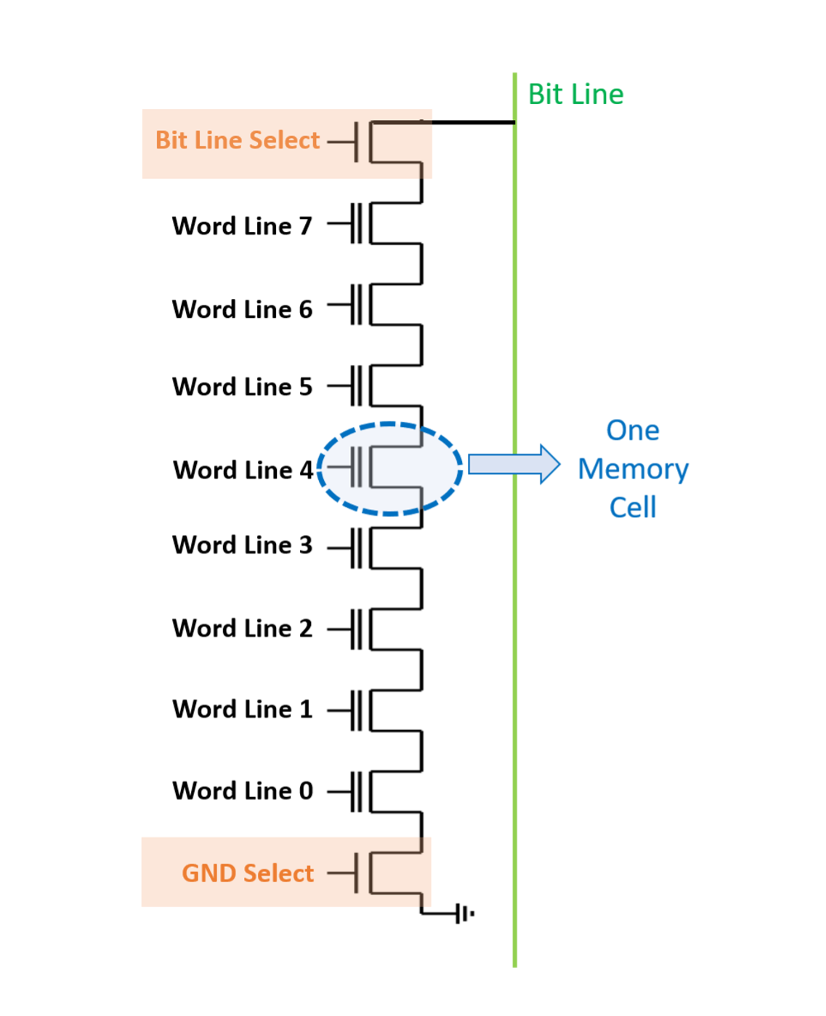
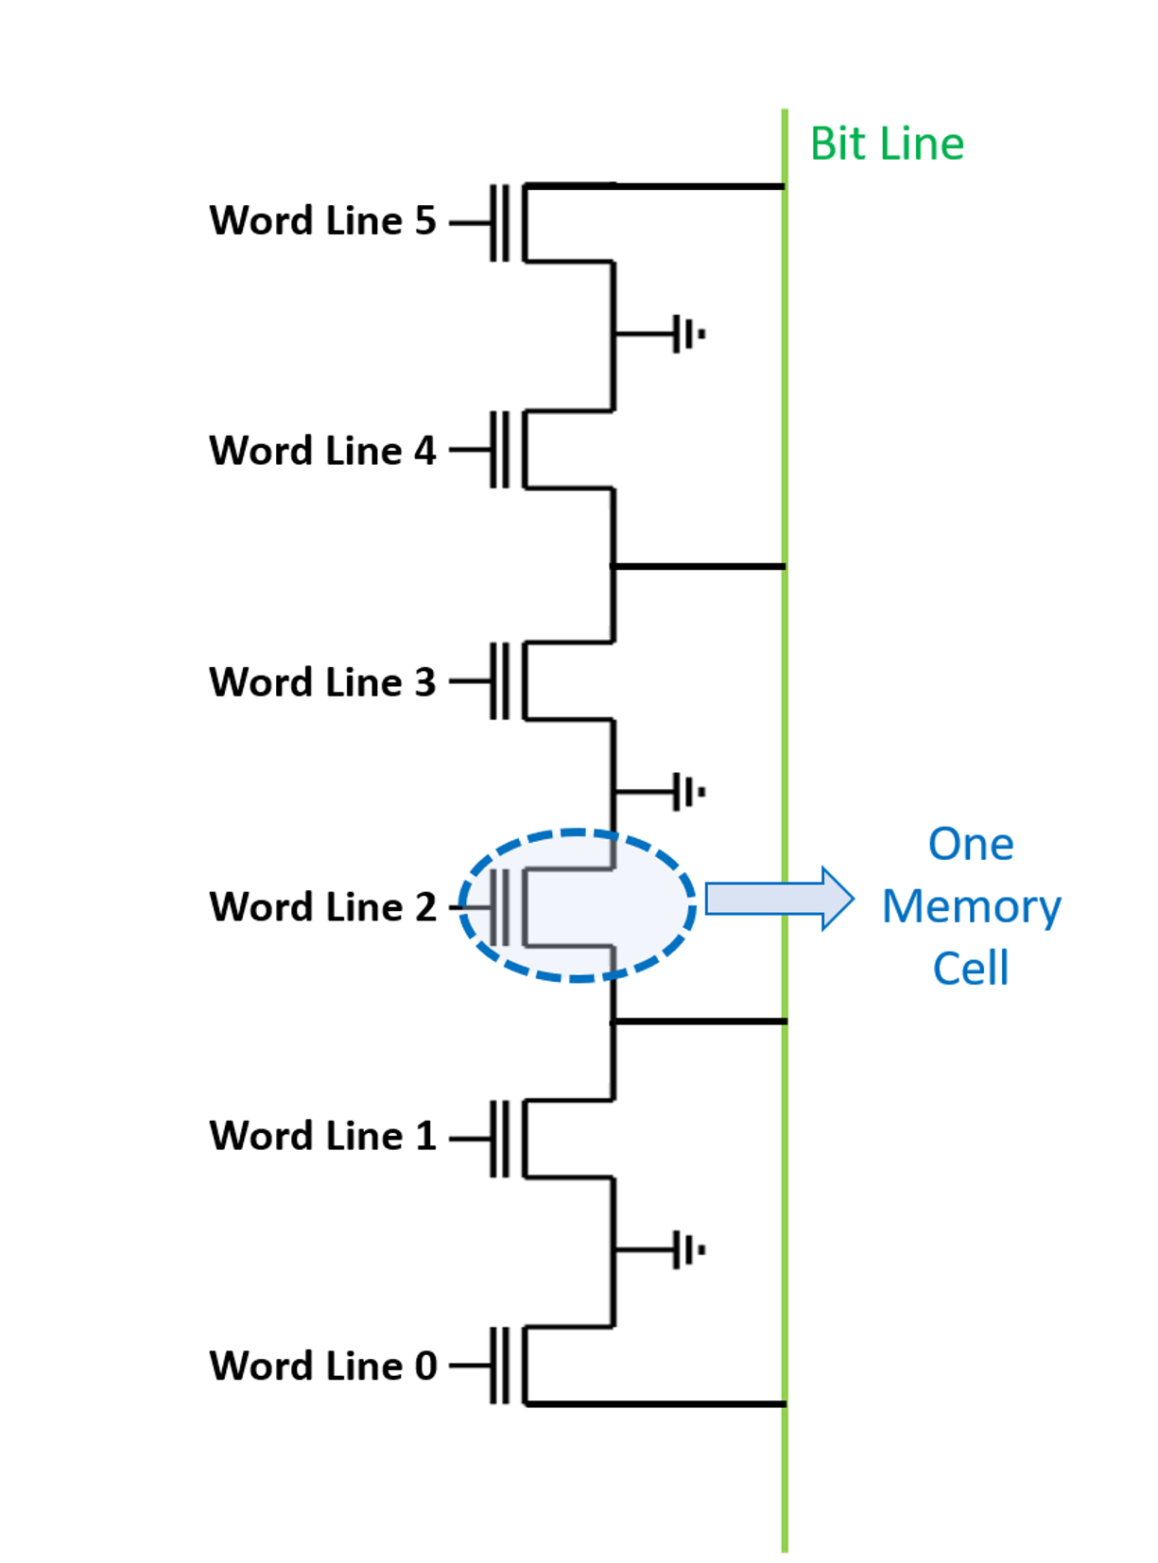
Need rise and fall times of CMOS equal
R_{PMOS} = 2R_{NMOS}
NAND:
2 NMOS in series: R = ? → Pull down
2 PMOS in parallel R = ? → Pull up
Lower resistance
Series connection means stackable, smaller (denser, cheaper)
NOR:
2 NMOS in parallel: R = ? → Pull down
2 PMOS in series: R = ? → Pull up
Higher resistance
Faster to read
(address each bit individually)
Slower to write/erase (erase each to 0
before over-writing)

Slide 18
Why CMOS specifically for inverters?
Low power: Once settled, no static current flow
V
V
~KΩ
~MΩ
-V
+V
+V1
-V1
~KΩ
~MΩ
-V
-V

