Slide 1
3E. The trouble with CMOS

Slide 2
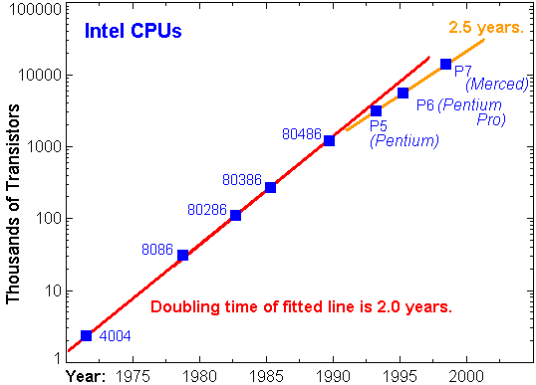
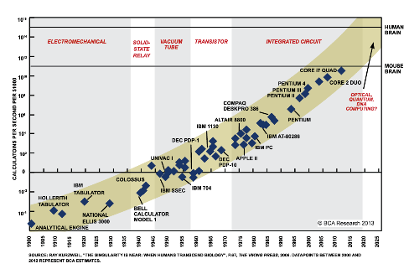
CMOS drove Moore’s Law for decades
Smaller/Faster/Cheaper

Slide 3
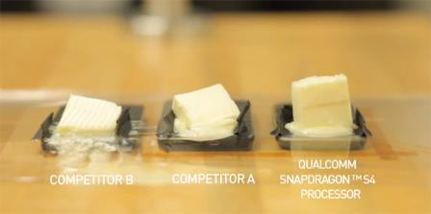
..Trouble in Paradise !
Pentium 2000, 50W/cm²;
~2025, 40MW/cm²
Based on Fundamental considerations alone !

Slide 4
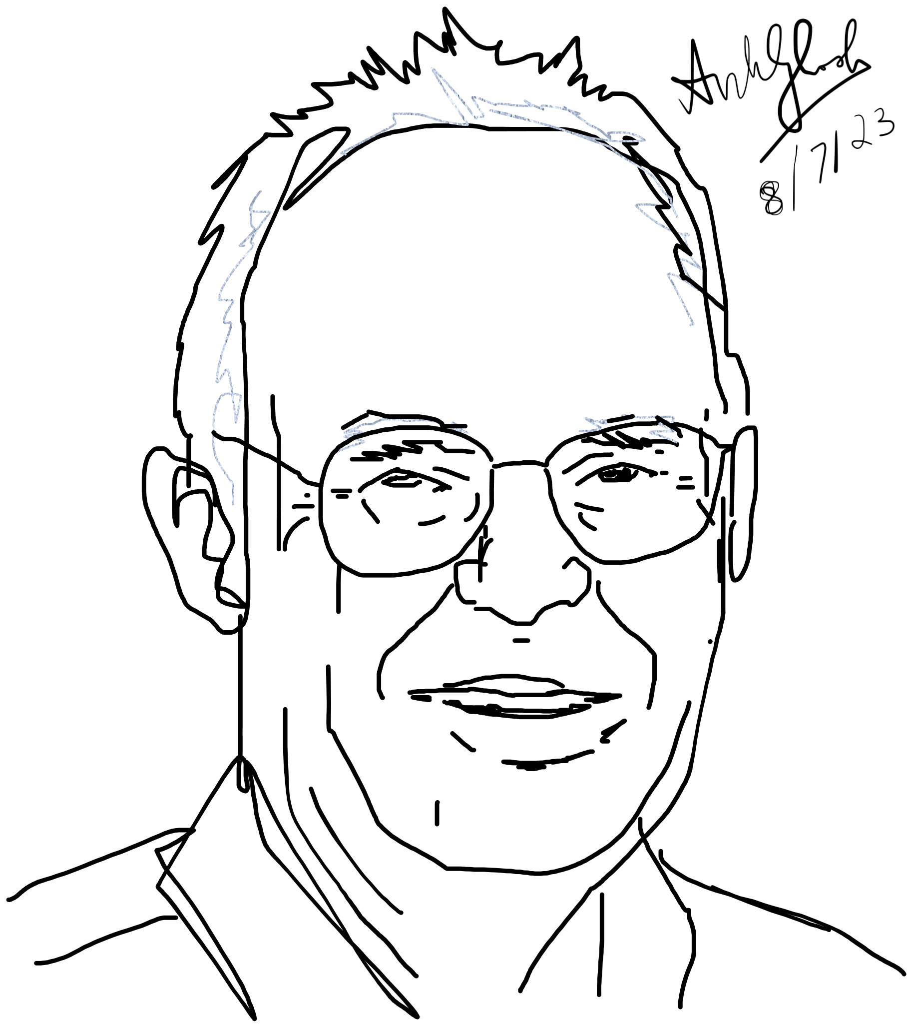
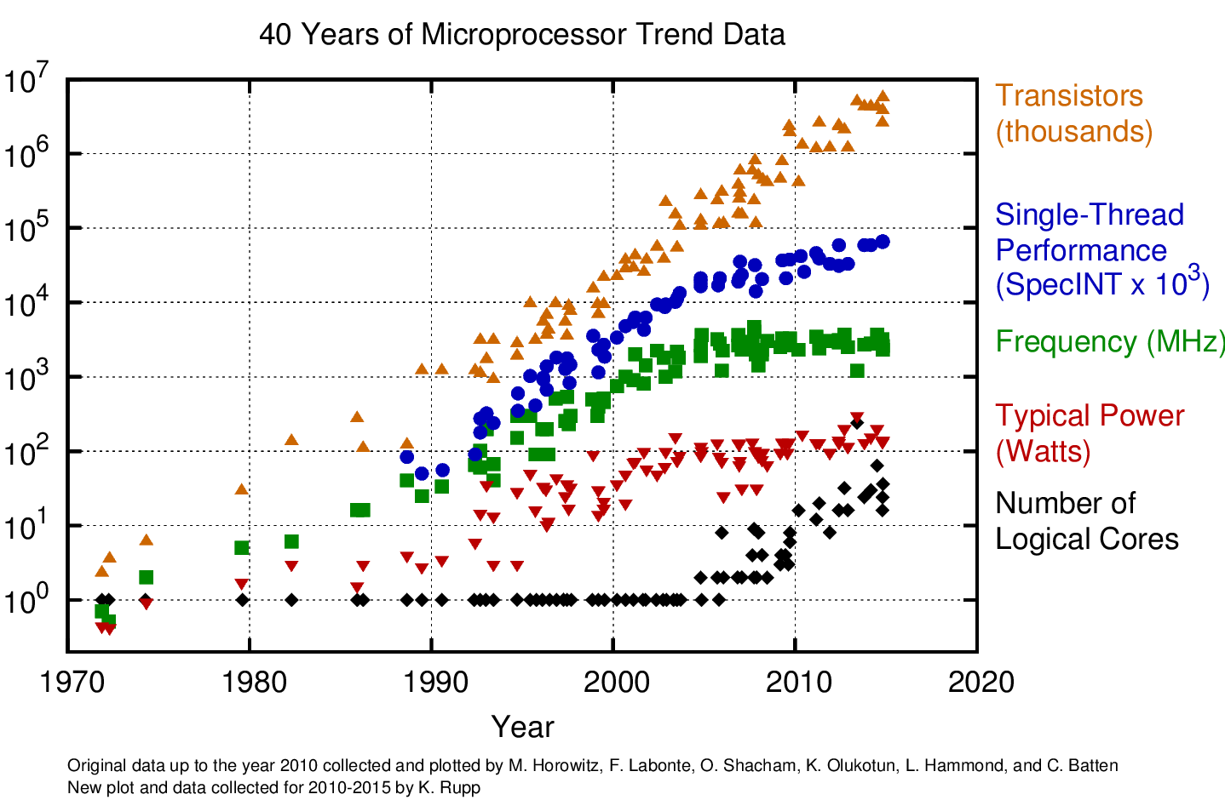
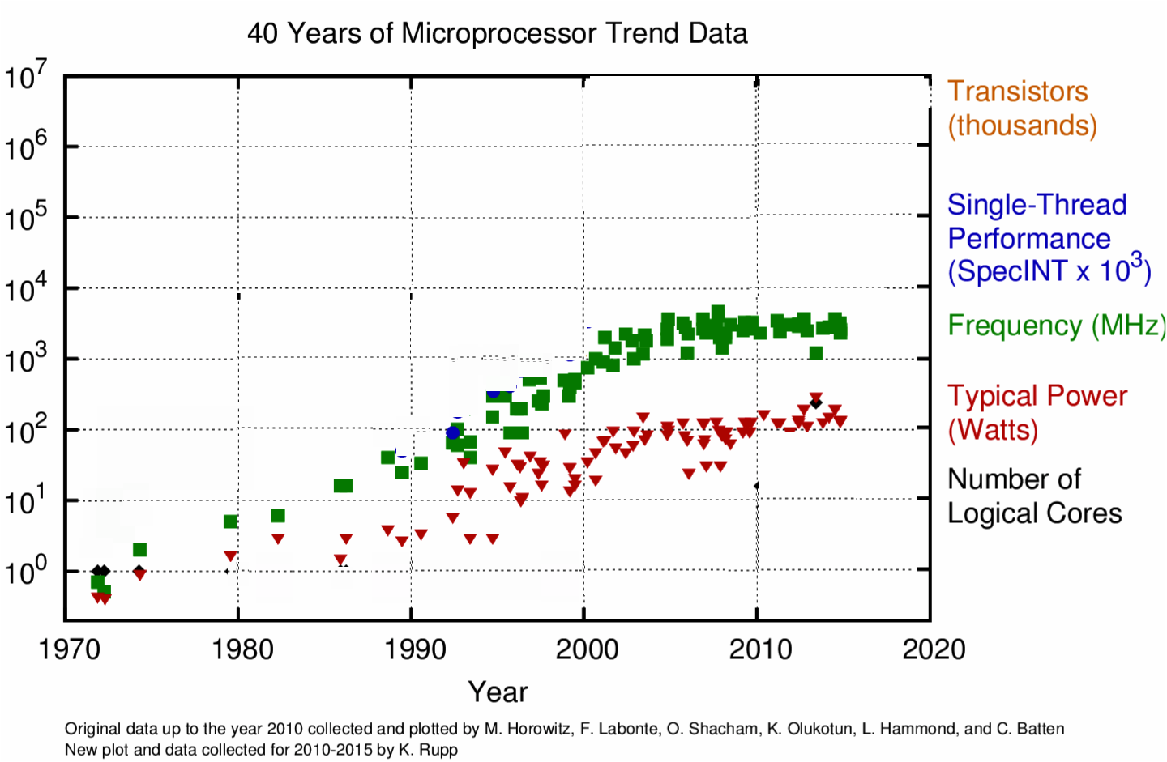
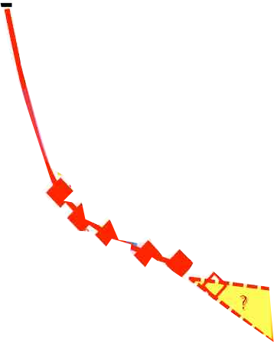
Dissipation in CMOS
P_{diss} ∝ V² f
Gordon Moore
3V
V
2V
f
Limited by
Heat
1V
Limited by
Error tolerance
No More
ITRS roadmap !
Freq & V
Scaling –
Death of Dennard Scaling
Strained
Si
NonPlanar
Gate
High-K
Metal Gate

Slide 5
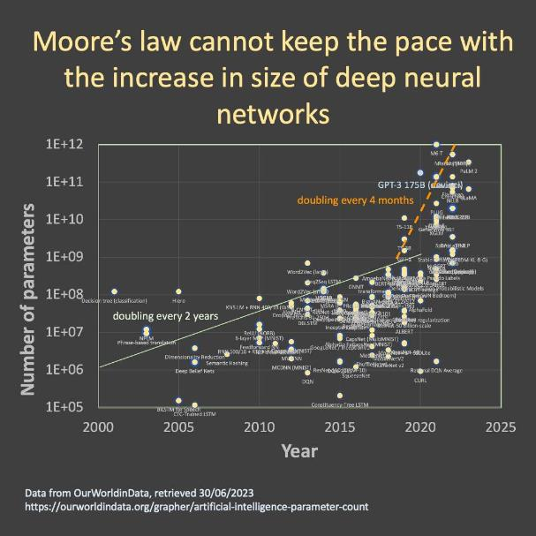

Slide 6
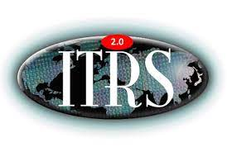
ITRS → IRDS

Slide 7
To summarize
Electrons in silicon are quick (low mass, clean systems)
~ GHz
They consume low power (CMOS architecture – no static
current), although high dynamic power is now slowing down
further scaling
~mW-W
They are accurate because the barriers (bandgaps) are
very large due to low electron mass, and much bigger than
thermal energy kT which is set by atomic mass and its
sluggish motion
~ 10⁻¹²-10⁻¹⁵ dynamic error

