Slide 1
3F. SPICE modeling of circuits

Slide 2
LAB : COMPUTER MODELING
Drift-Diffusion
Boltzmann Transport NEGF
SPICE

Slide 3
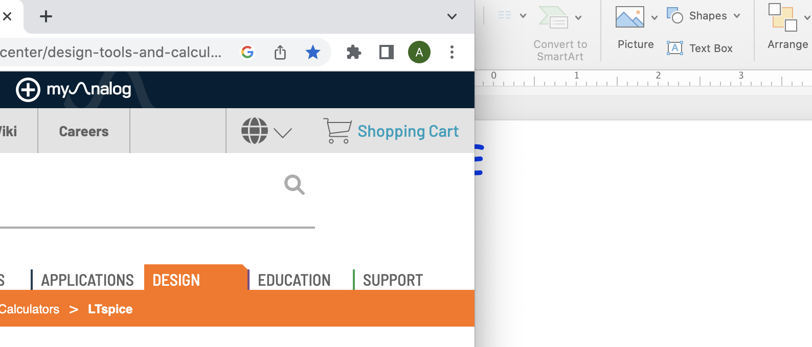
LTSPICE
Download LTSPICE for MAC-OSX
Install

Slide 4
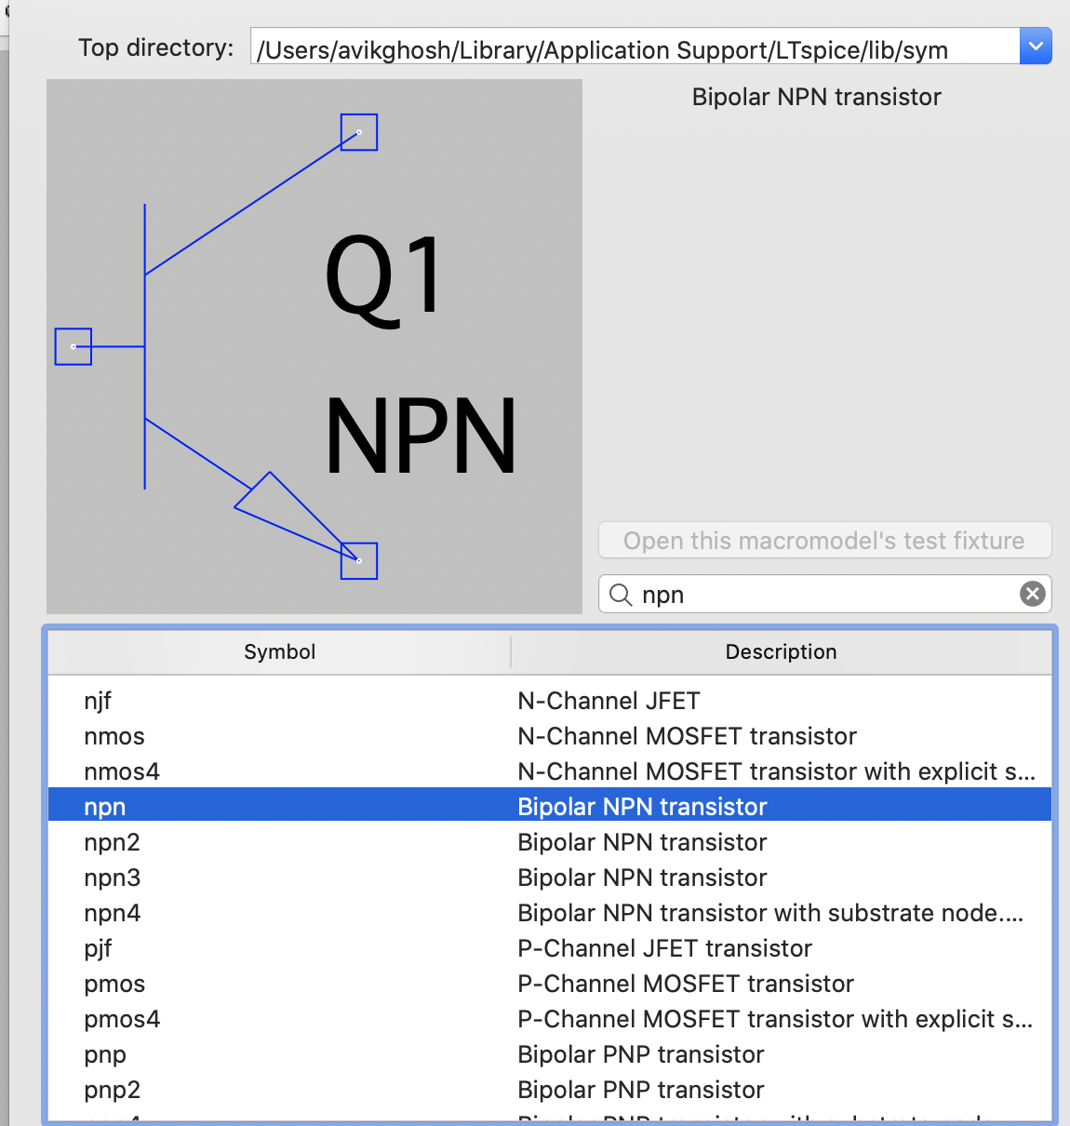
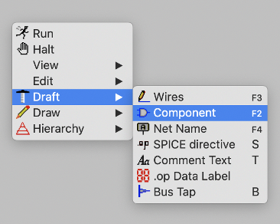
Open Draft --> component to pick a piece
Draft → Component → npn

Slide 5
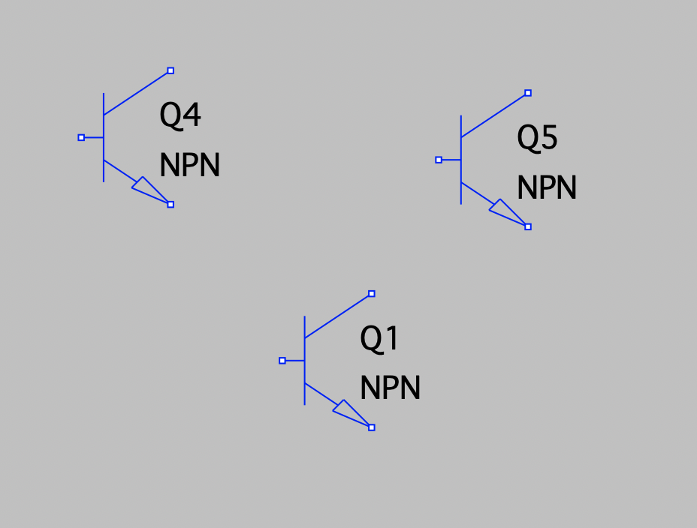
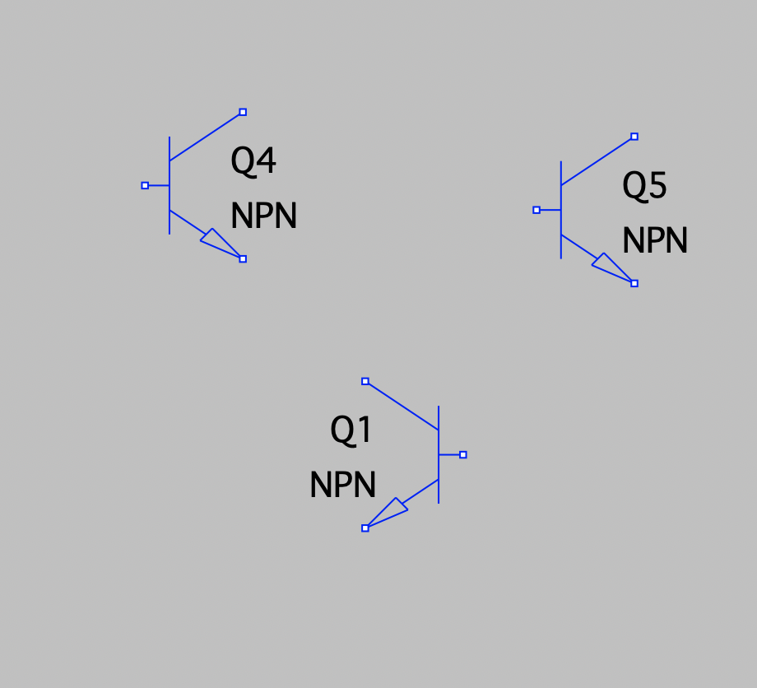
Duplicate, Erase, Drag, Flip
Replication is automatic with cursor movement
To stop, hit escape
To cancel, fn F5 (scissor comes up, then cut and then esc to stop)
To move, fn F7 then drag and draw box around limb of any subfigure, then move
To flip, click on figure after fn F7, then command E

Slide 6
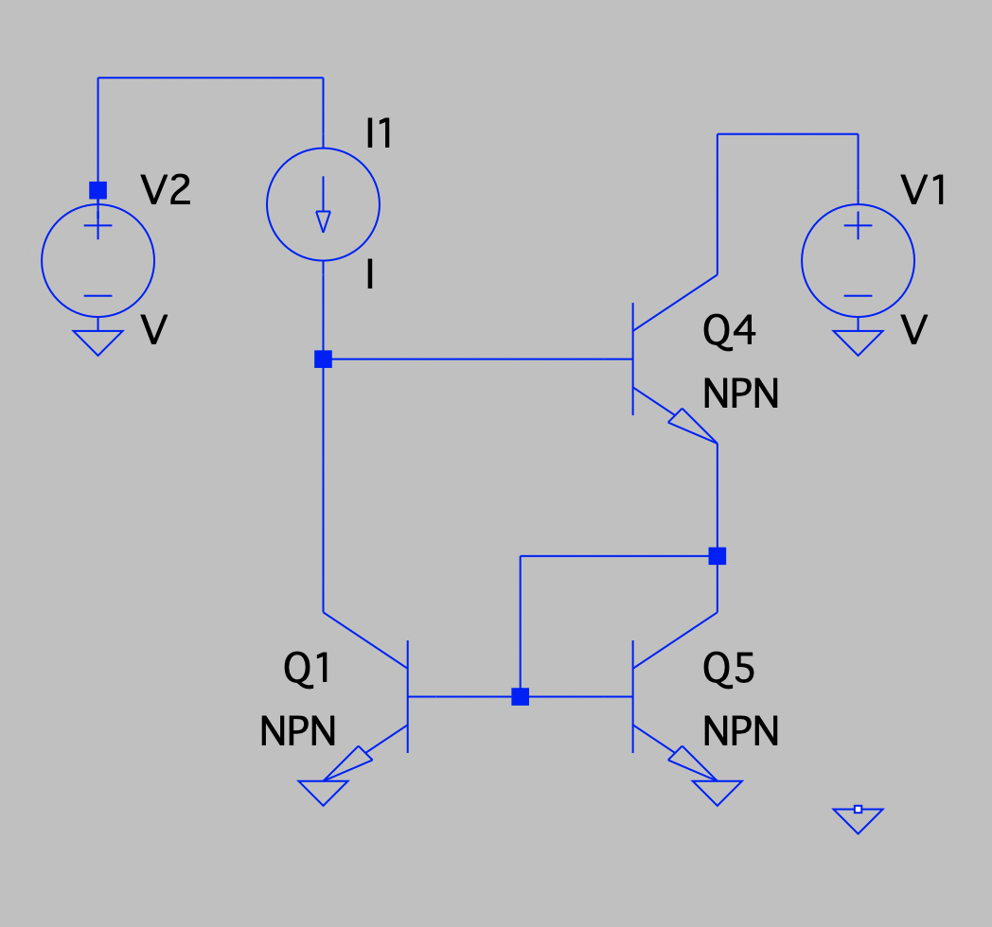
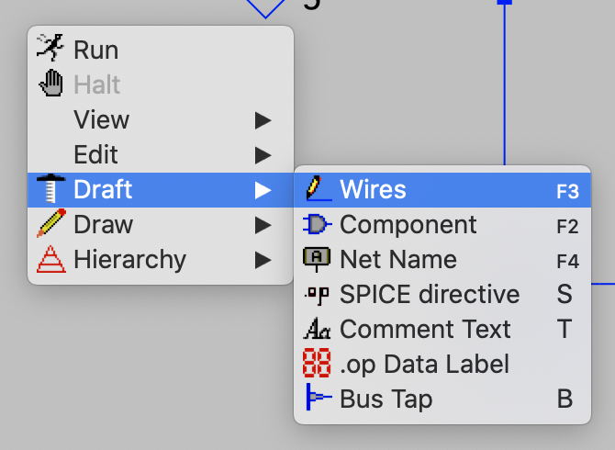
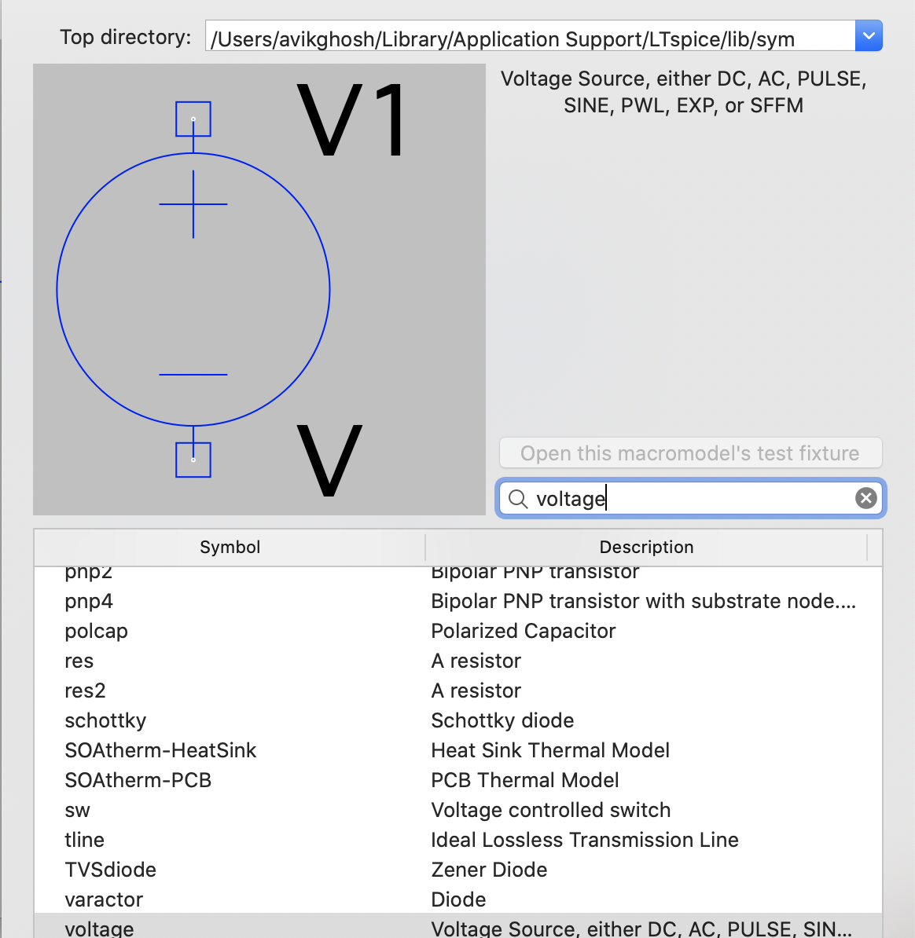
Draw wires, add ground, resistors, voltage/current sources
Draft → Wires, double click to start, single click to extend, esc to escape
fn G for each ground
Draft → Component → Voltage for V-source, current for current-source

Slide 7
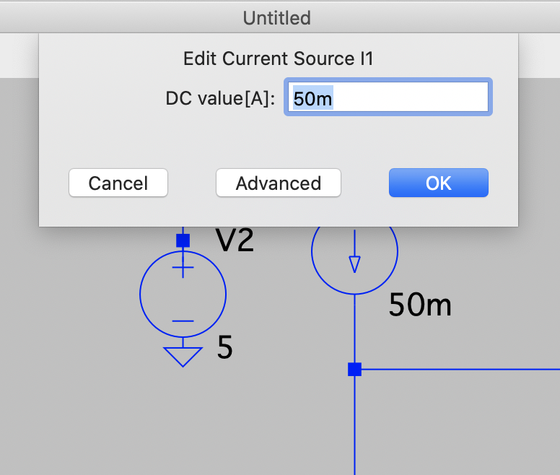
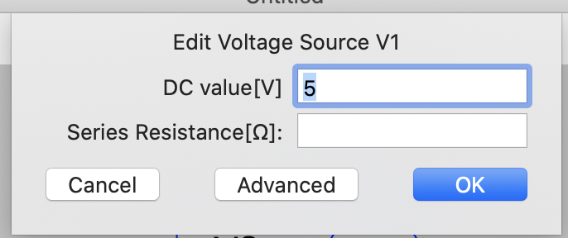
Fix NPN features, Voltages, current sources
Right Click, pulls up sheet for each component
Enter values (e.g. R, V)

Slide 8
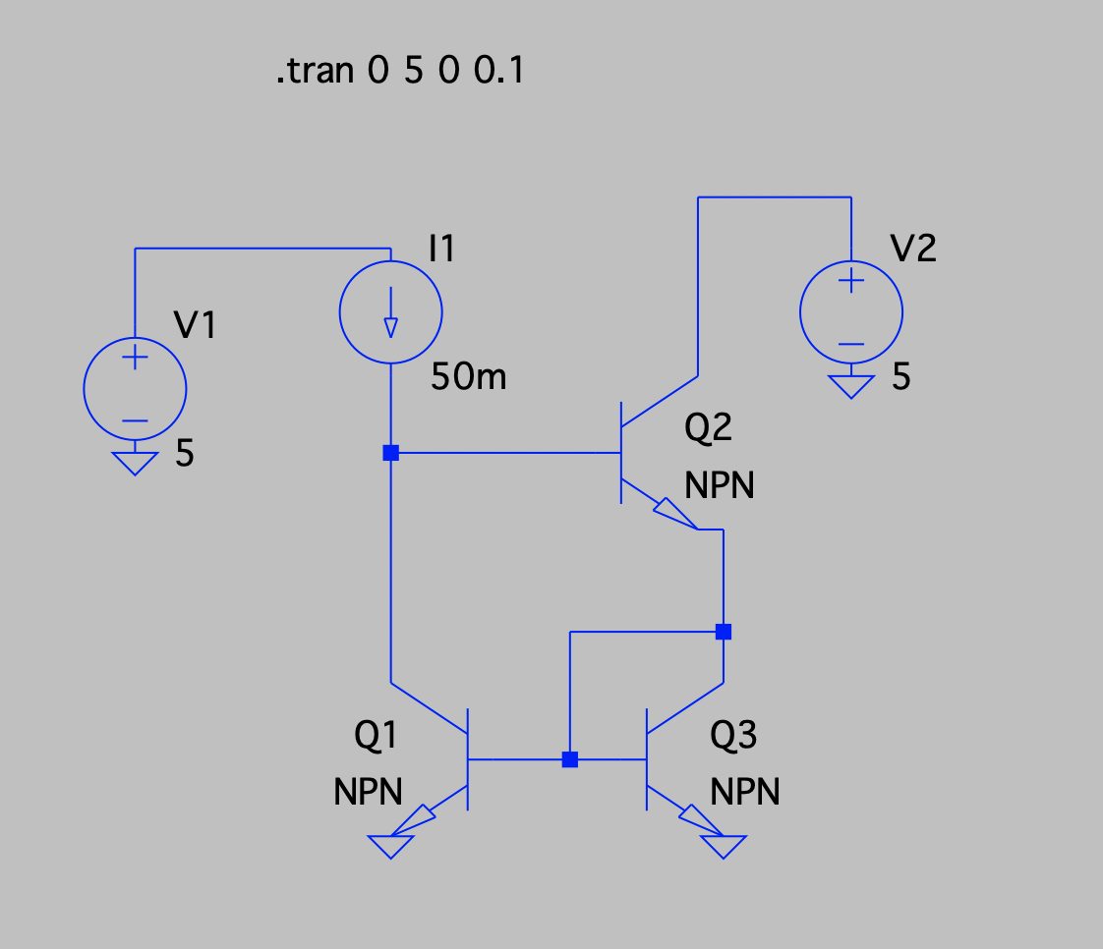
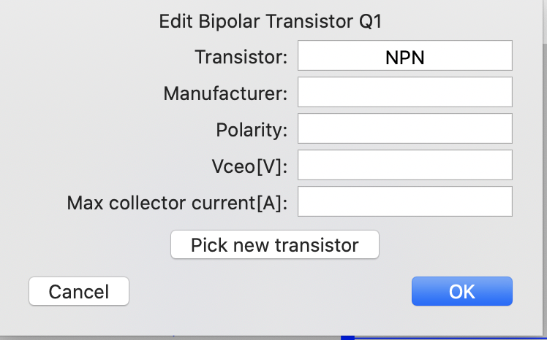
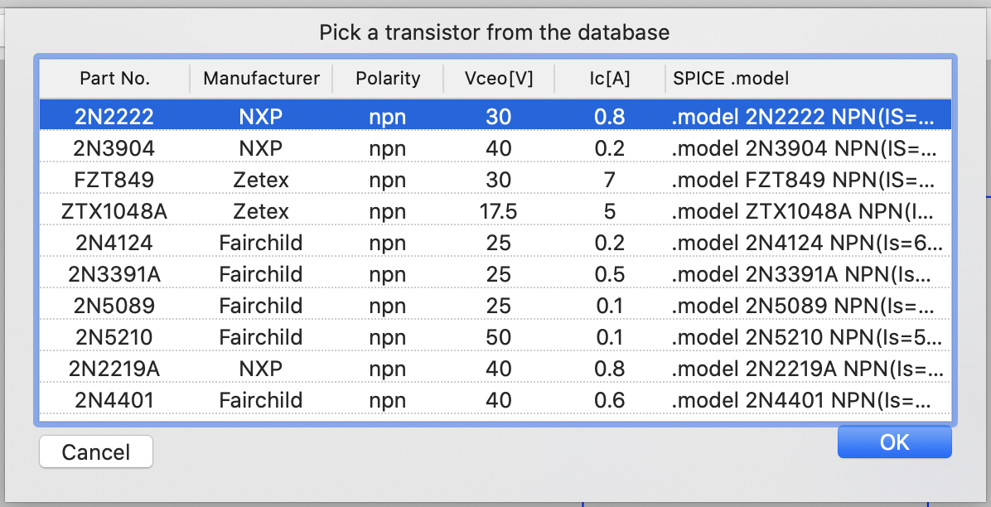
Fix Transistor specs
For each transistor, right click to pull up transistor data sheet, pick new transistor
CTRL c to copy any of the transistors (first one eg), then cancel

Slide 9
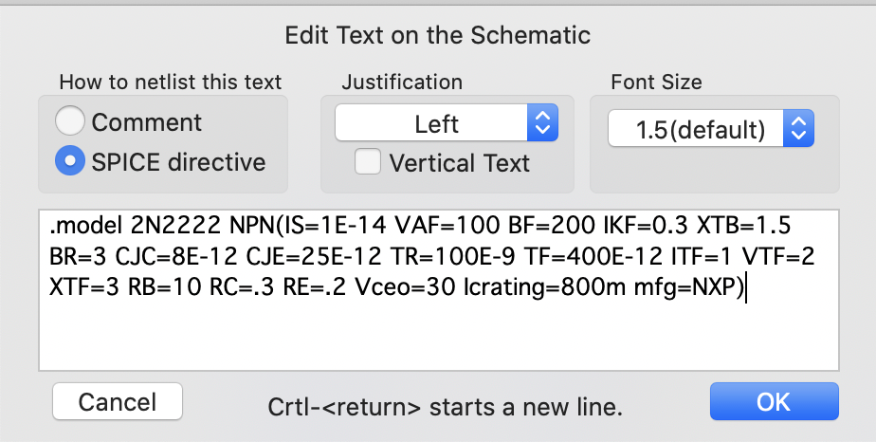
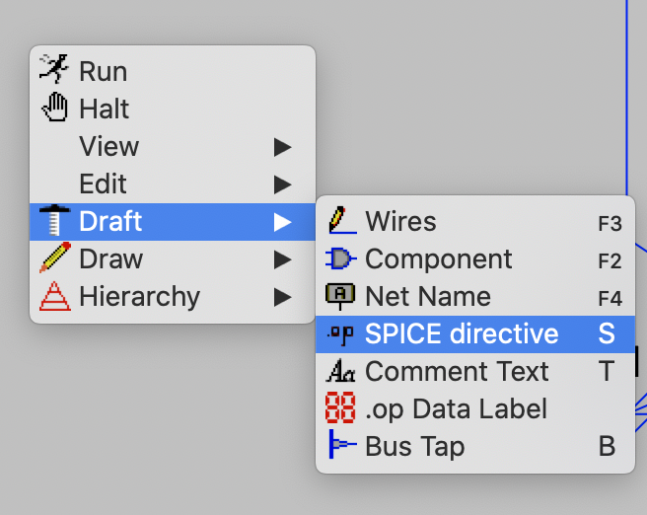
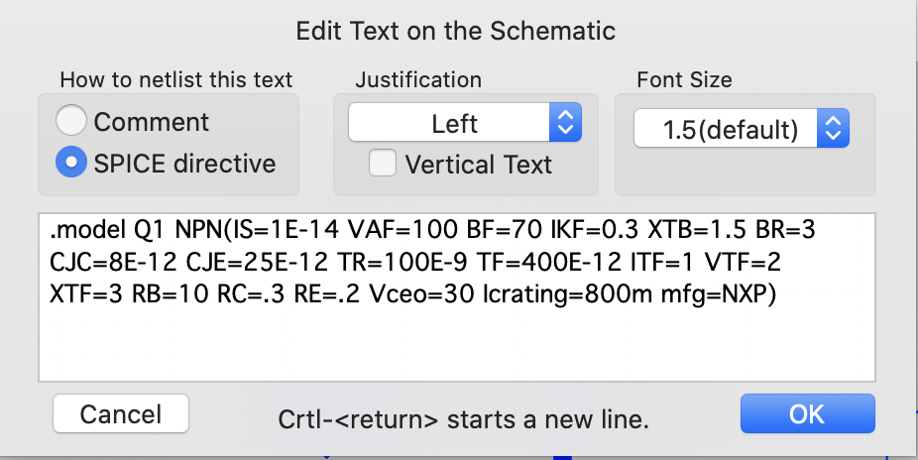
Fix Transistor specs
Replace model name with transistor name
Gain (BF), or other info (seek manual)
Draft SPICE directive then copy Ctrl V info into blank space, then edit

Slide 10
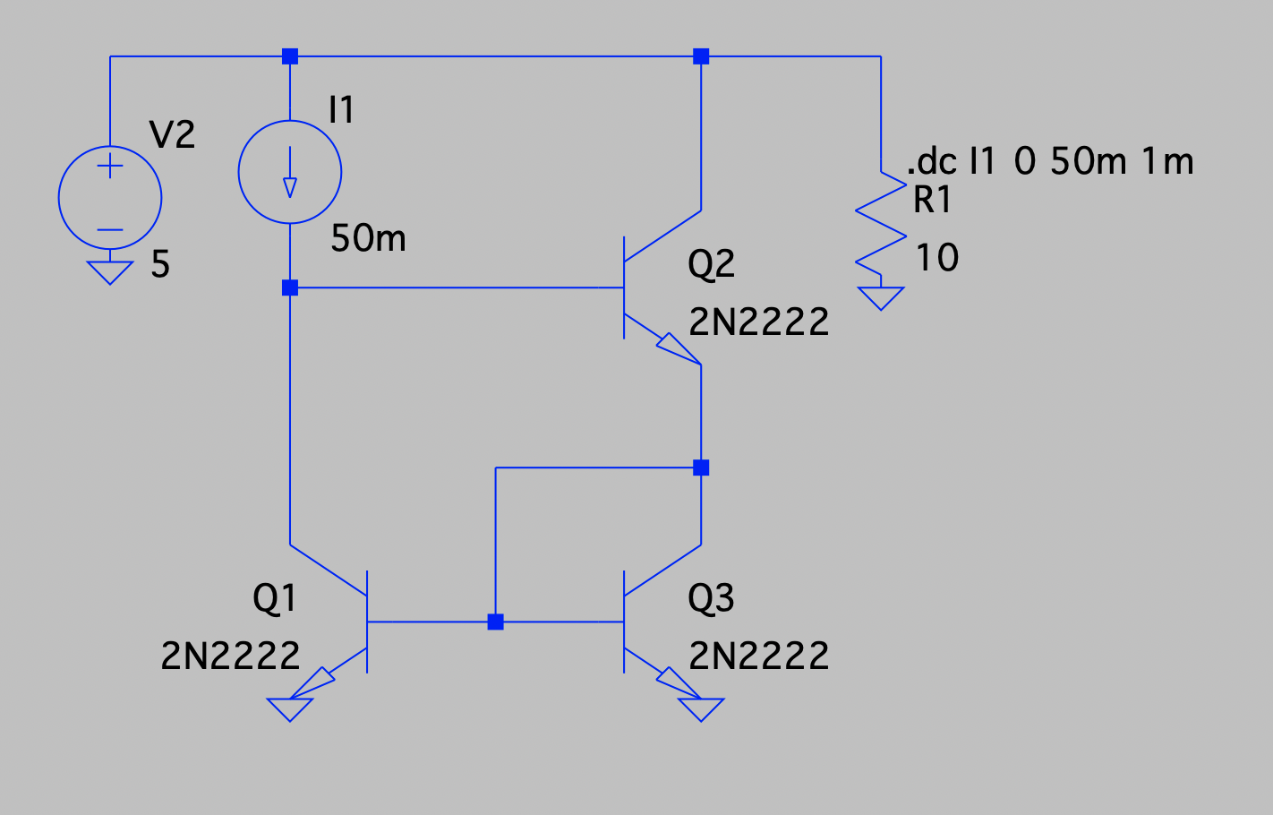
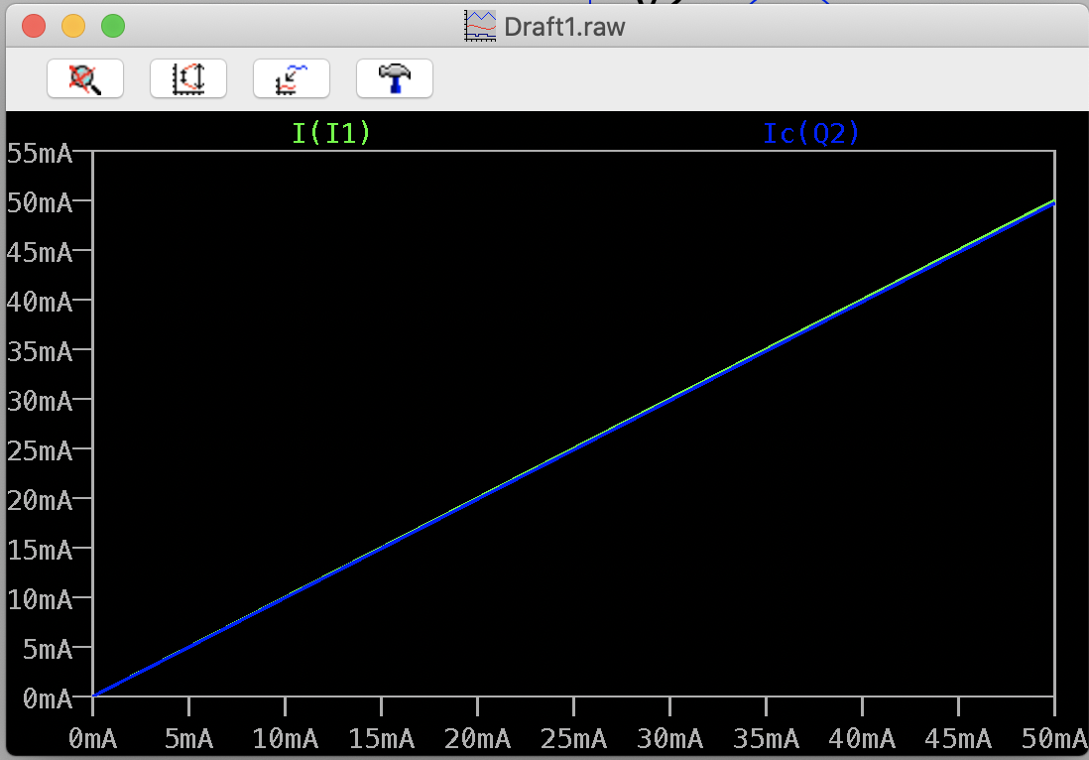
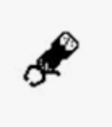
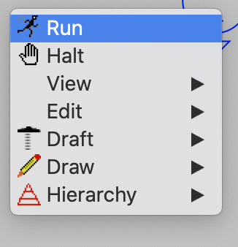
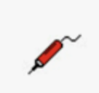
Set voltage conditions for run
[V0, V1 range, V0 start, ΔV step]
.tran 0 5 0 0.1 (in spice directive)
New window pops up
Bring cursor over wire on main window
Voltage probe (red) pops up
CMD switches to current probe
Graphs shown on output window
Current across top left and top right segments
(Mirror)

Slide 11
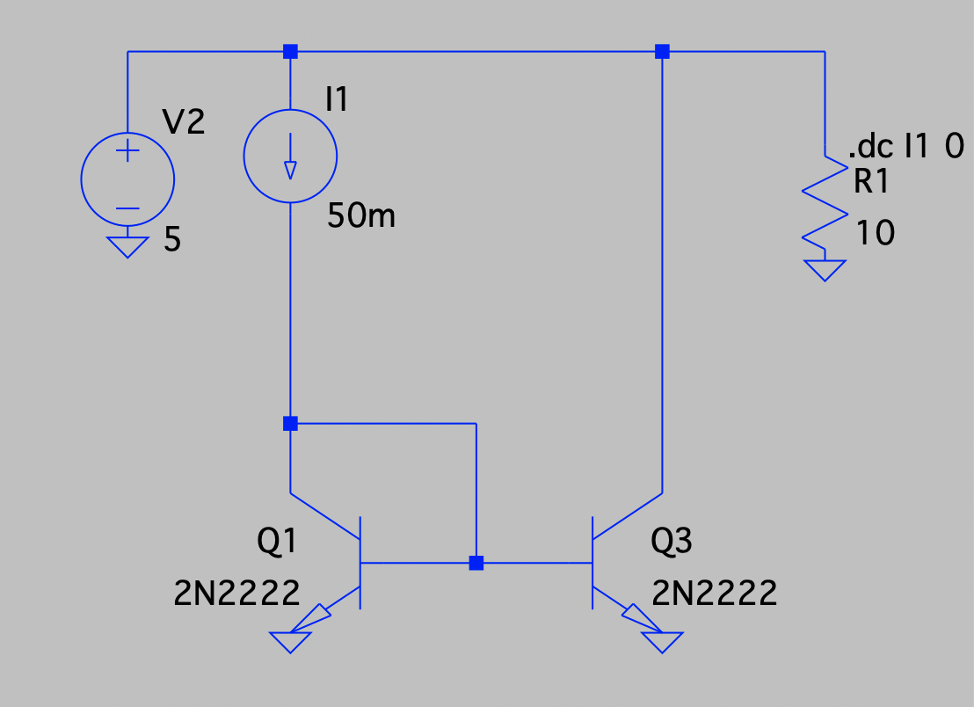
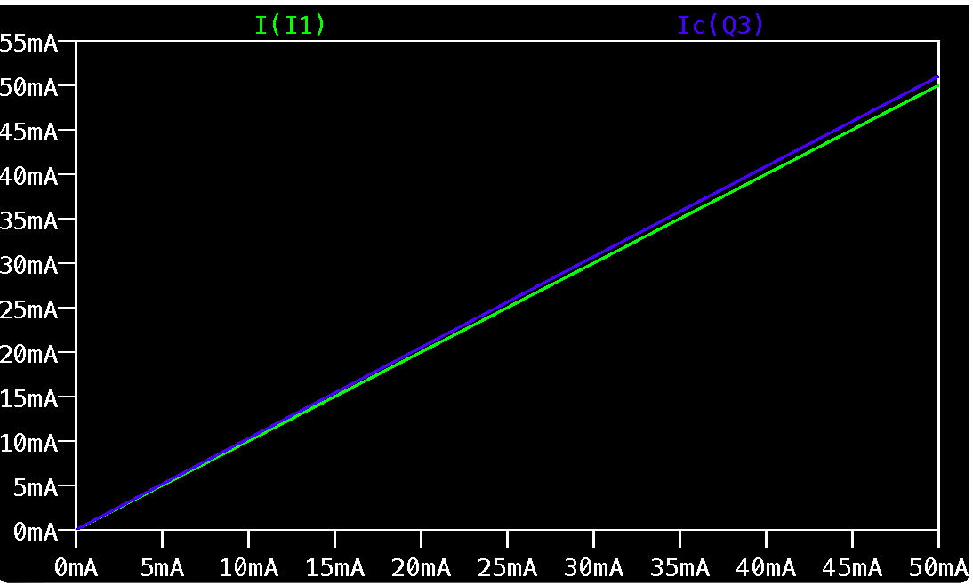
Poor mirror
Current across top left and top right segments
(Mirror)

Slide 12
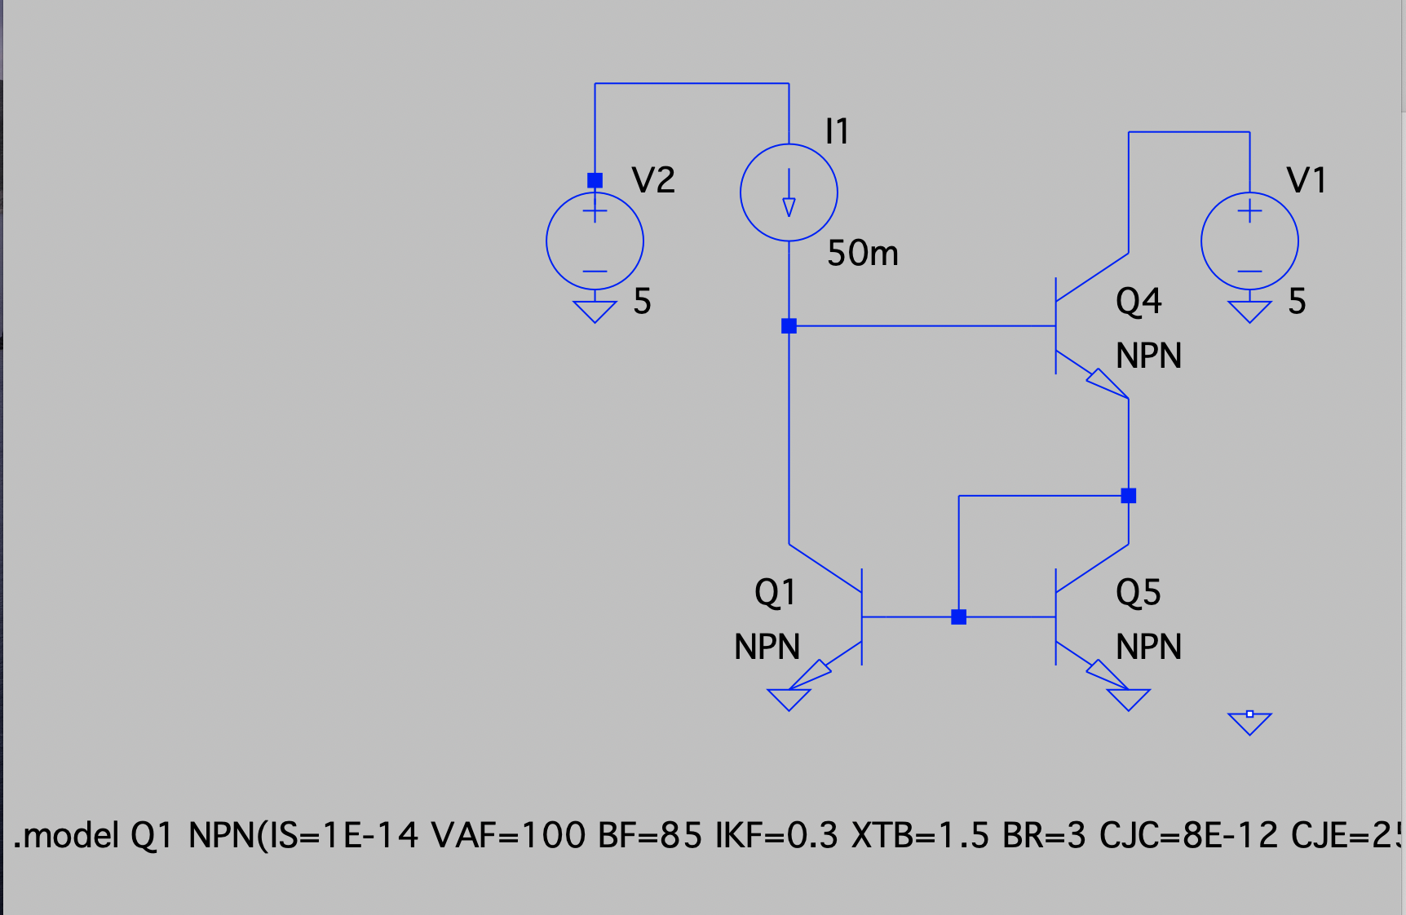
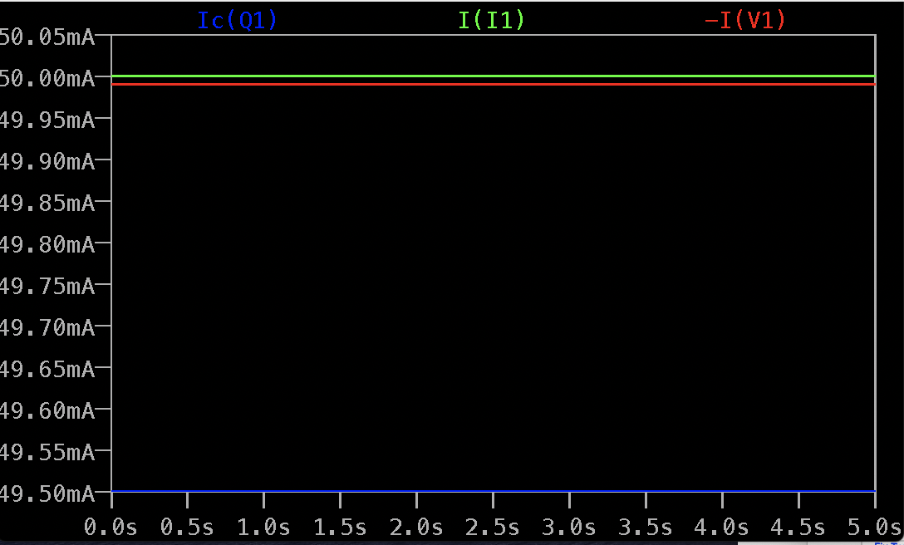
Current Mirror works because of the cross link, which allows I₁ to control VBE so that I_{out} equal I₁

Slide 13
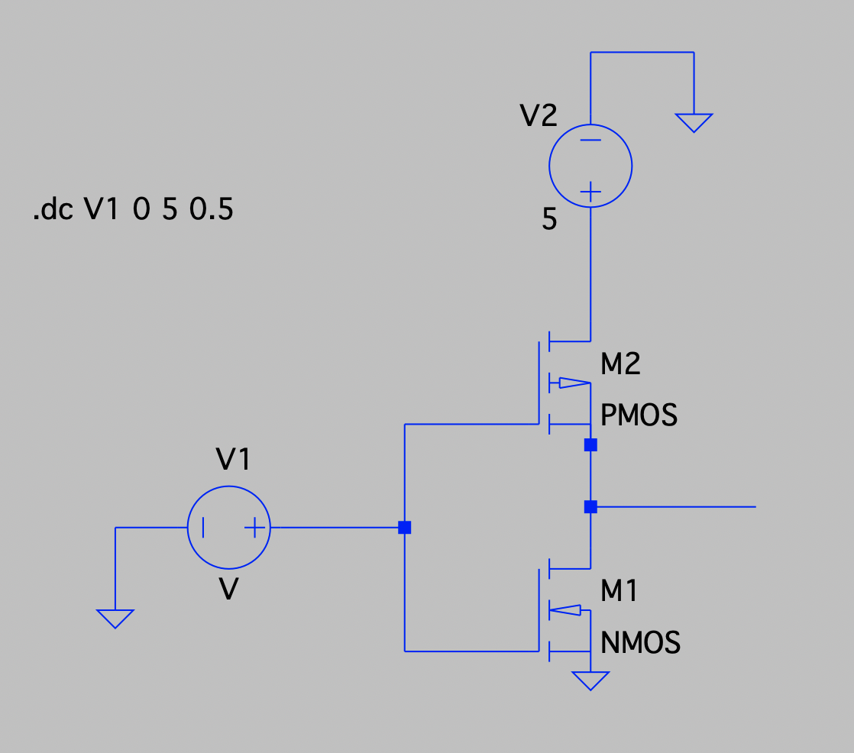
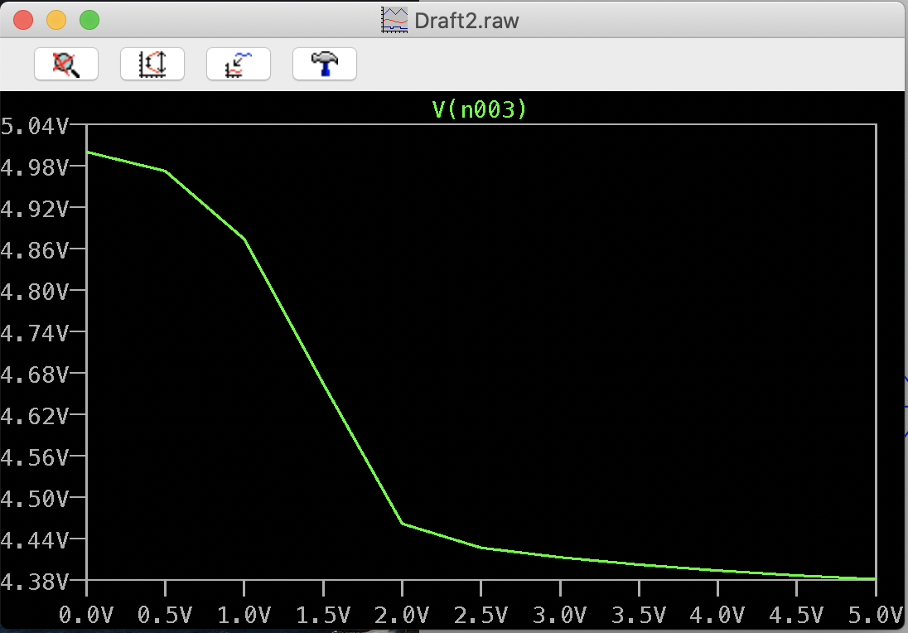
_{CMOS}

Slide 14
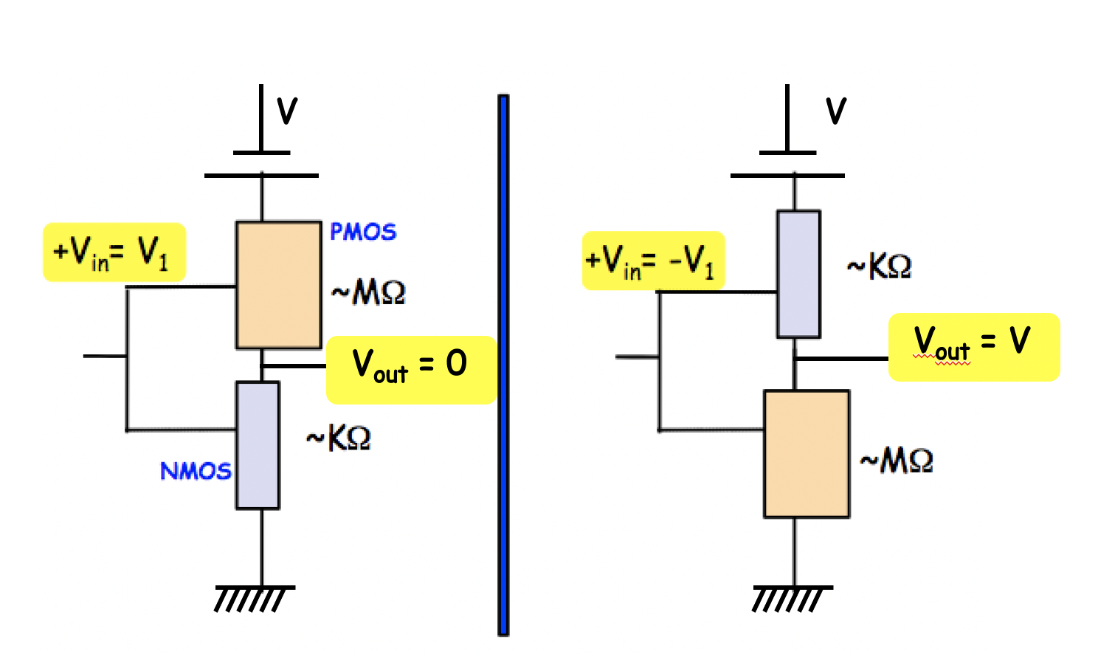
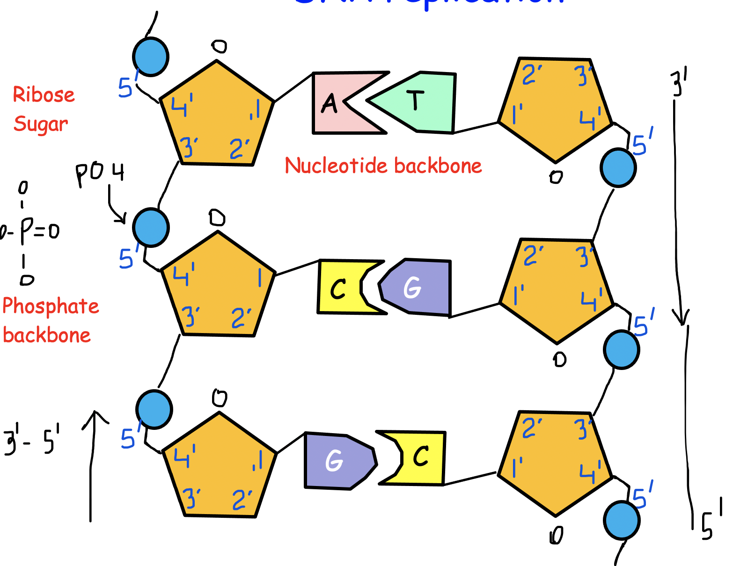
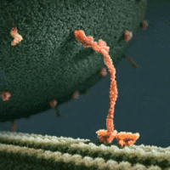
Next class
Lec 4
Thermodynamics of Computing

