Slide 1
Fundamentals of Computing
Lec 3
How we add quickly

Slide 2
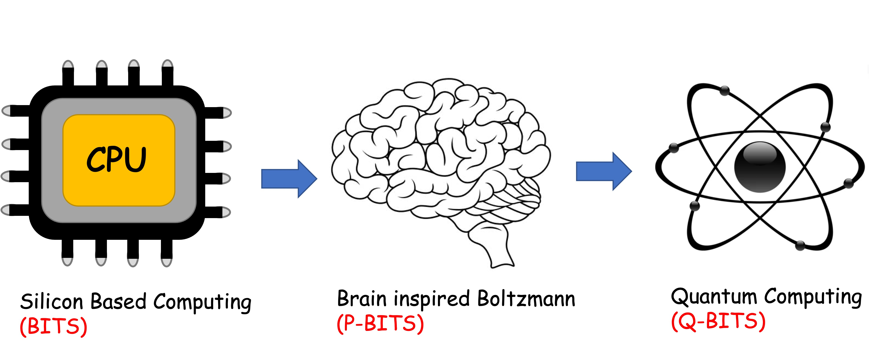
Overall structure of this course
Digital Computing in Silico
How we compute (algorithms)
How we add (Gates)
How we add quickly (CMOS)
Energy cost
How we fix errors
Analog Computing in Carbo
How we train (Supervision)
Physics of Neurons (Boltzmann)
How we learn (time sampling)
Optimizing and Classifying
Transition Theory & Inferencing
Quantum Computing in Magneto
Quantum Spins and Hardware
Quantum Physics
Entanglement and Superposition
Quantum Search and Annealing
Quantum Gates and Factorization

Slide 3
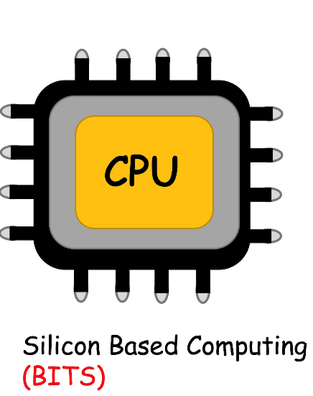

Slide 4
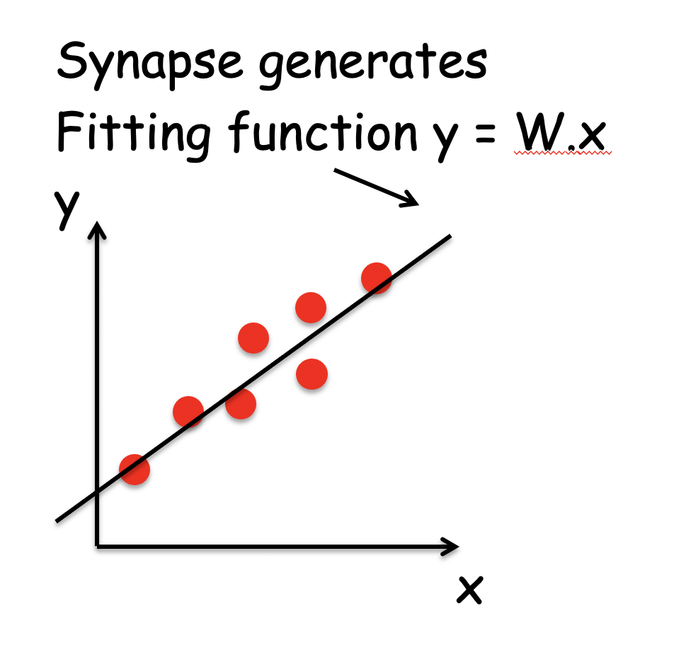
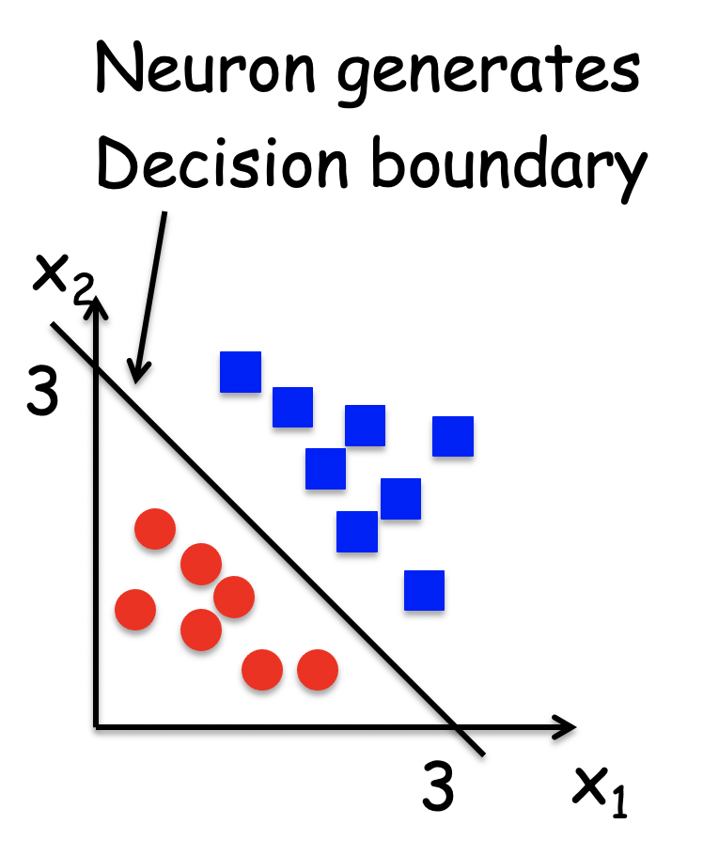
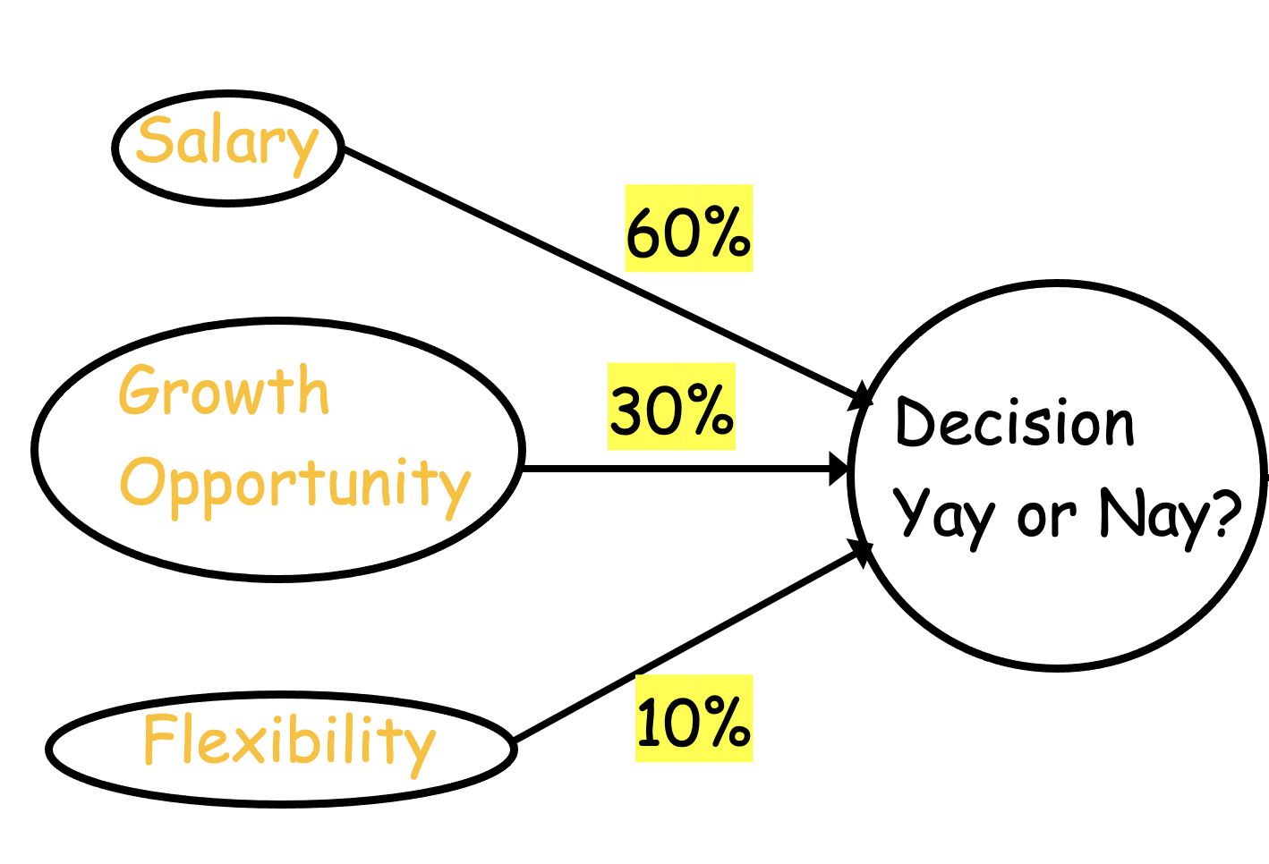
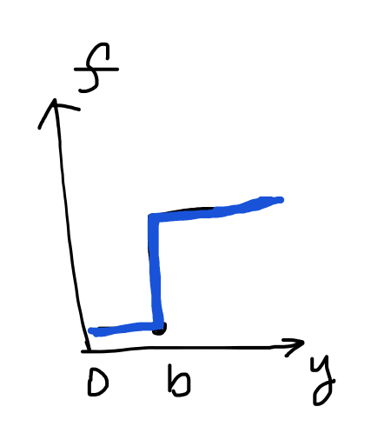
Recall Two pieces in ML/AI
Sum
Threshold

Slide 5
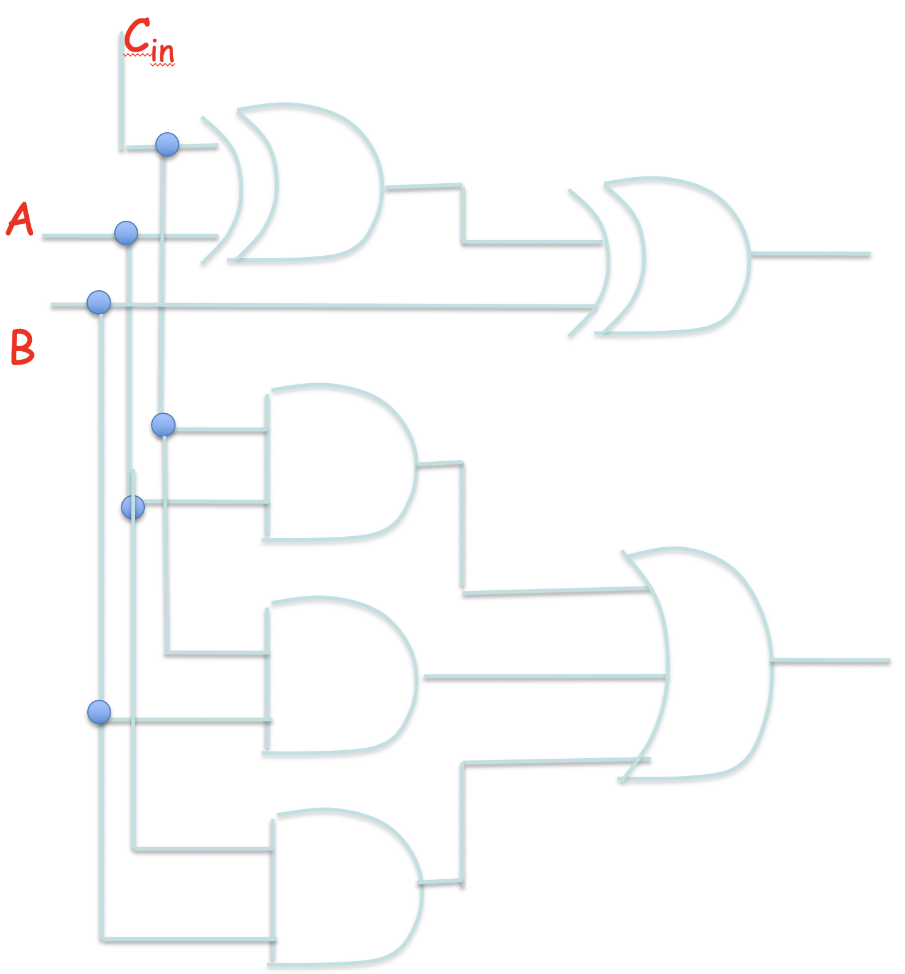
Silicon Brain
Encode info in binary (BITs):
→ 18
11011 → 27
We can store 0’s and 1’s as data strings
Logic gates map binary strings between
input and output
AND, XOR: (2 bits → 1 bit)
FA: (32+32 → 33)

Slide 6
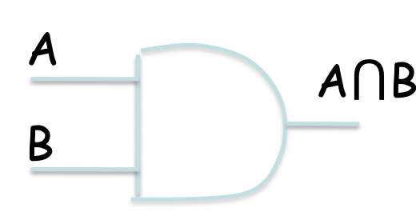
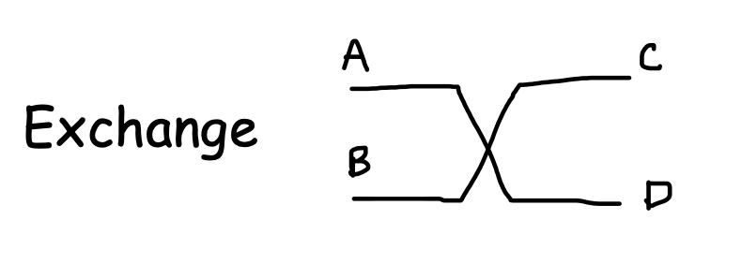
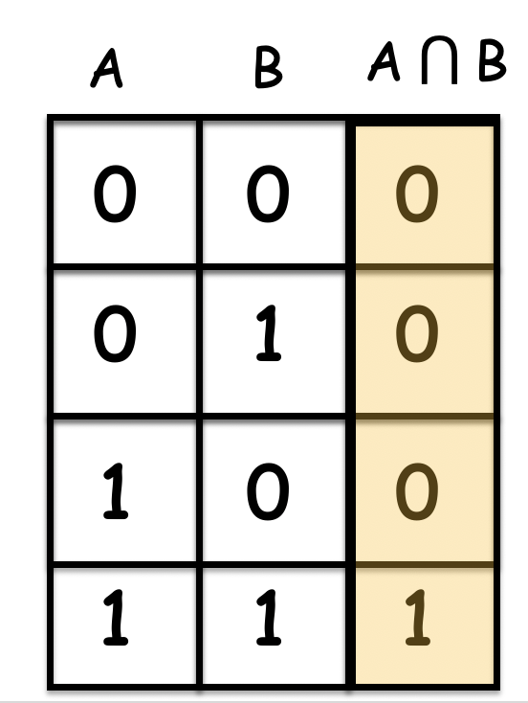
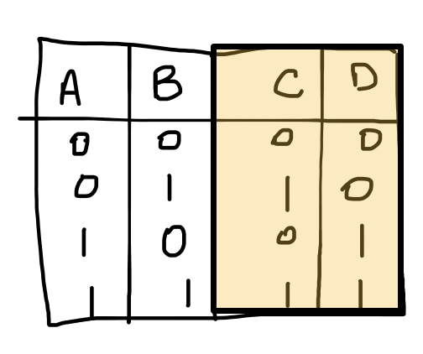
Silicon Brain
Manipulating these cost energy. How much? Energy loss related with information loss
Reduction of entropy consumes energy – Lec 4.

Slide 7
Silicon Brain
Encode info in binary (BITs):
1 1 0 1 1
1 0 0 1 0

Slide 8
Silicon Brain
Instead of mechanical switches, it’s electrical
1 0 0 1 0

Slide 9
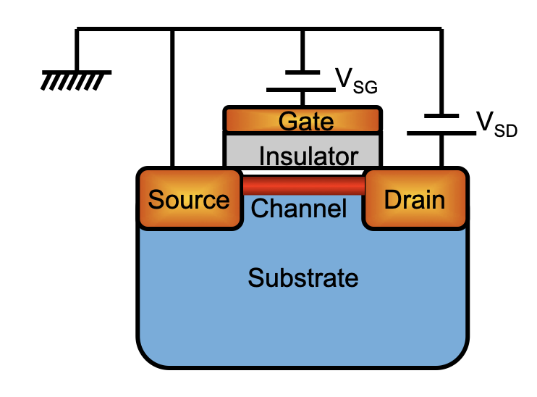
Silicon Brain
I
ON “1”
OFF “0”
V_{SD}
Signs flip between PMOS and NMOS

Slide 10
3A. Intro to CMOS

Slide 11
Basic NOT gate: an inverter
in
out
NOT
in
out
0
1
1
0
Do billions of this at
High speed (~GHz)
Low power (~mW in IoT, W on cell phones/laptops)
Low dynamic error (~10⁻¹²)

Slide 12
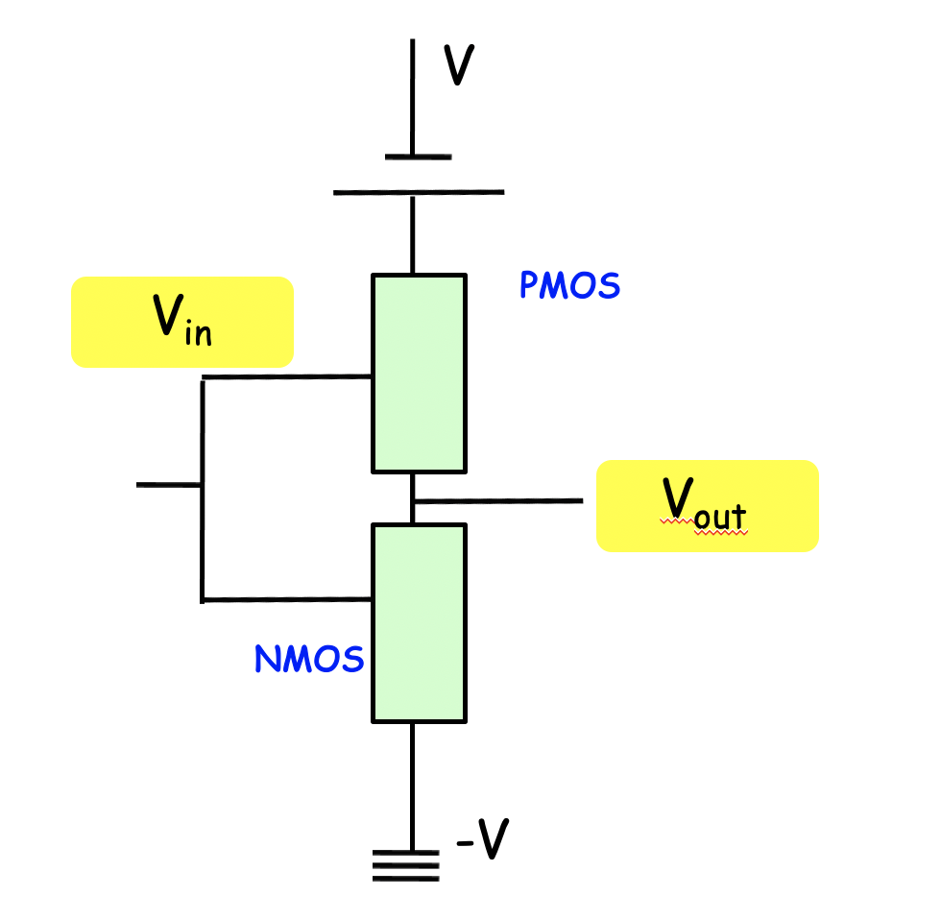
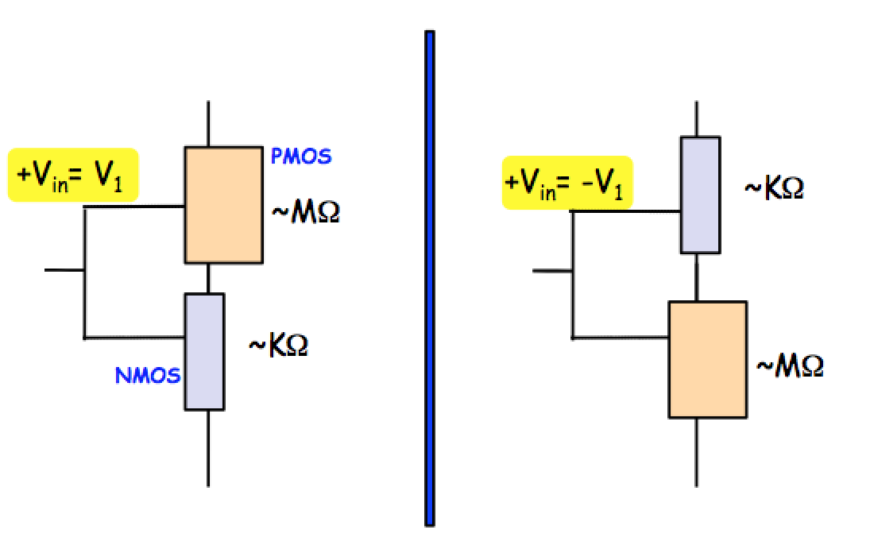
Electrical switching
V
V
V_{out} = V
V_{out} = 0
Positive input turns the lower limb (NMOS) on
Negative input turns the upper limb (PMOS) on → Inverter!!

Slide 13
Complementary Metal Oxide Semiconductor (CMOS)
Difference is orders of magnitude !
(resistivity of metals vs oxides ~10⁻⁶-10¹⁴ Ω–cm)
One is always off (static dissipation ideally ZERO)
V
V
V_{out} = V
V_{out} = 0

Slide 14
3B. How does each MOS transistor work?

Slide 15
Need a Band diagram first

Slide 16
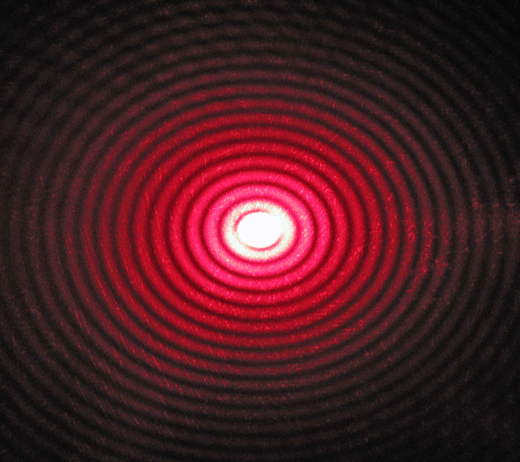
Electrons form standing waves in a grating
Some wavelengths filtered out
→ Energy gaps
E
Gap

Slide 17
Bands are direction dependent
Chemical orbitals (s,p,d)
Brillouin zone
Valleys and optical activity
Effective mass
Valence Bands and strain
Symmetry and topology
Heterostructures and band splitting
Density of States

Slide 18
E-k plots carry a lot of information
Optical absorption for direct bands (photons have zero mass and low momentum)
Fit a parabola to get an effective mass
Steeper is lighter (m_{GaAs} < m_{Si})
Orbital and spin characters control transitions between bands

Slide 19
Electrons occupy bands based on Pauli exclusion
E
Empty
Unavailable
Bandgap
~1 eV
Transition
~25meV
Fermi Energy E_{F}
Bandwidth
~5eV
Filled

Slide 20
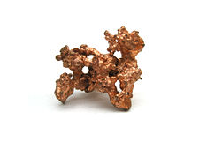
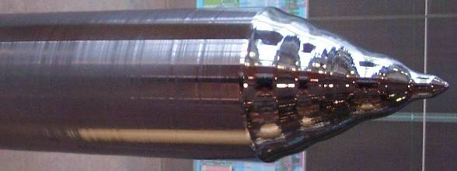
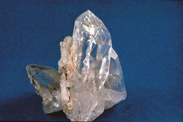
Bands determine what kind of solid we have
E
Empty levels
~1eV
~10eV
Filled
levels
Semiconductor (Si)
(charge movement
can be controlled)
Insulator (Silica)
(charges can’t move)
Metal (Copper)
(charges move)
1eV = 1.6 x 10⁻¹⁹ J = 1.24/λ(μm)

Slide 21
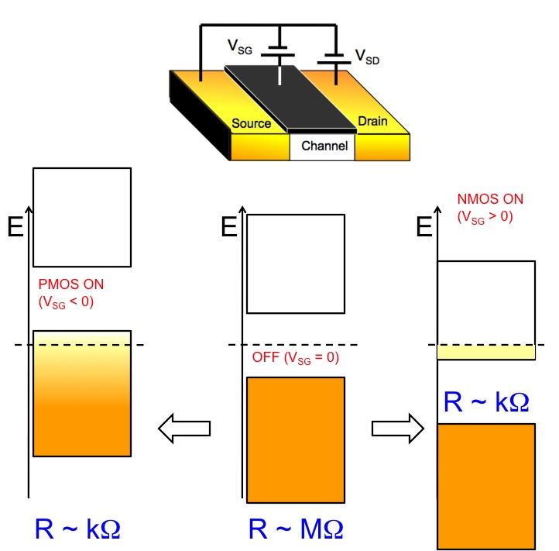
Act of electronic switching

Slide 22
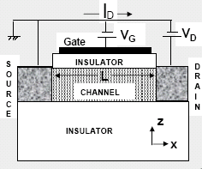
In plain English…
V_{G} > 0
n type operation
Vacuum
Level
More
electrons
Positive gate bias attracts electrons into channel
Channel now becomes more conductive

Slide 23
In plain English…
V_{G} < 0
p type operation
Vacuum
Level
More
holes
Negative gate bias attracts holes into channel
Channel now becomes more conductive

Slide 24
The origin of high ON-OFF

Slide 25
What is ‘n’?
Number of ‘free’ electrons in NMOS
(untied to parent)

Slide 26
There is a corresponding ‘p’
Number of ‘free’ holes in PMOS

Slide 27
Intrinsic semiconductor

Slide 28
Create excess electrons and holes by doping
This also moves E_{F} towards CB

Slide 29
Create electrons and holes by doping
This also moves E_{F} towards VB

Slide 30
Charges grow at each other’s expense
Arithmetic Mean can change with doping
Geometric Mean stays fixed

Slide 31
Charges grow at each other’s expense

Slide 32
Note how voltages are related
to concentration logarithmically
How can we use this?

Slide 33
3C. Building devices out of this
PN junctions

Slide 34
P and N together

Slide 35
P and N together

Slide 36
P and N together

Slide 37
P and N together

Slide 38
Forward Bias – Exponentially grow current

Slide 39
Reverse bias – Reduce current to saturation

Slide 40
Barrier Engineering

Slide 41
Speed of the diode

Slide 42
Speed of the diode

Slide 43
Mobility in an electric field

Slide 44
Diffusion in thermal field

Slide 45
Electrons in semiconductors are fast because
1. They are light!
2. Less interruptions in a clean solid (low scattering)
λ^{e}_{sc} ~ 10—100s of nm
(1000x electron size ~0.1 nm)
λ^{H20}_{sc} ~ 100 nm
(25x molecule size ~ 4 nm)

Slide 46
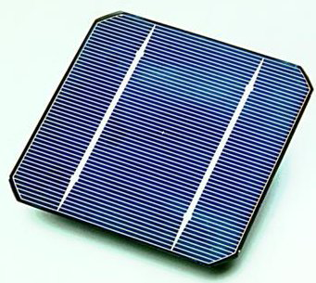
Use for a PN junction: Solar Cell

Slide 47
Solar Cell

Slide 48
3D. From single PN junction to MOS
transistor

Slide 49
Transistor acts like a solar cell
(Inundates with excess charges)

Slide 50
Transistor acts like a solar cell
(Inundates with excess charges)

Slide 51
NPN transistor → NMOS transfer characteristic

Slide 52
PNP transistor → PMOS transfer characteristic

Slide 53
Drain bias reverse biases one end
(like solar cell)

Slide 54
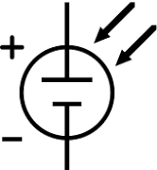
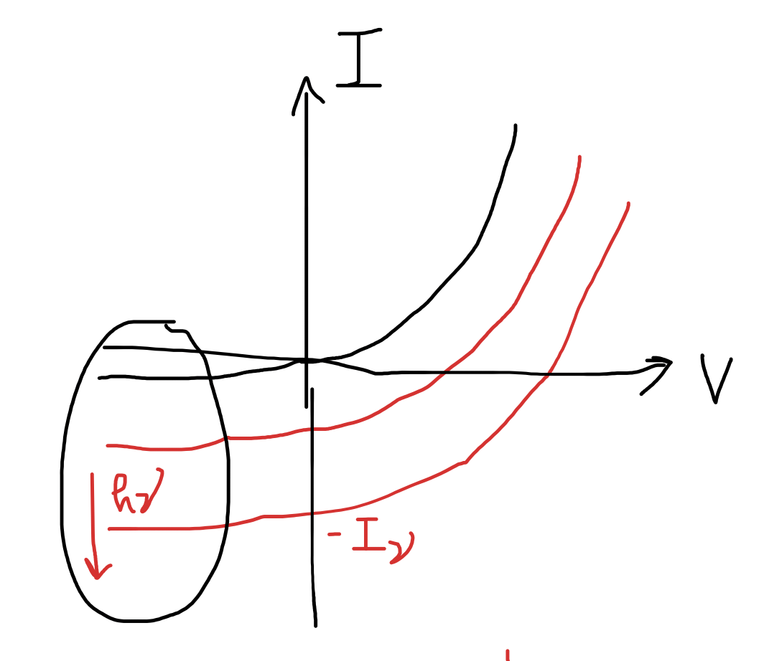
Output characteristics

Slide 55
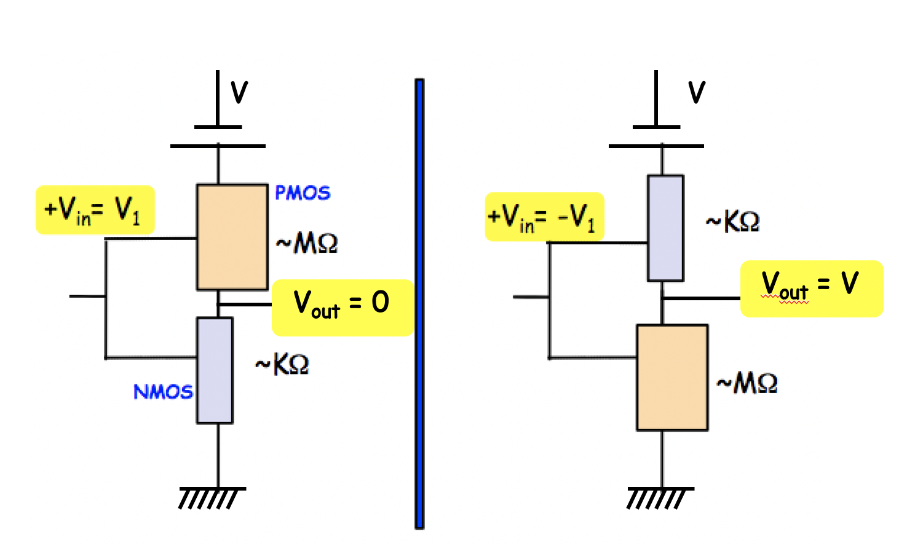
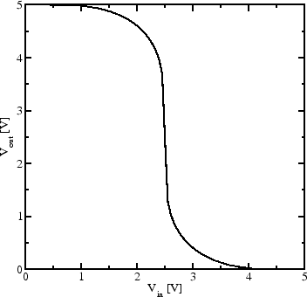
How do these I-Vs translate to CMOS inverter?
ON
Gain
OFF

Slide 56
CMOS – Combine NMOS and PMOS

Slide 57
Short-channel effects

Slide 58
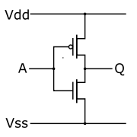
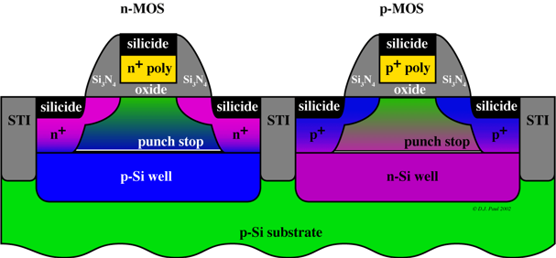
Build a “NOT” with CMOS inverters
PMOS
NMOS
+ voltage turns NMOS on, shorts to
ground
voltage turns
PMOS on, shorts
to power supply voltage
ON
Gain
OFF

Slide 59
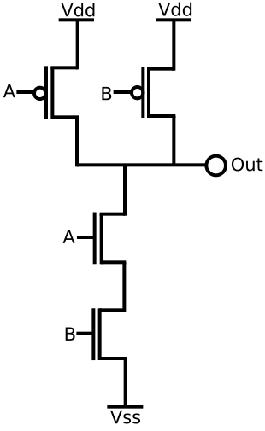
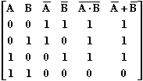
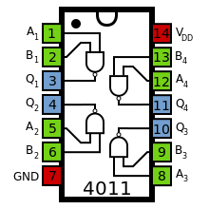
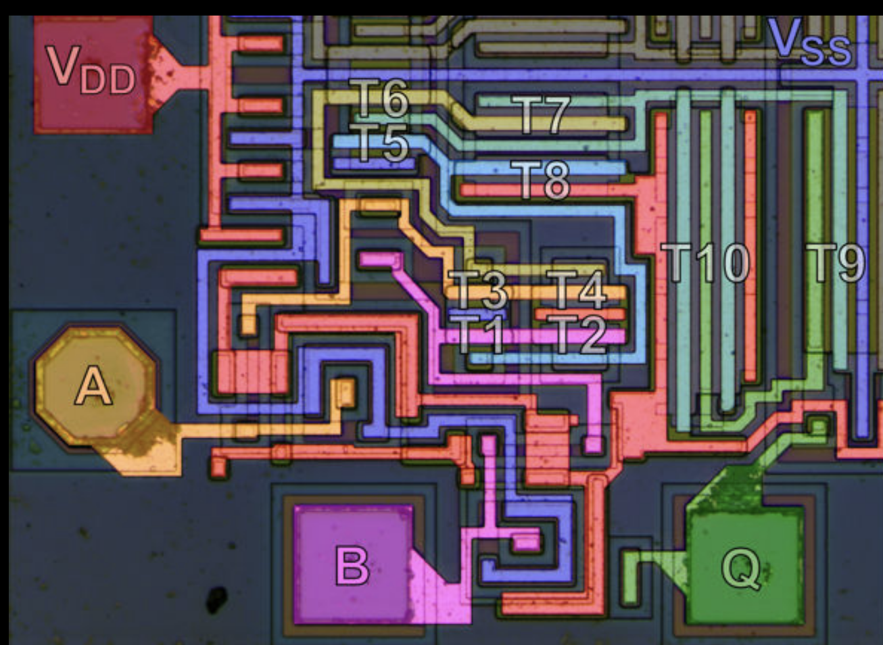
Build a NAND with CMOS inverters
NAND
0
0
1
0
1
1
1
0
1
1
1
0

Slide 60
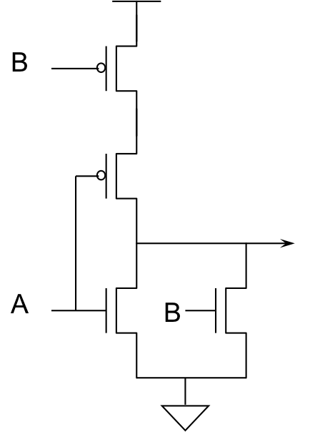
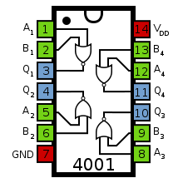
Build a NOR with CMOS inverters
NOR
0
0
1
0
1
0
1
0
0
1
1
0

Slide 61
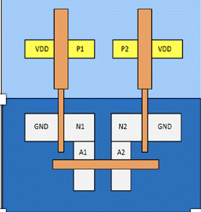
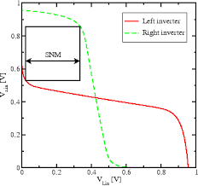
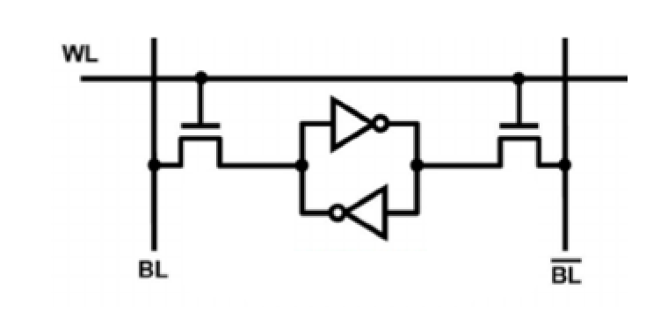
Build memory with CMOS
(6T-SRAM)
Cache memory

Slide 62
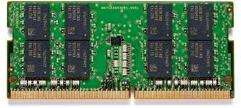
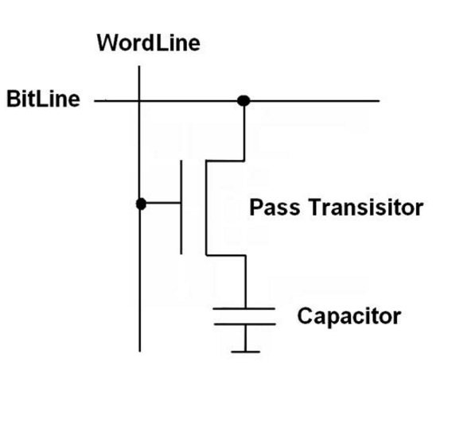
Build memory with CMOS
(DRAM)
Slower than SRAM (leakage)
Denser and cheaper
Main memory: PC, workstations, servers

Slide 63
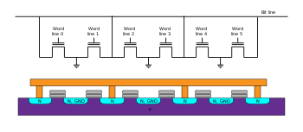
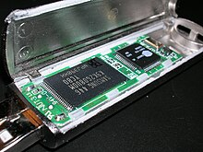
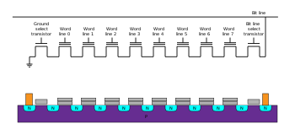
Memory Sticks, PC cards

Slide 64
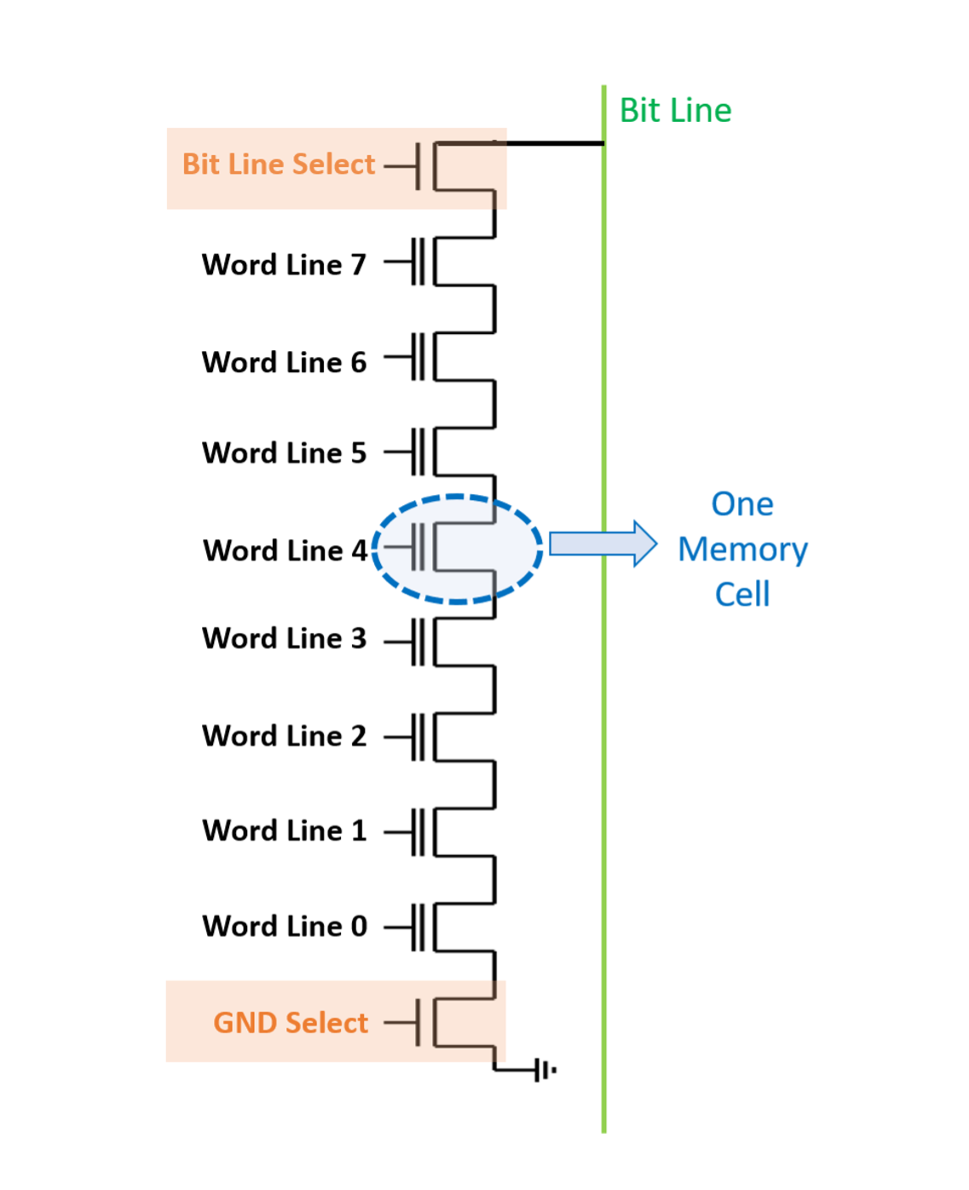
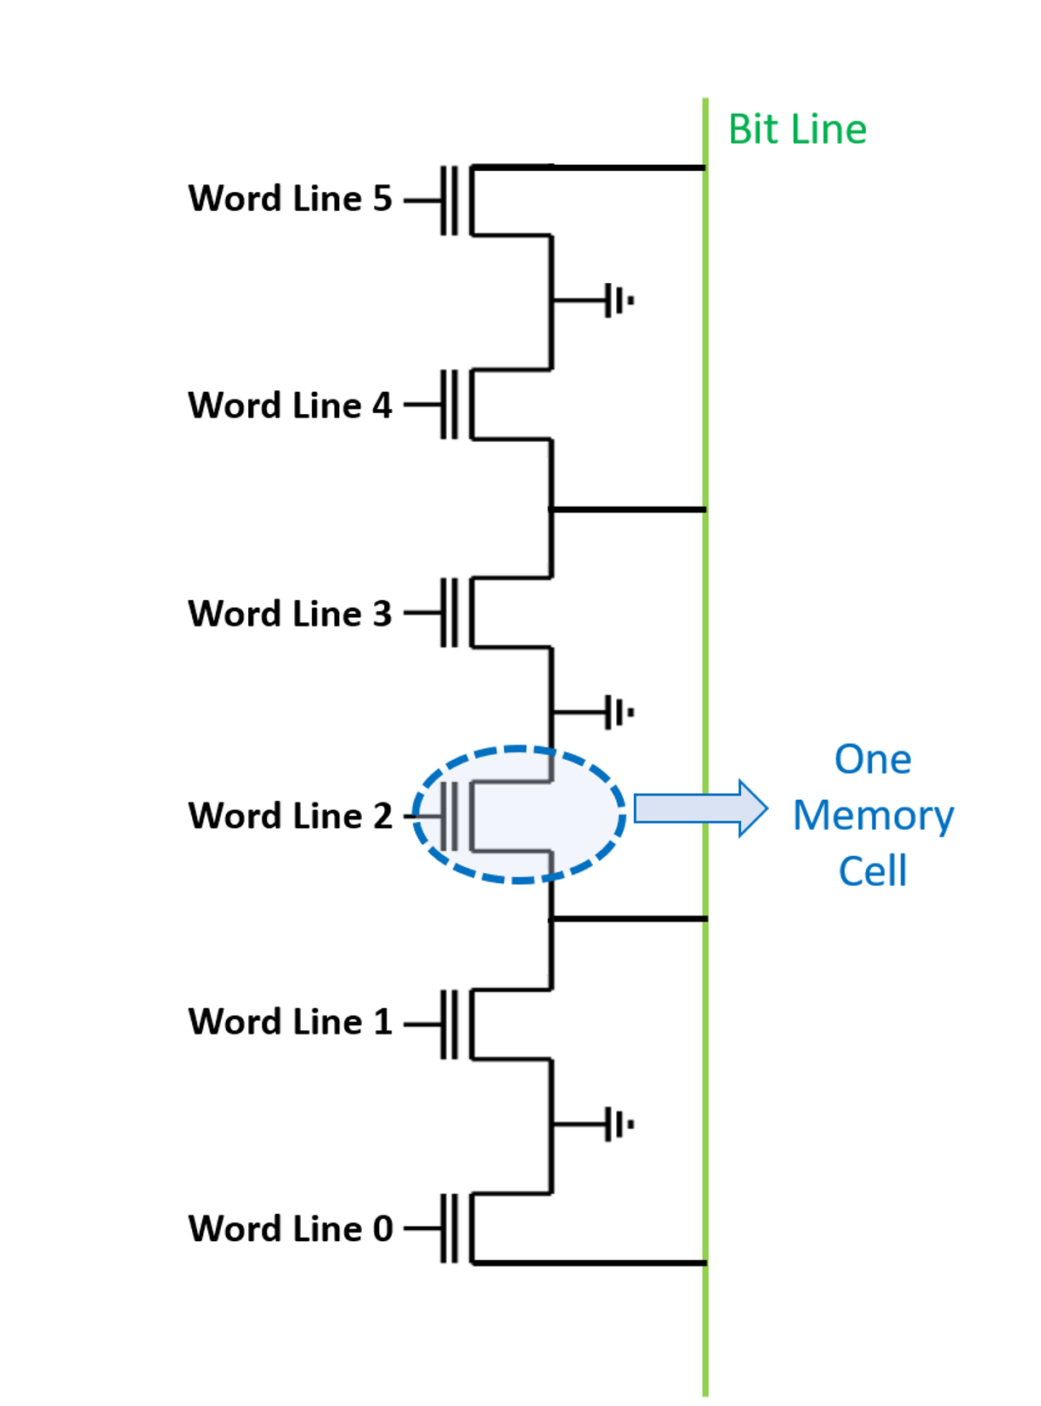
Need rise and fall times of CMOS equal
R_{PMOS} = 2R_{NMOS}
NAND:
2 NMOS in series: R = ? → Pull down
2 PMOS in parallel R = ? → Pull up
Lower resistance
Series connection means stackable, smaller (denser, cheaper)
NOR:
2 NMOS in parallel: R = ? → Pull down
2 PMOS in series: R = ? → Pull up
Higher resistance
Faster to read
(address each bit individually)
Slower to write/erase (erase each to 0
before over-writing)

Slide 65
Why CMOS specifically for inverters?
Low power: Once settled, no static current flow
V
V
~KΩ
~MΩ
-V
+V
+V1
-V1
~KΩ
~MΩ
-V
-V

Slide 66
3E. The trouble with CMOS

Slide 67
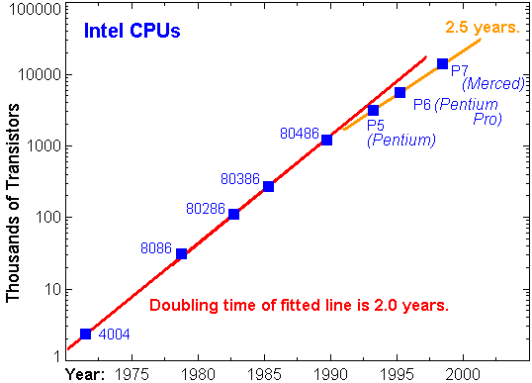
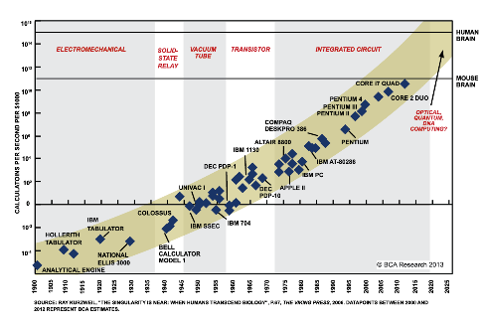
CMOS drove Moore’s Law for decades
Smaller/Faster/Cheaper

Slide 68
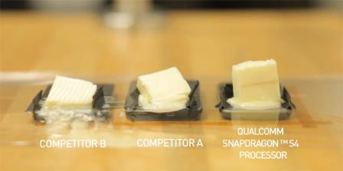
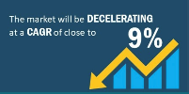
..Trouble in Paradise !
Pentium 2000, 50W/cm²;
~2025, 40MW/cm²
Based on Fundamental considerations alone !

Slide 69
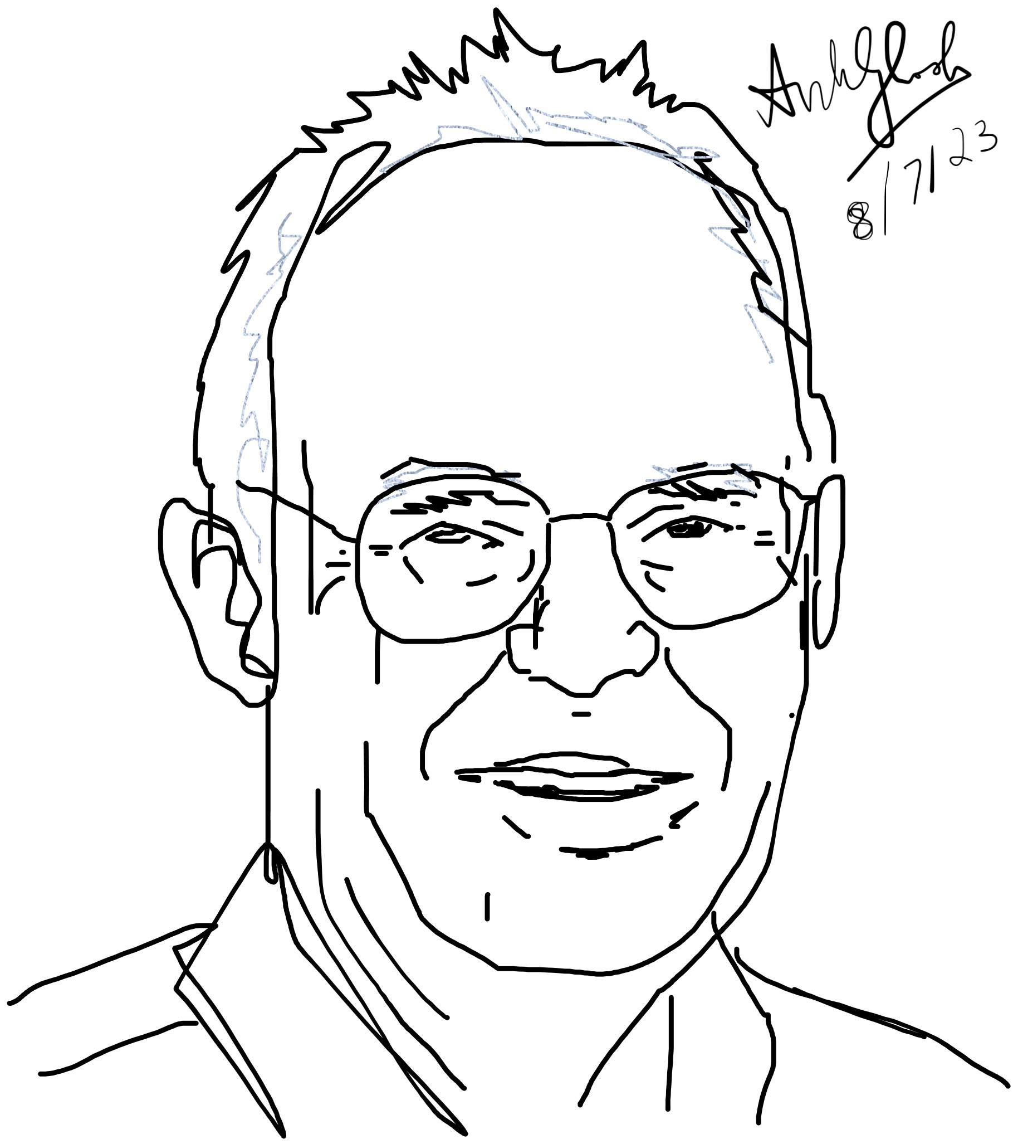
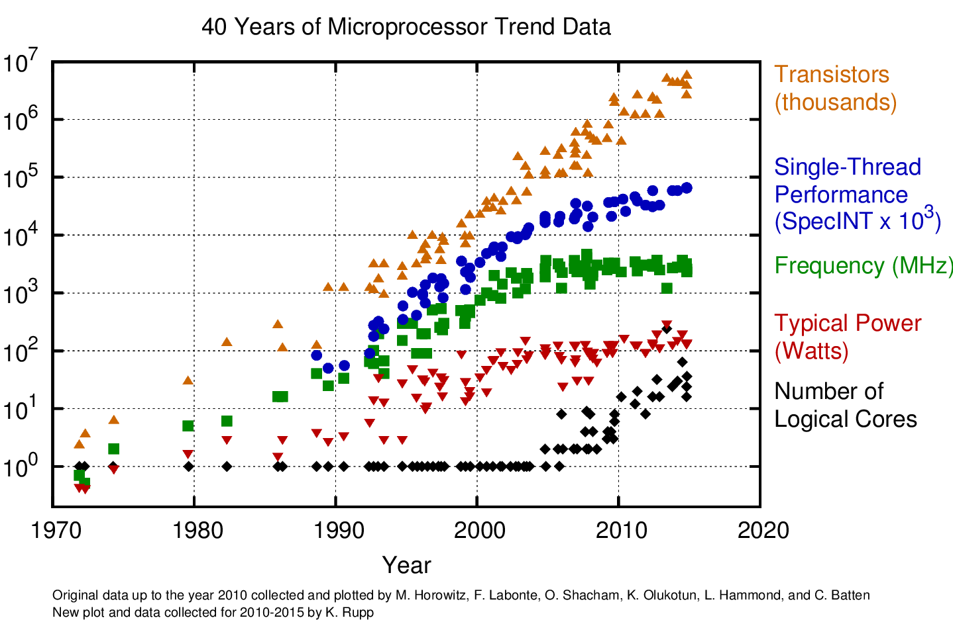
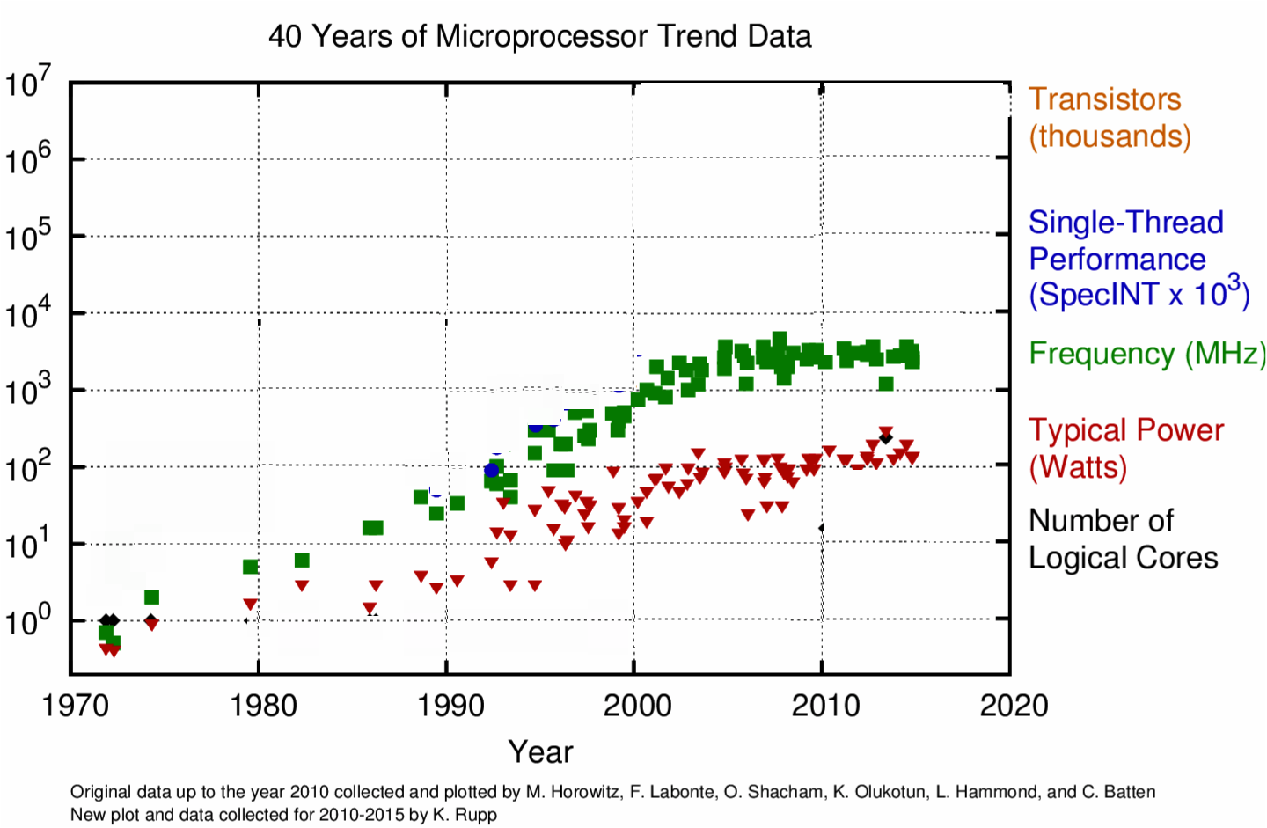
Dissipation in CMOS
P_{diss} ∝ V² f
Gordon Moore
3V
V
2V
f
Limited by
Heat
1V
Limited by
Error tolerance
No More
ITRS roadmap !
Freq & V
Scaling –
Death of Dennard Scaling
Strained
Si
NonPlanar
Gate
High-K
Metal Gate

Slide 71
ITRS → IRDS

Slide 72
To summarize
Electrons in silicon are quick (low mass, clean systems)
~ GHz
They consume low power (CMOS architecture – no static
current), although high dynamic power is now slowing down
further scaling
~mW-W
They are accurate because the barriers (bandgaps) are
very large due to low electron mass, and much bigger than
thermal energy kT which is set by atomic mass and its
sluggish motion
~ 10⁻¹²-10⁻¹⁵ dynamic error

Slide 73
3F. SPICE modeling of circuits

Slide 74
LAB : COMPUTER MODELING
Drift-Diffusion
Boltzmann Transport NEGF
SPICE

Slide 75
LTSPICE
Download LTSPICE for MAC-OSX
Install

Slide 76
Open Draft --> component to pick a piece
Draft → Component → npn

Slide 77
Duplicate, Erase, Drag, Flip
Replication is automatic with cursor movement
To stop, hit escape
To cancel, fn F5 (scissor comes up, then cut and then esc to stop)
To move, fn F7 then drag and draw box around limb of any subfigure, then move
To flip, click on figure after fn F7, then command E

Slide 78
Draw wires, add ground, resistors, voltage/current sources
Draft → Wires, double click to start, single click to extend, esc to escape
fn G for each ground
Draft → Component → Voltage for V-source, current for current-source

Slide 79
Fix NPN features, Voltages, current sources
Right Click, pulls up sheet for each component
Enter values (e.g. R, V)

Slide 80
Fix Transistor specs
For each transistor, right click to pull up transistor data sheet, pick new transistor
CTRL c to copy any of the transistors (first one eg), then cancel

Slide 81
Fix Transistor specs
Replace model name with transistor name
Gain (BF), or other info (seek manual)
Draft SPICE directive then copy Ctrl V info into blank space, then edit

Slide 82
Set voltage conditions for run
[V0, V1 range, V0 start, ΔV step]
.tran 0 5 0 0.1 (in spice directive)
New window pops up
Bring cursor over wire on main window
Voltage probe (red) pops up
CMD switches to current probe
Graphs shown on output window
Current across top left and top right segments
(Mirror)

Slide 83
Poor mirror
Current across top left and top right segments
(Mirror)

Slide 84
Current Mirror works because of the cross link, which allows I₁ to control VBE so that I_{out} equal I₁

Slide 85
_{CMOS}

Slide 86
Next class
Lec 4
Thermodynamics of Computing

