Slide 1
Fundamentals of Computing
Lec 4
Thermodynamics of
Computing

Slide 2
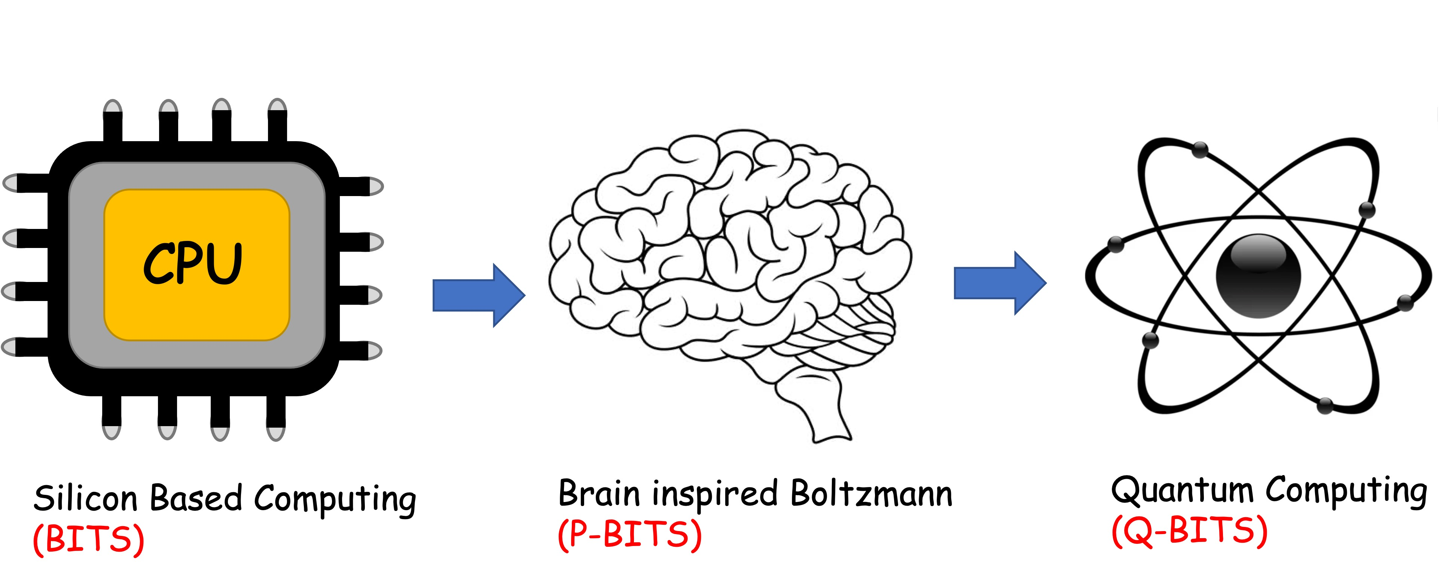
Overall structure of this course
Analog Computing in Carbo
How we train (Supervision)
Nature’s Supervision (Boltzmann)
How we learn (time sampling)
Optimizing
Classifying (Truth Tables)
Transition Theory
Inferencing (Bayesian)
Quantum Computing in Magneto
Quantum Spins and Hardware
Interacting Spins
Going parallel: Quantum Physics
Entanglement and Superposition
Cloning and Key Distribution
Quantum Search and Annealing
Quantum Gates and Factorization
Digital Computing in Silico
How we compute (algorithms)
How we add (Gates)
How we add quickly (CMOS)
Thermodynamics of Computing
How we fix errors

Slide 3
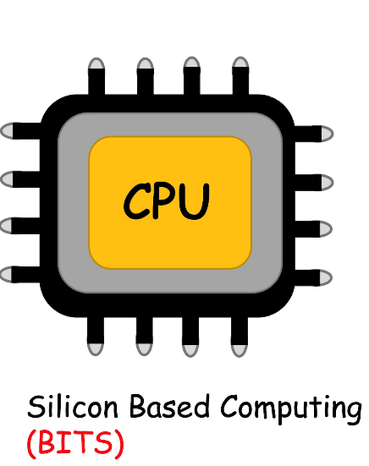

Slide 4
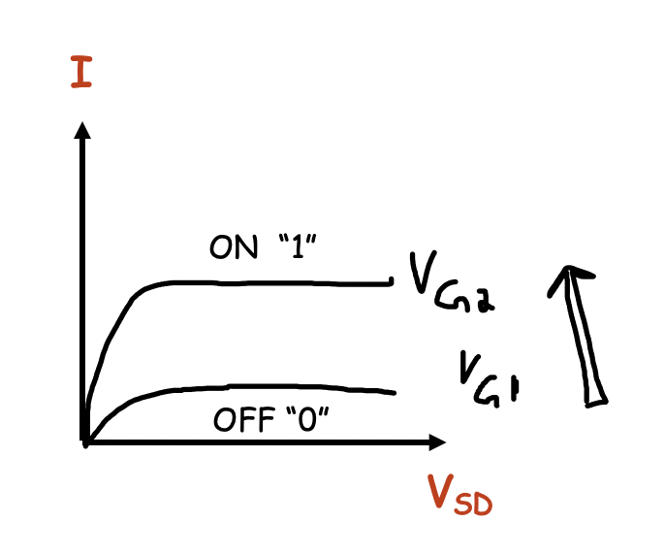
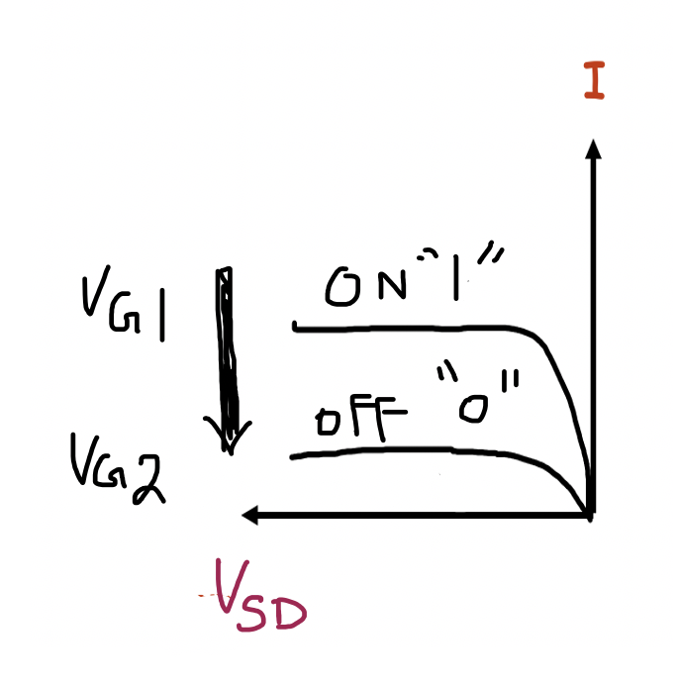
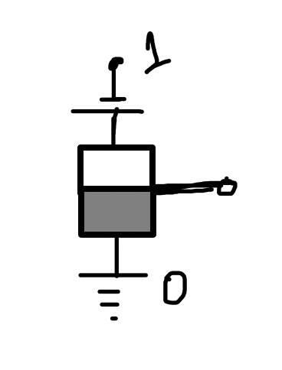
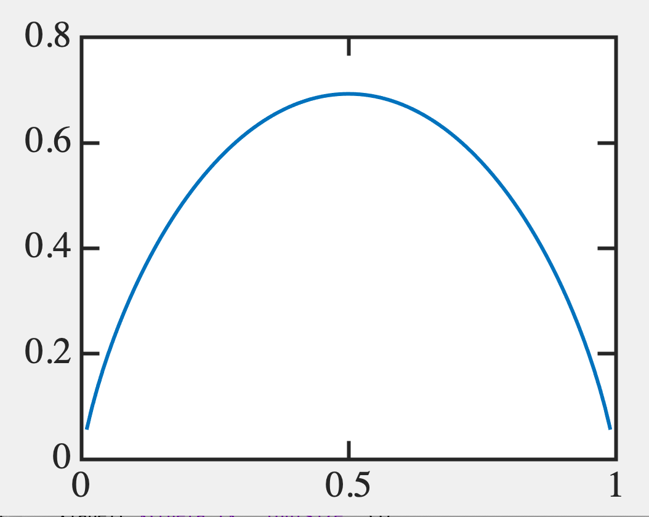
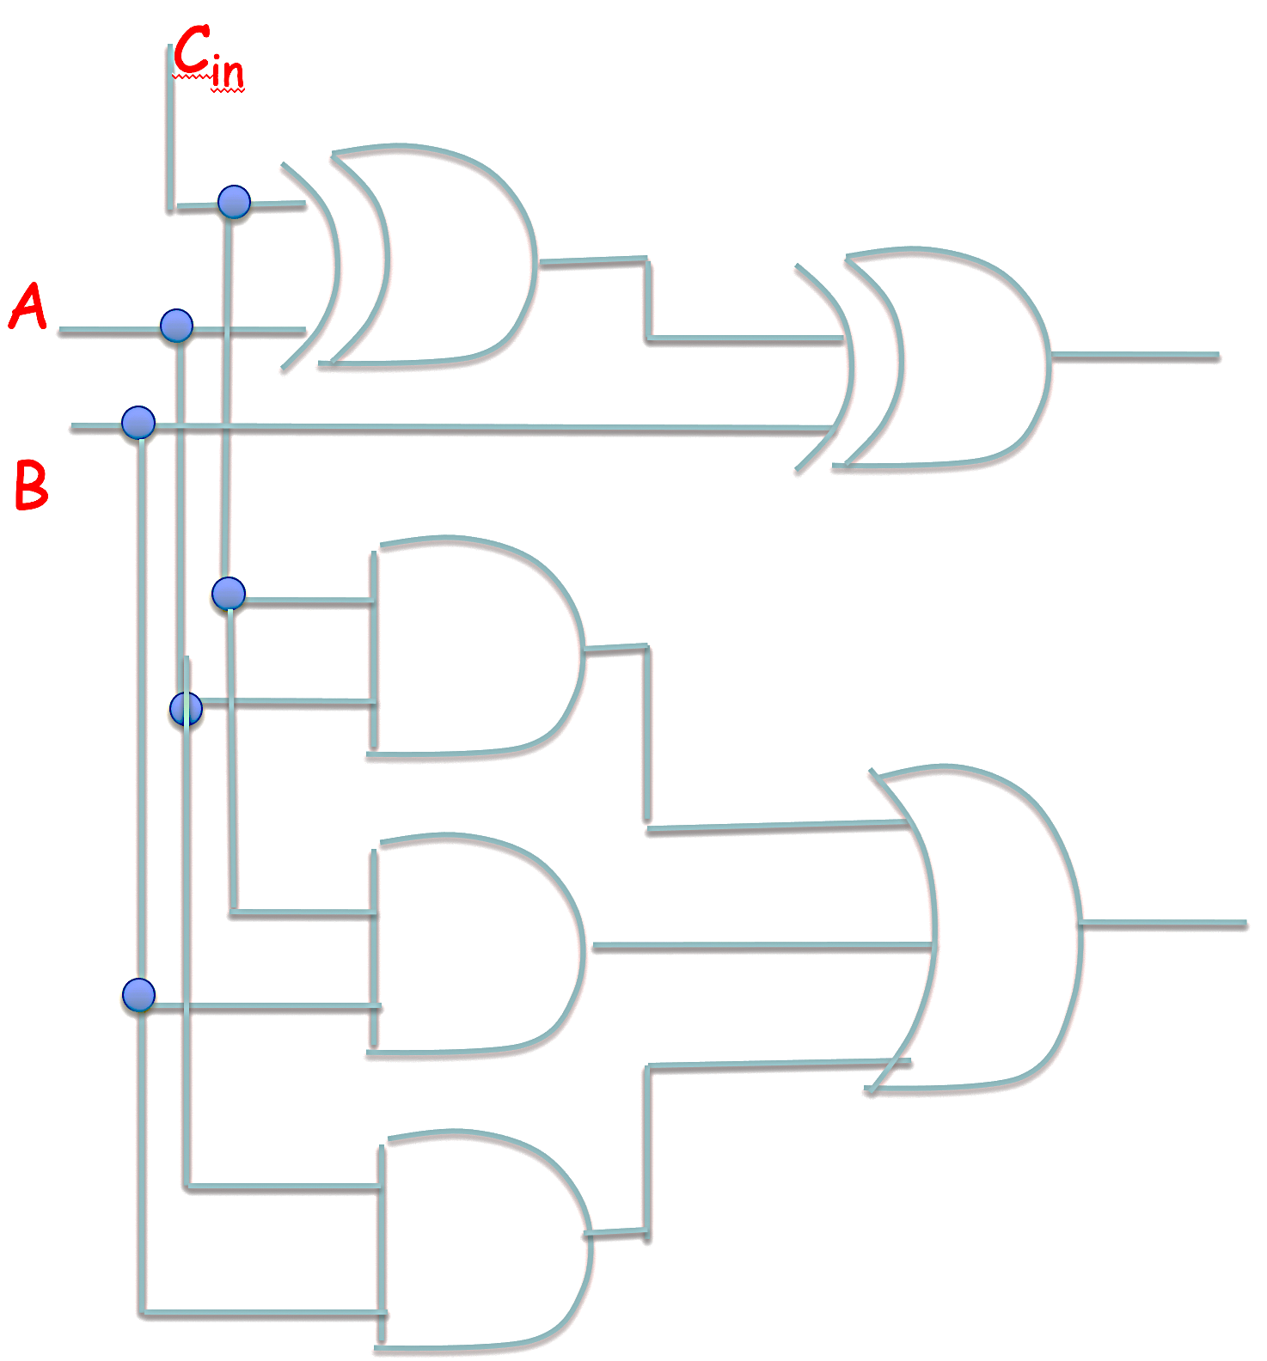
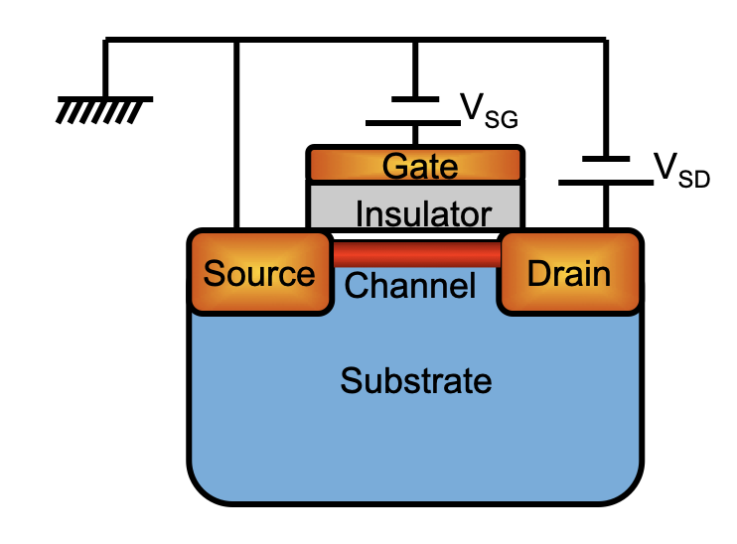
The story so far
y = W.x
Essential for regression,
Digital logic
y
CMOS
Turns on NMOS
Turns on PMOS
x
Dissipation of energy
Gate moves Fermi energy
in/out of band
Full Adder (Gates)
NMOS/PMOS

Slide 5
4A. Reversible & Irreversible computing

Slide 6
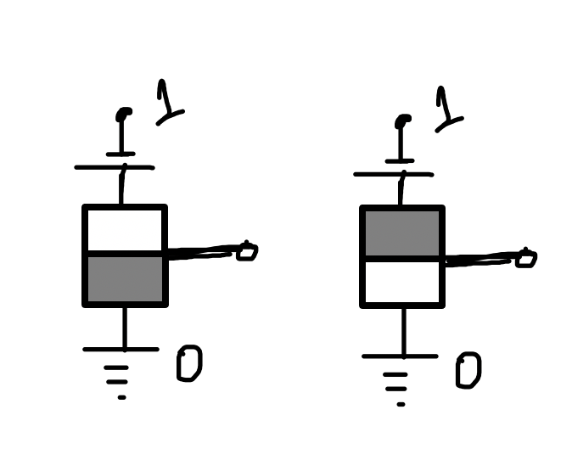
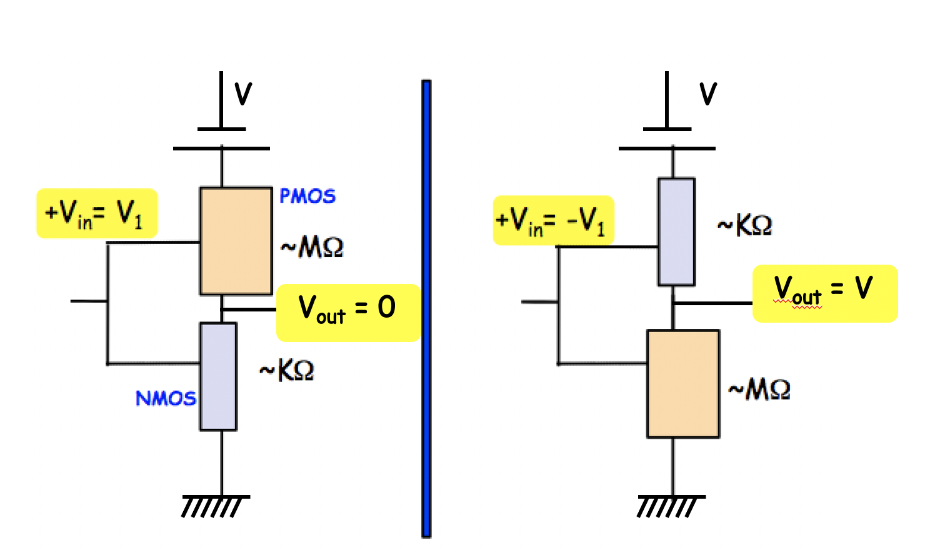
Recall why CMOS specifically for inverters
Low power: Once settled, no static current flow
Dynamic power - charging a capacitor to completeness
Charge falling downhill (high V to low V)

Slide 7
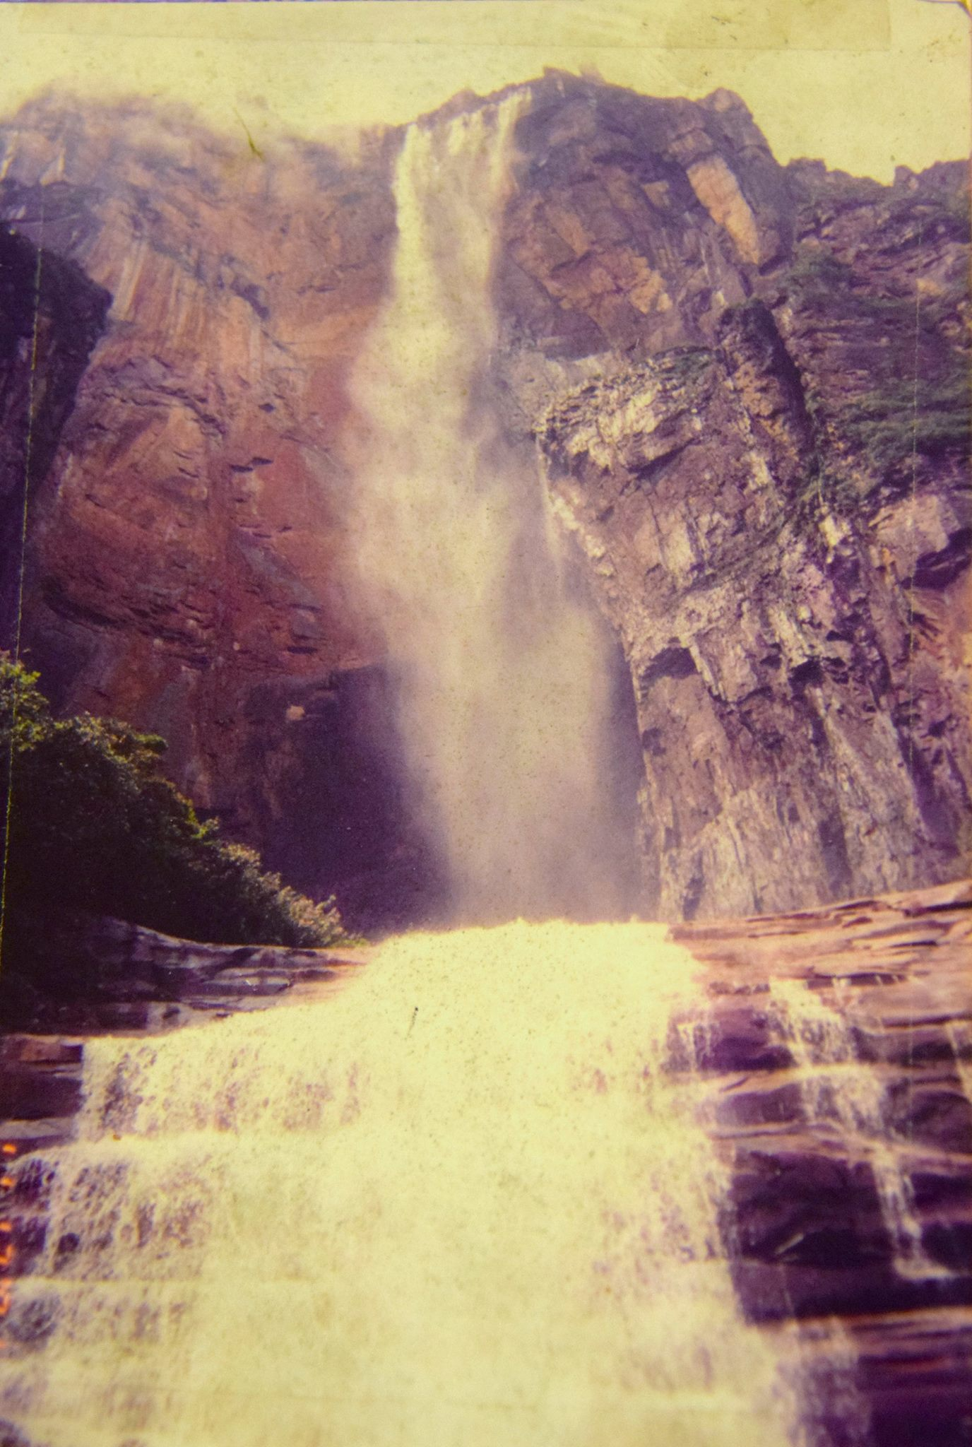
Energy dissipated to charge a capacitor
It’s the energy that cannot
be recovered !!
(Lost irretrievably)

Slide 8
A capacitor (two metal plates + insulator in between
to hold charge)
R
C
V₀
Energy units (eV) → Q x V
Capacitance C: capacity to store charge per volt
C = Q/V [Coulomb/Volts = Farad]
C prop to size: C = [ε]A/d [ε: Farad/m]

Slide 9
Energy to charge a capacitor
R
C
V₀
C charges to V₀ over time T
T = Q/I = CV/[V/R] = RC

Slide 10
Energy dissipated to charge a capacitor
R
C
V₀

Slide 11
Power dissipated in capacitor
R
C
V₀

Slide 12
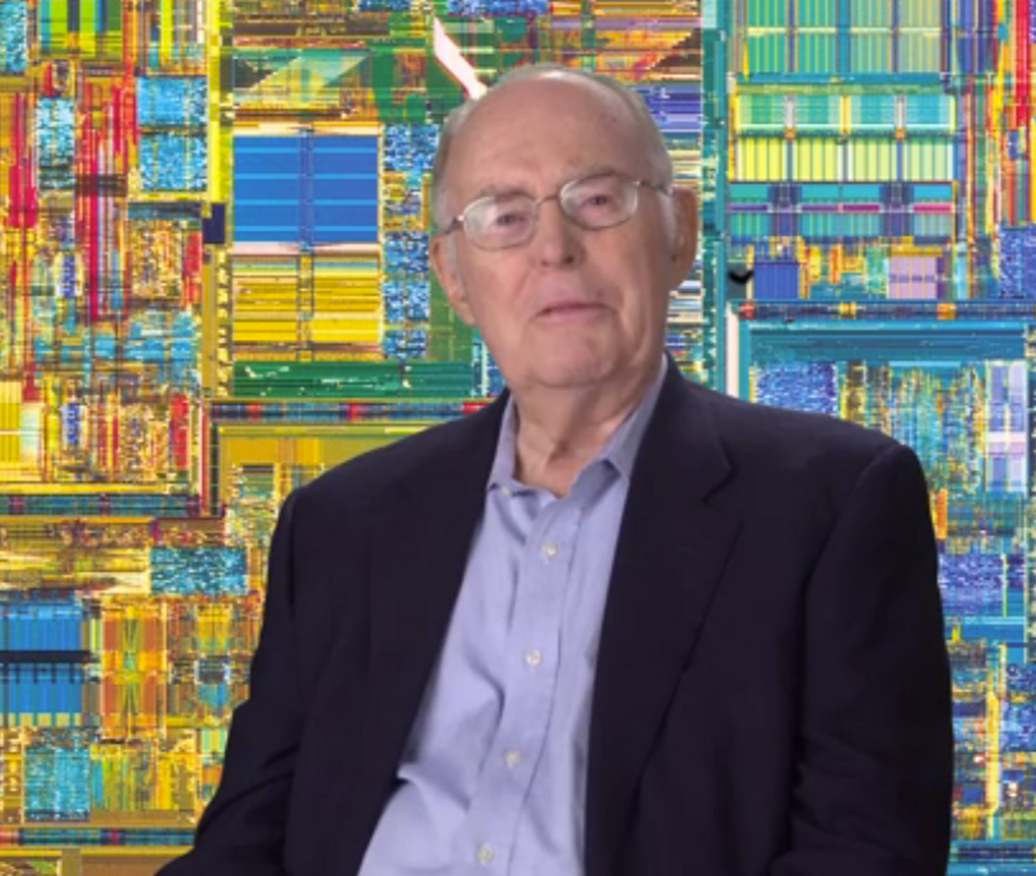
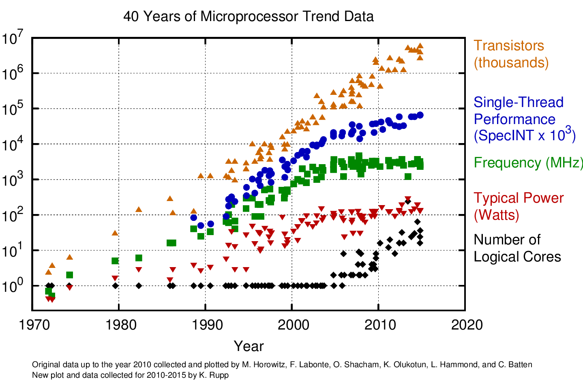
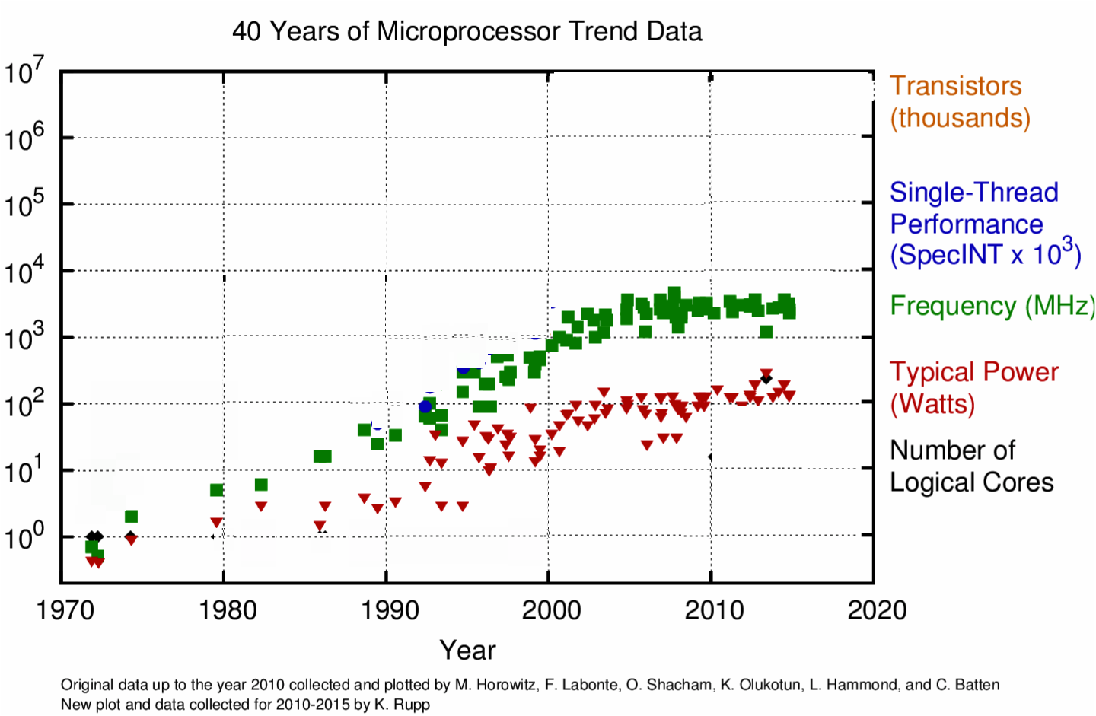
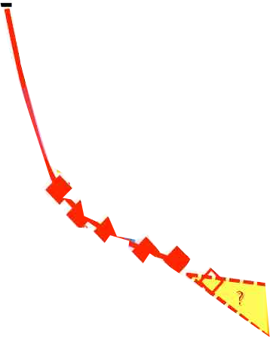
Le roi est Moore, vive le roi
P ∝ CV²f
3V
V
Moore
More
than
Moore
More
Without
Moore?
2V
f
Limited by
Heat
1V
Limited by
Error tolerance
No More
ITRS roadmap !
Freq & V
Scaling –
Death of Dennard Scaling
Strained
Si
NonPlanar
Gate
High-K
Metal Gate

Slide 13
Fairly Large Amt of Energy Wasted
P ~ 80 W at 3 GHz frequency, 2B transistors
~ 130 kW/cm²
E ~ 400 aJ/transistor ~ 2750 eV ~ 110,000 k_{B}T
N ~ 2750 e-s @ ~1 V
Why? Demands on (a) Speed (> 3GHz) and (b) accuracy (1V)
Brain uses ~200,000 more switches, at 1/4th the power by doing this 1.8M times slower.
Also, lower digital accuracy for each switch (~60 mV spikes). But info encoded not in a particular sequence of 0s and 1s, but their relative probabilities (ie, entropy).

Slide 14
Can we avoid this wasted energy or recycle it?

Slide 15
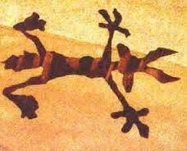
Dissipation for unidirectionality → electron falls & sticks
source
(Power)
drain (output)
DISSIPATION
Fall because one side is deeper - Irrespective of speed !
Dissipation due to ‘thud’ → Erasing information

Slide 16
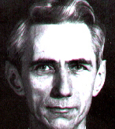
Origin of irreversibility
S H A N N O N
Erasure of information gives rise to irreversibility

Slide 17
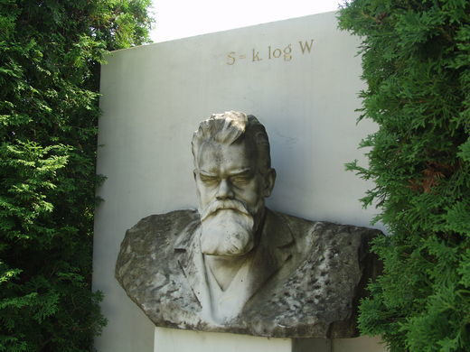
Quantifying knowledge and Dissipation
S = k_{B}lnW = k_{B}<ln(1/p)>
= -Σ_{i} k_{B}(p_{i}lnp_{i})
Dissipation (Energy Loss)
From statistical mechanics
ΔF = -TΔS
Error
1/W ~ exp[-ΔF/k_{B}T] (Boltzmann Limit)

Slide 18
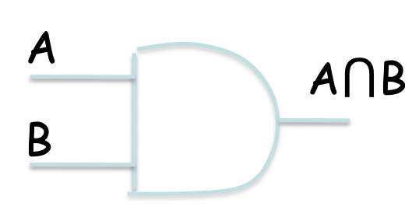
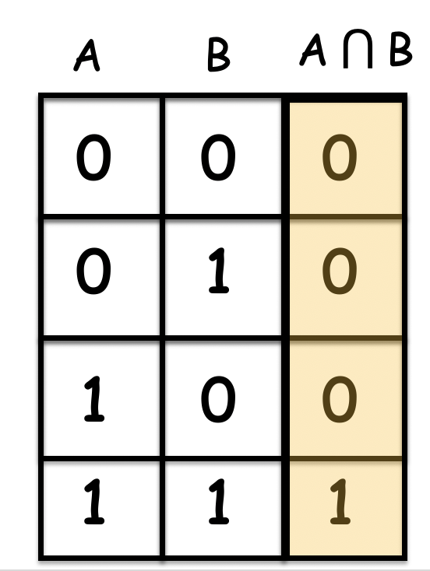
Dissipation in AND (single electron)
ΔF = -TΔS
S = -Σ_{i} k_{B}(p_{i}lnp_{i})
S_{i} = -4k_{B}(1/4ln1/4)
S_{f} = -k_{B}(3/4ln3/4 + 1/4ln1/4)
ΔF = 0.82k_{B}T ~3.2zJ

Slide 19
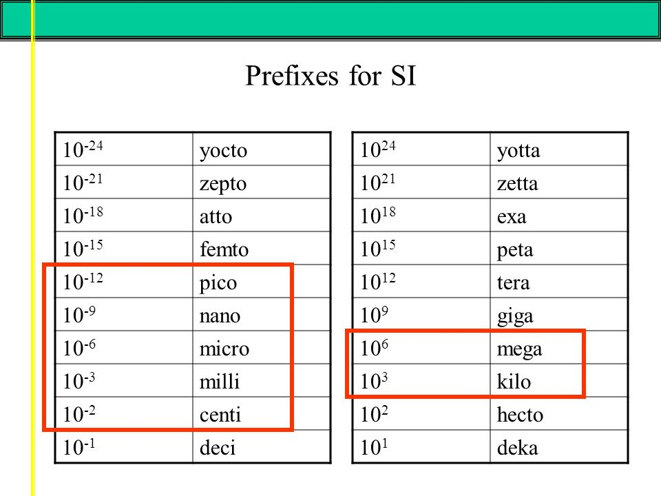
What is a zepto?
https://slideplayer.com/slide/8705768/

Slide 20
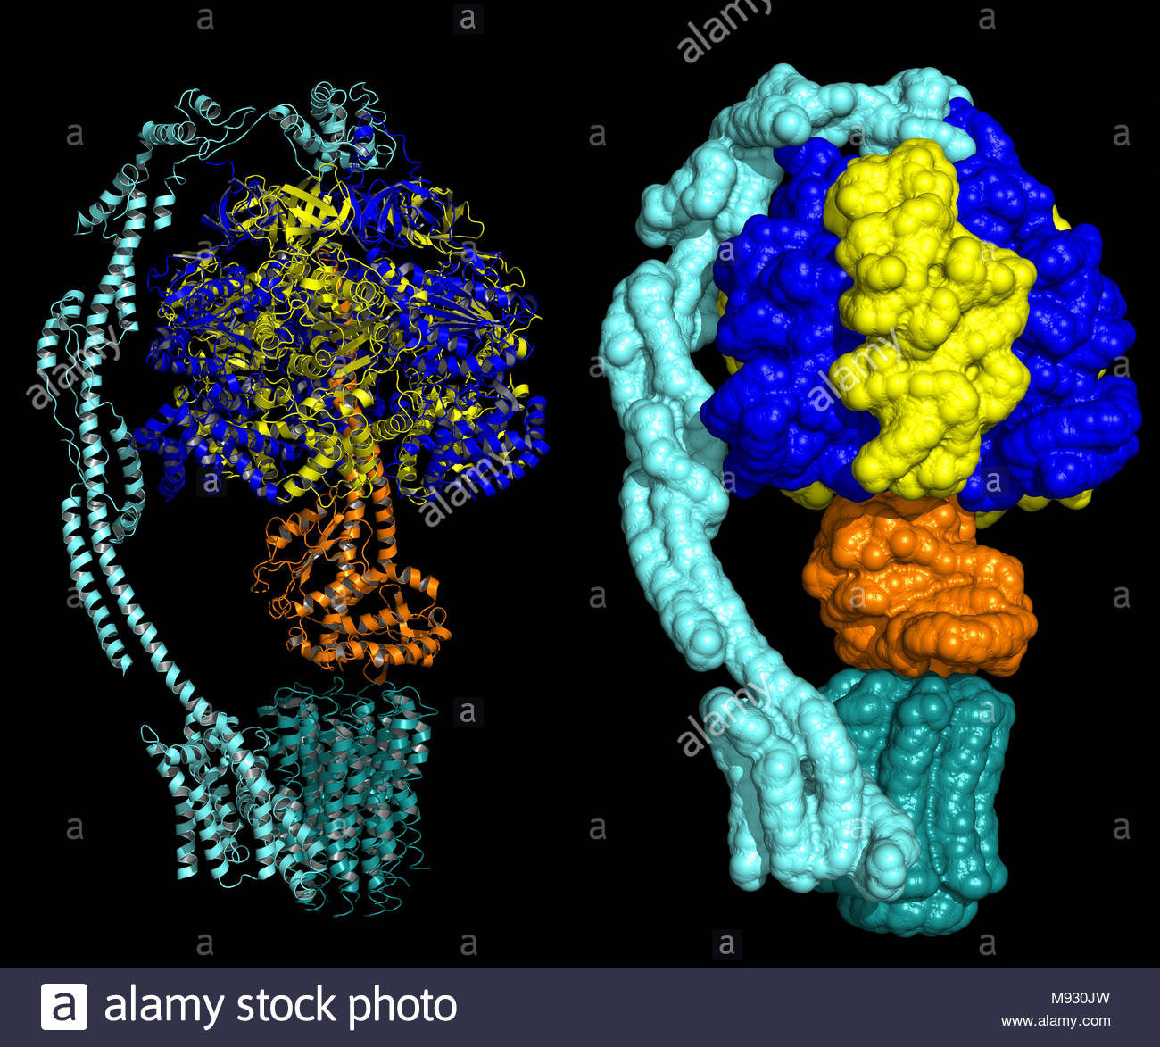
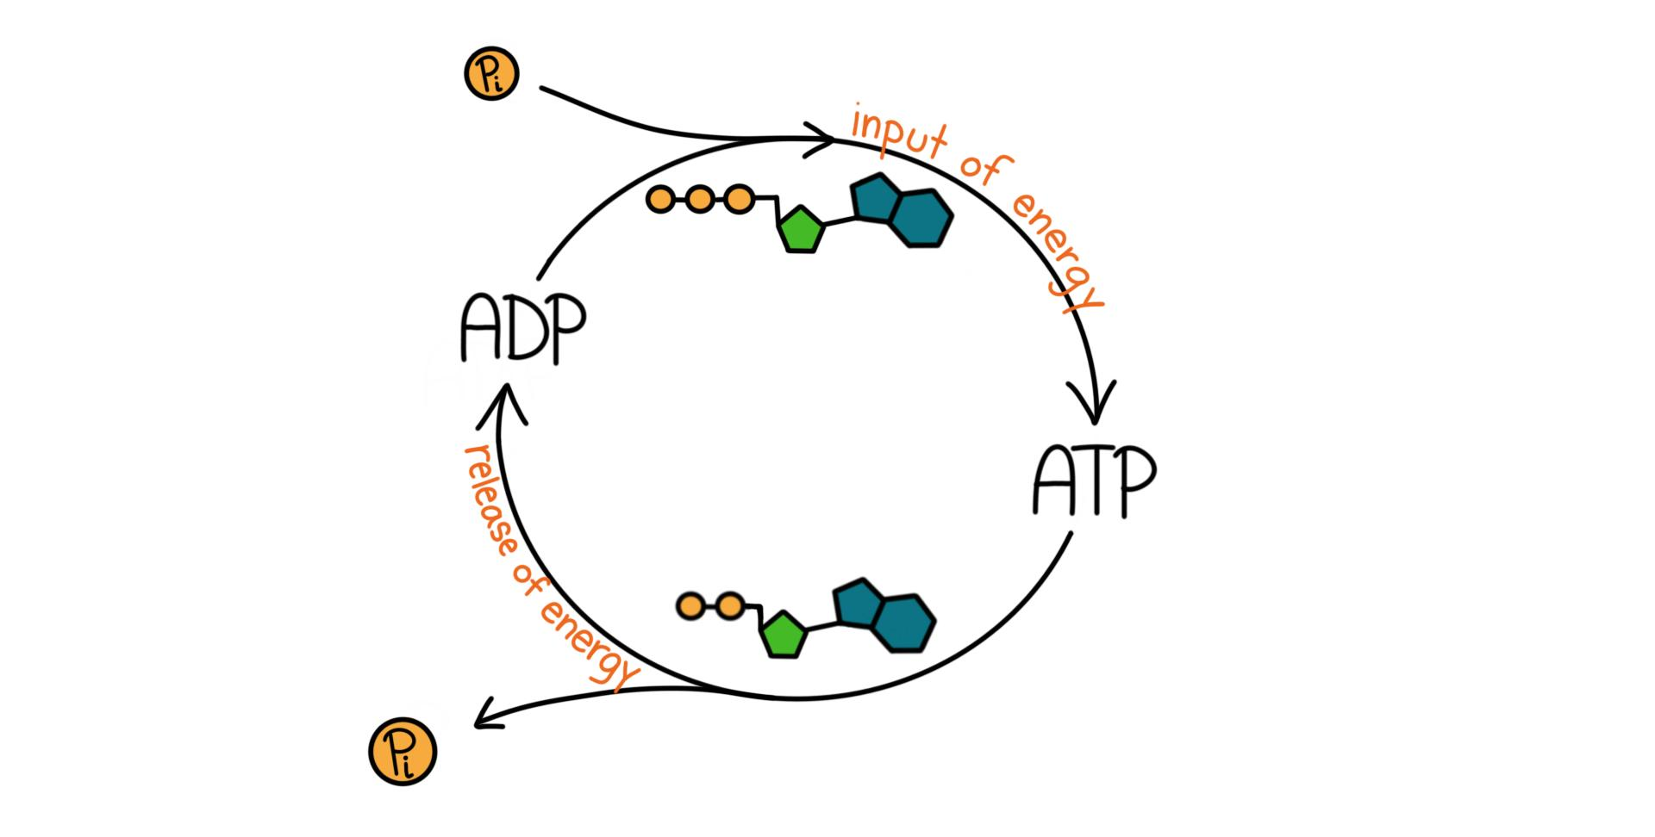
How much is a zepto-Joule?
1zJ = 2.39 x 10⁻²⁴ kcal
1 ATP molecule spends 28kCal/mole in hydrolysis during a phosphorylation reaction.
Divided by Avogadro #, this gives energy burnt by ATP as
4.6 x 10⁻²³ kCal ~ 20 zJ (6X of a 1-electron AND gate)
https://www.expii.com/t/atp-phosphorylation-and-hydrolysis-5775

Slide 21
Don’t let the electron fall & stick
source
(Power)
drain (output)
DISSIPATION
NO DISSIPATION ?
By storing information, can we remove dissipation?

Slide 22
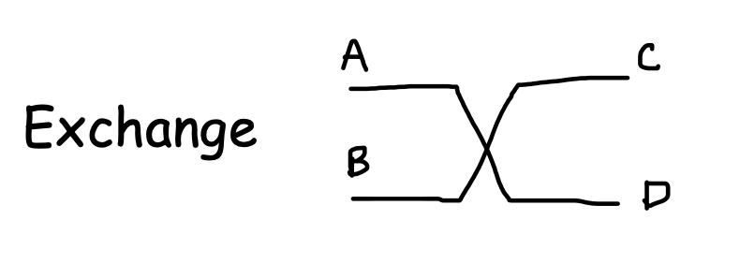
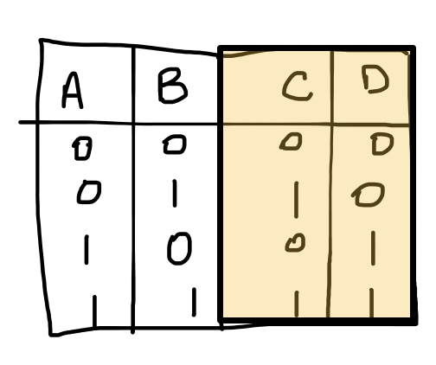
Dissipation in Exchange gate
ΔS = 0
Reminder:
We use base 2 for information entropy
Base e and an extra k_{B} for thermodynamic entropy

Slide 23
Dissipation in CMOS
ΔF = -TΔS
S = -Σ_{i} k_{B}(p_{i}lnp_{i})
When we know where electron sits (“moonwalk”)
Initial
Final
S_{i} = 0
S_{f} = 0
ΔF = 0, no dissipation
When we don’t know where electron sits (usual CMOS)
Initial
Final
S_{i} = -k_{B}ln1/2
= k_{B}ln2
S_{f} = 0
ΔF = k_{B}Tln2 ~ 17.3meV ~ 2.8zJ

Slide 24
Origin of irreversibility
Erasure of information gives rise to irreversibility (Shannon)
This resetting of entropy actually costs energy!!
We call this ‘dissipation’
Disordered
S = k_{B}ln2
Spend energy to reset
dE = TdS
Ordered
S = 0
Computation
Erasure
Energy k_{B}Tln2

Slide 25
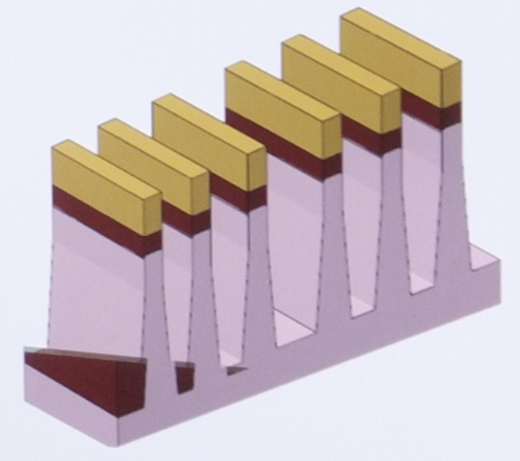
In real life… many electrons
V_{t}~k_{B}T/q ~ 25 mV needed to avoid backflips.
In practice price of high accuracy!!
V= V_{t} ln(1/p), need p ~ 10⁻¹⁵ not ½
Many electrons to charge a capacitor to this voltage
For ATP (1.4nm diameter)
C << 1 aF
Q ~ 1e
For 14nm Si FET with 100nm width
C= 1fF for interconnect with FO(4)
Q ~ 6,000e

Slide 26
Dissipation in CMOS
ΔF = k_{B}Tln2 dissipation
for 2 states
= Nk_{B}Tln2
for 2^{N} independent states
Magnets
N states are coupled (N → N*)
(act like a giant spin)
TunnelFETs (Seabaugh)
Negative Capacitance (Salahuddin)
MottFETs (Shukla/Datta)
Klein-Tunnel FETs (Ghosh)
NanoElectroMechanical FETs (Liu)
Nonequilibrium Physics (T → T*)
Internal voltage Amplification

