Slide 1
4B. So can we read and copy
without expending much energy?

Slide 2
DNA replication
Ribose
Sugar
A
T
Nucleotide backbone
C
G
Phosphate
backbone
G
C

Slide 3
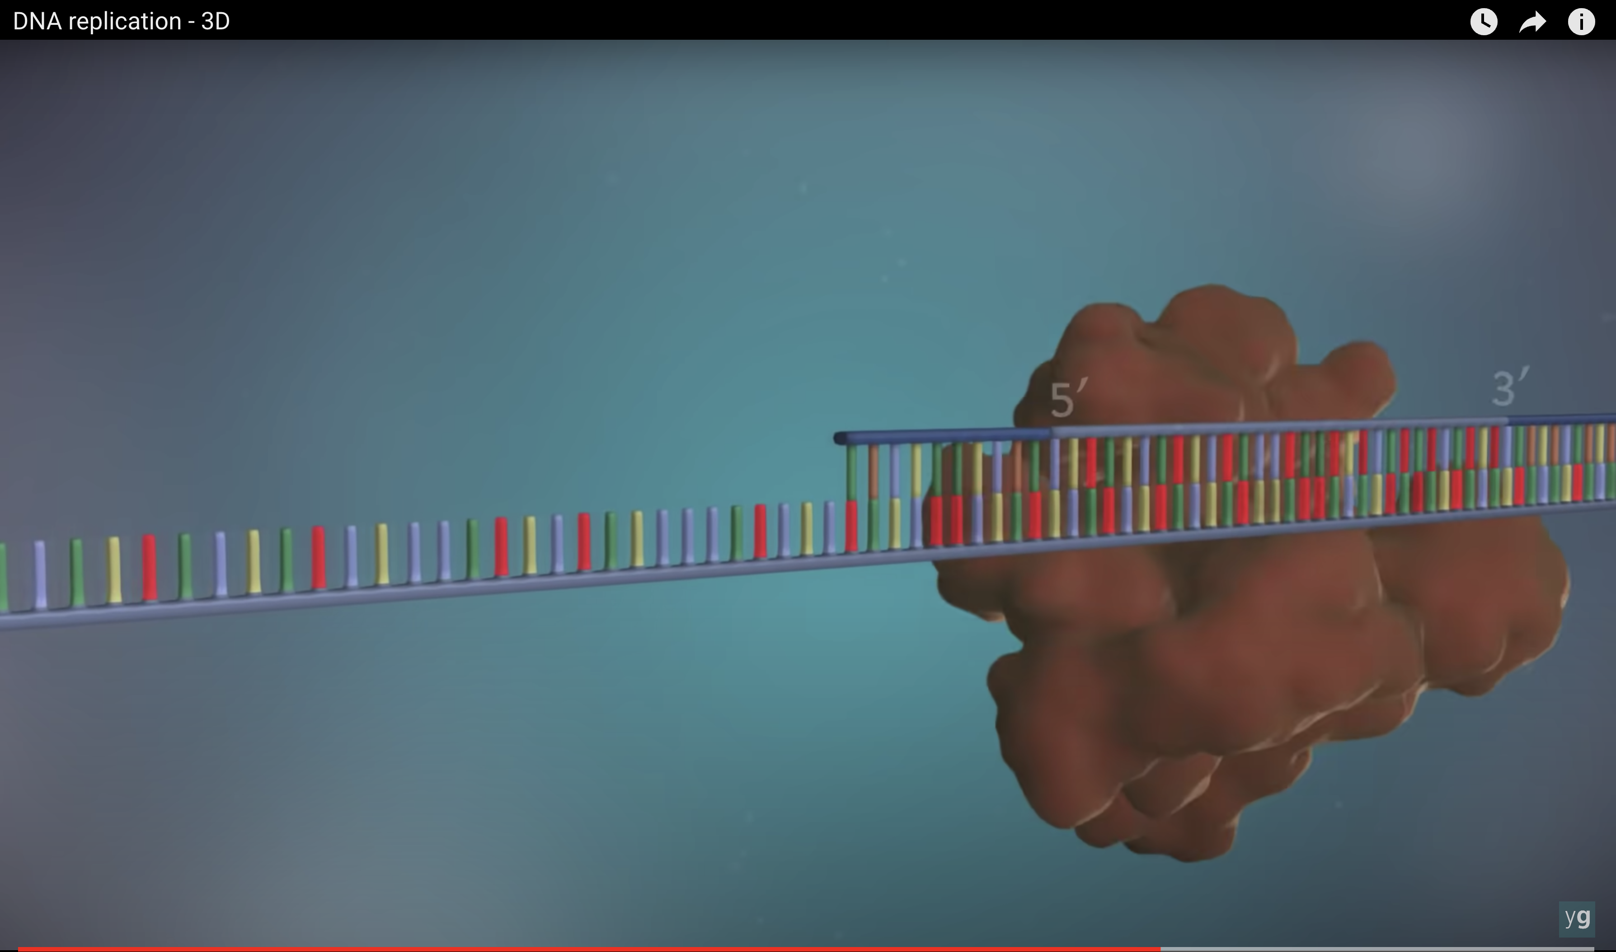
Polymerase only adds on 3’ end (ie, 5’-3’ direction)
One strand that goes with zip direction – continual
Another strand that goes against – chunk by chunk (Okazaki fragments)
https://www.youtube.com/watch?v=TNKWgcFPHqw

Slide 4
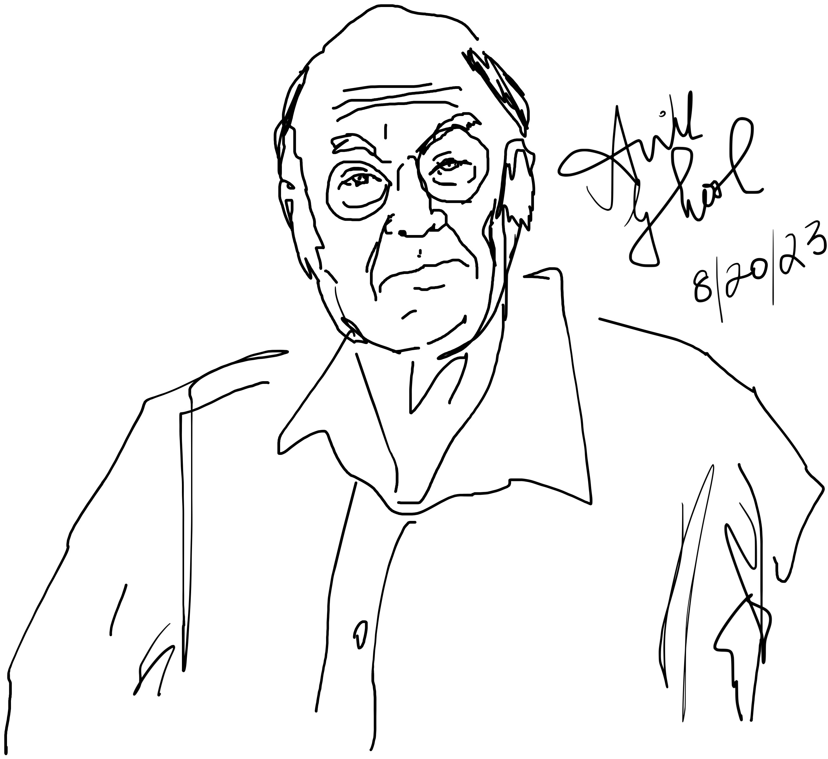
An ideal Copier (Bennett Clocking)
Object
Charles Bennett
Copy

Slide 5
An ideal Copier (Bennett Clocking)
Object
Copy
Erase copy bit
for easy write

Slide 6
An ideal Copier (Bennett Clocking)
Object
Copy
Erase copy bit
for easy write

Slide 7
An ideal Copier (Bennett Clocking)
Object
Copy
Erase copy bit
for easy write

Slide 8
An ideal Copier (Bennett Clocking)
Object
Copy
Bring closer to object

Slide 9
An ideal Copier (Bennett Clocking)
Object
Copy
Restore Barrier
Then move back

Slide 10
An ideal Copier (Bennett Clocking)
Object
Copy
Restore Barrier
Then move back

Slide 11
An ideal Copier (Bennett Clocking)
Object
Copy
Restore Barrier
Then move back

Slide 12
A Physical Implementation

Slide 13
Cannot just write magnet 1
???
Frustration

Slide 14
Use Erase first
Piezo
Piezo
Piezo
Atulasimha/Bandyopadhyay
VCU

Slide 15
Use Erase first
Piezo
Piezo
Piezo
Strain

Slide 16
Now write magnet 1
Piezo
Piezo
Piezo

Slide 17
Release magnet 2
Piezo
Piezo
Piezo
Release

Slide 18
Release magnet 3
Piezo
Piezo
Piezo
Release

Slide 19
Energy cost of the process
Piezo
Piezo
Piezo
The dissipation is during the ‘reset’ when you erase the downstream bits.
After release, they simply respond to their partners.
If you run at GHz, @ error ~ 10⁻⁵, estimates are ~4 aJ/magnet (VCU)
But fundamental limit on copying zero.

Slide 20
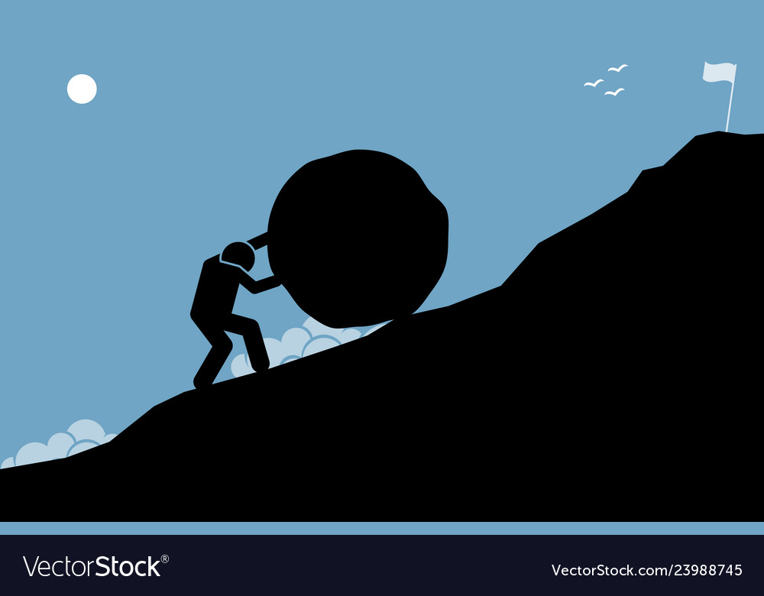
Where is energy spent?
Upgradient (Charging a battery)
Work done ON it
(energy spent)
Downgradient (Discharging a battery)
Work done BY it
(energy recovered)
Q
ΔV
Difference is the wasted expense
(e.g. friction, Ohmic losses)

Slide 21
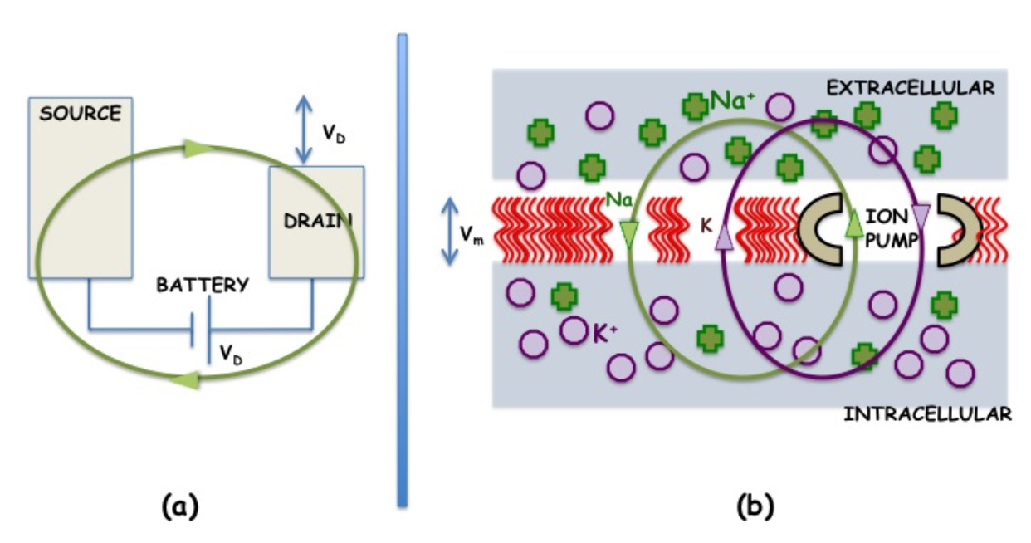
Energy spent in restoring state by battery
Down gradient (FET/ions in channel pushing towards equilibrium)
Up gradient (Battery/ion pump restoring device equilibrium)

Slide 22
Copy can be ‘free’ – but the energy cost
is in the resetting… e.g. erasing the bits
with the piezo by applying voltage
deliberately and deterministically. But in biology, we don’t apply voltages. It
is all thermal – how does that work then?

