Slide 1
4C. Operating a battery

Slide 2
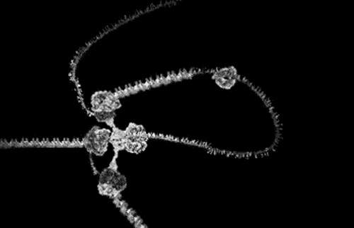
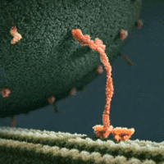
What powers molecular machines?
Source of
Energy
Unidirectionality
+
ATP hydrolysis
Non-Eq. Noise
Molecular Motor/
Brownian Ratchet

Slide 3
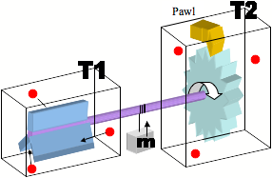
Brownian ratchets
Can thermal energy alone power this motion at T₁=T₂?
Only if thermal energy can lift pawl for forward motion
But this same energy can then push pawl for backflow!!
e^{-ΔU/kT}

Slide 4
It can rectify an energy source that
is correlated and/or nonequilibrium

Slide 5
Brownian ratchets rectify nonequilibrium noise
Carnot Efficiency: η = ΔW/Q₁ = 1 – T₂/T₁
Heat engine for T₂ < T₁, refrigerator for T₂ > T₁

Slide 6
Equilibrium Noise
P_{A→B} x n_{A} = P_{B→A} x n_{B}
n_{B} >> n_{A} → P_{A→B} >> P_{B→A}
We will later see
(Lec 07)

Slide 7
Nonequilibrium Noise
Hydrolysis of ATP
We deplete n_{A} quickly
till n_{A} << n_{B}
So to keep this going, need to replenish n_{A}
(Maxwell’s demon)
This is what the battery does, and the resetting/
erasure uses up the energy

