Slide 1
4D. How do we power those batteries?
Mostly using low ‘entropy’ (order)
i.e, Nonequilibrium noise S < NkTln2

Slide 2
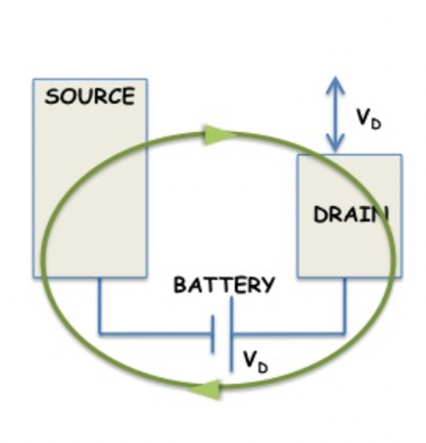
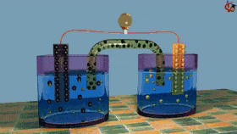
You can use stored chemical energy for that
Up gradient (Battery pushing towards equilibrium)
(Lec 07)

Slide 3
You can use stored chemical energy for that
Goldmann Equation
Nonequilibrium: Cathode has A, Anode has B
(p_{A}= 1-p_{B} = 1 at cathode, p_{B}= 1-p_{A} =1 at anode)
Low entropy
Equilibrium: Cathode and anode both have 50-50
A and B (p_{A}= p_{B} = ½ at both ends)
High entropy

Slide 4
Trading off energy E and entropy S
(Later Ch 7)
Helmholtz
Free Energy (Const T, V)
ΔF = ΔE - TΔS
Gibbs
Free Energy (Const T, P)
ΔG = ΔH - TΔS
ΔH = ΔE + PΔV
Enthalpy

Slide 5
Trading off energy and entropy
ΔF = ΔE - TΔS
ΔE = E_{f} - E_{i}
ΔS = S_{f} - S_{i}
ΔF
- + -
+ - +
Fusion
+ + - at high T
- - - at low T
(Magnets/SC/Xal)

Slide 6
Entropy of mixing
For each atom, choose right vs left
S = -plnp-(1-p)ln(1-p) = ln2.

Slide 7
Maxwell’s demon
Demon judiciously puts partition in when red atoms
move back to left, or blue goes to right… (it’s a phase
space point, less probable but not impossible)
But that requires it to do a measurement (ie, consume entropy), and resetting to ignorance costs energy

Slide 8
A spin based Maxwell’s demon
(S. Datta – “Spin Battery”)

Slide 9
A spin based Maxwell’s demon
(S. Datta)
Short circuit current like a solar cell (entropy of spins rather than light)

Slide 10
A spin based Maxwell’s demon
(S. Datta)
This continues till
Impurity spins become 50-50 & the two counter currents vanish

Slide 11
Energy spent to reset !
(against thermal fluctuations)

Slide 12
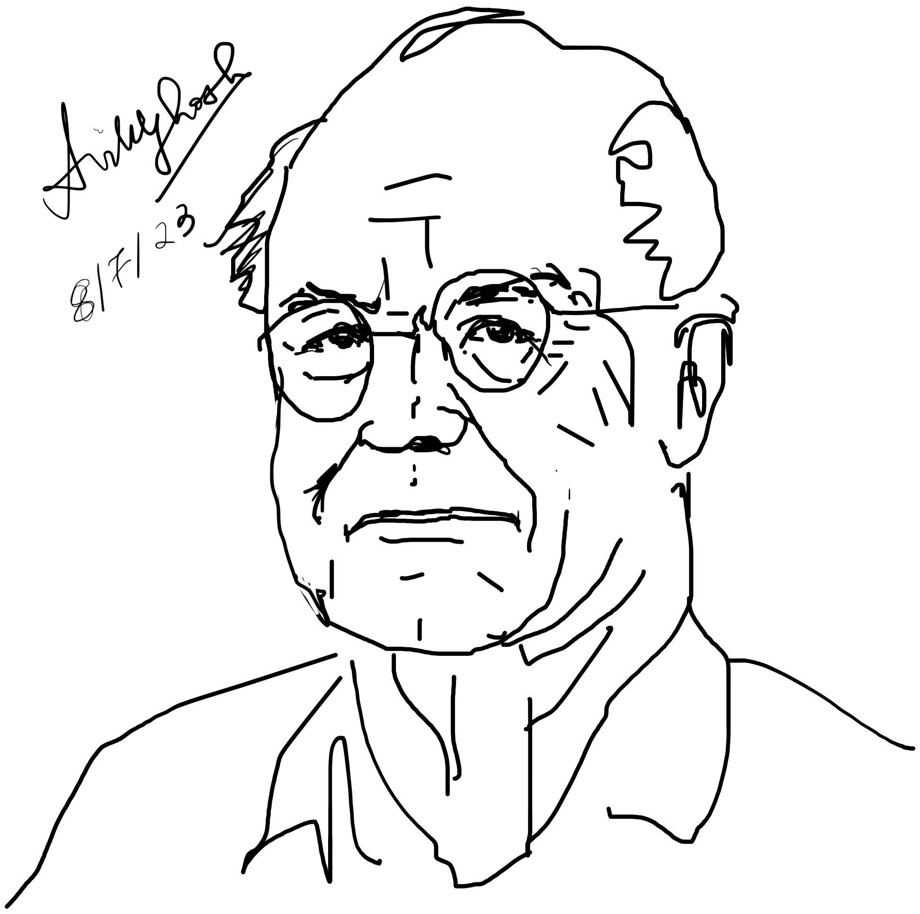
Fuel Value of Information
(Bennett)
Charles Bennett
Energy stored in order
(low entropy)
e.g. carbohydrate molecules

Slide 13
Every nonequilibrium to equilibrium
flow now and in the distant future
are powered by the energy budget
generated during the Big Bang….
(The “Big Chill”)
~10¹⁰⁰ years

Slide 14
The sun is a huge battery.. with a
finite lifetime (~10B yrs, half left)
That energy counters down gradient flow on
earth from low to high entropy and makes
ordered cells which in turn order objects
(eg. raise bricks to build a house that doesn’t
crumble)
Allows us to reset

Slide 15
Entropy machine
ΔF = -TΔS --> ΔS = -ΔQ/T

Slide 16
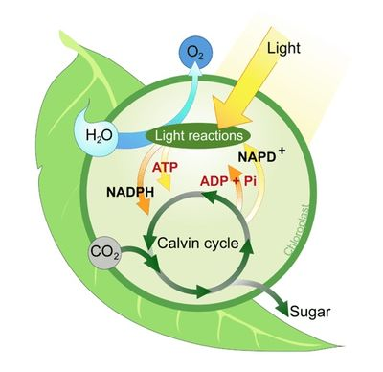
Up gradient (disorder to order)

Slide 17
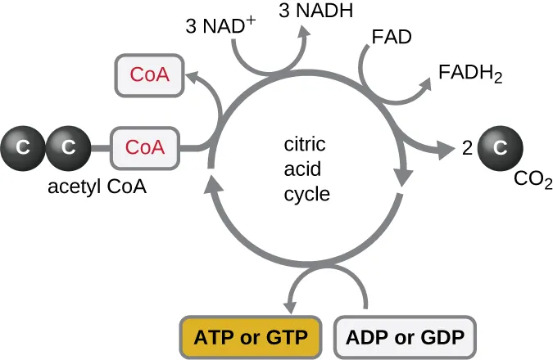
Down gradient (order to disorder)

Slide 18
To summarize
Down gradient (device pushing towards its equilibrium)
Up gradient (Battery pushing towards its equilibrium)
Switching battery off → making that transition slow

Slide 19
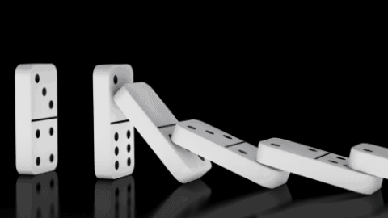
Basically various nonequilibria
playing against each other…
Trading off energy and entropy

Slide 20
Basically various nonequilibria
playing against each other…
Trading off energy and entropy

Slide 21
Basically various nonequilibria
playing against each other…
Trading off energy and entropy

Slide 22
Basically various nonequilibria
playing against each other…
Trading off energy and entropy

Slide 23
Basically various nonequilibria
playing against each other…
Trading off energy and entropy

