Slide 1
4E. So while resetting/erasing is
expensive, copying is ‘free’, …
(exploit downgradient from a battery)
…. unless you want it done quick !!

Slide 2
Why so?
If you move quicker than the natural time
constant of the particle, it will end up climbing
up the well (getting excited), then crash!!!

Slide 3
Why so?
If you move quicker than the natural time
constant of the particle, it will end up climbing
up the well (getting excited), then crash!!!

Slide 4
Why so?
If you move quicker than the natural time
constant of the particle, it will end up climbing
up the well (getting excited), then crash!!!

Slide 5
But do it slowly
What you want is to move it slowly enough that
in infinitesimal step, the particle can slide down
(assisted by friction) and stay pinned to the ground

Slide 6
Why so?
What you want is to move it slowly enough that
in infinitesimal step, the particle can slide down
(assisted by friction) and stay pinned to the ground

Slide 7
Why so?
What you want is to move it slowly enough that
in infinitesimal step, the particle can slide down
(assisted by friction) and stay pinned to the ground

Slide 8
But why is that slide itself not harmful
over time?
Nonlinearity: Because if you break it into N steps, the
dissipation/step goes down as 1/N² while # of steps
increases as N, so net dissipation goes down as N.
E_{N} = (E₁/N²) x N = E₁/N
But then time T_{N} goes up by N.
T_{N} = T₁N
So Energy-delay product stays same
E_{N}T_{N} = E₁T₁

Slide 9
For some applications, time not important
E_{N} = E₁/N
T_{N} = T₁N
Neural Processes
Pattern Recognition
~ Hz frequency
(millisec-sec fine, ions)
Banking software
Weather forecasting
~ GHz frequency
(Time matters, electrons)

Slide 10
Another consideration: Error
E_{N}T_{N} = E₁T₁
E₁ set by accuracy constraints
High bar
Low bar
Accurate information
More energy to write
Inaccurate information
Easy write

Slide 11
Trade-off
Accurate information
More energy to write

Slide 12
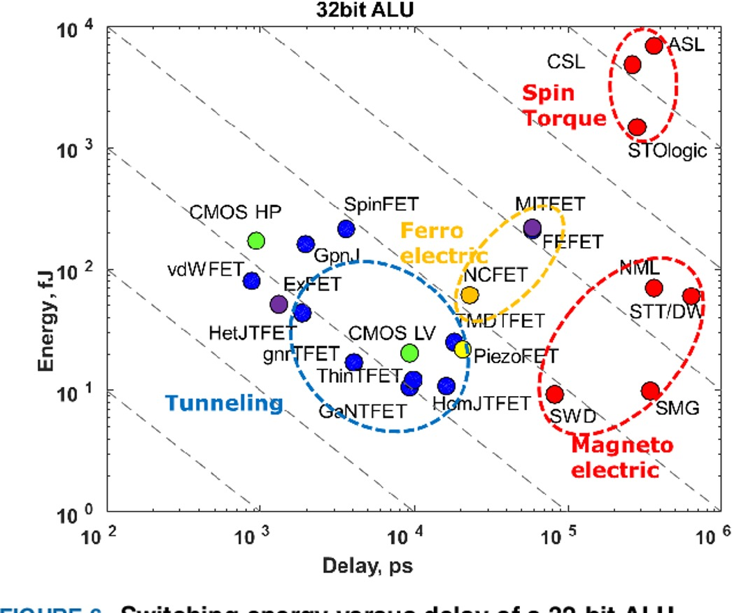
Energy-Delay trade-off

Slide 13
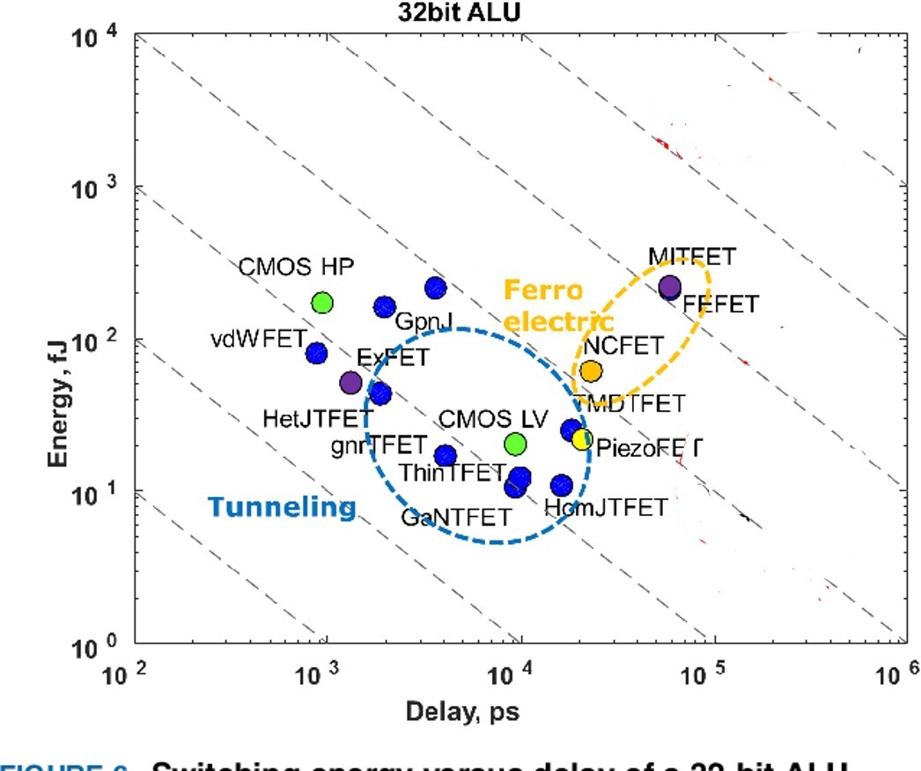
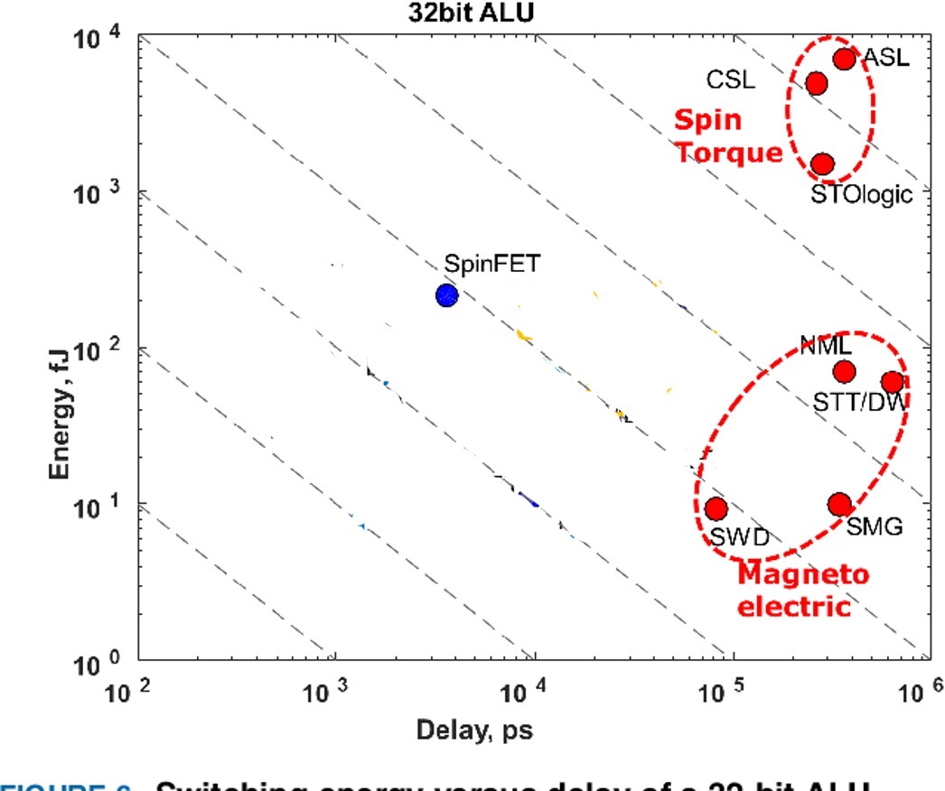
Energy-Delay trade-off
Nikonov-Young
Intel

Slide 14
Energy-Delay-Error trade-off
Accuracy

Slide 15
To summarize
Energy-delay-error tradeoff, application specific
Reduce dissipation by doing reversible computing
No energy needs to be spent if copying slowly
Energy spent is on resetting by battery
Battery trades off entropy to power device resets, by going from order to disorder (low to high entropy). This
is the ‘fuel value’ of information
Big Bang was the ultimate battery powering the universe till it discharges

Slide 16
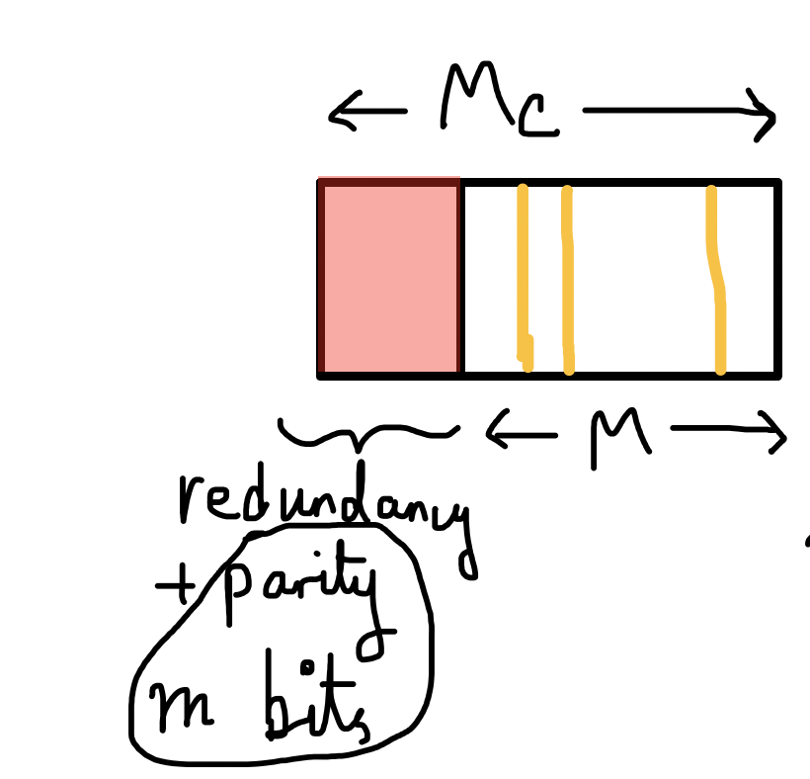
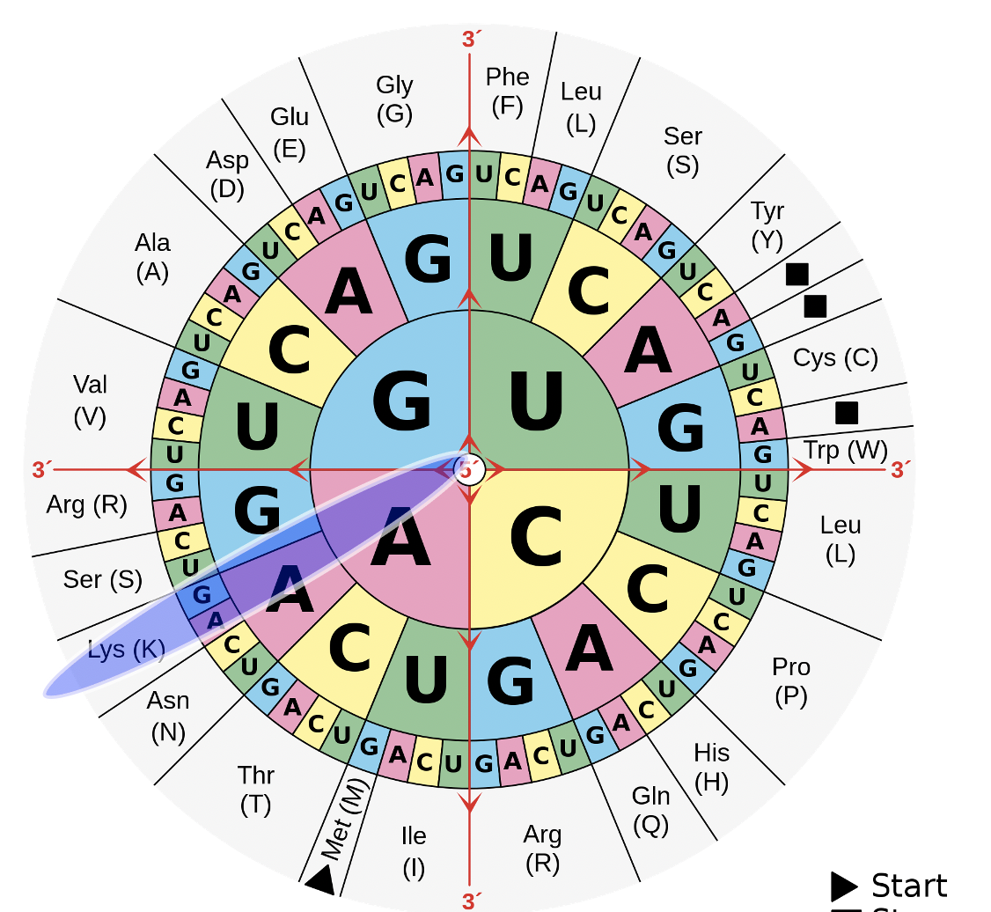
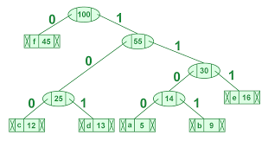
Next class
Lec 5
Error correction in Computing
Fixing information errors
Parity Bits and Hamming
Biological error correction
Nonsense mutations in DNA
(use redundancy)
Huffman Trees/Lempel-Ziv
Lossless data compression

