Slide 1
5B. Hamming Coding for parity bits

Slide 2
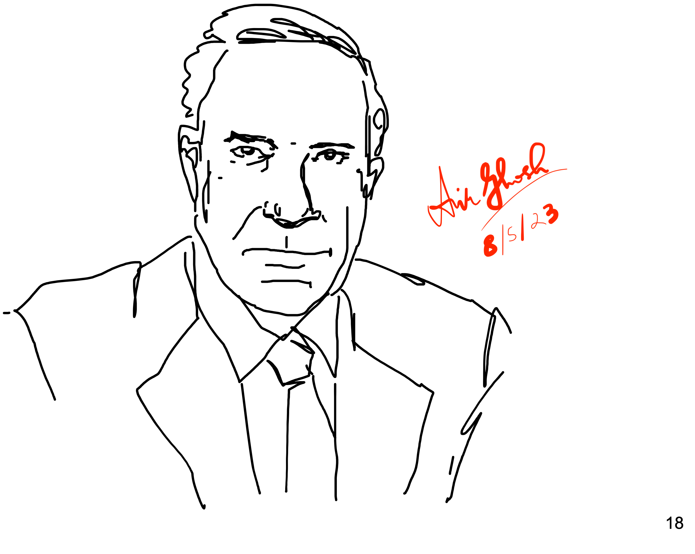
Hamming coding
⁷ ⁶ ⁵ ³
110c1ba
Hamming
Data 1101 and parity bits abc mixed so that each parity bit monitors multiple data bits in the set (3, 5, 6, 7)
a will cover parity of positions 3, 5, 7
b will cover positions 3, 6, 7
c will cover 5, 6, 7

Slide 3
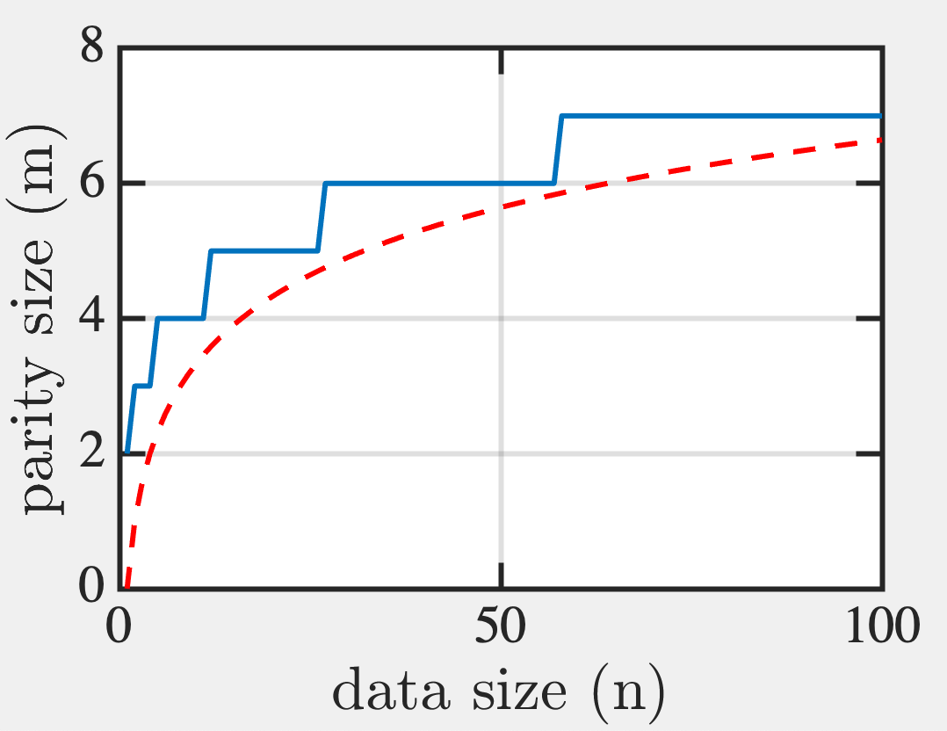
Hamming coding
Syndrome (Set of m Parity Bits with n data bits)
Coverage Rule: 2^m-1 possibilities must cover all 1-bit errors in word of size n+m
2^{m}-1 ≥ (n+m) → e.g. n=4, need m=3. Large n,
m ~ log₂n
log₂n

Slide 4
Hamming coding
Place m parity bits at positions 2^m (bit positions 1,2,4,8,16…. which in binary means 00001, 00010, 00100, 01000, 10000, with only 1 non-zero bit).
Each parity bit tracks all data bits with least significant bit at its position
e.g. bit 00001 tracks total parity of all data bits with 1 at 1’s position, ie, at 00001, 00011, 01001, 1011 etc (2⁴ options)
Bit 00010 tracks total parity of all with 1 at 2’s position…
110c1ba

Slide 5
Hamming coding
3 bits cover all 8 positions
110c1ba
a checks for error (1)
in position 1
So pos. 001, 011, 101, 111
position 1 (parity a)
position 3
position 5
position 7
b checks for error (1)
in position 2
So pos. 010, 011, 110, 111
position 2 (parity b)
position 3
position 6
position 7
c checks for error (1)
in position 4
So bits 100, 101, 110, 111
position 4 (parity c)
position 5
position 6
position 7
110c1ba
110c1ba
110c1ba
7 6 5 4 3 2 1
7 6 5 4 3 2 1
7 6 5 4 3 2 1
1100110

Slide 6
Example 1: error at bit 3
1100110 → 1100010

Slide 7
Example 2: error at bit 2 (parity)
1100110 → 1100100
No solution!
So second one is wrong
Bit 2

Slide 8
Example 3: 2-bit error
1100110 → 1000010
2-bit error looks like a single bit error at 5

Slide 9
Add an overall parity bit
01100110 → 01000010
So cannot be single bit error!

Slide 10
How to sniff out 2-bit error
01100110 → 01000010
Double negative gave +ve

Slide 11
How to sniff out 2-bit error
01100110 → 01000010
2 bit error in (3,6,7) --> (3,6), (3,7) or (6,7)
1 bit error in (3,5,7) → (3,6) or (6,7)
1 bit error in (5,6,7) --> (3,6)
→ Error in bits (3,6)

Slide 12
Example 4: 2-bit error incl parity bit
(0,2 errors)
01100110 → 01000100
1 error
(0,2 errors)
NOT POSSIBLE! → a,c suggests 6, and b is wrong → (2,6)

Slide 14
Parity helps detect binary errors
O and 1 errors can be sniffed out with parity bits. We will discuss the efficiency of parity encoding.
Errors in other languages (non-binary) are trickier. How does biology do it?

