Slide 1
5C. Error correction in biology
- Codons and Redundancy

Slide 2
Redundancy for Majority Logic
Make some copies of output
Take majority opinion
Problem - more wires

Slide 3
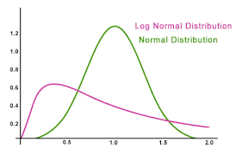
Biology can afford more wires
Ions do not tunnel, so can pack wires
Also, bio-signals slow and crude
(FO in VLSI ~ 4; at bio-synapses ~ 10,000)
Log-normal
Exponent is Gaussian

Slide 4
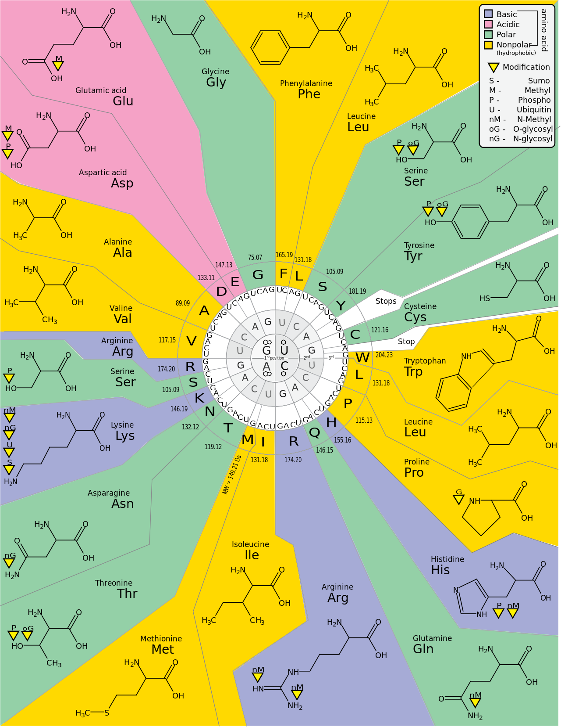
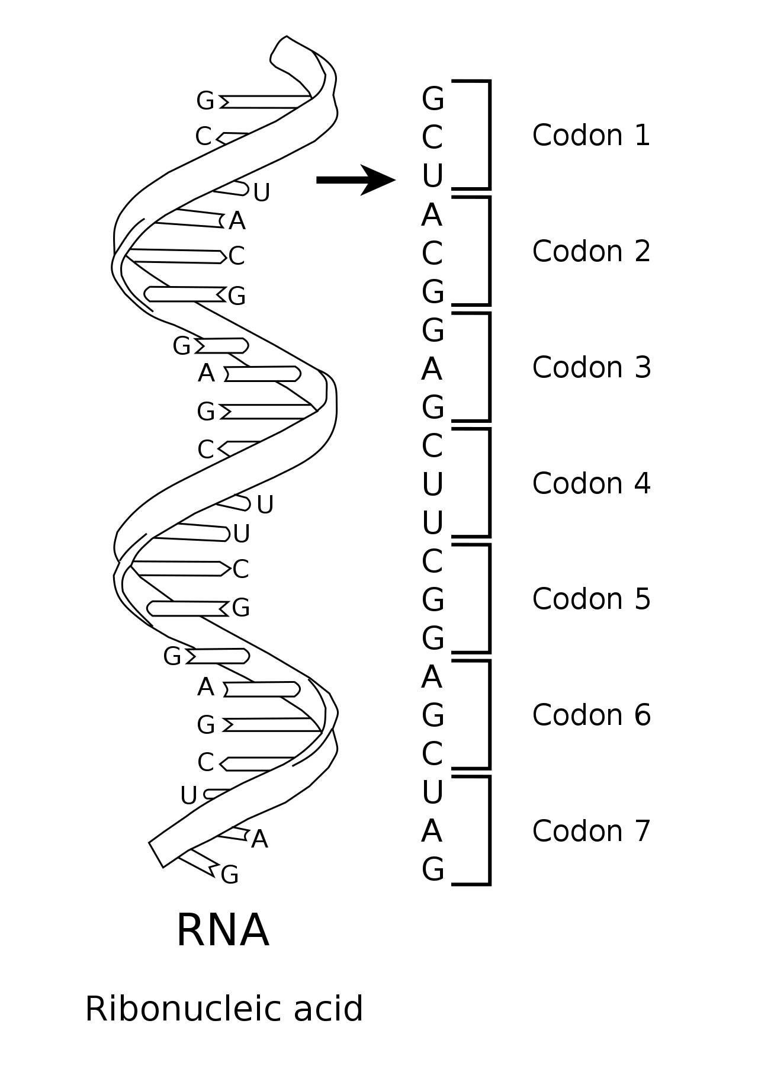
Data presented as 3 nucleotide codons

Slide 5
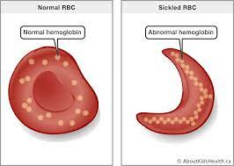
Point mutations can be serious
DNA Template
GGA-CTC-CTC
CCU-GAG-GAG
m-RNA
U
Val
Pro – Glu – Glu… (hemoglobine protein)
Glutamic acid is hydrophilic, Valine is hydrophobic
The change in the 6th position of β-globin changes conformation of protein
enough to cause sickle cell anemia
Alterations happened primarily in Africa to protect against malaria

Slide 6
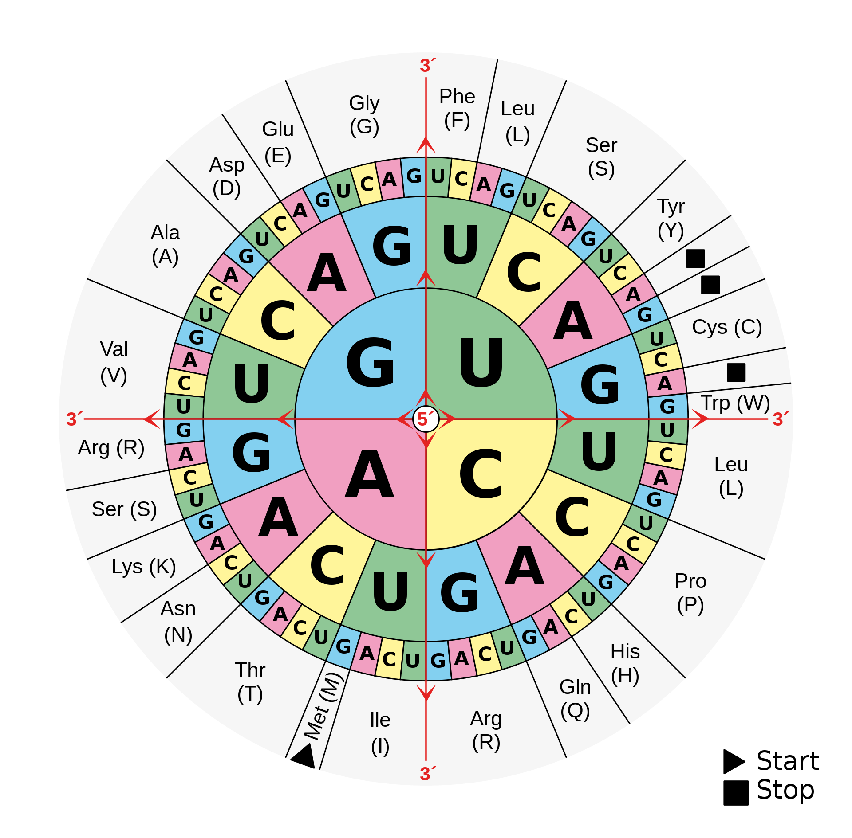
Missense mutations
5’...-AAG-…3’
G
DNA
C
3’...-TTC-…5’
...-AAG-…
m-RNA
G
… – Lys –…
Arg
Replacement makes protein nonfunctional

Slide 7
Missense mutations
5’...-AAG-…3’
G
DNA
C
3’...-TTC-…5’
...-AAG-…
m-RNA
G
… – Lys –…
Arg
Replacement makes protein nonfunctional

Slide 8
Nonsense mutations
T
5’...-AAG-…3’
DNA
A
3’...-TTC-…5’
...-AAG-…
m-RNA
U
… – Lys –…
STOP
Terminates protein synthesis prematurely (cystic fibrosis)
Other variants can erase a stop codon (longer protein)

Slide 9
Nonsense mutations
T
5’...-AAG-…3’
DNA
A
3’...-TTC-…5’
...-AAG-…
m-RNA
U
… – Lys –…
STOP
Terminates protein synthesis prematurely (cystic fibrosis)
Other variants can erase a stop codon (longer protein)

Slide 10
But some mutations can be silent !
A
5’...-AAG-…3’
DNA
T
3’...-TTC-…5’
A
m-RNA
...-AAG-…
Lys
… – Lys –…
This is because codons have degeneracy (redundancy)
64 codons: 61 for amino acids, 3 for STOP code
20 amino acids, so lot of repeats

Slide 11
But some mutations can be silent
A
5’...-AAG-…3’
DNA
T
3’...-TTC-…5’
A
m-RNA
...-AAG-…
Lys
… – Lys –…
This is because codons have degeneracy (redundancy)
64 codons: 61 for amino acids, 3 for STOP code
20 amino acids, so lot of repeats

Slide 12
Error correction in DNA
Mismatch repair: caught by DNA repair enzymes,
which could still miss 1 in 10 Bp
AAG
TTA

Slide 13
Error correction in DNA
Mismatch repair: DNA repair enzymes
AAG
TTC
After replication, no
error noticeable to a
repair enzyme
AAT
TTA

Slide 14
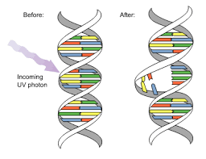
Pyrimidine dimers (UV photons)
Distortion of backbone
TAG
TTC
melanoma
Nuclease spots and snips the strand
Polymerase inserts correct bases
Ligase seals it

Slide 15
Oxidation (chemicals)
O
Oxo-G prefers A
GAG
ATC

Slide 16
Oxidation/alkylation (chemicals)
O
Oxo-G prefers A
GAG
TAG
ATC
After replication, wouldn’t know!
Glycosylase enzyme recognizes errant base pair
before forking and removes, polymerase fixes,
ligase seals it

Slide 17
Errors are recognized by proteins driven
by nonequilibrium noise. Error is a higher
energy configuration.
Best way to avoid errors – redundancy
But that reduces coding efficiency

