Slide 1
5D. How to minimize redundancy

Slide 4
Claude Shannon

Slide 5
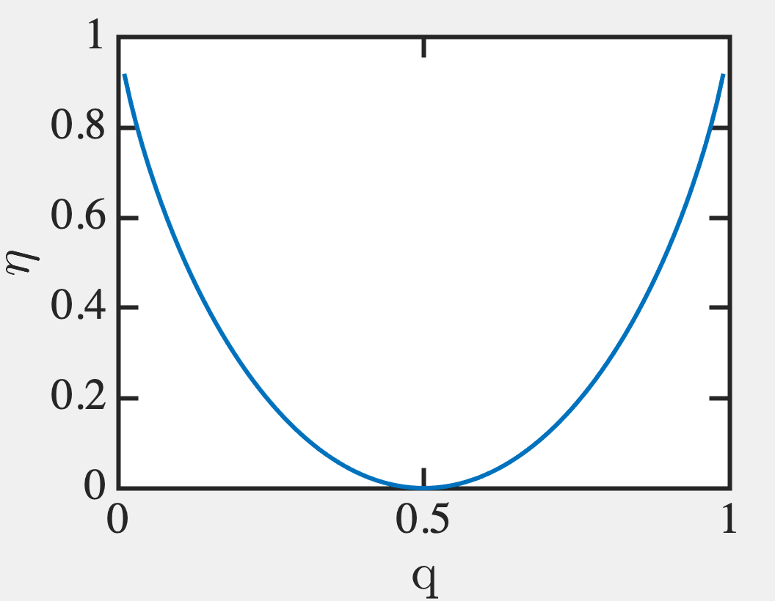

Slide 6
So we can satisfy Shannon’s inequality
by making M_{c} large.
But how to deal with a ‘q’ simply
by increasing sample size?

Slide 7
Gaussian distribution of errors

Slide 8
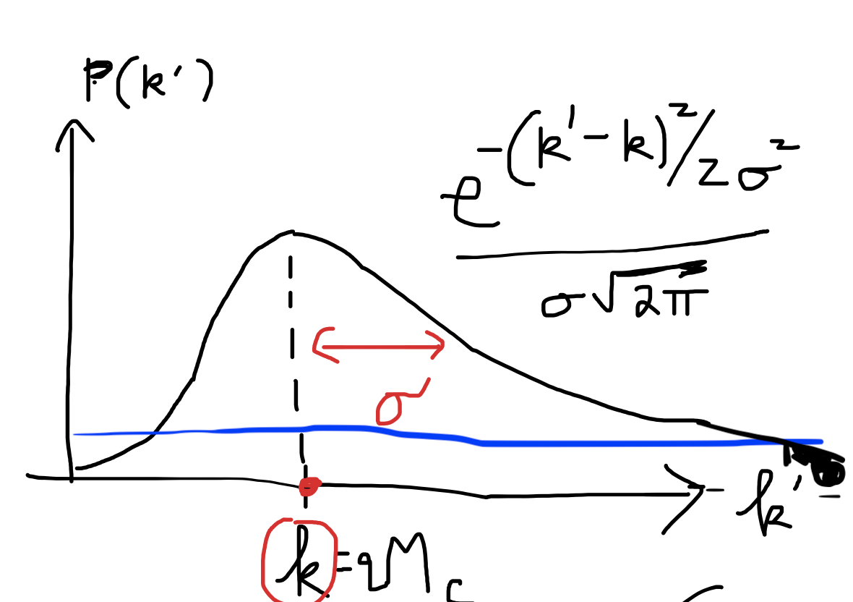
Batch error probability
How many batch errors would have a
probability of 10⁻³⁰?
Low probability works for larger number of
errors k’ >> k. Let k’ = k+g.σ
10⁻³⁰ = P(k’) = exp(-g²/2)/σ√2π ◊ g ~ 12.
k’ = k + 12σ = 10⁻³ + 12(0.03) = 0.3535 errors
So 10⁻³⁰ is odds of 0.35 batch errors

Slide 9
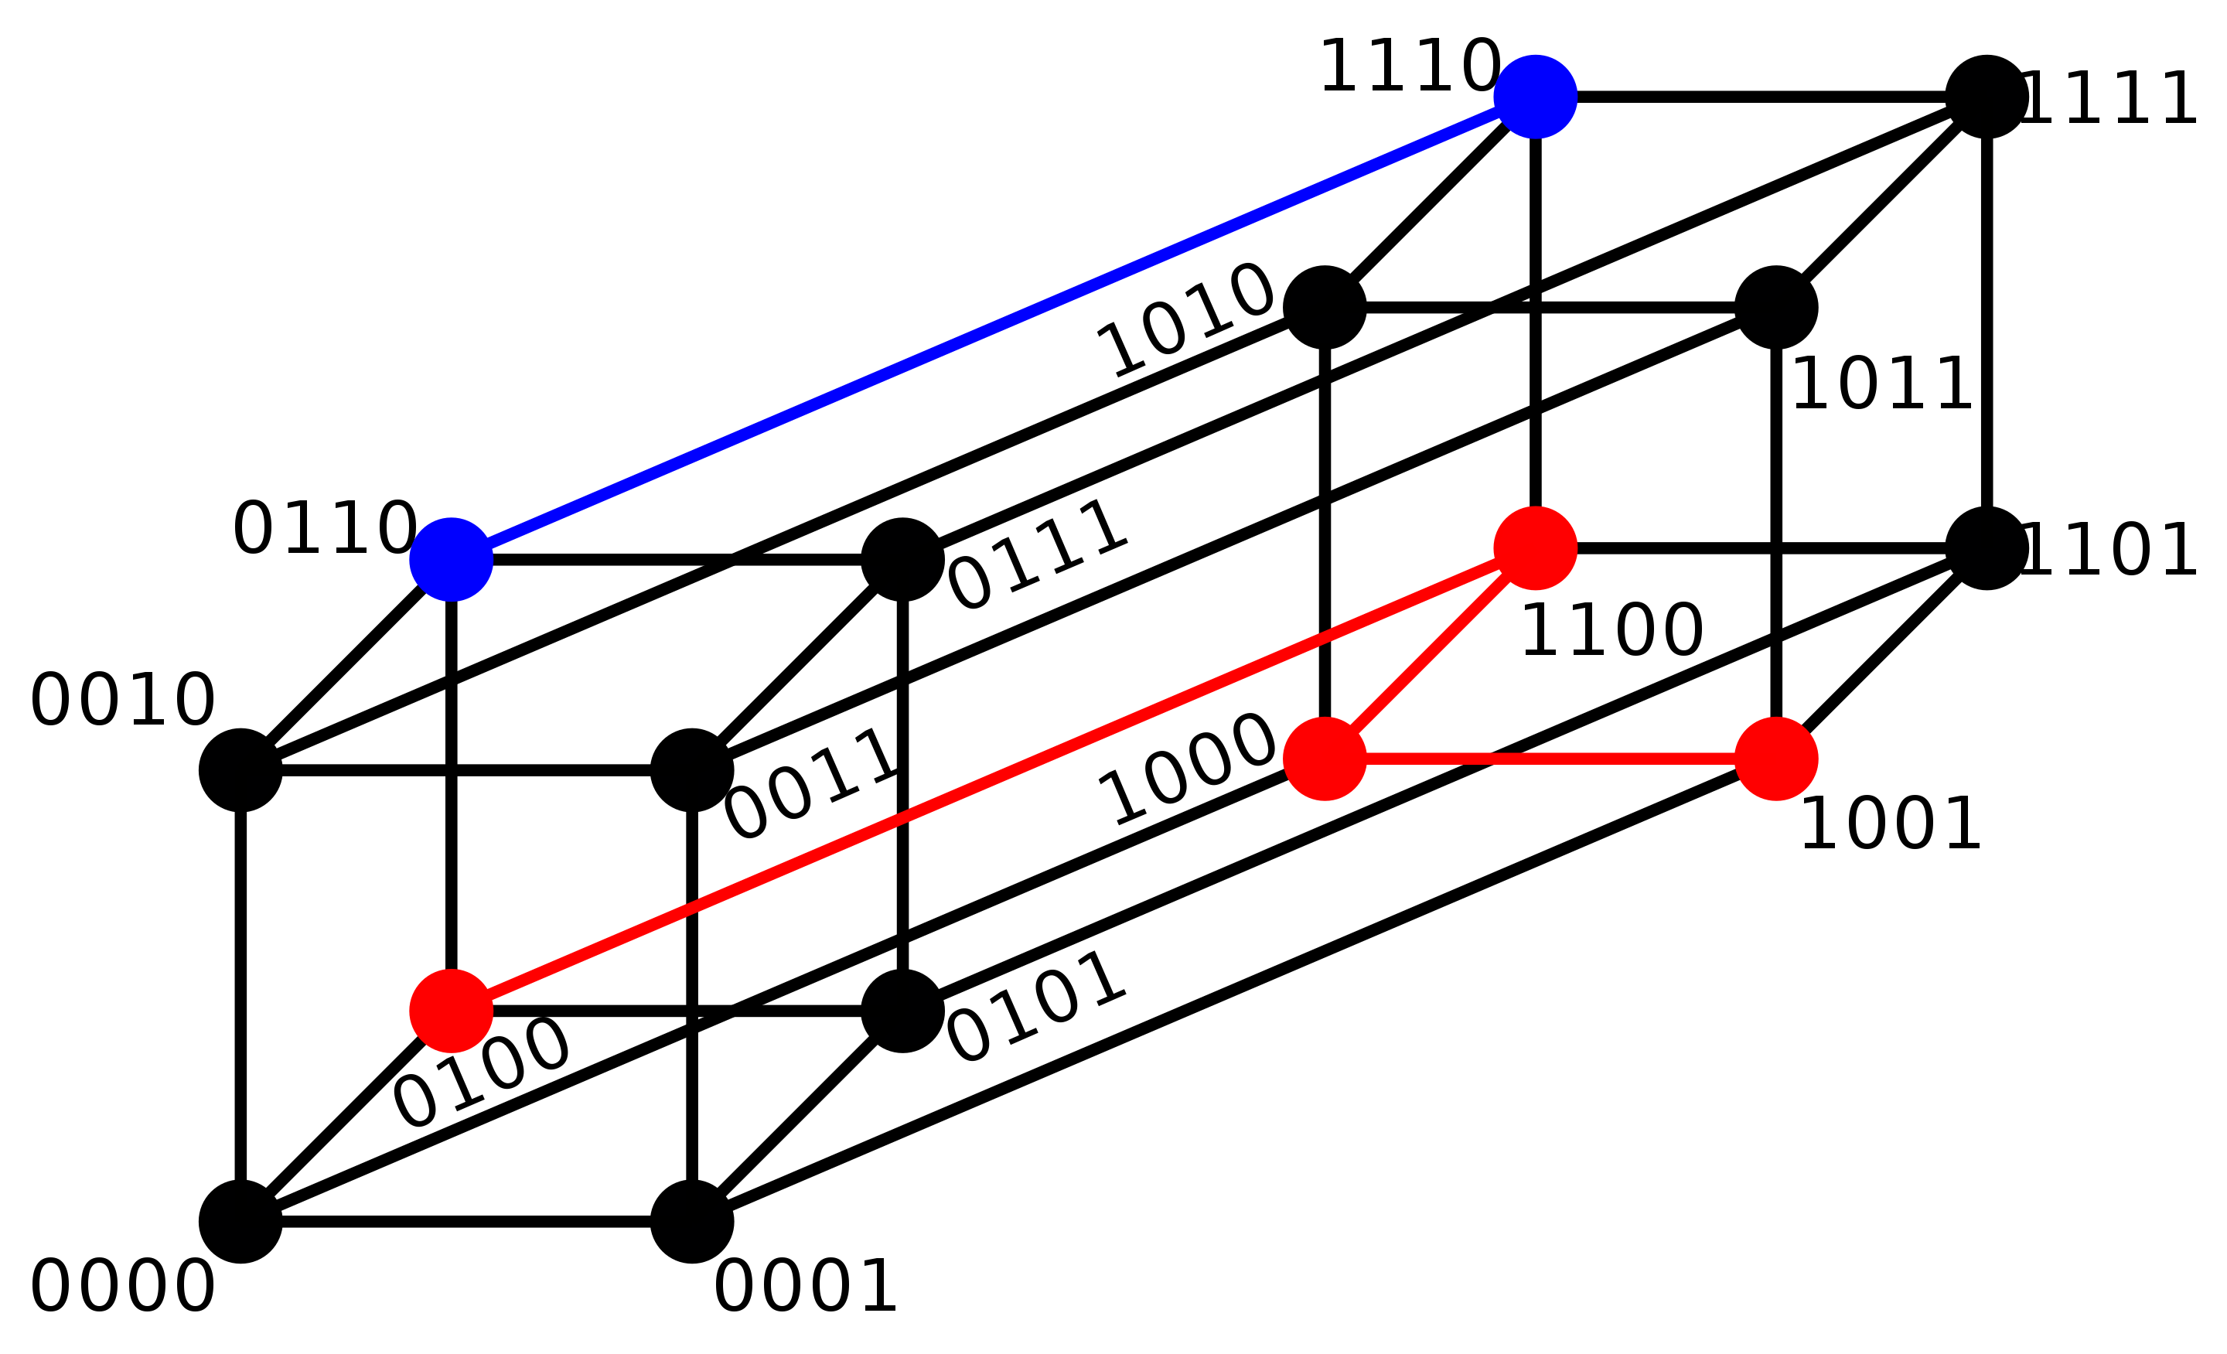
Hamming distance
Put various binary alternatives on vertices of a hypersurface
Each alteration is one node (substitution) away → Sequences of same length
0100 → 1001 shortest distance is 3 steps away
0110 → 1110 is 1 step away
2173896 and 2233796 is 3

Slide 10
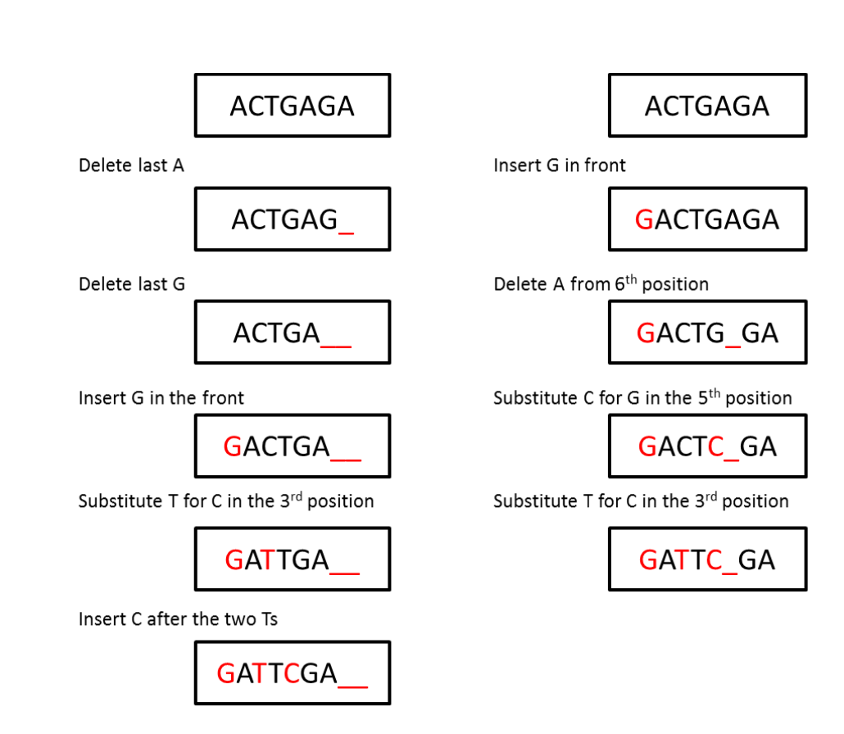
Levenshtein Distance
Alignment → # of insert-delete-substitute
operations to transform one sequence into another
(Edit or Levenshtein distance)
P
Deletions
Edit distance 5
Edit distance 4
Insertions
Q

Slide 11
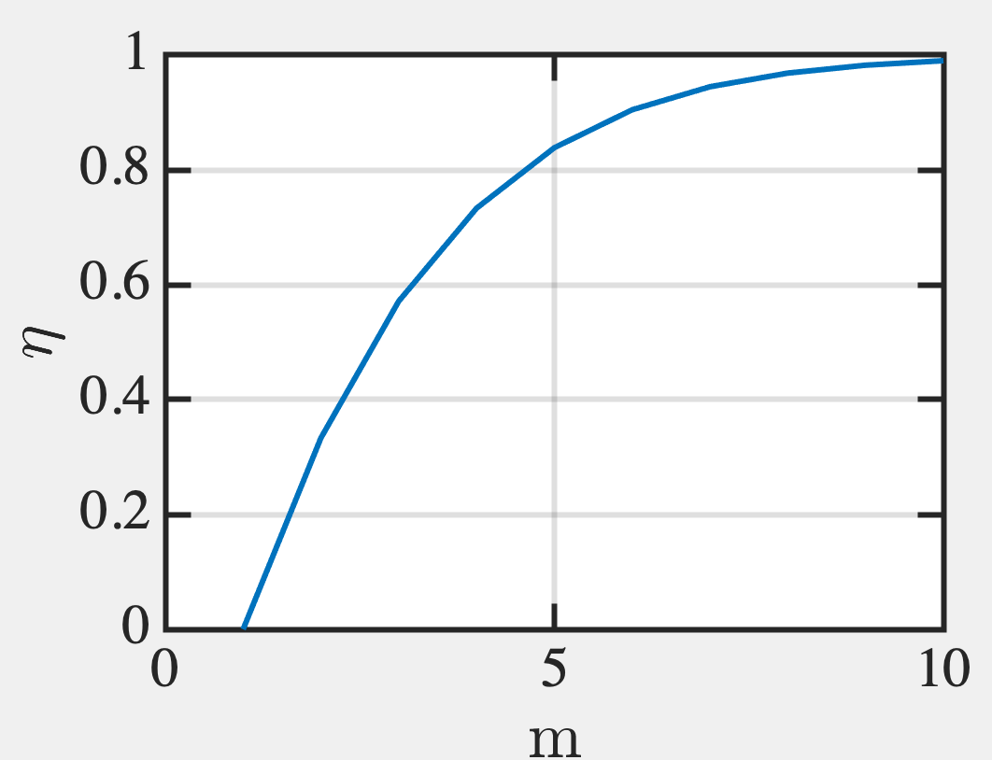
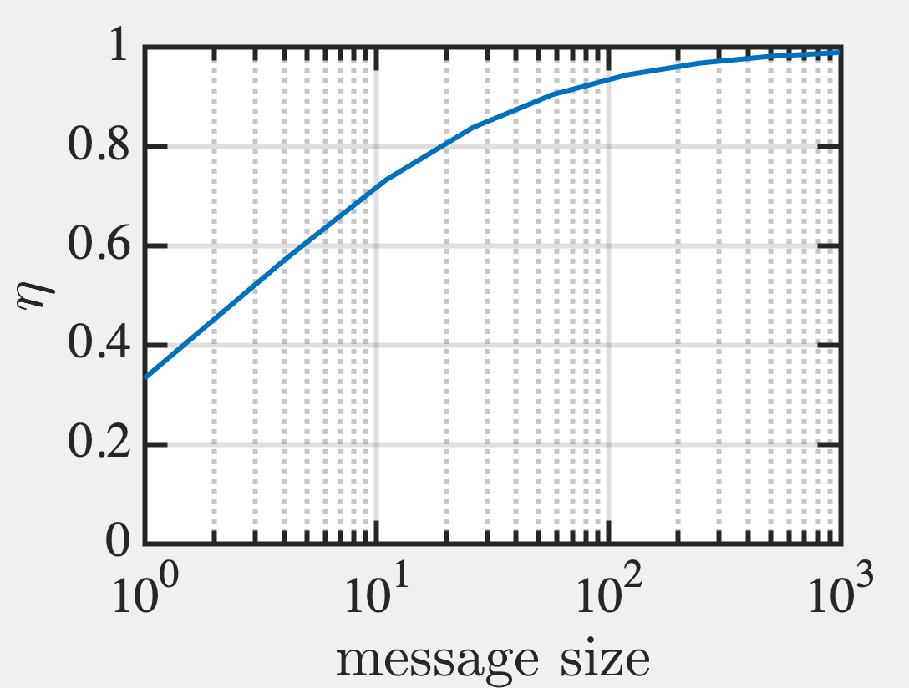
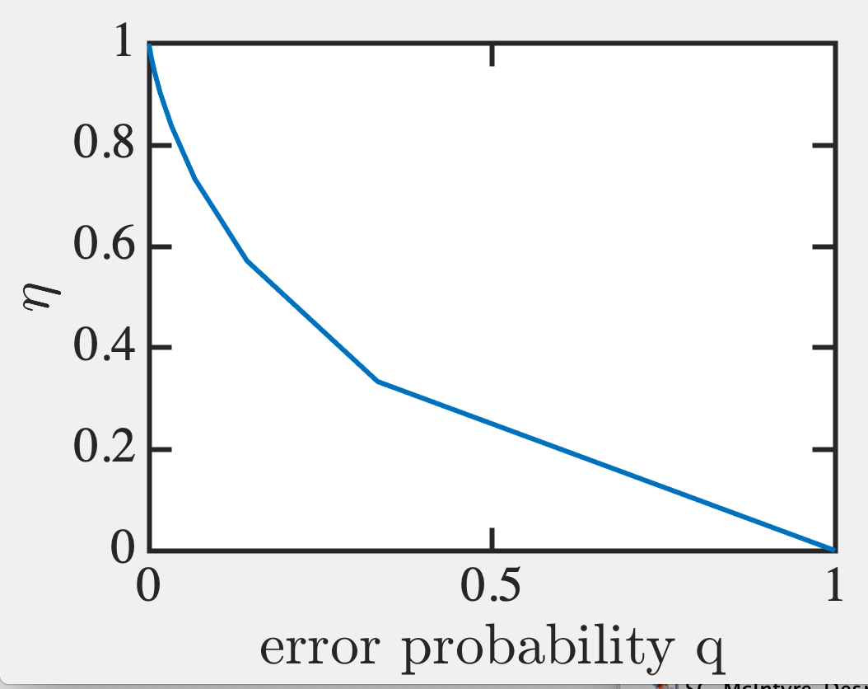
How efficient is a Hamming code?

Slide 13
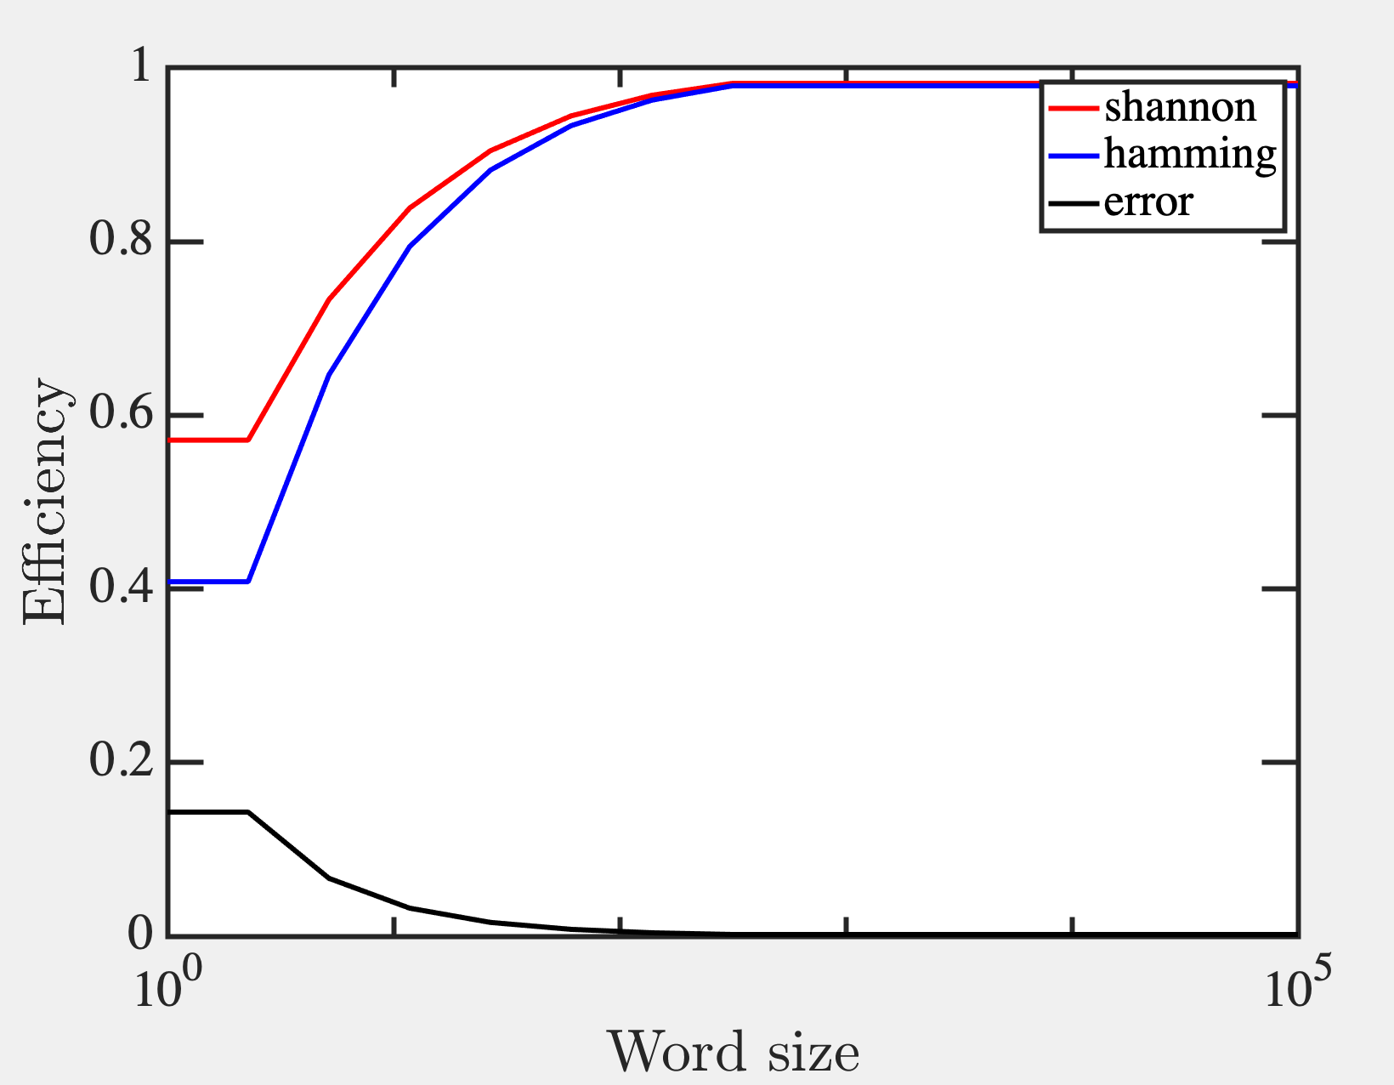

Slide 14
So we could compress the word
by minimizing errors or better
placement of parity bits for
Multi-state recognition.
But how do we compress better?

