Slide 1
5E. Lossless data compression

Slide 2
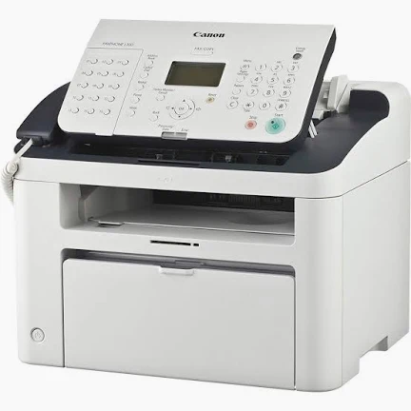
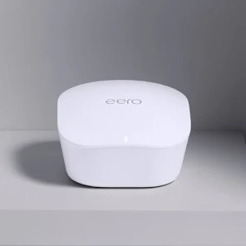
Huffman Coding
Fax Machines Modems
A B C D
0 10 110 111
David A
Huffman
No symbol is a prefix of another
A tree structure does that automatically !
Terminals are orthogonal (nodes aren’t)

Slide 3
Build bottom up, with lowest freq first

Slide 4
An example: brute force

Slide 5
Lower frequency – send further down the tree branches…

Slide 6
Follow from left till you reach a leaf.

Slide 7
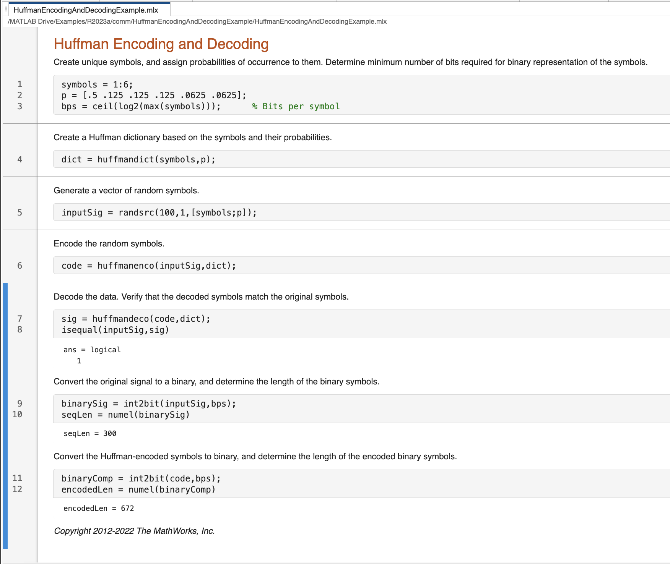
Calculate probabilities Step
Sort in ascending order
3. Left leaf lowest, right second lowest, combine to node
4. Replace those two characters with new node. Resort.
5. Repeat till one node left.

Slide 8
Need to do a frequency counter first of entire text
Different texts have different frequency

Slide 9
Lempel Ziv Welch
Yabbadabbado
12 letters composed of 5 characters:
a, b, d, o, y
→ Need 3 bits to represent the 5 (since 2^2 < 5 < 2^3)
Say, a=000, b=001, d=010, o=011, y=100
12 x 3 = 36 bits
100000001001000010000001001000010011
Abraham Lempel
Jacob Ziv
Terry
Welch
Zip/TIFF files

Slide 10
Lempel Ziv Welch
Yabbadabbado
1. Y: Unseen → (0, y)
2. a: Unseen → (0, a)
3. b: Unseen → (0, b)
4. ba: (b seen at position 3, adding a) → (3, a)
5. d: Unseen → (0, d)
6. ab: (a seen at position 2, adding b) → (2, b)
7. bad: (ba seen at position 4, adding d) → (4, d)
8. o: Unseen → (0, o)
END RESULT → only 8 letters, but each has more bits (3 + 3 = 6)
3 bits for pointers (0 to 4) → 000, 001, 010, 011, 100
3 bits for 5 characters (y,a,b,d,o) → 000,001,010,011,100
8 x 6 = 48 bits (12% reduction)
000000 000001 000010 011001 000011 010010 100011 000100

Slide 11
Decoding Lempel Ziv Welch
000000 000001 000010 011001 000011 010010 100011 000100
Dictionary has 5 characters y,a,b,d,o [000, 001, 010, 011, 100]
1. (0,000) → new, add 000 ie y
2. (0,001) → new, add 001 ie a
3. (0,010) → new, add 010 ie b
4. (3,001) → b from position 3, add 001 ie a → ba
5. (0,011) → new, add 011 ie d
6. (2,010) → a from position 2, add 010 ie b → ab
7. (4,011) → ba from position 4, add 011 ie d → bad
8. (0,100) → new, add 100 ie o
Put it together yabbadabbado

Slide 12
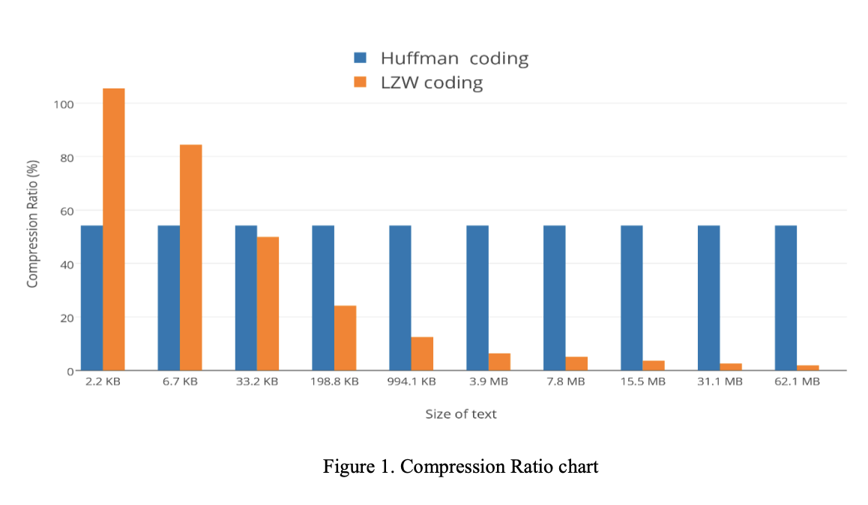
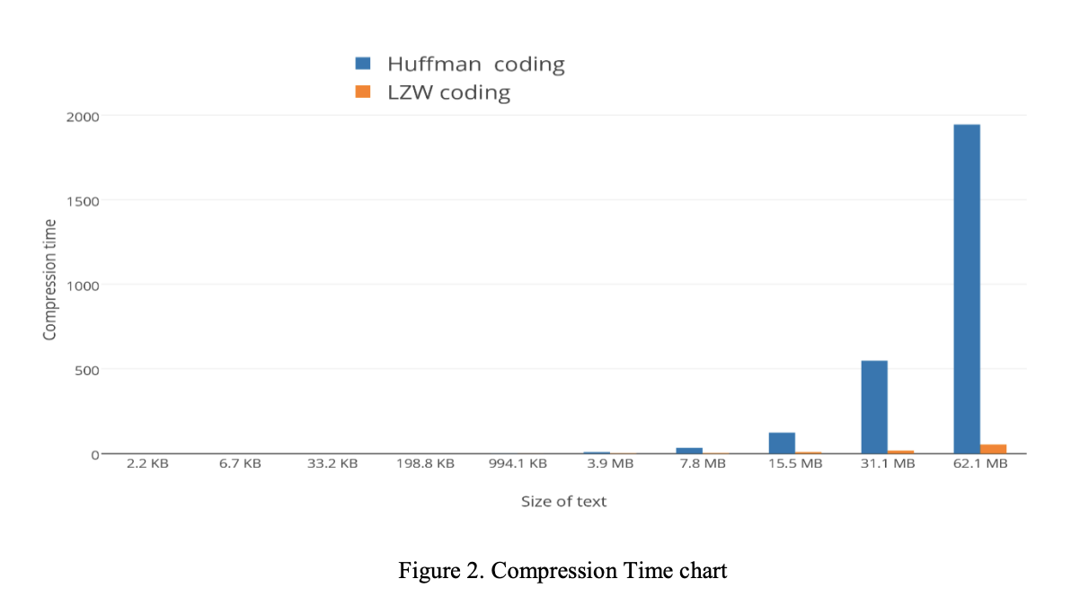
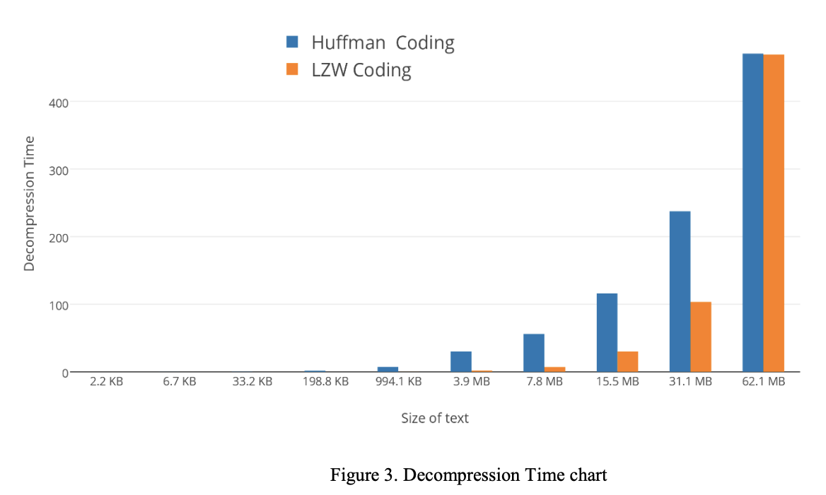
https://cmps-people.ok.ubc.ca/ylucet/DS/Huffman.html
LZW does not need to know frequencies … do on fly
Better if a lot of repetitive data. Faster
LZW → GIF, TIFF, PDF
ZIP – LZW + Huffman
https://www.isroset.org/pub_paper/IJSRCSE/5-ISROSET-IJSRCSE-02950.pdf
LZW great for short text, Huffmann for long text
LZW much faster for all compression
LZW faster for decompression of smaller texts

Slide 13
Combine with Predictive Coding
(e.g. ML/AI based predictor
Reservoir network)
1 if prediction is wrong
0 if prediction is correct

Slide 14
Combine with Predictive Coding
1 if prediction is wrong
0 if prediction is correct

