Slide 1
5F. Analog Data

Slide 2
How to transmit analog data?
Digitize into multibit info

Slide 3
How accurate is this?
How many bins (=2^{N}) for inaccuracy 1% ?
How many bits (N) to describe each bin?

Slide 4
Answers
Analog #
Binary representation

Slide 5
Matlab Communications Toolbox
10 bit precision

Slide 6
What about equal probability boxes?
Digitize, but with constant probability
in each bin (ie, unequal width)

Slide 7
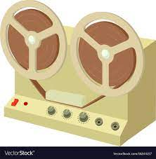
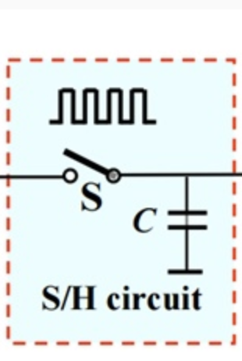
ADCs
Sample and Hold
Quantize and Encode

Slide 8
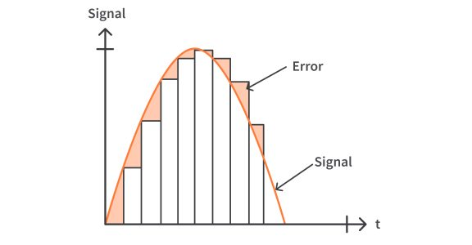
Sample and Hold

Slide 9
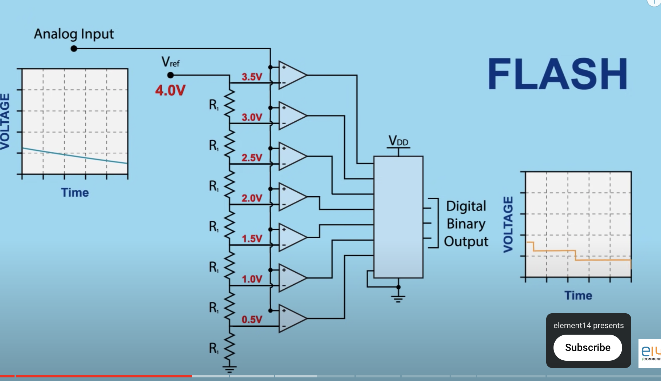
3-bit Flash ADC
https://www.youtube.com/watch?v=g4BvbAKNQ90

Slide 10
Time Sampling

Slide 11
Frequency domain

Slide 12
Nyquist Sampling Theorem
If we Fourier transform φ(ω) and capture all frequencies
ω > ν correctly, then a sampling time τ = 2π/2ν should suffice
Sampling time needed

Slide 13
Nyquist Sampling Theorem
If we Fourier transform φ(ω) and capture all frequencies
ω > ν correctly, then a sampling time τ = 2π/2ν should suffice

Slide 14
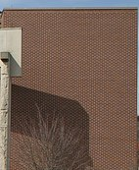
Sampling below Nyquist frequency: Aliasing
Moire pattern
Wagon Wheel Effect
32KHz sampling (must be > twice max freq)
Signals above 16KHz will cause aliasing during DAC/sampling

Slide 15
To summarize
Memory units can be error-corrected with parity bits. These can be
made efficient with Hamming coding, which approaches the Shannon limit
of efficiency for small error rates.
The Shannon limit sets the upper bound on efficiency equal to 1 minus
the information entropy
Error distributions follow Gaussian statistics
Biology does error corrections using codon degeneracy, and employing various fixers (nuclease for spotting, polymerase for correcting, ligase for sealing etc).
Huffman Trees (Fax/Modems) and Lempel-Ziv coding (TIFF/ZIP) allow lossless
data compression by assigning strings according to frequency or novelty.
Analog errors in ADC come from quantization (comparator quality) and sampling
(Nyquist theorem) and can show up as aliasing etc.

Slide 16
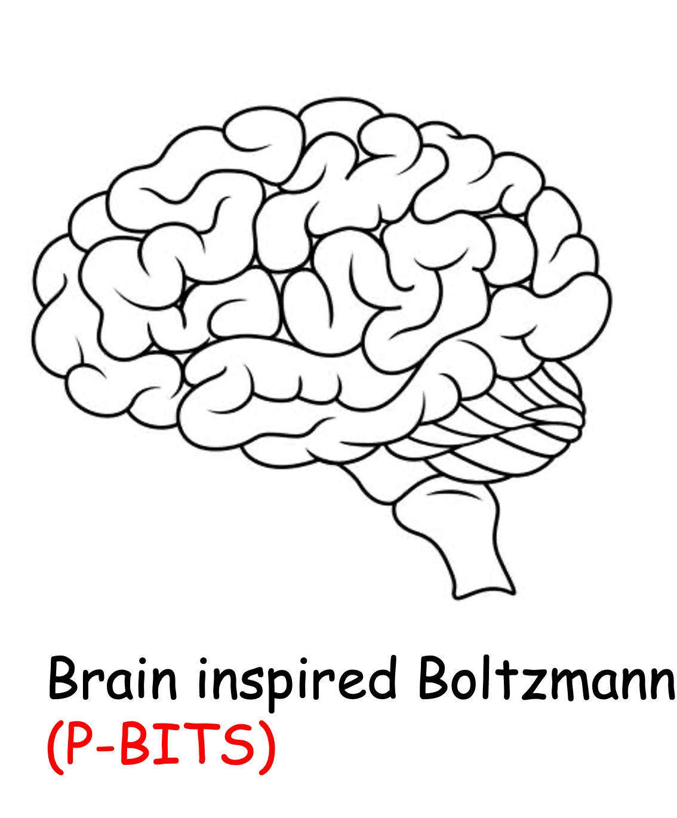
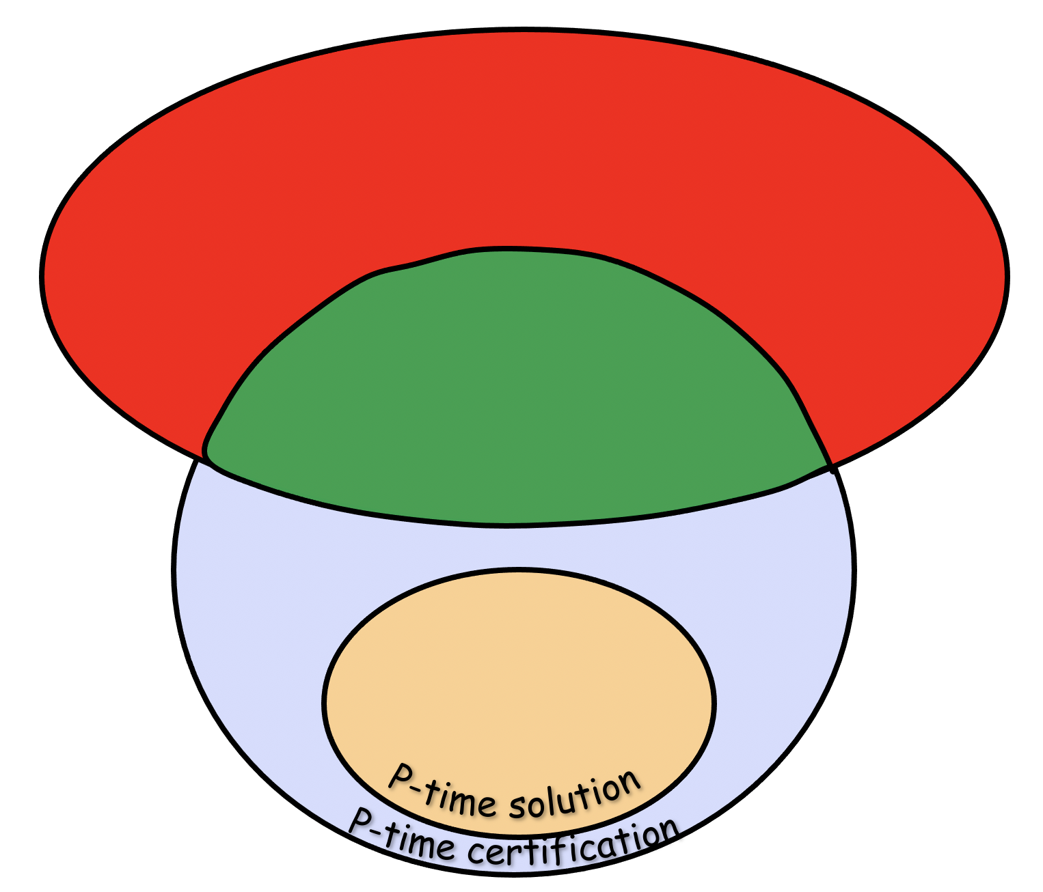
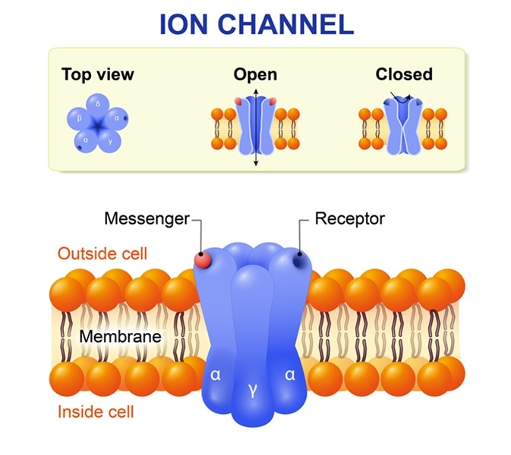
Next Lecture
Can we compute anything?
Turing Machine
Computational Complexity
Ion Channels

