Slide 1
Fundamentals of Computing
Lec 5
How we fix errors

Slide 2
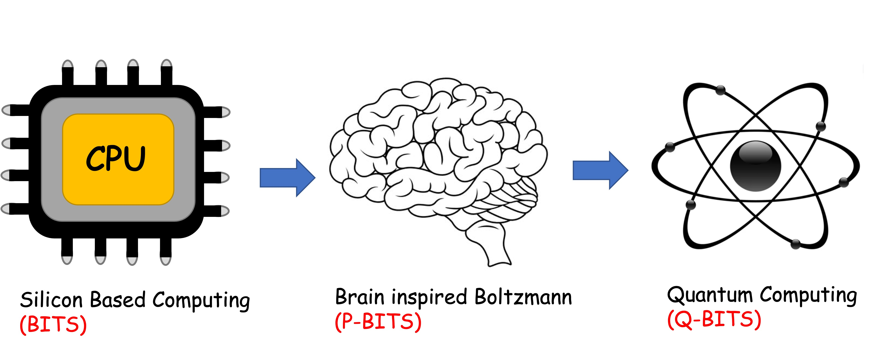
Overall structure of this course
Analog Computing in Carbo
How we train (Supervision)
Nature’s Supervision (Boltzmann)
How we learn (time sampling)
Optimizing
Classifying (Truth Tables)
Transition Theory
Inferencing (Bayesian)
Quantum Computing in Magneto
Quantum Spins and Hardware
Interacting Spins
Going parallel: Quantum Physics
Entanglement and Superposition
Cloning and Key Distribution
Quantum Search and Annealing
Quantum Gates and Factorization
Digital Computing in Silico
How we compute (algorithms)
How we add (Gates)
How we add quickly (CMOS)
Energetics of Computing
How we fix errors

Slide 3
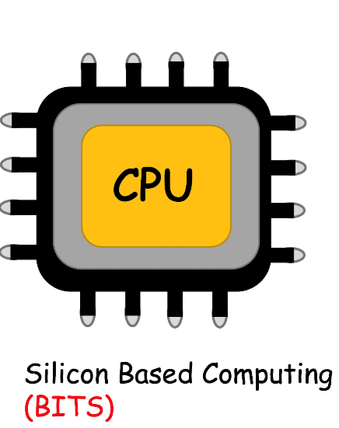

Slide 4
The story so far
Information is physical, captured by entropy from a probability distribution
Operating on information such as W.x needs fast addition
Binary representation is convenient (including negatives 2’s complement)
Boolean logic gates (e.g. XOR, NAND) can do addition, memory, MUX, LUTs
CMOS implements these operations with fast electrons at high accuracy
Energy wasted per cycle when charges drop from high to low V, equal to CV². Minimum waste connected to entropy change/accuracy, E_{min} = kTln(1/p)
This energy loss is replenished by battery, which goes from noneq (low entropy) to equilibrium (fuel value of information). Big Bang is ultimate battery.
We can avoid some loss with reversible computing that involves free copying if done slowly. But speed and accuracy demands will push up energy costs.

Slide 5
5A. Error correction with
Parity Bits

Slide 6
For logic operations, errors are not fixable on the fly (data are altering rapidly)
Digital Analog
CMOS Magnet

Slide 7
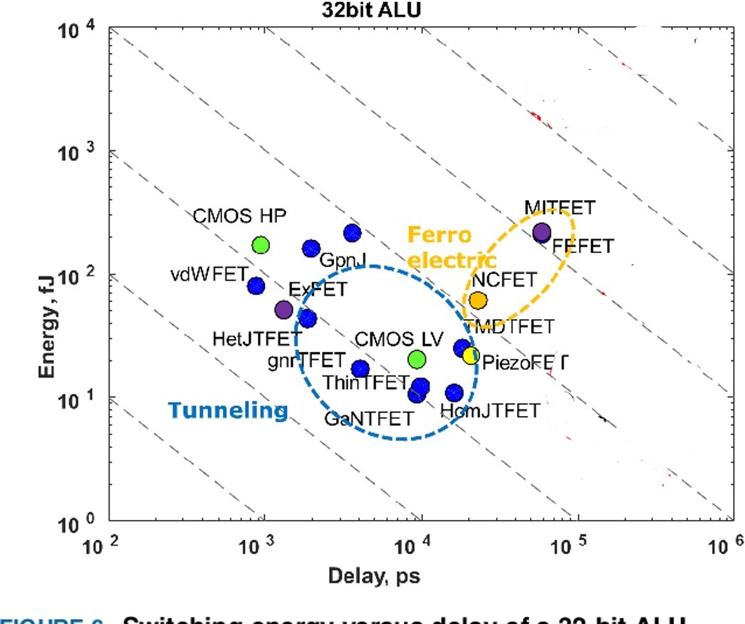
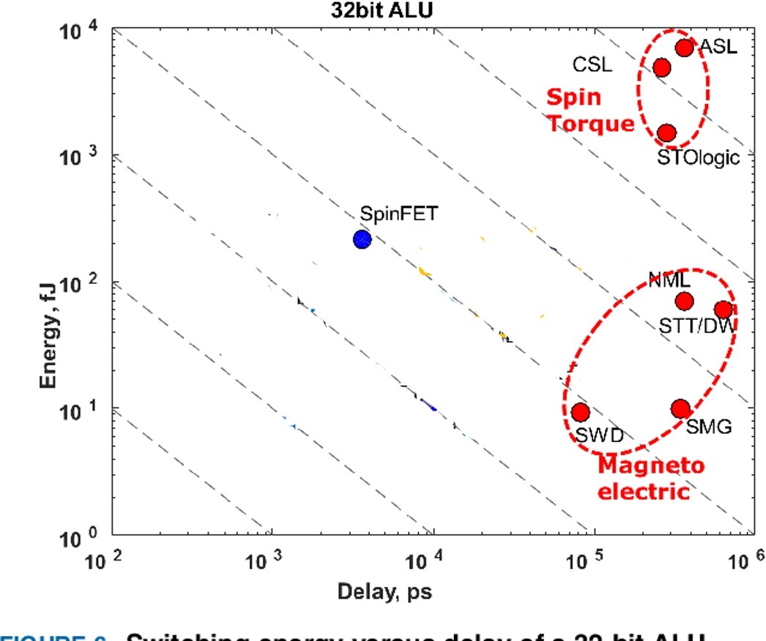
Energy-Delay-Error trade-off
Accuracy
Energy (fJ)
Delay (ps)

Slide 8
This puts severe restrictions on barriers and thus power
This is because we cannot fix dynamic errors on the fly at
high speed

Slide 9
What about memory?
Memory chunks allow post-processing for static error correction
(error could happen in real time, but static since data bits are not being acted upon)

Slide 10
One way to detect error: Parity bit
Random bit flip
Add in a parity bit (red)
P = 0 if even # of 1s
= 1 if odd # of 1s

Slide 11
Parity bit
Random bit flip
0101101
→
0101001
0 suggests even # of 1s even though should be 1 → Error
Efficiency = significant bits/total bits = 6/7 = 87%
Redundancy = inverse = 7/6
But how do we know where the flip is?
What about swaps, double, triple flips?
How do we maximize efficiency?

Slide 12
Rerrange and provide parity for
each row and column
N
10110110 -->
1
0
1011
0110
M
1101
Efficiency 8/14 = 57%, Redundancy 14/8
For large MxN structure including parity bits
R ~ MN/(M-1)(N-1) ~ 15/8

Slide 13
Locating an error
1
0
1011
0010
10110010 -->
Error in data bit
1 101
Row AND column error
1
1
1011
0110
Error in parity bit
Row OR column error
1 101

Slide 14
So parity bits can sniff out a single bit error by
using duplication of row-column (2N parity bits sample
N² data bits)
Is there something more efficient for dual coordinate
recognition?

Slide 15
5B. Hamming Coding for parity bits

Slide 16
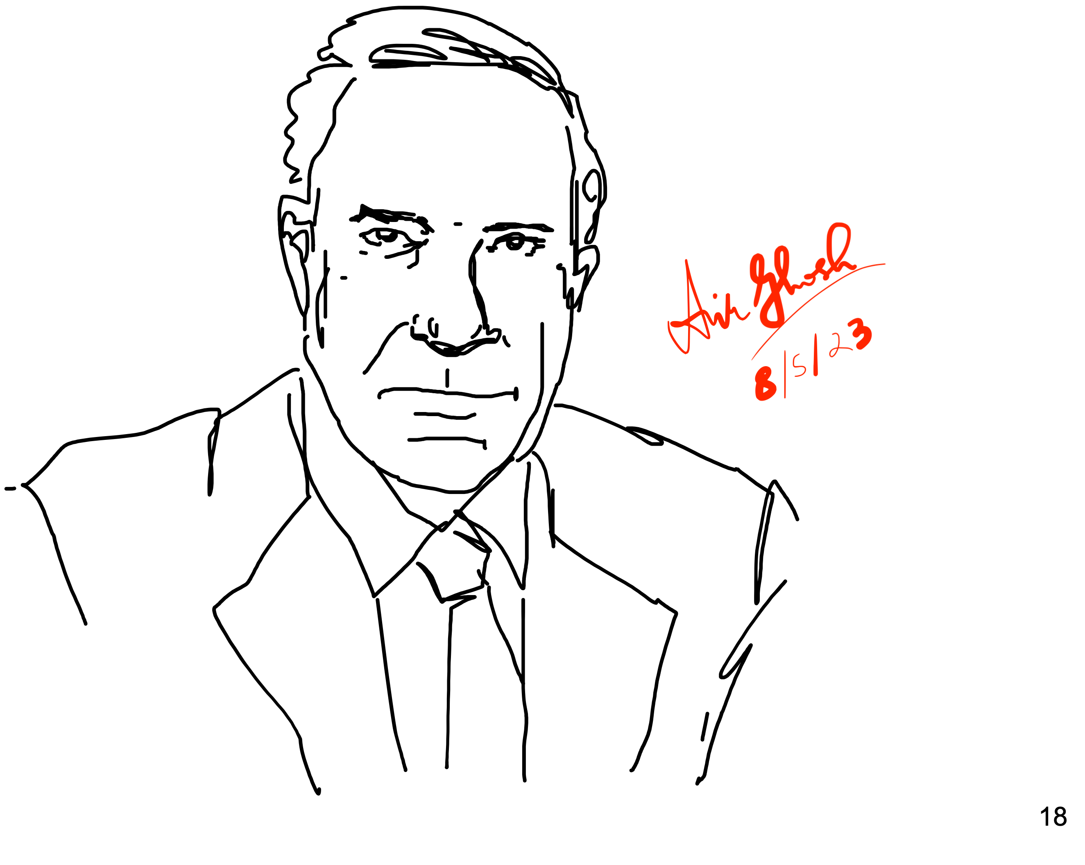
Hamming coding
⁷ ⁶ ⁵ ³
110c1ba
Hamming
Data 1101 and parity bits abc mixed so that each parity bit monitors multiple data bits in the set (3, 5, 6, 7)
a will cover parity of positions 3, 5, 7
b will cover positions 3, 6, 7
c will cover 5, 6, 7

Slide 17
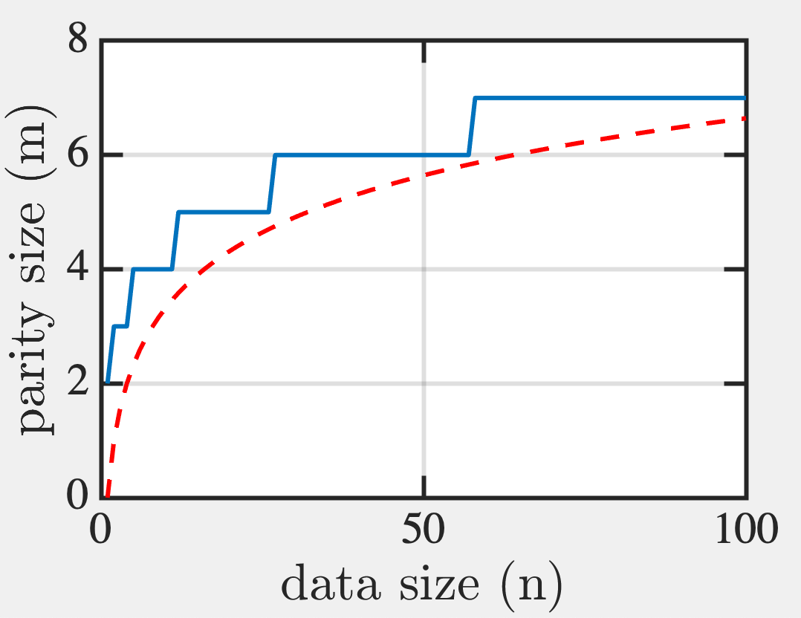
Hamming coding
Syndrome (Set of m Parity Bits with n data bits)
Coverage Rule: 2^m-1 possibilities must cover all 1-bit errors in word of size n+m
2^{m}-1 ≥ (n+m) → e.g. n=4, need m=3. Large n,
m ~ log₂n
log₂n

Slide 18
Hamming coding
Place m parity bits at positions 2^m (bit positions 1,2,4,8,16…. which in binary means 00001, 00010, 00100, 01000, 10000, with only 1 non-zero bit).
Each parity bit tracks all data bits with least significant bit at its position
e.g. bit 00001 tracks total parity of all data bits with 1 at 1’s position, ie, at 00001, 00011, 01001, 1011 etc (2⁴ options)
Bit 00010 tracks total parity of all with 1 at 2’s position…
110c1ba

Slide 19
Hamming coding
3 bits cover all 8 positions
110c1ba
a checks for error (1)
in position 1
So pos. 001, 011, 101, 111
position 1 (parity a)
position 3
position 5
position 7
b checks for error (1)
in position 2
So pos. 010, 011, 110, 111
position 2 (parity b)
position 3
position 6
position 7
c checks for error (1)
in position 4
So bits 100, 101, 110, 111
position 4 (parity c)
position 5
position 6
position 7
110c1ba
110c1ba
110c1ba
7 6 5 4 3 2 1
7 6 5 4 3 2 1
7 6 5 4 3 2 1
1100110

Slide 20
Example 1: error at bit 3
1100110 → 1100010

Slide 21
Example 2: error at bit 2 (parity)
1100110 → 1100100
No solution!
So second one is wrong
Bit 2

Slide 22
Example 3: 2-bit error
1100110 → 1000010
2-bit error looks like a single bit error at 5

Slide 23
Add an overall parity bit
01100110 → 01000010
So cannot be single bit error!

Slide 24
How to sniff out 2-bit error
01100110 → 01000010
Double negative gave +ve

Slide 25
How to sniff out 2-bit error
01100110 → 01000010
2 bit error in (3,6,7) --> (3,6), (3,7) or (6,7)
1 bit error in (3,5,7) → (3,6) or (6,7)
1 bit error in (5,6,7) --> (3,6)
→ Error in bits (3,6)

Slide 26
Example 4: 2-bit error incl parity bit
(0,2 errors)
01100110 → 01000100
1 error
(0,2 errors)
NOT POSSIBLE! → a,c suggests 6, and b is wrong → (2,6)

Slide 28
Parity helps detect binary errors
O and 1 errors can be sniffed out with parity bits. We will discuss the efficiency of parity encoding.
Errors in other languages (non-binary) are trickier. How does biology do it?

Slide 29
5C. Error correction in biology
- Codons and Redundancy

Slide 30
Redundancy for Majority Logic
Make some copies of output
Take majority opinion
Problem - more wires

Slide 31
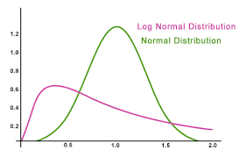
Biology can afford more wires
Ions do not tunnel, so can pack wires
Also, bio-signals slow and crude
(FO in VLSI ~ 4; at bio-synapses ~ 10,000)
Log-normal
Exponent is Gaussian

Slide 32
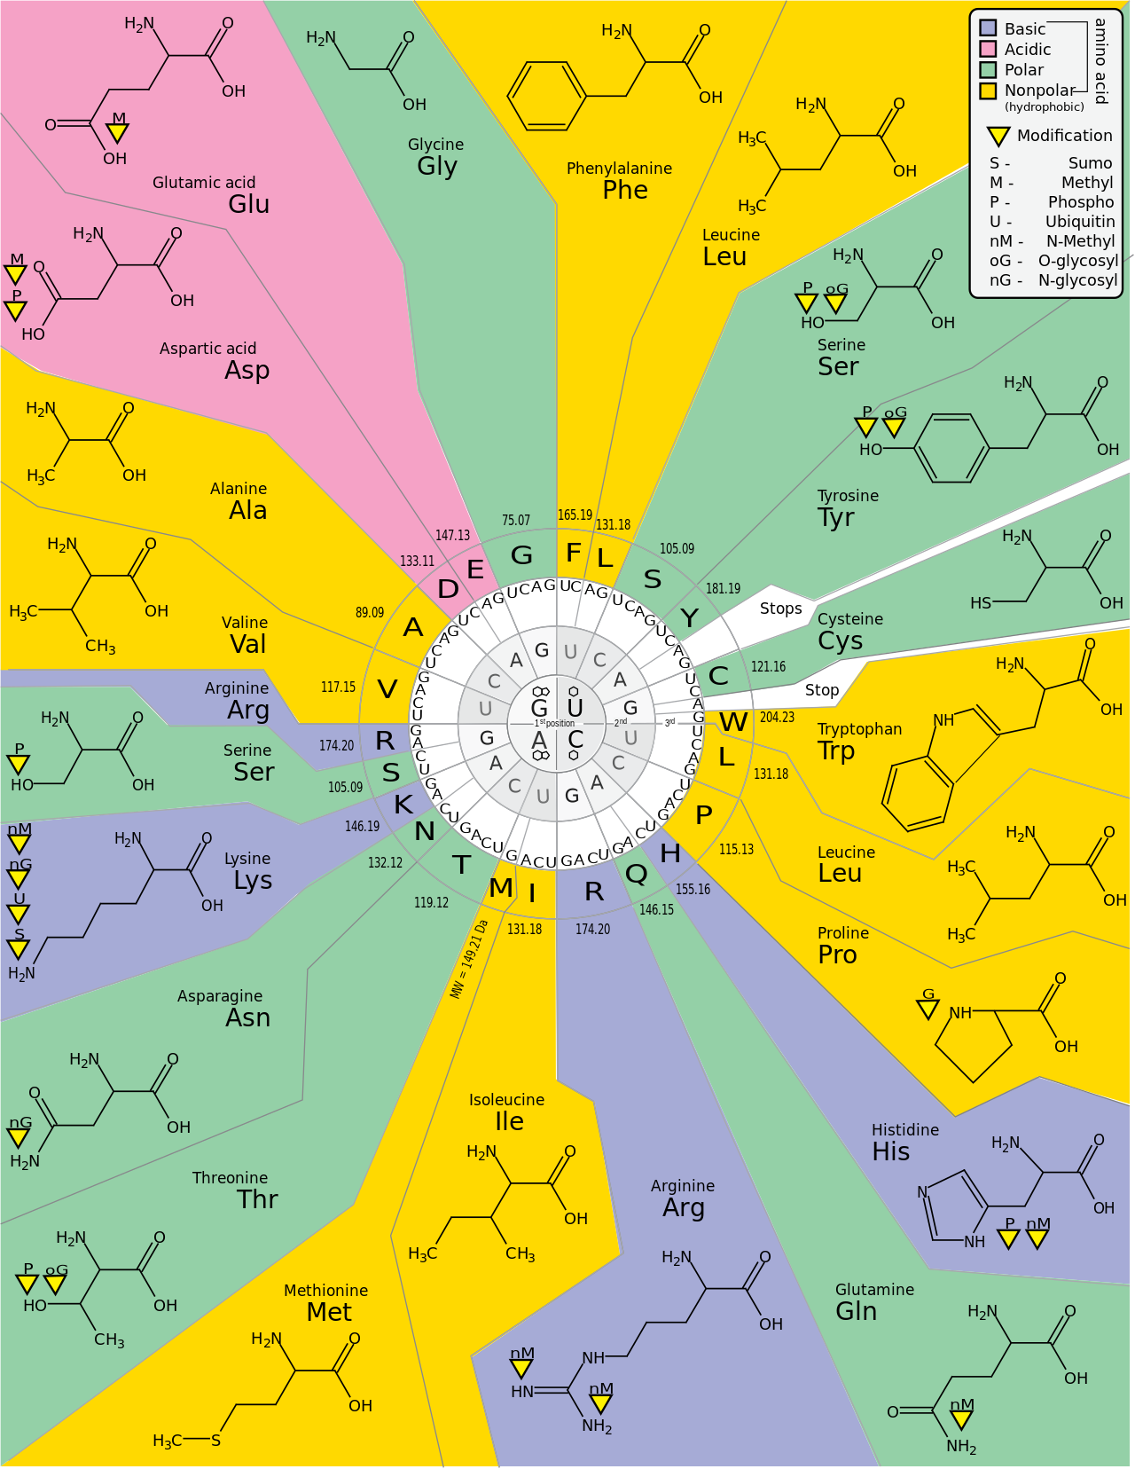
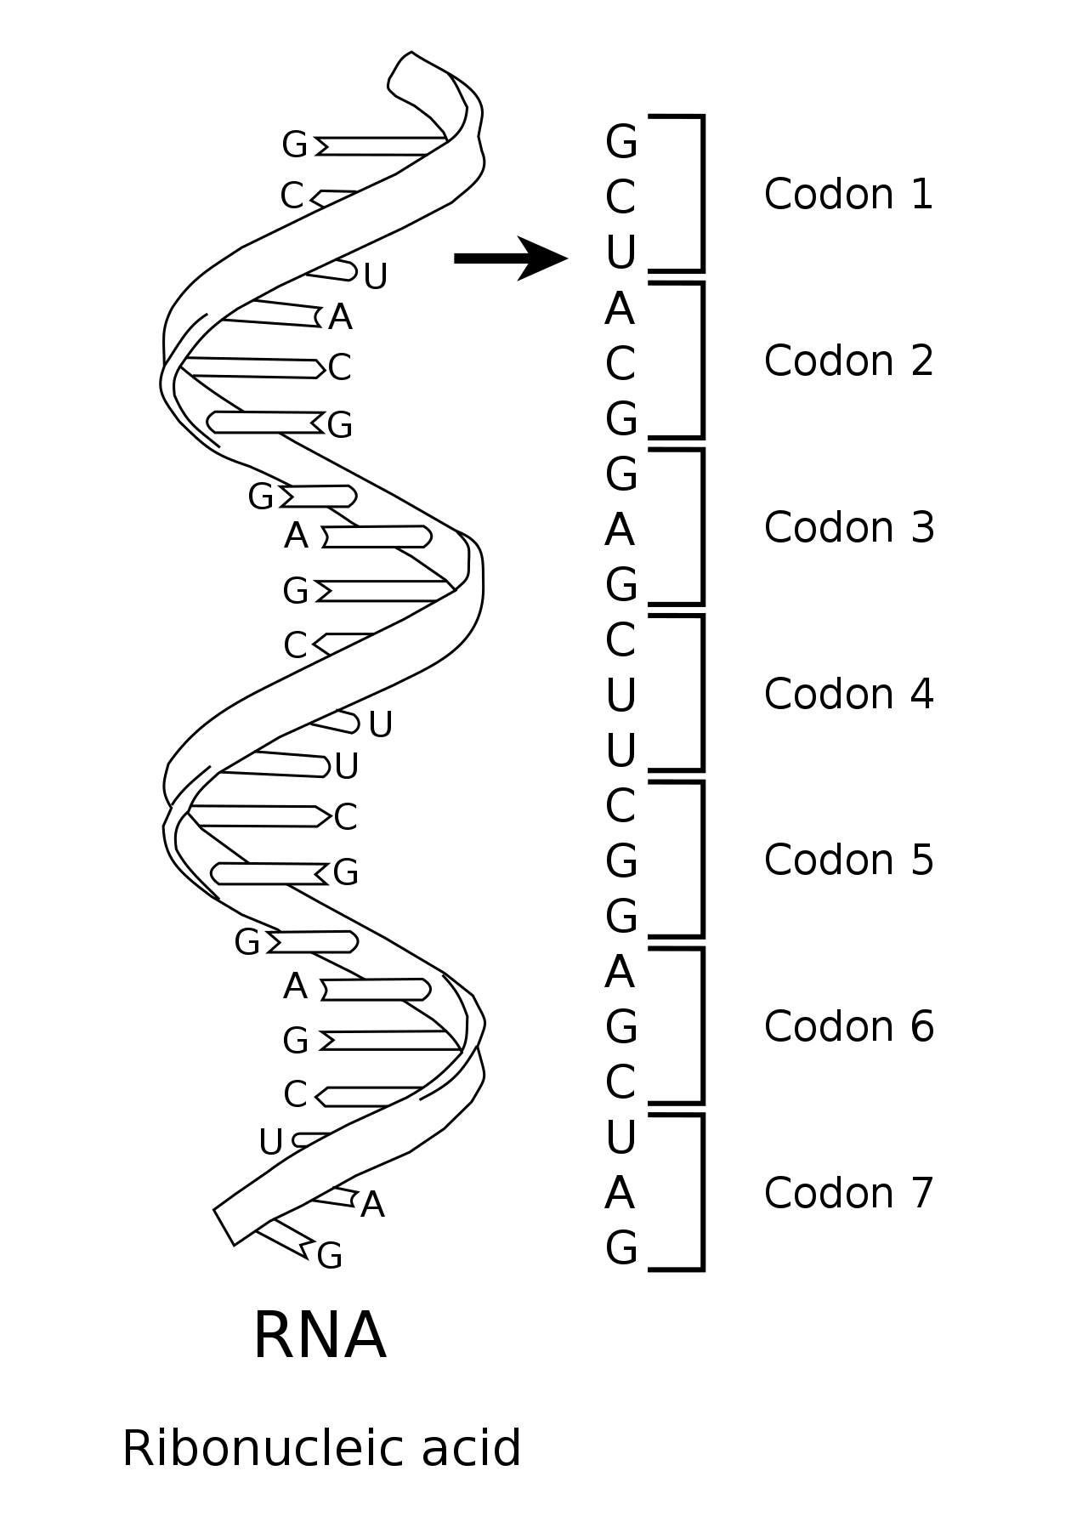
Data presented as 3 nucleotide codons

Slide 33
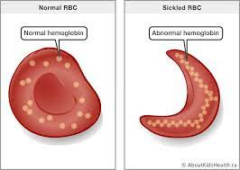
Point mutations can be serious
DNA Template
GGA-CTC-CTC
CCU-GAG-GAG
m-RNA
U
Val
Pro – Glu – Glu… (hemoglobine protein)
Glutamic acid is hydrophilic, Valine is hydrophobic
The change in the 6th position of β-globin changes conformation of protein
enough to cause sickle cell anemia
Alterations happened primarily in Africa to protect against malaria

Slide 34
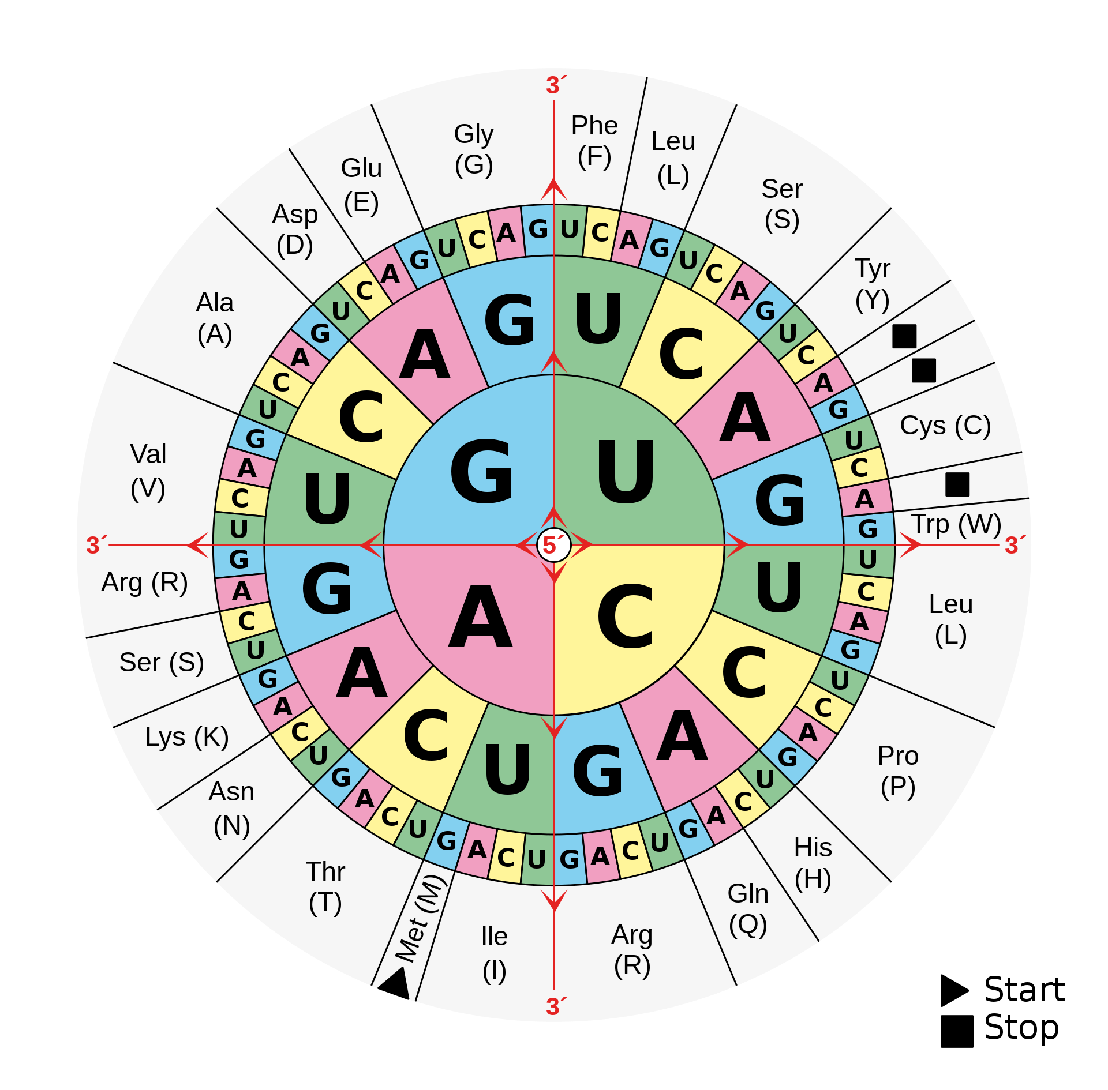
Missense mutations
5’...-AAG-…3’
G
DNA
C
3’...-TTC-…5’
...-AAG-…
m-RNA
G
… – Lys –…
Arg
Replacement makes protein nonfunctional

Slide 35
Missense mutations
5’...-AAG-…3’
G
DNA
C
3’...-TTC-…5’
...-AAG-…
m-RNA
G
… – Lys –…
Arg
Replacement makes protein nonfunctional

Slide 36
Nonsense mutations
T
5’...-AAG-…3’
DNA
A
3’...-TTC-…5’
...-AAG-…
m-RNA
U
… – Lys –…
STOP
Terminates protein synthesis prematurely (cystic fibrosis)
Other variants can erase a stop codon (longer protein)

Slide 37
Nonsense mutations
T
5’...-AAG-…3’
DNA
A
3’...-TTC-…5’
...-AAG-…
m-RNA
U
… – Lys –…
STOP
Terminates protein synthesis prematurely (cystic fibrosis)
Other variants can erase a stop codon (longer protein)

Slide 38
But some mutations can be silent !
A
5’...-AAG-…3’
DNA
T
3’...-TTC-…5’
A
m-RNA
...-AAG-…
Lys
… – Lys –…
This is because codons have degeneracy (redundancy)
64 codons: 61 for amino acids, 3 for STOP code
20 amino acids, so lot of repeats

Slide 39
But some mutations can be silent
A
5’...-AAG-…3’
DNA
T
3’...-TTC-…5’
A
m-RNA
...-AAG-…
Lys
… – Lys –…
This is because codons have degeneracy (redundancy)
64 codons: 61 for amino acids, 3 for STOP code
20 amino acids, so lot of repeats

Slide 40
Error correction in DNA
Mismatch repair: caught by DNA repair enzymes,
which could still miss 1 in 10 Bp
AAG
TTA

Slide 41
Error correction in DNA
Mismatch repair: DNA repair enzymes
AAG
TTC
After replication, no
error noticeable to a
repair enzyme
AAT
TTA

Slide 42
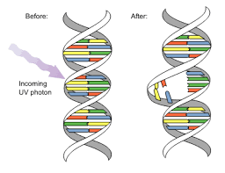
Pyrimidine dimers (UV photons)
Distortion of backbone
TAG
TTC
melanoma
Nuclease spots and snips the strand
Polymerase inserts correct bases
Ligase seals it

Slide 43
Oxidation (chemicals)
O
Oxo-G prefers A
GAG
ATC

Slide 44
Oxidation/alkylation (chemicals)
O
Oxo-G prefers A
GAG
TAG
ATC
After replication, wouldn’t know!
Glycosylase enzyme recognizes errant base pair
before forking and removes, polymerase fixes,
ligase seals it

Slide 45
Errors are recognized by proteins driven
by nonequilibrium noise. Error is a higher
energy configuration.
Best way to avoid errors – redundancy
But that reduces coding efficiency

Slide 46
5D. How to minimize redundancy

Slide 49
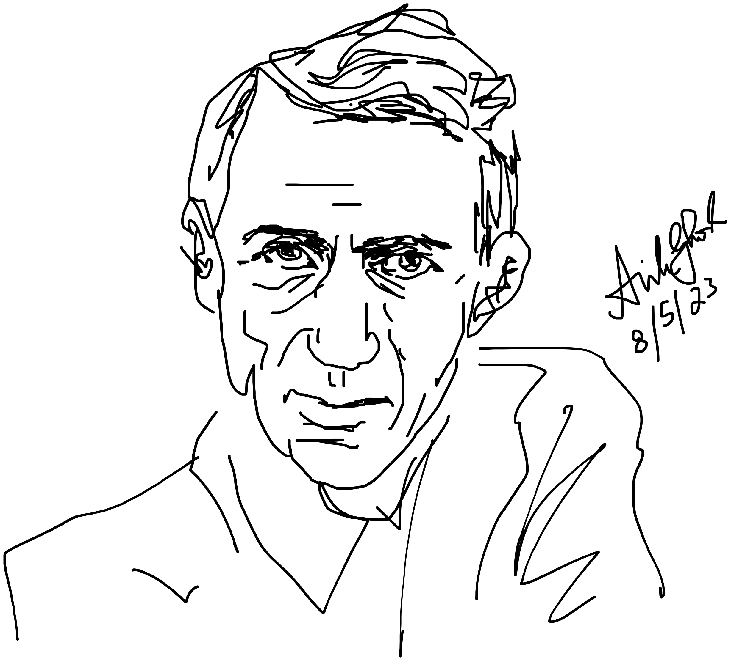
Claude Shannon

Slide 50
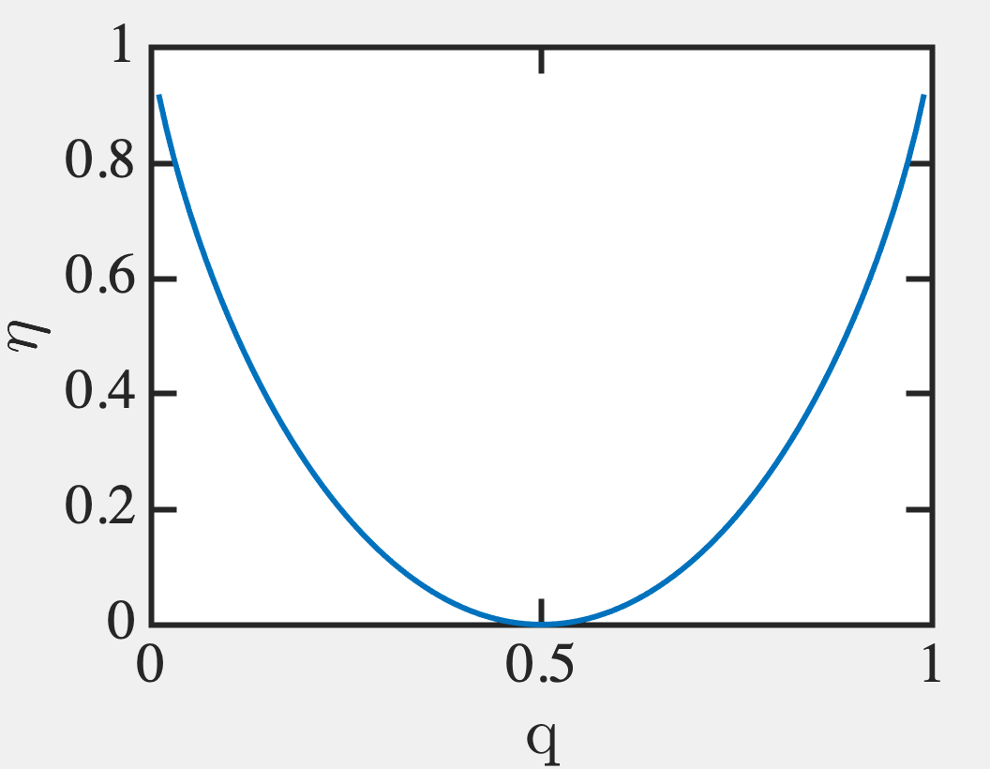

Slide 51
So we can satisfy Shannon’s inequality
by making M_{c} large.
But how to deal with a ‘q’ simply
by increasing sample size?

Slide 52
Gaussian distribution of errors

Slide 53
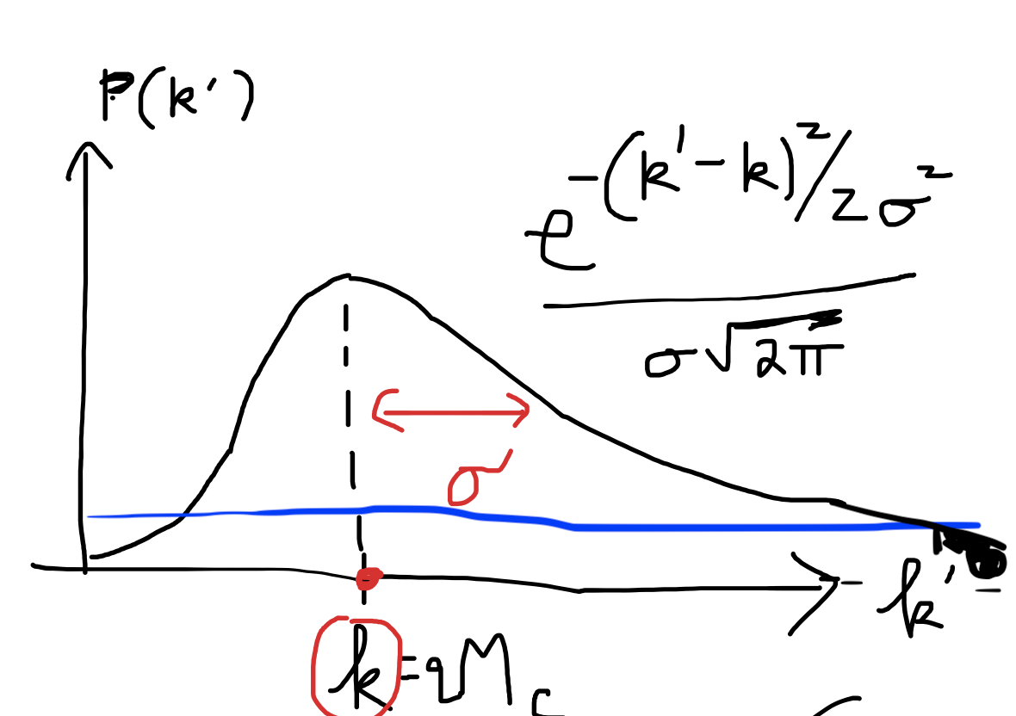
Batch error probability
How many batch errors would have a
probability of 10⁻³⁰?
Low probability works for larger number of
errors k’ >> k. Let k’ = k+g.σ
10⁻³⁰ = P(k’) = exp(-g²/2)/σ√2π ◊ g ~ 12.
k’ = k + 12σ = 10⁻³ + 12(0.03) = 0.3535 errors
So 10⁻³⁰ is odds of 0.35 batch errors

Slide 54
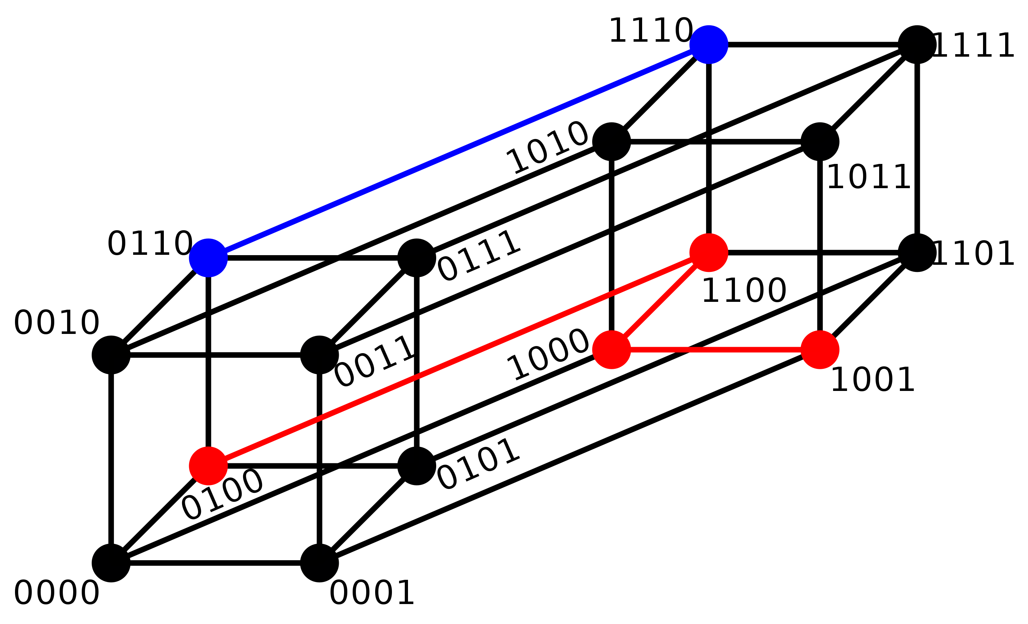
Hamming distance
Put various binary alternatives on vertices of a hypersurface
Each alteration is one node (substitution) away → Sequences of same length
0100 → 1001 shortest distance is 3 steps away
0110 → 1110 is 1 step away
2173896 and 2233796 is 3

Slide 55
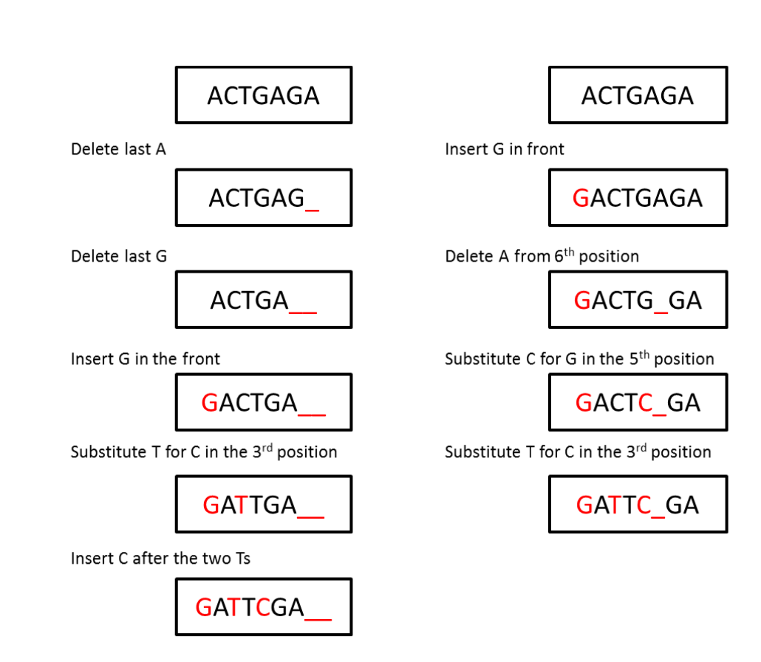
Levenshtein Distance
Alignment → # of insert-delete-substitute
operations to transform one sequence into another
(Edit or Levenshtein distance)
P
Deletions
Edit distance 5
Edit distance 4
Insertions
Q

Slide 56
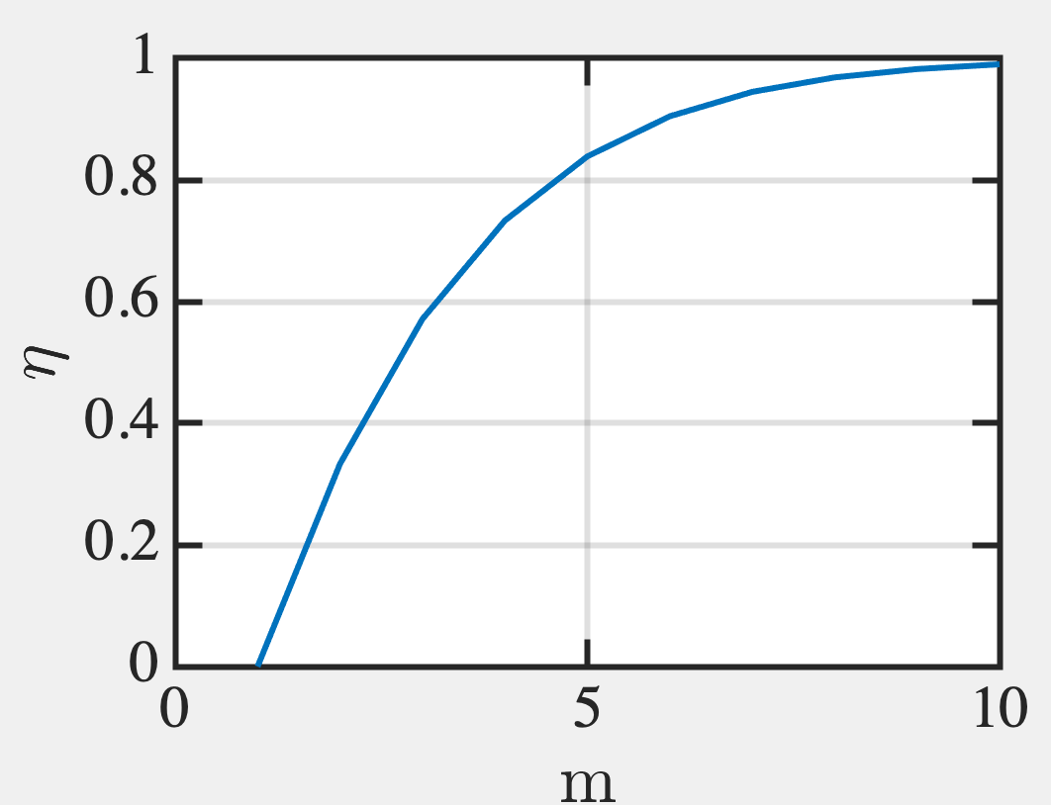
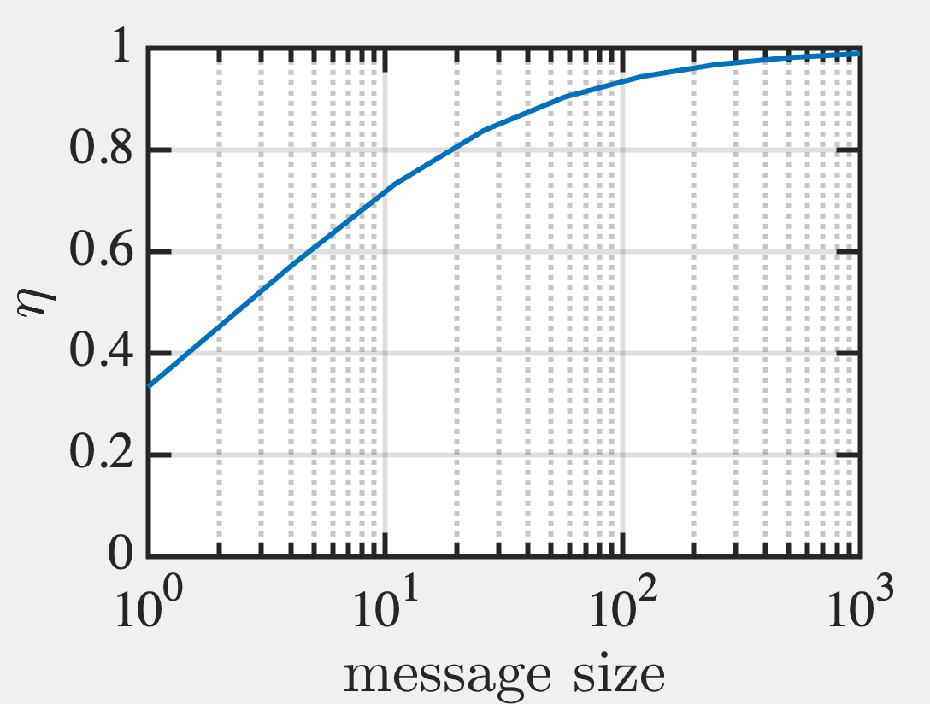
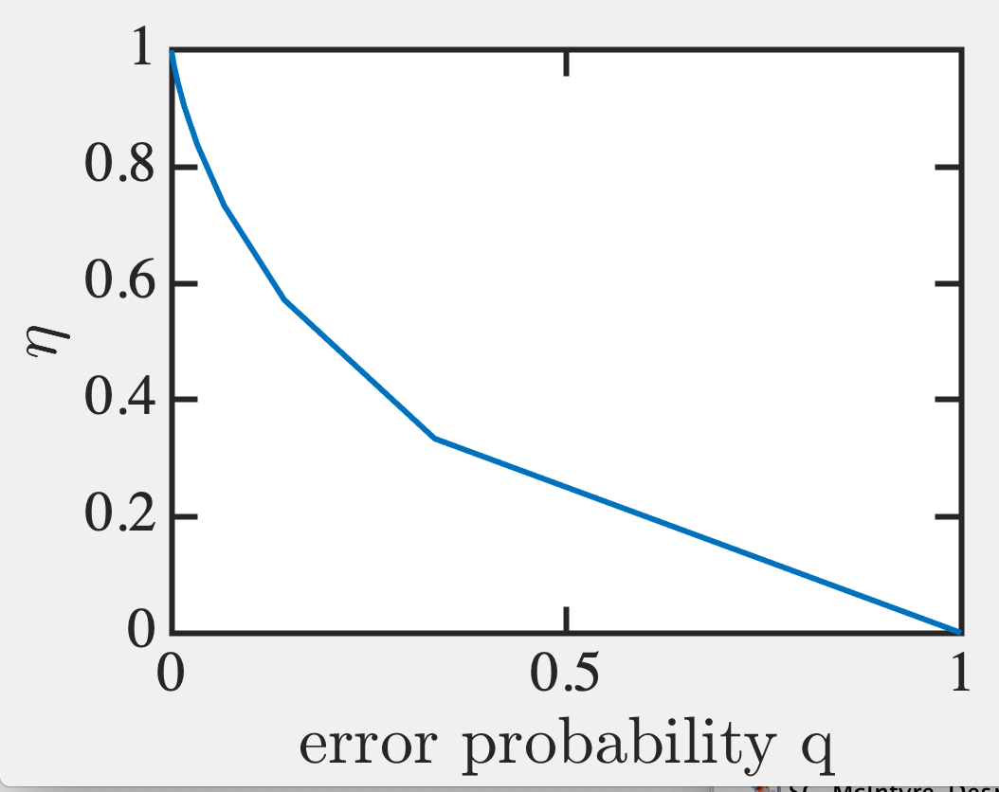
How efficient is a Hamming code?

Slide 58
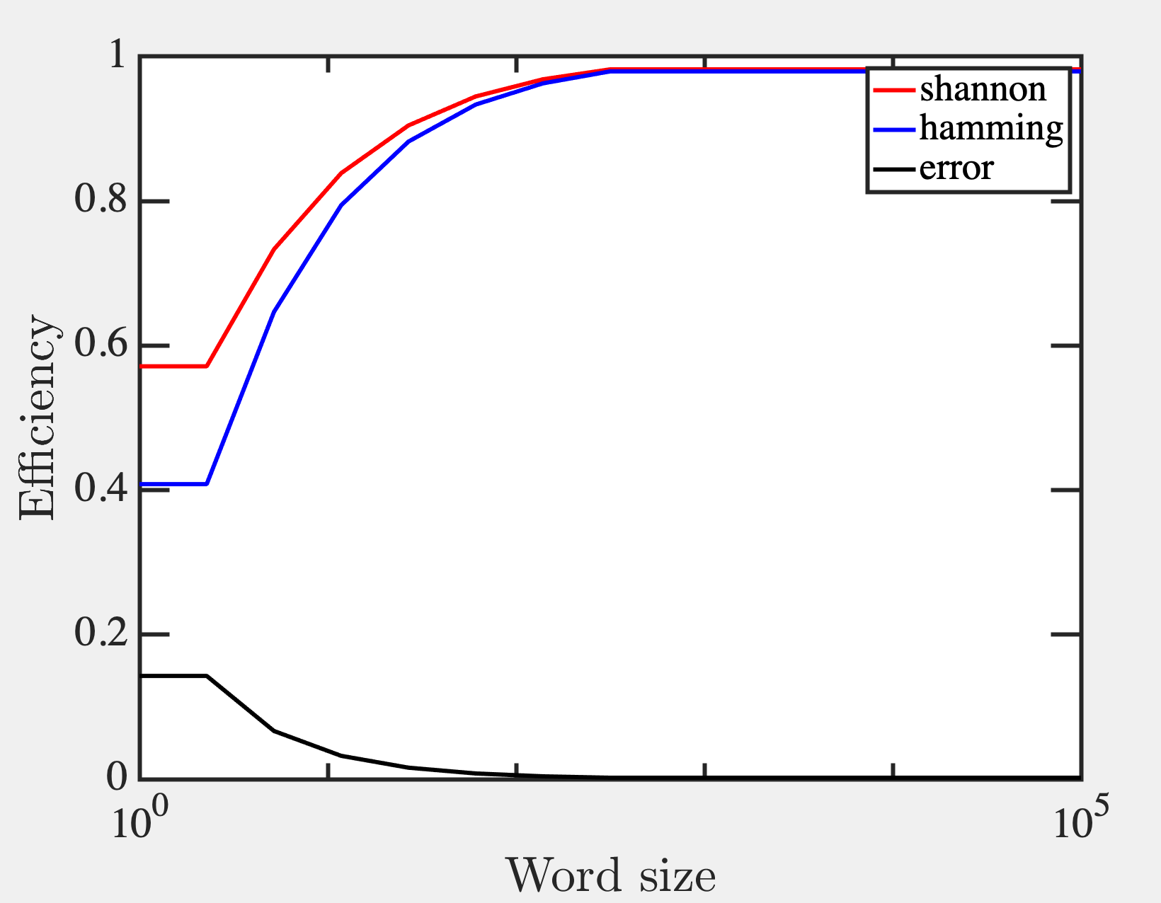

Slide 59
So we could compress the word
by minimizing errors or better
placement of parity bits for
Multi-state recognition.
But how do we compress better?

Slide 60
5E. Lossless data compression

Slide 61
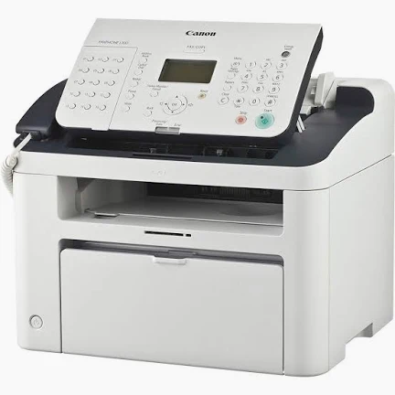
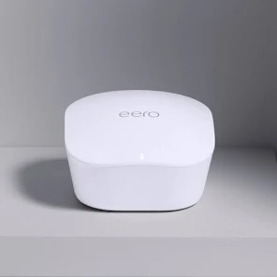
Huffman Coding
Fax Machines Modems
A B C D
0 10 110 111
David A
Huffman
No symbol is a prefix of another
A tree structure does that automatically !
Terminals are orthogonal (nodes aren’t)

Slide 62
Build bottom up, with lowest freq first

Slide 63
An example: brute force

Slide 64
Lower frequency – send further down the tree branches…

Slide 65
Follow from left till you reach a leaf.

Slide 66
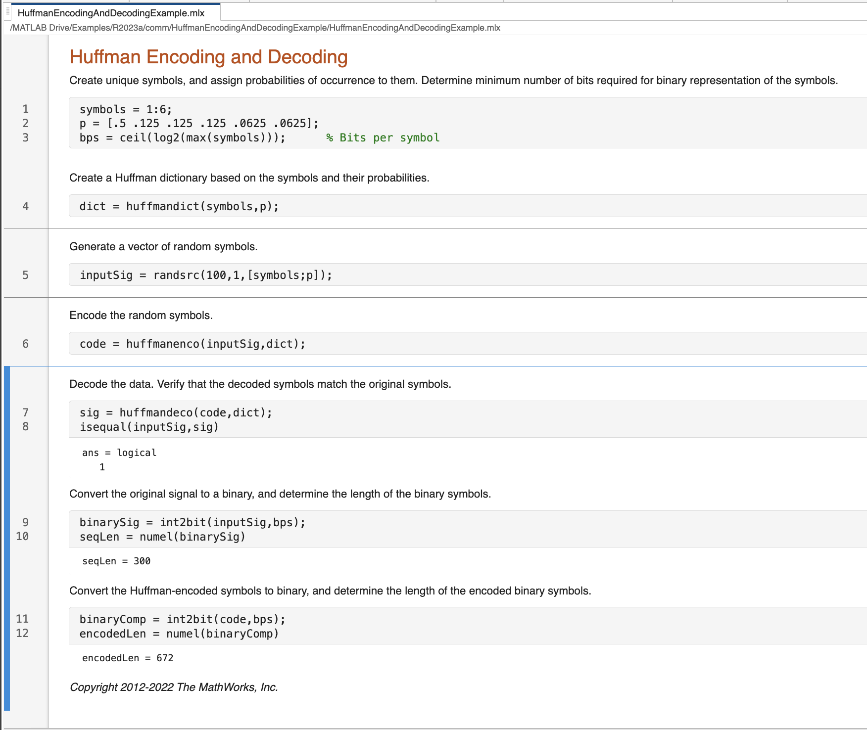
Calculate probabilities Step
Sort in ascending order
3. Left leaf lowest, right second lowest, combine to node
4. Replace those two characters with new node. Resort.
5. Repeat till one node left.

Slide 67
Need to do a frequency counter first of entire text
Different texts have different frequency

Slide 68
Lempel Ziv Welch
Yabbadabbado
12 letters composed of 5 characters:
a, b, d, o, y
→ Need 3 bits to represent the 5 (since 2^2 < 5 < 2^3)
Say, a=000, b=001, d=010, o=011, y=100
12 x 3 = 36 bits
100000001001000010000001001000010011
Abraham Lempel
Jacob Ziv
Terry
Welch
Zip/TIFF files

Slide 69
Lempel Ziv Welch
Yabbadabbado
1. Y: Unseen → (0, y)
2. a: Unseen → (0, a)
3. b: Unseen → (0, b)
4. ba: (b seen at position 3, adding a) → (3, a)
5. d: Unseen → (0, d)
6. ab: (a seen at position 2, adding b) → (2, b)
7. bad: (ba seen at position 4, adding d) → (4, d)
8. o: Unseen → (0, o)
END RESULT → only 8 letters, but each has more bits (3 + 3 = 6)
3 bits for pointers (0 to 4) → 000, 001, 010, 011, 100
3 bits for 5 characters (y,a,b,d,o) → 000,001,010,011,100
8 x 6 = 48 bits (12% reduction)
000000 000001 000010 011001 000011 010010 100011 000100

Slide 70
Decoding Lempel Ziv Welch
000000 000001 000010 011001 000011 010010 100011 000100
Dictionary has 5 characters y,a,b,d,o [000, 001, 010, 011, 100]
1. (0,000) → new, add 000 ie y
2. (0,001) → new, add 001 ie a
3. (0,010) → new, add 010 ie b
4. (3,001) → b from position 3, add 001 ie a → ba
5. (0,011) → new, add 011 ie d
6. (2,010) → a from position 2, add 010 ie b → ab
7. (4,011) → ba from position 4, add 011 ie d → bad
8. (0,100) → new, add 100 ie o
Put it together yabbadabbado

Slide 71
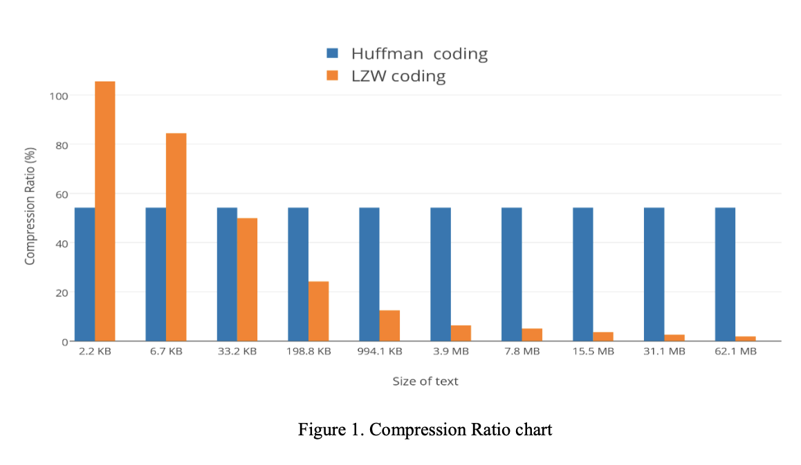
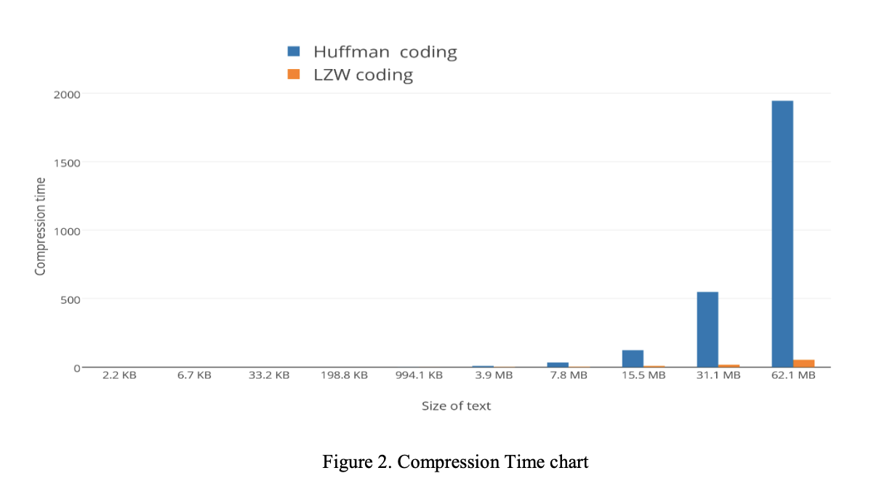
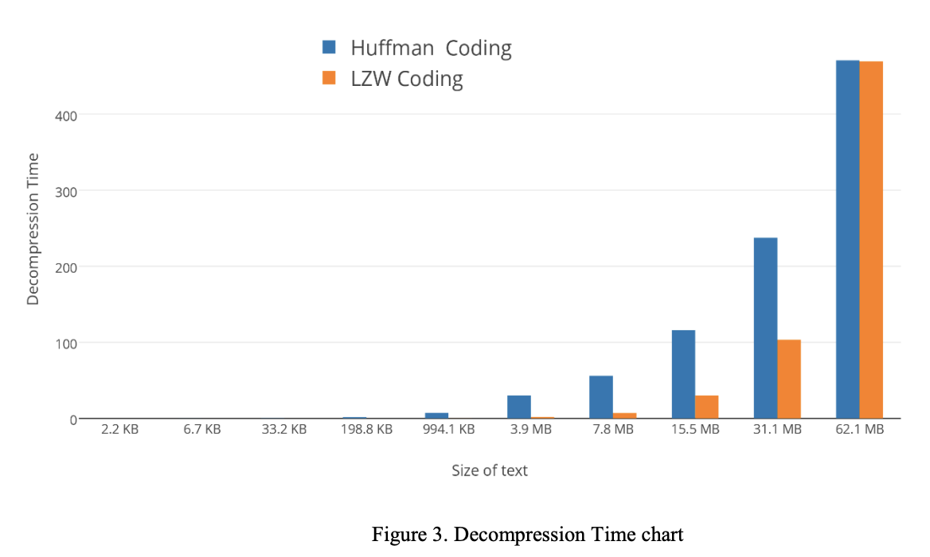
https://cmps-people.ok.ubc.ca/ylucet/DS/Huffman.html
LZW does not need to know frequencies … do on fly
Better if a lot of repetitive data. Faster
LZW → GIF, TIFF, PDF
ZIP – LZW + Huffman
https://www.isroset.org/pub_paper/IJSRCSE/5-ISROSET-IJSRCSE-02950.pdf
LZW great for short text, Huffmann for long text
LZW much faster for all compression
LZW faster for decompression of smaller texts

Slide 72
Combine with Predictive Coding
(e.g. ML/AI based predictor
Reservoir network)
1 if prediction is wrong
0 if prediction is correct

Slide 73
Combine with Predictive Coding
1 if prediction is wrong
0 if prediction is correct

Slide 74
5F. Analog Data

Slide 75
How to transmit analog data?
Digitize into multibit info

Slide 76
How accurate is this?
How many bins (=2^{N}) for inaccuracy 1% ?
How many bits (N) to describe each bin?

Slide 77
Answers
Analog #
Binary representation

Slide 78
Matlab Communications Toolbox
10 bit precision

Slide 79
What about equal probability boxes?
Digitize, but with constant probability
in each bin (ie, unequal width)

Slide 80
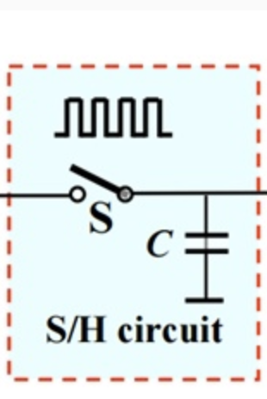
ADCs
Sample and Hold
Quantize and Encode

Slide 81
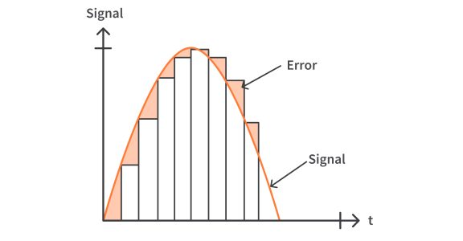
Sample and Hold

Slide 82
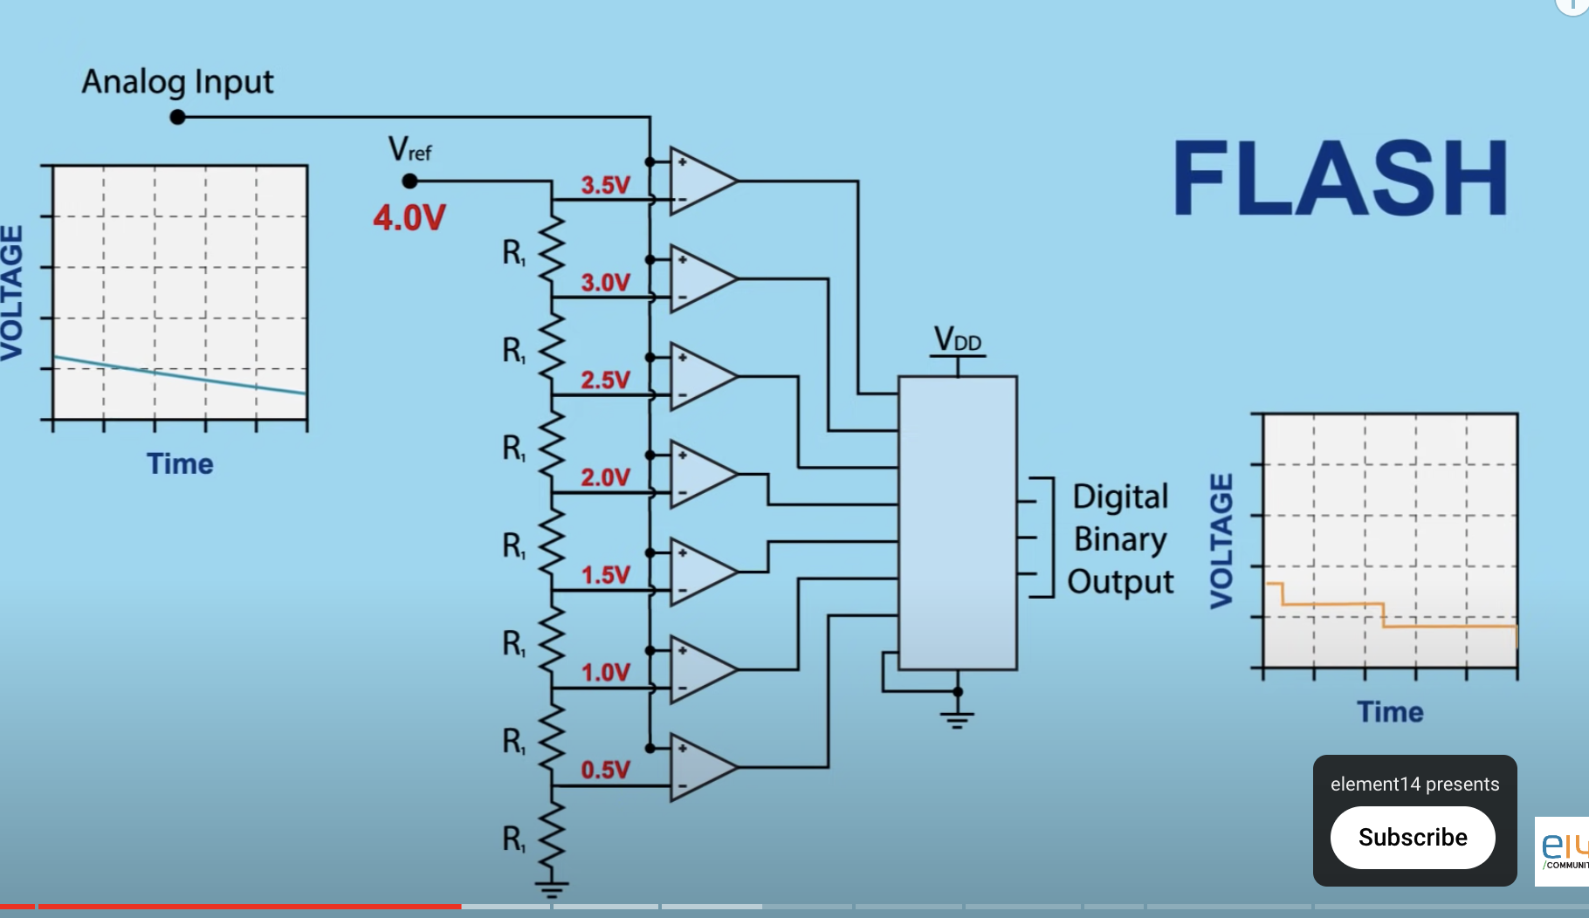
3-bit Flash ADC
https://www.youtube.com/watch?v=g4BvbAKNQ90

Slide 83
Time Sampling

Slide 84
Frequency domain

Slide 85
Nyquist Sampling Theorem
If we Fourier transform φ(ω) and capture all frequencies
ω > ν correctly, then a sampling time τ = 2π/2ν should suffice
Sampling time needed

Slide 86
Nyquist Sampling Theorem
If we Fourier transform φ(ω) and capture all frequencies
ω > ν correctly, then a sampling time τ = 2π/2ν should suffice

Slide 87
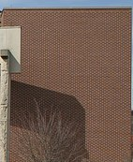
Sampling below Nyquist frequency: Aliasing
Moire pattern
Wagon Wheel Effect
32KHz sampling (must be > twice max freq)
Signals above 16KHz will cause aliasing during DAC/sampling

Slide 88
To summarize
Memory units can be error-corrected with parity bits. These can be
made efficient with Hamming coding, which approaches the Shannon limit
of efficiency for small error rates.
The Shannon limit sets the upper bound on efficiency equal to 1 minus
the information entropy
Error distributions follow Gaussian statistics
Biology does error corrections using codon degeneracy, and employing various fixers (nuclease for spotting, polymerase for correcting, ligase for sealing etc).
Huffman Trees (Fax/Modems) and Lempel-Ziv coding (TIFF/ZIP) allow lossless
data compression by assigning strings according to frequency or novelty.
Analog errors in ADC come from quantization (comparator quality) and sampling
(Nyquist theorem) and can show up as aliasing etc.

Slide 89
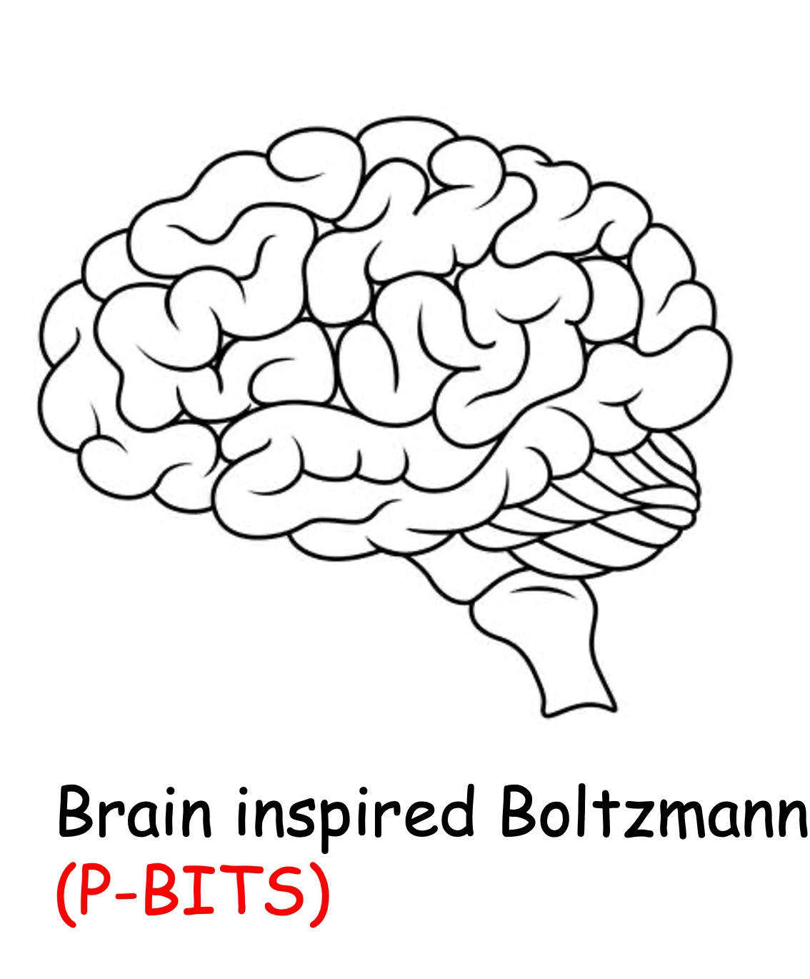
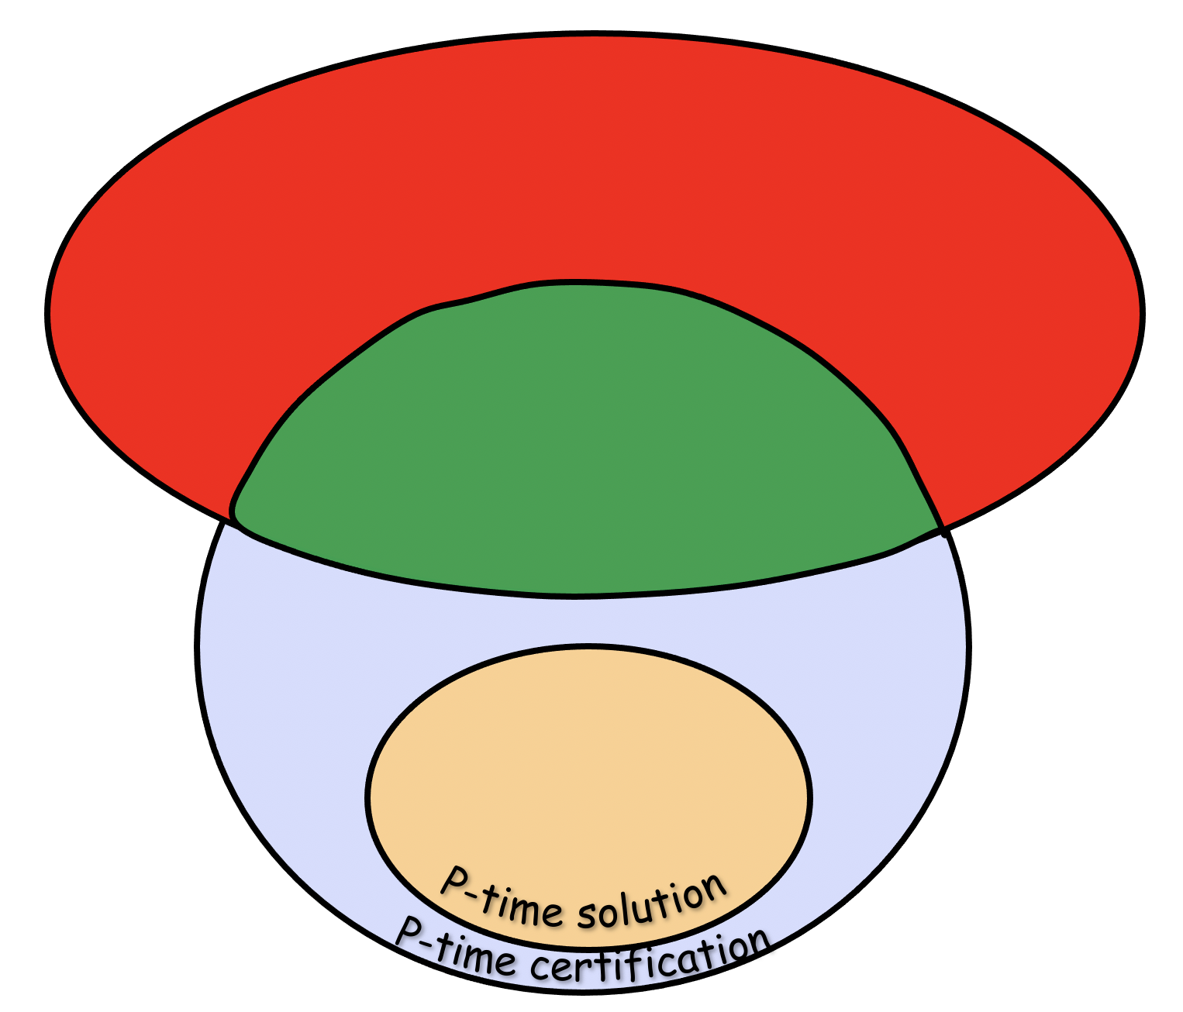
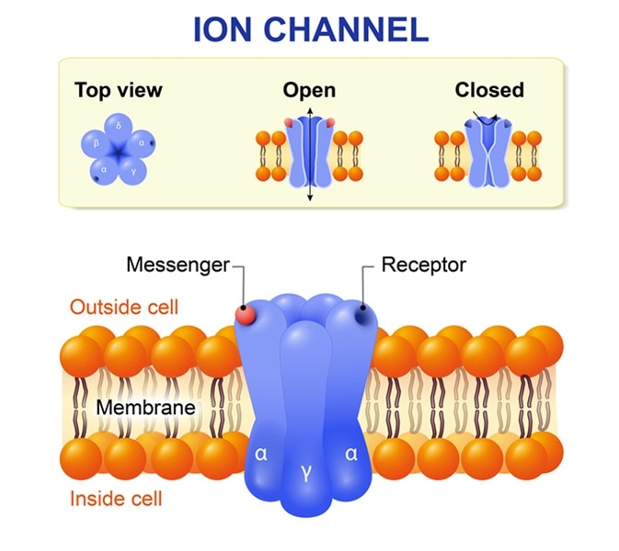
Next Lecture
Can we compute anything?
Turing Machine
Computational Complexity
Ion Channels

