Slide 1
Fundamentals of Computing
Lec 6
Can we compute anything?

Slide 2
The story so far
CMOS is great for operations like fast digital addition
It encodes info as specific binary strings of 1s and 0s, and operates using fast Boolean logic gates driven by light electrons jumping over sizeable, electrostatically tunable energy barriers.
Standby power dissipation is low because of CMOS architecture. It also allows error correction on static data (memory) using repetition codes and parity bits.
With dynamic data (logical operations), there is a considerable price for speed and accuracy.
Biological computers ditch speed and accuracy and look at classical parallelism. They also use frequency of 0s and 1s rather than the strings themselves, and also employ degeneracy of codons.
Quantum computers use qubits and quantum parallelism. They cannot use straightforward repetition codes due to no-cloning theorem.

Slide 3
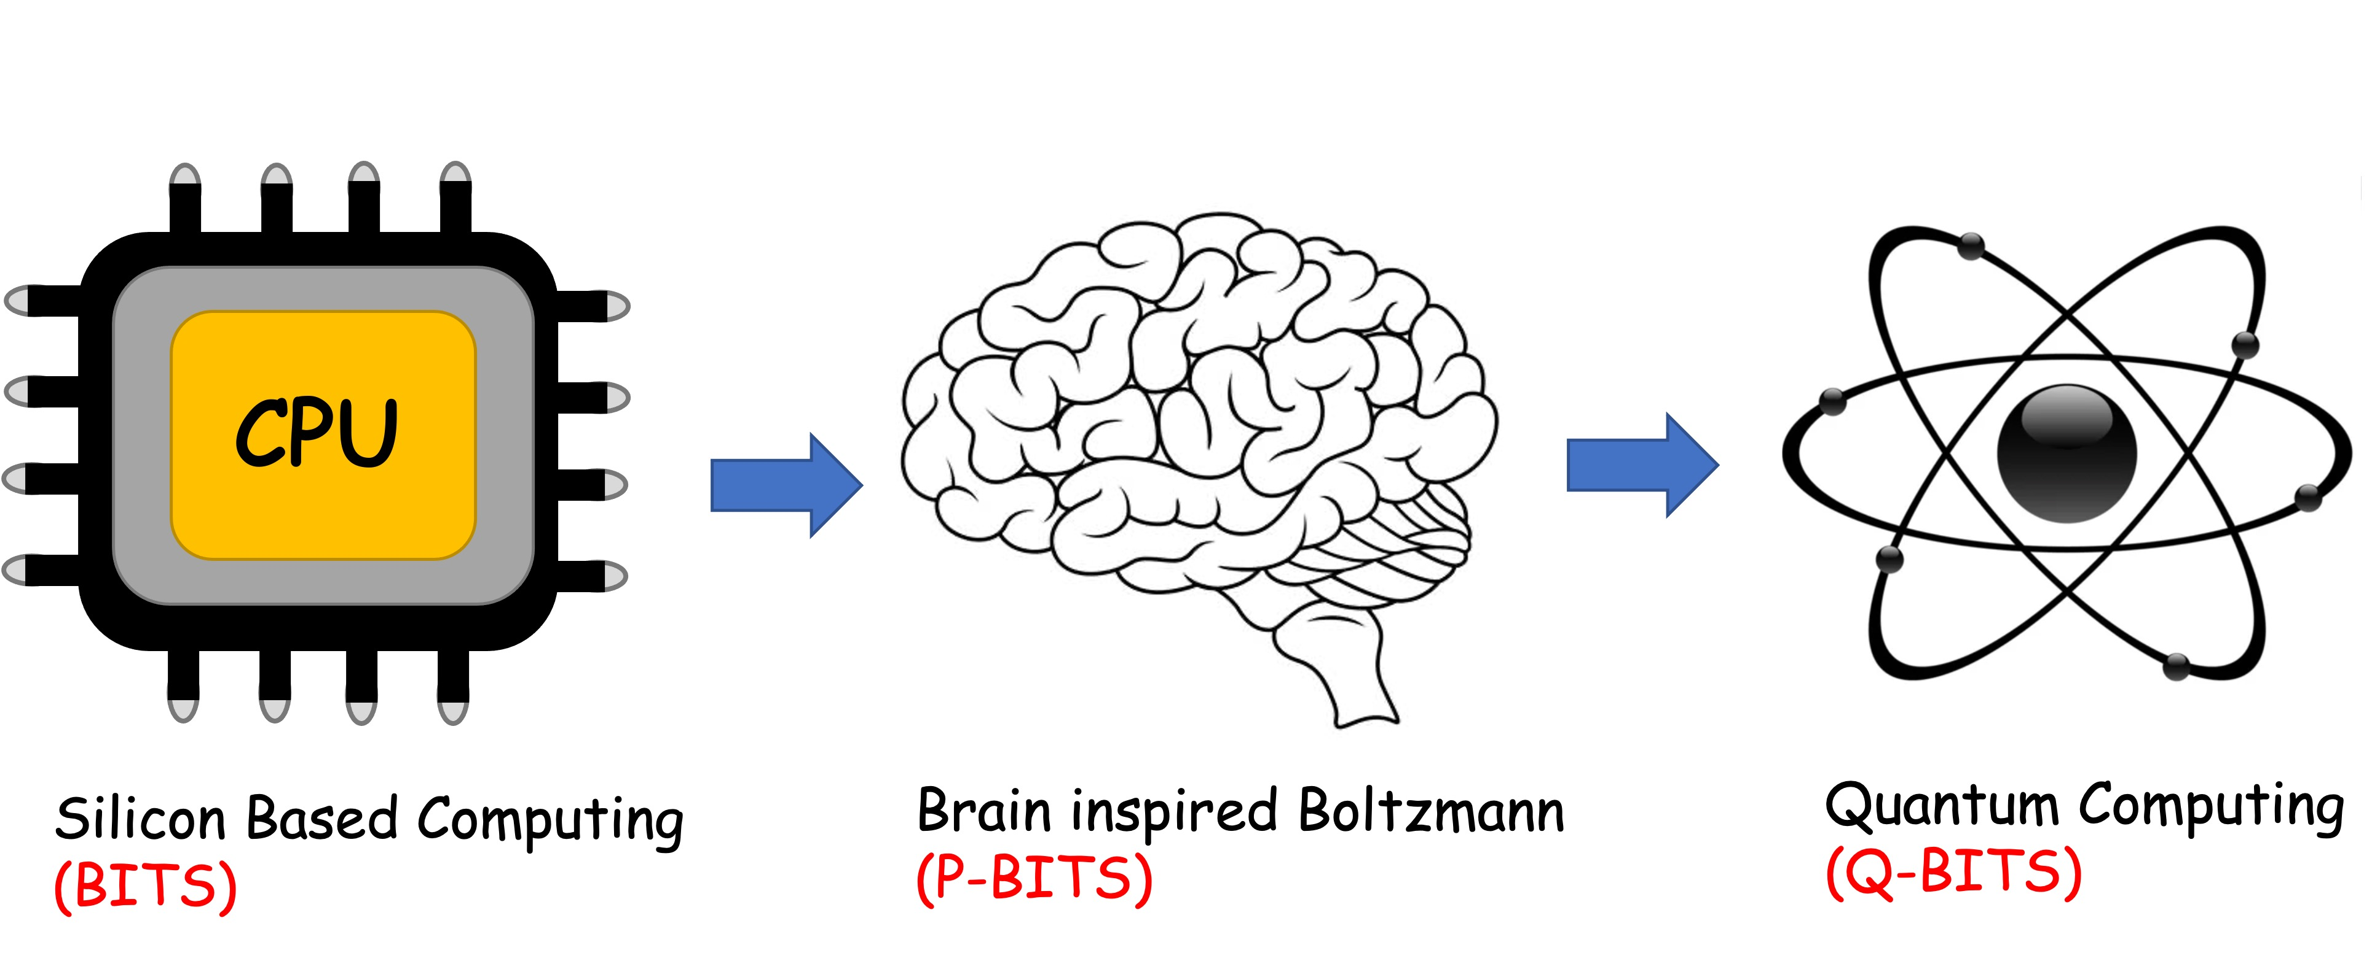
Overall structure of this course
Analog Computing in Carbo
How we train (Supervision)
Physics of Neurons (Boltzmann)
How we learn (time sampling)
Optimizing and Classifying
Transition Theory & Inferencing
Quantum Computing in Magneto
Quantum Spins and Hardware
Interacting Spins
Going parallel: Quantum Physics
Entanglement and Superposition
Cloning and Key Distribution
Quantum Search and Annealing
Quantum Gates and Factorization
Digital Computing in Silico
How we compute (algorithms)
How we add (Gates)
How we add quickly (CMOS)
How we fix errors
Thermodynamics of Computing

Slide 4
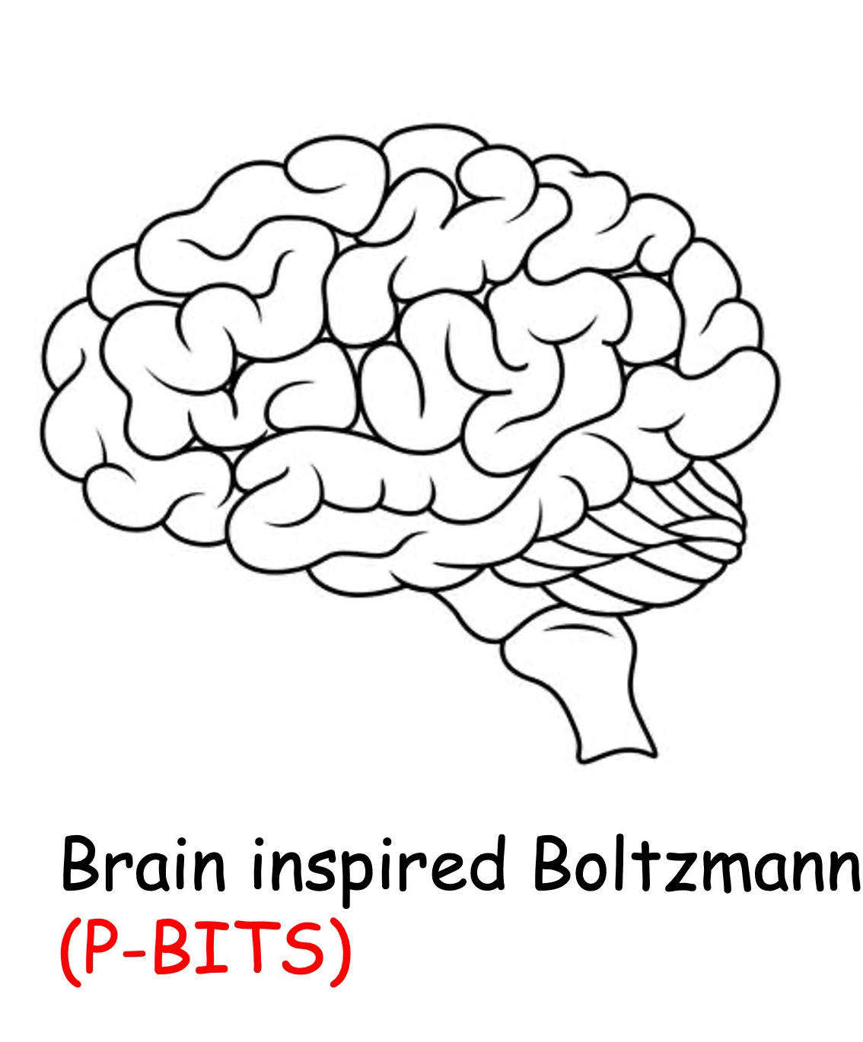

Slide 5
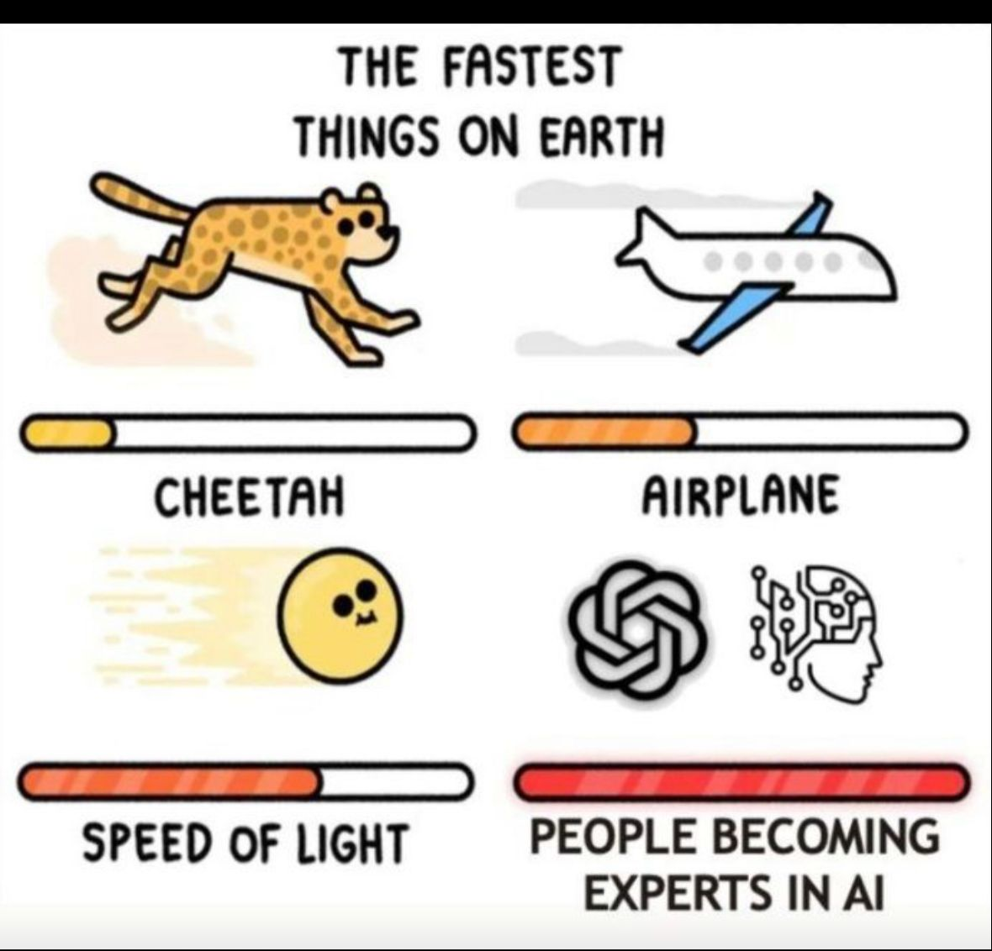

Slide 6
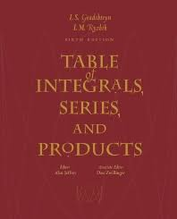
Is there an effective procedure for computing anything?
Factorization?

Slide 7
Logical inconsistencies
Solve sin(x) = 3 → π/2-1.77i – not inconsistent
Find a number N, so that 5 < N < 3
Can every problem be solved?
Would a hypothetical (Turing) machine halt?

Slide 8
6A. State Machines
(A gadget with an
effective procedure)

Slide 9
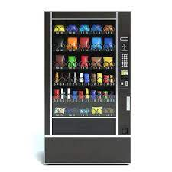
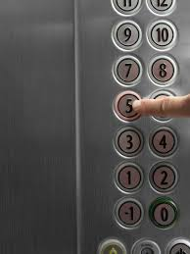
Finite State Automata
Finite # of internal states that change with input
(pre-determined action sequence on input series)
Combo of coins/buttons
Floor inputs

Slide 10
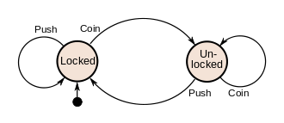
Finite State Diagram
Coin operated Turnstile

Slide 11
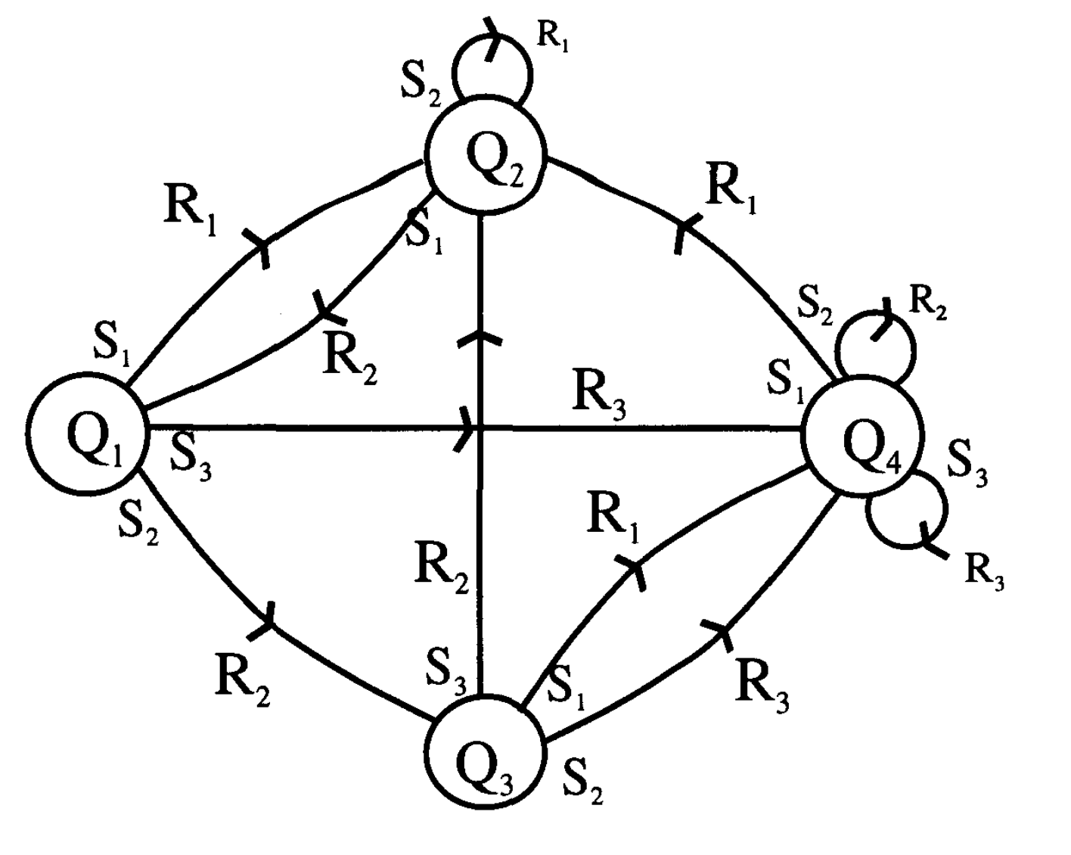
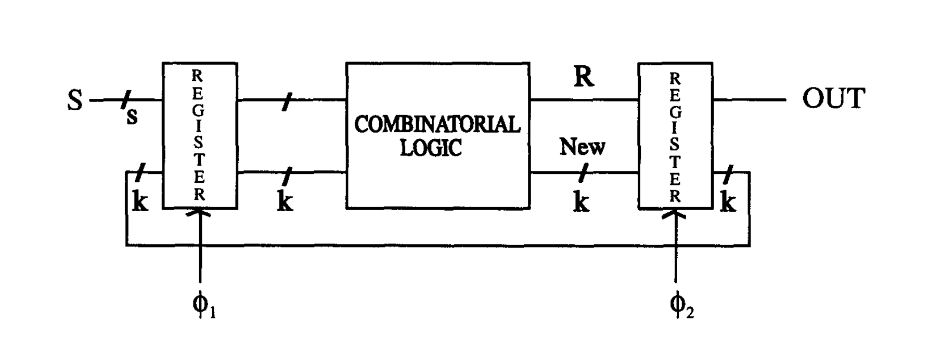
Could be complicated, but abstracted away

Slide 12
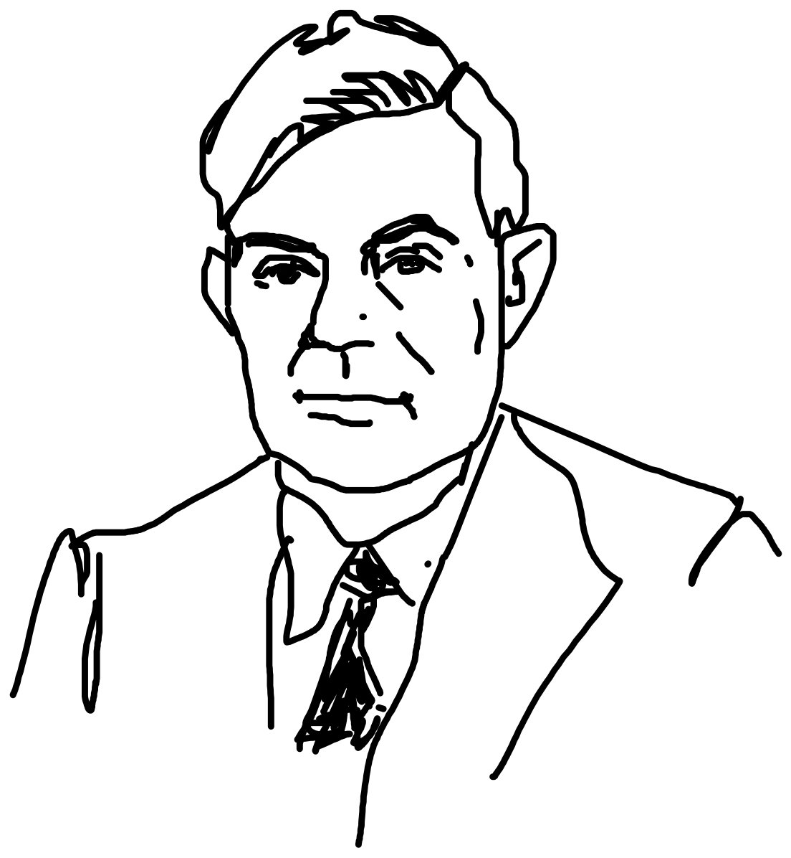
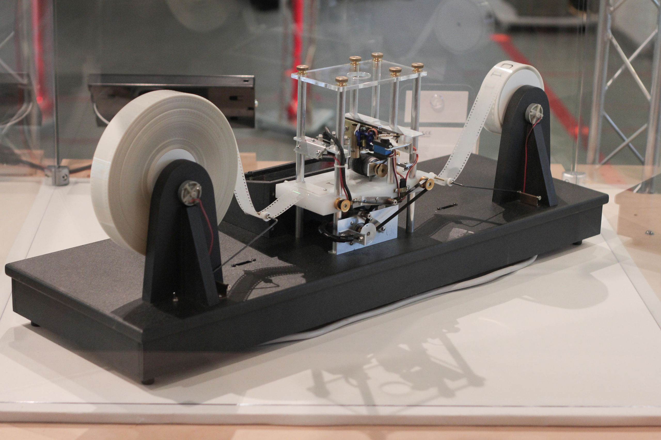
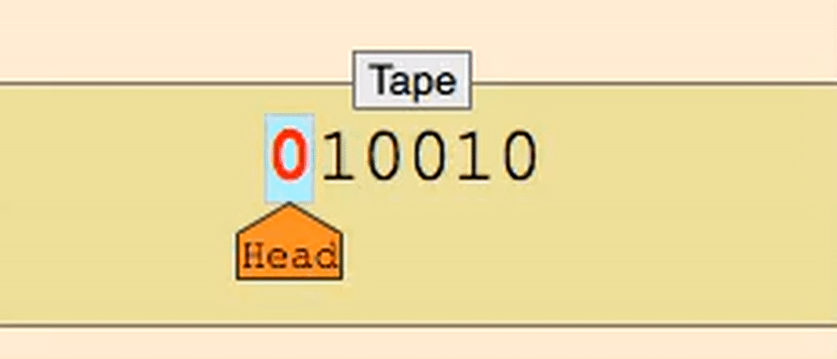
Turing machine
Infinite tape (memory), Infinite time
Read-write head
Instruction sets, state register (how to move)
Sequential access (different from RAM)
Deterministic algorithm
Halting Problem
Alan Turing
https://brilliant.org/wiki/turing-machines/
Non Turing: Random Access Computer

Slide 13
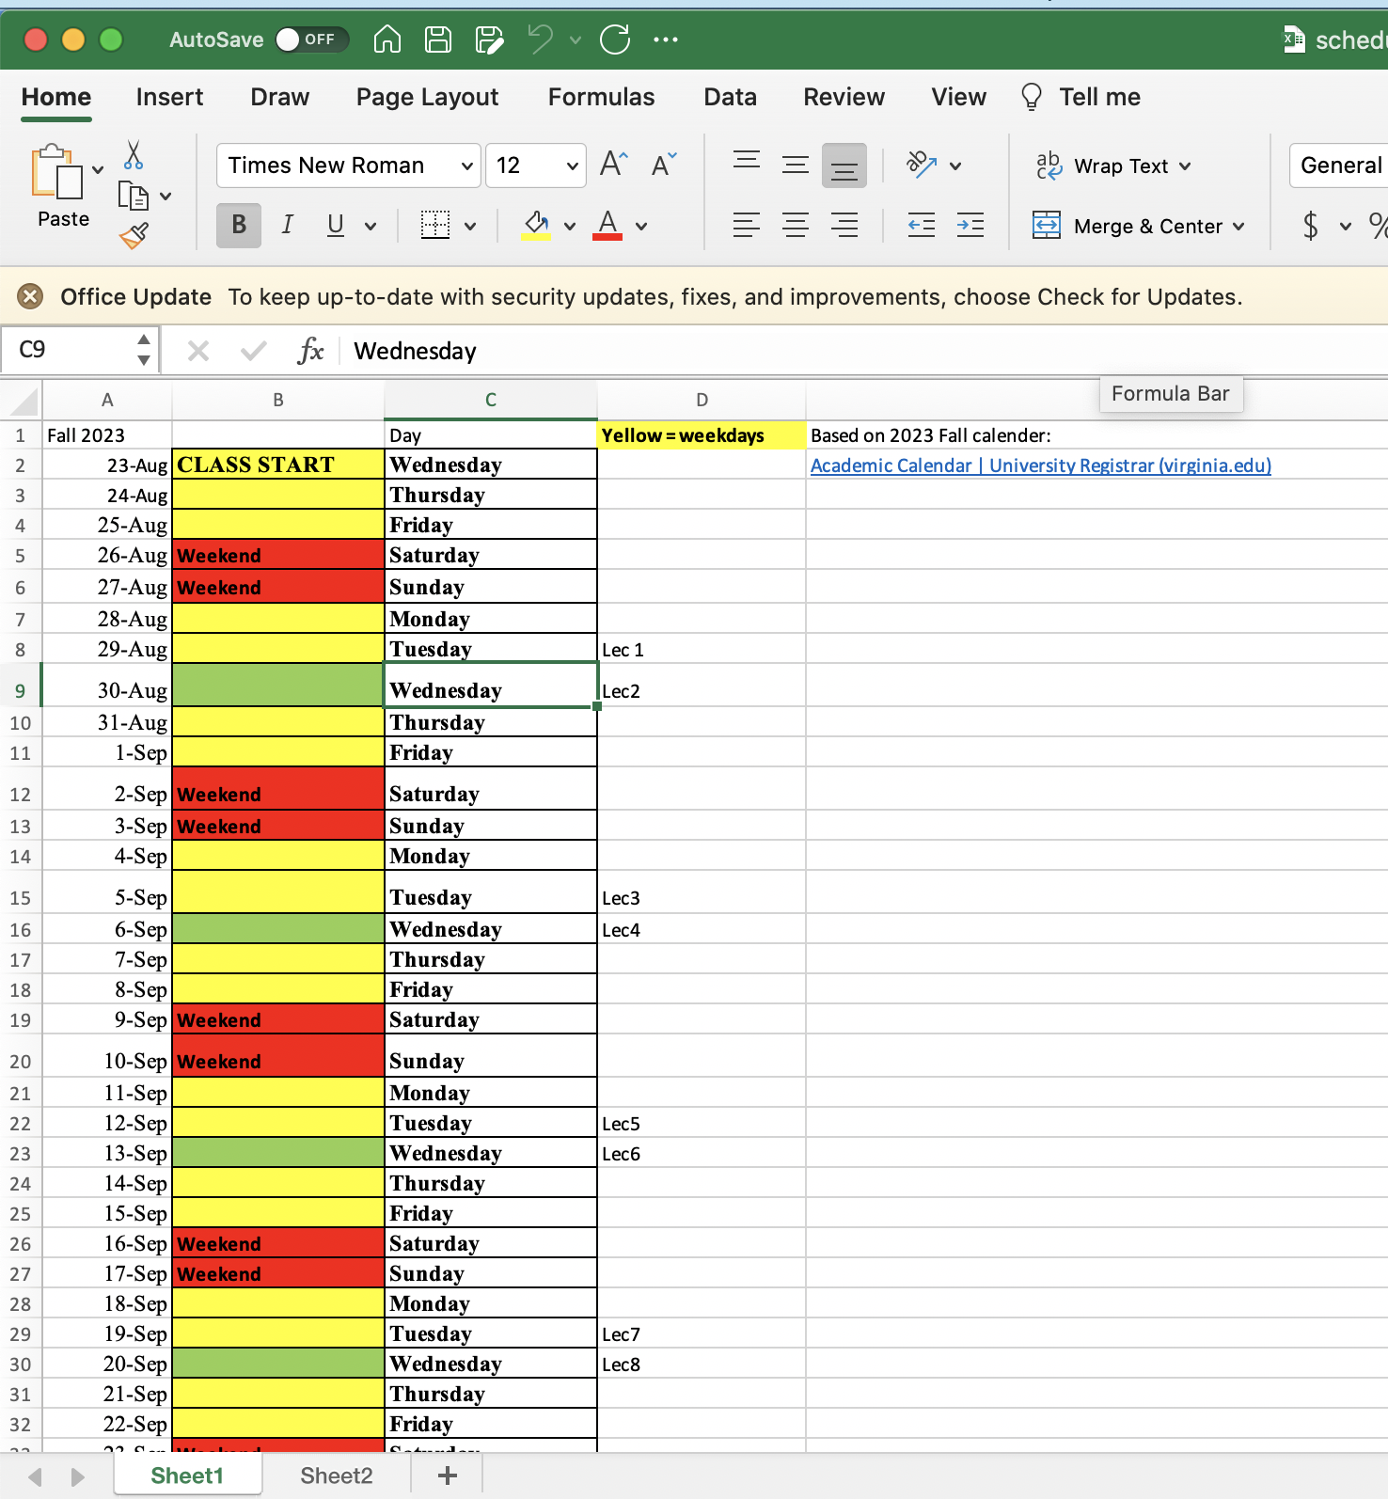
Turing complete
“universal” → Replicate an arb Turing machine

Slide 14
Needs a quintuple
Infinite memory
Read-Write head
State Register
Instructions

Slide 15
Parity Check Machine
0: even parity → another 0 keeps it even (0)
another 1 turns it odd (1)
1: odd parity → another 0 keeps it odd (1)
another 1 turns it even (0)

Slide 16
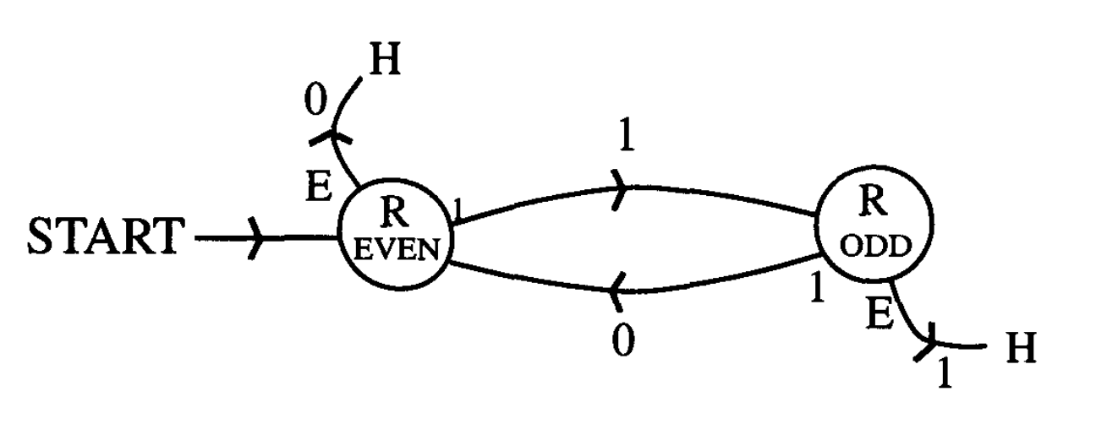
Turing Machine for Parity check
0
1
S
0
1
0
E
1
0
0
0
0
0
1
0
1
0
1
Read/Write/State change as before except Move direction, Start, Halt

Slide 17
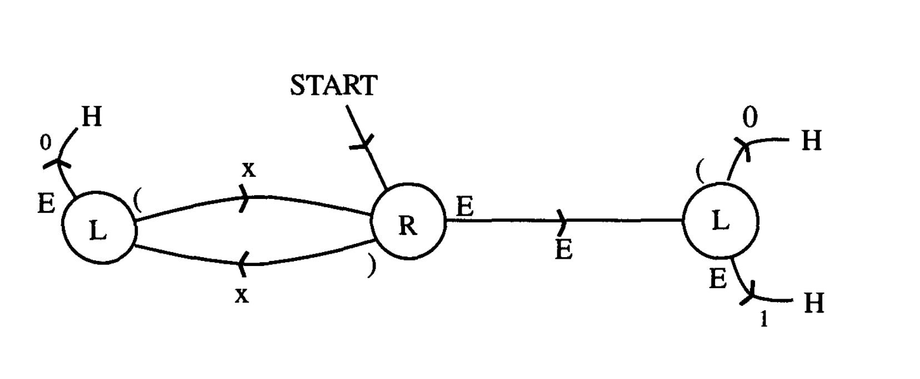
Turing Machine for parenthesis
E
0
X
X
X
X
X
X
E
H
FSM + Start-Stop and move
Two diff L states
one after ) another after E

Slide 18
Turing Machine for addition (4 + 3 = 7)
0
B
B
0
0
B
0
0
0
0
0
B
0

Slide 19
Turing Machine for Location
Target
Mismatch
Success
Y
1
0
x
A
B
x
1
1
x
1
0
x
1
1
x
B
A
0
1
B
1
If mismatch move right to X then back to Y
Flip numbers to letters along the way
If match, flip and move left to Y
Mismatch is outer loop
Note 1st target
Match is Inner loop

Slide 20
Turing Machine for Location
Target
Mismatch
Match !!
Success
Y
B
A
x
A
x
B
x
x
x
1
0
0
B
1
1
1
0
1
1
B
A
1
B
B
1
0
1
If mismatch move right to X then back to Y
Flip numbers to letters along the way
If match, flip and move left to Y
Mismatch is outer loop
Note 1st target
Match is Inner loop

Slide 21
Turing Machine for Location
Target
Success
Y
B
A
x
A
x
B
x
A
x
x
1
0
0
B
1
1
1
0
1
1
1
0
1
B
B
B
A
B
1
0
1
If mismatch move right to X then back to Y
Flip numbers to letters along the way
If match, flip and move left to Y
COPY
Mismatch is outer loop
Note 1st target
Match is Inner loop

Slide 22
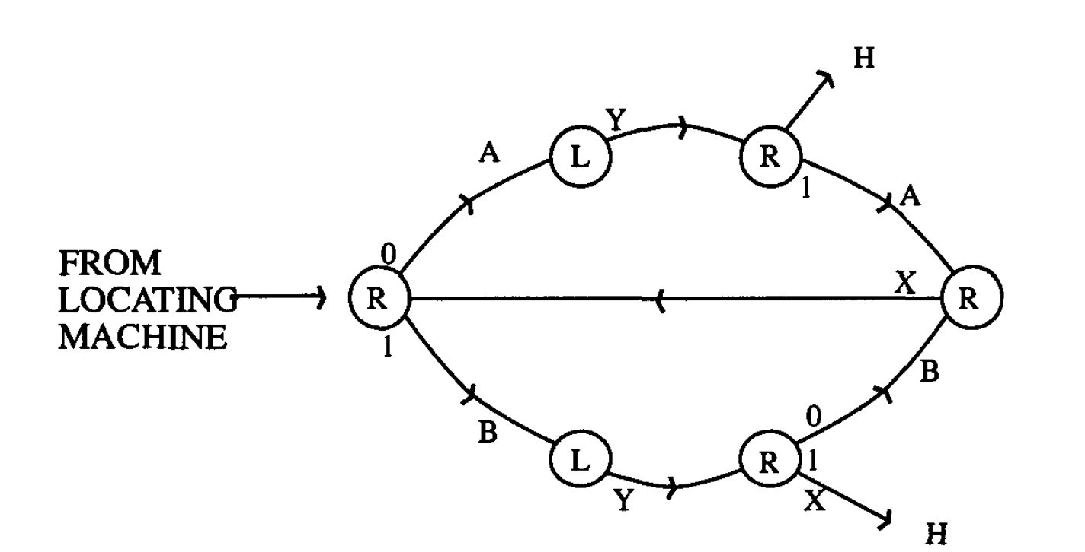
Turing Machine for Copy
Target
Y
A
x
AB AA
x
BB AB
x
A
B
x
B
BA 01
A
1
0
0
0
0
1
B
0
B
A
B
1
0
1
H

Slide 23
What computers may not be able to do: Halting problem
Logical Paradox
Can we determine if every program will halt or not? → NO
In practice with finite memory → YES (jus wait and see ☺ )

Slide 24
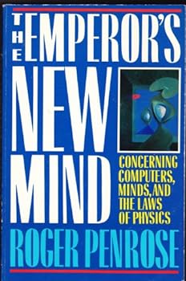
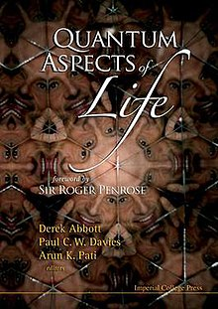
Human consciousness is non-algorithmic and cannot be described by a Turing machine.
QM (‘collapse of wavefunction’) essential for understanding human consciousness (microtubules allow superposition). This is a controversial assessment, but a huge improvement over random assertions of ‘quantum consciousness’…

Slide 25
Neuromorphic Computing is Turing complete
Can emulate an universal Turing machine → gets
you to an answer if infinite runtime/memory
straight-line sequences of code
if-then-else - iteration
unbounded iteration (e.g., while loops) - recursion
Non-Turing Languages
Remove while loop → can’t do a computation that is endless
(i --> i+1)
HTML (just represent data, not computation)
Bitcoin Blockchain (cannot do loops, arb read/writes from memory)

