Slide 1
6B. Solving difficult problems
-- Computational Complexity

Slide 2
Calculating sums etc are ‘easy’. CMOS does that very
quickly. We keep pushing our limits on this.
There are problems that are fundamentally harder
to solve. They need an entirely different approach.

Slide 3
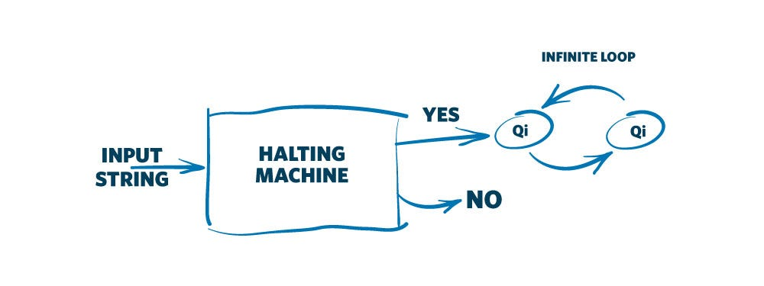
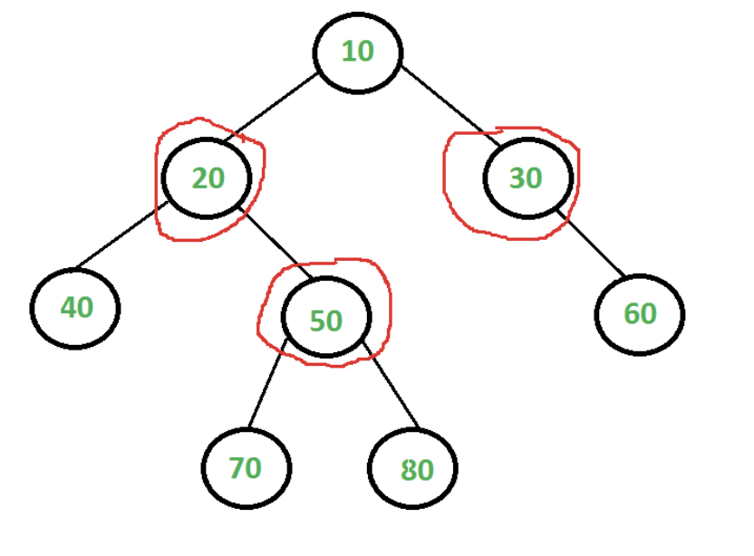
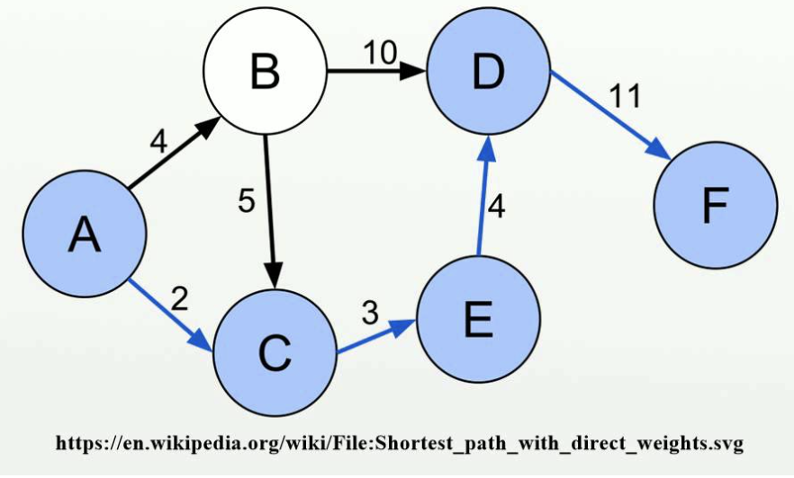
Turing Halting Pb:
Will the code
get stuck
in a loop?
NPH: Solving takes NP
NPC: Solve NP, Cerify P
Polynomial equiv of SAT
Vertex covering:
Min set of vertices
that cover every edge
of an undirected graph
NPI:
Good example? Conjectures exist…
P-time solution
P-time certification
P: Solve & certify in P
Shortest path in a weighted
network (Dijkstra)
NP: Certify in P

Slide 4
P-time solution
P-time certification
Is P = NP ??

Slide 5
Karp’s 21 NP-complete problems (polynomial equiv of SAT)
Satisfiability: the boolean satisfiability problem for formulas in conjunctive normal form (SAT)
0–1 integer programming (only the restrictions must be satisfied, with no optimization)
Clique (see also independent set problem)
Set packing
Vertex cover
Set covering
Feedback node set
Feedback arc set
Directed Hamilton circuit (Directed Hamiltonian cycle)
Undirected Hamilton circuit (Undirected Hamiltonian cycle)
Satisfiability with at most 3 literals per clause (equivalent to 3-SAT)
Chromatic number (also called the Graph Coloring Problem)
Clique cover
Exact cover
Hitting set
Steiner tree
3-dimensional matching
Knapsack (Karp's definition of Knapsack is closer to Subset sum)
Job sequencing
Partition
Max cut

Slide 6
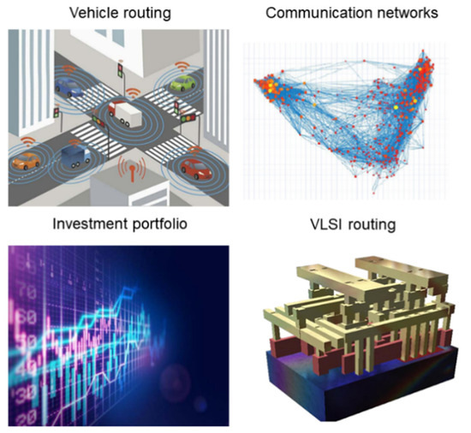
Real world applications
Zhang, Y.; Deng, Y.; Lin, Y.; Jiang, Y.; Dong, Y.; Chen, X.; Wang, G.; Shang, D.; Wang, Q.; Yu, H.; et al. Oscillator-Network-Based Ising Machine. Micromachines 2022, 13, 1016.
Ahmed, I.; Chiu, P.W.; Moy, W.; Kim, C.H. A probabilistic compute fabric based on coupled ring oscillators for solving combinatorial optimization problems. IEEE J. Solid-State Circuits 2021, 56, 2870–2880.

Slide 7
MAX-CUT (NP-Complete)
Happy scissor that wants to cut as many
edges as possible along one smooth line
Tank deciding how many routes can I destroy
in one motion without going backward

Slide 8
MAX-CUT
Easy to check if this solution is better
than another offered solution

Slide 9
MAX-CUT

Slide 10
MAX-CUT

Slide 11
e.g. Image Classification
Weighted max cut
(maximize distance
BETWEEN groups)
???

Slide 12
Boolean 3-SAT
(x₁ v x₂ v x₃) ^ (x₁ v x₂ v x₄) ^ (x₄ v x₁ v x₃) ^ (x₄ v x₁ v x₂)
Find consistent assignments of x_{i} = 0, 1 such that
the net result is 1 (TRUE)
x₁ = 1
x₂= 0
x₃= 0
x₄= 1

