Slide 1
6C. But how do we solve these in a reasonable time?

Slide 2
How we ‘process’ information
“Neuron”
(Decision maker)
--> Logic
Inputs
{0, 1}
“Synapse”
(Info collecting and
Storage → Memory)
x₁
w₁
w₂
x₂
y = x₁w₁ + x₂w₂ + x₃w₃
= x.w
w₃
x₃

Slide 3
A bit more multi-dimensional
– a cascade of decisions
Inputs
x_{i}
Outputs
y_{i}⁽¹⁾
z_{i}⁽¹⁾
y_{i}⁽²⁾
z_{i}⁽²⁾
O_{i}
⎲
⎲
⎲
y_{i}⁽¹⁾ = W_{ij}⁽¹⁾ x_{j}
z_{i}⁽¹⁾ = f(y_{i}⁽¹⁾ -b_{i}⁽¹⁾)
y_{i}⁽²⁾ = W_{ij}⁽²⁾ z_{i}⁽¹⁾
z_{i}⁽²⁾ = f(y_{i}⁽²⁾ -b_{i}⁽²⁾)
y_{i}^{(N)} = W_{ij}^{(N)} z_{i}^{(N-1)}
O_{i} = f(y_{i}^{(N)} -b_{i}^{(N)})
⎳
⎳
⎳
_{j}
_{j}
_{j}

Slide 4
Simple mathematical way to think
Inputs
f(x) = 1/(1+e^{-x/a})
x₁
w₁
“Synapse”
“COST”
“Neuron”
w₂
x₂
y = x.w
z = f(y-b)
U = λ(z-z*)²
w₃
x₃

Slide 5
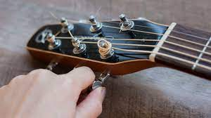
Supervised vs Unsupervised
Adjust parameters
(bias, weights) to
get to a minimum loss.
Loss function can be
set by nature, or
‘designed’ by an algo
Parameters self-adjust
by natural selection (e.g. coincidence detection)

Slide 6
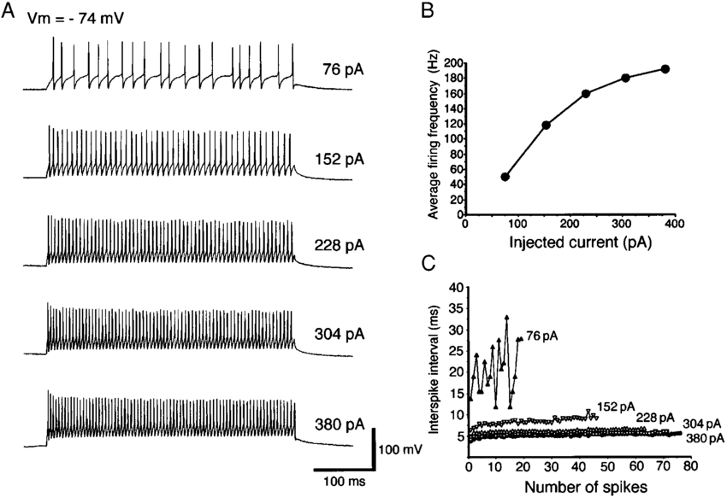
Biology: the origin of our inspiration
Input (ionic current) Controls signal (current) amplitude
Pulse Position Modulation
Electrophysiological and Morphological Properties of Neurons in the Rat Superior Colliculus. I. Neurons in the Intermediate Layer –
Y. Saito and T. Isa Journal of Neurophysiology 82(2):754-67, 1999.

Slide 7
Biophysics of Spike generation and propagation
Na
Na Channel
K Channel
0 mV
I (mA)
+
+
+
+
+
+
+
+
+
-
+
-
-
-
-
+
-
+
-
-
-
+
-
-
-
-
30 mV
-70 mV
-55 mV
-70 mV
-65 mV
K
Ion Pumps

Slide 8
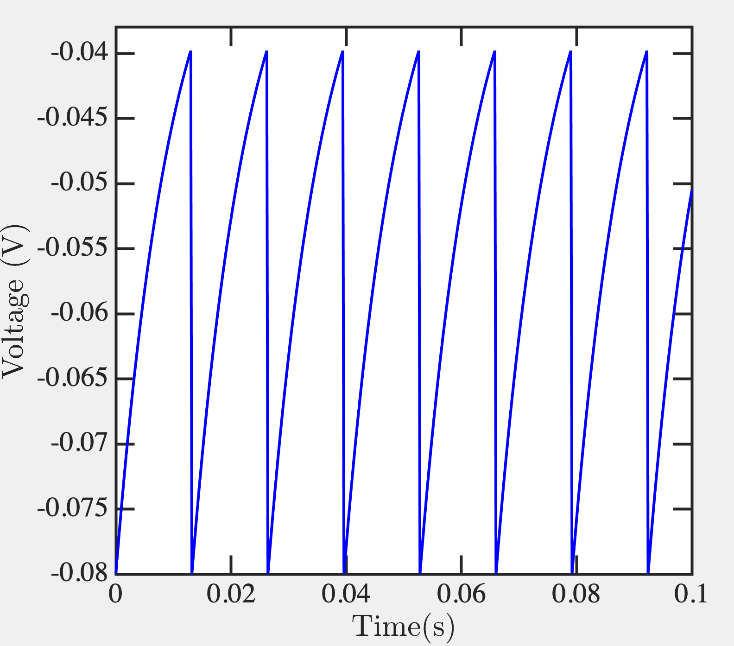
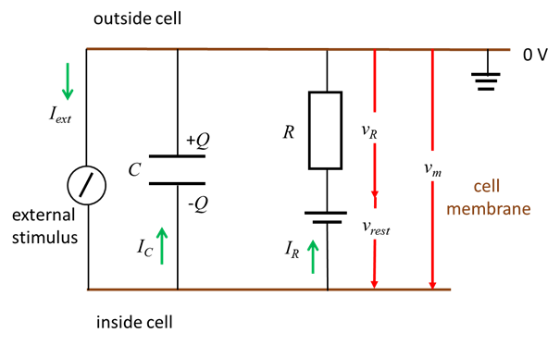
Leaky Integrate and Fire model
%% Leaky Integrate and Fire model VHLab
V_reset = -0.080; % -80mV
V_e = -0.075; % -75mV
V_th = -0.040; % -40mV
Rm = 10e6; % membrane resistance
tau_m = 10e-3; % membrane time constant
dt = 0.0002;
T = 0:dt:1; % 1 second simulation
Vm(1) = V_reset;
Im = 5e-9;
for t=1:length(T)-1,
if Vm(t) > V_th,
Vm(t+1) = V_reset;
else,
Vm(t+1) = Vm(t) + dt * ( -(Vm(t) - V_e) + Im * Rm) / tau_m;
end;
end;
plot(T,Vm,'b-');
xlabel('Time(s)');
ylabel('Voltage (V)');
https://d-arora.github.io/Doing-Physics-With-Matlab/mpDocs/pbs007.htm

Slide 9
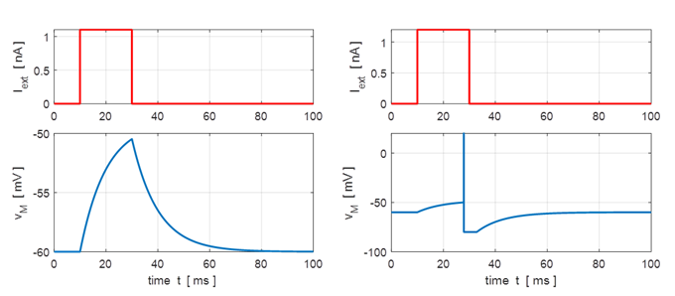
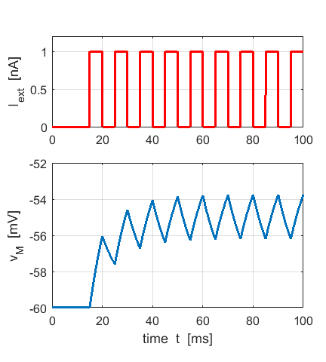
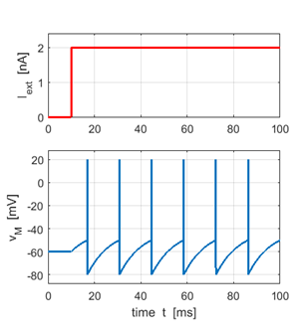
Playing with parameters

Slide 10
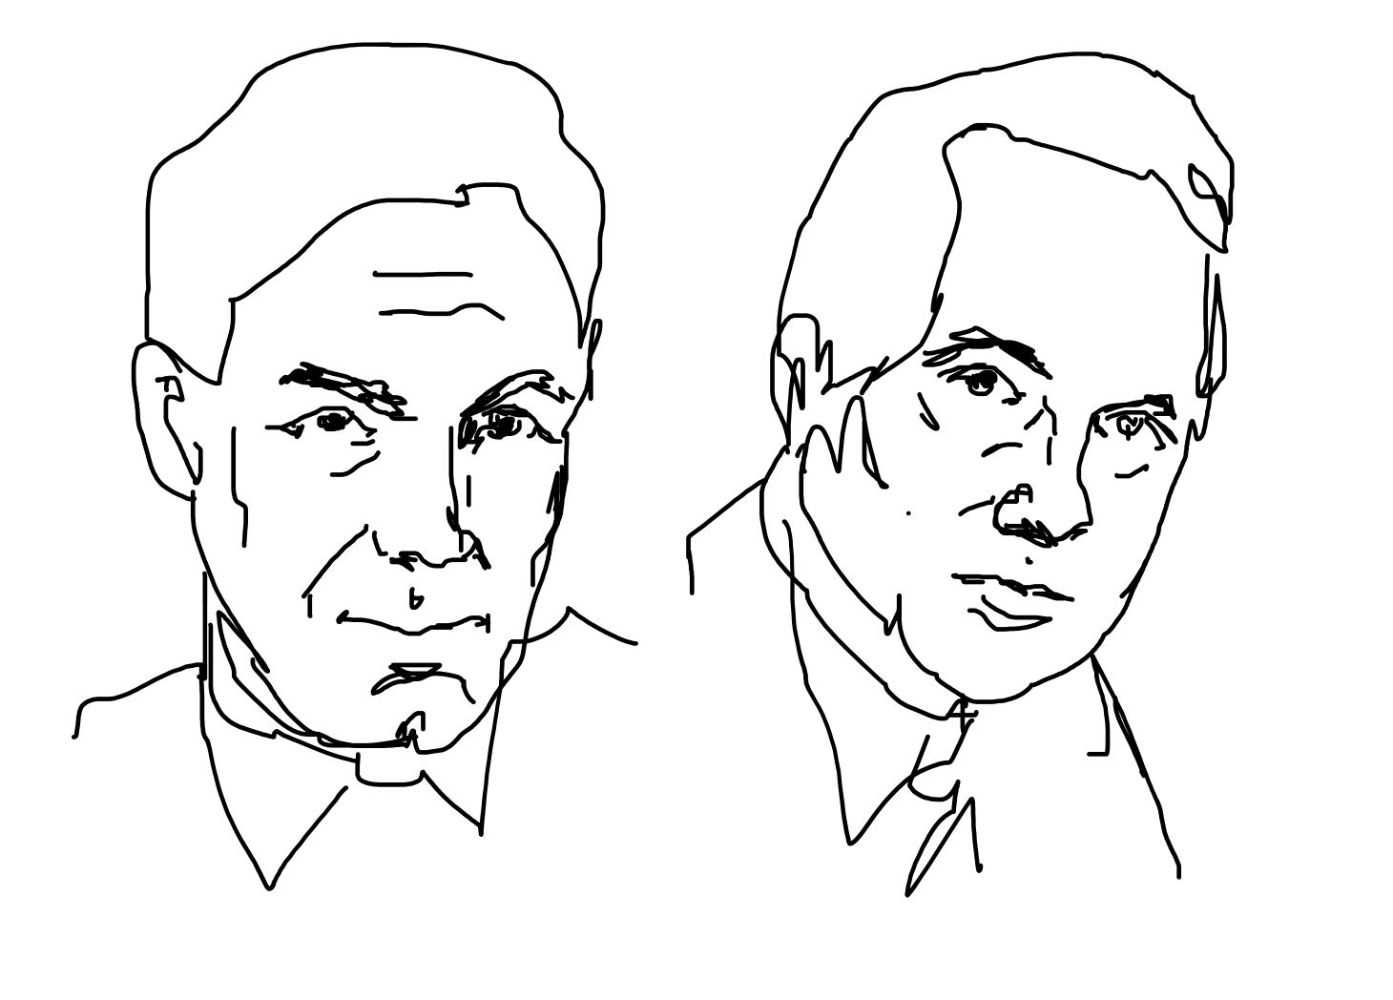
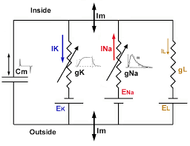
A Hodgkin-Huxley Circuit

Slide 11
A Hodgkin-Huxley Circuit

Slide 12
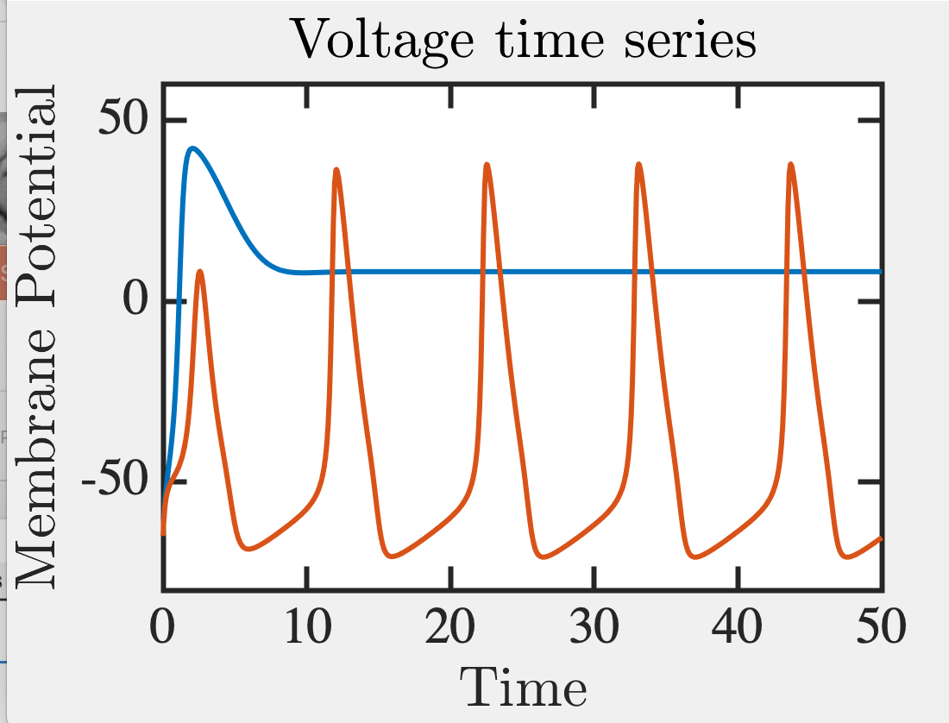
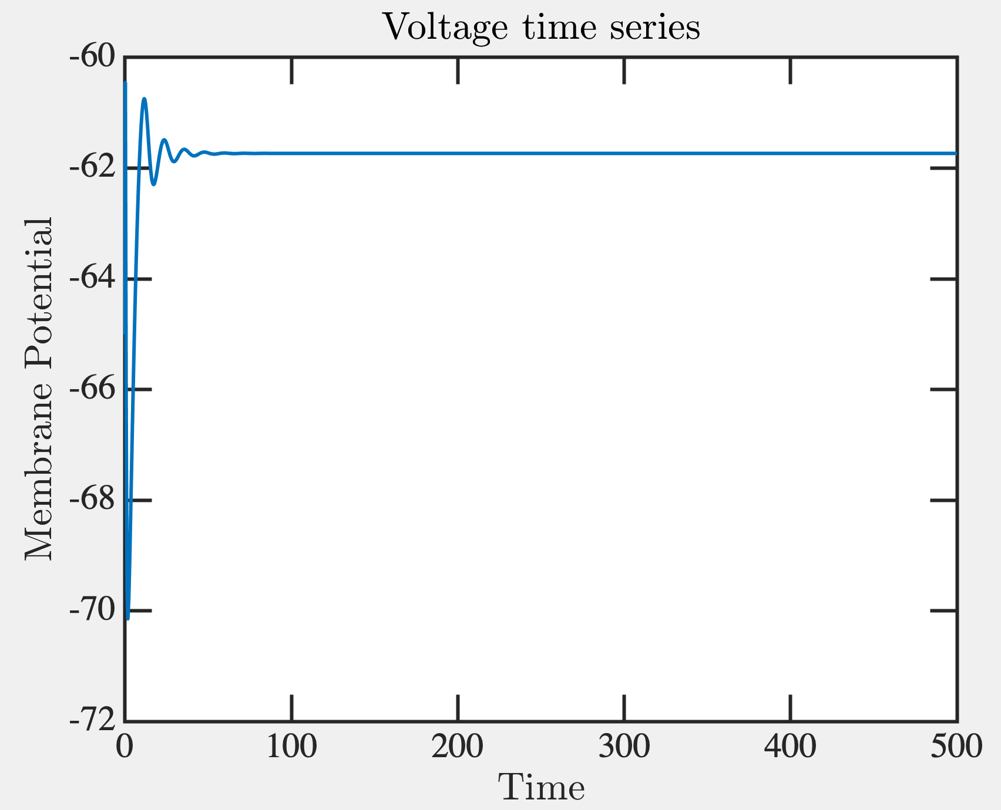
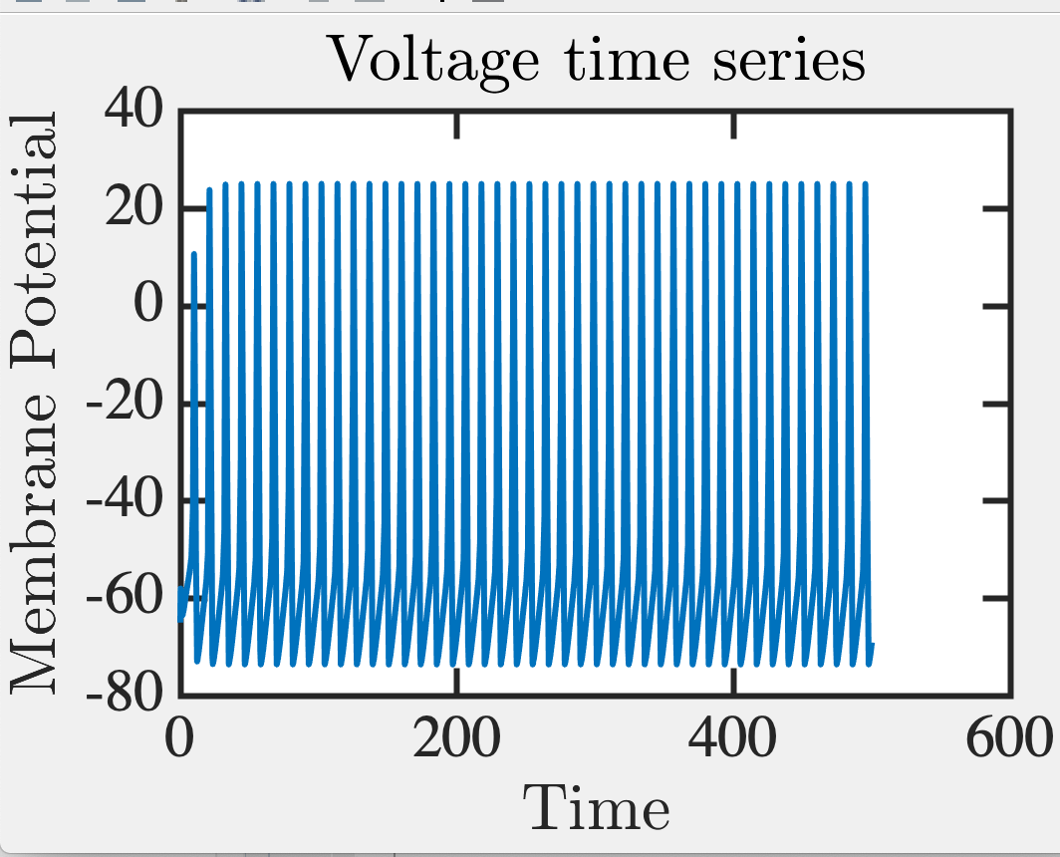
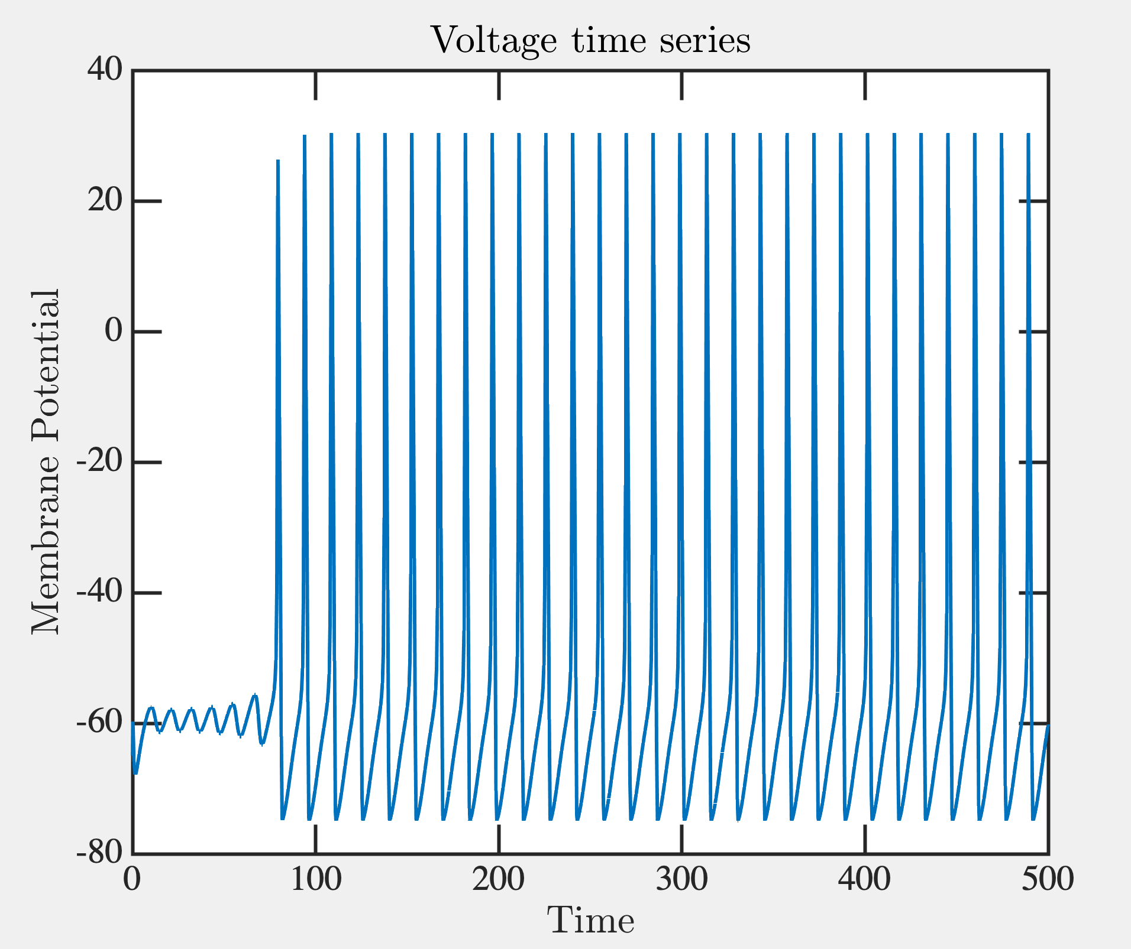
All or none
I = 5mA
I = 10mA
I = 20mA
Matlab code share Rohit Chandra

Slide 13
Glutamates
-
-
-
-
+
+
+
+
+
+
+
+
+
+
+
+
+
Axon
Dendrite
Fitzhugh-Nagumo Model
Cable Equation
Morris-Lecar
Hodgkin-Huxley
Leaky Integrate and Fire
Izhikevich Model

Slide 14
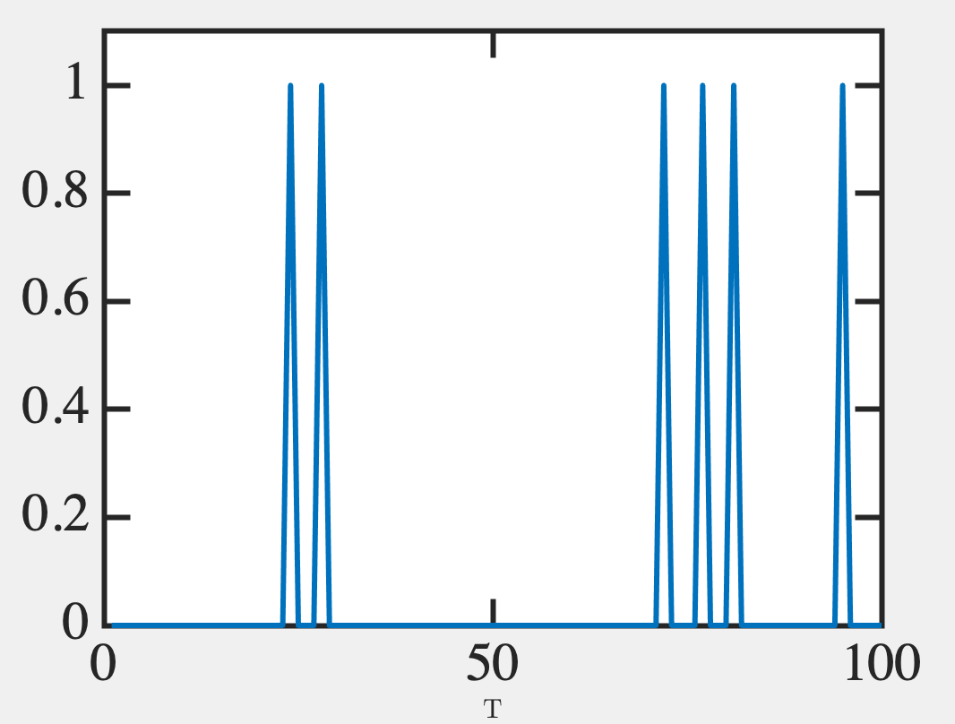
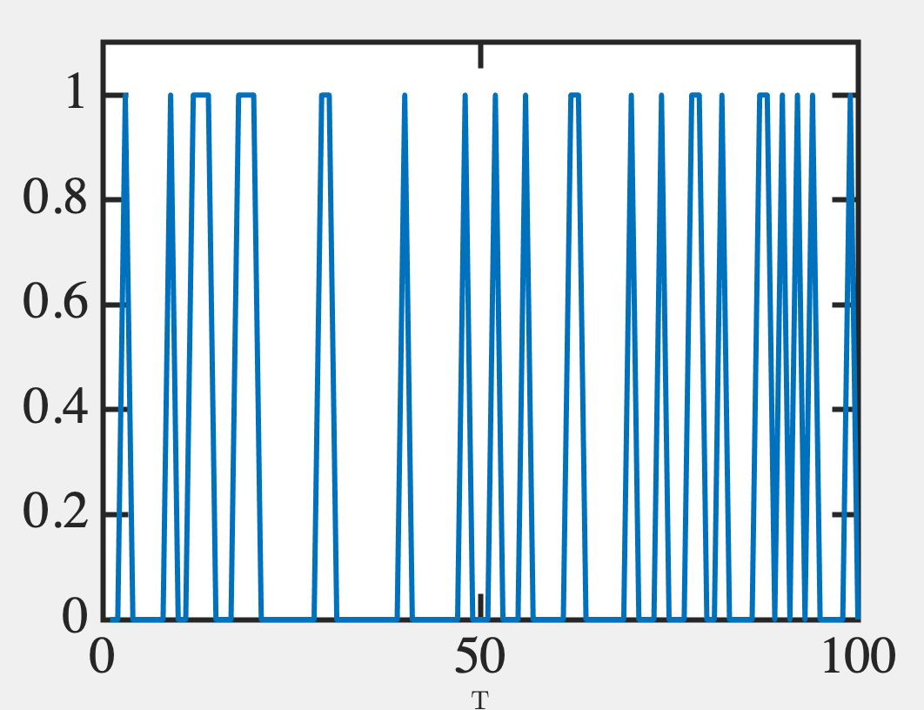
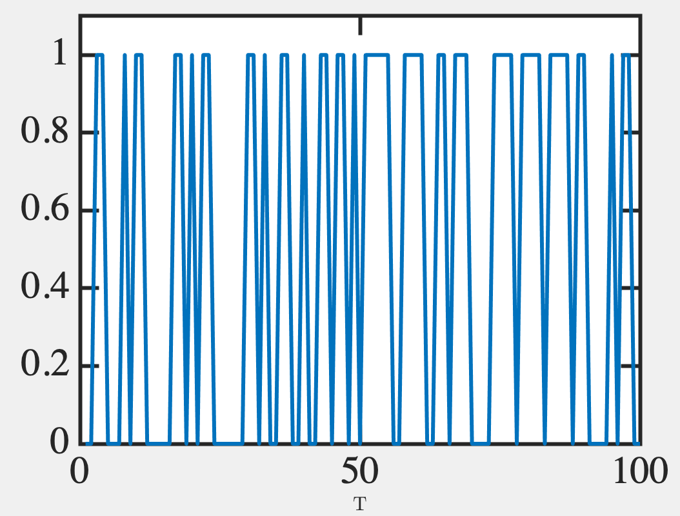
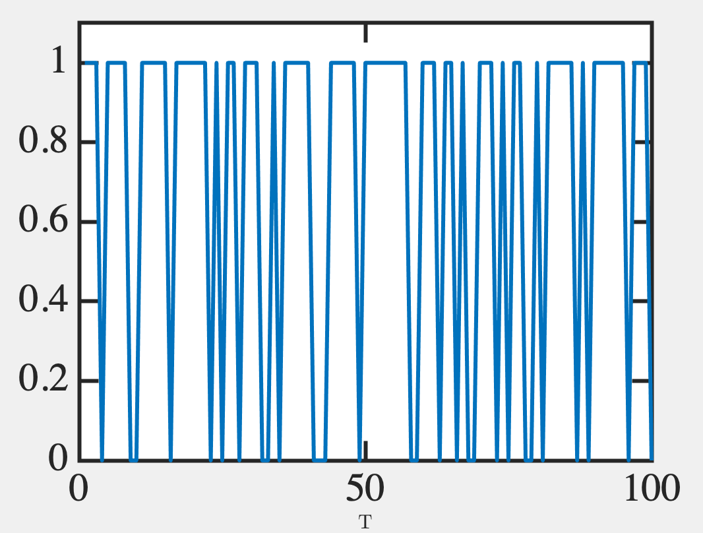
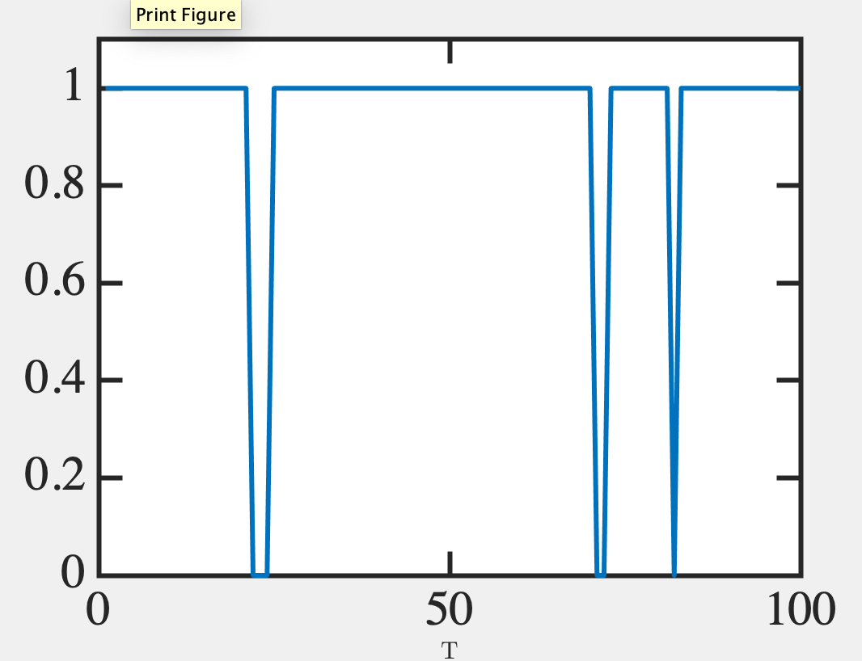
Probabilistic bits (p-bits)
Digital data analog read-out
V=-55mV
V=-50mV
V=-45mV
0.5
0.3
0.1
V=-40mV
V=-35mV
0.9
0.7

Slide 15
0.7
y → stream of 100 random #s between 0 and 1
y=rand(100,1);
Matlab
Binarize with a given probability p=0.7
(y < p → print 1, else 0)
y=y<p;
import numpy as np y = np.random.rand(100,1)
Python

Slide 16
Probability set by interconnects and neighboring neuronal outputs
How do we program interconnects?
Biology: unsupervised, Hebb’s rule (“neurons that fire together wire together”)
Feedback Loop
y₂ set by W₁₂
W₁₂ set by y₂
Donald O Hebb

Slide 17
Example Hebbian
Neurons connect over time as Venn diagrams to form cliques
(Not fully unsupervised – Hippocampus directs it)

Slide 18
How are arrival probabilities relevant?
STDP: Spike Timing Dependent Plasticity

