Slide 1
6D. Bio-inspired Neuromorphic Computing

Slide 2
Dynamics of Physical Neurons
Each is 0 (quiescent)
or 1 (fired)

Slide 3
Programming interconnects
in Artificial Neural Nets

Slide 4
Programming interconnects
in Artificial Neural Nets

Slide 5
Map onto a known problem

Slide 6
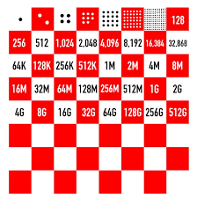
The neuronal space
Phase space of 2^{n} possibilities
2⁶⁴ grains of rice is > 1 millennium of global rice production
(storage space > 50 countries in the globe)
2¹⁰⁰ = 10³⁰ (1 kg has 10³⁰ electrons)
Can embed a large search space there!!
Finding a ground state is hard and may take time, with false positives

Slide 7
The neuronal space
Can be stuck in ‘metastable’ states
Rock or tilt the potential
Change the temperature

Slide 8
Neuro-synaptic systems
can be programmed to
solve very large
optimization problems
approximately at moderate
speeds

Slide 9
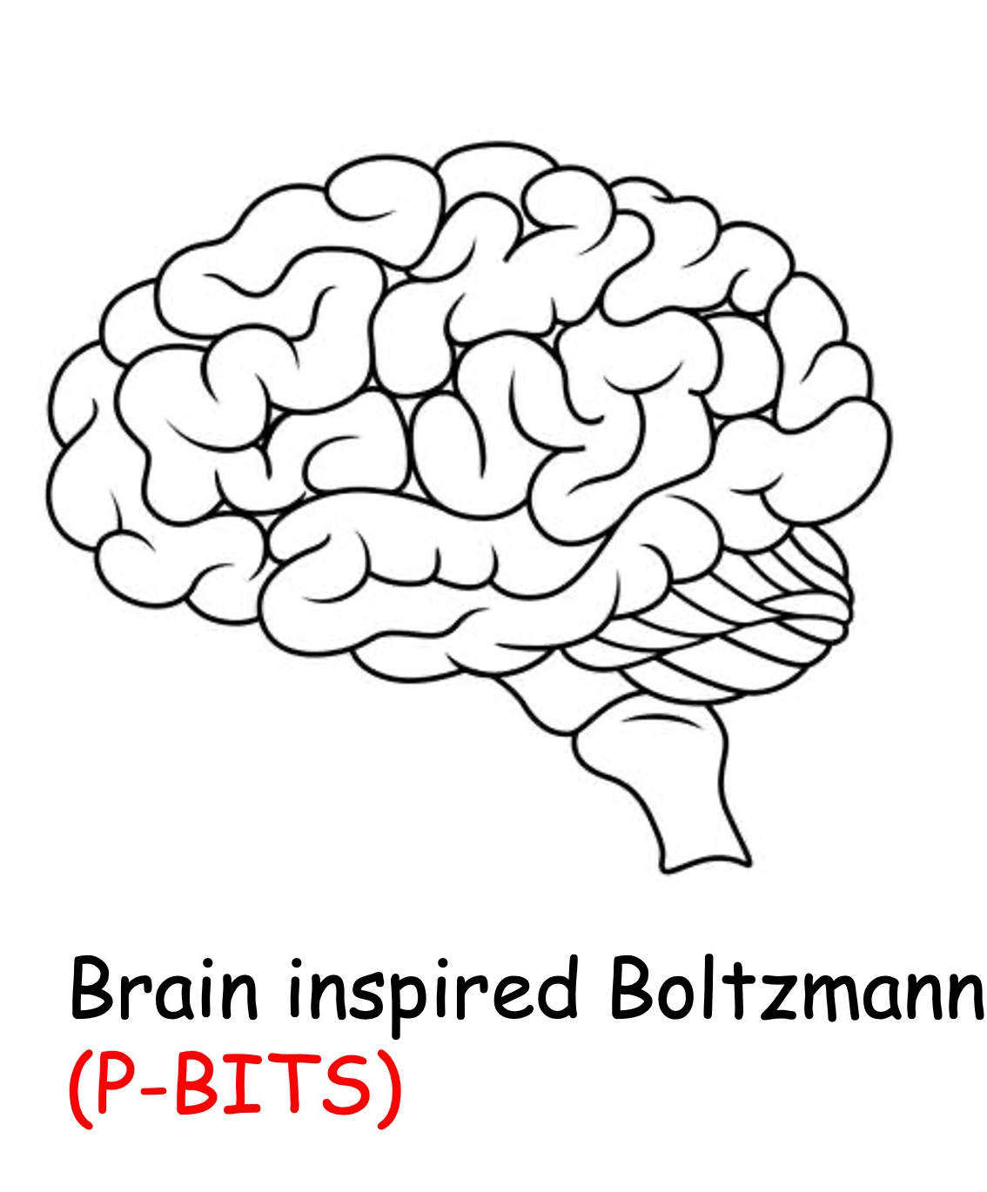
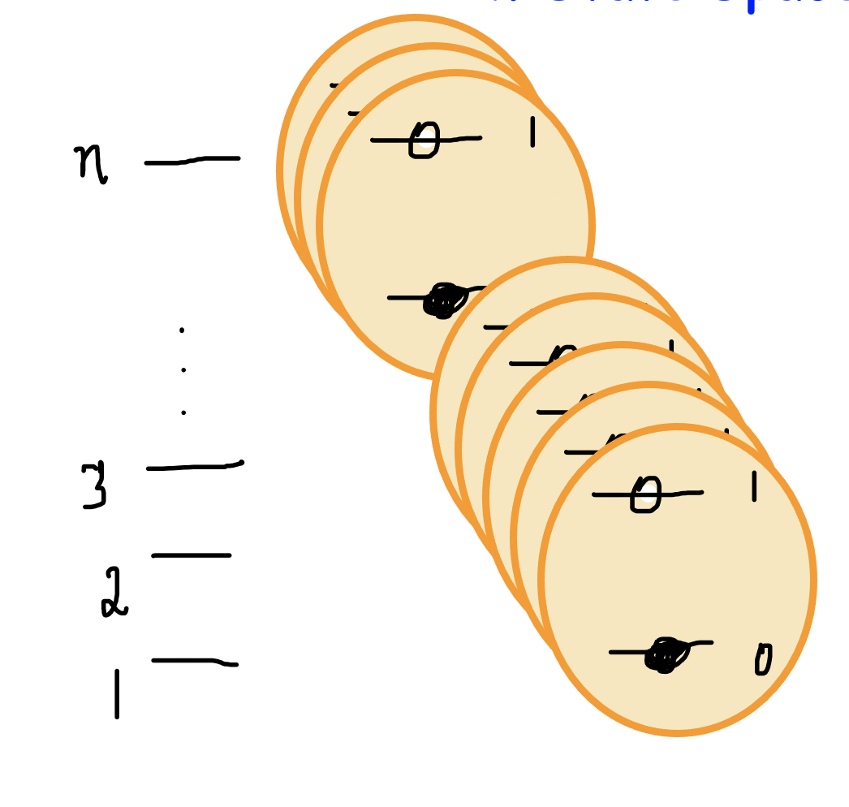
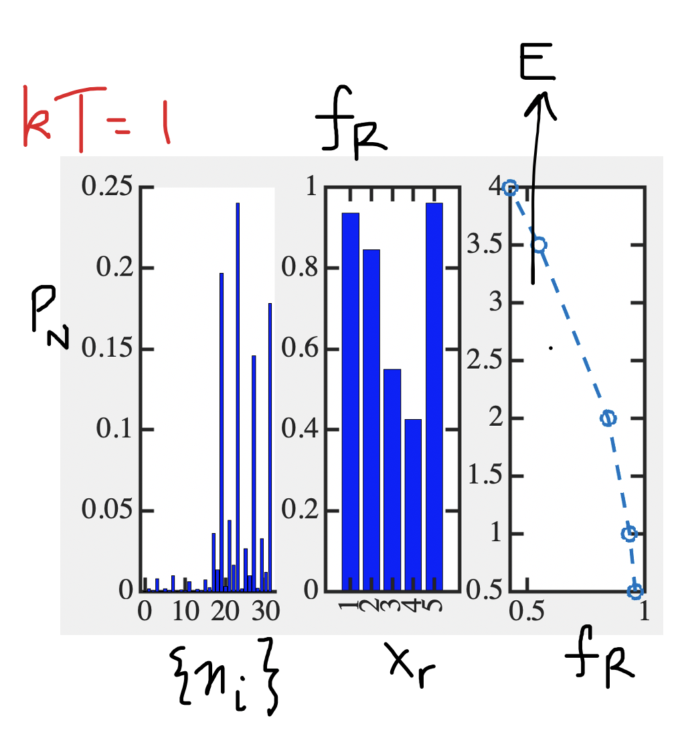
Next Lecture
Boltzmann Machines
2^{n} configuration space
Solving with time sampling

