Slide 1
Fundamentals of Computing
Lec 6
Can we compute anything?

Slide 2
The story so far
CMOS is great for operations like fast digital addition
It encodes info as specific binary strings of 1s and 0s, and operates using fast Boolean logic gates driven by light electrons jumping over sizeable, electrostatically tunable energy barriers.
Standby power dissipation is low because of CMOS architecture. It also allows error correction on static data (memory) using repetition codes and parity bits.
With dynamic data (logical operations), there is a considerable price for speed and accuracy.
Biological computers ditch speed and accuracy and look at classical parallelism. They also use frequency of 0s and 1s rather than the strings themselves, and also employ degeneracy of codons.
Quantum computers use qubits and quantum parallelism. They cannot use straightforward repetition codes due to no-cloning theorem.

Slide 3
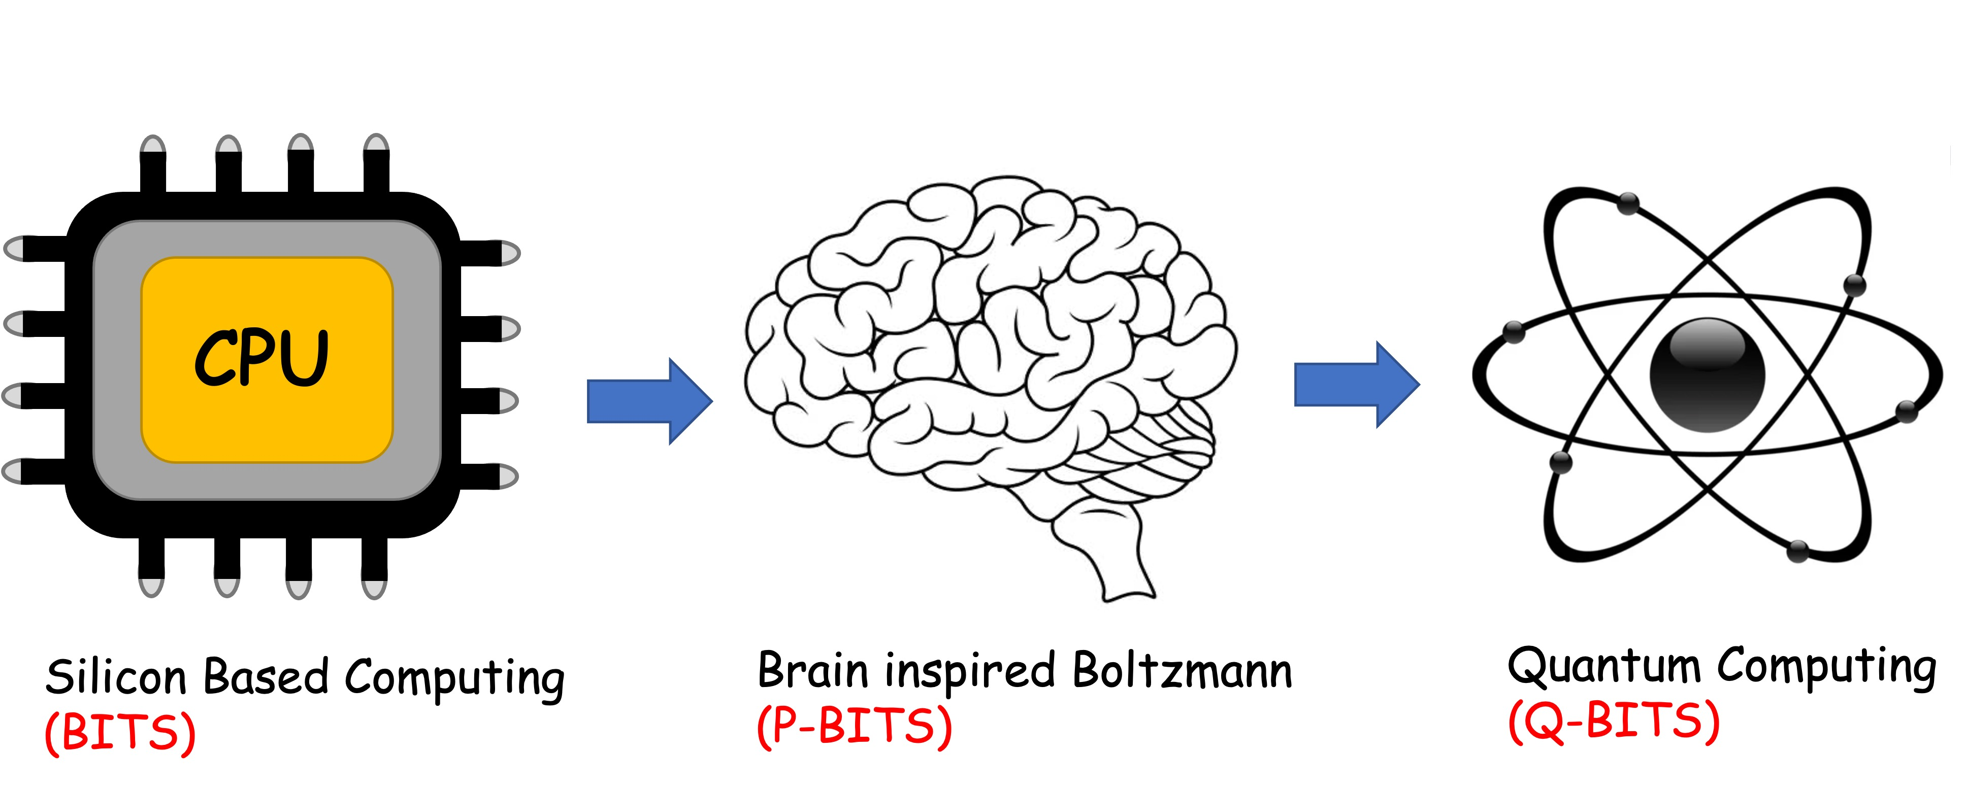
Overall structure of this course
Analog Computing in Carbo
How we train (Supervision)
Physics of Neurons (Boltzmann)
How we learn (time sampling)
Optimizing and Classifying
Transition Theory & Inferencing
Quantum Computing in Magneto
Quantum Spins and Hardware
Interacting Spins
Going parallel: Quantum Physics
Entanglement and Superposition
Cloning and Key Distribution
Quantum Search and Annealing
Quantum Gates and Factorization
Digital Computing in Silico
How we compute (algorithms)
How we add (Gates)
How we add quickly (CMOS)
How we fix errors
Thermodynamics of Computing

Slide 4
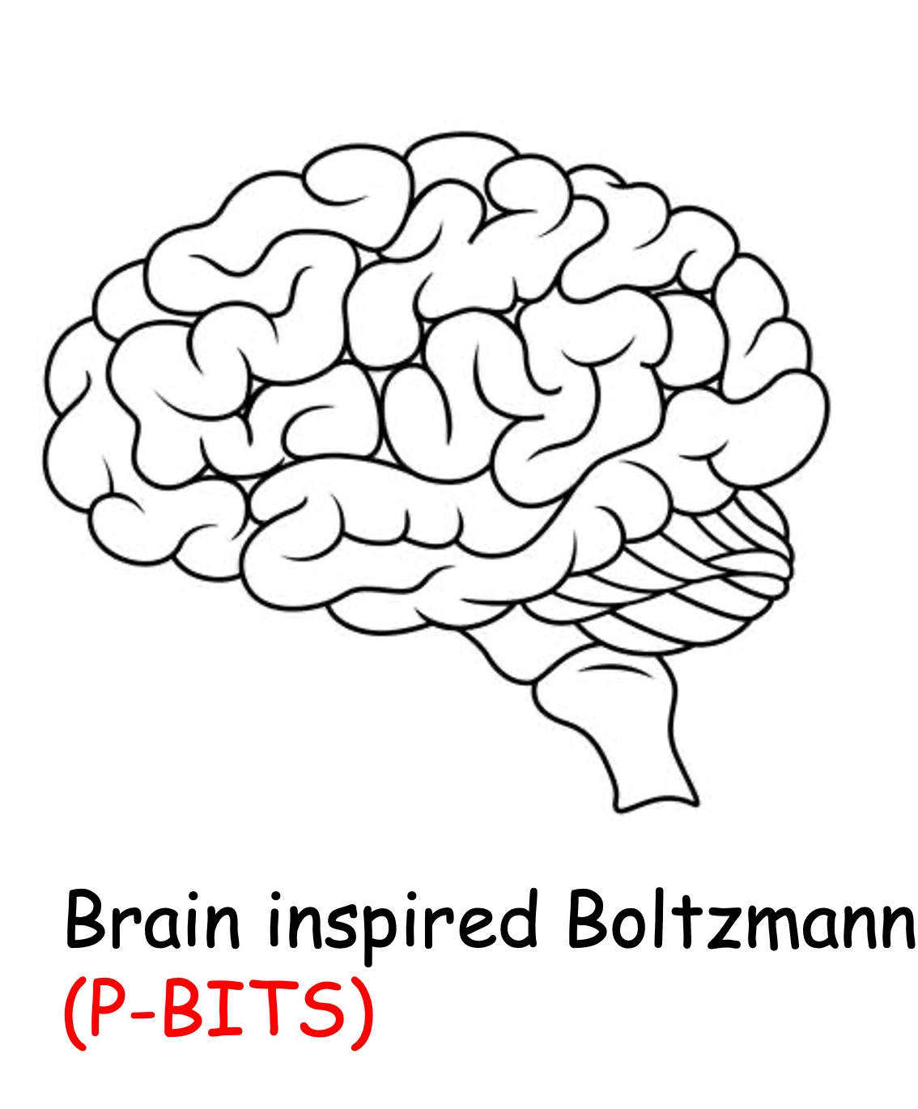

Slide 5
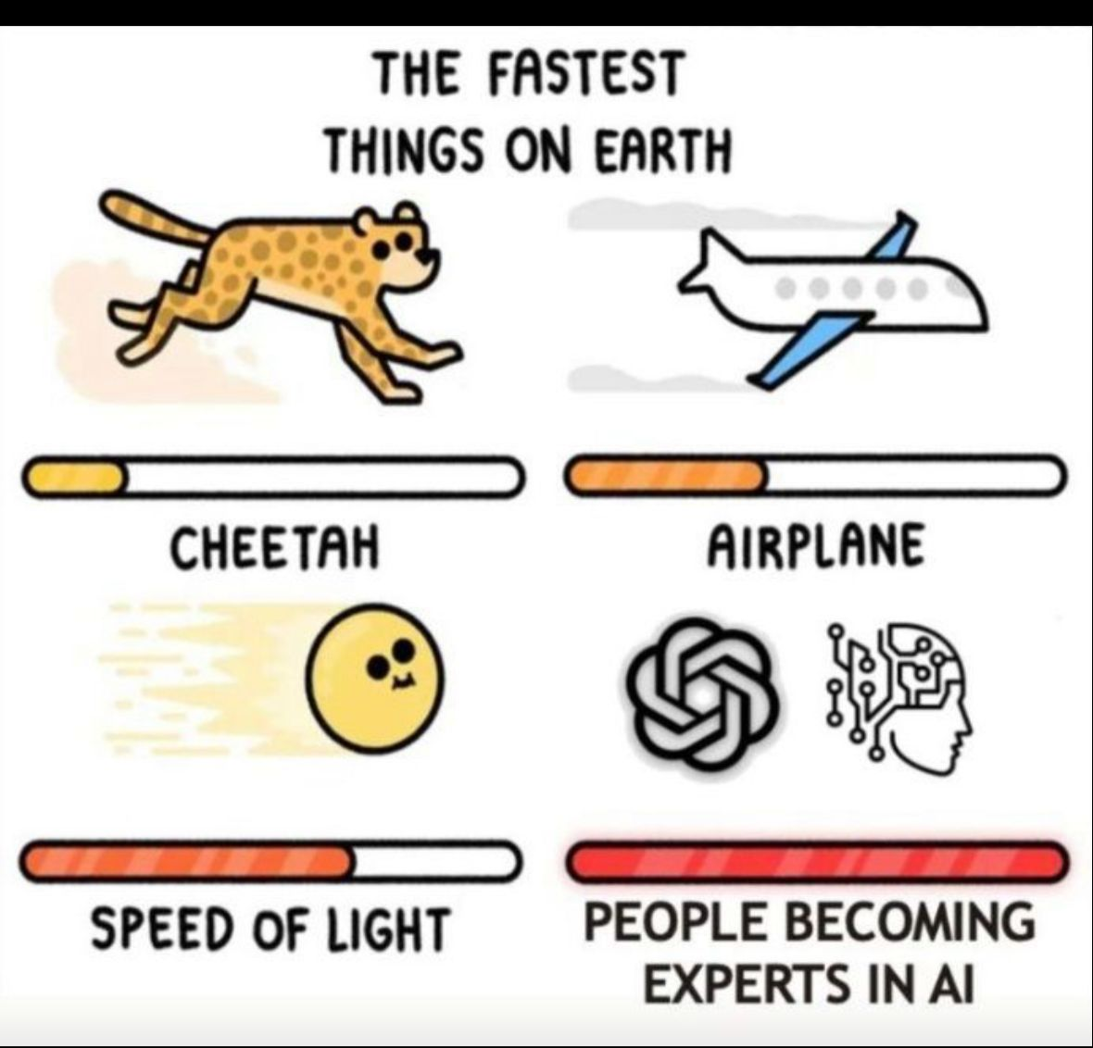

Slide 6
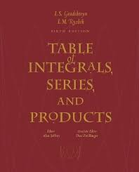
Is there an effective procedure for computing anything?
Factorization?

Slide 7
Logical inconsistencies
Solve sin(x) = 3 → π/2-1.77i – not inconsistent
Find a number N, so that 5 < N < 3
Can every problem be solved?
Would a hypothetical (Turing) machine halt?

Slide 8
6A. State Machines
(A gadget with an
effective procedure)

Slide 9
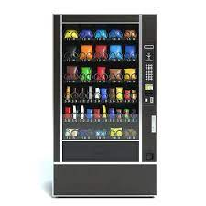
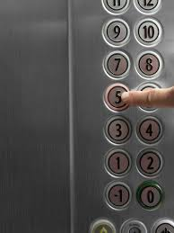
Finite State Automata
Finite # of internal states that change with input
(pre-determined action sequence on input series)
Combo of coins/buttons
Floor inputs

Slide 10
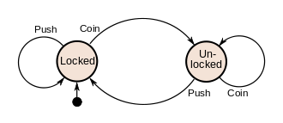
Finite State Diagram
Coin operated Turnstile

Slide 11
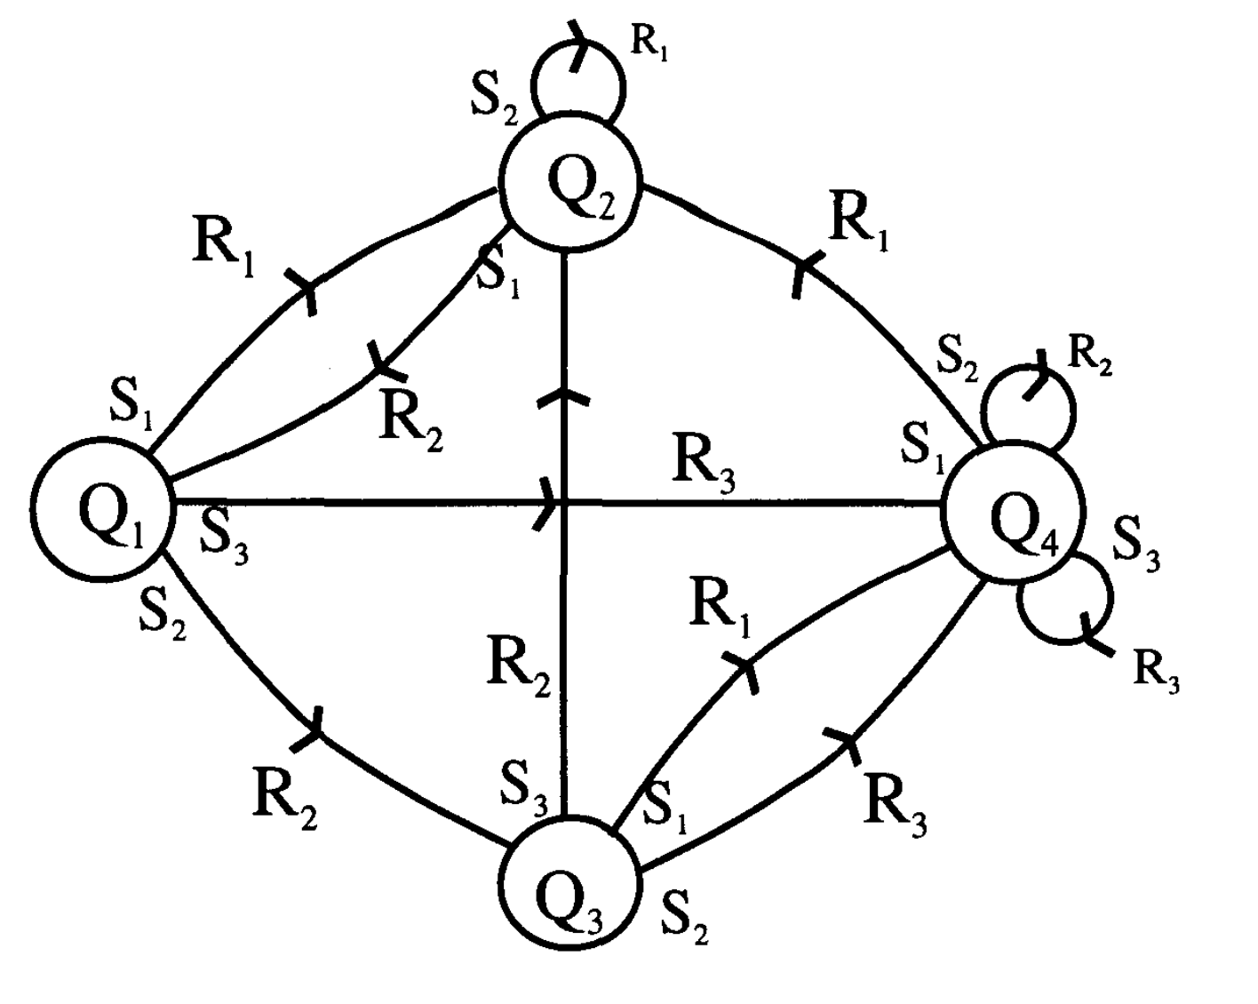
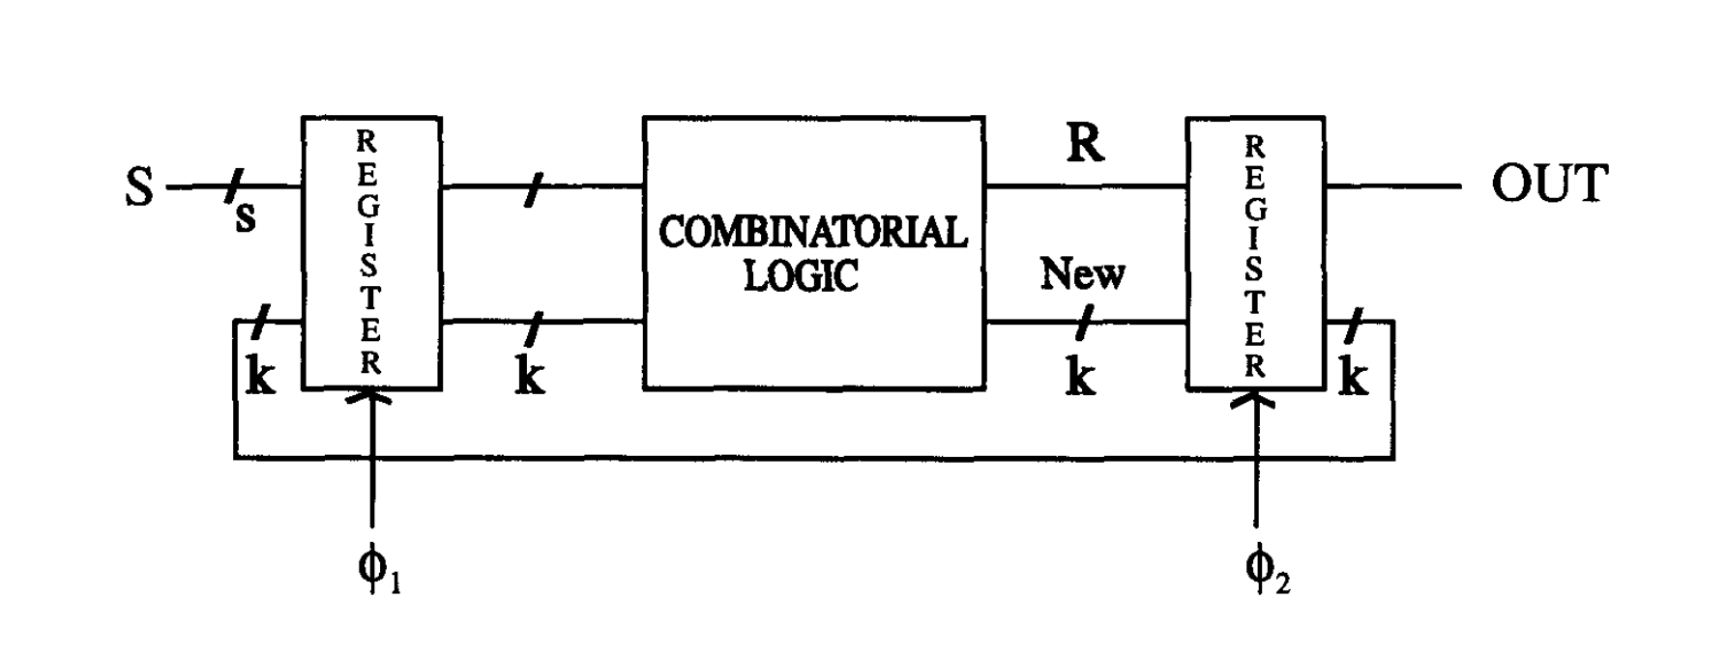
Could be complicated, but abstracted away

Slide 12
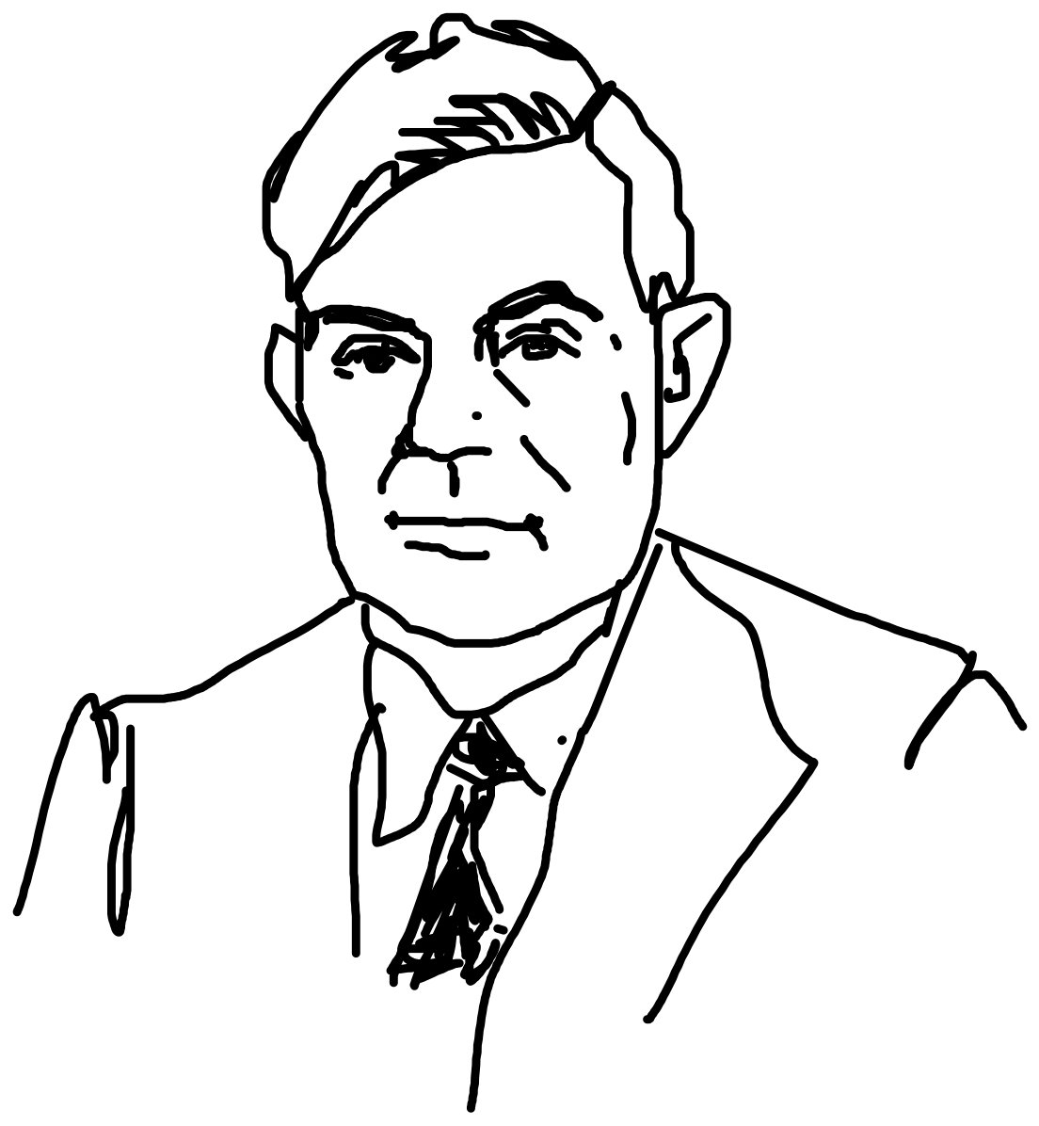
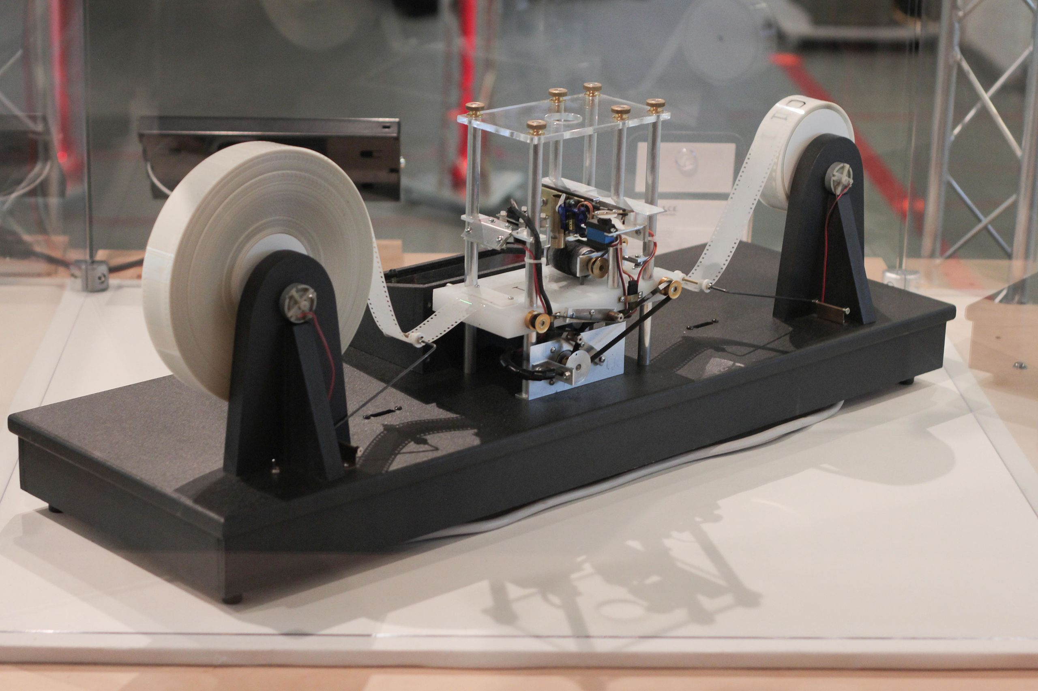
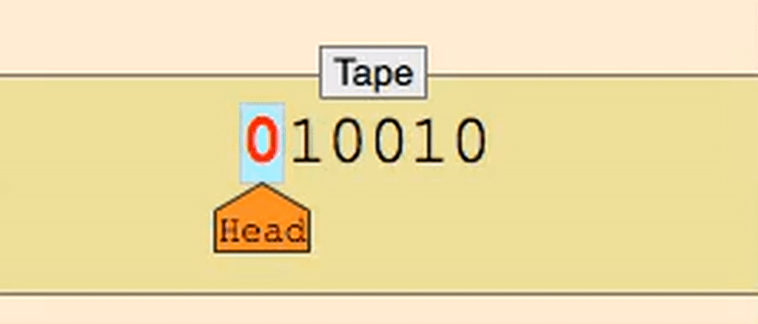
Turing machine
Infinite tape (memory), Infinite time
Read-write head
Instruction sets, state register (how to move)
Sequential access (different from RAM)
Deterministic algorithm
Halting Problem
Alan Turing
https://brilliant.org/wiki/turing-machines/
Non Turing: Random Access Computer

Slide 13
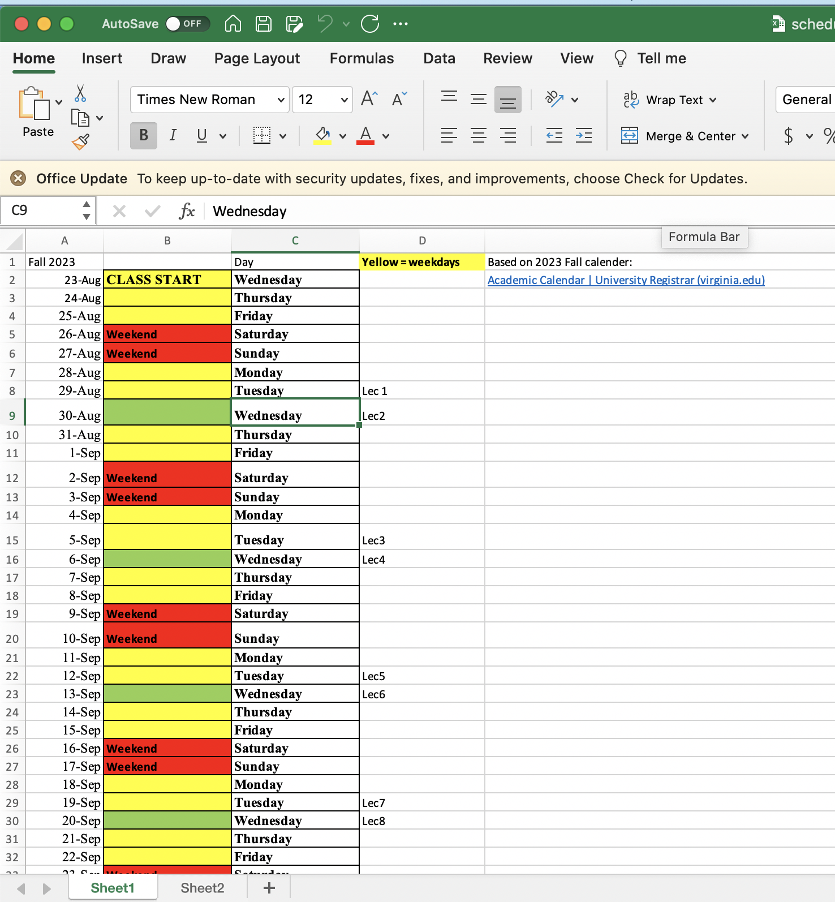
Turing complete
“universal” → Replicate an arb Turing machine

Slide 14
Needs a quintuple
Infinite memory
Read-Write head
State Register
Instructions

Slide 15
Parity Check Machine
0: even parity → another 0 keeps it even (0)
another 1 turns it odd (1)
1: odd parity → another 0 keeps it odd (1)
another 1 turns it even (0)

Slide 16
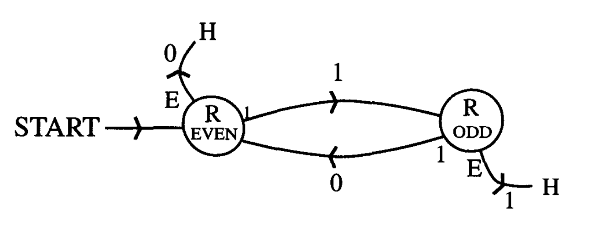
Turing Machine for Parity check
0
1
S
0
1
0
E
1
0
0
0
0
0
1
0
1
0
1
Read/Write/State change as before except Move direction, Start, Halt

Slide 17
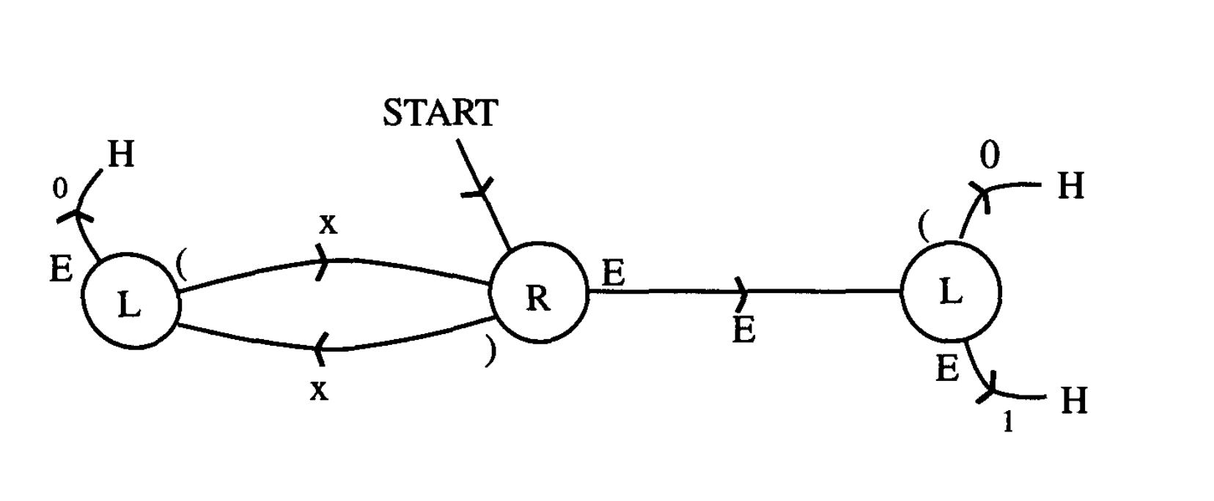
Turing Machine for parenthesis
E
0
X
X
X
X
X
X
E
H
FSM + Start-Stop and move
Two diff L states
one after ) another after E

Slide 18
Turing Machine for addition (4 + 3 = 7)
0
B
B
0
0
B
0
0
0
0
0
B
0

Slide 19
Turing Machine for Location
Target
Mismatch
Success
Y
1
0
x
A
B
x
1
1
x
1
0
x
1
1
x
B
A
0
1
B
1
If mismatch move right to X then back to Y
Flip numbers to letters along the way
If match, flip and move left to Y
Mismatch is outer loop
Note 1st target
Match is Inner loop

Slide 20
Turing Machine for Location
Target
Mismatch
Match !!
Success
Y
B
A
x
A
x
B
x
x
x
1
0
0
B
1
1
1
0
1
1
B
A
1
B
B
1
0
1
If mismatch move right to X then back to Y
Flip numbers to letters along the way
If match, flip and move left to Y
Mismatch is outer loop
Note 1st target
Match is Inner loop

Slide 21
Turing Machine for Location
Target
Success
Y
B
A
x
A
x
B
x
A
x
x
1
0
0
B
1
1
1
0
1
1
1
0
1
B
B
B
A
B
1
0
1
If mismatch move right to X then back to Y
Flip numbers to letters along the way
If match, flip and move left to Y
COPY
Mismatch is outer loop
Note 1st target
Match is Inner loop

Slide 22
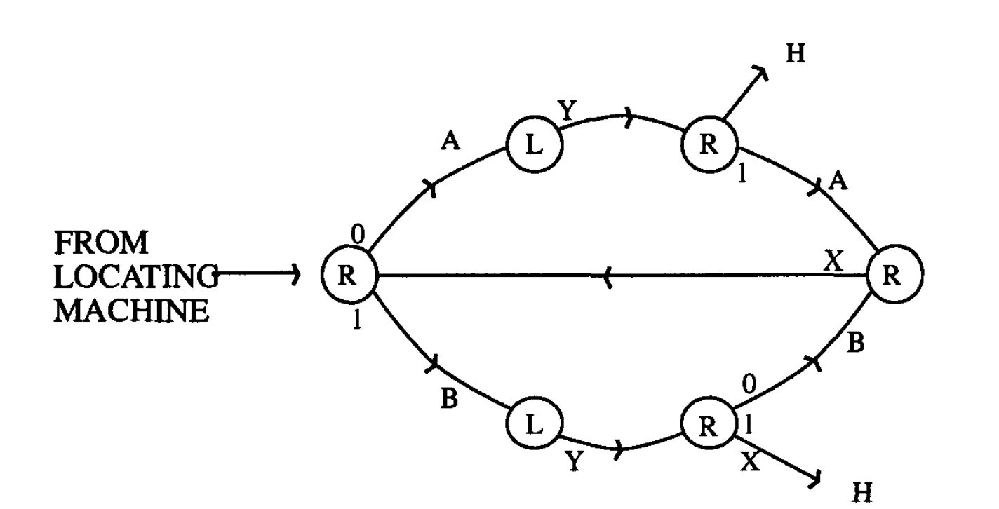
Turing Machine for Copy
Target
Y
A
x
AB AA
x
BB AB
x
A
B
x
B
BA 01
A
1
0
0
0
0
1
B
0
B
A
B
1
0
1
H

Slide 23
What computers may not be able to do: Halting problem
Logical Paradox
Can we determine if every program will halt or not? → NO
In practice with finite memory → YES (jus wait and see ☺ )

Slide 24
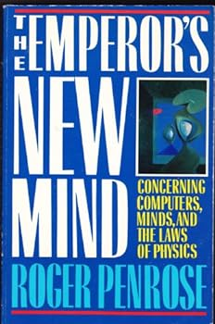
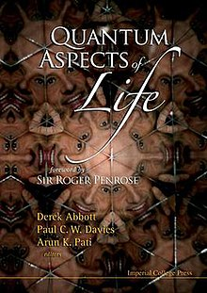
Human consciousness is non-algorithmic and cannot be described by a Turing machine.
QM (‘collapse of wavefunction’) essential for understanding human consciousness (microtubules allow superposition). This is a controversial assessment, but a huge improvement over random assertions of ‘quantum consciousness’…

Slide 25
Neuromorphic Computing is Turing complete
Can emulate an universal Turing machine → gets
you to an answer if infinite runtime/memory
straight-line sequences of code
if-then-else - iteration
unbounded iteration (e.g., while loops) - recursion
Non-Turing Languages
Remove while loop → can’t do a computation that is endless
(i --> i+1)
HTML (just represent data, not computation)
Bitcoin Blockchain (cannot do loops, arb read/writes from memory)

Slide 26
6B. Solving difficult problems
-- Computational Complexity

Slide 27
Calculating sums etc are ‘easy’. CMOS does that very
quickly. We keep pushing our limits on this.
There are problems that are fundamentally harder
to solve. They need an entirely different approach.

Slide 28
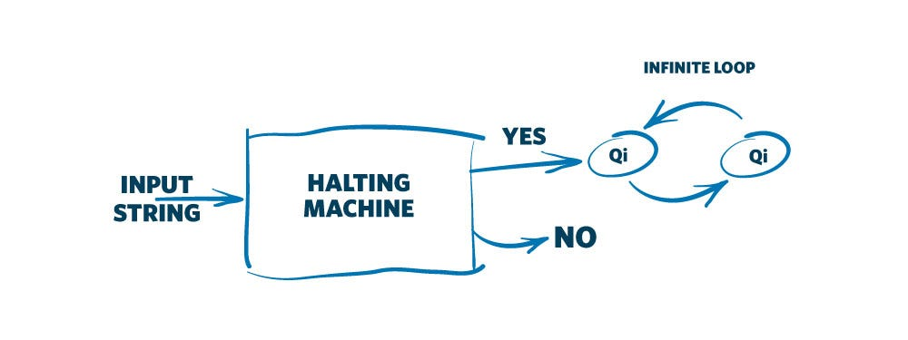
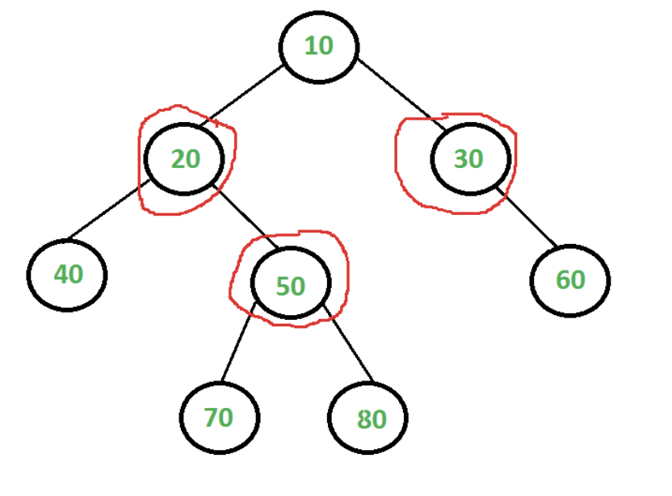
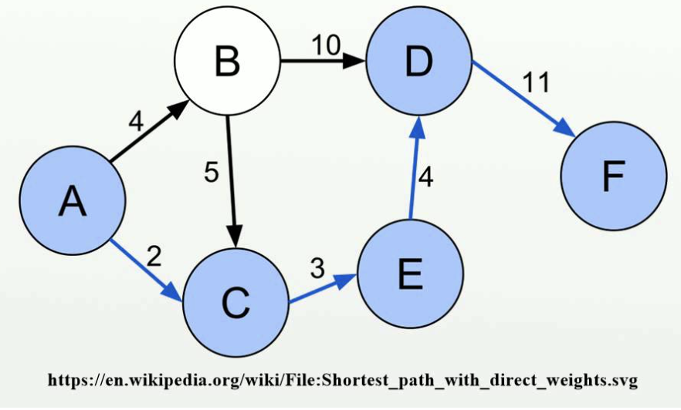
Turing Halting Pb:
Will the code
get stuck
in a loop?
NPH: Solving takes NP
NPC: Solve NP, Cerify P
Polynomial equiv of SAT
Vertex covering:
Min set of vertices
that cover every edge
of an undirected graph
NPI:
Good example? Conjectures exist…
P-time solution
P-time certification
P: Solve & certify in P
Shortest path in a weighted
network (Dijkstra)
NP: Certify in P

Slide 29
P-time solution
P-time certification
Is P = NP ??

Slide 30
Karp’s 21 NP-complete problems (polynomial equiv of SAT)
Satisfiability: the boolean satisfiability problem for formulas in conjunctive normal form (SAT)
0–1 integer programming (only the restrictions must be satisfied, with no optimization)
Clique (see also independent set problem)
Set packing
Vertex cover
Set covering
Feedback node set
Feedback arc set
Directed Hamilton circuit (Directed Hamiltonian cycle)
Undirected Hamilton circuit (Undirected Hamiltonian cycle)
Satisfiability with at most 3 literals per clause (equivalent to 3-SAT)
Chromatic number (also called the Graph Coloring Problem)
Clique cover
Exact cover
Hitting set
Steiner tree
3-dimensional matching
Knapsack (Karp's definition of Knapsack is closer to Subset sum)
Job sequencing
Partition
Max cut

Slide 31
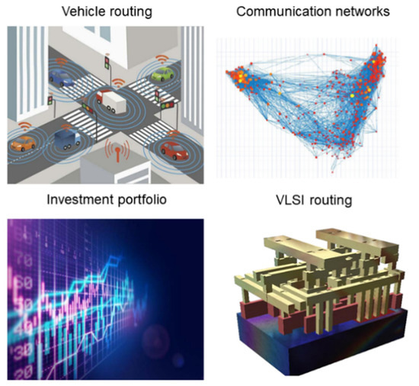
Real world applications
Zhang, Y.; Deng, Y.; Lin, Y.; Jiang, Y.; Dong, Y.; Chen, X.; Wang, G.; Shang, D.; Wang, Q.; Yu, H.; et al. Oscillator-Network-Based Ising Machine. Micromachines 2022, 13, 1016.
Ahmed, I.; Chiu, P.W.; Moy, W.; Kim, C.H. A probabilistic compute fabric based on coupled ring oscillators for solving combinatorial optimization problems. IEEE J. Solid-State Circuits 2021, 56, 2870–2880.

Slide 32
MAX-CUT (NP-Complete)
Happy scissor that wants to cut as many
edges as possible along one smooth line
Tank deciding how many routes can I destroy
in one motion without going backward

Slide 33
MAX-CUT
Easy to check if this solution is better
than another offered solution

Slide 34
MAX-CUT

Slide 35
MAX-CUT

Slide 36
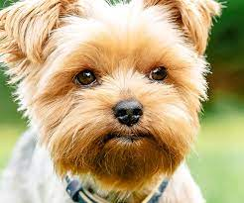
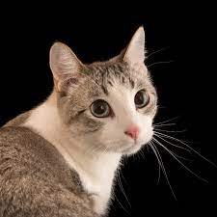
e.g. Image Classification
Weighted max cut
(maximize distance
BETWEEN groups)
???

Slide 37
Boolean 3-SAT
(x₁ v x₂ v x₃) ^ (x₁ v x₂ v x₄) ^ (x₄ v x₁ v x₃) ^ (x₄ v x₁ v x₂)
Find consistent assignments of x_{i} = 0, 1 such that
the net result is 1 (TRUE)
x₁ = 1
x₂= 0
x₃= 0
x₄= 1

Slide 38
6C. But how do we solve these in a reasonable time?

Slide 39
How we ‘process’ information
“Neuron”
(Decision maker)
--> Logic
Inputs
{0, 1}
“Synapse”
(Info collecting and
Storage → Memory)
x₁
w₁
w₂
x₂
y = x₁w₁ + x₂w₂ + x₃w₃
= x.w
w₃
x₃

Slide 40
A bit more multi-dimensional
– a cascade of decisions
Inputs
x_{i}
Outputs
y_{i}⁽¹⁾
z_{i}⁽¹⁾
y_{i}⁽²⁾
z_{i}⁽²⁾
O_{i}
⎲
⎲
⎲
y_{i}⁽¹⁾ = W_{ij}⁽¹⁾ x_{j}
z_{i}⁽¹⁾ = f(y_{i}⁽¹⁾ -b_{i}⁽¹⁾)
y_{i}⁽²⁾ = W_{ij}⁽²⁾ z_{i}⁽¹⁾
z_{i}⁽²⁾ = f(y_{i}⁽²⁾ -b_{i}⁽²⁾)
y_{i}^{(N)} = W_{ij}^{(N)} z_{i}^{(N-1)}
O_{i} = f(y_{i}^{(N)} -b_{i}^{(N)})
⎳
⎳
⎳
_{j}
_{j}
_{j}

Slide 41
Simple mathematical way to think
Inputs
f(x) = 1/(1+e^{-x/a})
x₁
w₁
“Synapse”
“COST”
“Neuron”
w₂
x₂
y = x.w
z = f(y-b)
U = λ(z-z*)²
w₃
x₃

Slide 42
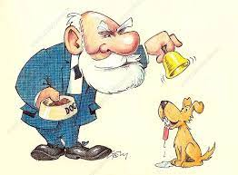
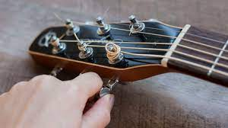
Supervised vs Unsupervised
Adjust parameters
(bias, weights) to
get to a minimum loss.
Loss function can be
set by nature, or
‘designed’ by an algo
Parameters self-adjust
by natural selection (e.g. coincidence detection)

Slide 43
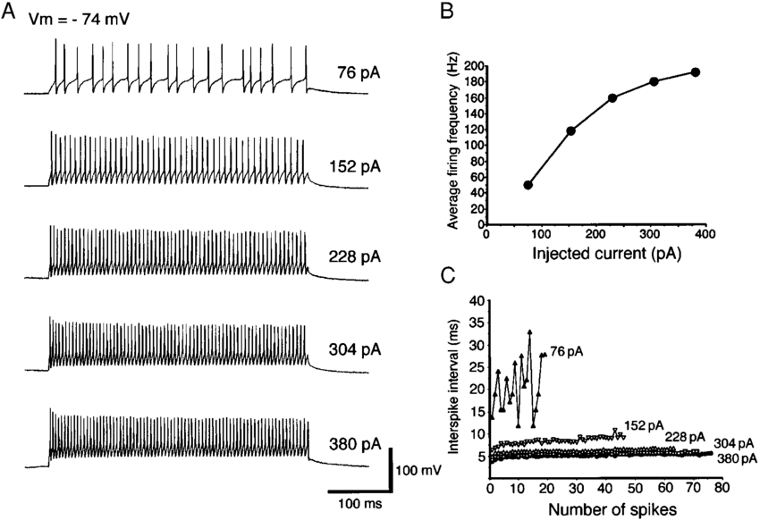
Biology: the origin of our inspiration
Input (ionic current) Controls signal (current) amplitude
Pulse Position Modulation
Electrophysiological and Morphological Properties of Neurons in the Rat Superior Colliculus. I. Neurons in the Intermediate Layer –
Y. Saito and T. Isa Journal of Neurophysiology 82(2):754-67, 1999.

Slide 44
Biophysics of Spike generation and propagation
Na
Na Channel
K Channel
0 mV
I (mA)
+
+
+
+
+
+
+
+
+
-
+
-
-
-
-
+
-
+
-
-
-
+
-
-
-
-
30 mV
-70 mV
-55 mV
-70 mV
-65 mV
K
Ion Pumps

Slide 45
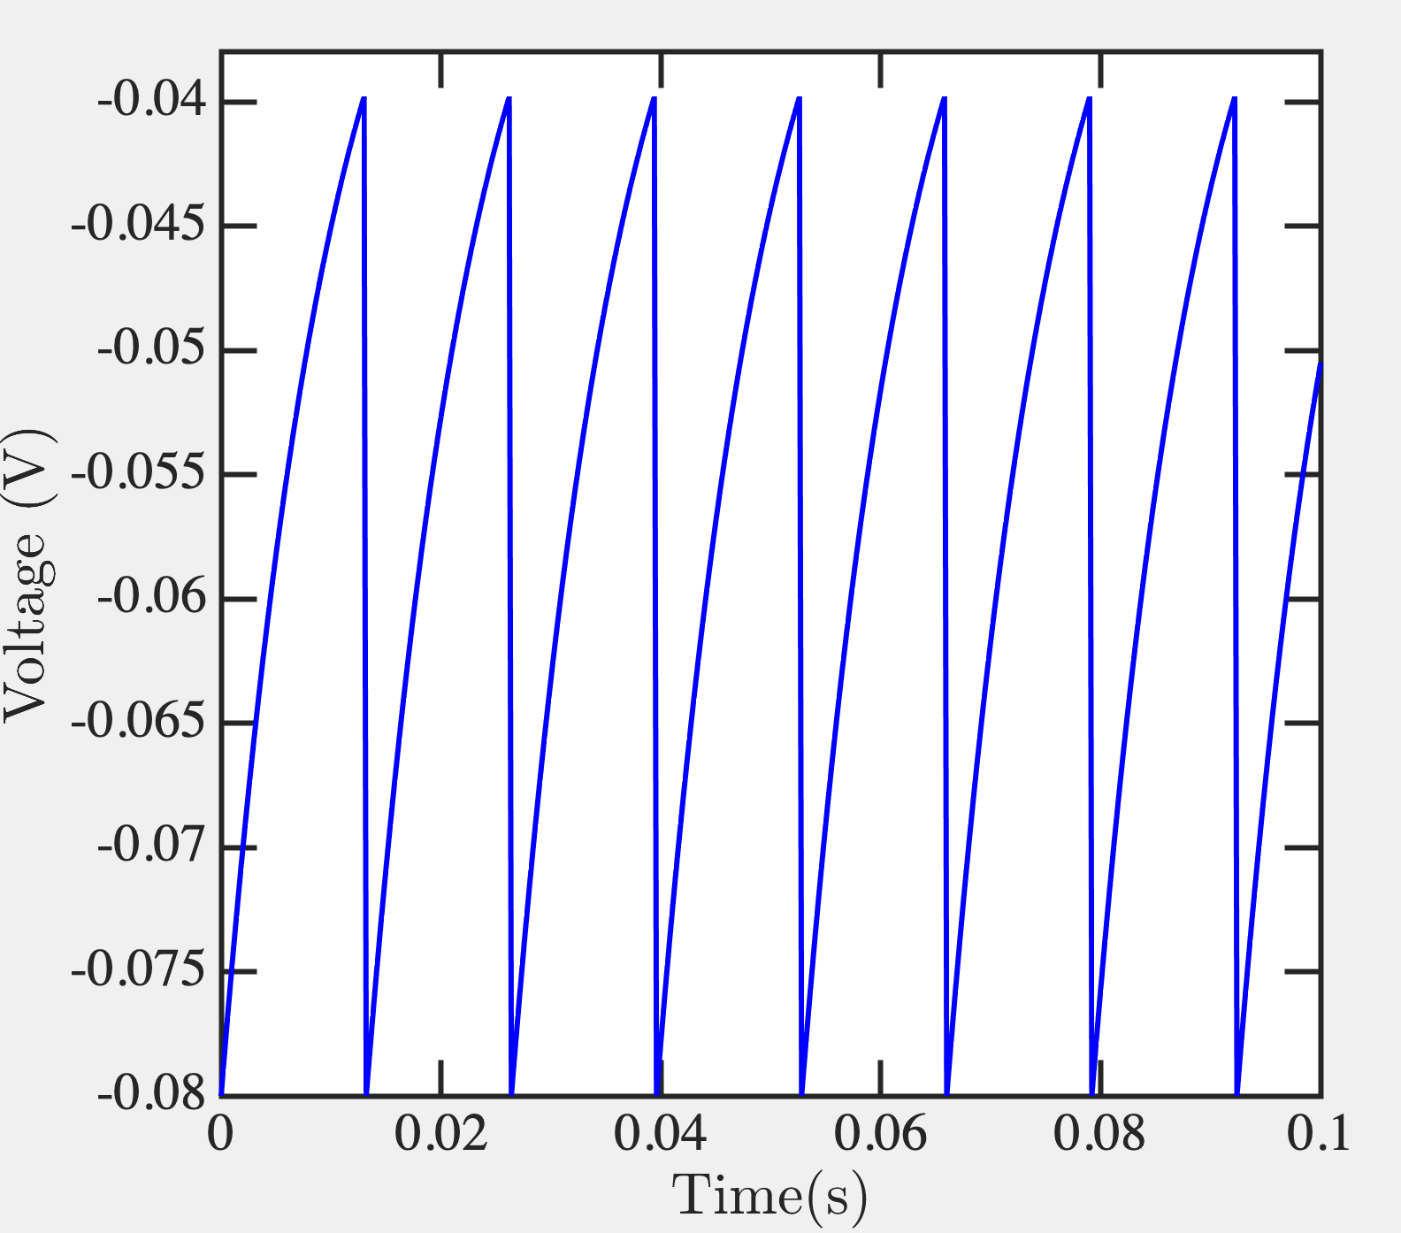
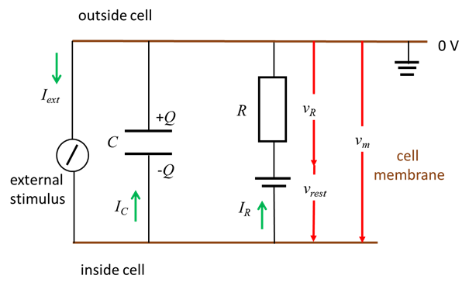
Leaky Integrate and Fire model
%% Leaky Integrate and Fire model VHLab
V_reset = -0.080; % -80mV
V_e = -0.075; % -75mV
V_th = -0.040; % -40mV
Rm = 10e6; % membrane resistance
tau_m = 10e-3; % membrane time constant
dt = 0.0002;
T = 0:dt:1; % 1 second simulation
Vm(1) = V_reset;
Im = 5e-9;
for t=1:length(T)-1,
if Vm(t) > V_th,
Vm(t+1) = V_reset;
else,
Vm(t+1) = Vm(t) + dt * ( -(Vm(t) - V_e) + Im * Rm) / tau_m;
end;
end;
plot(T,Vm,'b-');
xlabel('Time(s)');
ylabel('Voltage (V)');
https://d-arora.github.io/Doing-Physics-With-Matlab/mpDocs/pbs007.htm

Slide 46
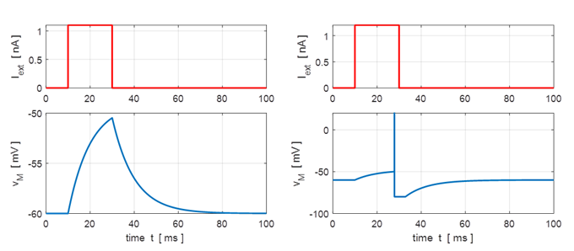
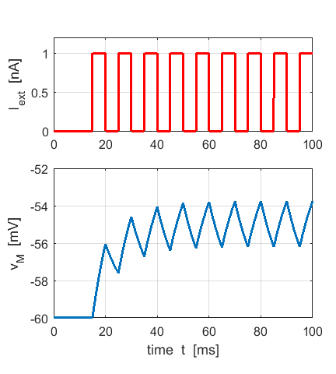
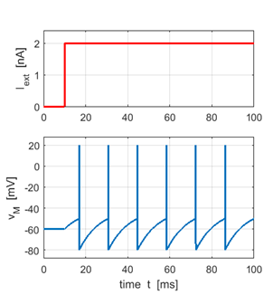
Playing with parameters

Slide 47
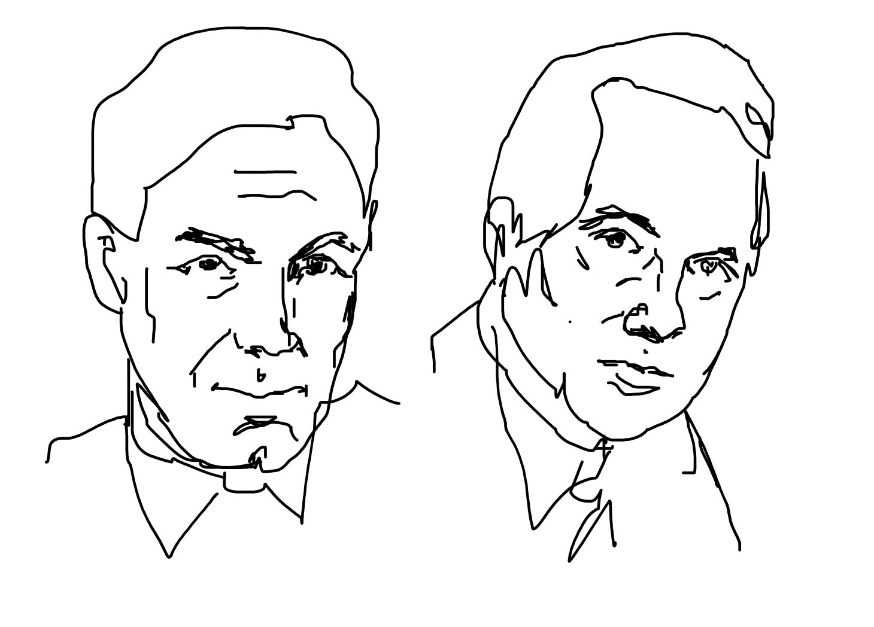
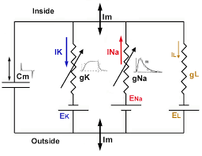
A Hodgkin-Huxley Circuit

Slide 48
A Hodgkin-Huxley Circuit

Slide 49
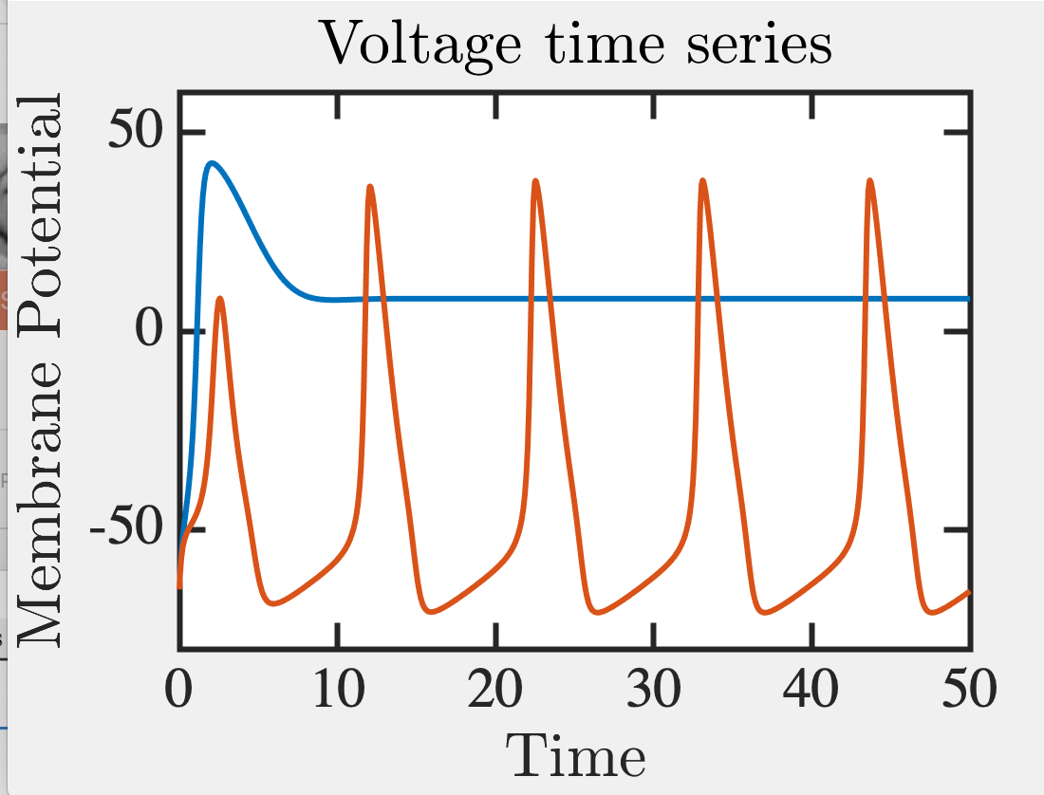
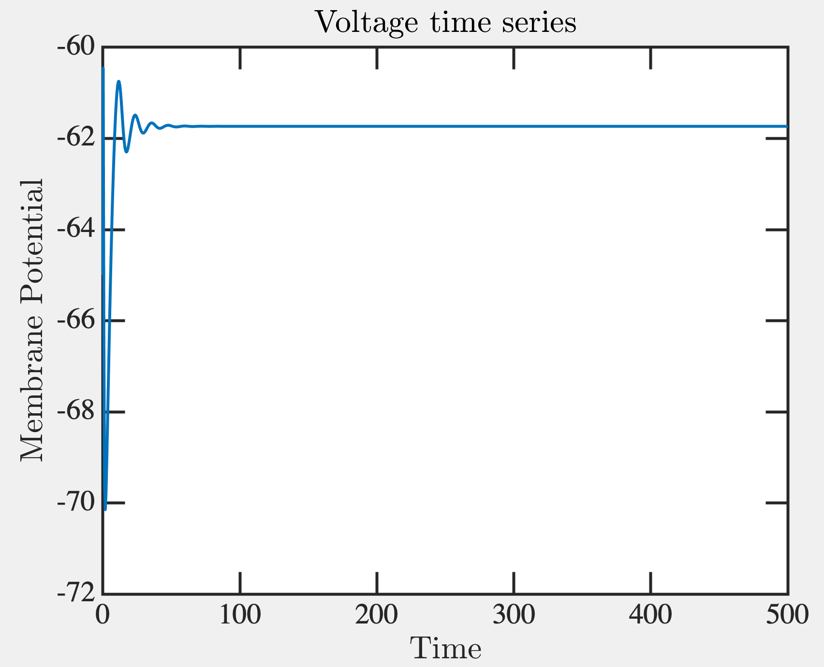
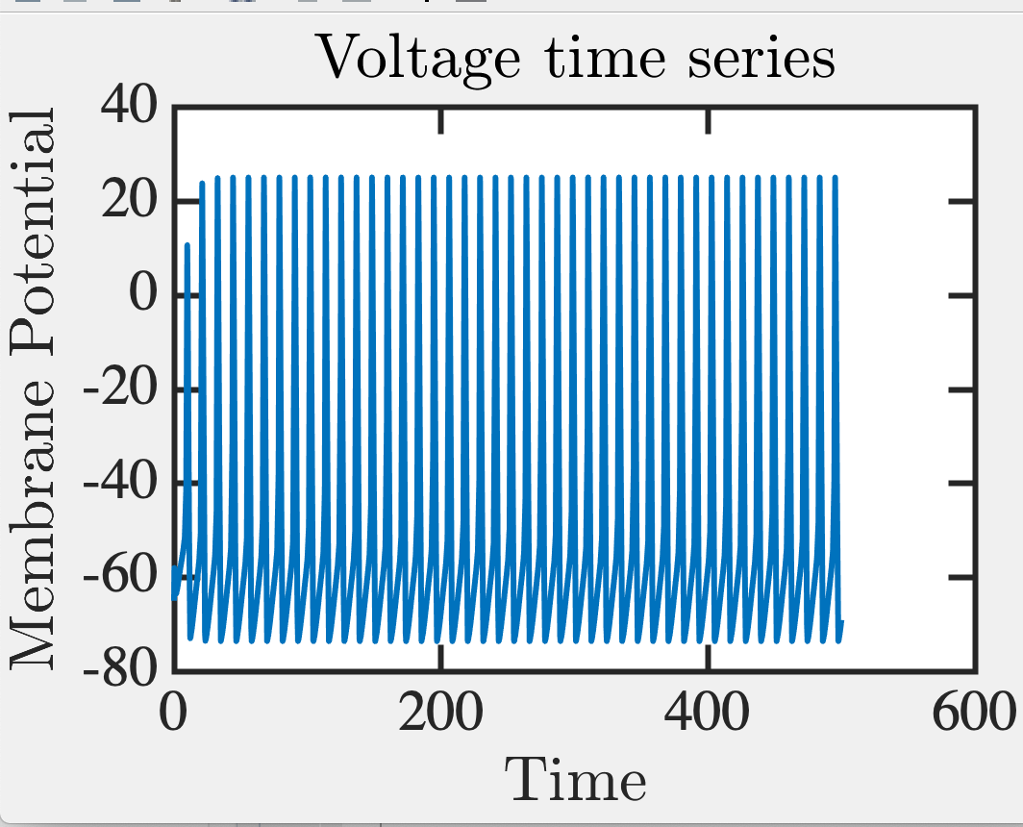
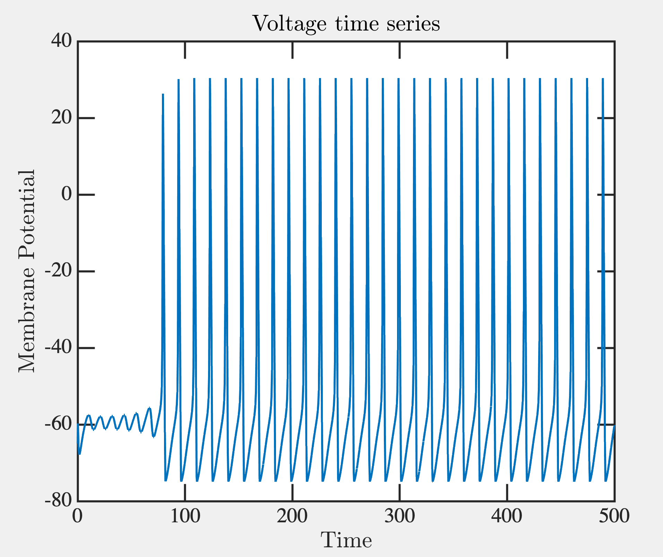
All or none
I = 5mA
I = 10mA
I = 20mA
Matlab code share Rohit Chandra

Slide 50
Glutamates
-
-
-
-
+
+
+
+
+
+
+
+
+
+
+
+
+
Axon
Dendrite
Fitzhugh-Nagumo Model
Cable Equation
Morris-Lecar
Hodgkin-Huxley
Leaky Integrate and Fire
Izhikevich Model

Slide 51
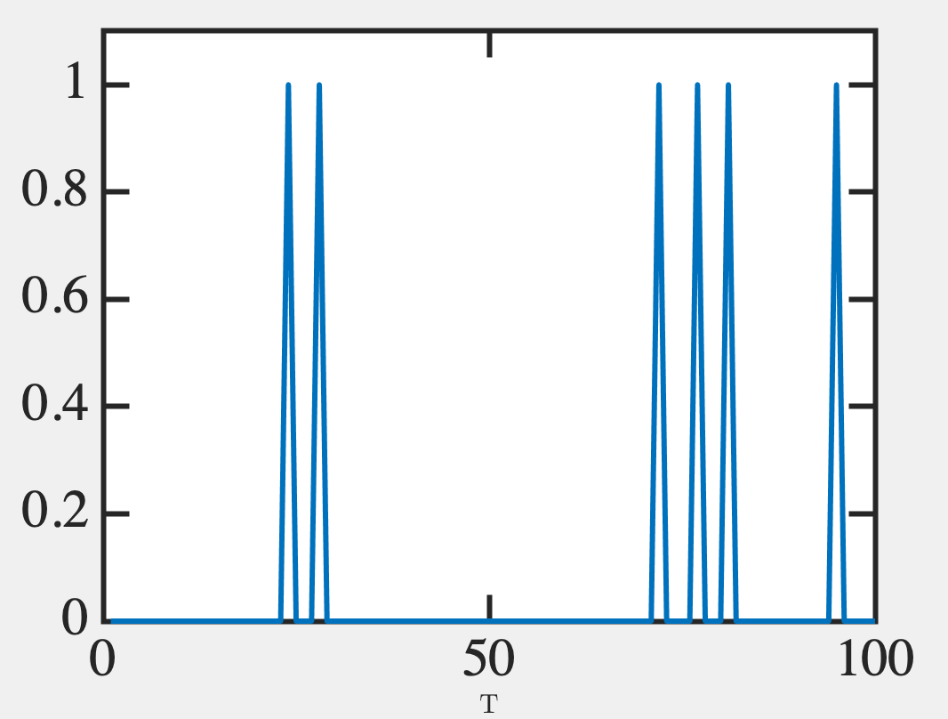
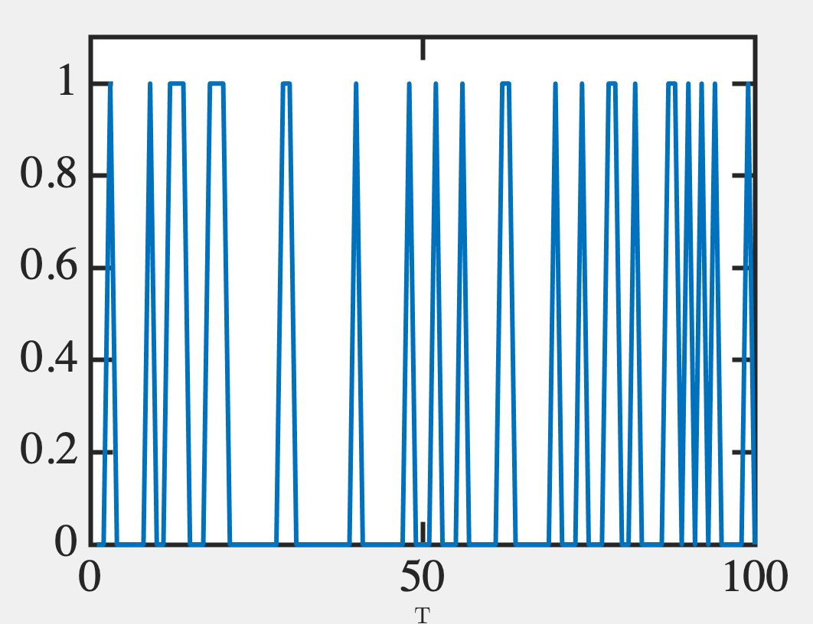
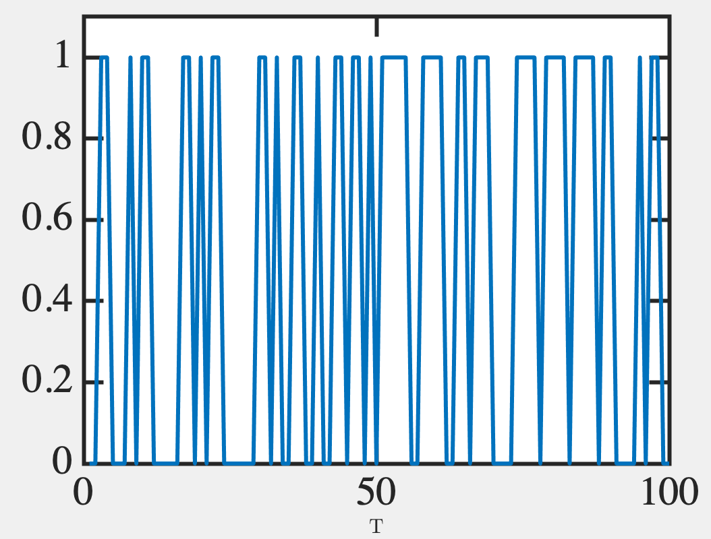
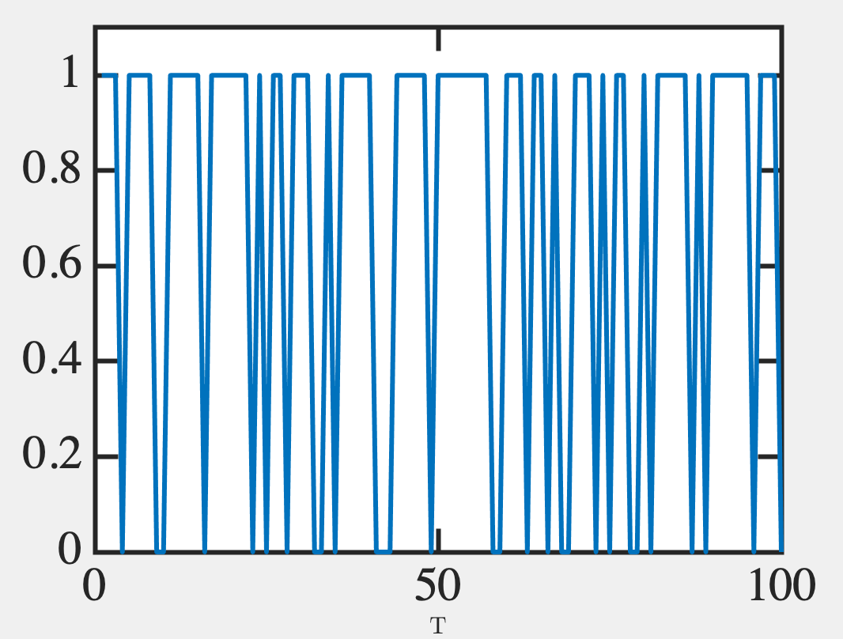
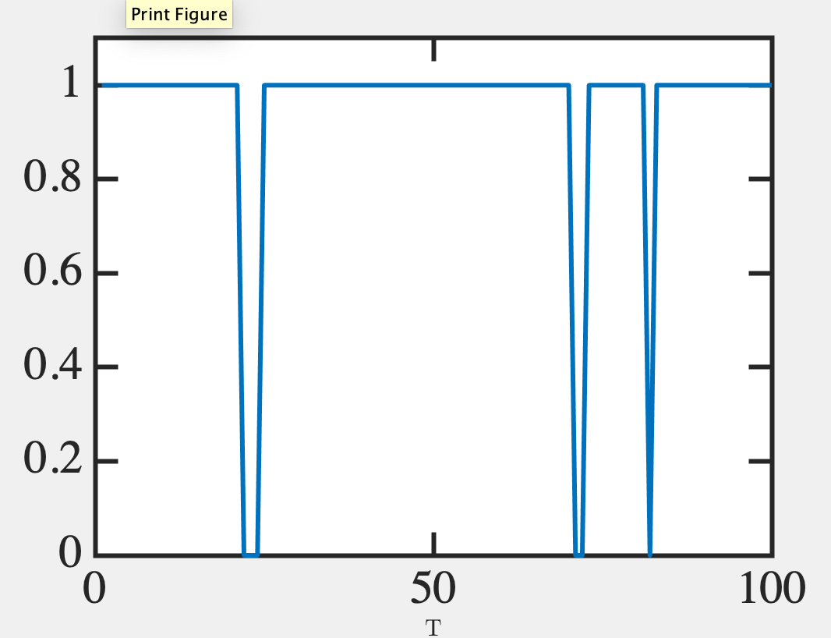
Probabilistic bits (p-bits)
Digital data analog read-out
V=-55mV
V=-50mV
V=-45mV
0.5
0.3
0.1
V=-40mV
V=-35mV
0.9
0.7

Slide 52
0.7
y → stream of 100 random #s between 0 and 1
y=rand(100,1);
Matlab
Binarize with a given probability p=0.7
(y < p → print 1, else 0)
y=y<p;
import numpy as np y = np.random.rand(100,1)
Python

Slide 53
Probability set by interconnects and neighboring neuronal outputs
How do we program interconnects?
Biology: unsupervised, Hebb’s rule (“neurons that fire together wire together”)
Feedback Loop
y₂ set by W₁₂
W₁₂ set by y₂
Donald O Hebb

Slide 54
Example Hebbian
Neurons connect over time as Venn diagrams to form cliques
(Not fully unsupervised – Hippocampus directs it)

Slide 55
How are arrival probabilities relevant?
STDP: Spike Timing Dependent Plasticity

Slide 56
6D. Bio-inspired Neuromorphic Computing

Slide 57
Dynamics of Physical Neurons
Each is 0 (quiescent)
or 1 (fired)

Slide 58
Programming interconnects
in Artificial Neural Nets

Slide 59
Programming interconnects
in Artificial Neural Nets

Slide 60
Map onto a known problem

Slide 61
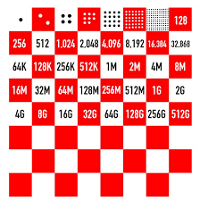
The neuronal space
Phase space of 2^{n} possibilities
2⁶⁴ grains of rice is > 1 millennium of global rice production
(storage space > 50 countries in the globe)
2¹⁰⁰ = 10³⁰ (1 kg has 10³⁰ electrons)
Can embed a large search space there!!
Finding a ground state is hard and may take time, with false positives

Slide 62
The neuronal space
Can be stuck in ‘metastable’ states
Rock or tilt the potential
Change the temperature

Slide 63
Neuro-synaptic systems
can be programmed to
solve very large
optimization problems
approximately at moderate
speeds

Slide 64
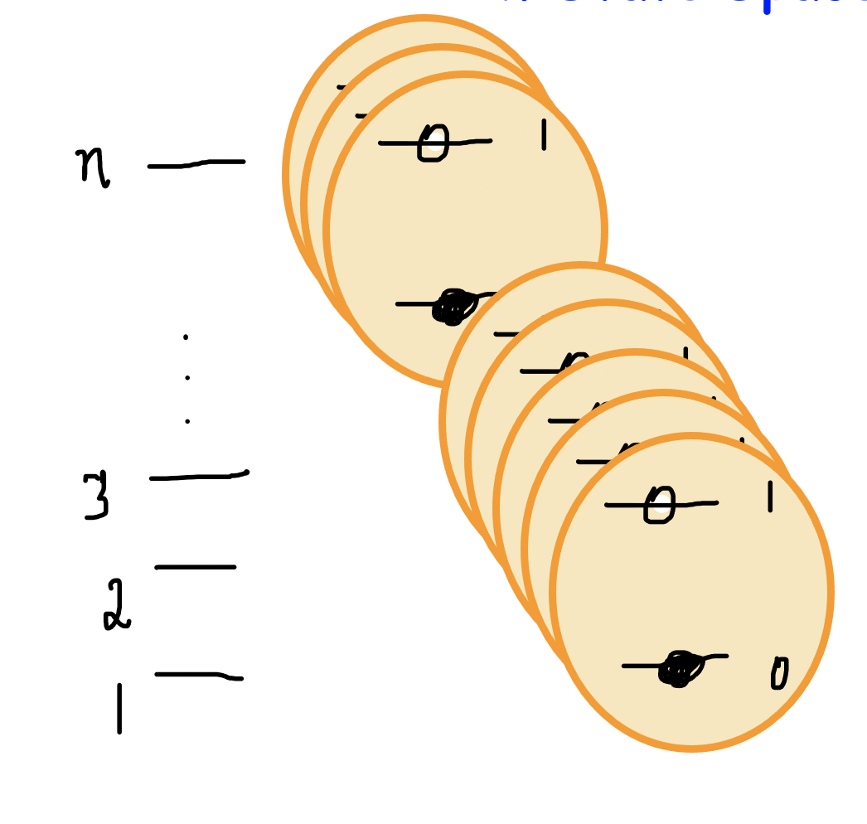
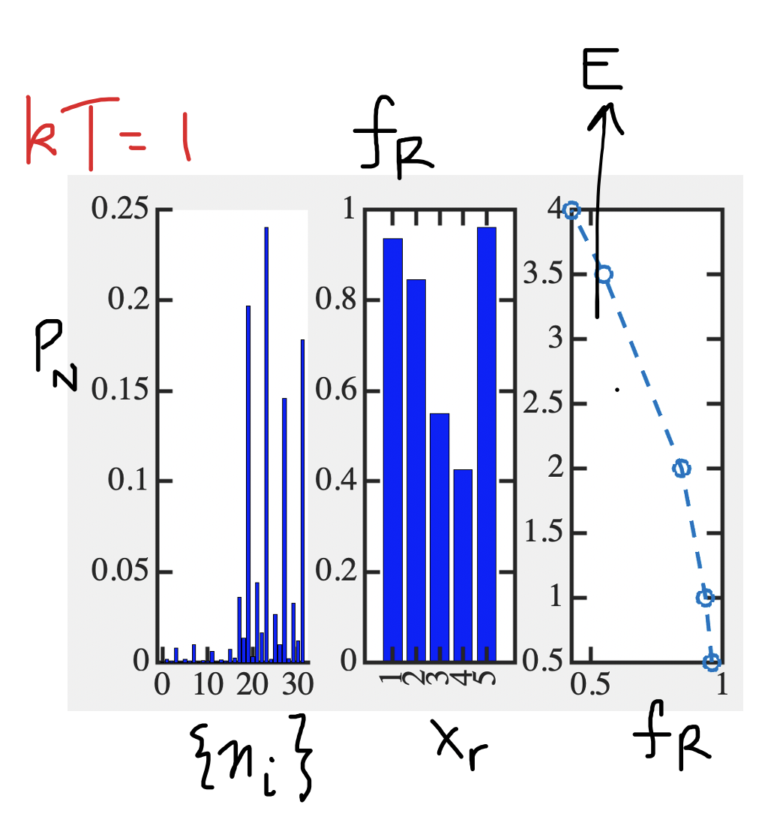
Next Lecture
Boltzmann Machines
2^{n} configuration space
Solving with time sampling

