Slide 1
Fundamentals of Computing
Lec 7
Boltzmann Machines

Slide 2
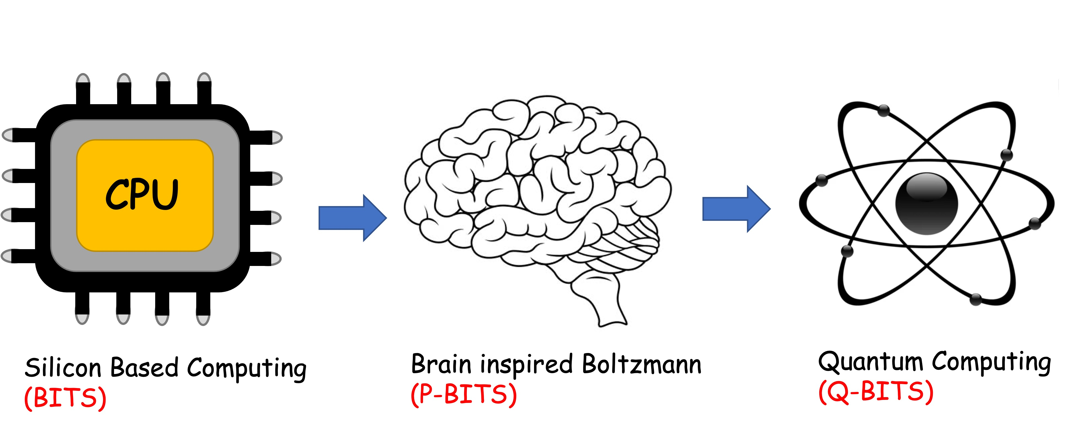
Overall structure of this course
Analog Computing in Carbo
How we train (Supervision)
Physics of Neurons (Boltzmann)
How we learn (time sampling)
Optimizing and Classifying
Transition Theory & Inferencing
Quantum Computing in Magneto
Quantum Spins and Hardware
Interacting Spins
Going parallel: Quantum Physics
Entanglement and Superposition
Cloning and Key Distribution
Quantum Search and Annealing
Quantum Gates and Factorization
Digital Computing in Silico
How we compute (algorithms)
How we add (Gates)
How we add quickly (CMOS)
How we fix errors
Thermodynamics of Computing

Slide 3
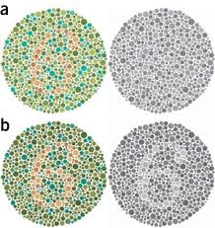
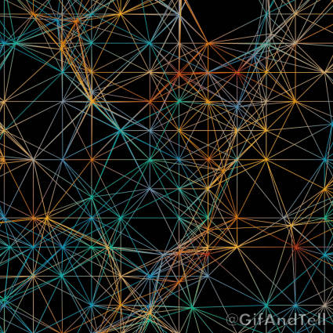
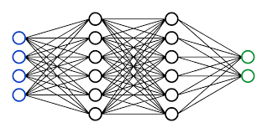
Analytical thinking
Ability to segregate objects
measurably so we can count
Static datastreams so we can fixate
Logical thinking
Ability to learn & infer
(interpolate & extrapolate)
Depth of Neurons
Speed of CMOS
Architecture of GPUs
https://gifandtell.wordpress.com/2015/09/21/displaced-dots-33-connected-chaos/

Slide 4
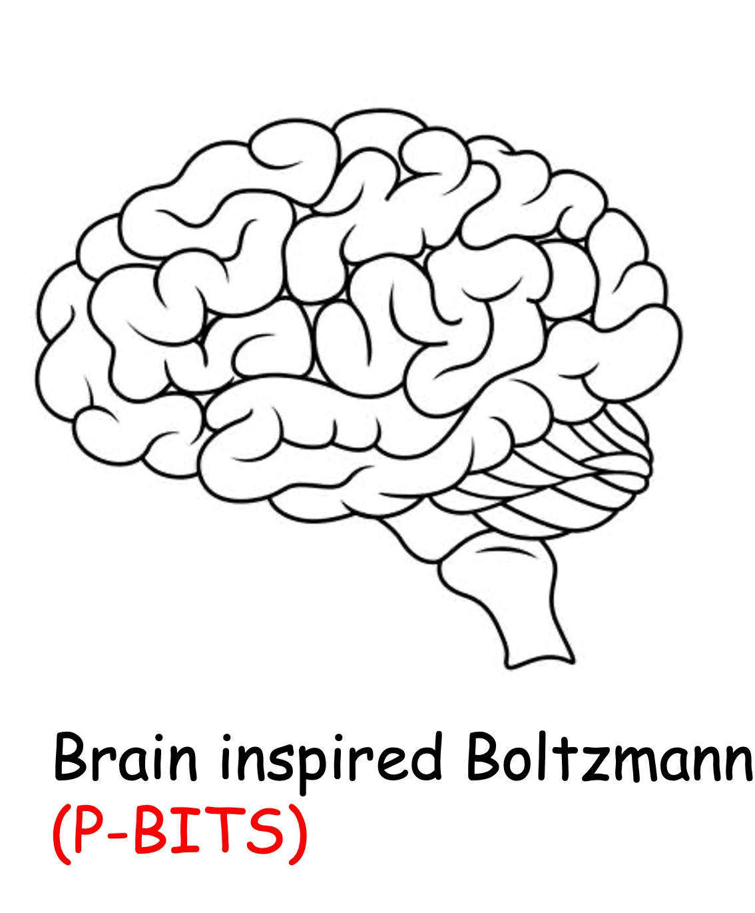

Slide 5
Neuro-synaptic systems can be programmed to solve very large optimization problems approximately at moderate speeds

Slide 6
What is the underlying physics of interacting neurons?
What is the underlying physics of coupled binary variables?

Slide 7
7A. Configuration Space

Slide 8
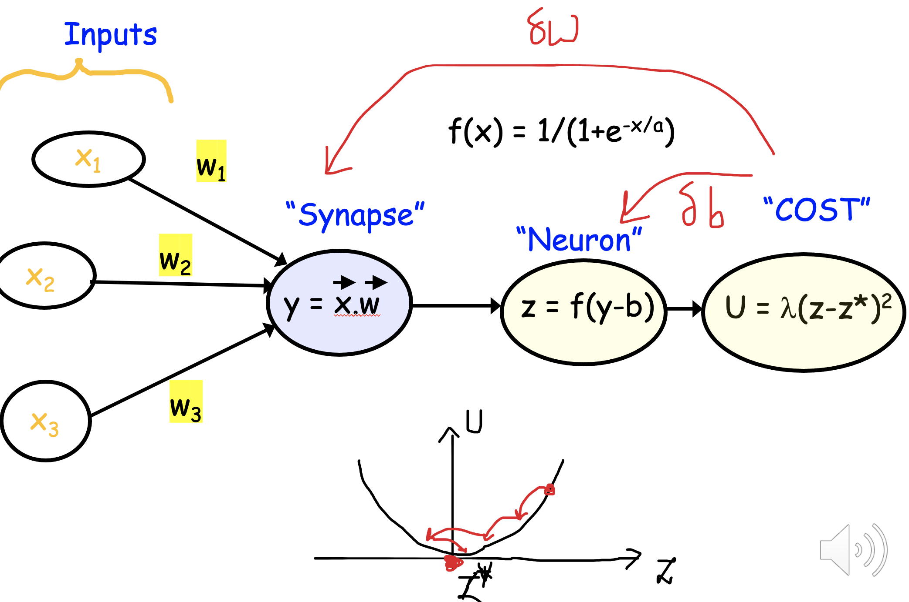
State Space of Neurons

Slide 9
More on State Space
How does nature decide with electrons?
Decision making moves you to a ‘ground state’..
This means energy must leave the system through friction
A larger reservoir at equilibrium must siphon out this energy
(and/or particles) through continuous exchange
The reservoir sets the average energy
with a temperature, and the average particle
number with a chemical potential

Slide 10
Intuitive description of the ground state configuration
Lower energies occupied
Fermi
Energy
(See Lec 3B)

Slide 11
However, this is only one out of many configurations

Slide 12
n-State Space → 2^{n} configuration space

Slide 13
Boltzmann Law in 2^{n} configuration space

Slide 14
Z is normalization (Partition Function)

Slide 15
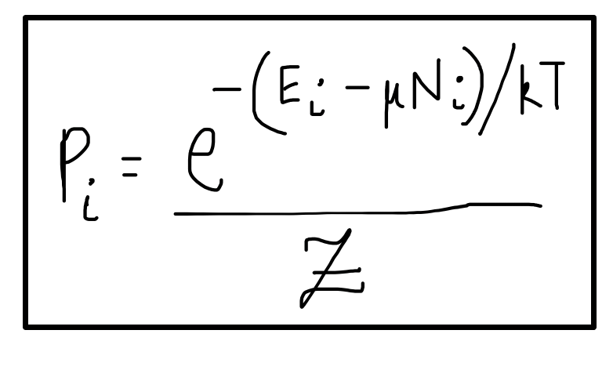
Case 1: 1 energy level

Slide 16
The one particle version
Fairly intuitive !

Slide 17
Case 2: 2 independent levels

Slide 18
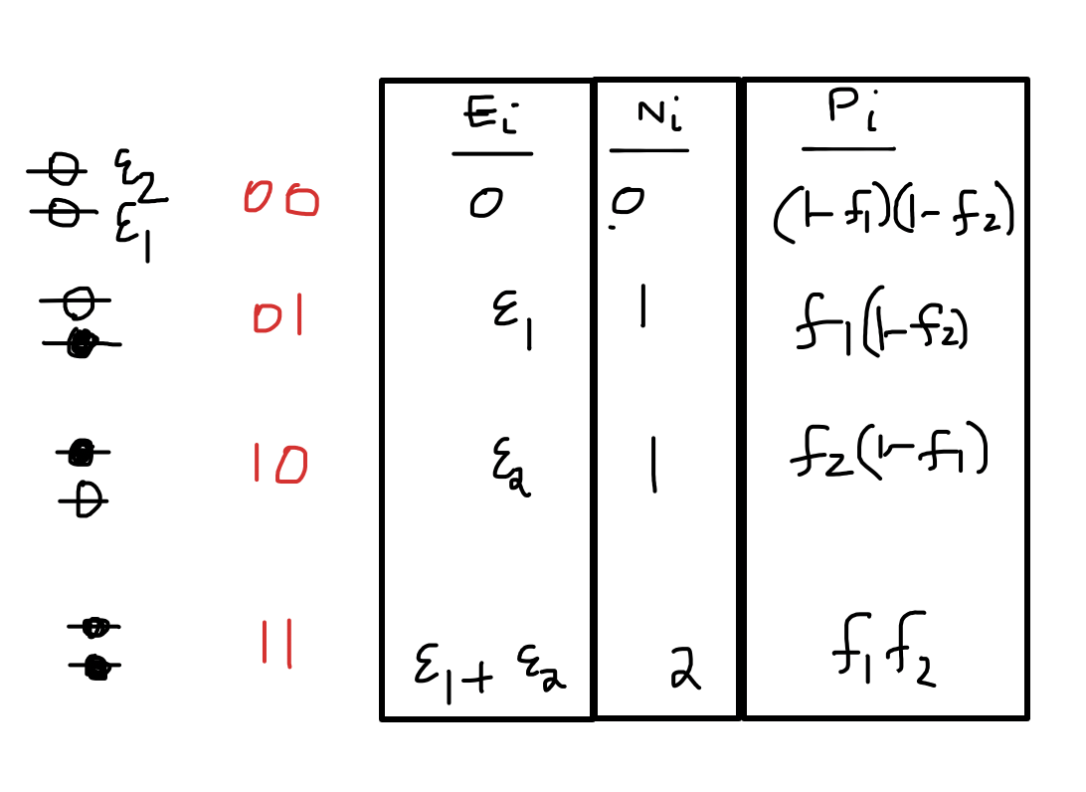
Occupancy of each level
Still intuitive !

Slide 19
Occupancy of each level

Slide 20
Case 3: 2 interacting levels

Slide 21
Reinterpreting

Slide 22
Occupancy of each level
Not that intuitive !!!

Slide 23
For interacting systems, we can no longer
use simple n-state approximations like f(x).
The answer can be hopelessly complicated,
not generalizable, and only extracted in 2^{n} space where Boltzmann law still persists

Slide 24
But why does Boltzmann law work
in 2^{n} space ?

