Slide 1
7C. Implementing Boltzmann
in 2^{n} space

Slide 2
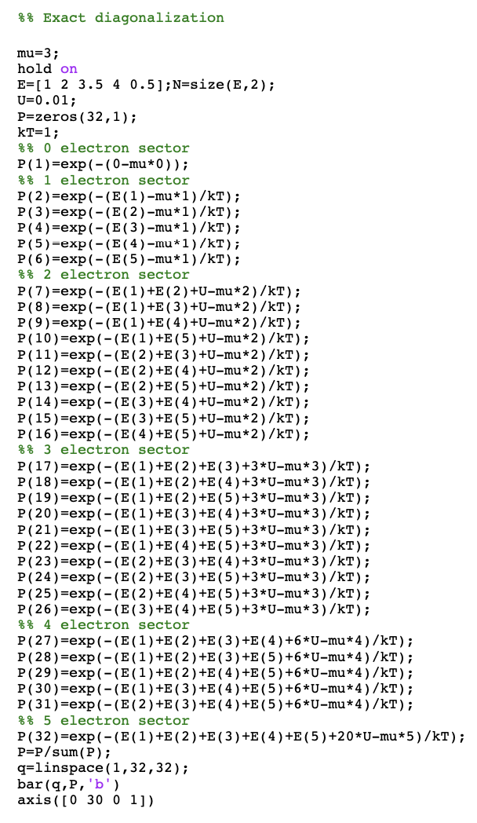
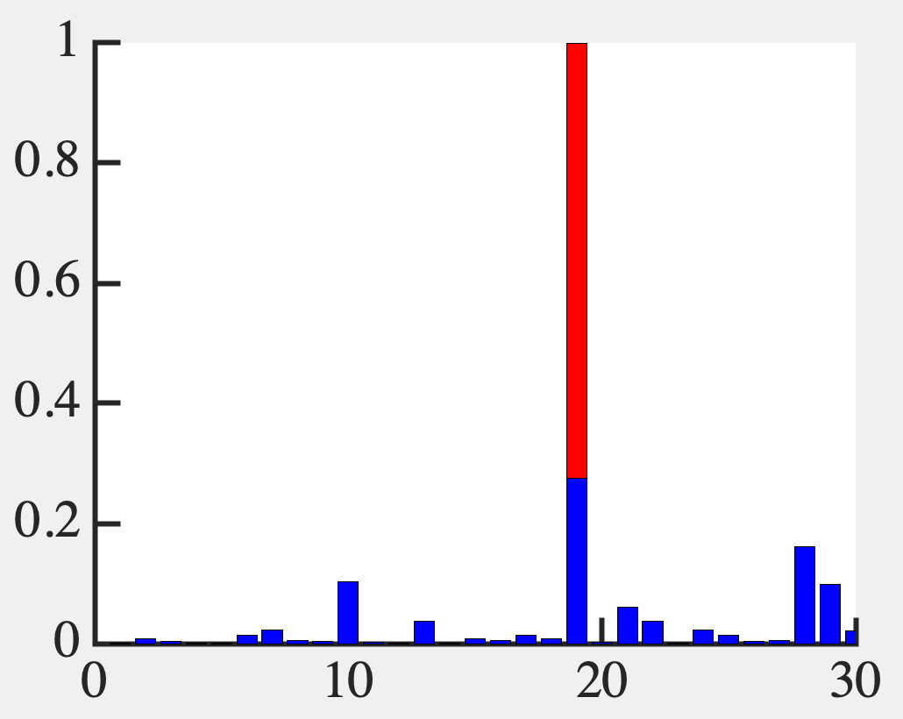
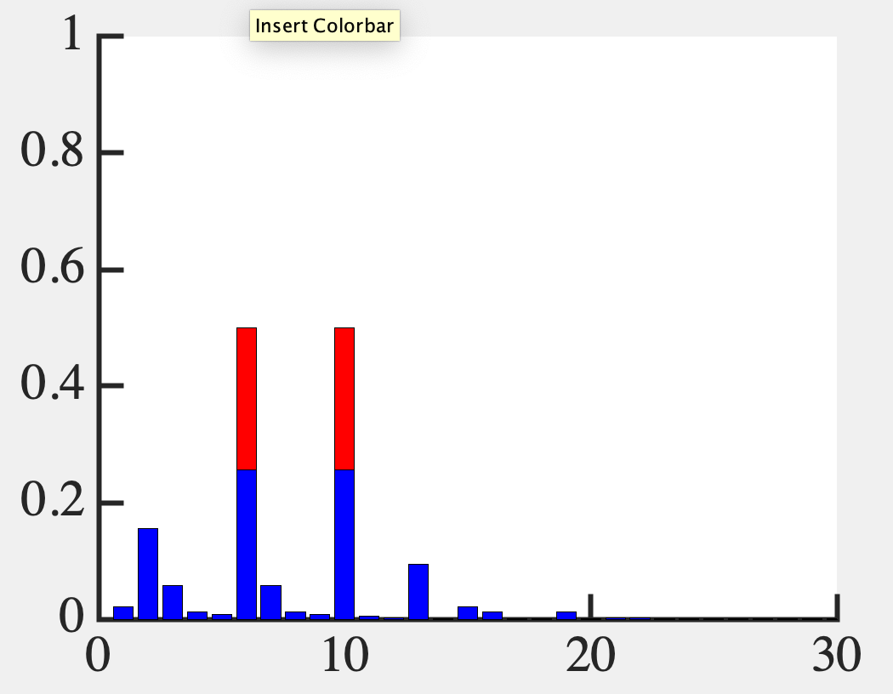
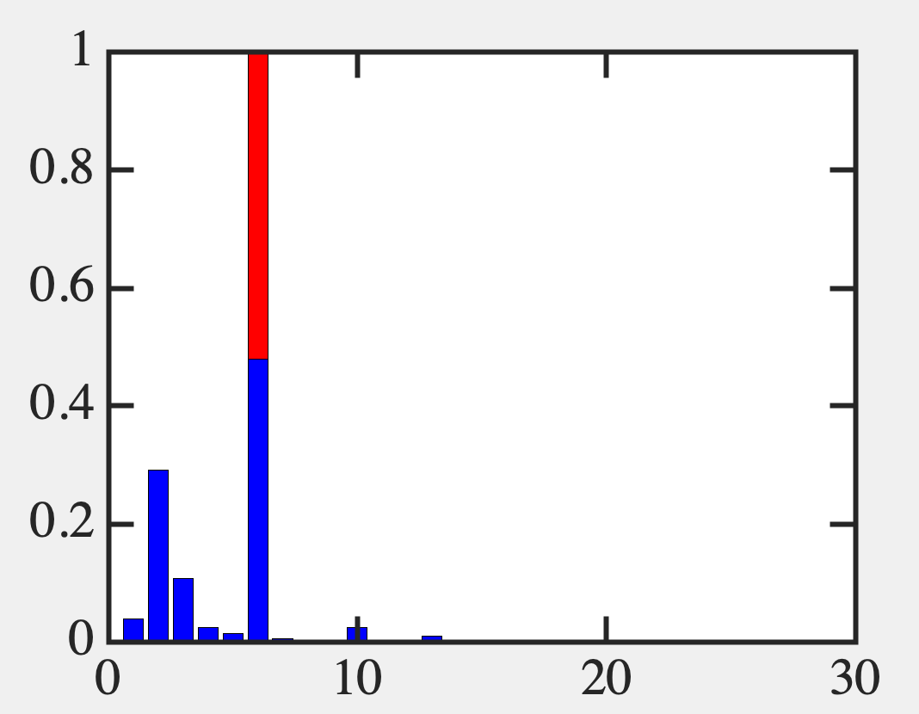
Let’s do the exact problem first
U=0.01
U=2
U=5

Slide 3
Can automate this a bit…

Slide 4
Coulomb

Slide 5
Exact solution

Slide 6
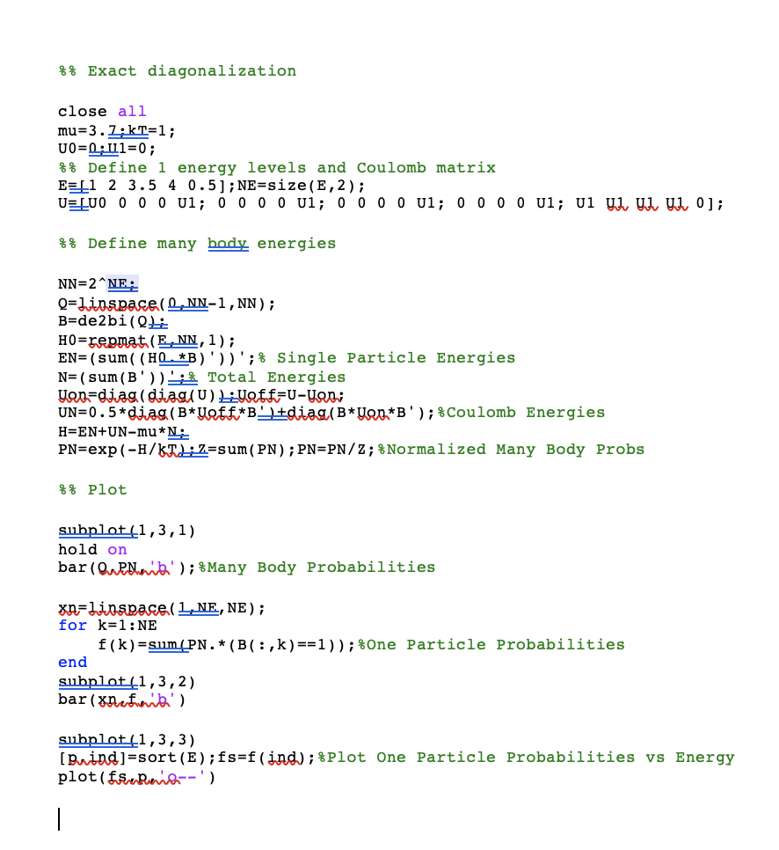

Slide 7
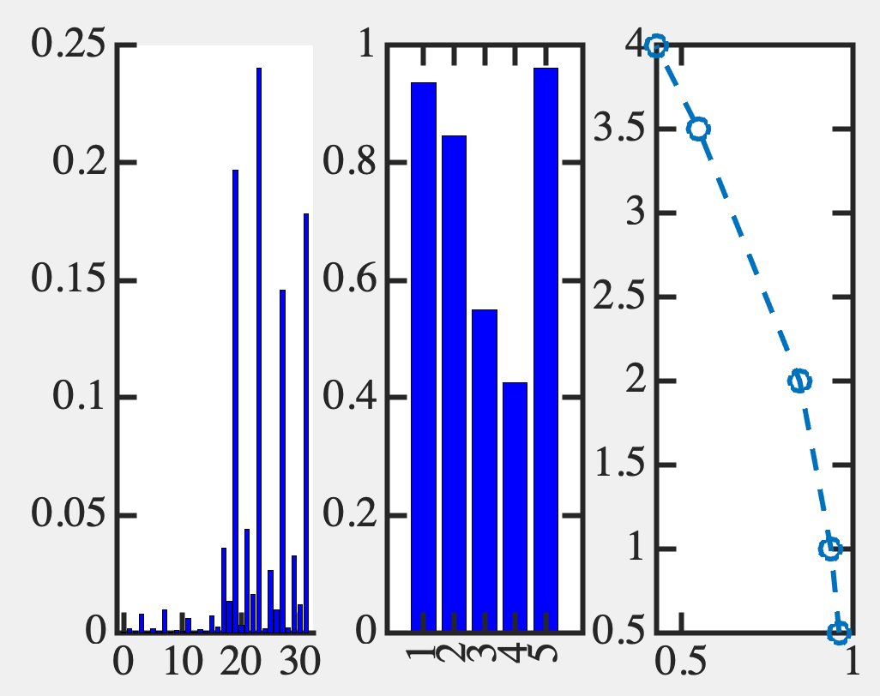
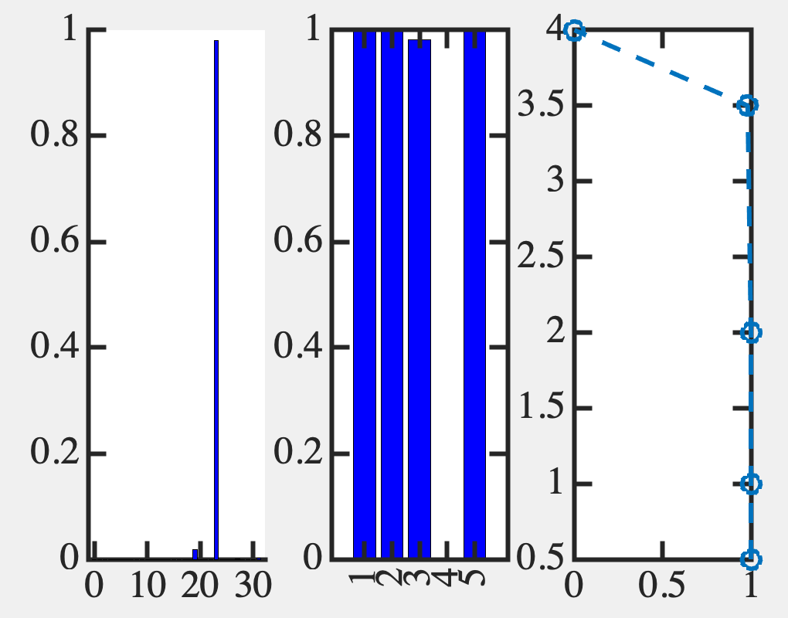
Exact solution (Fermi like)

Slide 8
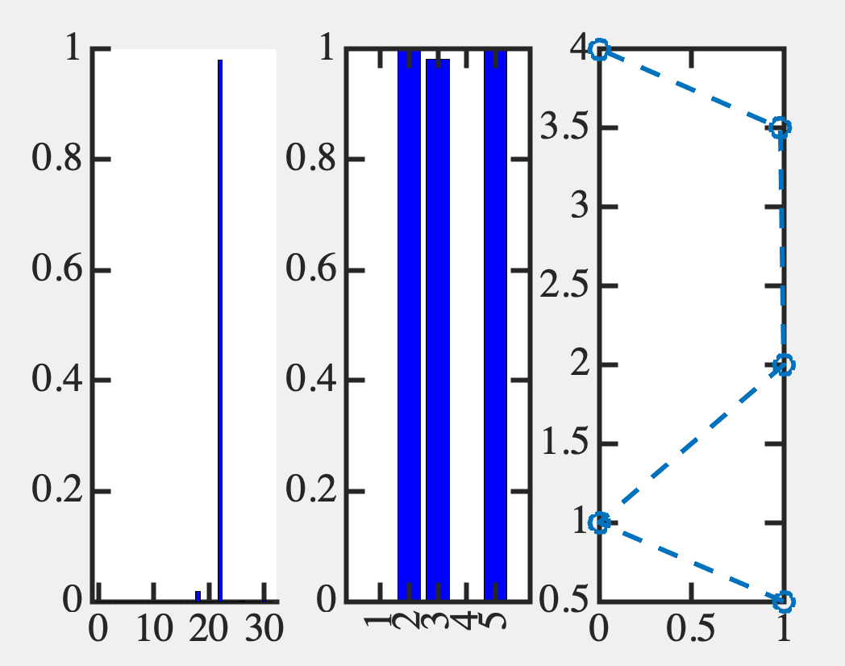
Exact solution (non Fermi like)

Slide 9
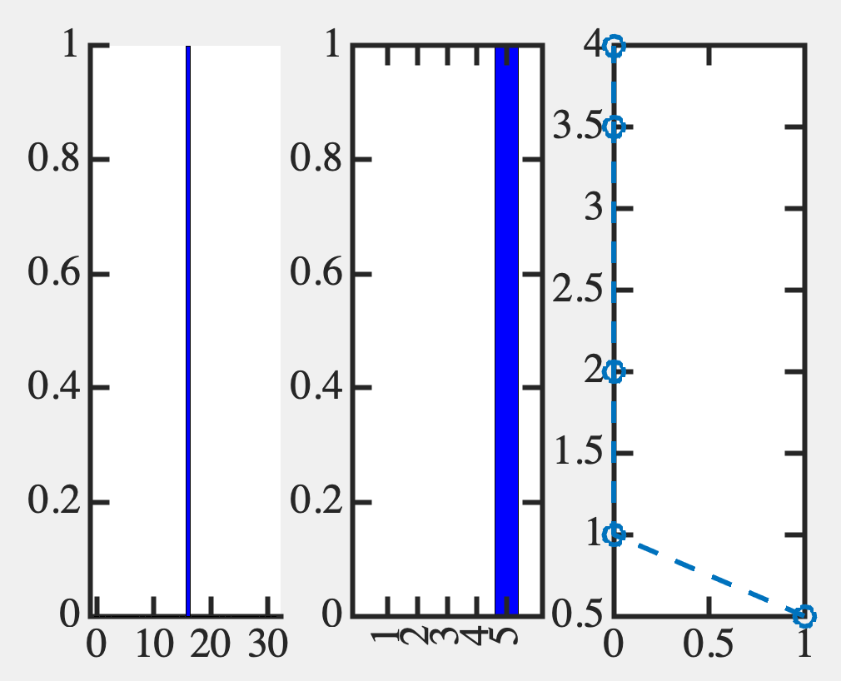
Exact solution (non Fermi like)

Slide 10
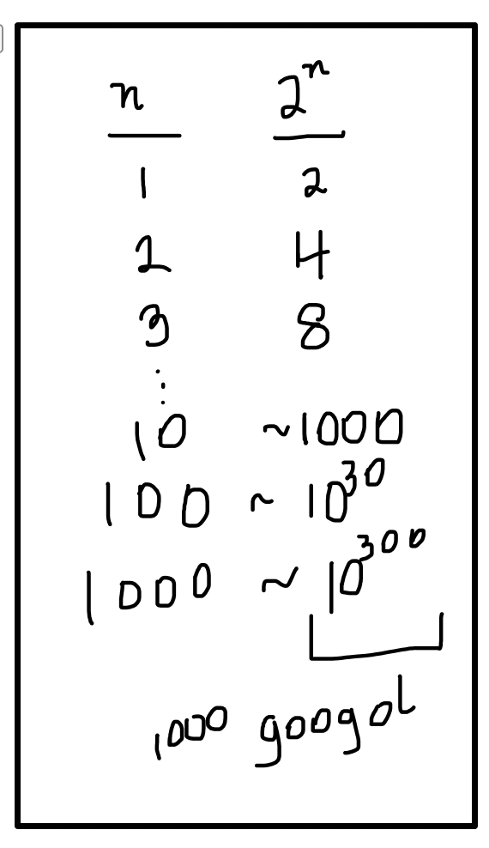
OK, so Boltzmann law works but only
in 2^{n} space, & this is not practical !!!

Slide 11
Can we work in n x n space approximately?
Yes !! Much of condensed matter physics
But it needs dynamics and good guesses

Slide 12
Look at 1-electron sector
We can replicate that approximately

