Slide 1
7D. The self-consistent field
approach in n-space

Slide 2
Remember the exact approach

Slide 3
Approximate now

Slide 4
Approximate now
This is an approximation because the form of f can
be more complicated with interactions

Slide 5
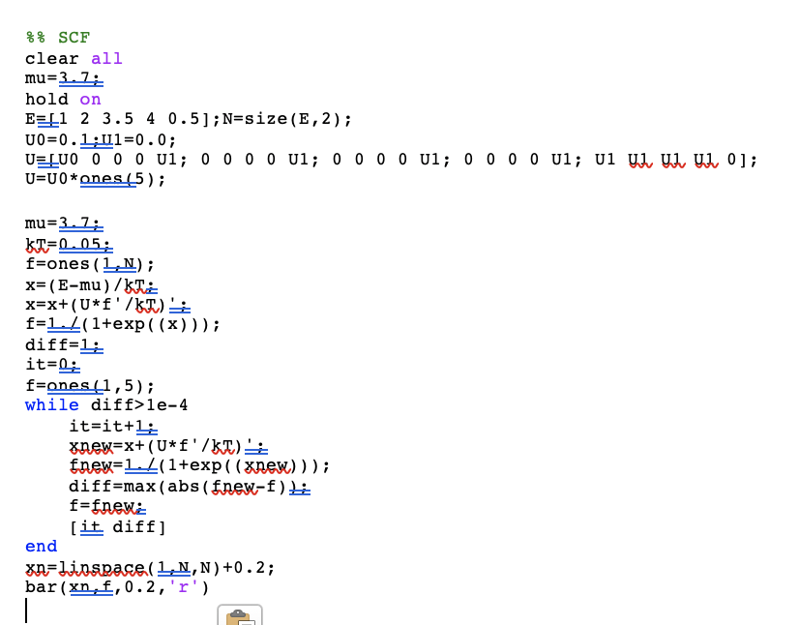

Slide 6
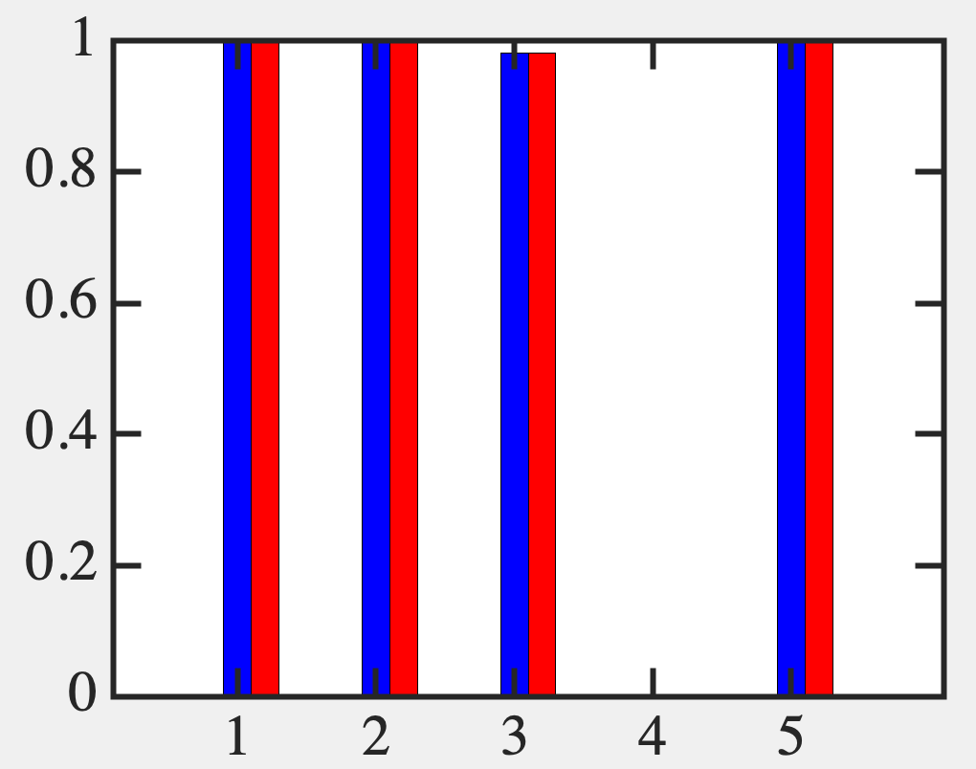
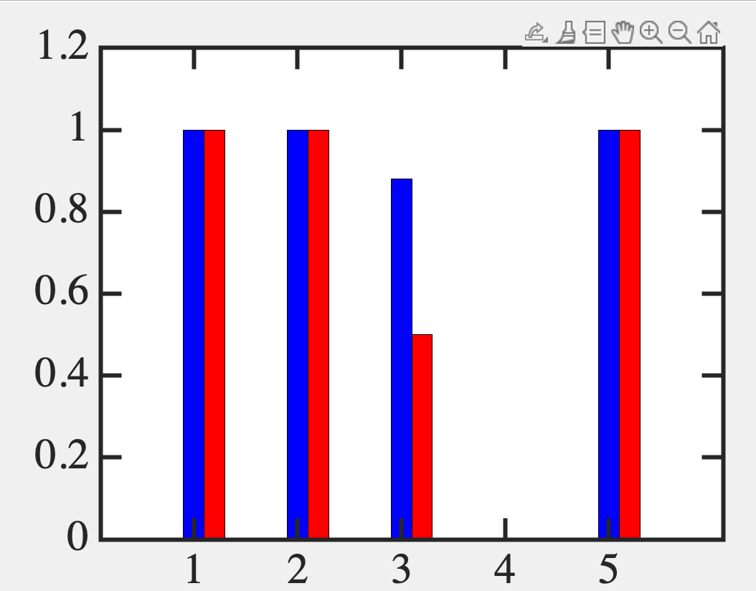
Replicates 1 electron sector

Slide 7
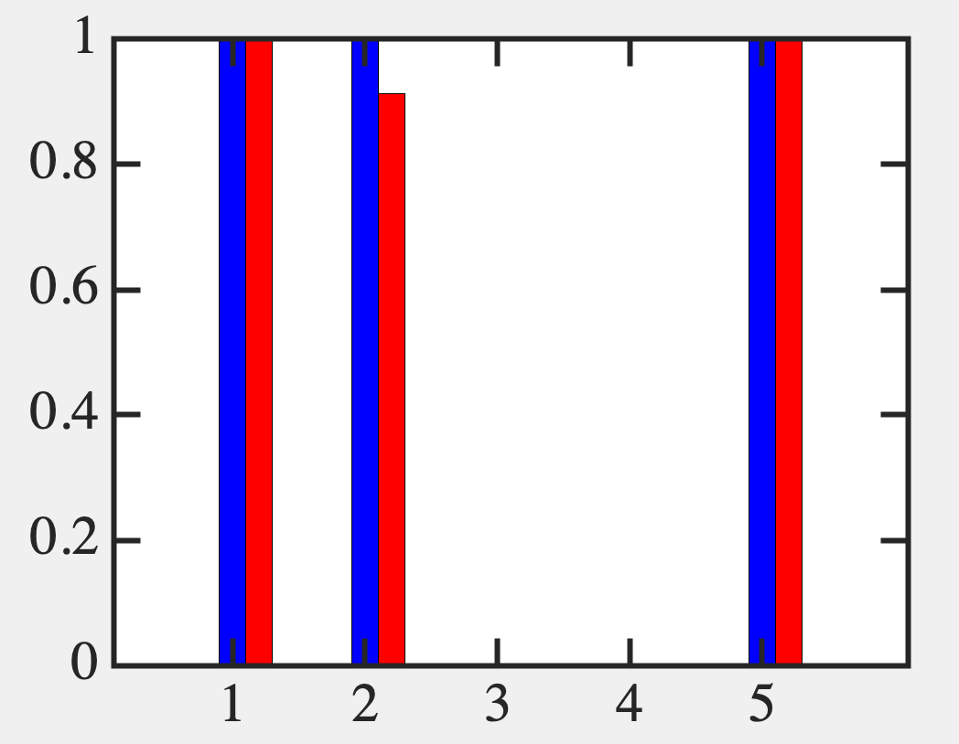
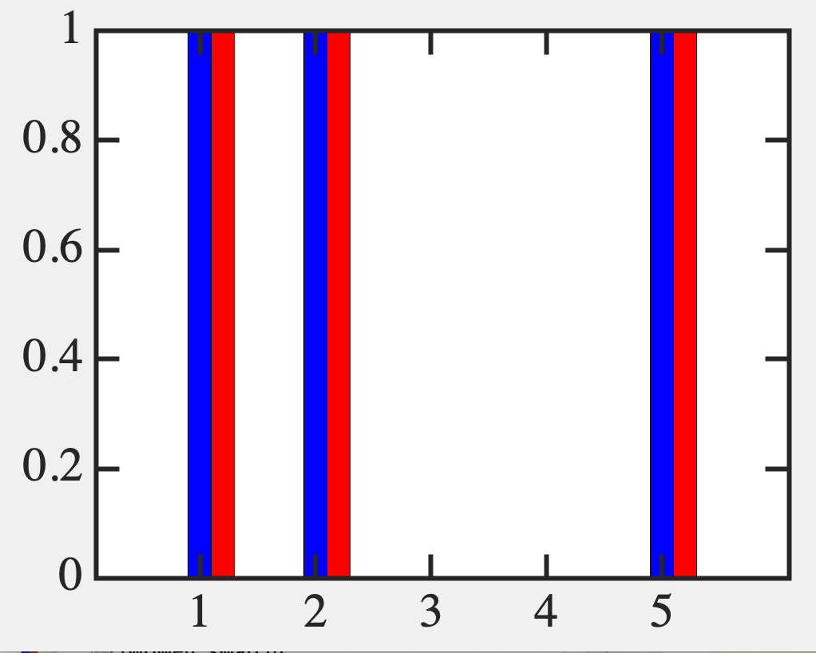
All to all
Plot new E
x*kT+mu

Slide 8
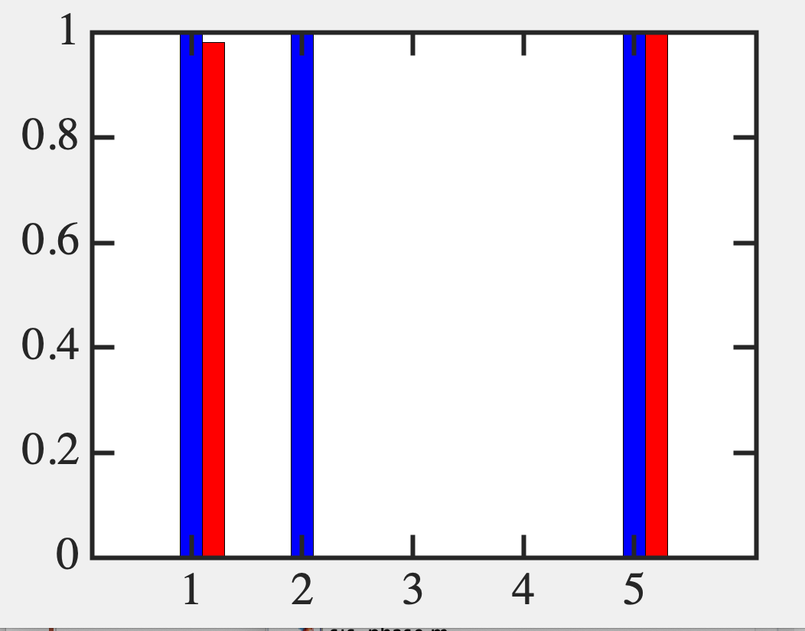
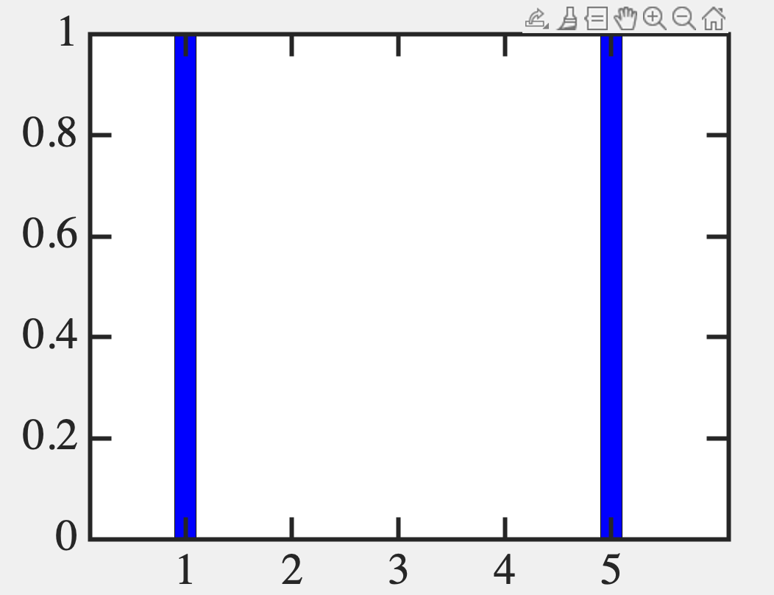
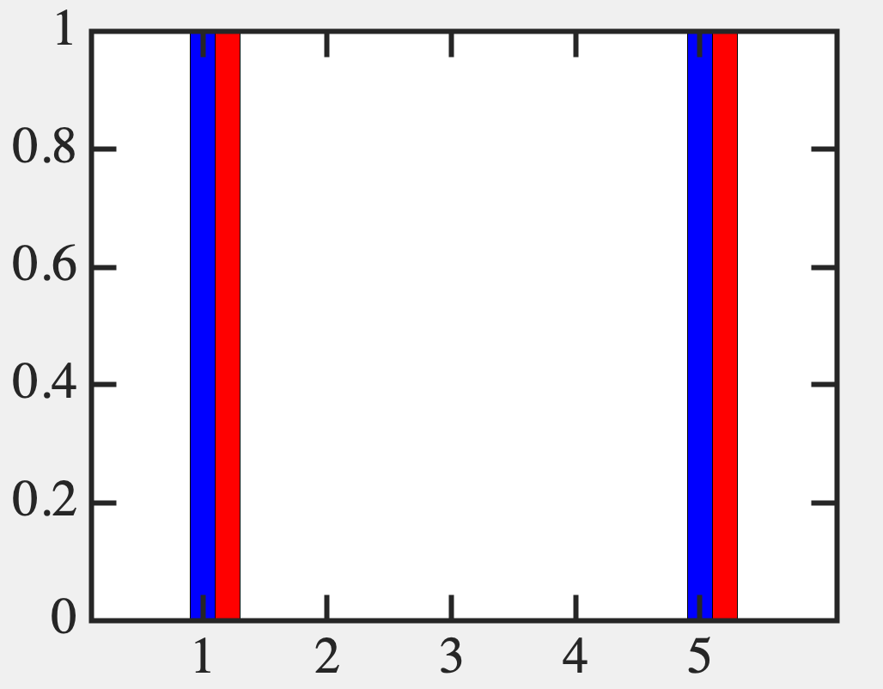
SCF is much more convenient !
(Working with n-space instead of 2^{n})
It is not good with higher Coulomb
unless you have the right guess

Slide 9
Most theories of Magnetism and Superconductivity

Slide 10
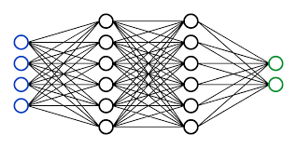
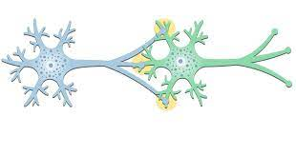
Condensed Matter Physics → For a given set of [Us]
ML/AI → Reverse engineer U to achieve a certain goal

Slide 11
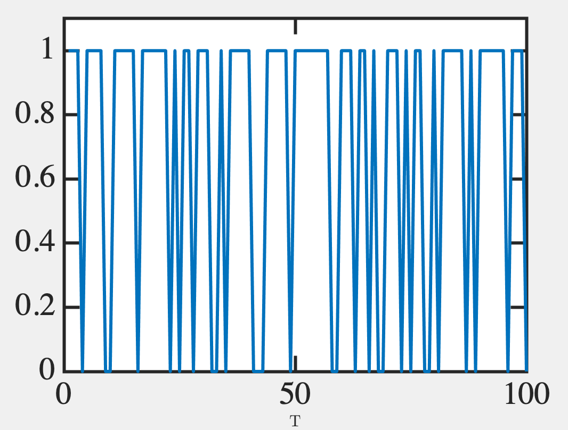
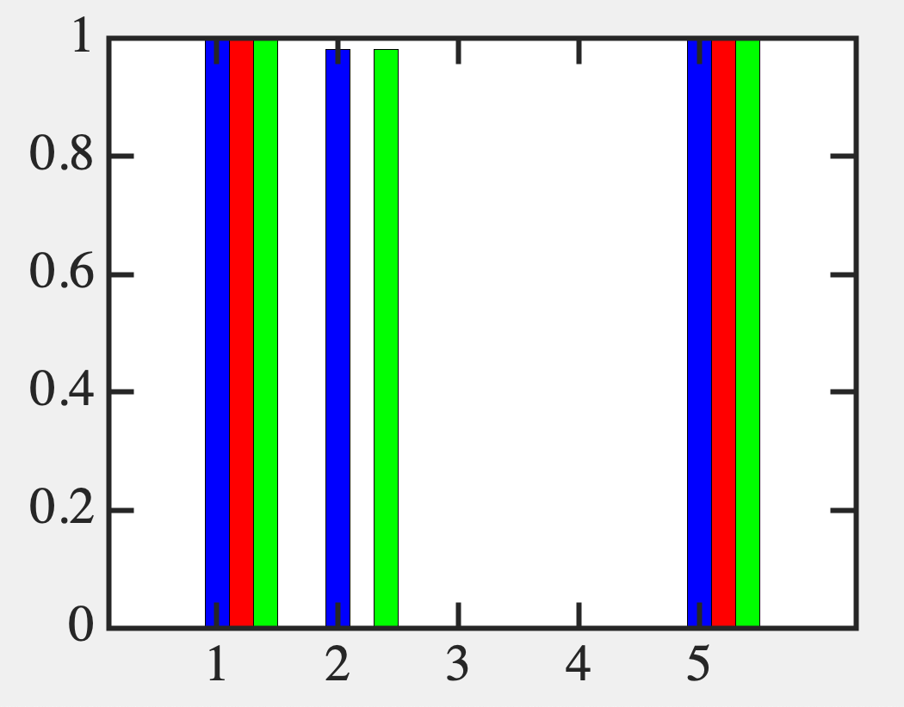
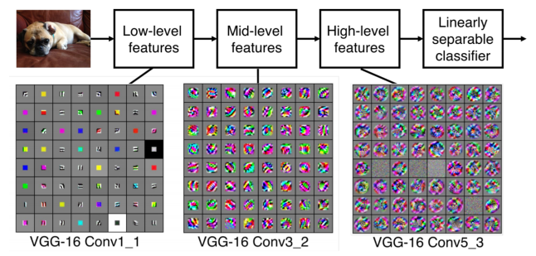
Fundamentals of Computing
Lec 8
Time Sampling
0.7
11111111
11111111
11111111
11001000
11001000
01100100
00011001
00000000
Monte Carlo
Support Vector Machines
Backpropagation
Convolutional Neural Nets
Edges, curves
Paws, flippers, hands
Face, Skin, Eyes

