Slide 1
Fundamentals of Computing
Lec 7
Boltzmann Machines

Slide 2
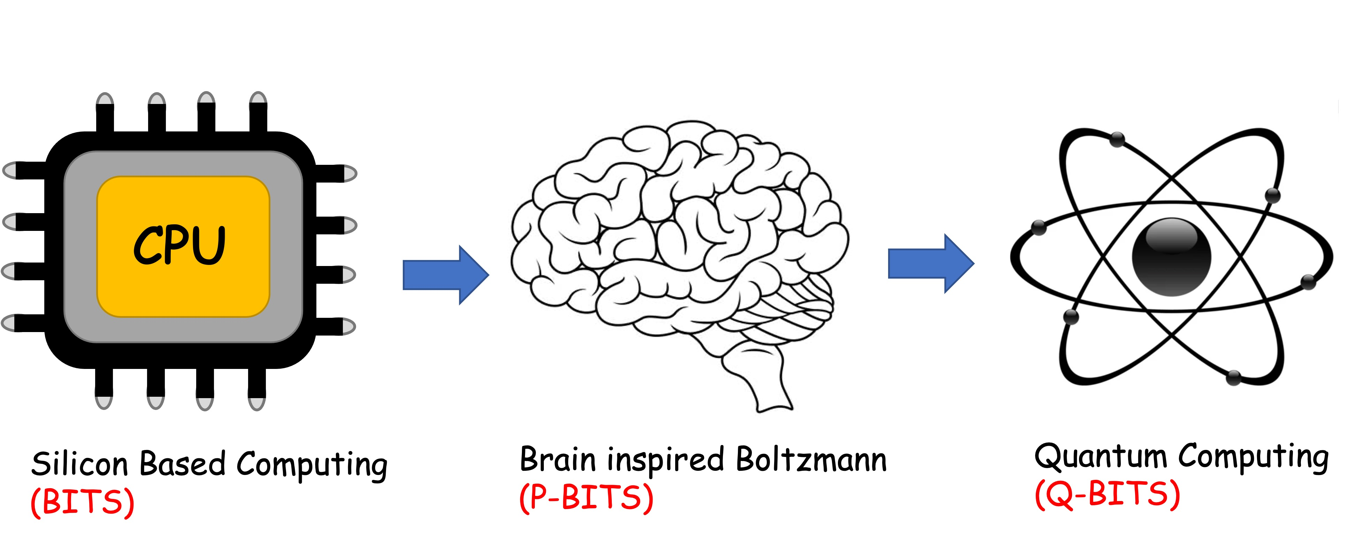
Overall structure of this course
Analog Computing in Carbo
How we train (Supervision)
Physics of Neurons (Boltzmann)
How we learn (time sampling)
Optimizing and Classifying
Transition Theory & Inferencing
Quantum Computing in Magneto
Quantum Spins and Hardware
Interacting Spins
Going parallel: Quantum Physics
Entanglement and Superposition
Cloning and Key Distribution
Quantum Search and Annealing
Quantum Gates and Factorization
Digital Computing in Silico
How we compute (algorithms)
How we add (Gates)
How we add quickly (CMOS)
How we fix errors
Thermodynamics of Computing

Slide 3
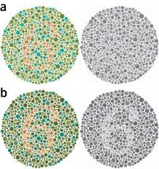
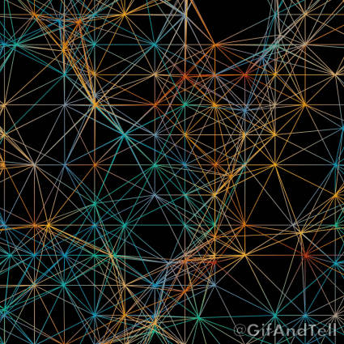
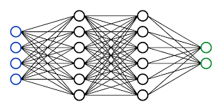
Analytical thinking
Ability to segregate objects
measurably so we can count
Static datastreams so we can fixate
Logical thinking
Ability to learn & infer
(interpolate & extrapolate)
Depth of Neurons
Speed of CMOS
Architecture of GPUs
https://gifandtell.wordpress.com/2015/09/21/displaced-dots-33-connected-chaos/

Slide 4
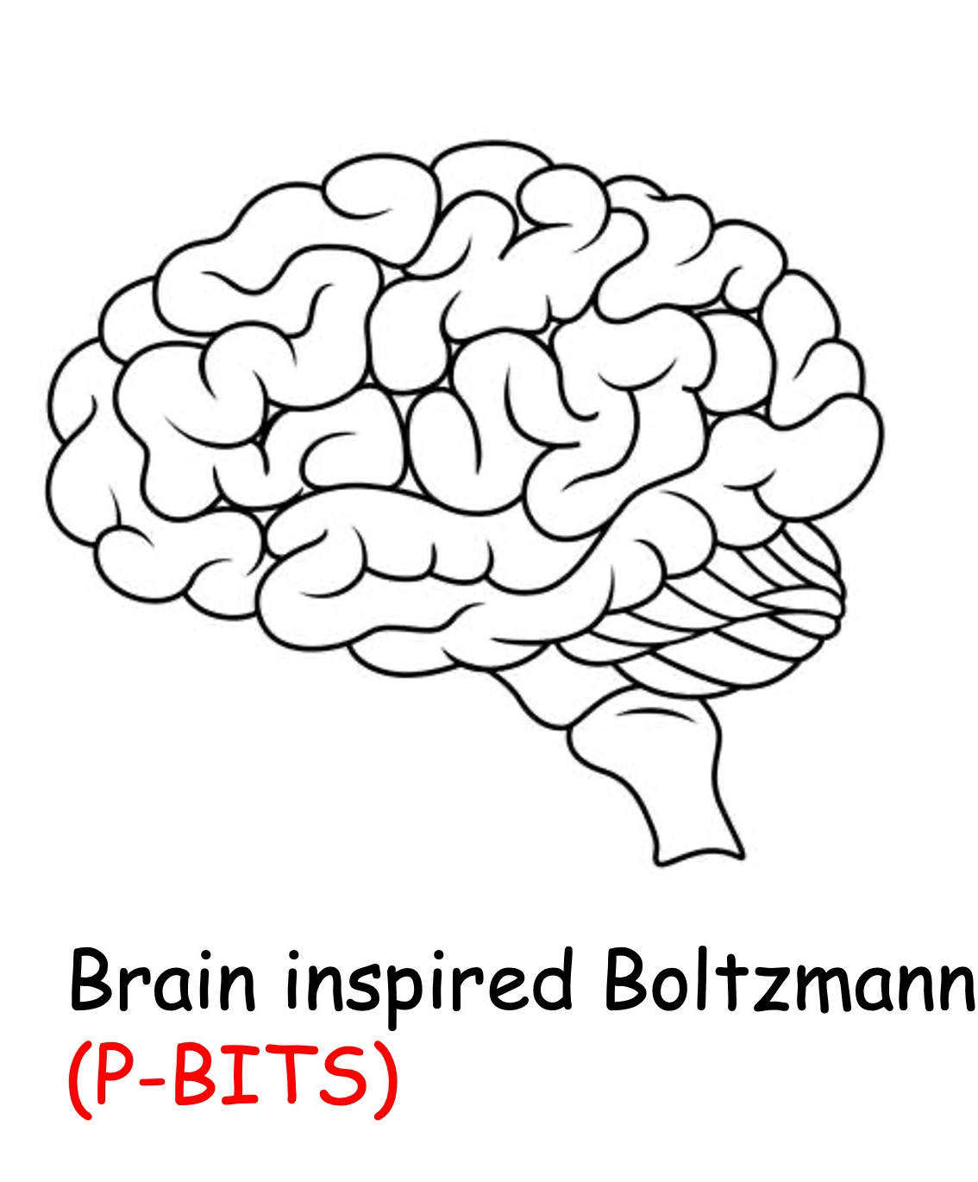

Slide 5
Neuro-synaptic systems can be programmed to solve very large optimization problems approximately at moderate speeds

Slide 6
What is the underlying physics of interacting neurons?
What is the underlying physics of coupled binary variables?

Slide 7
7A. Configuration Space

Slide 8
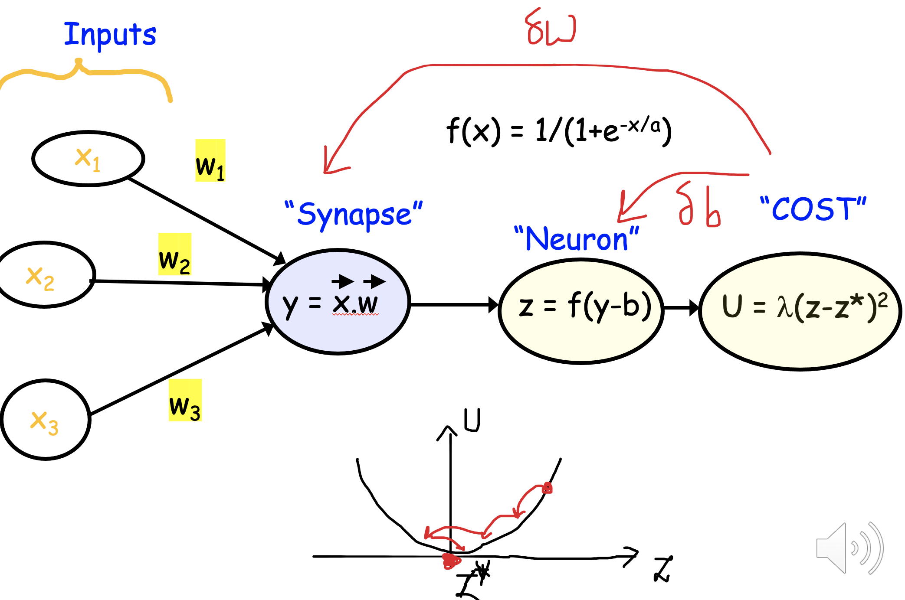
State Space of Neurons

Slide 9
More on State Space
How does nature decide with electrons?
Decision making moves you to a ‘ground state’..
This means energy must leave the system through friction
A larger reservoir at equilibrium must siphon out this energy
(and/or particles) through continuous exchange
The reservoir sets the average energy
with a temperature, and the average particle
number with a chemical potential

Slide 10
Intuitive description of the ground state configuration
Lower energies occupied
Fermi
Energy
(See Lec 3B)

Slide 11
However, this is only one out of many configurations

Slide 12
n-State Space → 2^{n} configuration space

Slide 13
Boltzmann Law in 2^{n} configuration space

Slide 14
Z is normalization (Partition Function)

Slide 15
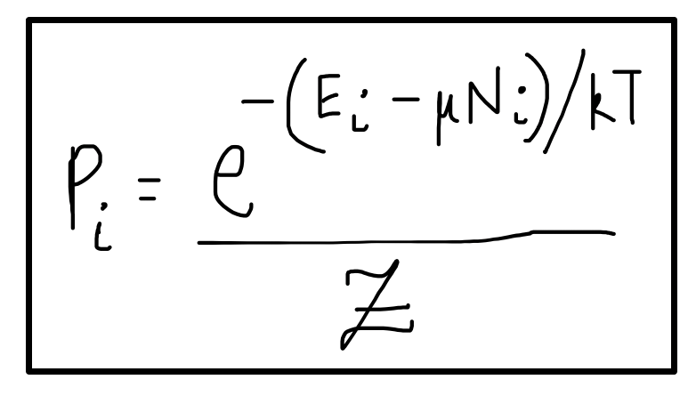
Case 1: 1 energy level

Slide 16
The one particle version
Fairly intuitive !

Slide 17
Case 2: 2 independent levels

Slide 18
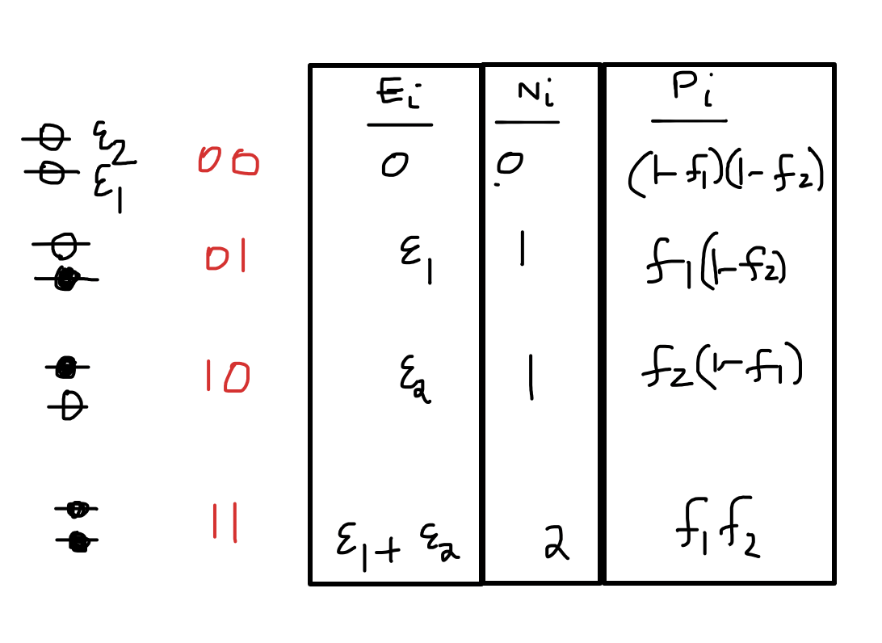
Occupancy of each level
Still intuitive !

Slide 19
Occupancy of each level

Slide 20
Case 3: 2 interacting levels

Slide 21
Reinterpreting

Slide 22
Occupancy of each level
Not that intuitive !!!

Slide 23
For interacting systems, we can no longer
use simple n-state approximations like f(x).
The answer can be hopelessly complicated,
not generalizable, and only extracted in 2^{n} space where Boltzmann law still persists

Slide 24
But why does Boltzmann law work
in 2^{n} space ?

Slide 25
7B. Boltzmann physics in
configuration space

Slide 26
Equilibrium with a reservoir
(with many more levels and modes)
Energy conservation

Slide 27
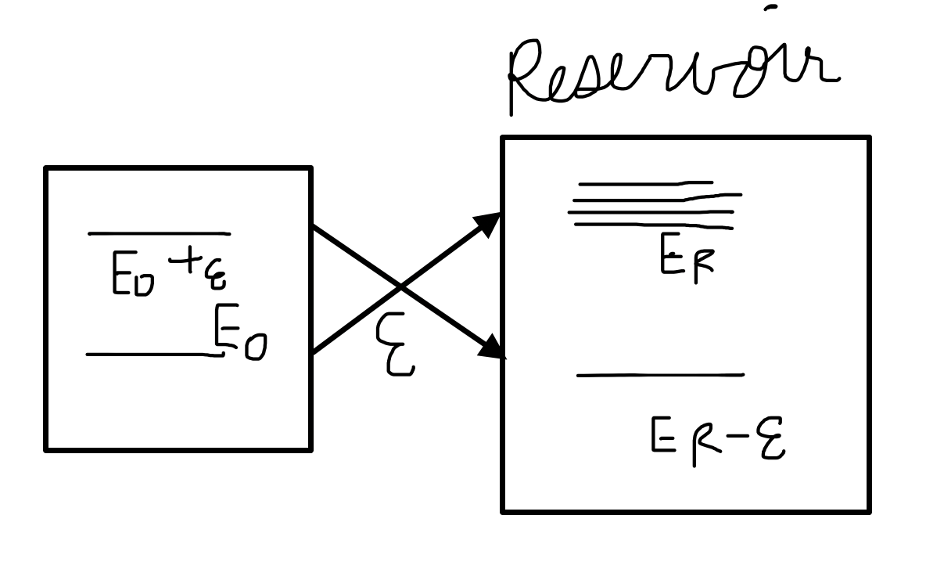
Reservoir has many more states at higher energy
So it gets stuck there!

Slide 28
System stuck in lower energy system states
(many more reservoir states)

Slide 29
Same with particle exchange

Slide 30
Introduce a Helmholtz Free energy

Slide 31
For chemists (const temperature, pressure)

Slide 32
For chemists (const temperature, pressure)

Slide 33
From a probability distribution

Slide 34
From a probability distribution

Slide 35
Differentiate

Slide 36
Substitute

Slide 37
For other non-optimal probability distributions

Slide 38
Gibbs Inequality

Slide 39
So nature tries to minimize F
and adjusts probability distributions p*
accordingly at equilibrium
Any nonequilibrium p ≠ p* will give higher F

Slide 40
7C. Implementing Boltzmann
in 2^{n} space

Slide 41
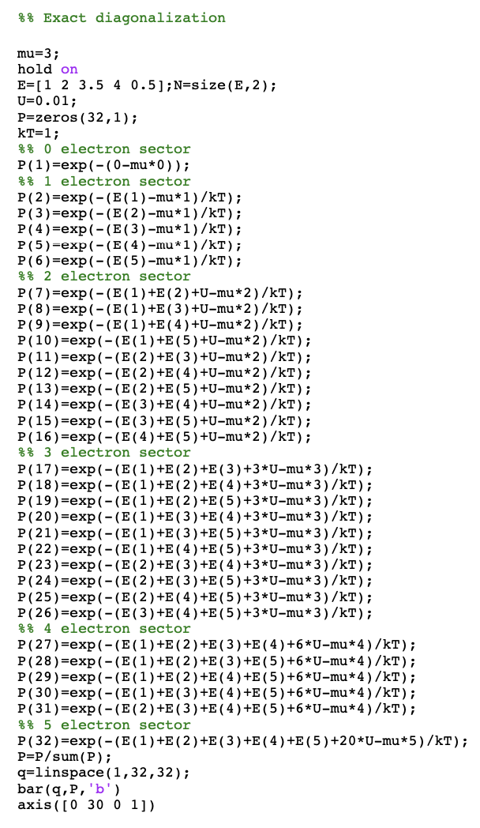
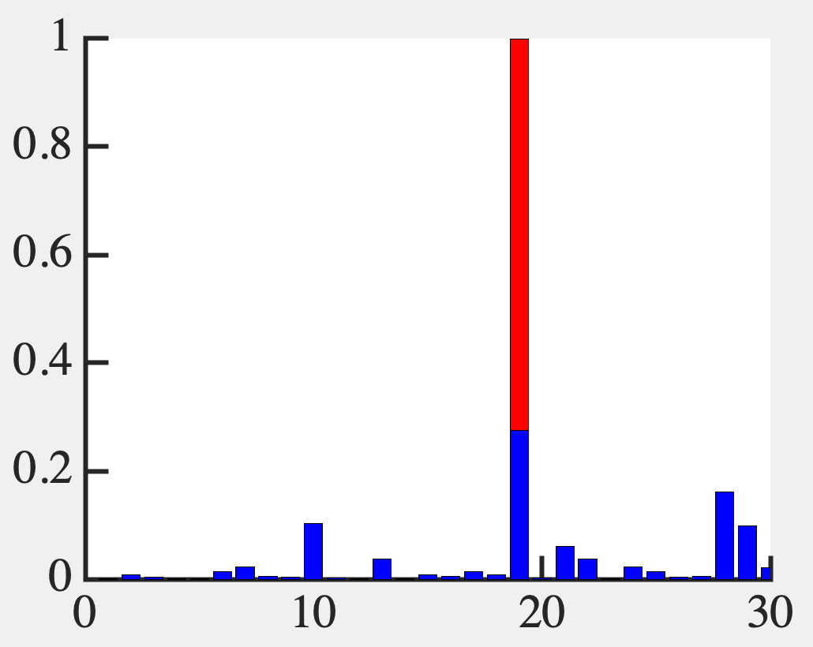
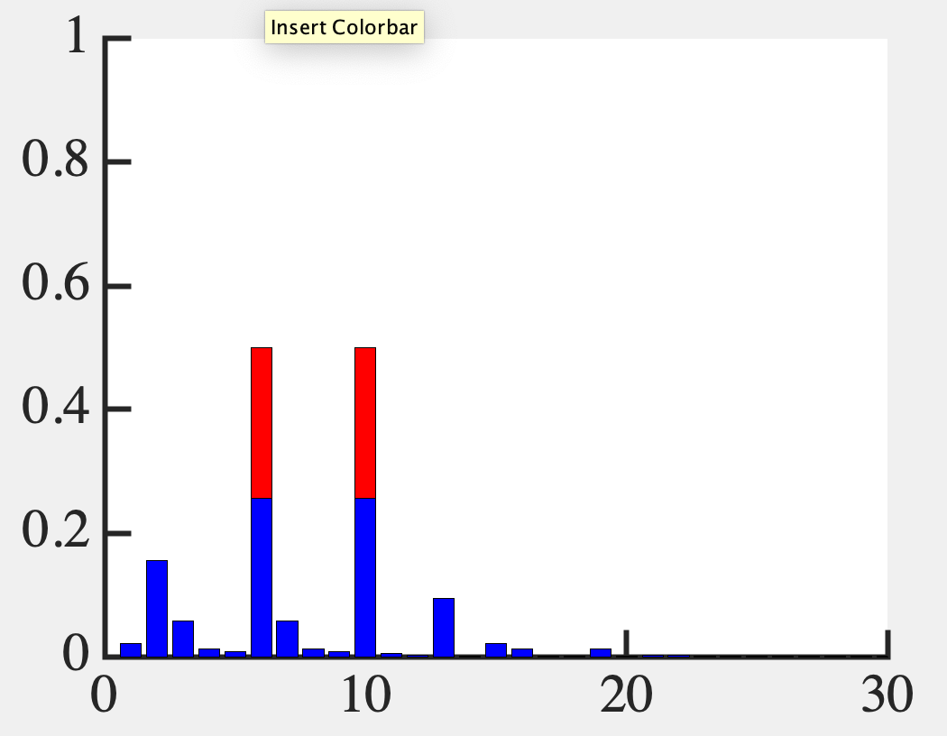
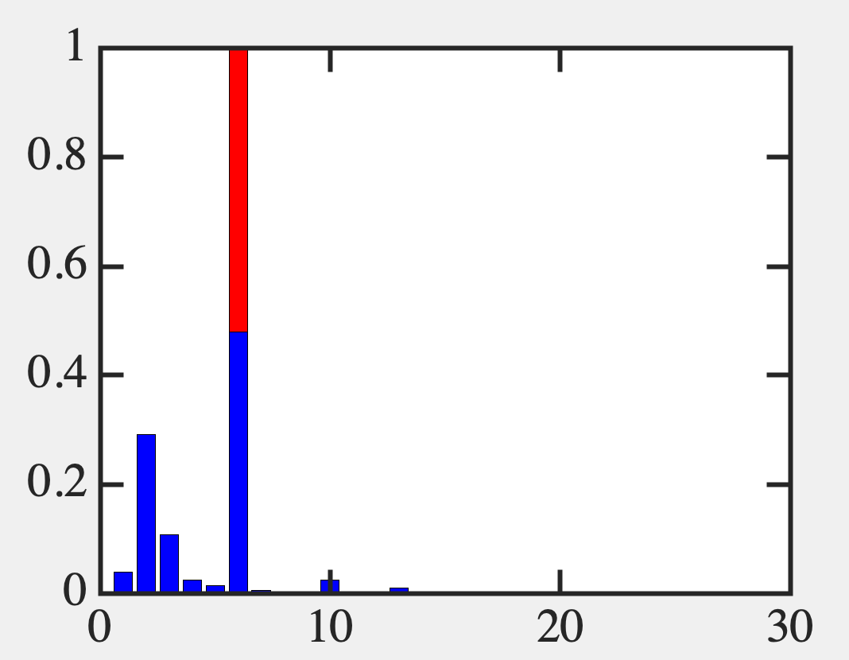
Let’s do the exact problem first
U=0.01
U=2
U=5

Slide 42
Can automate this a bit…

Slide 43
Coulomb

Slide 44
Exact solution

Slide 45
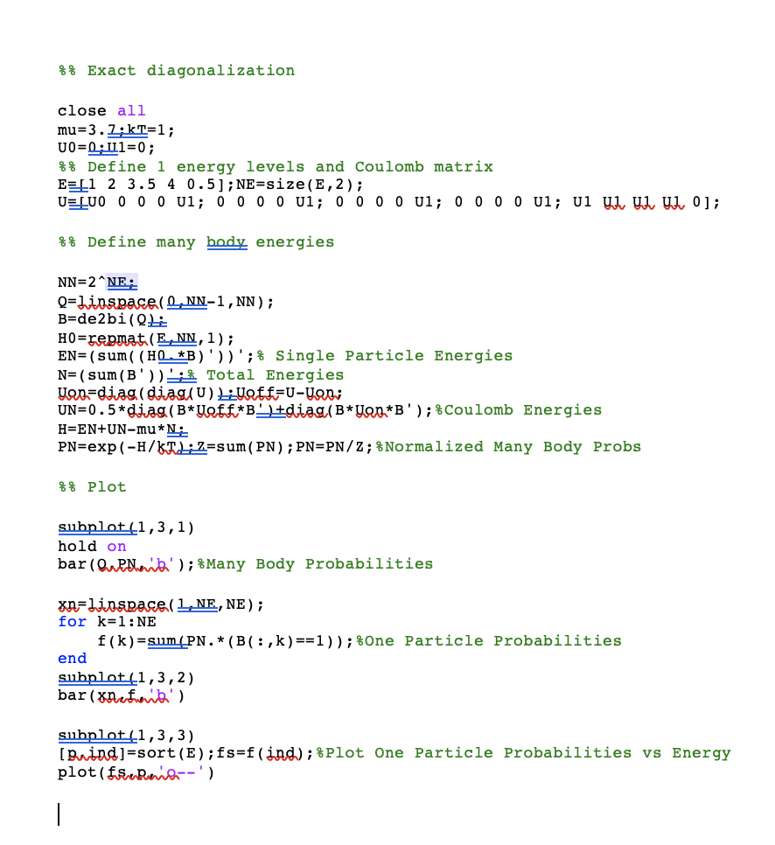

Slide 46
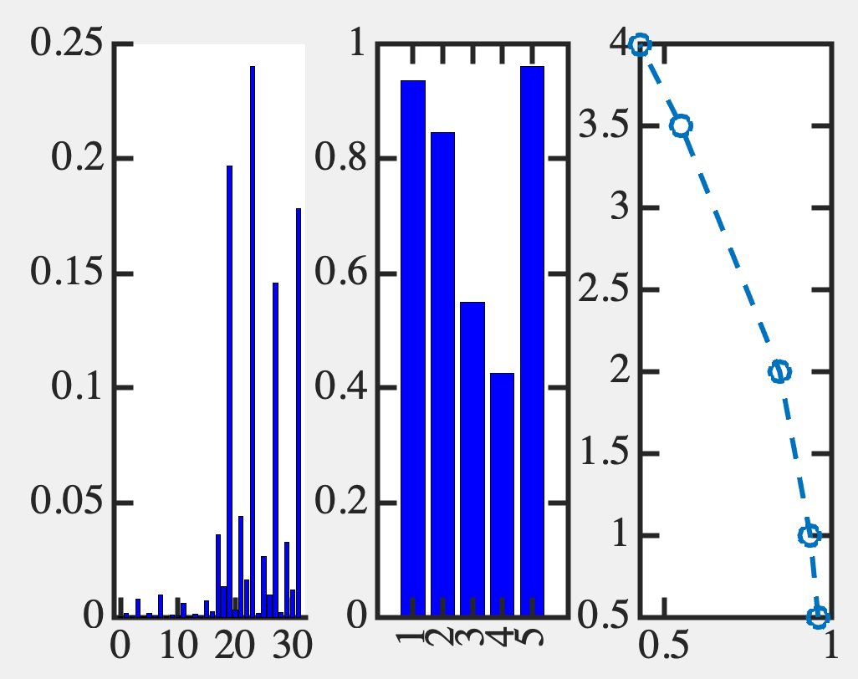
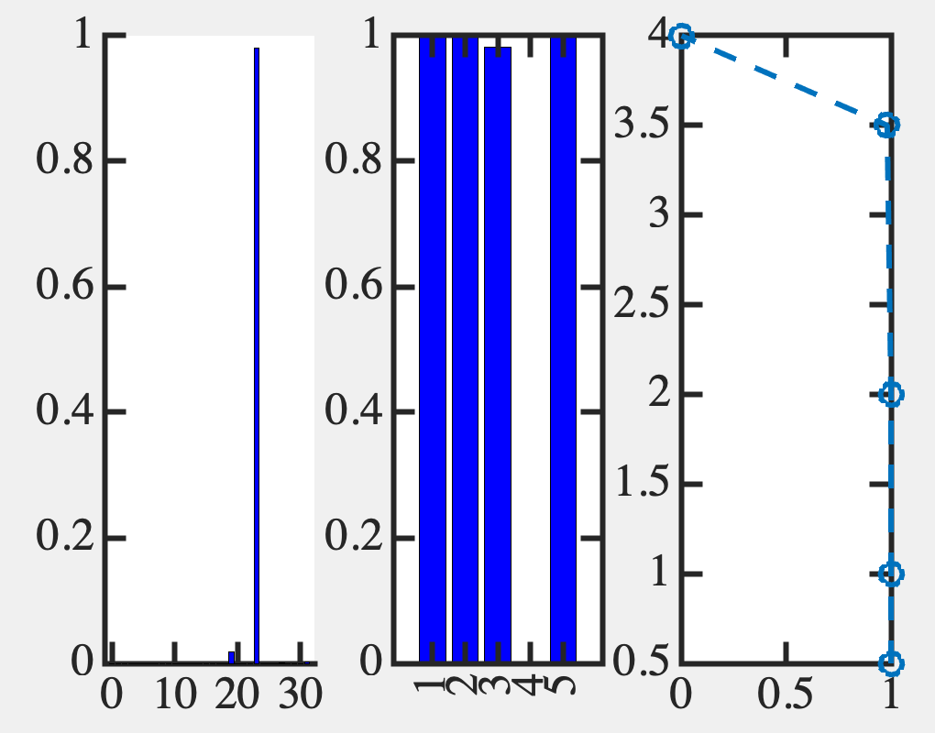
Exact solution (Fermi like)

Slide 47
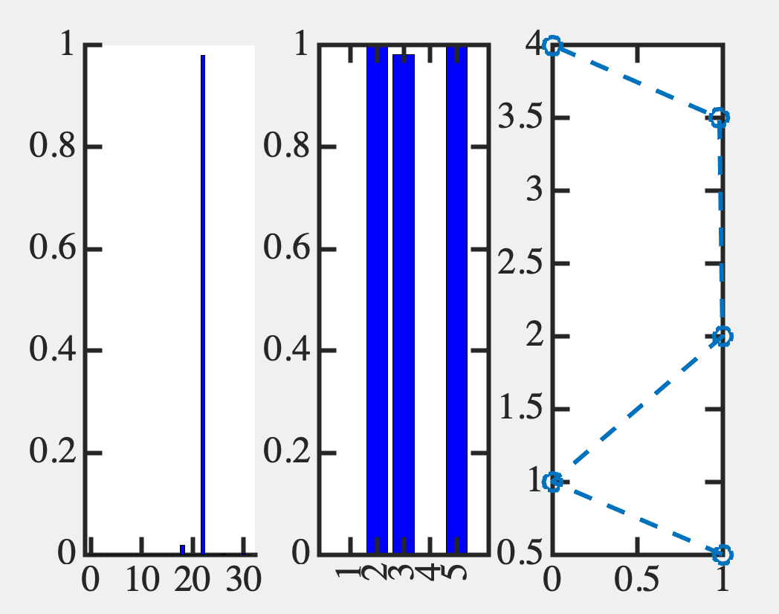
Exact solution (non Fermi like)

Slide 48
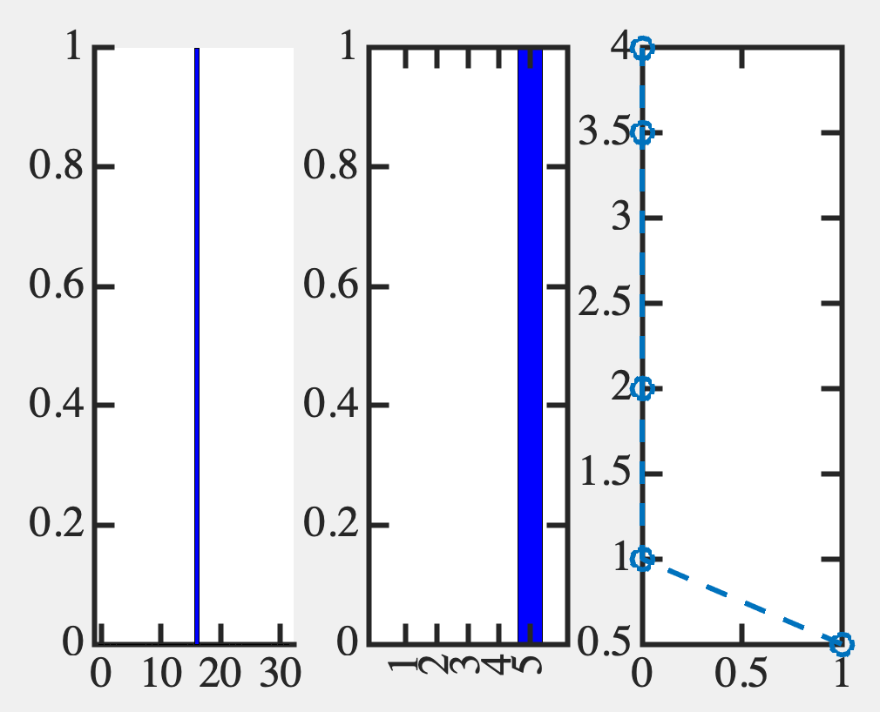
Exact solution (non Fermi like)

Slide 49
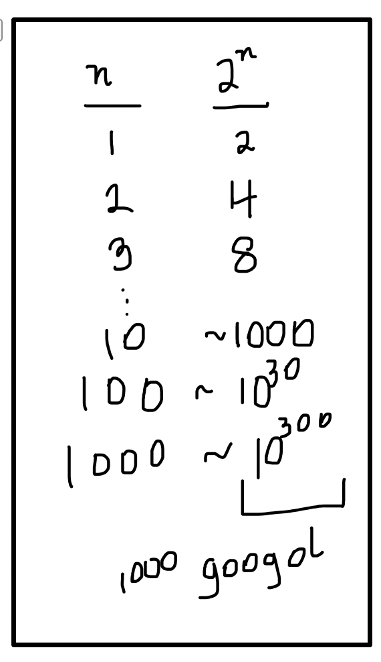
OK, so Boltzmann law works but only
in 2^{n} space, & this is not practical !!!

Slide 50
Can we work in n x n space approximately?
Yes !! Much of condensed matter physics
But it needs dynamics and good guesses

Slide 51
Look at 1-electron sector
We can replicate that approximately

Slide 52
7D. The self-consistent field
approach in n-space

Slide 53
Remember the exact approach

Slide 54
Approximate now

Slide 55
Approximate now
This is an approximation because the form of f can
be more complicated with interactions

Slide 56
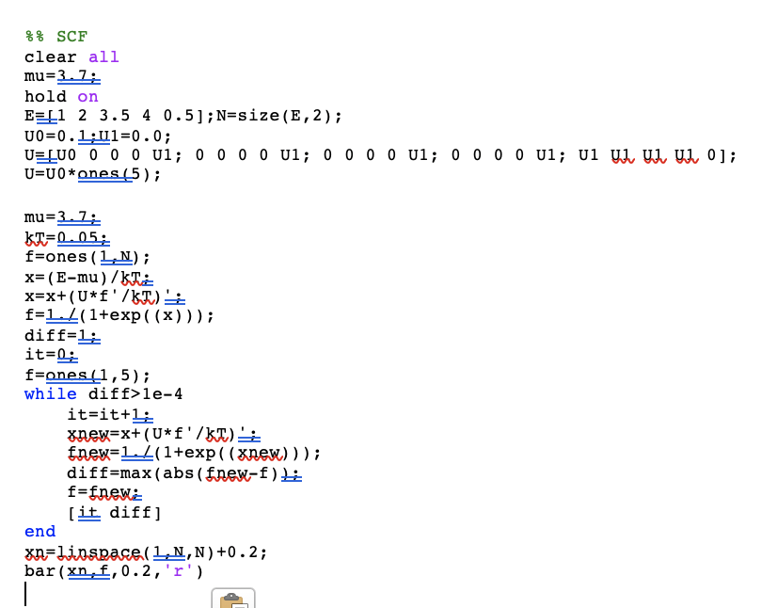

Slide 57
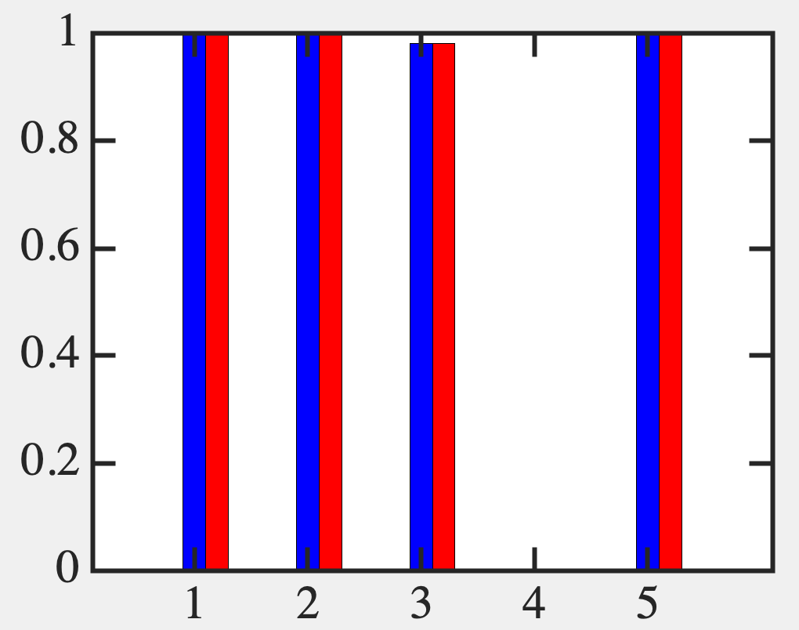
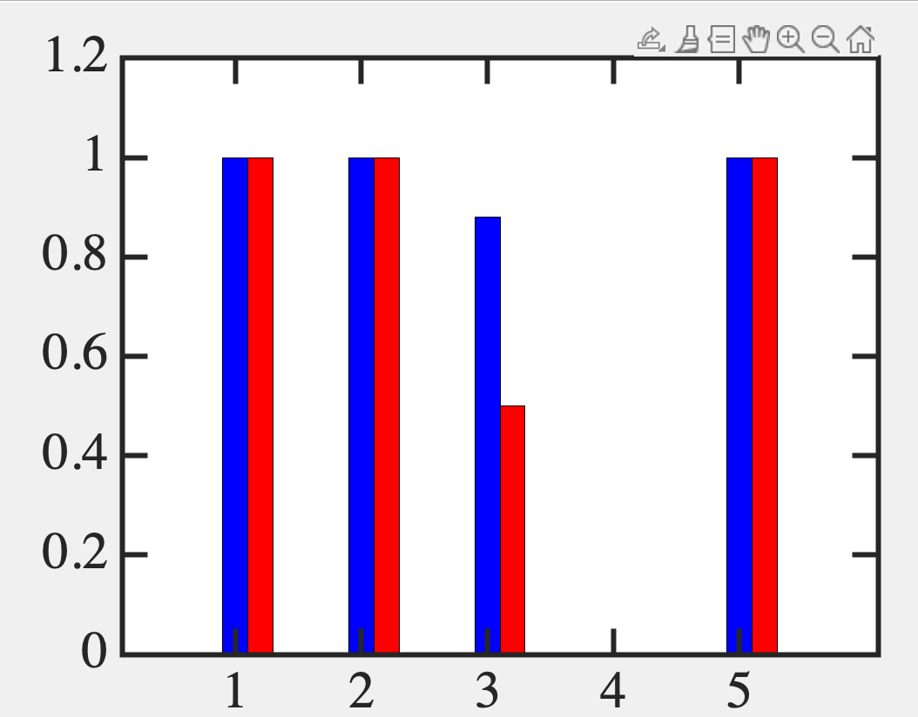
Replicates 1 electron sector

Slide 58
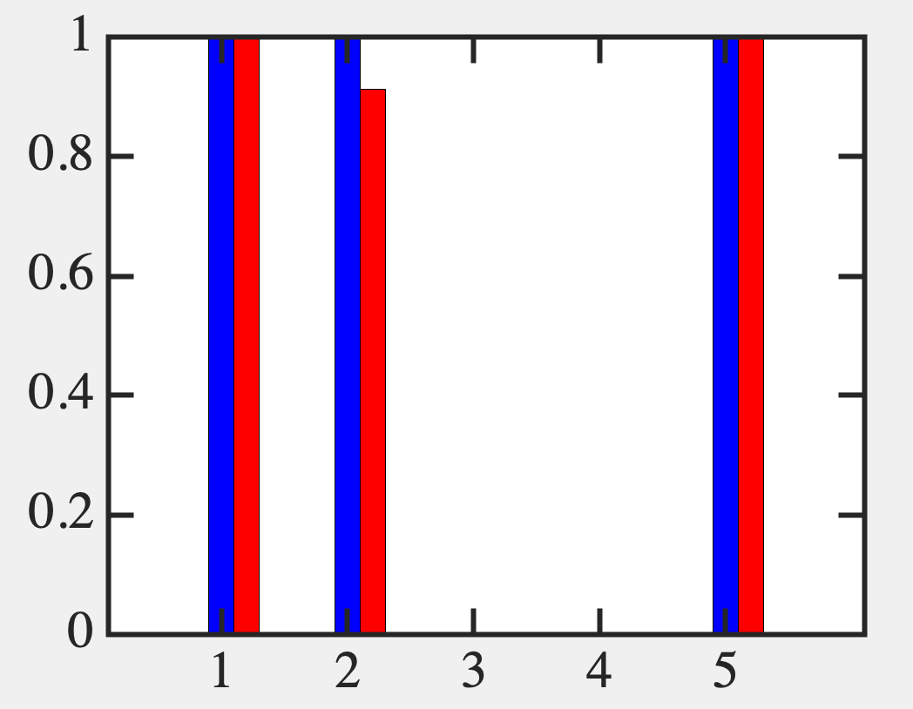
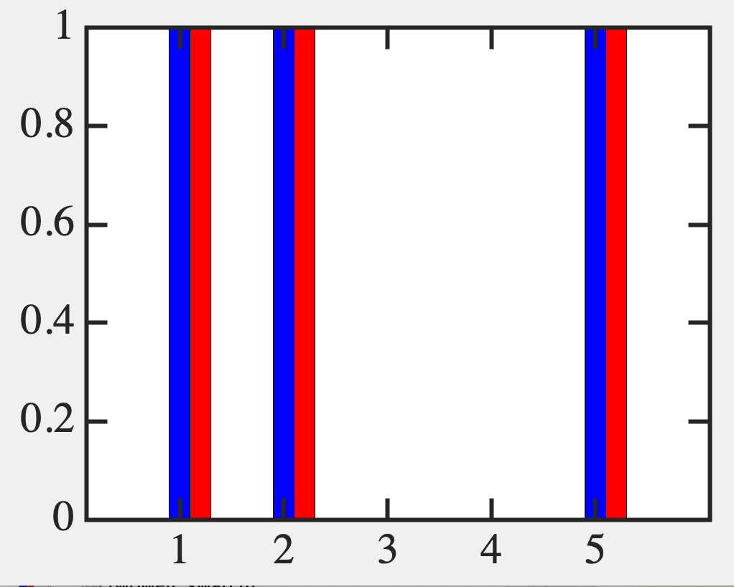
All to all
Plot new E
x*kT+mu

Slide 59
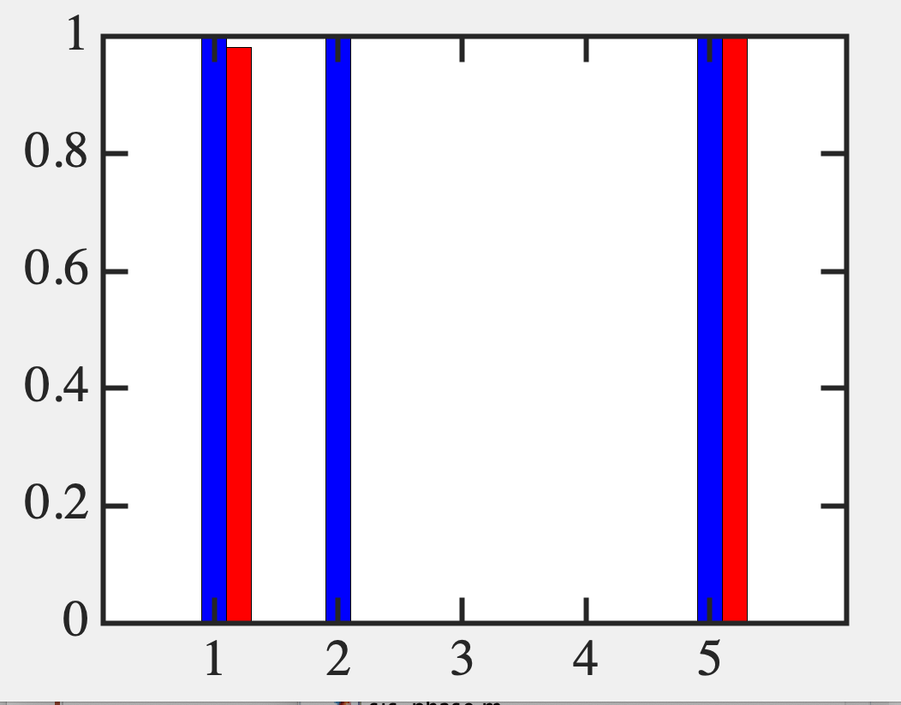
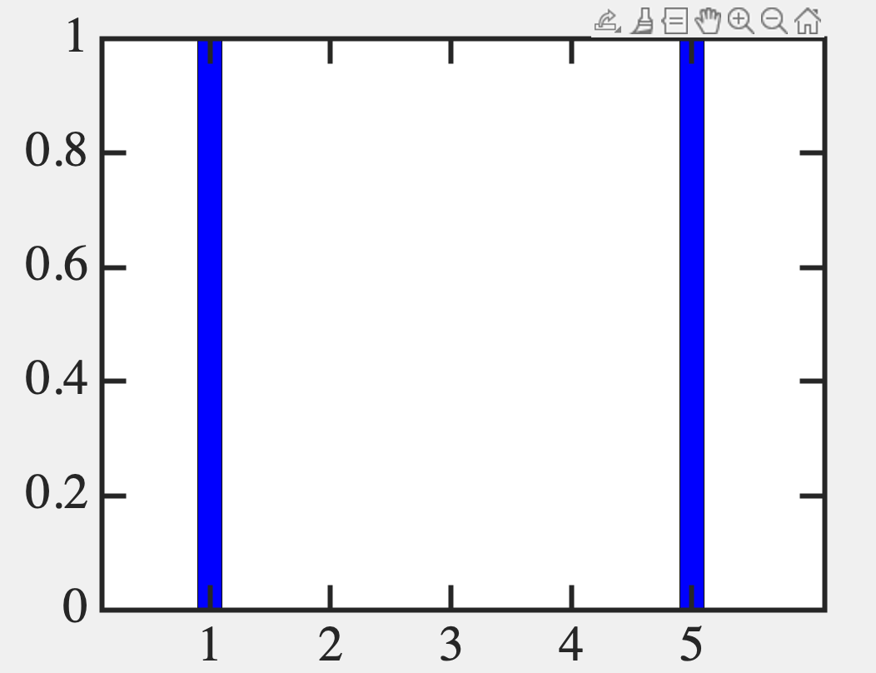
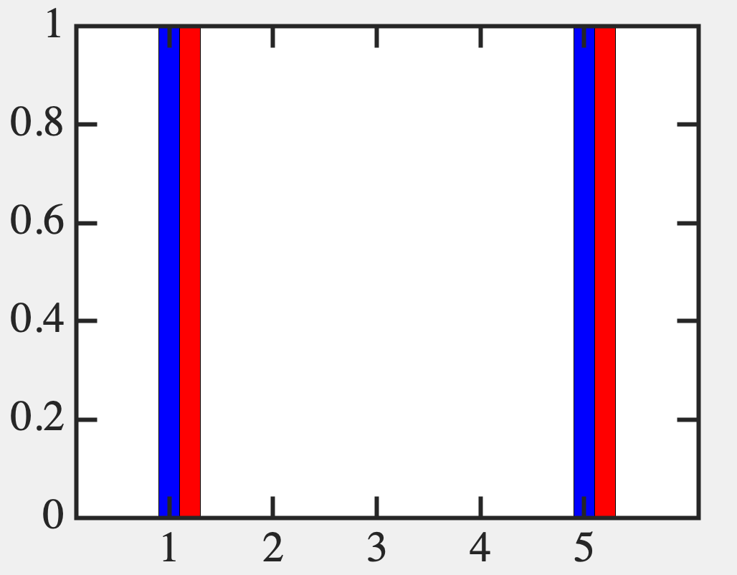
SCF is much more convenient !
(Working with n-space instead of 2^{n})
It is not good with higher Coulomb
unless you have the right guess

Slide 60
Most theories of Magnetism and Superconductivity

Slide 61
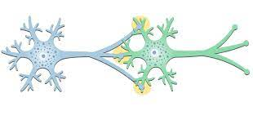
Condensed Matter Physics → For a given set of [Us]
ML/AI → Reverse engineer U to achieve a certain goal

Slide 62
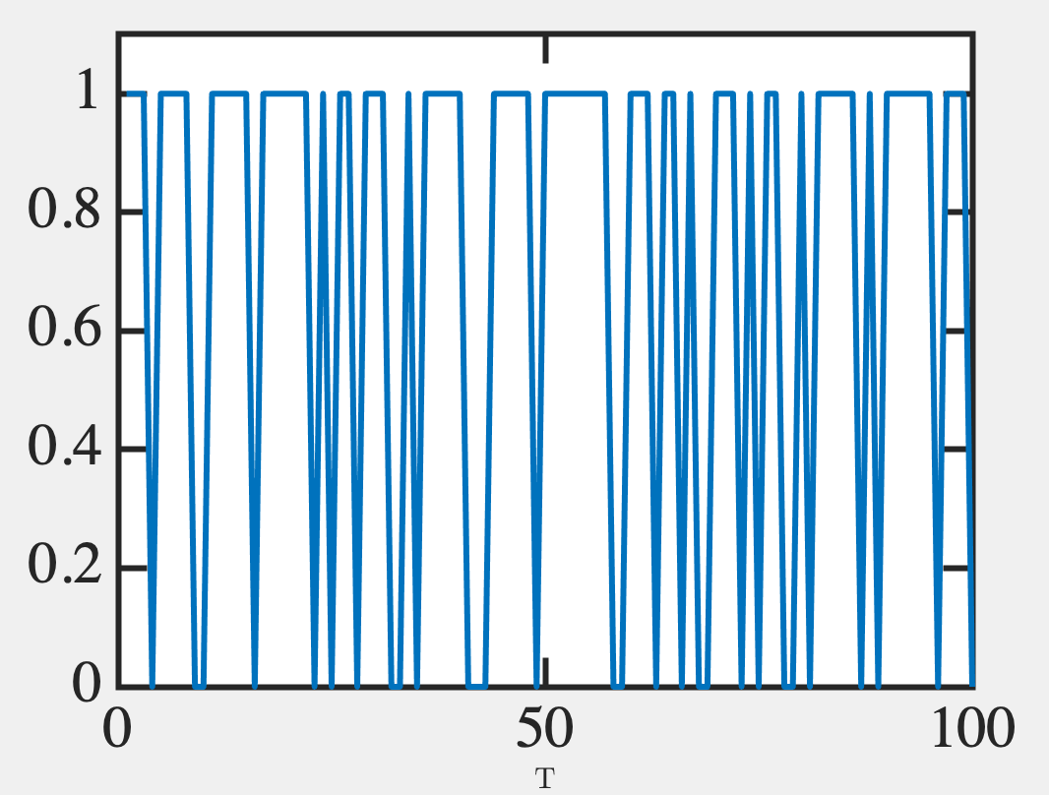
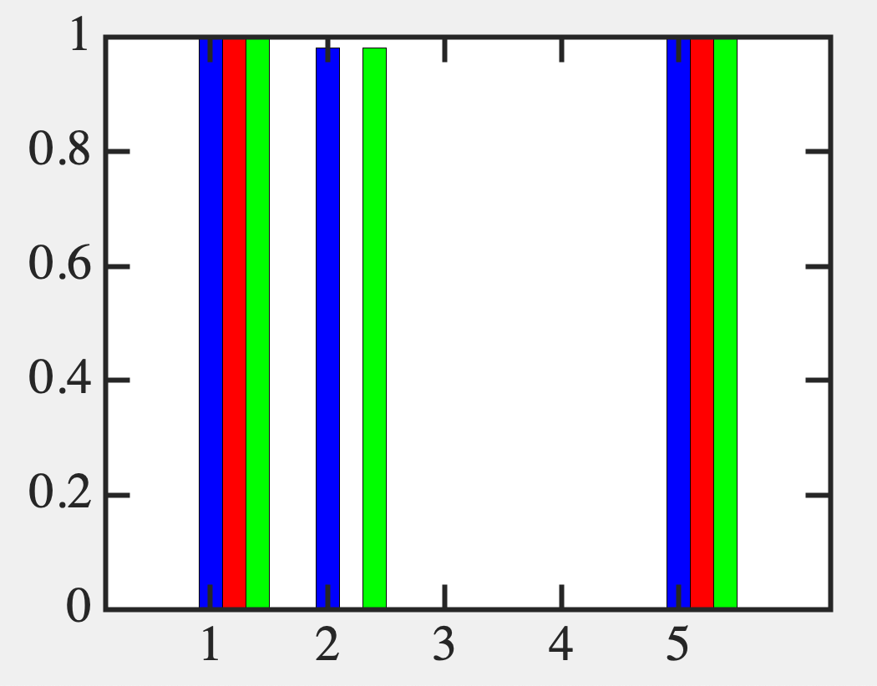
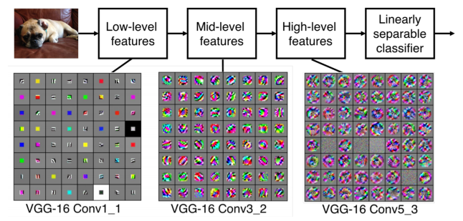
Fundamentals of Computing
Lec 8
Time Sampling
0.7
11111111
11111111
11111111
11001000
11001000
01100100
00011001
00000000
Monte Carlo
Support Vector Machines
Backpropagation
Convolutional Neural Nets
Edges, curves
Paws, flippers, hands
Face, Skin, Eyes

