Slide 1
Fundamentals of Computing
Lec 8
Time Sampling
Learning & Inferencing

Slide 2
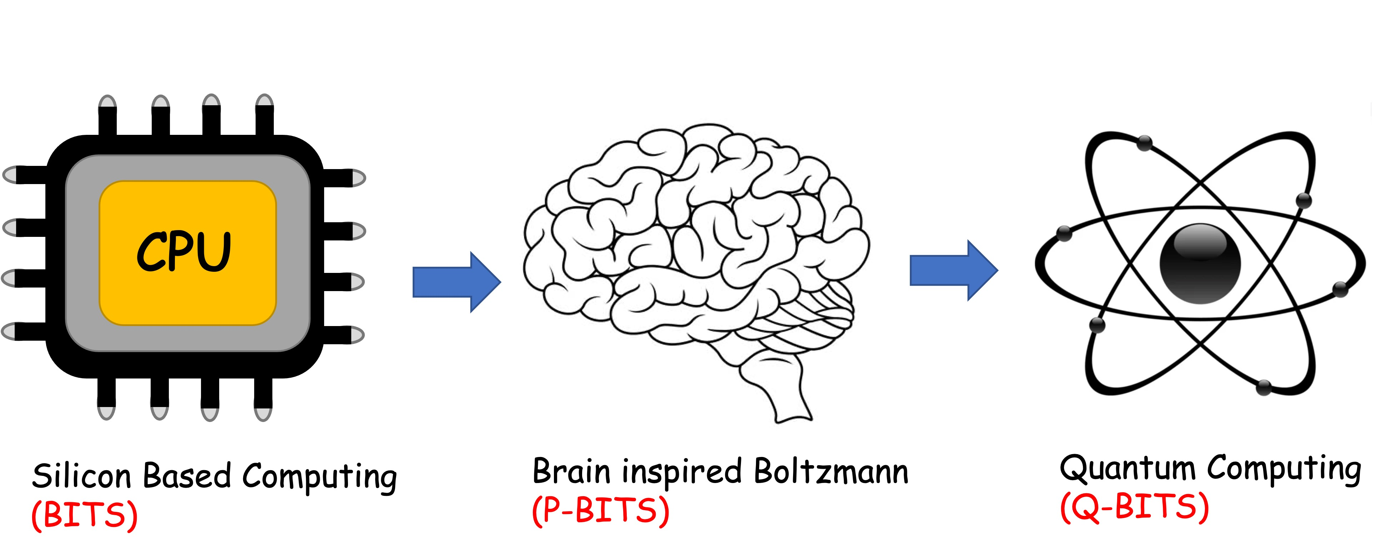
Overall structure of this course
Analog Computing in Carbo
How we train (Supervision)
Physics of Neurons (Boltzmann)
How we learn (time sampling)
Optimizing and Classifying
Transition Theory & Inferencing
Quantum Computing in Magneto
Quantum Spins and Hardware
Interacting Spins
Going parallel: Quantum Physics
Entanglement and Superposition
Cloning and Key Distribution
Quantum Search and Annealing
Quantum Gates and Factorization
Digital Computing in Silico
How we compute (algorithms)
How we add (Gates)
How we add quickly (CMOS)
How we fix errors
Thermodynamics of Computing

Slide 3
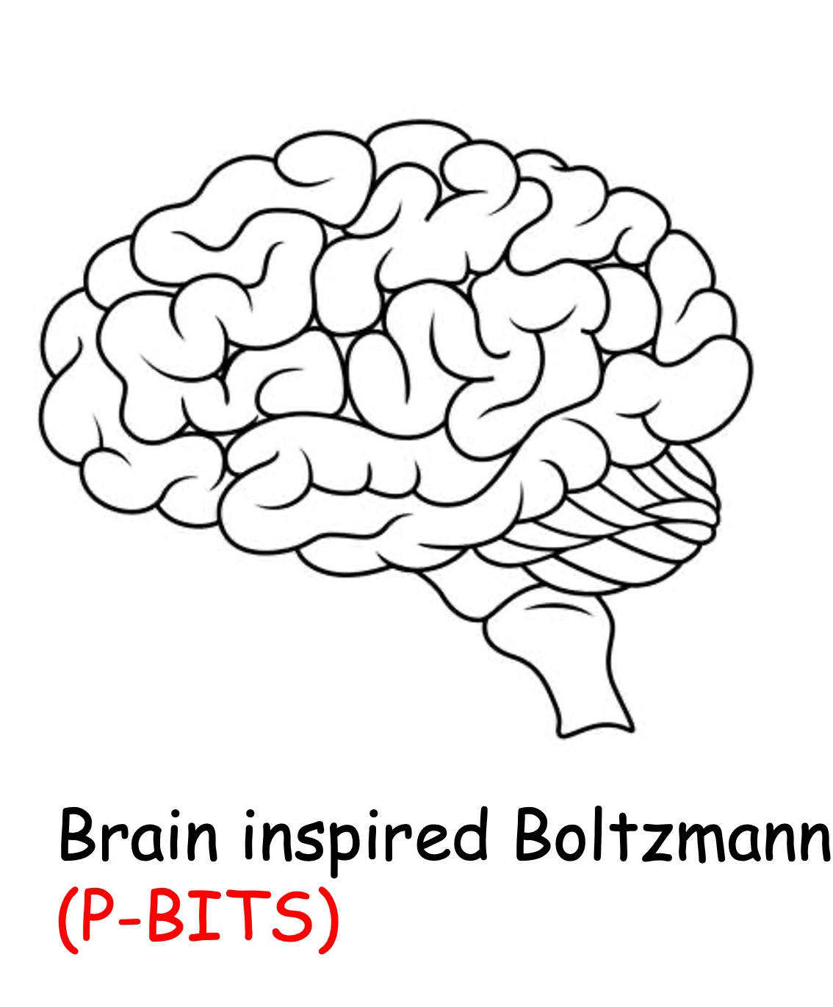

Slide 4
Neuro-synaptic systems can be programmed to solve very large optimization problems approximately at moderate speeds

Slide 5
8A. The Monte Carlo approach
to configuration space

Slide 6
Exact (Many-body) approach
Expand to 2⁵ = 32 configurations

Slide 7
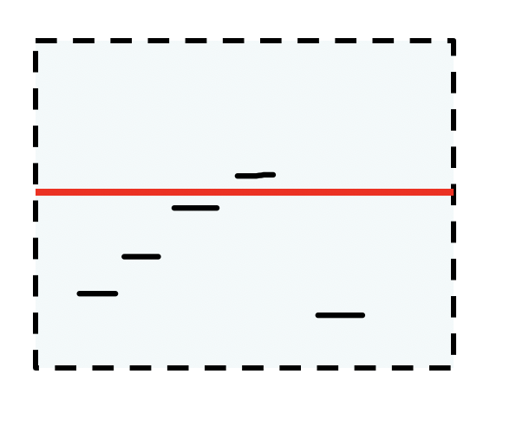
00000
00001
00010
00011
00100
00101
00110
00111
01000
01001
01010
01011
01100
01101
01110
01111
10000
10001
10010
10011
10100
10101
10110
10111
11000
11001
11010
11011
11100
11101
11110
11111

Slide 8
N=0
N=1
00000
00001
00010
00100
01000
10000
N=2
00011
00101
00110
01001
01010
01100
N=3
10001
10010
10100
11000
00111
01011
01101
10011
01110
10101
10110
11100
N=4
11001
11010
01111
11011
10111
11101
N=5
11110
11111

Slide 10
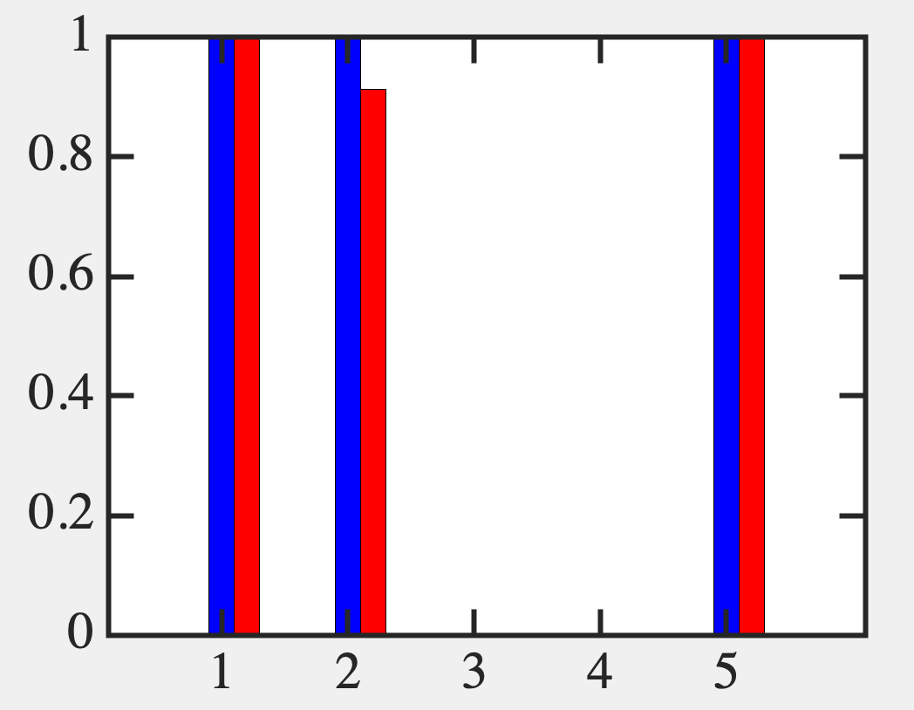

Slide 11
Approximate (SCF approach)
Stay with 5 modified states
Introduce SCF loops

Slide 13
f is an approximate guess
We are working directly in energy
space and not really sampling
configuration space

Slide 14
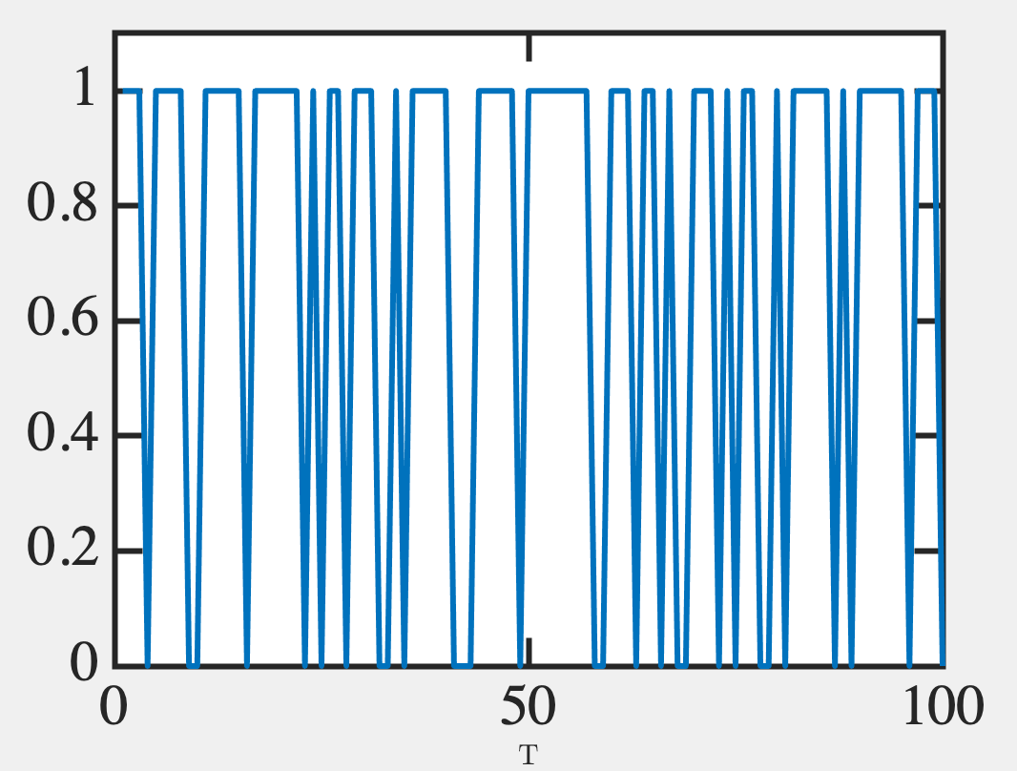
Monte Carlo Time Sampling
Make f variables binary, n (0 or 1) with probability f. Generate Single shot results
2. Repeat over time.

Slide 15
We can make this near-exact using the ergodic hypothesis (over enough time, the system will span the entire config space, visiting higher probability sectors more frequently)
This is the essence of the Monte Carlo technique
It may not immediately capture rare configurations, but
will capture the likely ones quickly !

Slide 16
What is the Monte Carlo technique?
Monte Carlo has a prominent casino and a Grand Prix tournament.
I once had coffee there – nobody around me was smiling, everyone looked like a James Bond villain (apologies to any of you who may have been there since – I’m sure you were different).
But then again, I was an indigent post-doc who could only afford coffee there. I could afford to smile however, as I had nothing to lose ☺

Slide 17
Encoding a probability (Metropolis algorithm)
Instead of choosing configurations randomly, then weighting them with exp(−E/kT),
we choose configurations with a probability exp(−E/kT) and weight them evenly.
— Nicholas Metropolis et al.

Slide 18
Encoding a probability (Metropolis algorithm)

Slide 19
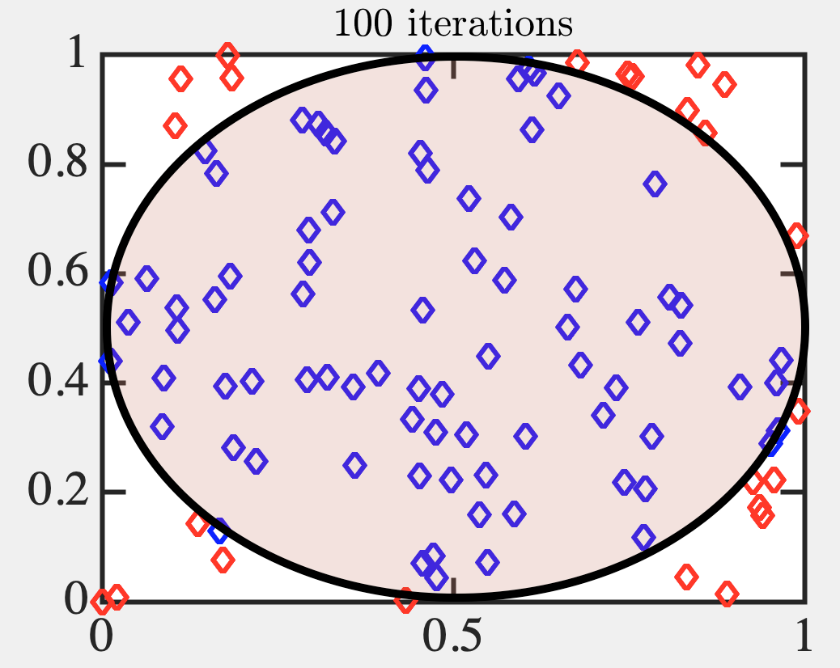
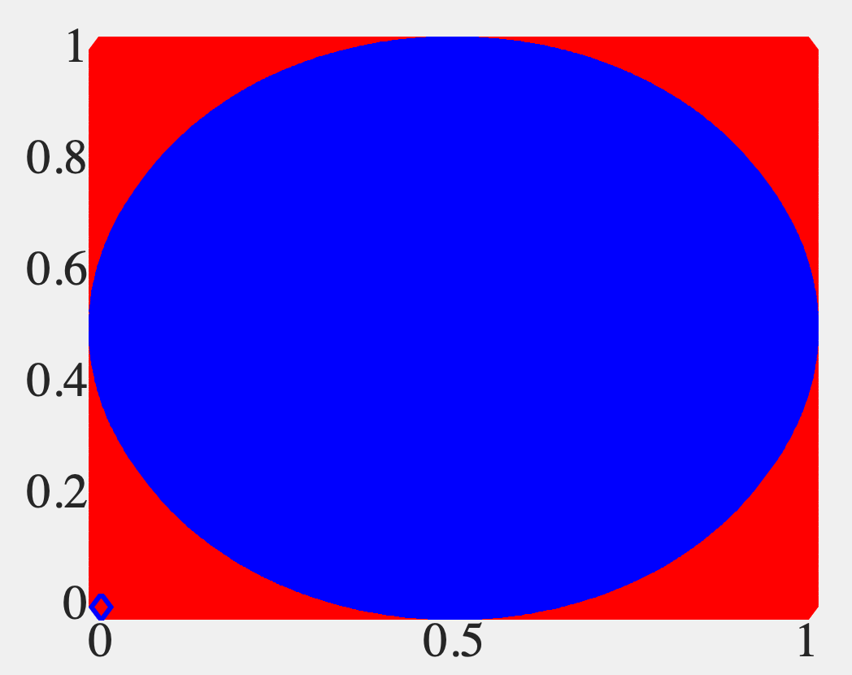
Metropolis in action
(Estimating pi)
78536261
21463739

Slide 20
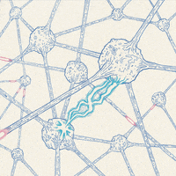
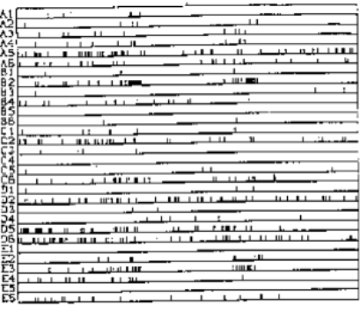
From SCF to Monte Carlo
Unlike an analog neuron, real neurons
are binary and digital (’all or none’ spikes)
0.7
palerlotus.tumblr.com/
Krüger and Aiple, 1988

Slide 21
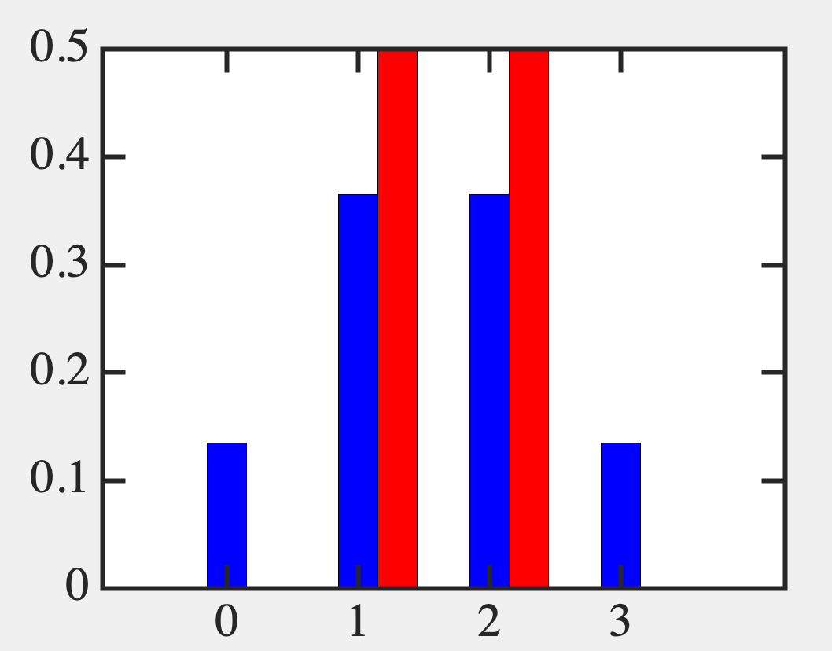
Let’s start with a simple example

Slide 22
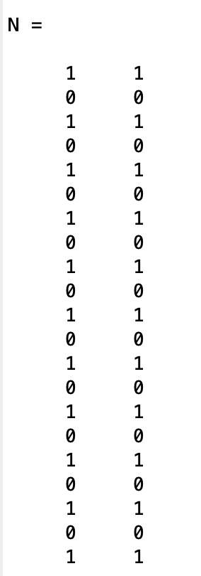
Time sampling solution

Slide 23
Time sampling solution
Modify x₁ and x₂ together
Oscillate between [0 0] and [1 1]

Slide 24
Modify one at a time!!!
Modify x₁ first
Locked into [0 1]

Slide 25
Modify one at a time!!!
Modify x₂ first
Locked into [1 0]

Slide 26
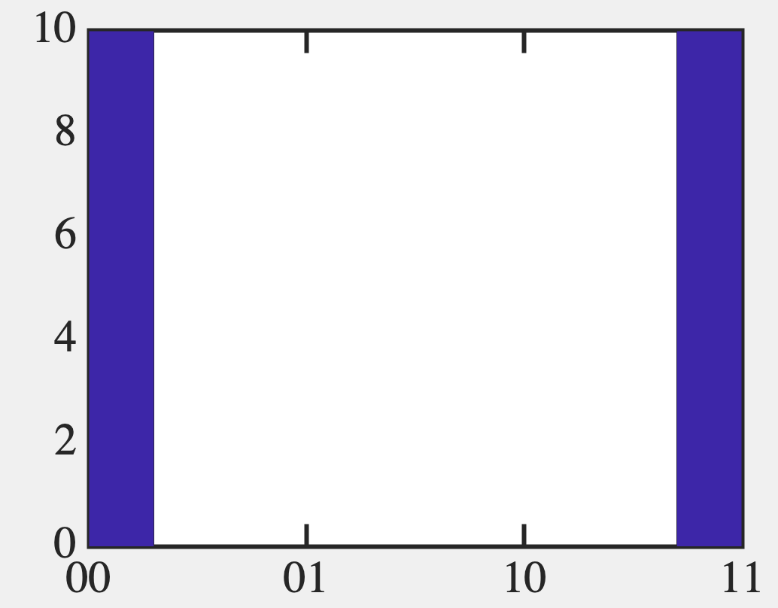
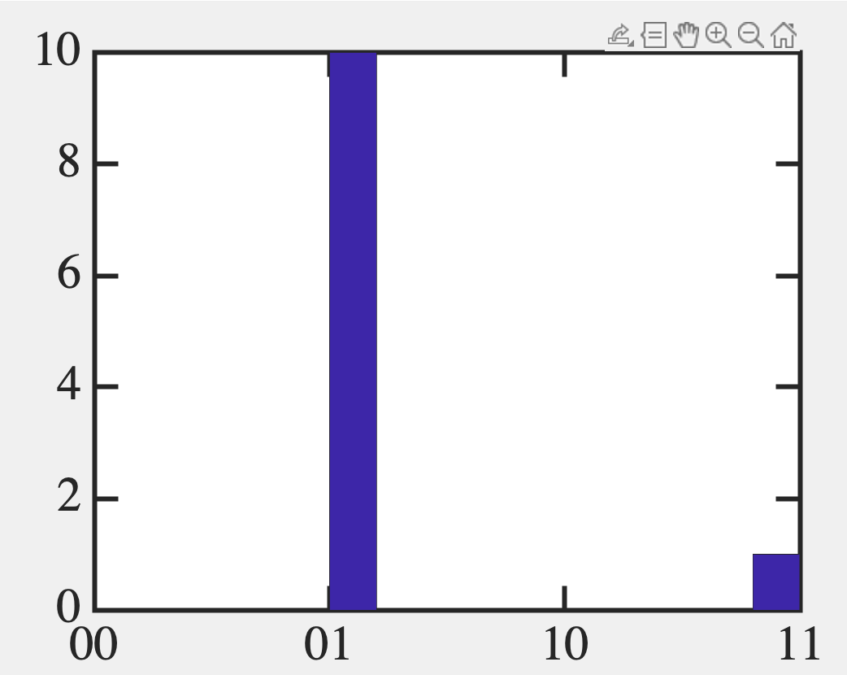
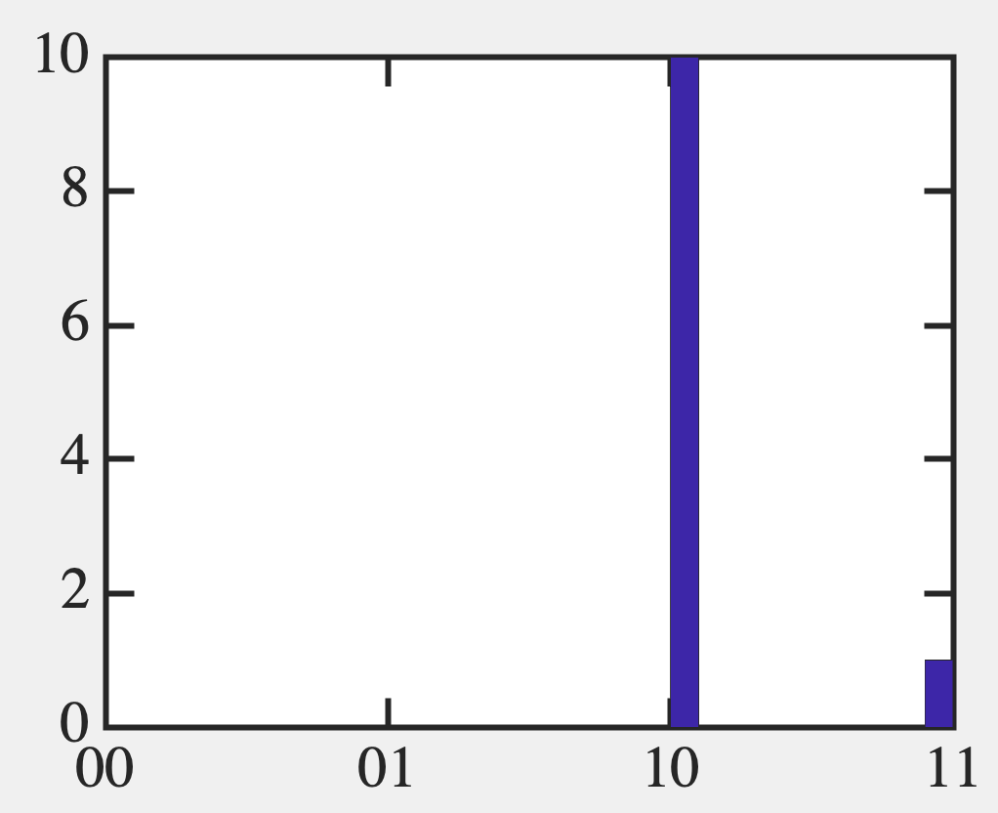
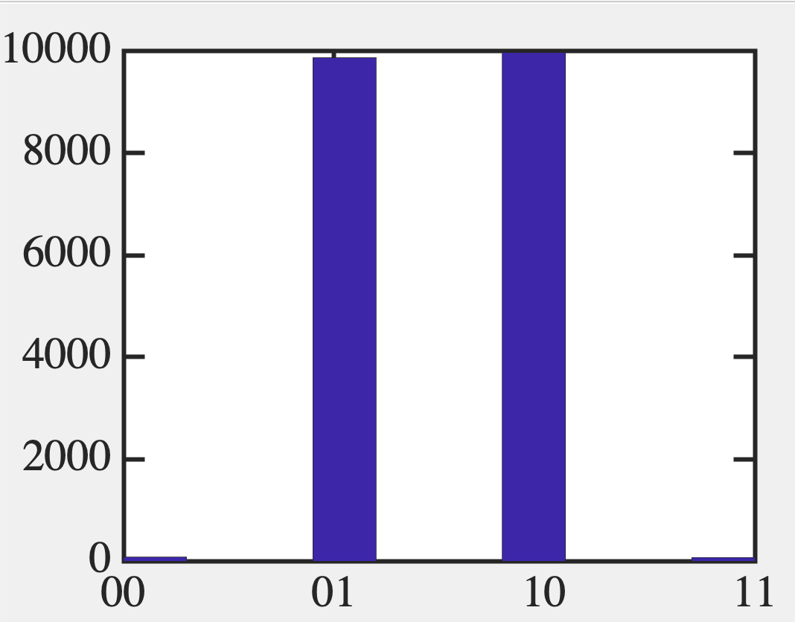
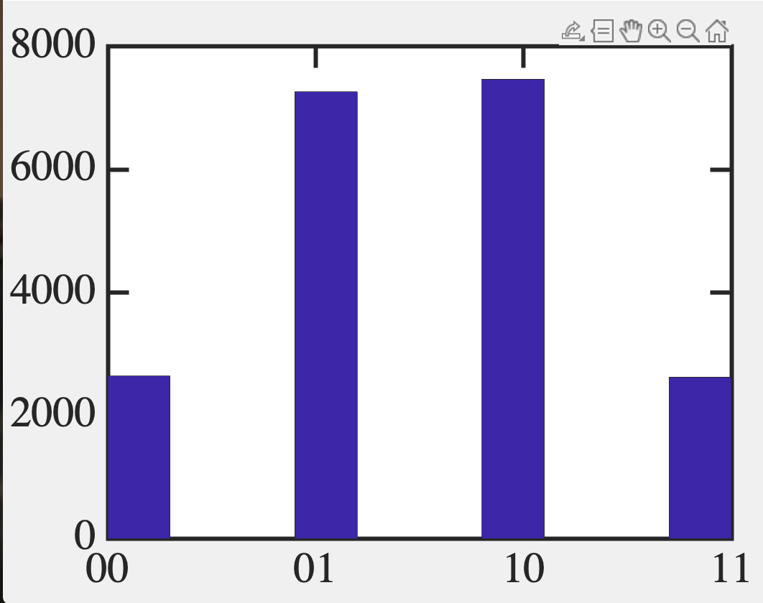

Slide 27
Note what our neurons are spelling out
Input Hamiltonian
We can use neurons to realize
a truth table

Slide 28
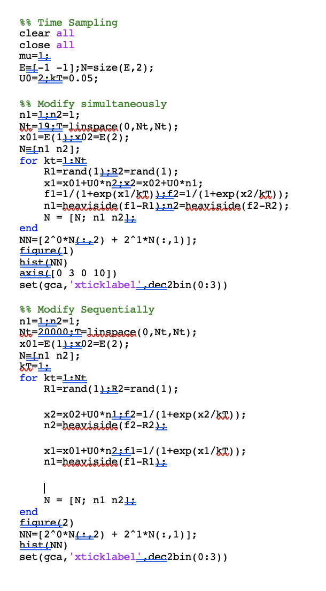

Slide 29
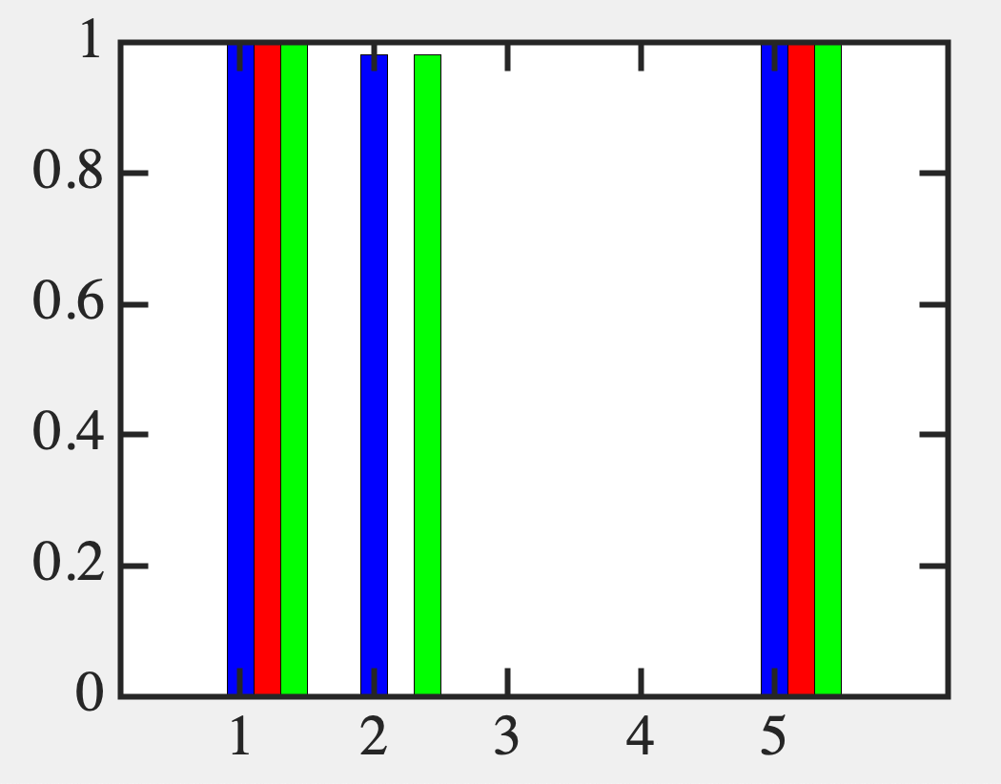
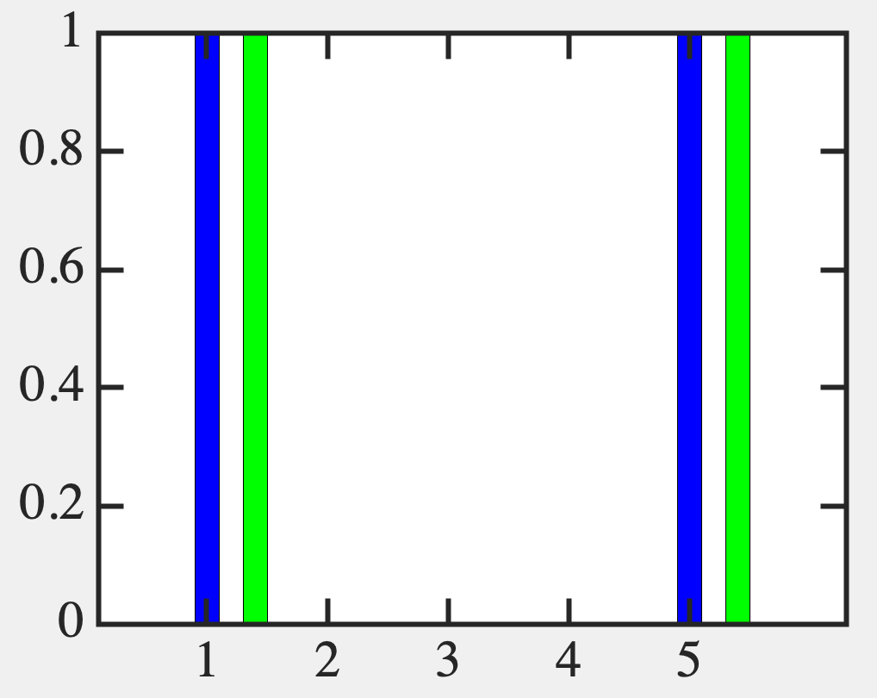
Back to SCF example

Slide 30
So time sampling captures PDF quite well, given a set of
couplings U (ie, energy expression E), and in particular the ground state.
Can we reverse engineer the couplings and to get a desired ground state ? E.g. solution to an optimization problem ?

