Slide 1
8B. Forward Propagation
From parameters to solution

Slide 3
No SCF back-and-forth
1 way stepping (rand # bitstream), then get a histogram
So no convergence issues !

Slide 4
Time sampling solution

Slide 5
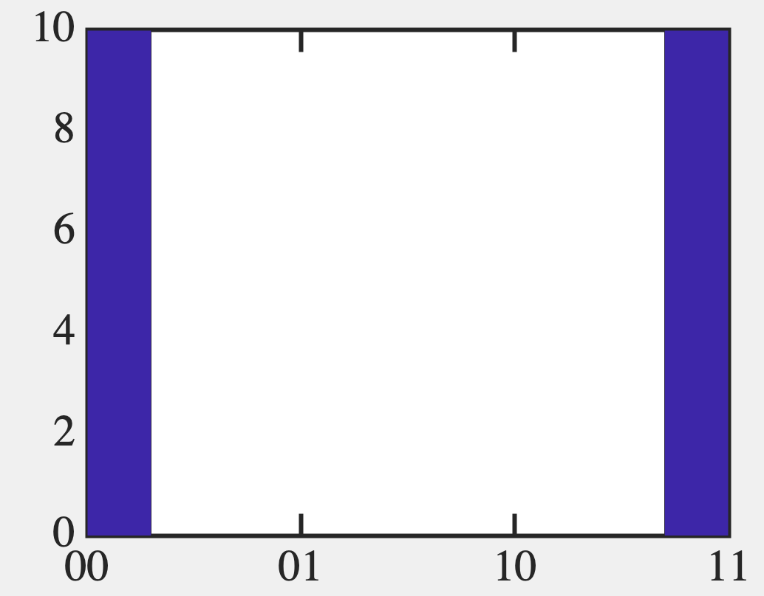
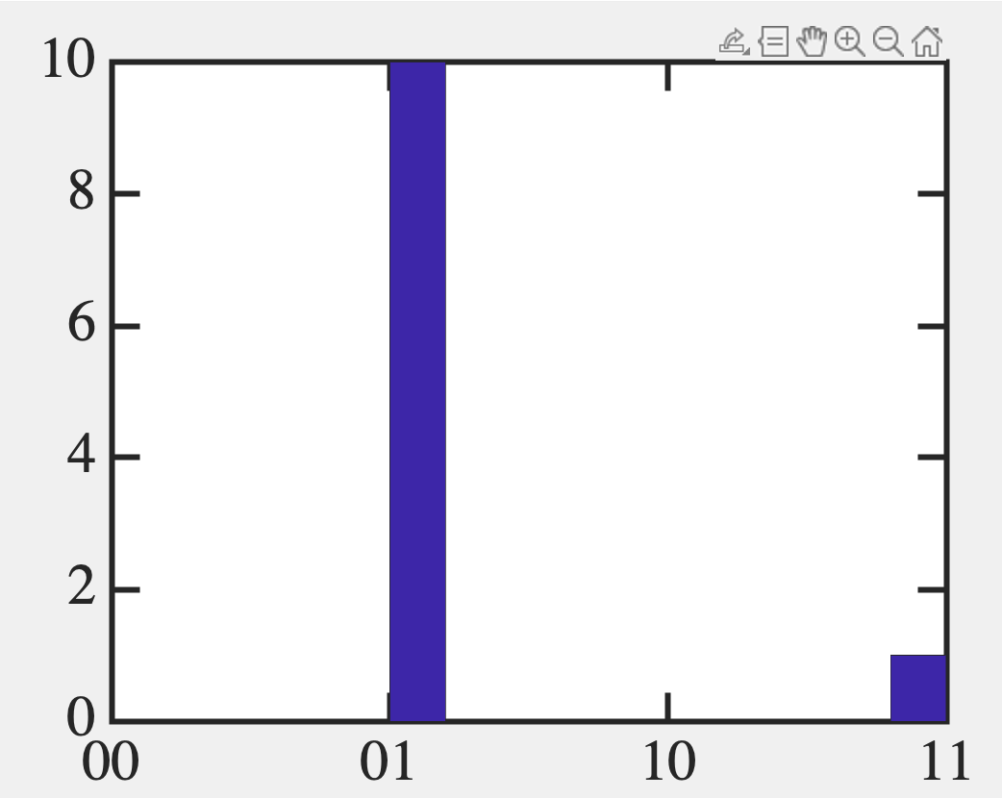
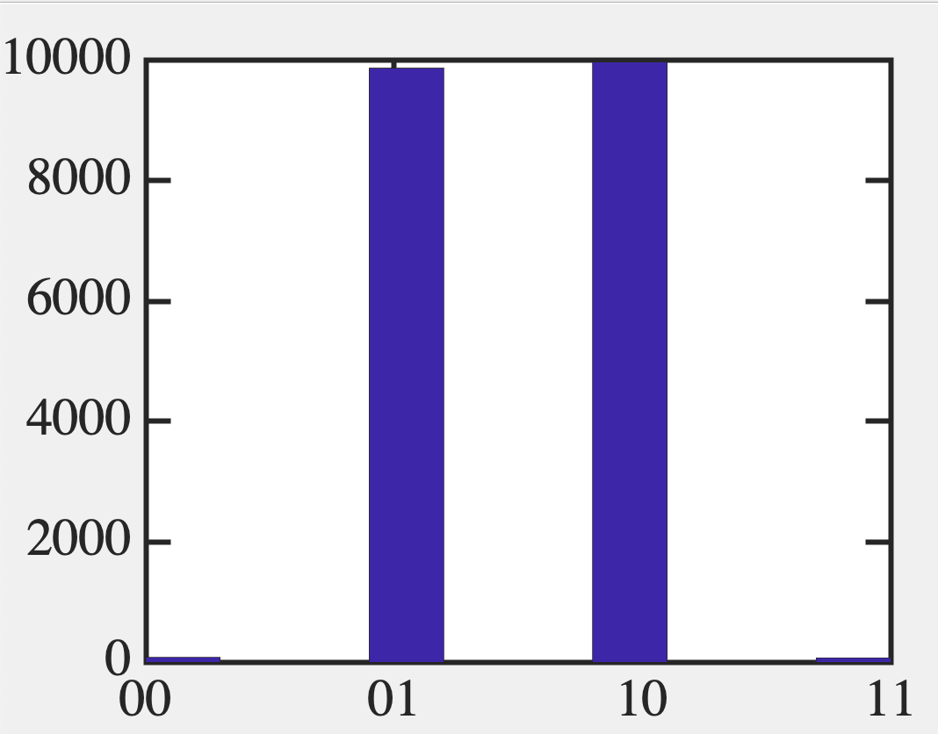
Time sampling solution
Sensitive to parameters

Slide 6
How to automate higher dimensions (many binaries)

Slide 7
Matricize

Slide 8
Matricize

Slide 9
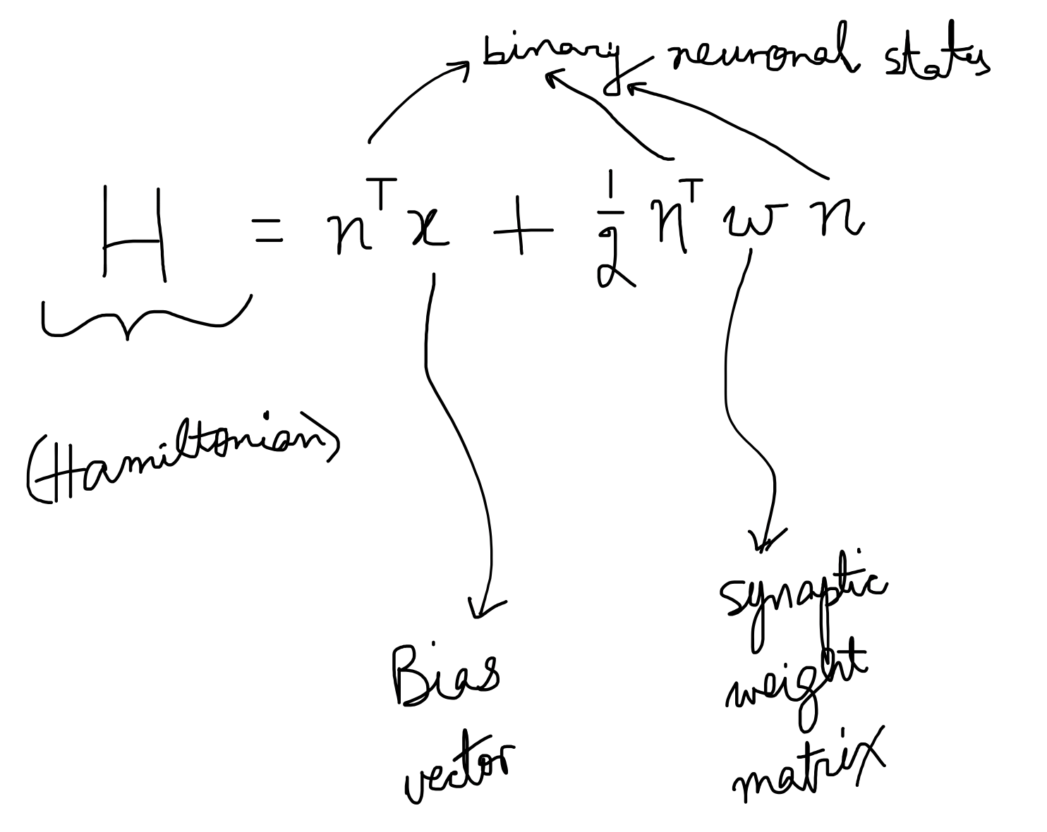
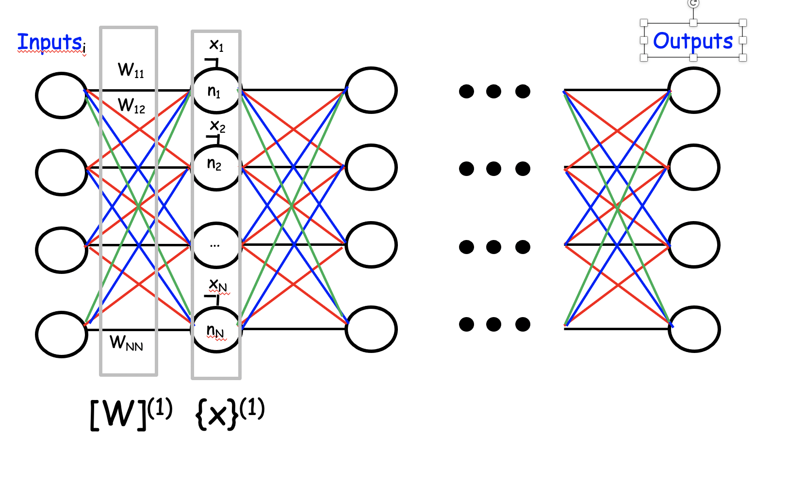
Bias vector {x} and weight matrix [w] control the dynamics

Slide 10
So what sets W ?
W set by physics (Free energy minimization)
Condensed Matter Physics
W set by cost function (pattern matching, classification,
etc – Regression, Support Vector Machines etc)
ML/AI
W set by algorithm (Set energy landscape by looking at desired class of results)
Neuromorphic Computing/ANN

