Slide 1
8C. Backward Propagation
From solution to parameters

Slide 2
Example: [W] set by a truth table → OR gate

Slide 3
Set values from a phase diagram

Slide 4
AND gate

Slide 5
Set values from a phase diagram

Slide 6
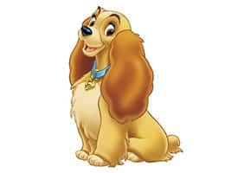
Support Vector Machines
Need a boundary area for a clean Classification

Slide 7
Aside on Support Vector Machines
Input Space
(Nonlinear)
Feature Space
(Higher dimension
Linear decision bdry)

Slide 8
Example
r < r’
r > r’
x₂
θ
x₁
r’
r
Conformal Mapping
(preserves local angles)

Slide 9
But a single threshold works for OR gate

Slide 10
A single threshold (neuron layer) however will
NOT work for XNOR gate

Slide 11
Set values from a phase diagram ?

Slide 12
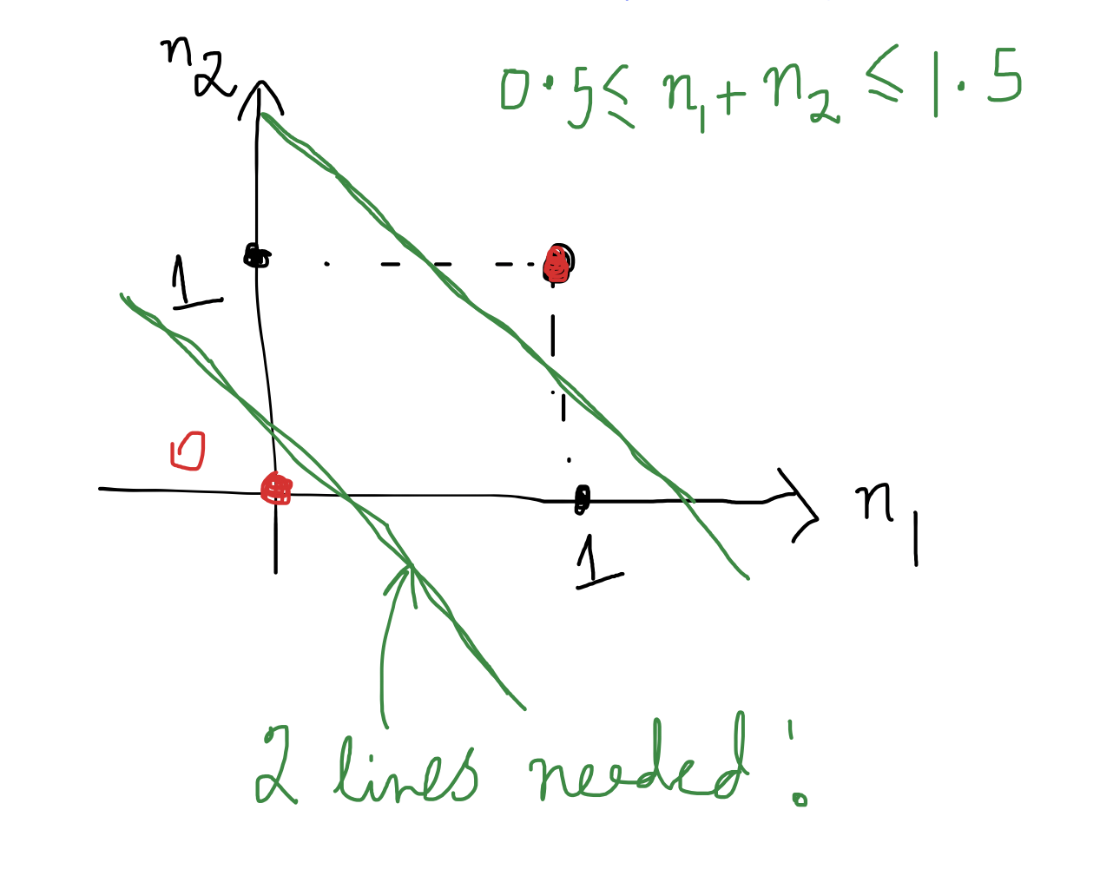
Need at least two layers (hence Deep NNs)
Unlike SVMs, we need a boundary area by necessity

Slide 13
Make an educated guess on W, x

Slide 14
We can set Ws, and xs by ‘eyeballing’.
But we need a systematic way to adjust W and x
for large multi-dimensional systems!!
How about ‘trial and error’ ??

Slide 15
Program by looking at individual answers

Slide 16
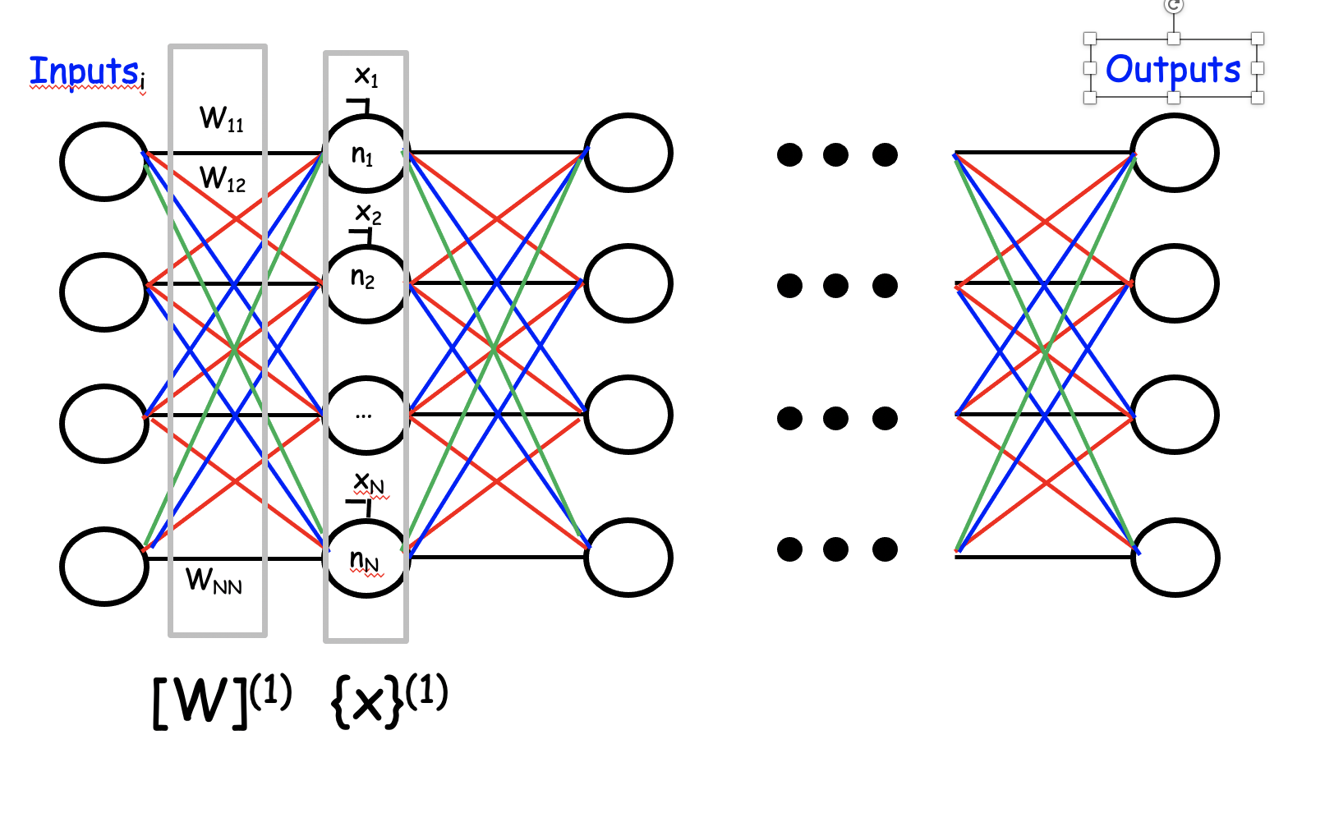
Program by looking at individual answers
11111111
11111111
11111111
11001000
11001000
01100100
00011001
00000000

Slide 17
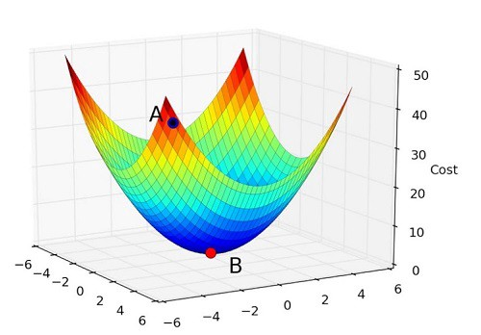
Error sets backpropagation rules
U(θ₀ ,θ₁)
θ₁
θ₀

Slide 18
Error sets backpropagation rules
Small learning rate
U
θ₁
Large learning rate
U
θ₁

Slide 19
Chain Rule of differentiation
Math Lecture Notes

Slide 20
Apply to XNOR gate

Slide 21
Apply to XNOR gate

Slide 22
Apply to XNOR gate

Slide 23
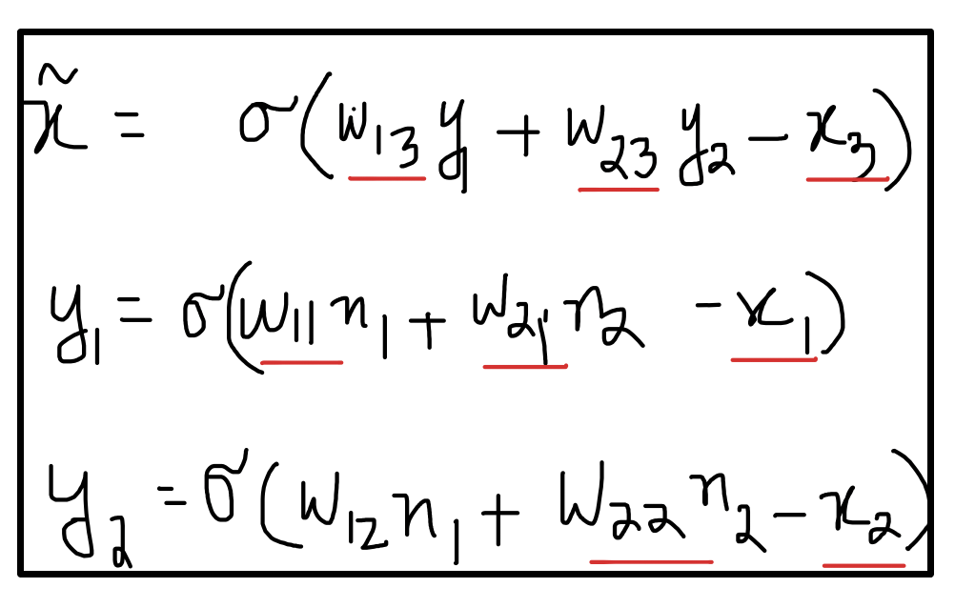
Apply to XNOR gate

Slide 24
Apply to XNOR gate

Slide 25
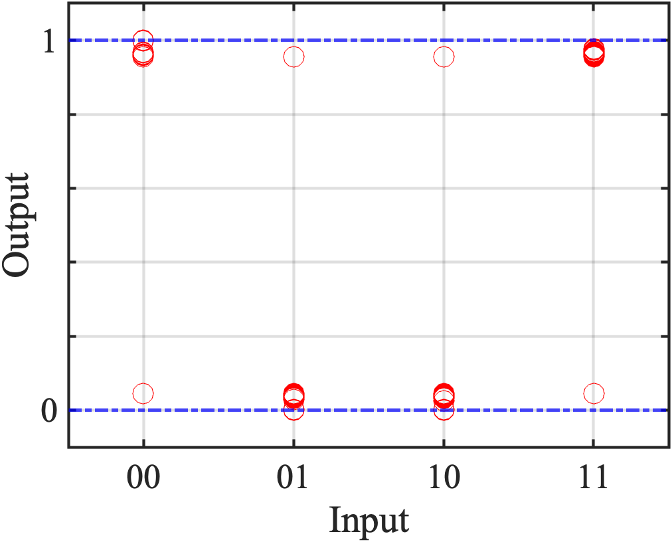
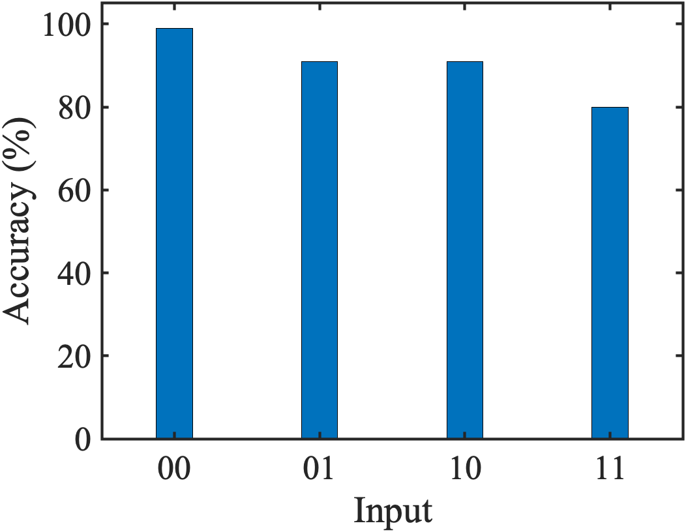
Apply to XNOR gate

Slide 26
Apply to XNOR gate

Slide 27
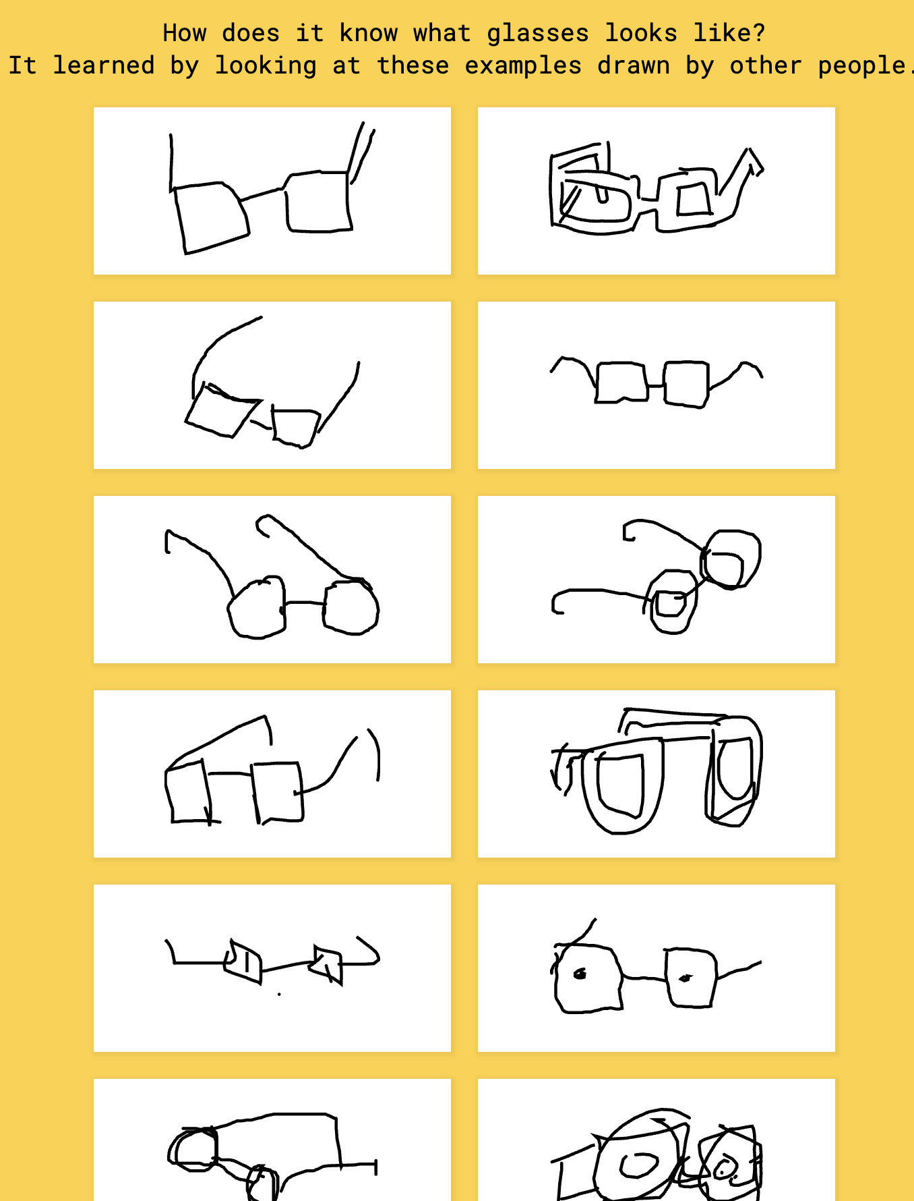
Just need data to train
https://quickdraw.withgoogle.com/

