Slide 1
8D. Data compression in AI
Spooling, CNN

Slide 2
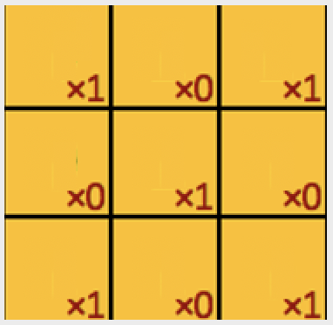
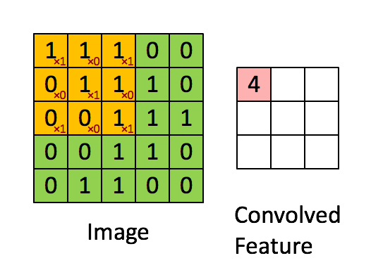
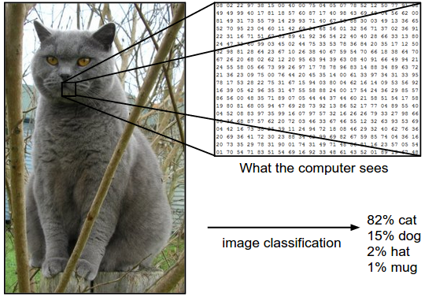
It also helps to do a ‘spooling’
Convolution with a kernel

Slide 3
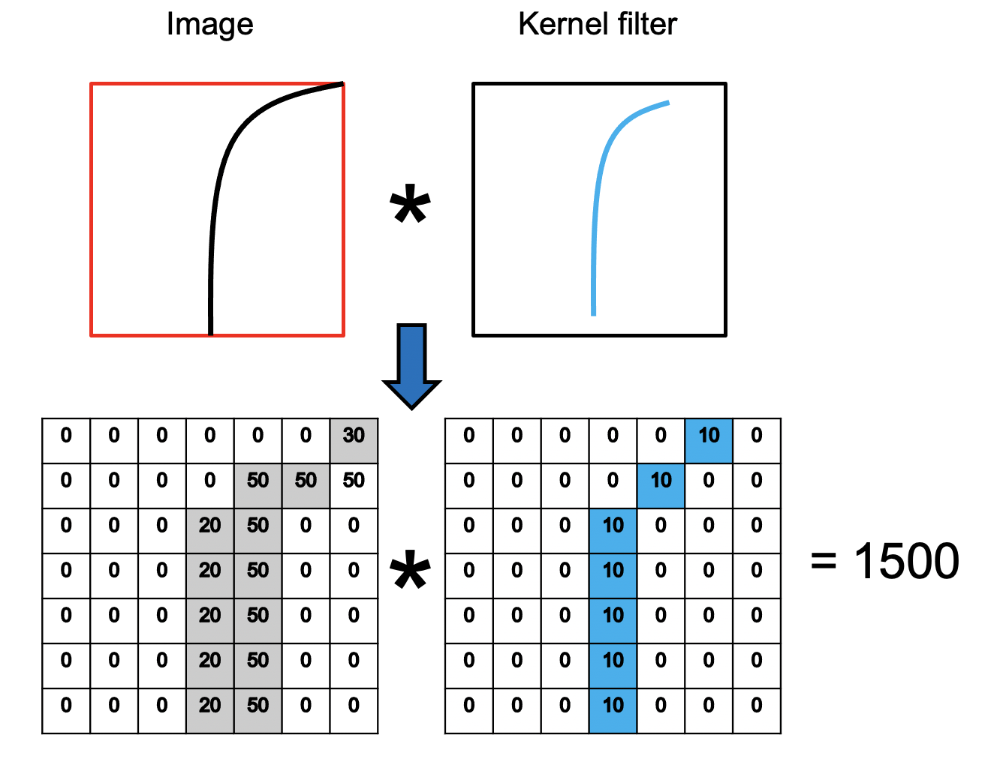
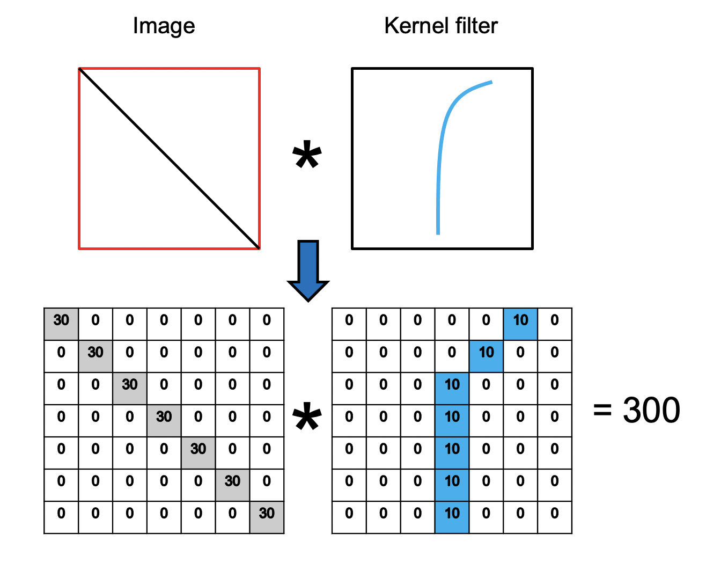
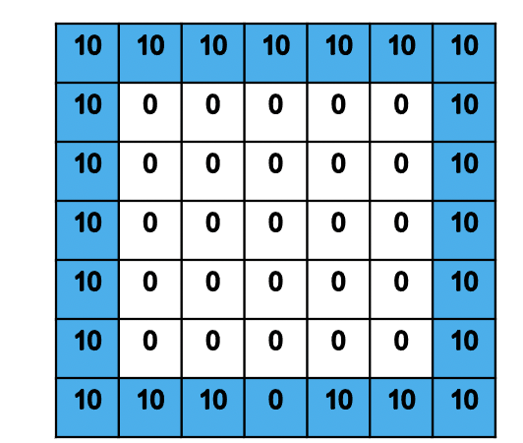
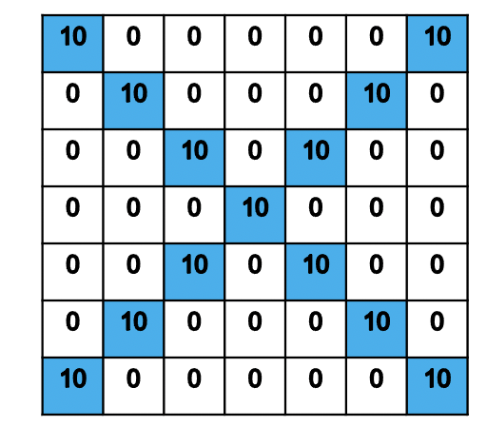
Each kernel filters out a specific pattern
Edges (Sobel Filter)
Rectangle
Cross
RGB[255, 0, 0]

Slide 4
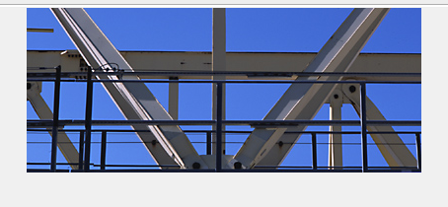
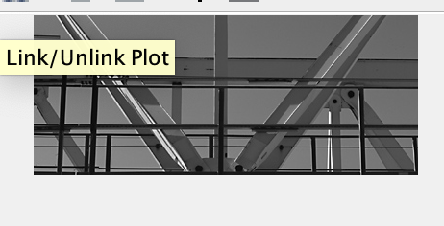
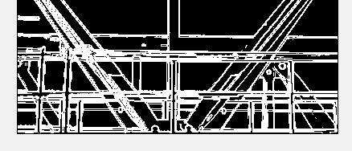
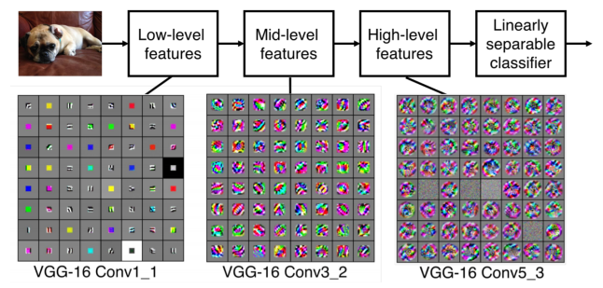
Edges, curves
Paws, flippers, hands
Face, Skin, Eyes

Slide 5
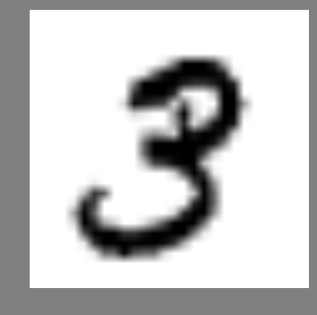
feature map C2:
10*10*12
feature map S1:
5*5*12
feature map S1:
14*14*4
feature map C1:
28*28*4
0
Input:
32*32
1
8
9
5*5 convolution
2*2 maxpooling
2*2 maxpooling
5*5 convolution

Slide 6
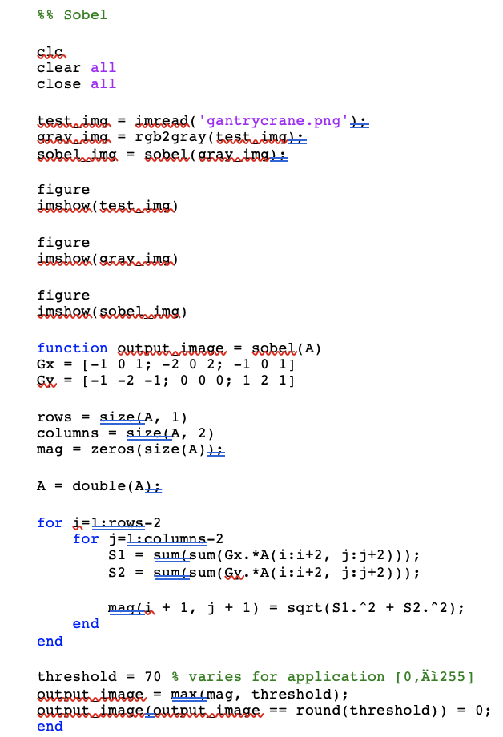

Slide 7
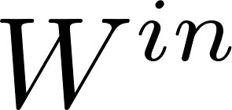
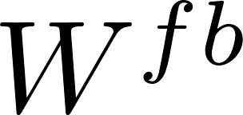
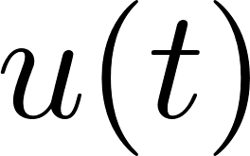
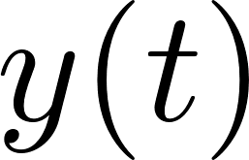
Other versions of neurons
Time-series recognition: Reservoir Computing
Input
Output
Learning
Reservoir

Slide 8
Other versions of neurons
Time-series recognition: Reservoir Computing

Slide 9
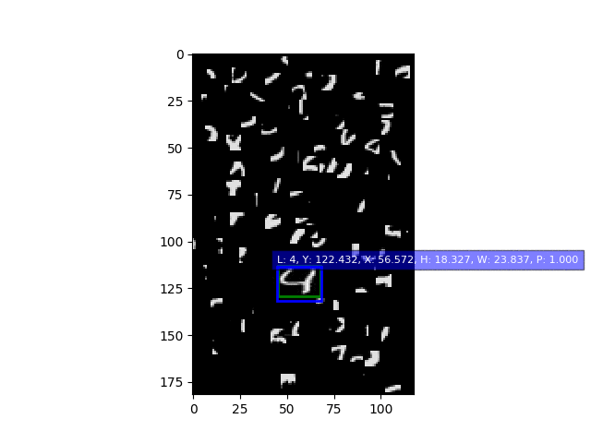
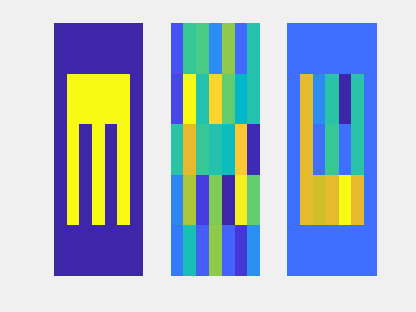
Brain
inspired
Algos
Spatio-temporal Tracking and prediction
Neural Filtering
Spatial Correlations
Temporal
Correlation
Spatio-
Temporal
Inferencing
Echo-State networks
Convolutional Neural Networks
Hierarchical Temporal Memory
Ganguly et al. “Hardware based Spatio-Temporal Neural Processing Backend for Imaging Sensors: Towards a Smart Camera”, Proc. SPIE 2018
Original
Distorted
Filtered
Combine three diff neural models above (ESN, CNN, HTM) to do:
1. Filtering, 2. Tracking and 3. Learning & Prediction in real-time

Slide 10
Brain
inspired
Algos
Spatio-temporal Tracking and prediction
Neural Filtering
Spatial Correlations
Temporal
Correlation
Spatio-
Temporal
Inferencing
Echo-State networks
Convolutional Neural Networks
Hierarchical Temporal Memory
Ganguly et al. “Hardware based Spatio-Temporal Neural Processing Backend for Imaging Sensors: Towards a Smart Camera”, Proc. SPIE 2018
Original
Distorted
Filtered
Trajectory
Prediction
(extrapolation)
Combine three diff neural models above (ESN, CNN, HTM) to do:
1. Filtering, 2. Tracking and 3. Learning & Prediction in real-time

Slide 11
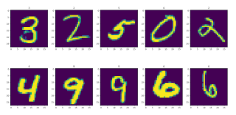
Fundamentals of Computing
Lec 9
Optimizing and Classifying

