Slide 1

9F. Hardware Implementation

Slide 2
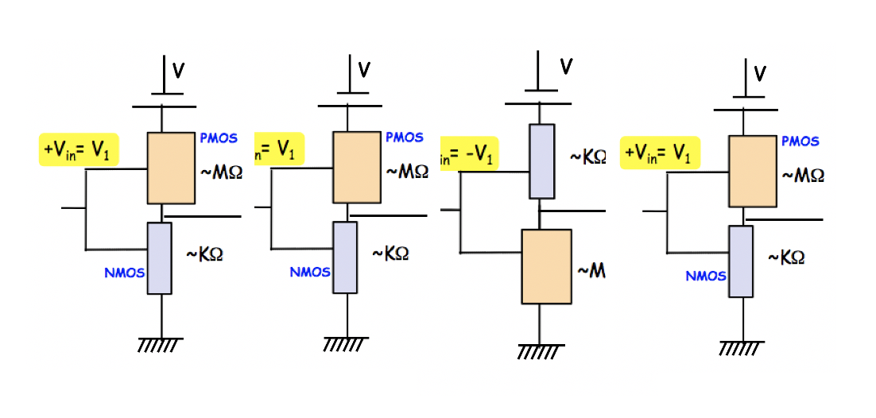

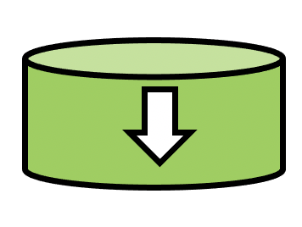
A hardware realization

Slide 3
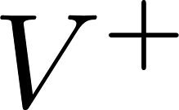
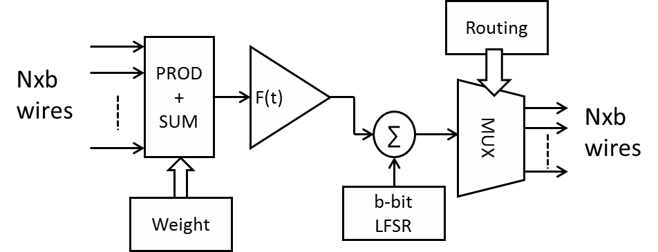
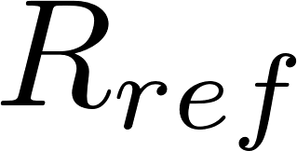
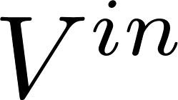

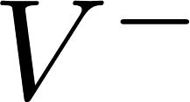
Emerging technologies for neurons
CMOS Neuron (140 transistors, 140 fJ-ps)
Magnetic Neuron (4 transistors, 2.2 fJ-ps)

Slide 4
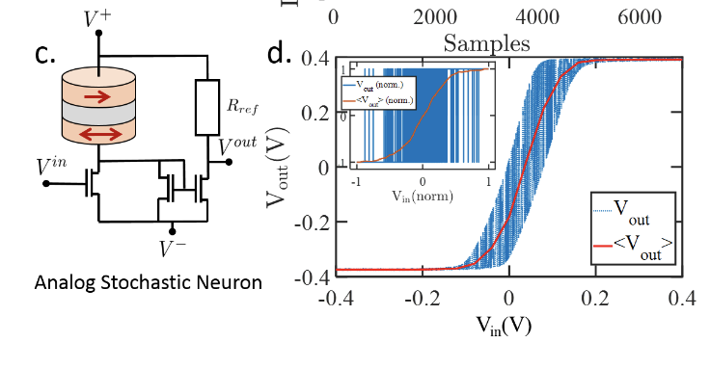
Magnet based stochastic neurons (‘spin dice’)
Stochasticity allows you to sample the phase space quickly and ergodically
CMOS random number generators are VERY inefficient
Kamsari, Ganguly, Sutton, Datta (Purdue)
Ganguly, Ghosh (UVA)
        Binary
        Stochastic
        Neurons
        Analog
        Stochastic
        Neurons
Magnet in pull-up/pull-down + Inverters
Energy-Momentum Optimization Algos
Probabilistic Graph Algos
Magnet in pull-up/pull down + Buffer
Signal Proessing (EKF), Inferencing

Slide 5





A hardware realization
On-chip → Instant (don’t need cloud upload/download)
Cloud could be unavailable or unreliable
EDGE INTELLIGENCE
Output Nodes
Synaptic network
Dense, highly scalable, neural networks
Programming Network

Slide 6
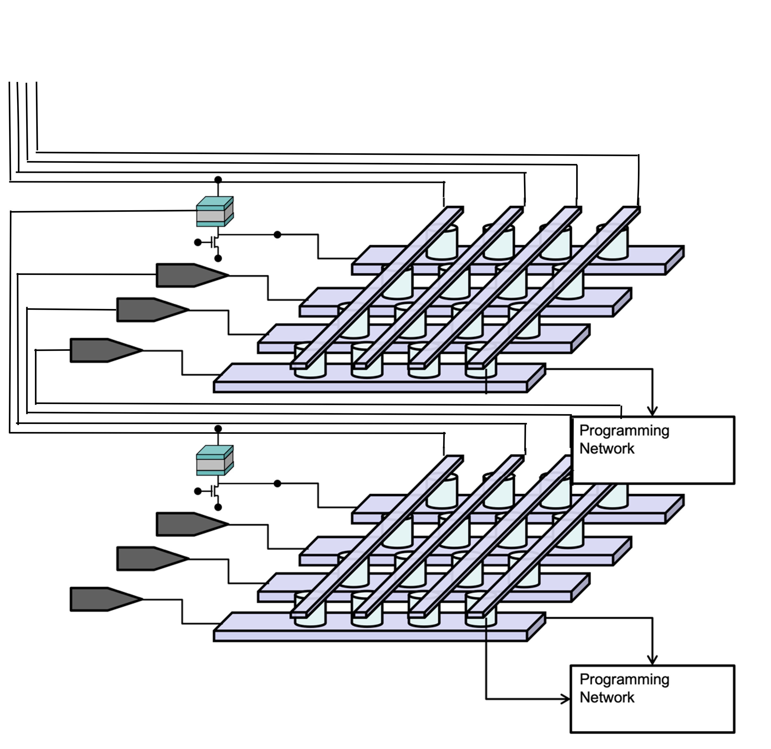
Stack them for depth

Slide 7
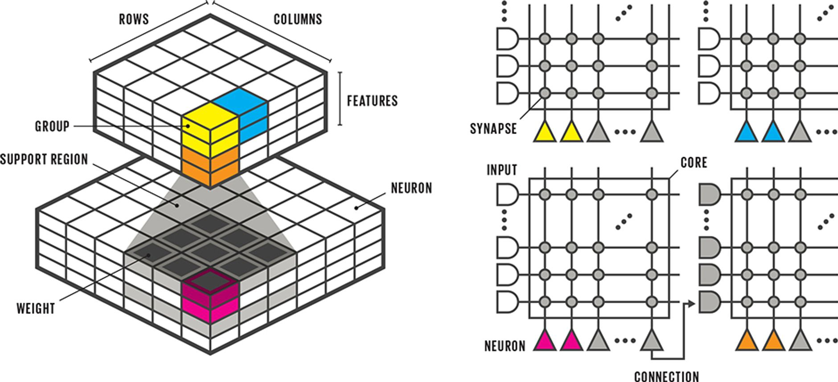
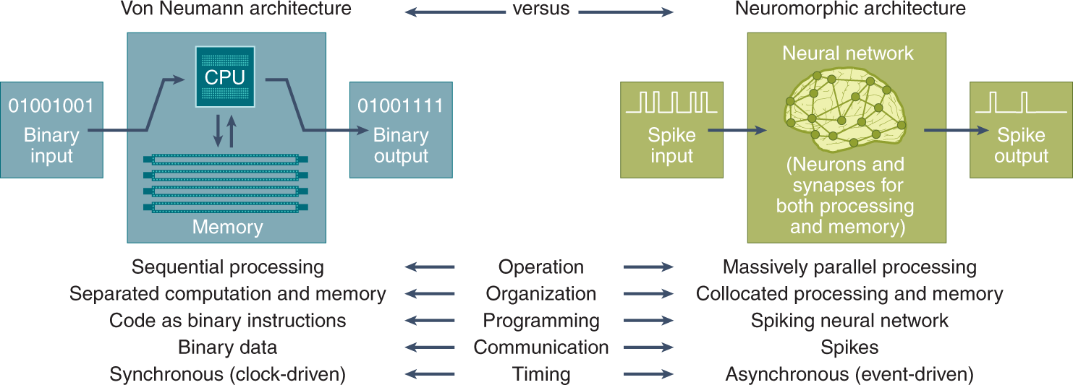
IEEE Spectrum, May 2017
Catherine Schumann et al, Nature Computational Science 2, 10 (Jan 22)

Slide 8
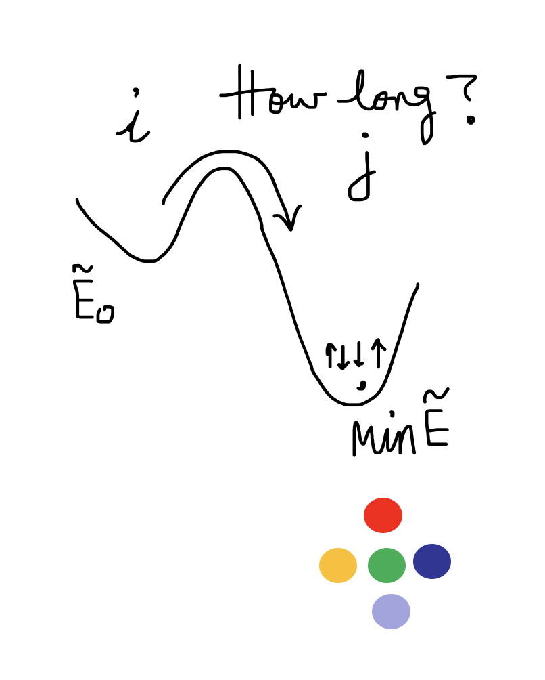
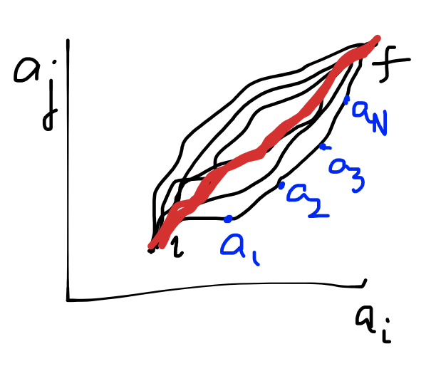
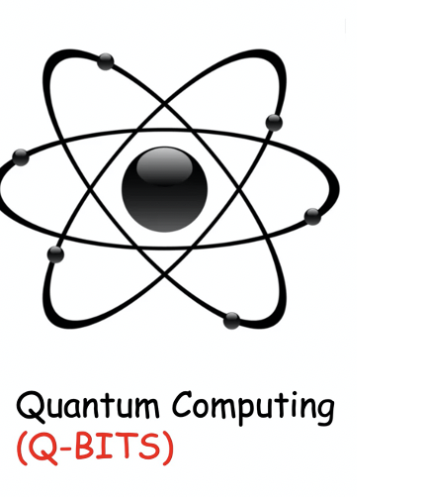
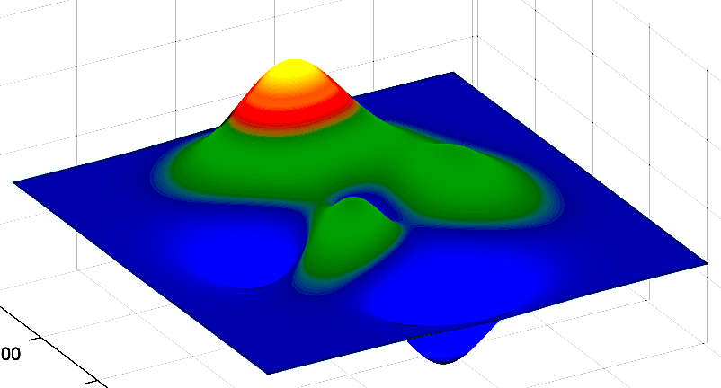
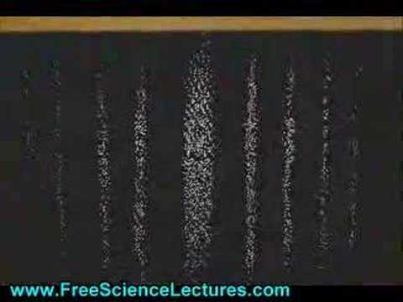
Fundamentals of Computing
Lec 10
Dynamics
Path Integrals
Quantum Spins
Interfering States

