Slide 1

Fundamentals of Computing
Lec 9
Truth Tables

Slide 2
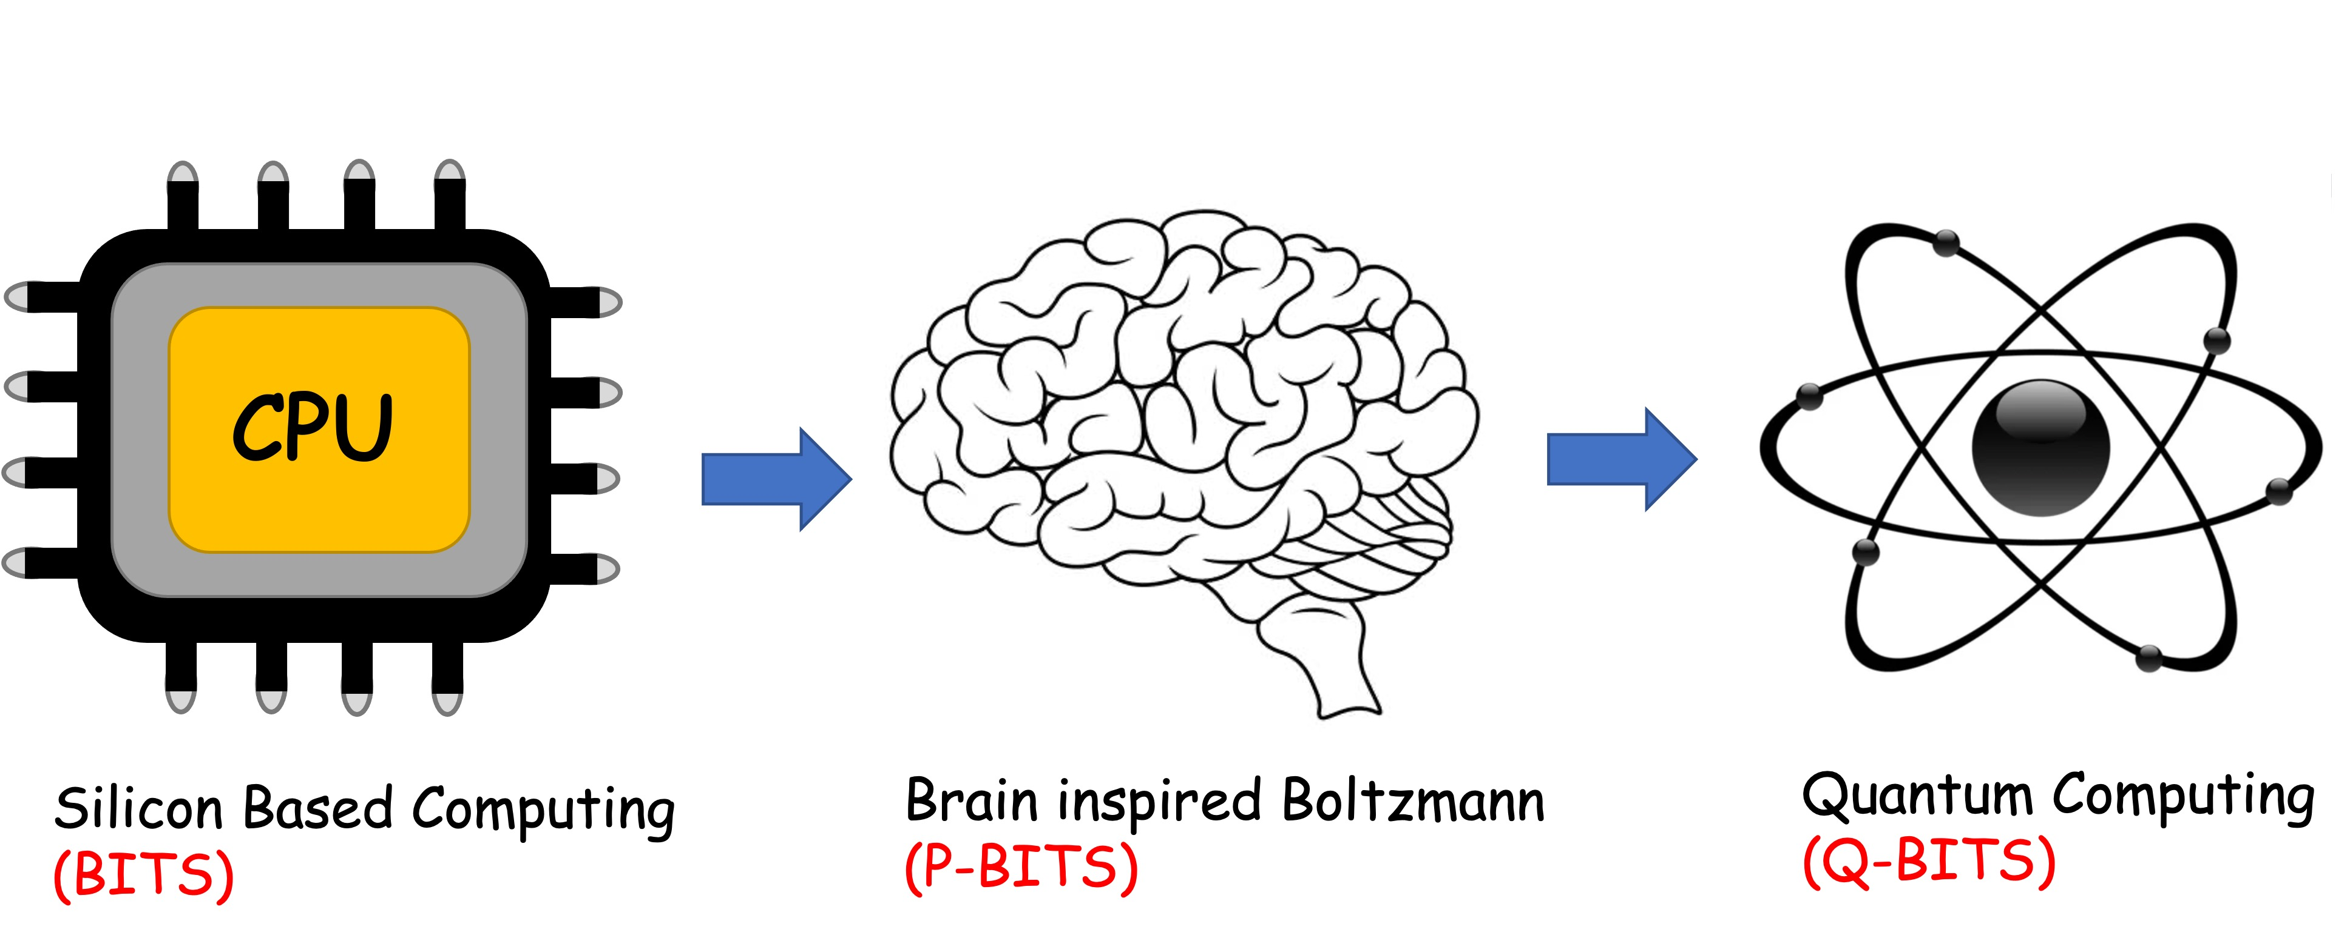
Overall structure of this course
Analog Computing in Carbo
How we train (Supervision)
Physics of Neurons (Boltzmann)
How we learn (time sampling)
Optimizing and Classifying
Transition Theory & Inferencing
Quantum Computing in Magneto
Quantum Spins and Hardware
Interacting Spins
Going parallel: Quantum Physics
Entanglement and Superposition
Cloning and Key Distribution
Quantum Search and Annealing
Quantum Gates and Factorization
Digital Computing in Silico
How we compute (algorithms)
How we add (Gates)
How we add quickly (CMOS)
How we fix errors
Thermodynamics of Computing

Slide 3
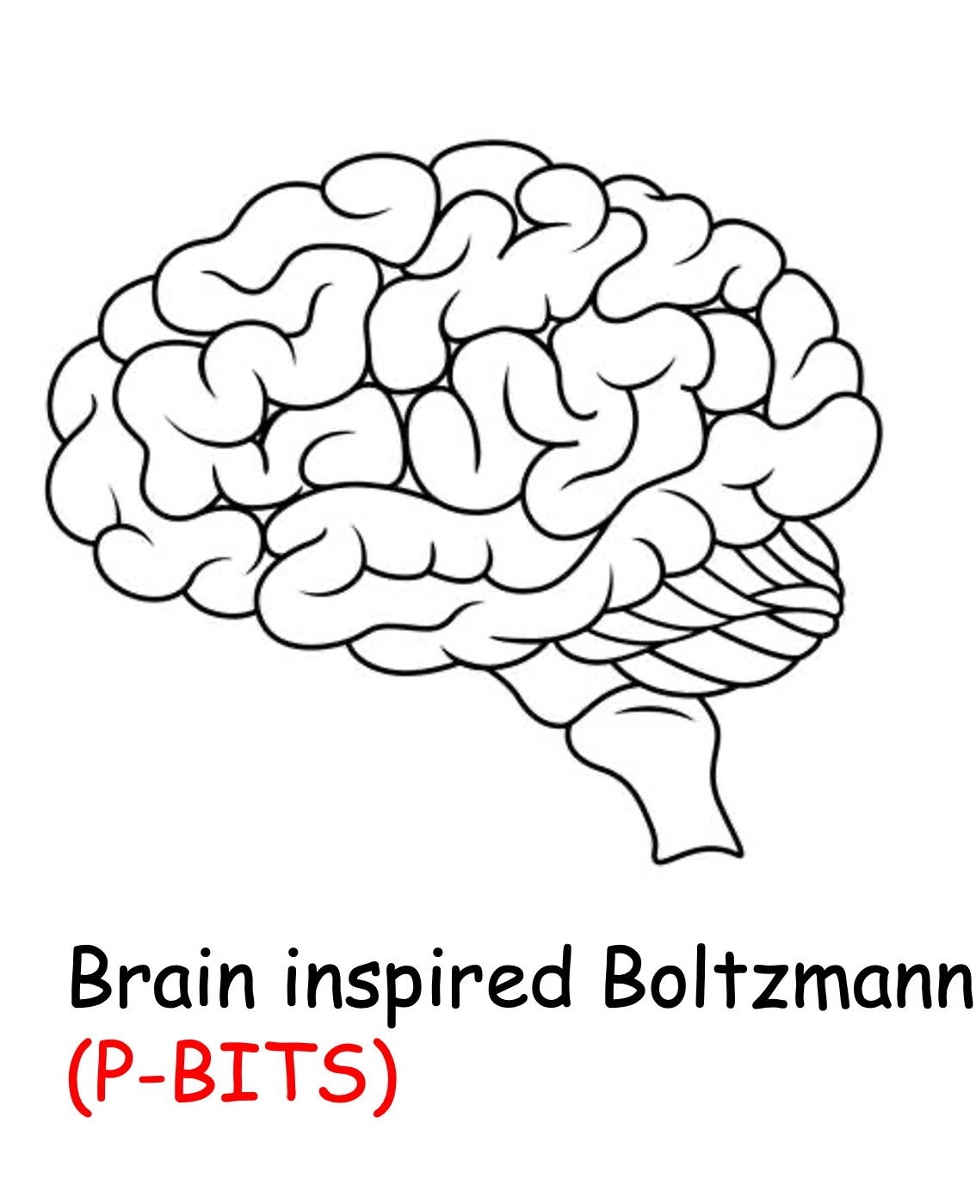

Slide 4
Neuro-synaptic systems can be programmed to solve very large optimization problems approximately at moderate speeds

Slide 5
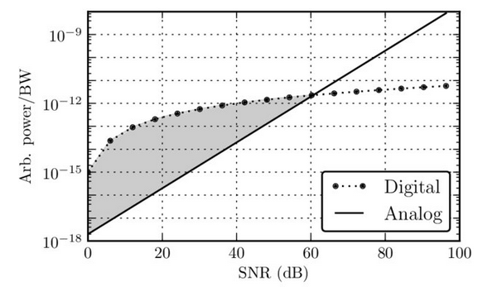
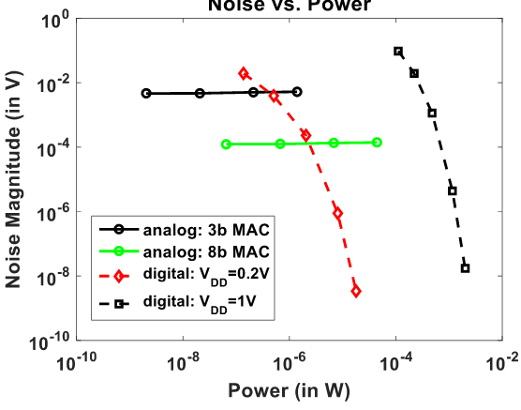
Energy-reliability trade-off
White et. al., Sensors, 2013
See Sarpeshkar, Neural Comp. 1998
Sen, US-Korea Forum on Nanotech, 2016
Digitization (quantization) needs precision – accorded by a ‘gain’ curve
This costs a lot of energy !!
Neuronal processes do not need high precision (e.g. facial recognition)
For low precision, analog beats digital hands down !!

Slide 6
9A. Optimization problems

Slide 7


Recall the Problem – Electrons in a solid

Slide 8







Recall the Problem – Neural Nets

Slide 9








Recall the Solution

Slide 10
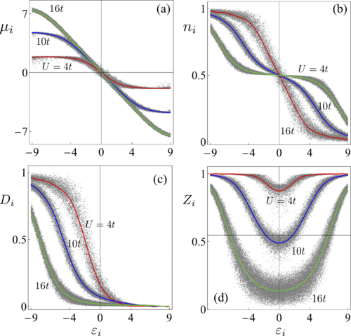
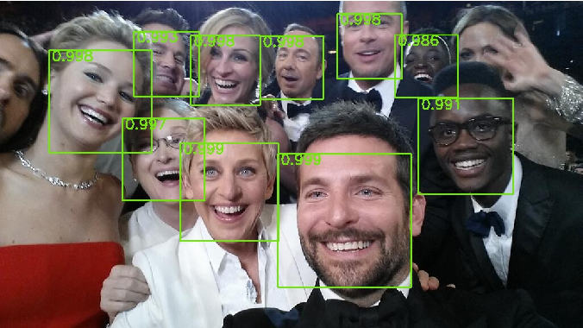
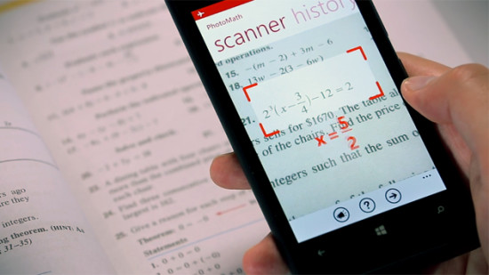
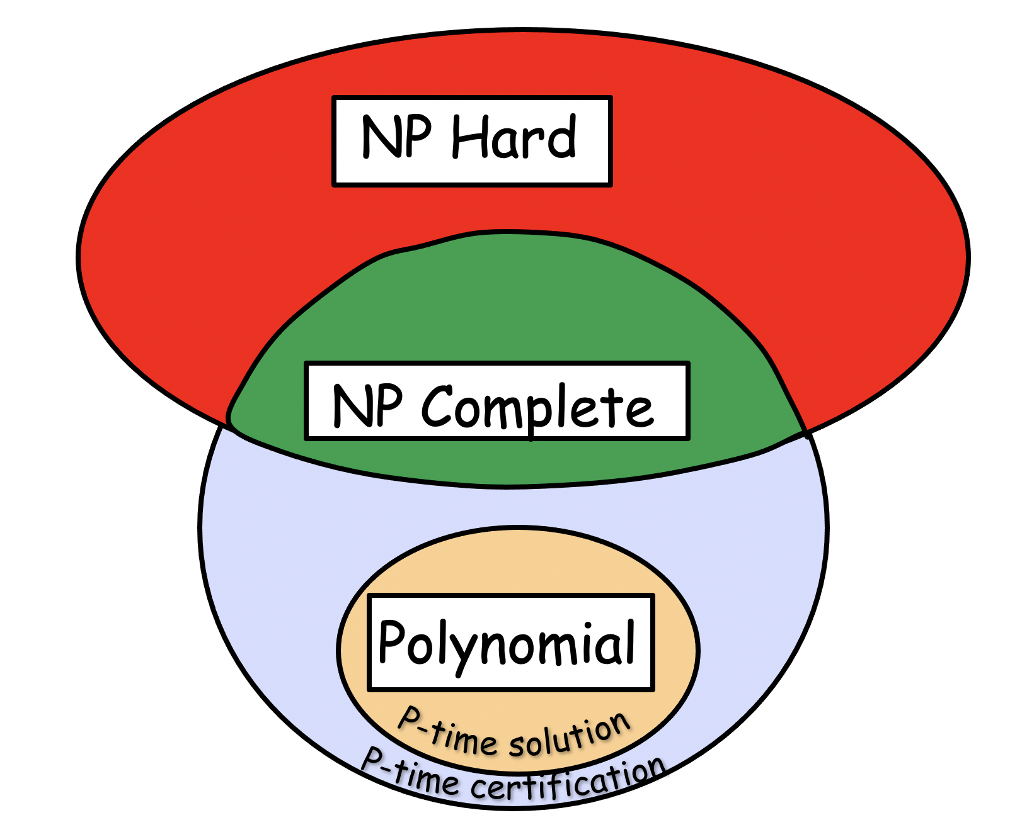
Given [W], we can solve it with SCF and Monte Carlo
Who gives us the matrix?
1. Physics
2. Backpropagation (trial and error) to get a desired answer
3. Construct by mapping onto an equivalent problem
Condensed Matter Physics
Interacting Electrons in a Disordered Solid
Ma, Zhang, Tan, Ghosh, Chern
PRB 99, 085118 (‘19)
Face/Handwriting recognition

Slide 11
On occasion, we just map a problem onto our
energy functional → This means [W] comes straight
out of connection matrices
QUBO problems
(Quadratic Binary Optimization)

Slide 12





Boutique problems – MIN CUT

Slide 13




Boutique problems – MIN CUT (MAX FLOW)
The red and blue groups have no bonds
in between, so min-cut = 0

Slide 14
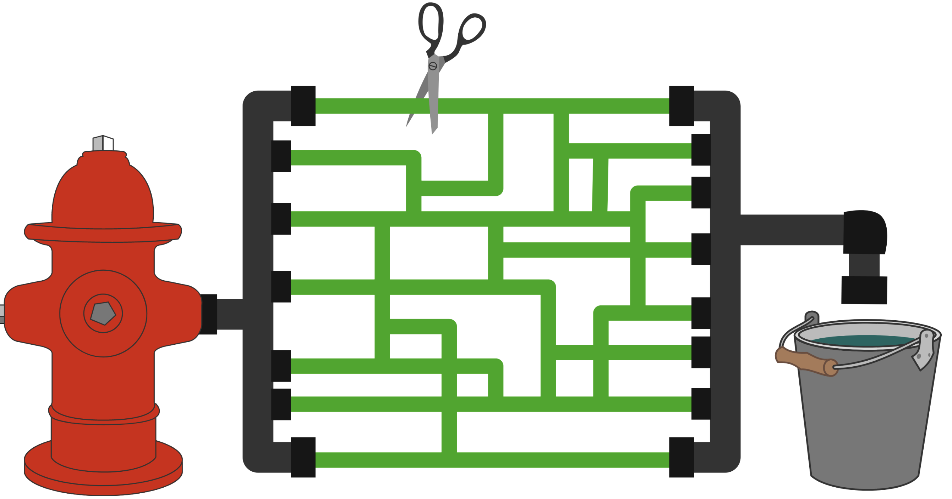




Cut minimum number of bonds to sequester into groups
Military → destroy one bridge to isolate the enemy from back-up or provisions
Network reliability (“Weakest Link” problem), Grid safety
Remove a tumor with minimum damage to surrounding
tissues
Image segmentation
Max flow – airlines want to schedule to maximize
flight departures
https://brilliant.org/wiki/max-flow-min-cut-algorithm/

Slide 15




Boutique problems – MIN CUT
But how would we solve this in general?

Slide 16
Basically write out E(s) so that it works for a small system, then extract x = dE/ds

Slide 17
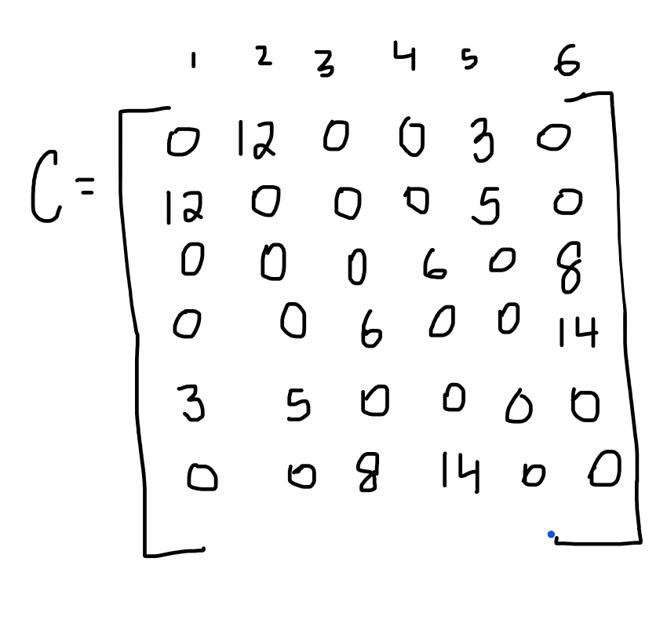


Boutique problems – MIN CUT
s: binary variable 0 or 1 for two groups
Increase cost when bond C lies between groups
No cost when C lies within group

Slide 18
Boutique problems – MIN CUT

Slide 19

Boutique problems – MIN CUT

Slide 20



Problem – Trivial solutions

Slide 21
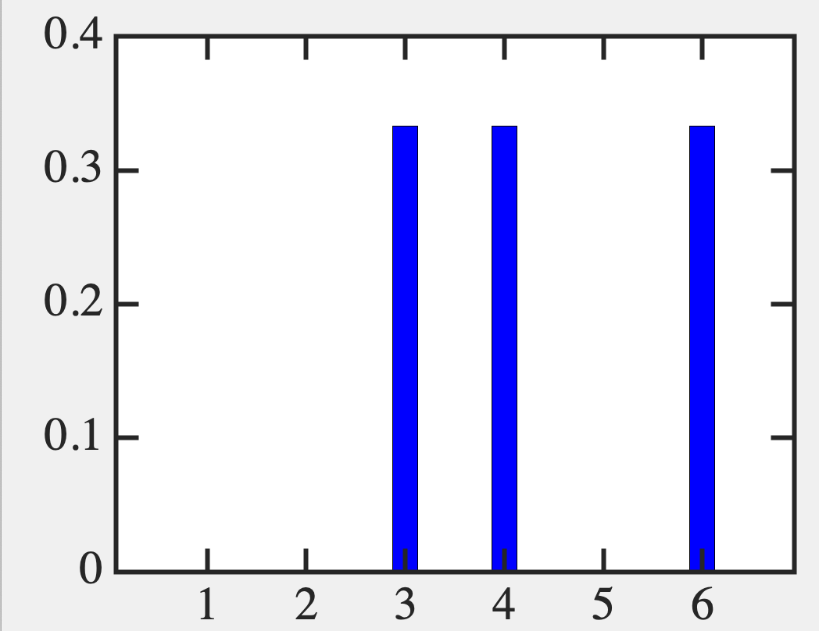
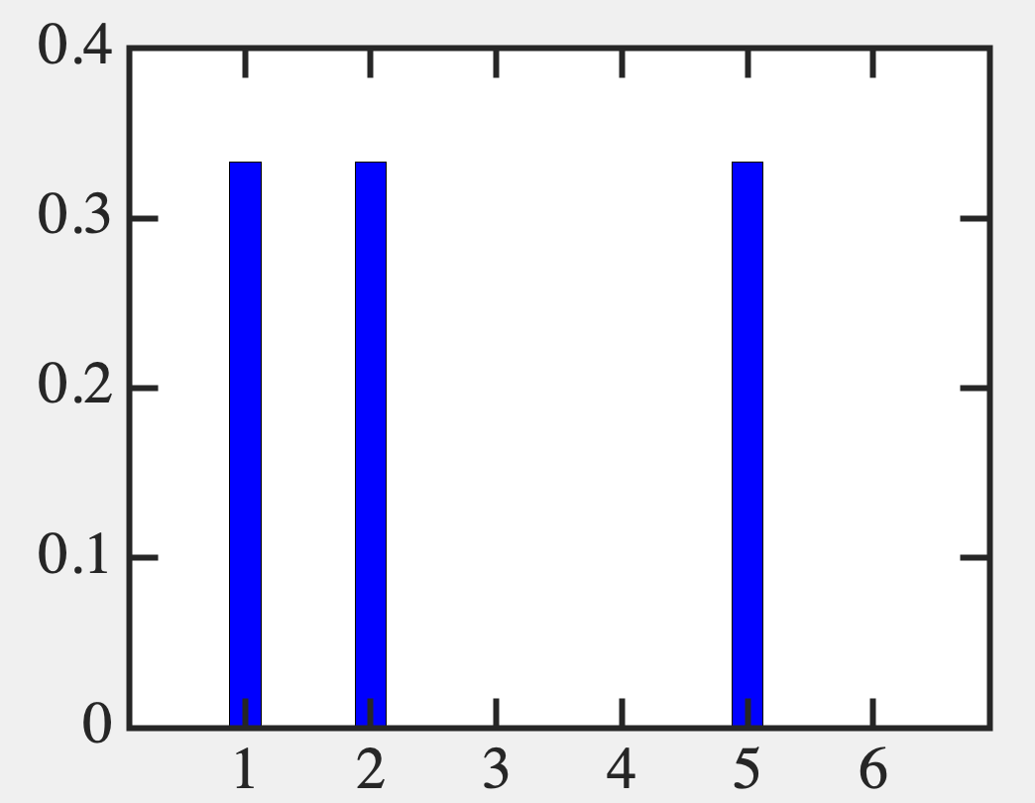
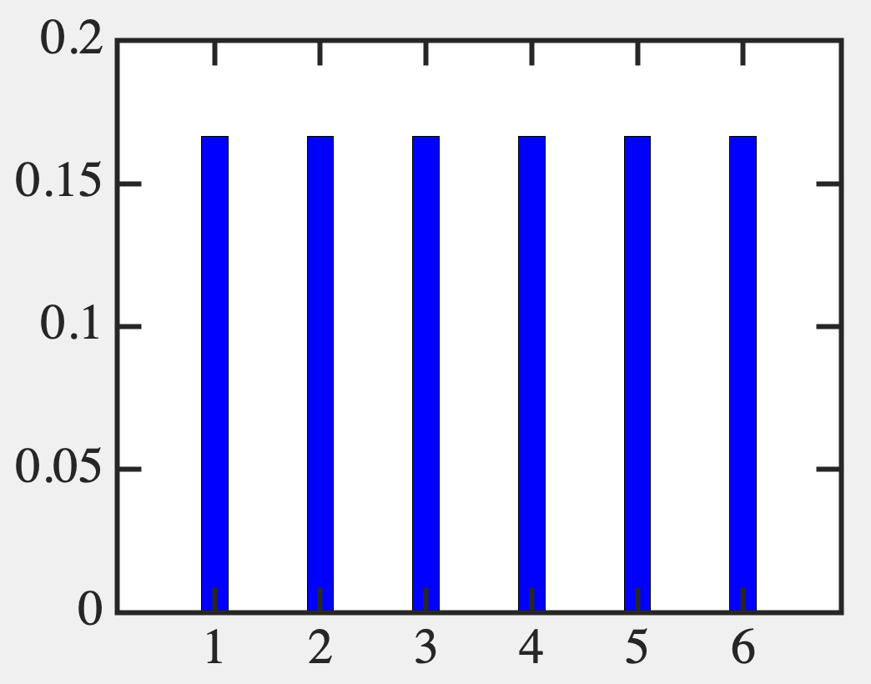





Random initial conditions
%% Find bias and weight matrices, and constrained optimization
T=1e6;
x=sum(C+C');
W=-4*C;
n=rand(N,1);
nn=zeros(N,T);
for ii=1:T %Time steps
for jj=1:N % Update neurons
xx=x(jj)+W(jj,:)*n; %1
xx = xx*4;
f=1/(1+exp(xx)); %2a
n(jj)=0; %2b
if f > rand; %2b
n(jj)=1;
end
end
nn(:,ii)=n;
end %Store time sampleshelp
Z=sum(nn');Z=Z/sum(Z);
bar(Z,0.25,'b')
Need to enforce equal
sized groups

Slide 22


Slide 23



Slide 24



Slide 25













Summary – Min/Max Cut

Slide 26
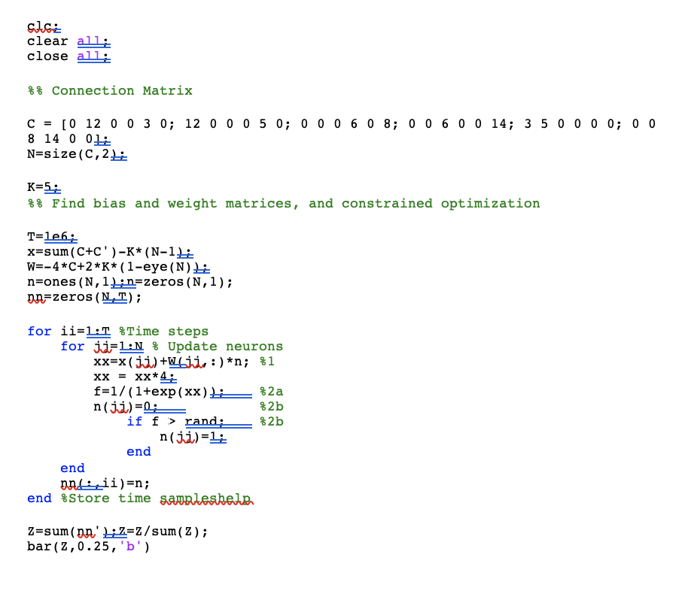
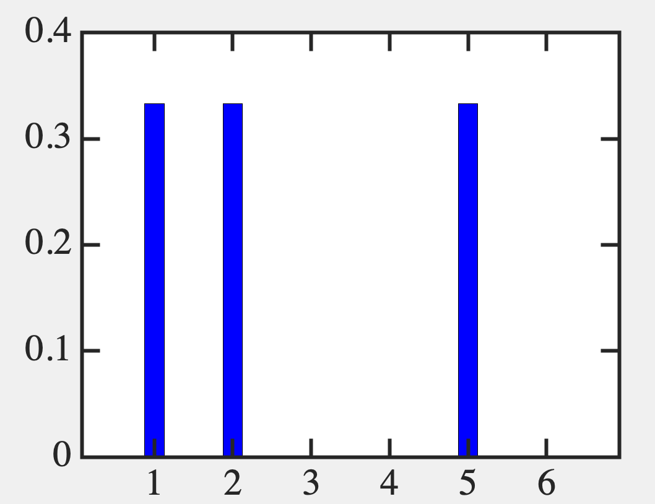
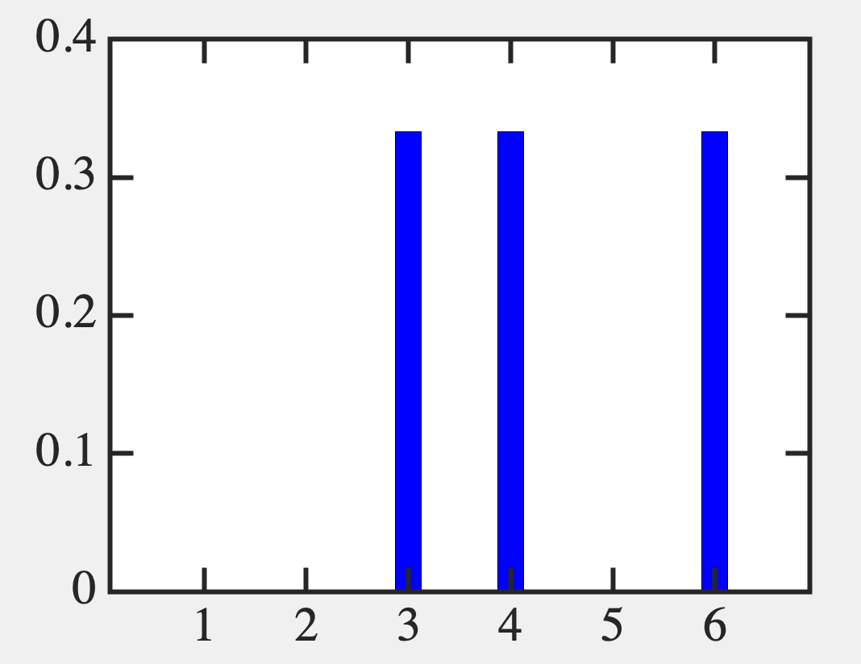
Min Cut
n₀=(000000)
n₀=(111111)

Slide 27
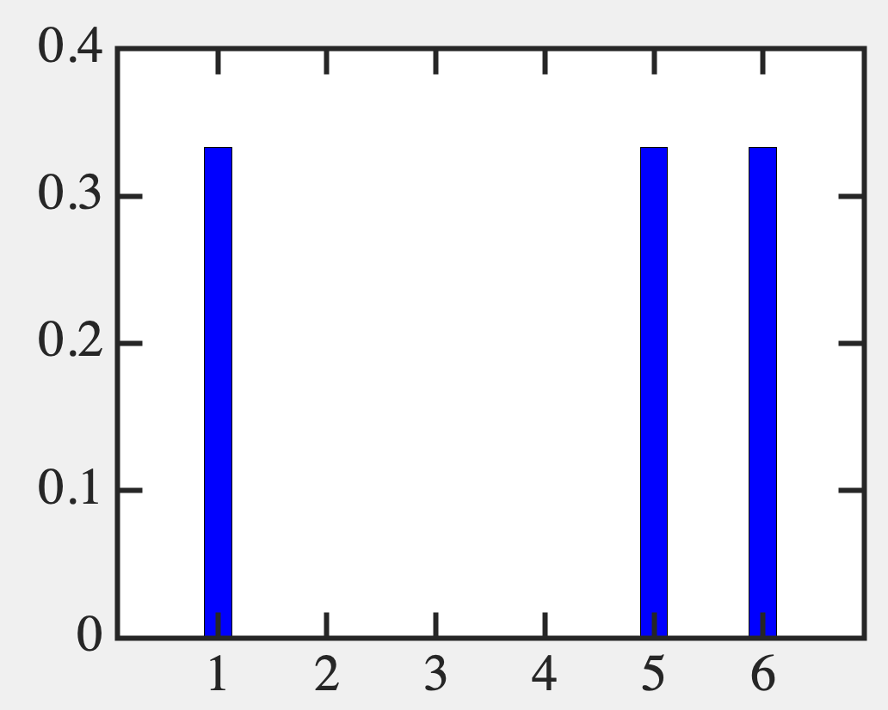



Max Cut
Minor changes to
previous code
Cut bonds
1-2: w=12
2-5: w=5
3-6: w=8
4-6: w=14
----------
Cut wt = 39

Slide 28
9B. Another optimization
(Boolean 3-sat)

Slide 29
Boolean 3-sat
(x₁ U x₂) ⋂ (x₁ U x₃) ⋂ (x₂ U x₃) ⋂ (x₁ U x₂ U x₄)
Find consistent assignments of x_{i} = 0, 1 such that
the net result is 1 (TRUE)
N
S
N
S
S
N
S
N

Slide 30




Energy minimization provides solution
(x₁ U x₂) ⋂ (x₁ U x₃) ⋂ (x₂ U x₃) ⋂ (x₁ U x₂ U x₄)

Slide 31











Incentivize each term to become 1
(x₁ U x₂) ⋂ (x₁ U x₃) ⋂ (x₂ U x₃) ⋂ (x₁ U x₂ U x₄)

Slide 32





Incentivize each term to become 1
(x₁ U x₂) ⋂ (x₁ U x₃) ⋂ (x₂ U x₃) ⋂ (x₁ U x₂ U x₄)

Slide 33




Relate Magnetization to Neuronal firing

Slide 34


Rewrite in neuronal terms
(x₁ U x₂) ⋂ (x₁ U x₃) ⋂ (x₂ U x₃) ⋂ (x₁ U x₂ U x₄)

Slide 35
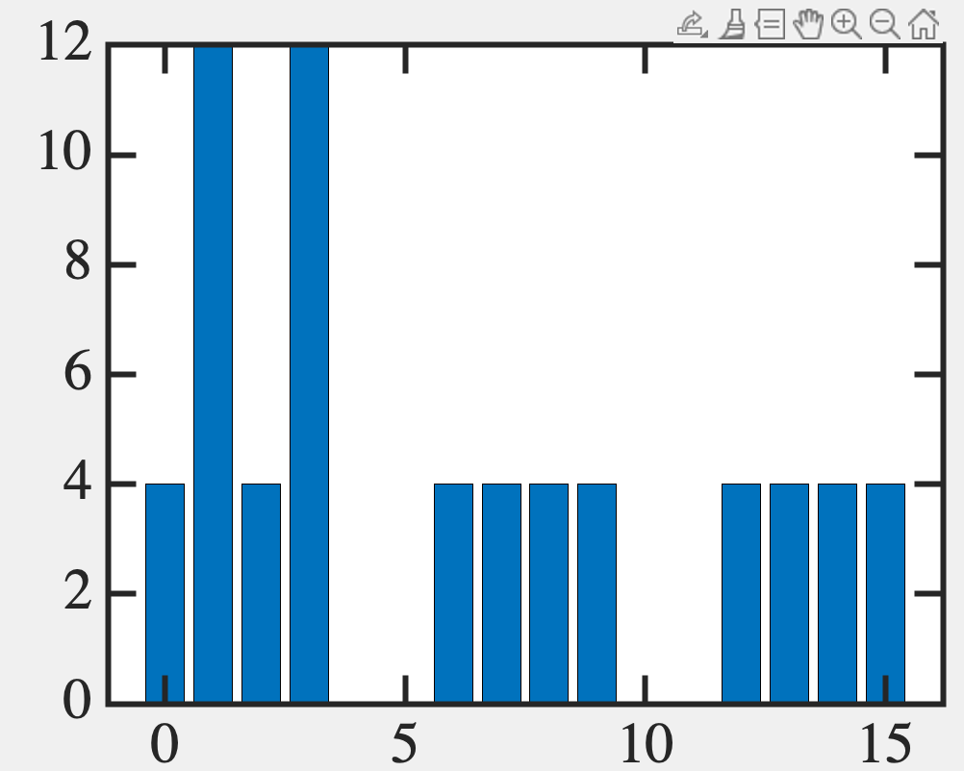
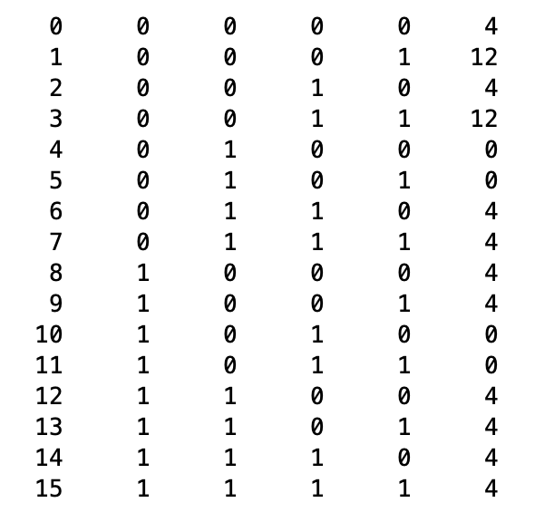
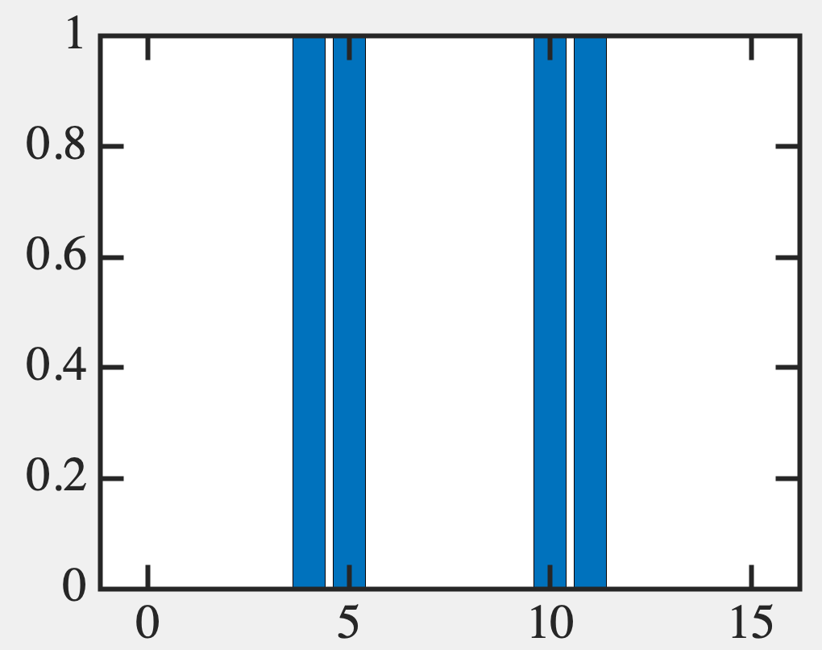





Boltzmann solution: track 2⁴ configs
(x₁ U x₂) ⋂ (x₁ U x₃) ⋂ (x₂ U x₃) ⋂ (x₁ U x₂ U x₄)

Slide 36


Time-sampling: track 4 neurons over time

Slide 37
9C. View input-output as
a truth table

Slide 38












Multiple peaks → Truth Table

Slide 39
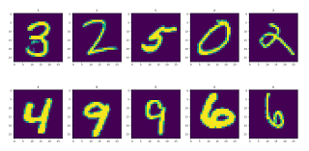





Example Image classification

Slide 40
How do we set up a neural net?
How do we specify an input or output?
How do we program the interconnects
(synaptic weights, bias values) [W], {x}?

Slide 41




Recall how to solve a neural net

Slide 42









How to do a read-out?

Slide 43



How to do a read-out?

Slide 44
9D. Tweaking {x}, W for
a given truth table

Slide 45
But how to work out {x}, [W]
for a given input-output relation
(ie, truth table)?
Use backpropagation

Slide 46




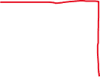



Two equivalent models
Solid-State/ANNs
Magnetism

Slide 47

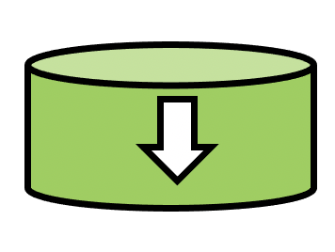




Two equivalent models

Slide 48


x, w → h, J

Slide 49


x, w → h, J

Slide 50

x, w → h, J

Slide 51



x, w <-- h, J

Slide 52


Two equivalent models
Advantage of m = ±1 → Unbiased Average = 0

Slide 53
But avoid J becoming too big
(Regularization)

Slide 54
9E. How to extract the
averages?

Slide 55








Finding the averages <…>

Slide 56









Average of target easy: probabilities must
peak on the n neurons

Slide 57


Average of actuals: these are in state space

Slide 58


Replace with time-sampling

Slide 59






Logical Flow

Slide 60
Backpropagation for a full adder?

Slide 61
Approach to equilibrium (Transient Dynamics)
Some layers could be hidden (unsupervised)
You could add randomness – Generative Ais
You could have directed Non-Boltzmann networks
Synaptic weights asymmetric (W_{ij} >> W_{ji})
Parent to Child – Bayesian networks
Easier to train because they are directed

Slide 62
9F. Hardware Implementation

Slide 63
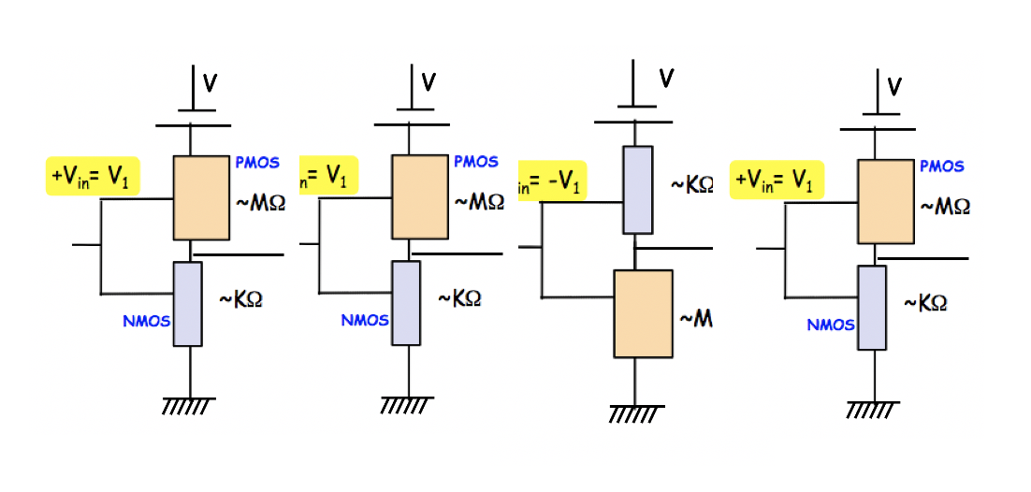
A hardware realization

Slide 64
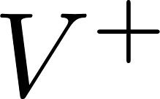
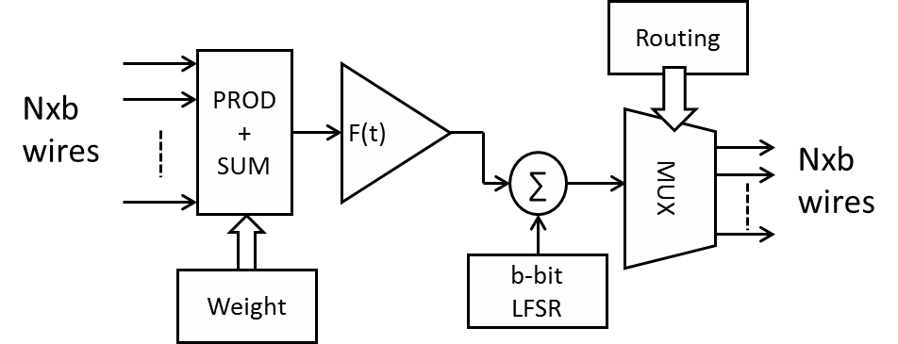
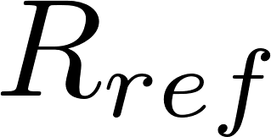
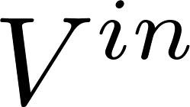

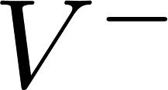
Emerging technologies for neurons
CMOS Neuron (140 transistors, 140 fJ-ps)
Magnetic Neuron (4 transistors, 2.2 fJ-ps)

Slide 65
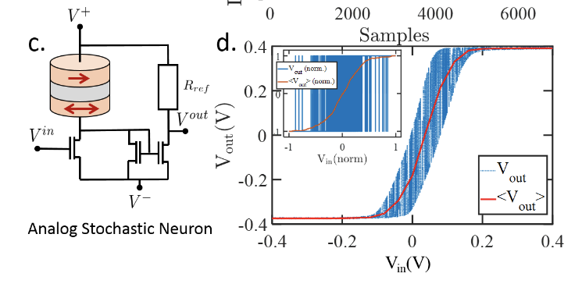
Magnet based stochastic neurons (‘spin dice’)
Stochasticity allows you to sample the phase space quickly and ergodically
CMOS random number generators are VERY inefficient
Kamsari, Ganguly, Sutton, Datta (Purdue)
Ganguly, Ghosh (UVA)
        Binary
        Stochastic
        Neurons
        Analog
        Stochastic
        Neurons
Magnet in pull-up/pull-down + Inverters
Energy-Momentum Optimization Algos
Probabilistic Graph Algos
Magnet in pull-up/pull down + Buffer
Signal Proessing (EKF), Inferencing

Slide 66





A hardware realization
On-chip → Instant (don’t need cloud upload/download)
Cloud could be unavailable or unreliable
EDGE INTELLIGENCE
Output Nodes
Synaptic network
Dense, highly scalable, neural networks
Programming Network

Slide 67
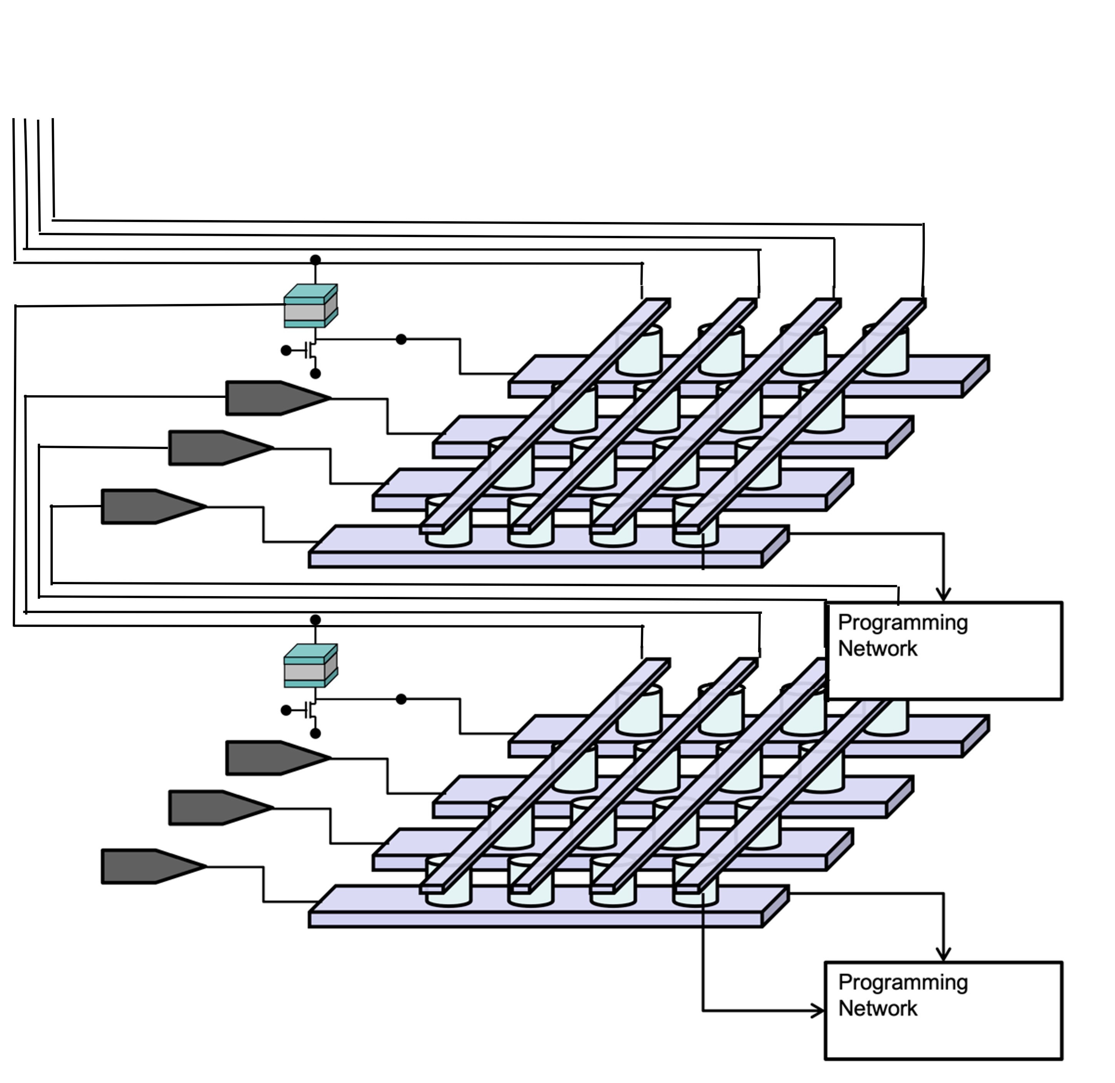
Stack them for depth

Slide 68
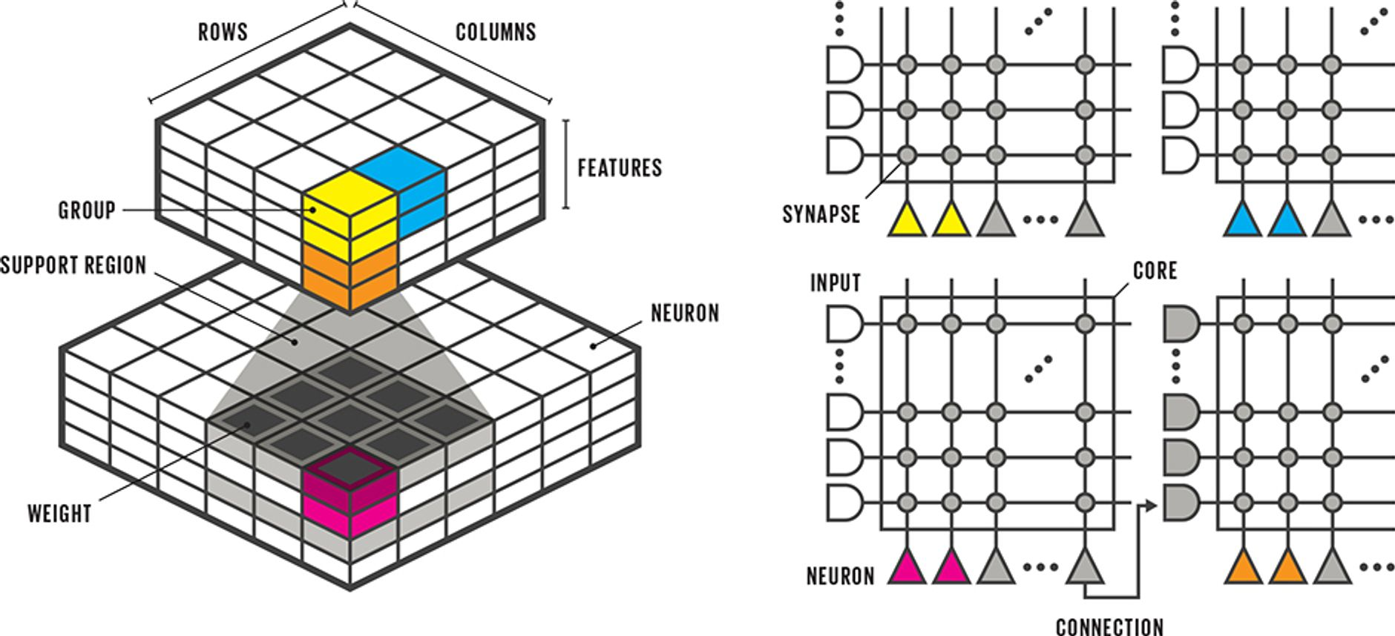
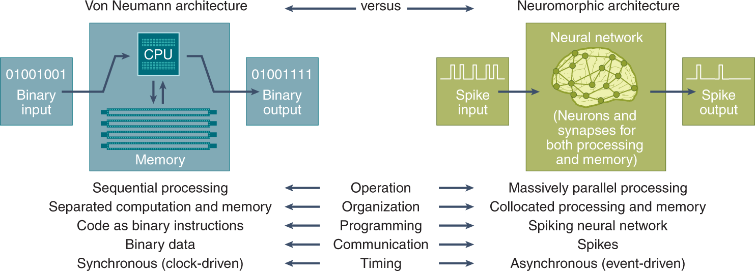
IEEE Spectrum, May 2017
Catherine Schumann et al, Nature Computational Science 2, 10 (Jan 22)

Slide 69
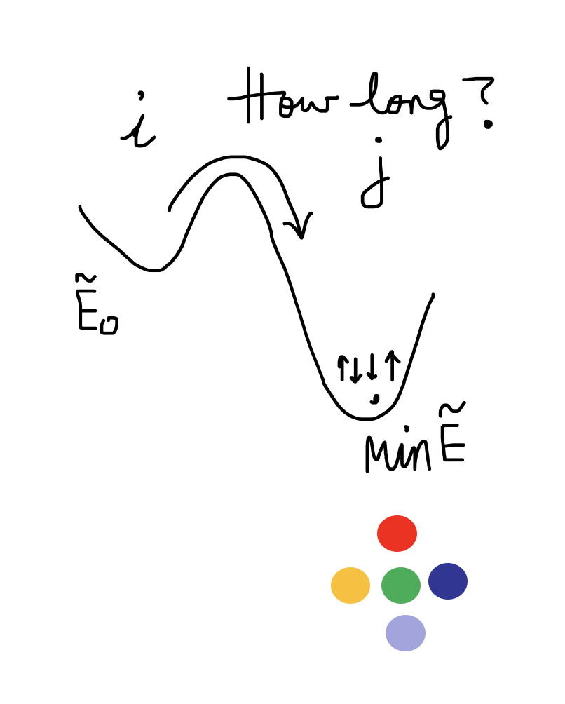
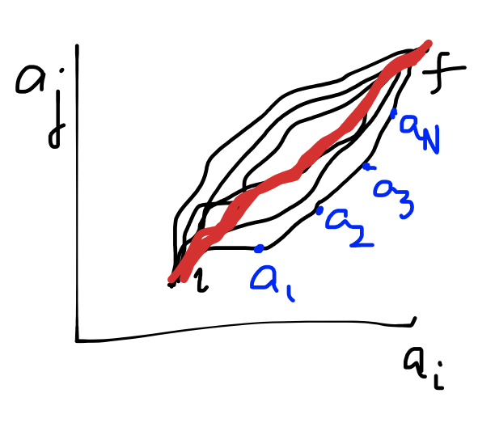

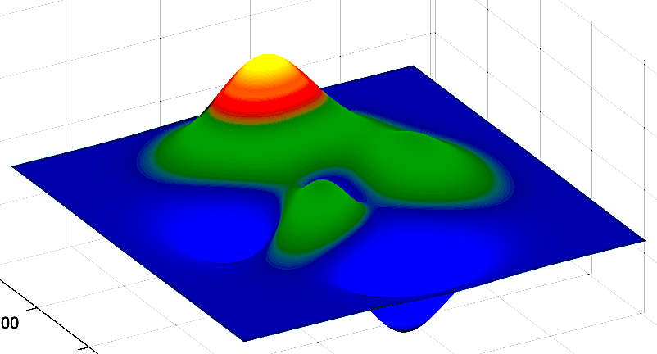
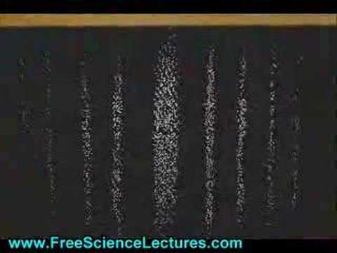
Fundamentals of Computing
Lec 10
Dynamics
Path Integrals
Quantum Spins
Interfering States

