Slide 1
Fundamentals of Computing
Lec 12
Quantum Gates

Slide 2
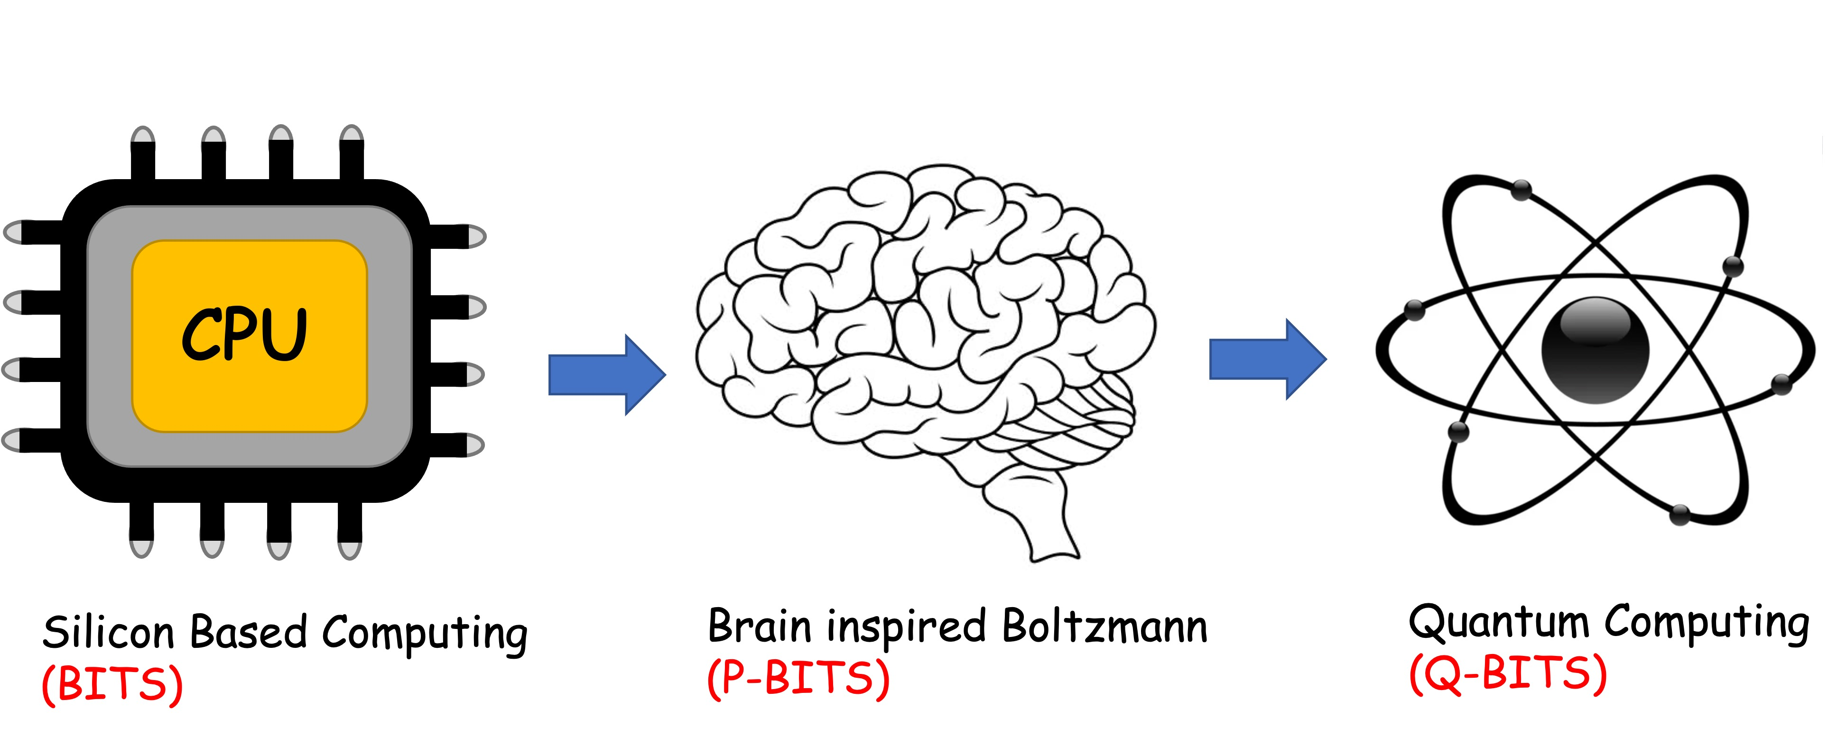
Overall structure of this course
Analog Computing in Carbo
How we train (Supervision)
Physics of Neurons (Boltzmann)
How we learn (time sampling)
Optimizing and Classifying
Transition Theory & Inferencing
Quantum Computing in Magneto
Quantum Spins and Hardware
Quantum Gates
Quantum Error Correction
Quantum Search and Annealing
Digital Computing in Silico
How we compute (algorithms)
How we add (Gates)
How we add quickly (CMOS)
How we fix errors
Thermodynamics of Computing

Slide 3
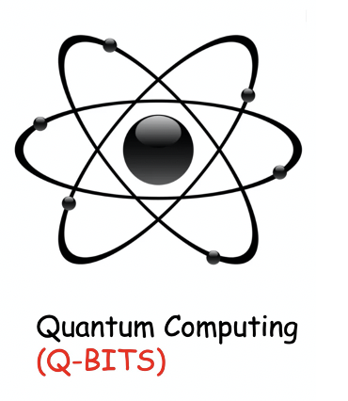

Slide 4
12A: Quantum Operators

Slide 5
Classical systems are easy to express

Slide 6
Magnetic Equivalent heading to quantum spins

Slide 7
But Quantum spins are different !
Continuum of values
Measurable together

Slide 8
But Quantum spins are different !
Each measurement along an axis reveals discrete measurements (eigen-values) ±1
Cannot measure them simultaneously without erasing previous results

Slide 9
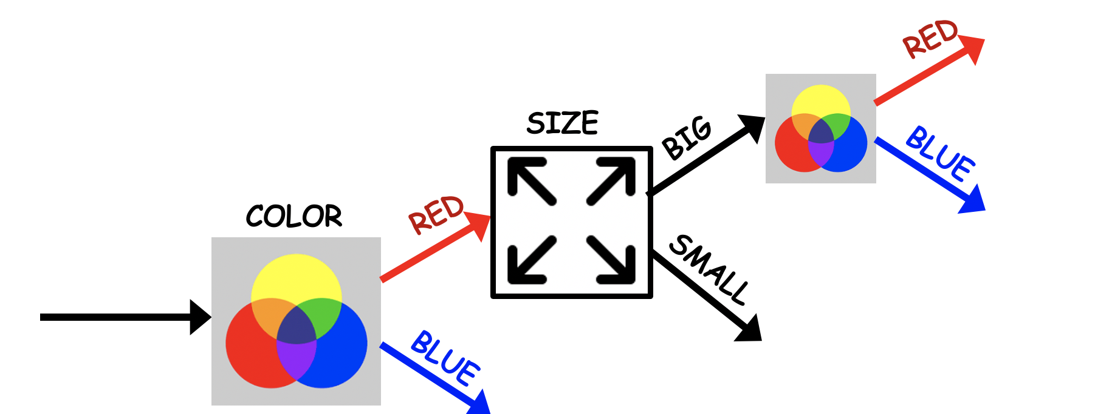
The quantum world is counter-intuitive
Photons
Spins

Slide 10
Measurements do not commute – their
operators are best expressed as matrices

Slide 11
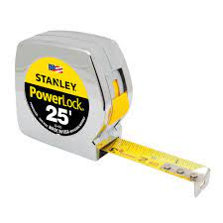
Quantum States and measurements
Schrodinger Equation

Slide 12
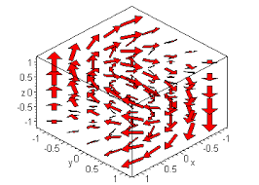
Operator form needed
Vector field: We can also throw in
coordinates, m_{x,y,z}(x,y,z)
How do we describe a matrix field?

Slide 13
Recall : Tensor or Kronecker Product
a
A =
B = (α β)
b
aB
aα aβ
bα bβ
A ⊗ B = =
bB
αa βa
αb βb
B ⊗ A = (αA βA) =

Slide 14
Matrix field: a Kronecker product

Slide 15
Matrix field: a Kronecker product
Stick in identity matrices wherever there’s no action
Net result: 2^{N}x2^{N} matrices, 2^{N} eigenvalues for N spins

Slide 16
Then do Boltzmann
If we can find a representation where this is diagonal, then we just deal with
diagonal matrices (independent rows) ie, eigenvalues. This would be like separate
neurons. E.g. if h along z, and we are only measuring z components.
But in QM, operators do not commute. This means when one is diagonal, another
must be off-diagonal. So if we measure z, or couple z-spins but field is along x,
we need Quantum operators

Slide 17
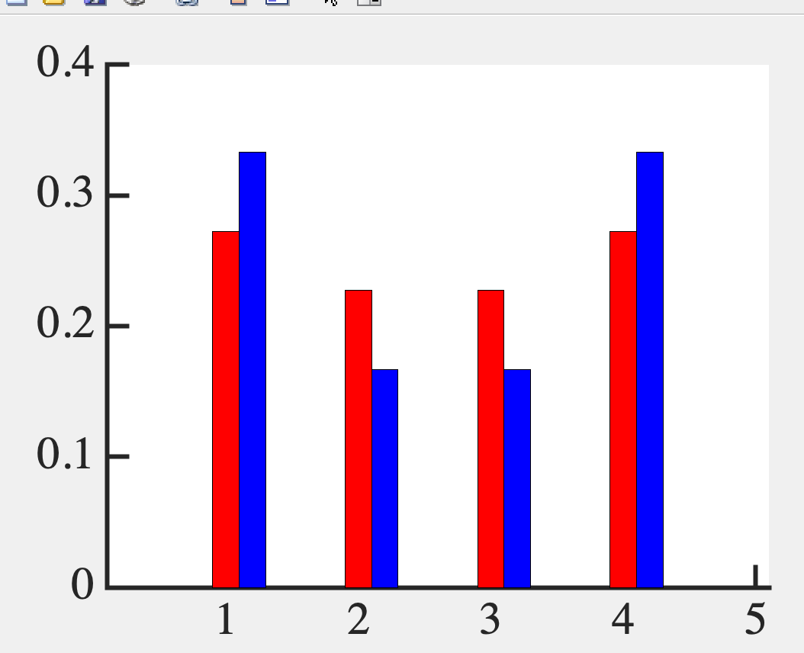
J=20;
sx=[0 1; 1 0]; sy=[0 -i; i 0]; sz=[1 0; 0 -1];
H=-J*(kron(sx,sx)+kron(sy,sy)+kron(sz,sz));
P=expm(-H);Z=trace(P);
bar(diag(P/Z),0.2)

Slide 18
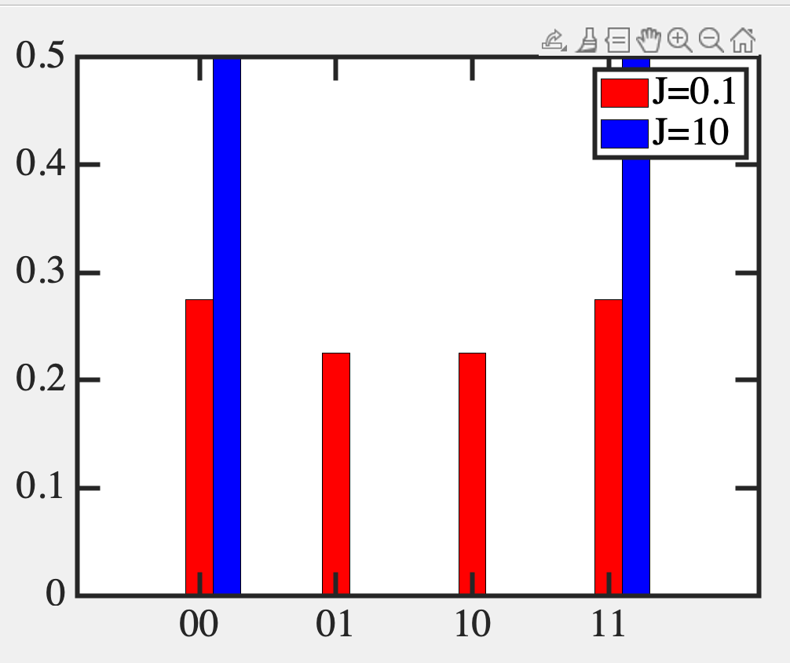
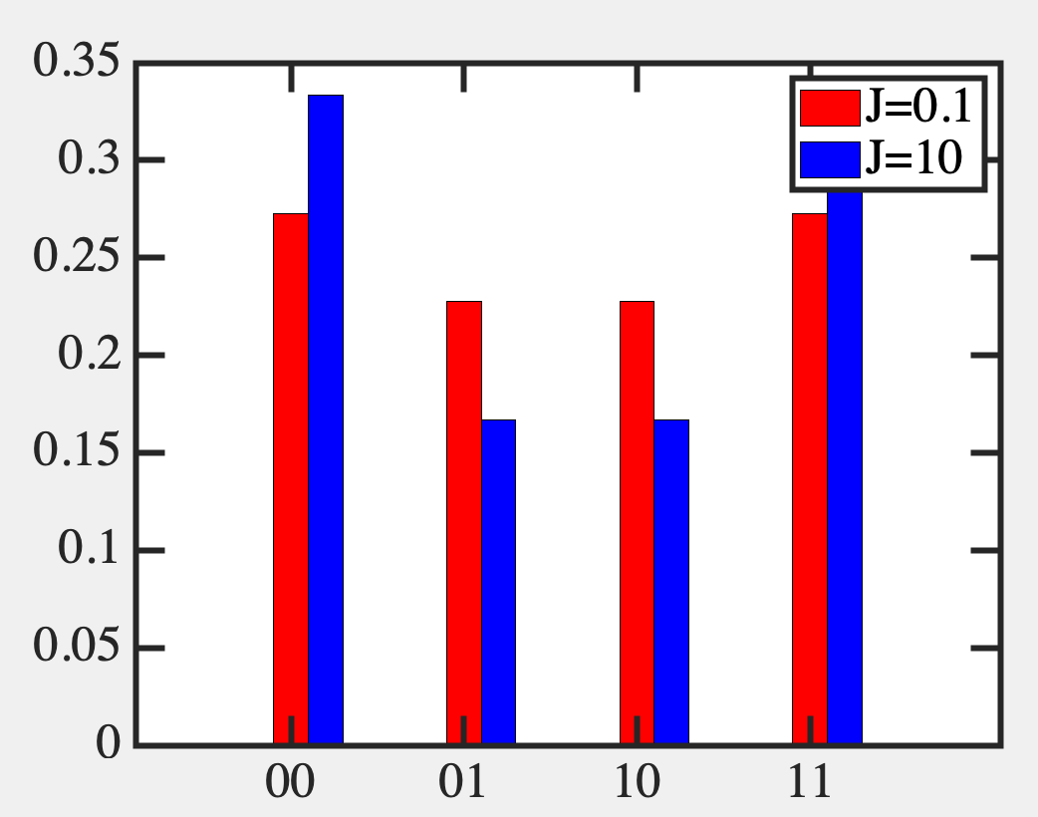
Off-diagonal terms are spreading states around
Use it like temperature !!!
CLASSICAL
QUANTUM
Quantum when off-diagonal terms arise. E.g. we measure
S_{z} but put h-field along S_{x}. These two spin operators do
not commute. But this allows us to ‘anneal’ a state.

Slide 19
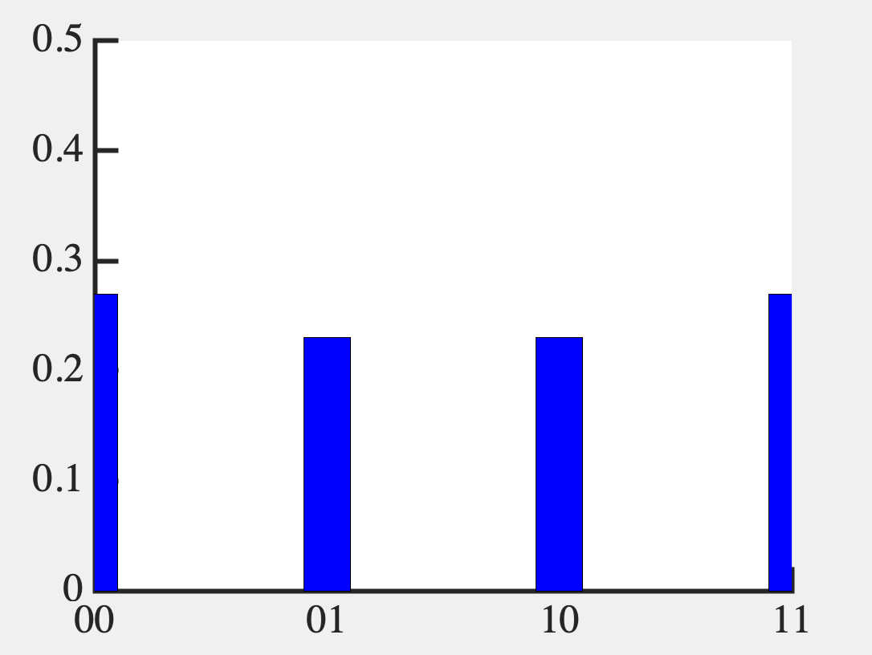
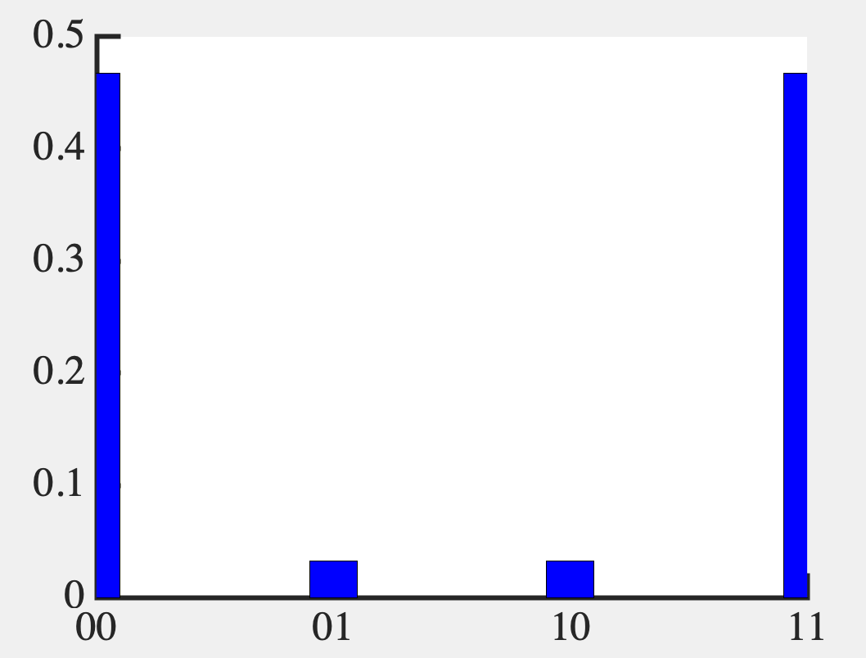
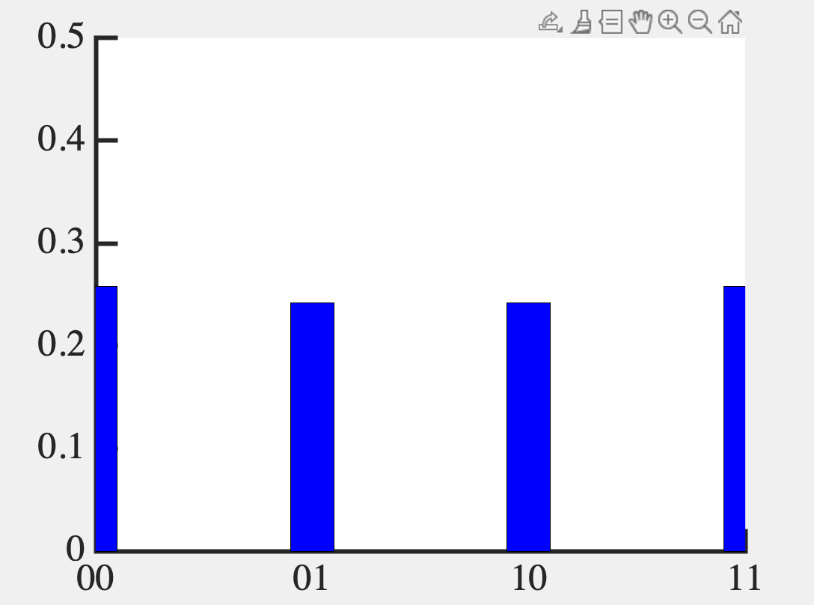
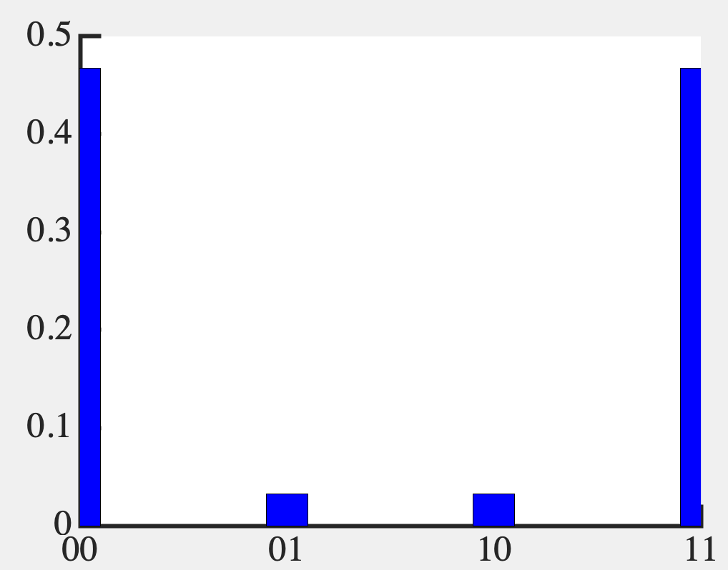

Slide 20
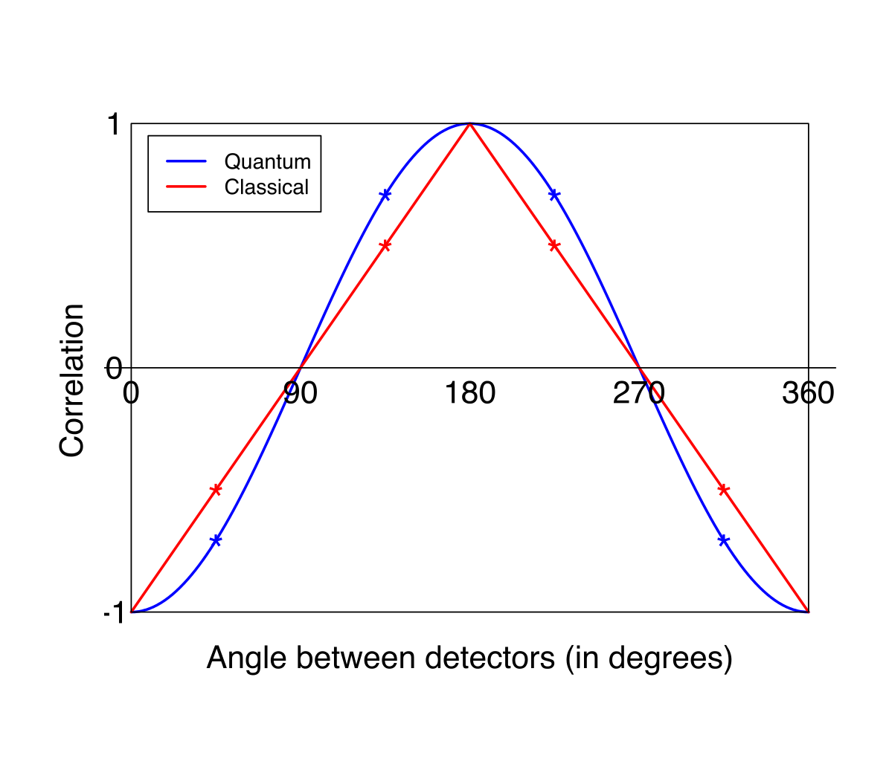
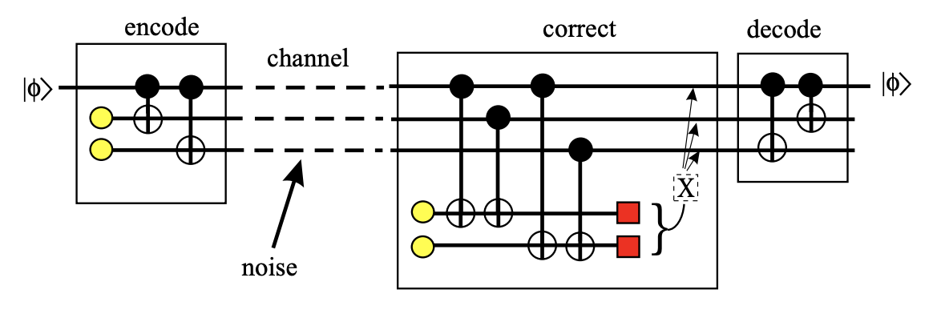
Fundamentals of Computing
Lec 13
Quantum Entanglement and Errors
Bell’s Inequality Error Correction

