Slide 1
12B: Qubits and Quantum Gates

Slide 2
The reason for this ‘mix’: S_{z} + S_{x} is a new qubit

Slide 3
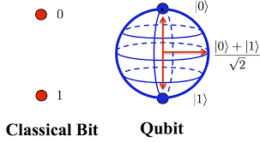
Qubit: superposition of bits

Slide 4
Can we define a gate for this?

Slide 5
Gate Operations
in
out
in
out
0
1
NOT
1
0
0
1
1
0
=
1
0
0
1
|0>
|1>
0
1
0
1
=
1
0
1
0
|1>
|0>

Slide 6
Quantum NOT

Slide 7
To realize a Quantum NOT

