Slide 1
12C: More sophisticated gates

Slide 2
What do the x-y-z gates do?

Slide 3
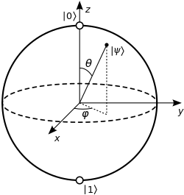
What do the gates do?
Move the states around on
the Bloch sphere
X-gate (θ,ϕ): (0,0) → (π,0)
(π,0) → (0,0)
Z-gate (θ,ϕ): (0,0) → (0,π)
(π,0) → (π,π)

Slide 4
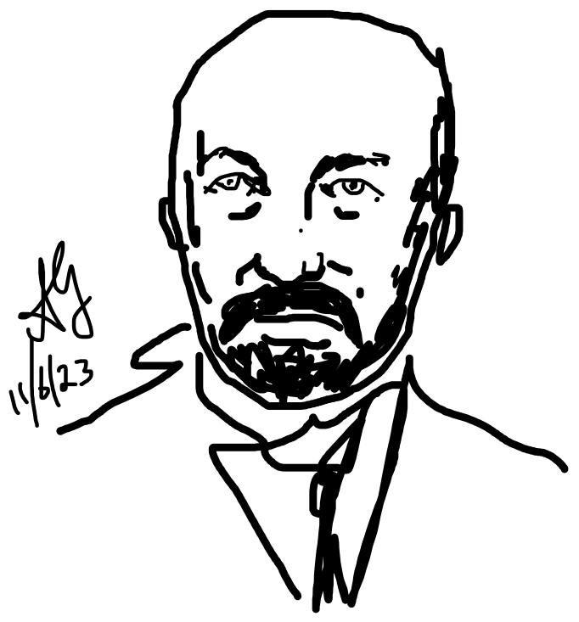
Not just flip, but superposition
1
1
/√2
1
-1
Jacques Hadamard
Η|0> = (|0> + |1>)/√2
Η|1> = (|0> - |1>)/√2

Slide 5
It is also reversible

Slide 6
Is there an easy way to derive H?
Η|0> = (|0> + |1>)/√2
Η|1> = (|0> - |1>)/√2
1
1
/√2
1
-1

Slide 7
To proceed further, define a ‘ket’
c₁
c₂
..
..
c_{n}
⎲
Ψ = c_{n}ψ_{n} =
⎳
_{n}
1
0
0
0
..
..
0
1
..
..
0
0
..
..
1
|ψ₁> =
|ψ₂> =
|ψ_{N}> =

Slide 8
Corresponding “Bra”
< ψ₁| = (1 0 ….0)
< ψ₂| = (0 1 ….0)
< ψ_{N}| = (0 0….1)
< Ψ| = (c₁* c₂*….c_{N}*)

Slide 9
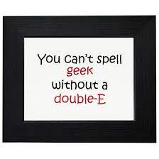
“Bra-ket” (Bracket)
<Ψ|Ψ> = |c₁|² + |c₂|² +...+ |c_{N}|²

Slide 10
Basis sets are orthonormal

Slide 11
Basis sets are complete
For a complete set
(sum of 2^{n} terms for n bits)

Slide 12
Compact way to derive the gate
Η|0> = (|0> + |1>)/√2
Η|1> = (|0> - |1>)/√2

Slide 13
Controlled Not gate: CNOT
A
A
A
B
Aout
Bout
B
Flip B iff A = 1
0
0
0
0
0
1
0
1
Preserve phase space
1
0
1
1
1
1
1
0
XOR

Slide 14
CNOT is reversible !
Aout
A
A
Bout
B
B

Slide 15
CNOT matrix

Slide 16
Matrix operation for CNOT
A
B
Aout
Bout
1
0
0
0
00
00
0
1
0
0
01
01
0
0
0
0
=
0
0
0
1
10
11
0
0
1
0
11
10
0
1
0
1
G_{CN}
1
0
1
1
1
1
1
0
For reversible, need unitarity
G_{CN}G_{CN}⁺ = I
G_{CN}⁻¹ = G_{CN}⁺

Slide 17
No Dissipation (CNOT)
A
A
A
B
Aout
Bout
B
Flip B iff A = 1
0
0
0
0
S_{i} = -4k_{B}(1/4ln1/4)
0
1
0
1
S_{f} = -4k_{B}(1/4ln1/4)
1
0
1
1
1
1
1
0

Slide 18
CNOT can copy
A
B
Bout
A
A
0
0
0
0
A
1
0
1
We will use it for
Quantum error correction
But is it universal?

Slide 19
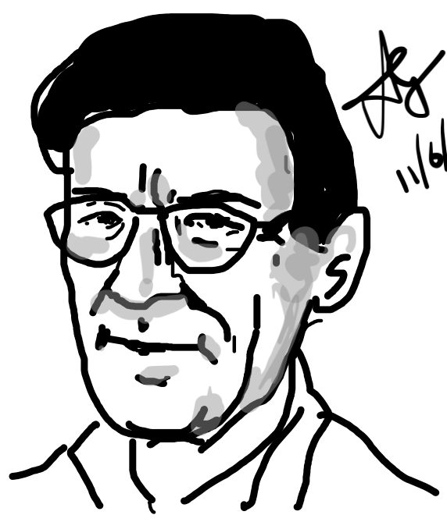
CCNOT (Toffoli gate) is universal
A
A
Tommasso Toffoli
B
B
Flip C
iff
A = 1
and
B = 1
A
B
C
Aout
Bout
Cout
C
0
0
0
0
0
0
0
0
1
0
0
1
0
1
0
0
1
0
0
1
1
0
1
1
1
0
0
1
0
0
A=1 B=1 means NOT
A=1 means CNOT
(= A XOR B
= SUM Bit)
1
0
1
1
0
1
1
1
0
1
1
1
1
1
1
1
1
0

Slide 20
CCNOT is universal
1
1
1
1
Can create NOT
C
NOT(C)
0
0
B
B
Can ignore input B
1
1

Slide 21
NOT with CCNOT
A
A
B
B
A
B
C
Aout
Bout
Cout
C
C’
0
0
0
0
0
0
(A=B=1, C’ = NOT C)
0
0
1
0
0
1
0
1
0
0
1
0
0
1
1
0
1
1
1
0
0
1
0
0
1
0
1
1
0
1
1
1
0
1
1
1
1
1
1
1
1
0

Slide 22
AND with CCNOT
A
A
B
B
A
B
C
Aout
Bout
Cout
C
C’
0
0
0
0
0
0
0
0
1
0
0
1
0
1
0
0
1
0
0
1
1
0
1
1
We have AND
(Set C=0
C’=1 iff A=B=1)
1
0
0
1
0
0
1
0
1
1
0
1
1
1
0
1
1
1
1
1
1
1
1
0

Slide 23
OR with CCNOT
A
A
B
B
C
C’

Slide 24
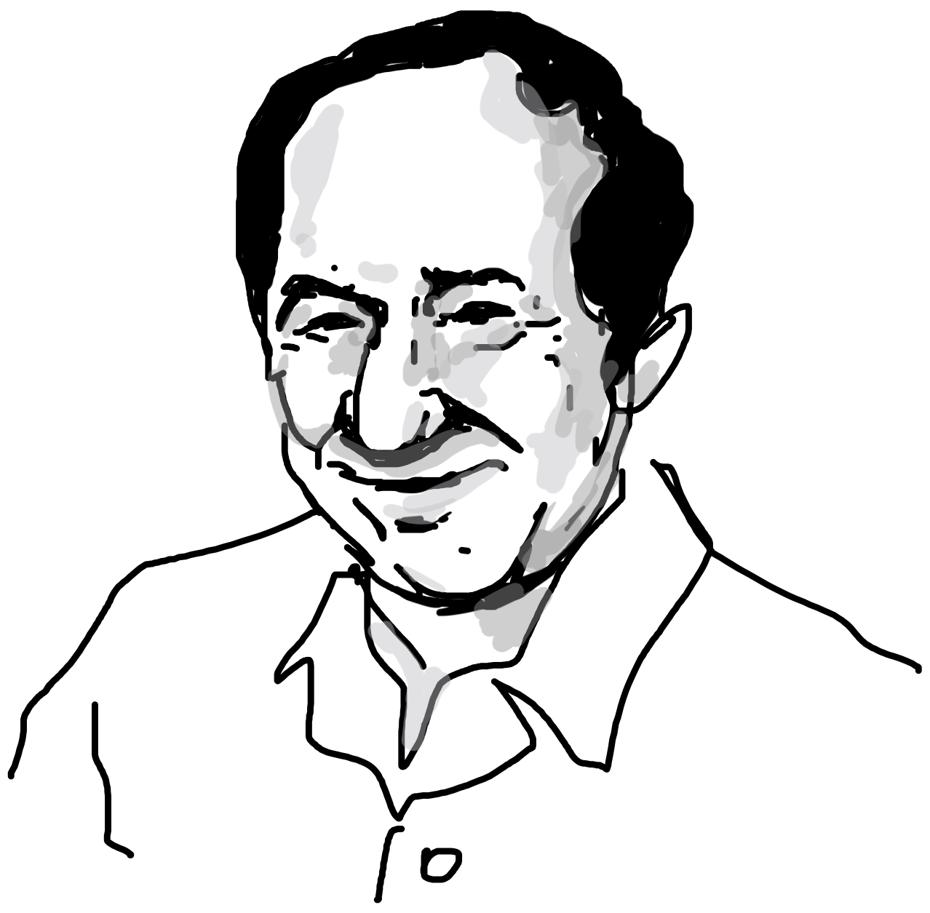
CSWAP (Fredkin) also conservative
A
A
B
Flip B and C if A = 1
C
Edward
Fredkin
A
B
C
A_{out}
B_{out}
C_{out}
0
0
0
0
0
0
Conserves # of
0s and 1s
0
0
1
0
0
1
0
1
0
0
1
0
0
1
1
0
1
1
1
0
0
1
0
0
1
0
1
1
1
0
1
1
0
1
0
1
1
1
1
1
1
1

Slide 25
NOT and BLOCK
A
A’
0
B’
C’ = NOT (A)
1
C’
0
0
B
B’
C’ = 1 independent of B
A’= 0 independent of B
1
C’

Slide 26
AND with CSWAP
C’ = A.B
= 1 iff A=B=1
A
A
B
0 (garbage bit)
0
A.B

Slide 27
Clearing Garbage bits
C
x
0
0
0
O U T
x
x
I
N
0
0
0
0
0
O
U
T
G A R B
I
N
0
0
0
0
0
M
M⁻¹

Slide 28
Given that these are reversible
gates, need special ways to
realize them
(e.g. can’t use AND gates!)
Recall each AND costs
ΔF = 0.82k_{B}T ~3.2zJ

Slide 29
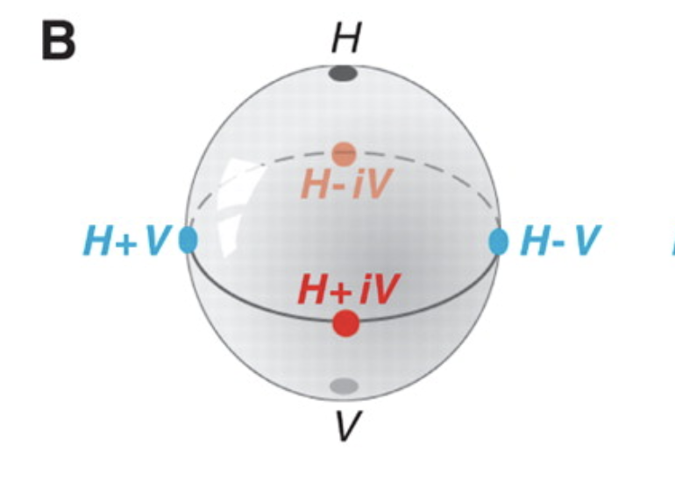
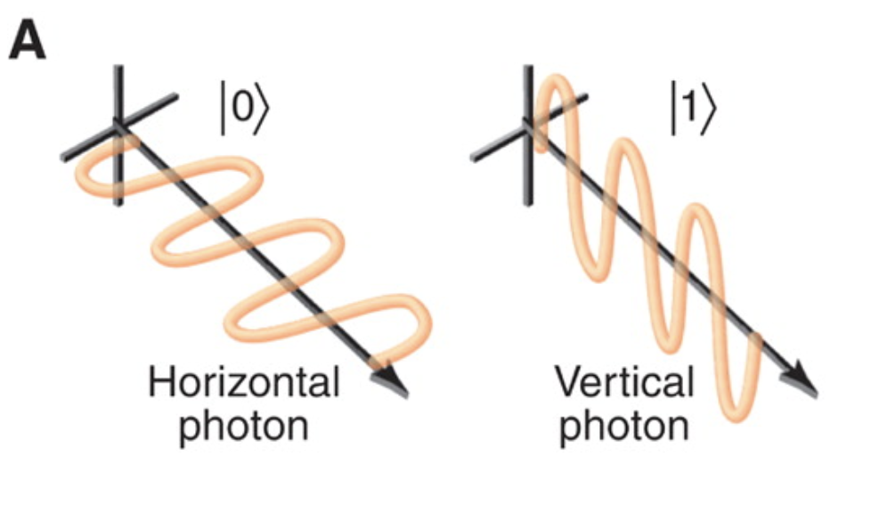
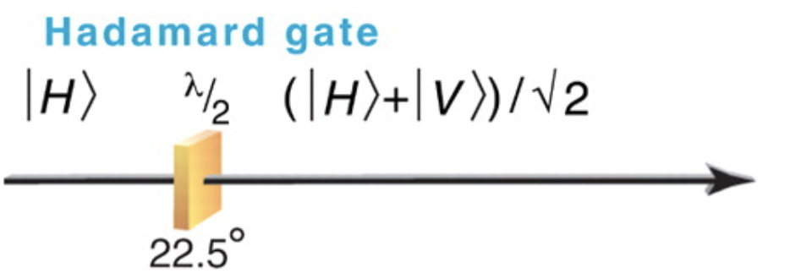
Realizing a Hadamard Gate with photons
Delay one component relative to another using a Birefringent crystal
Optical Quantum Computing
Jeremy L. O'Brien
See all authors and affiliations
Science 07 Dec 2007:
Vol. 318, Issue 5856, pp. 1567-1570
DOI: 10.1126/science.1142892

Slide 30
Various other gates

